Slide 1
EECE.4810/EECE.5730 Operating Systems
Instructor:
Dr. Michael Geiger
Spring 2018
Lecture 14:
Memory management

Slide 2
Lecture outline
Announcements/reminders
Program 2 due today
Program 3 to be posted; due TBD
Exam 2: Wednesday, 3/28 in class
Will cover everything after Exam 1
Today’s lecture: memory management
Address translation basics
Address translation schemes
Base and bounds
Segmentation
Paging

Slide 3
Memory management
Program brought (from disk) into memory and placed within a process to be run
Recall: process = 1+ threads in address space
Thread: set of executing instructions
Address space: all memory used by process as it runs
Characterizing address space
HW view: fixed amount of memory shared between processes
OS: each process has its own, large memory
Logical or virtual address space

Slide 4
Address space-related abstractions
Address independence: same numeric address used in multiple processes, kept logically distinct
Most easily handled with relocatable code
Protection: one process can’t access another’s address space unless explicitly given access
Virtual memory: address space larger than physical memory

Slide 5
Address Binding
Addresses represented in different ways at different stages of a program’s life
Source code addresses usually symbolic
Compiled code addresses bind to relocatable addresses
i.e. “14 bytes from beginning of this module”
Linker or loader will bind relocatable addresses to absolute addresses
i.e. 74014
Each binding maps one address space to another

Slide 6
Address Binding (continued)
Binding of instructions/data to memory addresses happens at 3 different stages
Compile time: If exact memory location known, absolute code can be generated
Must recompile code if starting location changes
Load time: Must generate relocatable code if memory location is not known at compile time
Execution time: Binding delayed until run time if the process can be moved during its execution from one memory segment to another
Execution time binding most common in multiprogrammed systems
Requires OS (& HW) support for address translation
Only scheme in which logical, physical addresses differ

Slide 7
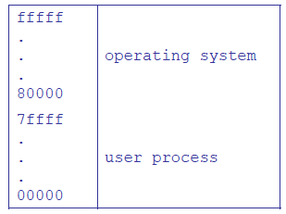
Uni-programmed systems
1 process occupies memory at a time
Always loaded to same memory location
Space saved for OS
Problems?
Long context switch
Inflexibility
Wasted space
Not enough space

Slide 8
Multiprogrammed systems
Multiprogramming: >1 process in memory at once
Requires address translation
Support for protection in translation mechanism
Forms of address translation
Static address translation: translate addresses before execution (compile time, load time)
Can provide address independence; protection, virtual memory more difficult (VM almost impossible)
Dynamic address translation: translate addresses during execution
Translation can change as process runs!

Slide 9
Dynamic address translation
Translate every memory reference
Process uses virtual addresses
Hardware uses physical addresses
Translation enforces protection
One process can’t access another’s address space unless allowed
Translation enables virtual memory
Virtual address only in physical memory when necessary
Can change translations on the fly--physical memory addresses assigned when blocks brought in from disk

Slide 10
Address Translation Concept

Slide 11
Forms of address translation
Base and bounds
Contiguous region allocated for entire address space
Segmentation
Address space split into variable-sized segments
Paging
Address space split into fixed-size pages
Tradeoffs between
Flexibility (sharing, growth, VM)
Size of data needed to support translation
Speed of translation

Slide 12
Base and bounds
Each process allocated contiguous block for entire address space
Address space defined by two values
Base (or relocation register): lowest PA used
Bound (or limit): total size of address space
Only OS can change values
HW support: only two registers
Process sees virtual address space
0 ≤ address < bound
Simple translation: PA = VA + base

Slide 13
Virtually Addressed Base and Bounds

Slide 14
Base and bounds pros/cons
What are benefits?
What are downsides?
Does base and bounds support:
Address independence?
Protection?
Virtual memory?
Notes:
Provides level of indirection: OS can move bits around behind the program's back, for instance, if program needs to grow beyond its bounds, or if need to coalesce fragments of memory. Stop program, copy bits, change base and bounds registers, restart.
Because OS manages the translation, we control the vertical, we control the horizontal.
Hardware cost:
2 registers
adder, comparator
Plus, slows down hardware because need to take time to do add/compare on every memory reference.
In 60's, thought to be too expensive!
But get better use of memory, and you get protection. These are really important. CPU speed (especially now) is the easy part.

Slide 15
Base and bounds pros/cons (continued)
Pros
Simple
Fast (2 registers, adder, comparator)
Context switch—save base/bound (mem if needed)
Safe … as far as multiple processes are concerned
Can relocate in physical memory without changing process
Cons
Can’t keep program from accidentally overwriting its own code
Can’t share (partial) code/data with other processes
Can’t grow stack/heap as needed
Fragmentation
Notes:
Provides level of indirection: OS can move bits around behind the program's back, for instance, if program needs to grow beyond its bounds, or if need to coalesce fragments of memory. Stop program, copy bits, change base and bounds registers, restart.
Because OS manages the translation, we control the vertical, we control the horizontal.
Hardware cost:
2 registers
adder, comparator
Plus, slows down hardware because need to take time to do add/compare on every memory reference.
In 60's, thought to be too expensive!
But get better use of memory, and you get protection. These are really important. CPU speed (especially now) is the easy part.

Slide 16
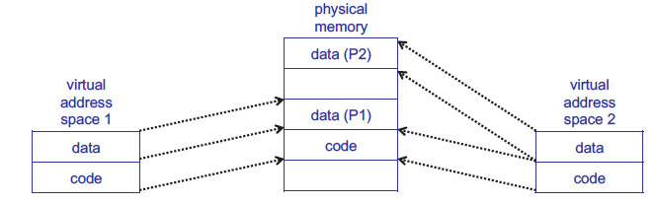
Base and bounds sharing
Even if we split code/data, sharing all or none

Slide 17
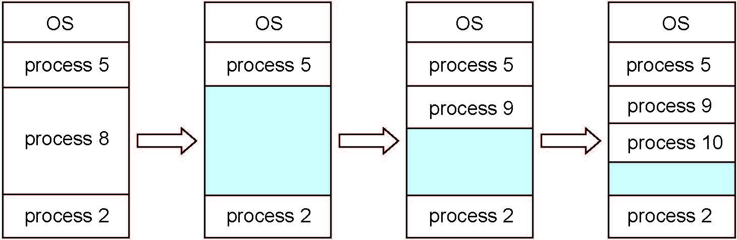
Multiple-partition allocation
Degree of multiprogramming limited by number of partitions
Variable-sized partitions for efficiency
Hole – block of available memory; holes of various size are scattered throughout memory
When a process arrives, it is allocated memory from a hole large enough to accommodate it
Process exiting frees its partition, adjacent free partitions combined
Operating system maintains information about: a) allocated partitions b) free partitions (hole)

Slide 18
Fragmentation
Internal fragmentation
Wasted space inside partition
External fragmentation
Total memory space exists to satisfy request but is non-contiguous
Result of leftover space as processes exit
Can resolve through compaction
Shuffle memory blocks to make partitions use consecutive addresses

Slide 19
Storage Allocation Problem
Given space request and list of holes in memory, how do we satisfy it?
First-fit: Allocate the first hole that is big enough
Best-fit: Allocate the smallest hole that is big enough; must search entire list, unless ordered by size
Produces the smallest leftover hole
Worst-fit: Allocate the largest hole; must also search entire list
Produces the largest leftover hole

Slide 20
Storage allocation example
You are given:
List of holes: 300 KB, 600 KB, 350 KB, 200 KB, 750 KB, 125 KB
List of processes with address space sizes: 115 KB, 500 KB, 358 KB, 200 KB, 375 KB
How would these processes be placed using
First-fit?
Best-fit?
Worst-fit?
Which uses memory most efficiently?
Which is most time-efficient?
Time based on time required to search list of holes

Slide 21
Example solution: first fit
Address spaces and how they fit:
115 KB → 300 KB hole
Holes now: 185, 600, 350, 200, 750, 125 KB
500 KB → 600 KB hole
Holes now: 185, 100, 350, 200, 750, 125 KB
358 KB → 750 KB hole
Holes now: 185, 100, 350, 200, 392, 125 KB
200 KB → 350 KB hole
Holes now: 185, 100, 150, 200, 392, 125 KB
375 KB → 392 KB hole
Holes now: 185, 100, 350, 200, 17, 125 KB

Slide 22
Example solution: best fit
Address spaces and how they fit:
115 KB → 125 KB hole
Holes now: 300, 600, 350, 200, 750, 10 KB
500 KB → 600 KB hole
Holes now: 300, 100, 350, 200, 750, 10 KB
358 KB → 750 KB hole
Holes now: 300, 100, 350, 200, 392, 10 KB
200 KB → 200 KB hole
Holes now: 300, 100, 350, 0, 392, 10 KB
375 KB → 392 KB hole
Holes now: 300, 100, 350, 17, 10 KB

Slide 23
Example solution: worst fit
Address spaces and how they fit:
115 KB → 750 KB hole
Holes now: 300, 600, 350, 200, 635, 125 KB
500 KB → 635 KB hole
Holes now: 300, 600, 350, 200, 135, 125 KB
358 KB → 600 KB hole
Holes now: 300, 242, 350, 200, 135, 125 KB
200 KB → 350 KB hole
Holes now: 300, 242, 150, 200, 135, 125 KB
375 KB → doesn’t fit!

Slide 24
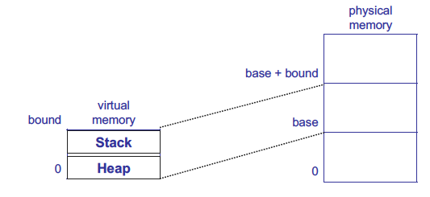
Growing memory regions independently
How can these regions grow independently?
Each needs own space! → segmentation/paging

Slide 25
Segmentation
Base & bounds groups entire address space together
Programs more logically organized into units
Main program, functions, stack, heap, etc.
Segment: contiguous region of memory
Base & bounds = 1 segment
Generalized segmentation allows >1 segment per program
Each process has a segment table
Entry in table = segment
HW support
Segment table base register (STBR) points to segment table
Segment table length register (STLR) indicates number of segments
Segment can be located anywhere in physical memory
Each segment has: start, length, access permission
Processes can share segments
Same start, length, same/different access permissions

Slide 26
Segmentation
Notes:
This should seem a bit strange: the virtual address space has gaps in it! Each segment gets mapped to contiguous locations in physical memory, but may be gaps between segments.
This is a little like walking around in the dark, and there are huge pits in the ground where you die if you step in the pit.
But! of course, a correct program will never step off into a pit, so ok.
A correct program will never address gaps; if it does, trap to kernel and then core dump. Minor exception: stack, heap can grow. In UNIX, sbrk() increases size of heap segment. For stack, just take fault, system automatically increases size of stack.
Detail: Protection mode in segmentation table entries. For example, code segment would be read-only (only execution and loads are allowed). Data and stack segment would be read-write (stores allowed).
What must be saved/restored on context switch? Typically, segment table stored in CPU, not in memory, because it’s small.
Contents must be saved/restored.

Slide 27
Segment table
Segment # | V | Base | Bounds | Access
0 | 1 | 4000 | 700 | read/exec | code segment
1 | 1 | 0 | 500 | read/write | data segment
2 | 0 | n/a | n/a |  | unused segment
3 | 1 | 2000 | 1000 | read/write | stack segment
Protection handled by segment table contents
Valid bit (V) indicates if segment in use
Access indicates privileges (read/write/execute)
Virtual address: segment #, offset
Segment number must be valid
Offset must be < bound
If either false, trap to OS → invalid address

Slide 28
Segmentation
Pros?
Can share code/data segments between processes
Can protect code segment from being overwritten
Can transparently grow stack/heap as needed
Cons?
Complex memory management
Need to find chunk of a particular size
May need to rearrange memory from time to time to make room for new segment or growing segment
External fragmentation: wasted space between chunks

Slide 29
Segmentation example
Segment # | V | Base | Bounds | Access
0 | 1 | 219 | 600 | read/write
1 | 1 | 2300 | 14 | read/write
2 | 1 | 90 | 100 | read/exec
3 | 1 | 1327 | 580 | read/write
4 | 0 | 1952 | 96 | read
Given segment table above, what are physical addresses for following virtual addresses (of form <seg #>, <offset>)?
0, 430
1, 10
2, 500
3, 400
4, 112

Slide 30
Example solution
Segment # | V | Base | Bounds | Access
0 | 1 | 219 | 600 | read/write
1 | 1 | 2300 | 14 | read/write
2 | 1 | 90 | 100 | read/exec
3 | 1 | 1327 | 580 | read/write
4 | 0 | 1952 | 96 | read
Given segment table above, what are physical addresses for following virtual addresses (of form <seg #>, <offset>)?
0, 430 → 219 + 430 = 649
1, 10 → 2300 + 10 = 2310
2, 500 → offset > bound → illegal access
3, 400 → 1327 + 400 = 1727
4, 112 → segment 4 not valid → illegal access

Slide 31
Paged Translation
Manage memory in fixed size units, or pages
Often refer to pages in virtual address space, frames in physical address space
Finding a free frame is easy
Bitmap allocation: 0011111100000001100
Each bit represents one physical page frame
Each process has its own page table
Stored in physical memory
Hardware registers
pointer to page table start
page table length
Notes:
Simpler, because allows use of a bitmap. What's a bitmap?
001111100000001100
Each bit represents one page of physical memory -- 1 means allocated, 0 means unallocated. Lots simpler than base&bounds or segmentation

Slide 32
Paged Translation (Abstract)

Slide 33
Paged Translation (Implementation)

Slide 34
Paging Questions
With paging, what is saved/restored on a process context switch?
Pointer to page table, size of page table
Page table itself is in main memory
What if page size is very small?
What if page size is very large?
Internal fragmentation: if we don’t need all of the space inside a fixed size chunk
Notes:
Means lots of space taken up with page table entries.

Slide 35
Paging basics
Major benefits
No need for bounds checking
Easy to allocate fixed-size units
Simple translation
Virtual address: page number & offset
Use page # to index into page table
Physical address: frame number & offset
Page # simply replaced by frame #--no arithmetic
Organization
Usually one page size (some systems support >1)
Page size determines offset size (log₂(page size))
VA > PA
Larger virtual address space than physical address space
# page table entries (PTE) determines page # size
# frames determines frame # size

Slide 36
Paging examples
Consider logical address space of 256 pages with 4 KB page size, mapped onto physical memory of 64 frames
How many bits are in the virtual address?
How many bits are in the physical address?
What’s the total size of each address space (virtual and physical)?

Slide 37
Paging examples
Consider logical address space of 256 pages with 4 KB page size, mapped onto phsyical memory of 64 frames
Offset size = log₂(4 KB) = log₂(2¹² bytes) = 12 bits
How many bits are in the virtual address?
Page # size = log₂(256 pages) = log₂(2⁸ pages) = 8 bits
VA size = 8 + 12 = 20 bits
How many bits are in the physical address?
Frame # size = log₂(64 frames) = log₂(2⁶ frames) = 6 bits
VA size = 6 + 12 = 18 bits
What’s the total size of each address space (virtual and physical)?
Address space size = 2^{address} ^{size}
Virtual address space = 2²⁰ = 1 MB
Physical address space = 2¹⁸ = 256 KB

Slide 38
Paging issues
What’s biggest issue with large virtual address space?
Size of page table → space in memory, speed of translation
How do we determine page to evict if physical address space is full?

Slide 39
Final notes
Next time
More on memory management
Exam 2 Preview
Reminders:
Program 2 due 3/21
Program 3 to be posted; due TBD
Exam 2: Wednesday, 3/28 in class
Will cover everything after Exam 1

Slide 40
Acknowledgements
These slides are adapted from the following sources:
Silberschatz, Galvin, & Gagne, Operating Systems Concepts, 9th edition
Anderson & Dahlin, Operating Systems: Principles and Practice, 2nd edition
Chen & Madhyastha, EECS 482 lecture notes, University of Michigan, Fall 2016

