Slide 1
EECE.3220 Data Structures
Instructor:
Dr. Michael Geiger
Fall 2019
Lecture 37:
Exam 3 Preview

Slide 2
Announcements/reminders
Text exercises (Ch. 22, 23) due 12/12
Textbook exercises total: 1461 points
Will compute average based on 1200 points total
Remaining points = extra credit
P4: Queue program posted (50 points)
Assignment total: 450 points (with P4)
Will compute average based on 400 points total
Code submissions allowed until 12/18 (day after final)
Course evals to be posted online; return at final
Can also get hard copy in today’s class or at my office
Final exam: Tuesday, 12/17, 8-11 AM, Olsen 407

Slide 3
Lecture outline
Exam 3 Preview
Honors-by-contract presentation for Jack Flood

Slide 4
Exam 3 notes
Allowed two 8.5” x 11” double-sided sheet of notes
No other notes, electronic devices (calculator, phone)
Exam will last three hours but will be roughly same length as Exams 1/2
Covers lectures 29-36
Question formats similar to previous exams
Code writing, code reading, multiple choice, short answer
SA example: Given a specific data set, show the binary search tree built by adding this data to the tree in the order shown
Newer topics tested in less detail
Extra credit problem based on Program 3
Using stacks to evaluate expressions

Slide 5
List of exam topics
Recursion
Binary search trees
Balanced BSTs
AVL trees
Red-black trees
Heaps
Priority queues
Hash tables
C++ standard containers

Slide 6
Review: Recursion
Some functions call other functions
Recursive functions call themselves
A recursive function has two parts
Anchor / base case: function value is defined for one or more specific argument values
Inductive / recursive case: function value for current argument value defined in terms of previously defined function values and/or arguments
Note: function may have >1 of each case

Slide 7
Review: Recursive example
Recursive power function
double power(double x, unsigned n){
if (n == 0)
return 1.0;
else
return x * power(x, n – 1);
}

Slide 8
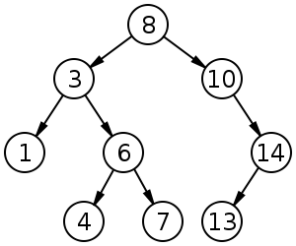
Review: Binary search tree
Binary search tree: binary tree in which each node follows property
value in left child of node ≤ value in node ≤ value in right child of node
Source: https://commons.wikimedia.org/w/index.php?curid=488330

Slide 9
Review: BST insert/delete
BST insertion
Modified search—find correct position for new node, then insert
New nodes always inserted as leaf node (in non-balanced BST)
BST deletion: 3 cases to consider
Leaf node: simply set parent->leaf ptr = NULL
Node w/1 child: set parent->node ptr =
parent->node->child
Node w/2 children: copy immediate successor to node to be deleted, then delete immediate successor
Immediate successor: go R once, then L as far as possible
Can also use immediate predecessor (go L once, then R as far as possible)

Slide 10
Review: AVL trees
Track balance factor in each node
Balance factor = difference in height of L & R subtrees
When adding/removing data
Use same rules as BST, then work up from added/deleted nodes and recompute balance factors
If balance factor +/- 2, use rotations to rebalance

Slide 11
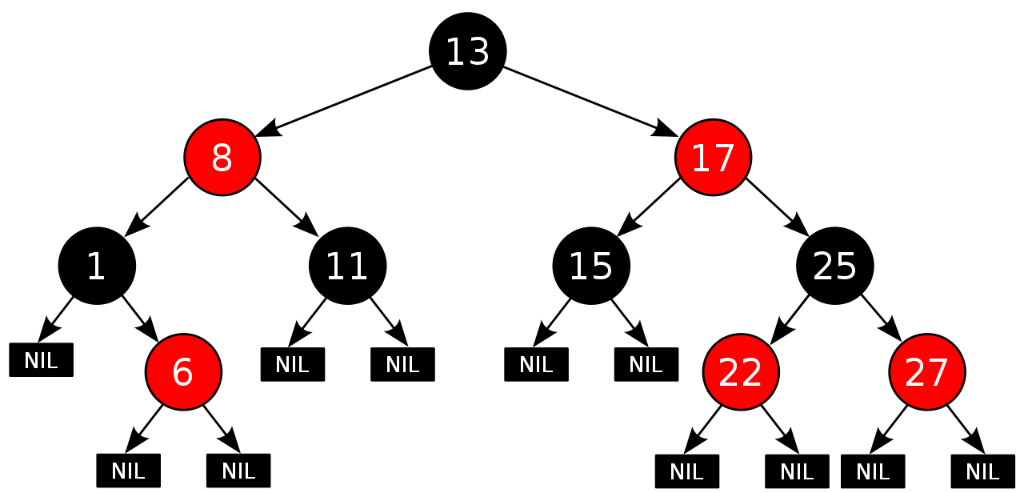
Review: Red-black trees
BST in which each node has a color
Some implementations consider links, not nodes, w/color
Not perfectly height balanced, but path from root to furthest leaf is no more than 2x path from root to closest leaf

Slide 12
Review: Red-black tree properties
Root node is black
All NULL pointers treated as black
If a node is red, both child nodes are black
Every path from a node to a NULL pointer contains the same number of black nodes
Source: https://commons.wikimedia.org/w/index.php?curid=31167379

Slide 13
Review: Heaps
A heap is a binary tree with properties:
It is complete
Each level of tree completely filled (except possibly bottom)
It satisfies heap-order property
Data in each node >= data in children (max-heap)
If data in node <= data in children, it’s a min-heap
Can be efficiently stored in array
Store all nodes at given level from left to right in consecutive locations
If first element @ index 0, then, given index n
Children are at indexes 2*n + 1 and 2*n + 2
Parent is at index (n-1)/2
Heapsort: O(n log(n)) sort
Make array/part of array into heap, then move highest val
Operate on smaller & smaller subsets

Slide 14
Review: Priority Queue
A collection of data elements
Items stored in order by priority
Higher priority items removed ahead of lower
Commonly implemented in heap
Highest priority item → top of heap
Write priority queue operations in terms of heap operations
Example: remove highest priority = remove top of heap

Slide 15
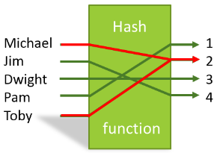
Review: Hash Tables
In some situations faster search is needed
Solution is to use a hash function
Value of key field given to hash function
Location in a hash table is calculated

Slide 16
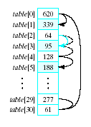
Review: Linear probing
Observe the problem with same value returned by h(i) for different values of i
Called collisions
A simple solution is linear probing
Linear search begins at collision location
Continues until empty slot found for insertion

Slide 17
Review: collision strategies
Linear probing: start at index & search in order
Quadratic probing
Probe sequence from location i is i + 1, i – 1, i + 4, i – 4, i + 9, i – 9, …
Secondary clusters can still form
Double hashing
Use a second hash function to determine probe sequence
Chaining: build linked list at each position

Slide 18
Review: C++ containers
Sequence containers: array, vector, deque, forward list, list
Linear data storage
Sequence container adapters: stack, queue, priority queue
Use sequence containers + rules on usage
Associative containers: set, map, multiset, multimap
Built on BSTs for O(log n) search
Unordered associative containers
Unordered versions of 4 containers above
Built on hash tables

Slide 19
Final notes
Next time
Exam 3: 12/17, 8-11 AM, Olsen 407
Reminders:
Text exercises (Ch. 22, 23) due 12/12
Textbook exercises total: 1461 points
Will compute average based on 1200 points total
Remaining points = extra credit
P4: Queue program posted (50 points)
Assignment total: 450 points (with P4)
Will compute average based on 400 points total
Code submissions allowed until 12/18 (day after final)
Course evals to be posted online; return at final

