Slide 1
16.482 / 16.561
Computer Architecture and Design
Instructor: Dr. Michael Geiger
Spring 2015
Lecture 3:
Datapath and control
Pipelining

Slide 2
Lecture outline
Announcements/reminders
  HW 2 due today
  HW 3 to be posted; due 5/29
Review: Arithmetic for computers
Today’s lecture
  Basic datapath design
  Single-cycle datapath
  Pipelining
Computer Architecture Lecture 3

Slide 3
Review: Binary multiplication
Generate shifted partial products and add them
Hardware can be condensed to two registers in iterating multiplier
  N-bit multiplicand
  2N-bit running product / multiplier
  At each step
    Check LSB of multiplier
    Add multiplicand/0 to left half of product/multiplier
    Shift product/multiplier right
Other multipliers (i.e., tree multiplier) trade more hardware for faster multiplication
Computer Architecture Lecture 3

Slide 4
Review: IEEE Floating-Point Format
single: 8 bits
double: 11 bits
single: 23 bits
double: 52 bits
S
Exponent
Fraction
S: sign bit (0 ⇒ non-negative, 1 ⇒ negative)
Normalize significand: 1.0 ≤ |significand| < 2.0
  Significand is Fraction with the “1.” restored
Actual exponent = (encoded value) - bias
  Single: Bias = 127; Double: Bias = 1023
Encoded exponents 0 and 111 ... 111 reserved
FP addition: match exponents, add, then normalize result
FP multiplication: add exponents, multiply significands, normalize results
Computer Architecture Lecture 3
Notes:
Morgan Kaufmann Publishers
Chapter 3 — Arithmetic for Computers

Slide 5
Datapath & control intro
Recall: How does a processor execute an instruction?
  Fetch the instruction from memory
  Decode the instruction
  Determine addresses for operands
  Fetch operands
  Execute instruction
  Store result (and go back to step 1 … )
First two steps are the same for all instructions
Next steps are instruction-dependent
Computer Architecture Lecture 3

Slide 6
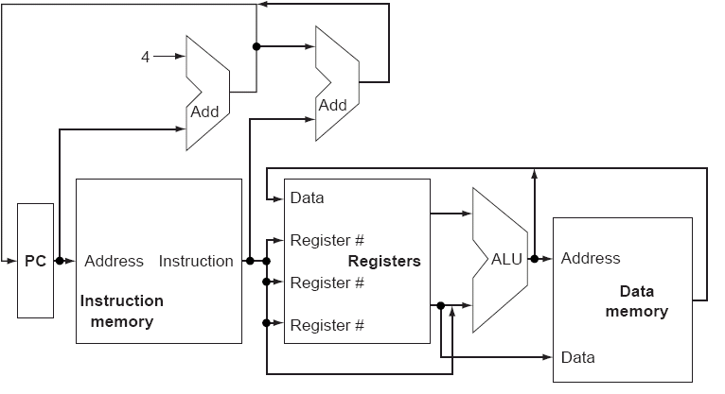
Basic processor implementation
Shows datapath elements: logic blocks that operate on or store data
Need control signals to specify multiplexer selection, functional unit operations
Computer Architecture Lecture 3

Slide 7
Basic design choices
Single-cycle implementation
  Every instruction takes one clock cycle
  Instruction fetch, decoding, execution, memory access, and result writeback in same cycle
  Cycle time determined by longest instruction
  Will discuss first as a means for simply introducing the different hardware required to execute each instruction
Pipelined implementation
  Simultaneously execute multiple instructions in different stages of execution
Computer Architecture Lecture 3

Slide 8
MIPS subset
We’ll go through simple processor design for subset of MIPS ISA
  add, sub, and, or (also immediate versions)
  lw, sw
  slt
  beq, j
Datapath design
  What elements are necessary (and which ones can be re-used for multiple instructions)?
Control design
  How do we get the datapath elements to perform the desired operations?
Will then discuss other operations
Computer Architecture Lecture 3

Slide 9
Datapath design
What steps in the execution sequence do all instructions have in common?
  Fetch the instruction from memory
  Decode the instruction
Instruction fetch brings data in from memory
Decoding determines control over datapath
Computer Architecture Lecture 3

Slide 10
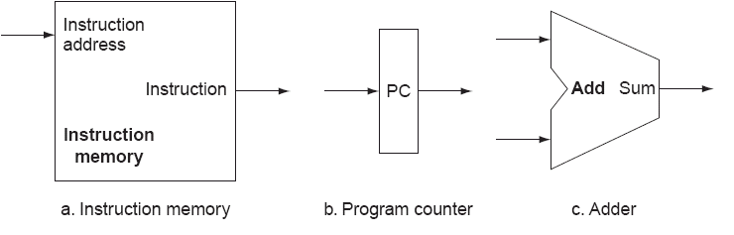
Instruction fetch
What logic is necessary for instruction fetch?
  Instruction storage → Memory
  Register to hold instruction address → program counter
  Logic to generate next instruction address
    Sequential code is easy: PC + 4
    Jumps/branches more complex (we’ll discuss later)
Computer Architecture Lecture 3

Slide 11
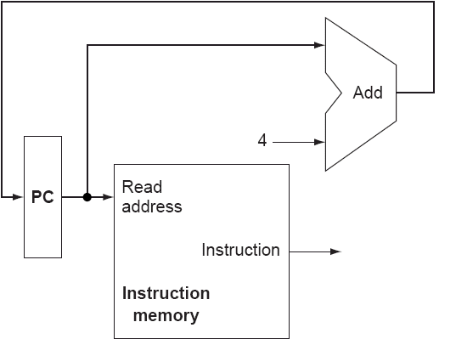
Instruction fetch (cont.)
Loader places starting address of main program in PC
PC + 4 points to next sequential address in main memory
Computer Architecture Lecture 3

Slide 12
Instruction decoding
Generate control signals from instruction bits
Recall: MIPS instruction formats
  Register instructions: R-type
  Immediate instructions: I-type
  Jump instructions: J-type
31 26 | 25 21 | 20 16 | 15 11 | 10 6 | 5 0
op | rs | rt | rd | shamt | funct
31 26 | 25 21 | 20 16 | 15 0
op | rs | rt | immediate/address
31 26 | 25 0
op | target (address)
Computer Architecture Lecture 3
Notes:
ADD FIGURES

Slide 13
Executing MIPS instructions
Look at different classes within our subset (ignore immediates for now)
  add, sub, and, or
  lw, sw
  slt
  beq, j
2 things processor does for all instructions except j
  Reads operands from register file
  Performs an ALU operation
1 additional thing for everything but sw, beq, and j
  Processor writes a result into register file
Computer Architecture Lecture 3

Slide 14
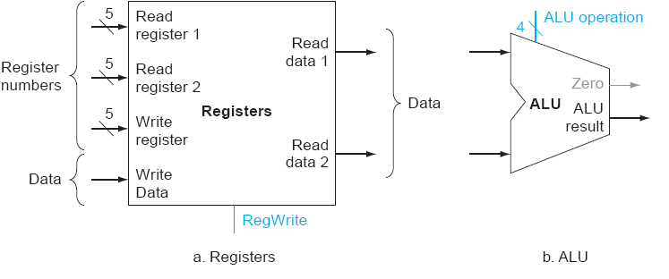
R-type execution datapath
R-type instructions (in our subset)
  add, sub, and, or, slt
What logic is necessary?
  Register file to provide operands
  ALU to operate on data
31 26 | 25 21 | 20 16 | 15 11 | 10 6 | 5 0
op | rs | rt | rd | shamt | funct
Computer Architecture Lecture 3

Slide 15
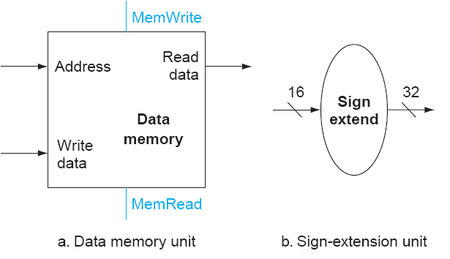
Memory instructions
lw, sw → I-type instructions
Use register file
  Base address
  Source data for store
  Destination for load
Compute address using ALU
What additional logic is necessary?
  Data memory
  Sign extension logic (why?)
Computer Architecture Lecture 3

Slide 16
Branch instructions
Simple beq implementation
  Branch if (a – b) == 0; use ALU to evaluate condition
Branch address = (PC + 4) + (offset << 2)
  Where’s offset encoded?
    Immediate field
  Why shift by 2?
    Instruction addresses word aligned—2 least significant bits are 0
Computer Architecture Lecture 3

Slide 17
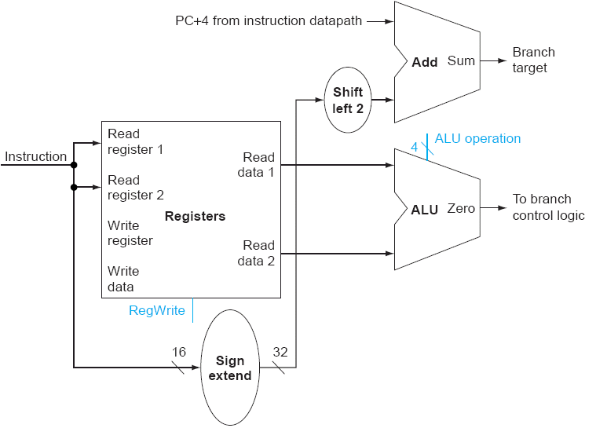
Branch instruction datapath
31 26 | 25 21 | 20 16 | 15 0
op | rs | rt | immediate/address
Computer Architecture Lecture 3

Slide 18
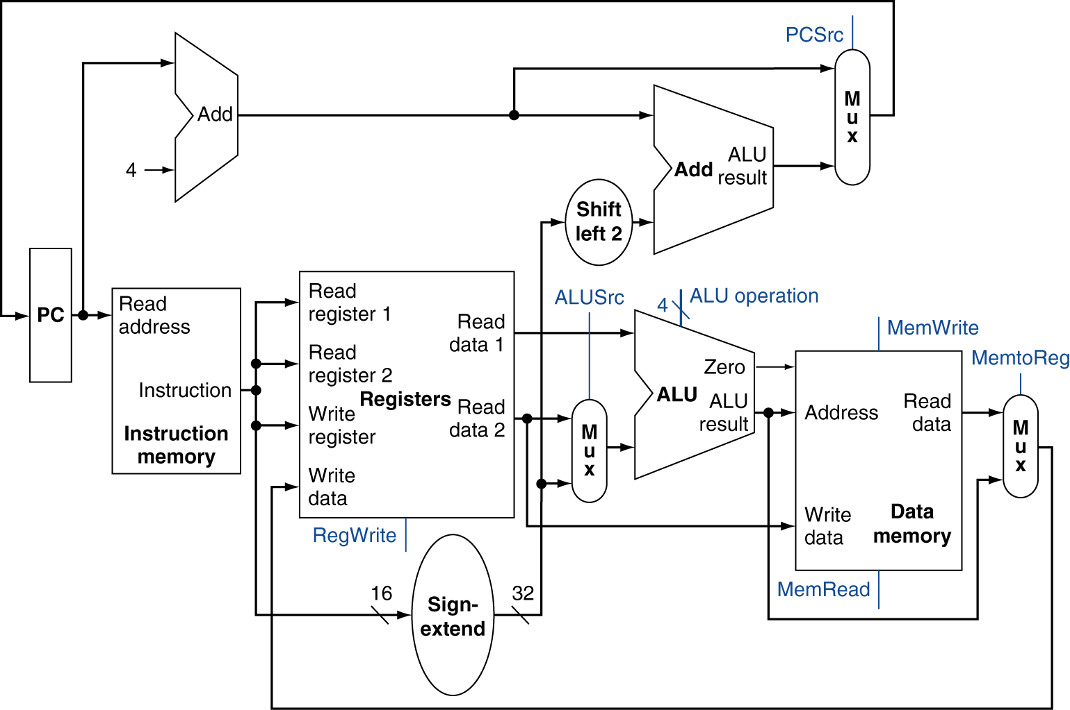
Putting the pieces together
Chooses PC+4 or branch target
Chooses ALU output or memory output
Chooses register or sign-extended immediate
Computer Architecture Lecture 3

Slide 19
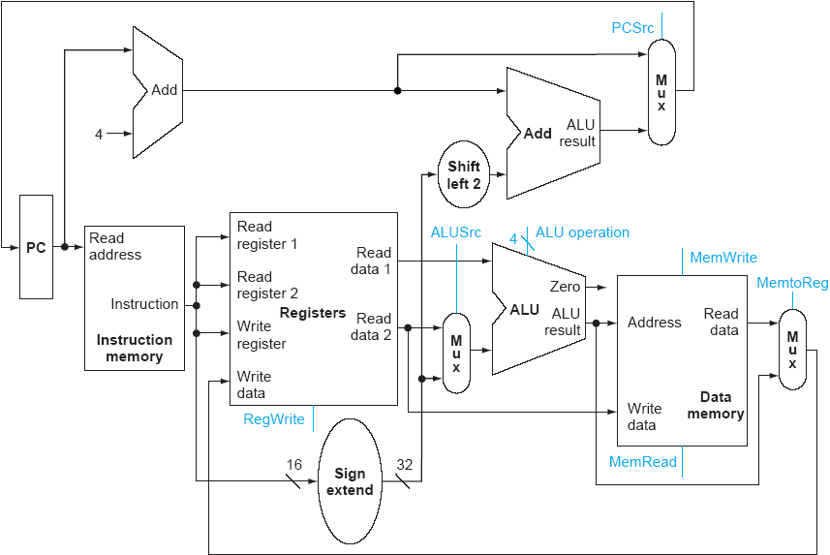
Datapath for R-type instructions
EXAMPLE:
add $4, $10, $30
($4 = $10 + $30)
Computer Architecture Lecture 3

Slide 20
Datapath for I-type ALU instructions
EXAMPLE:
addi $4, $10, 15
($4 = $10 + 15)
Computer Architecture Lecture 3

Slide 21
Datapath for beq (not taken)
EXAMPLE:
beq $1,$2,label
(branch to label if
$1 == $2)
Computer Architecture Lecture 3

Slide 22
Datapath for beq (taken)
EXAMPLE:
beq $1,$2,label
(branch to label if
$1 == $2)
Computer Architecture Lecture 3

Slide 23
Datapath for lw instruction
EXAMPLE:
lw $2, 10($3)
($2 = mem[$3 + 10])
Computer Architecture Lecture 3

Slide 24
Datapath for sw instruction
EXAMPLE:
sw $2, 10($3)
(mem[$3 + 10] = $2)
Computer Architecture Lecture 3

Slide 25
The Main Control Unit
Control signals derived from instruction
R-type
0
rs
rt
rd
shamt
funct
31:26
25:21
20:16
15:11
10:6
5:0
Load/
Store
35 or 43
rs
rt
address
31:26
25:21
20:16
15:0
Branch
4
rs
rt
address
31:26
25:21
20:16
15:0
opcode
always read
read, except for load
write for R-type and load
sign-extend and add
Computer Architecture Lecture 3
Notes:
Morgan Kaufmann Publishers
Chapter 4 — The Processor

Slide 26
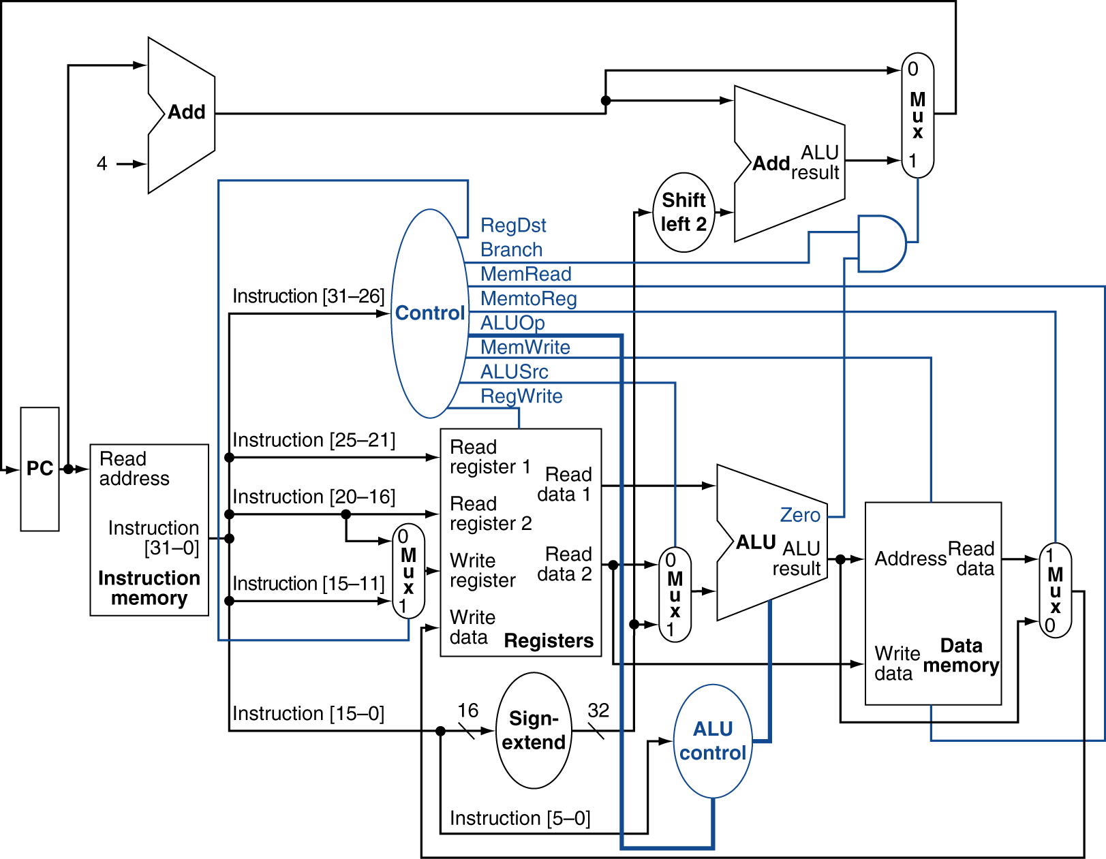
Datapath With Control
Computer Architecture Lecture 3
Notes:
Morgan Kaufmann Publishers
Chapter 4 — The Processor

Slide 27
Adding j instruction
J-type format
Next PC = (PC+4)[31:28] combined with (target<<2)
3 choices for next PC
  PC + 4
  beq target address
  j target address
Need another multiplexer and control bit!
31 26 | 25 0
2 | target (address)
Computer Architecture Lecture 3

Slide 28
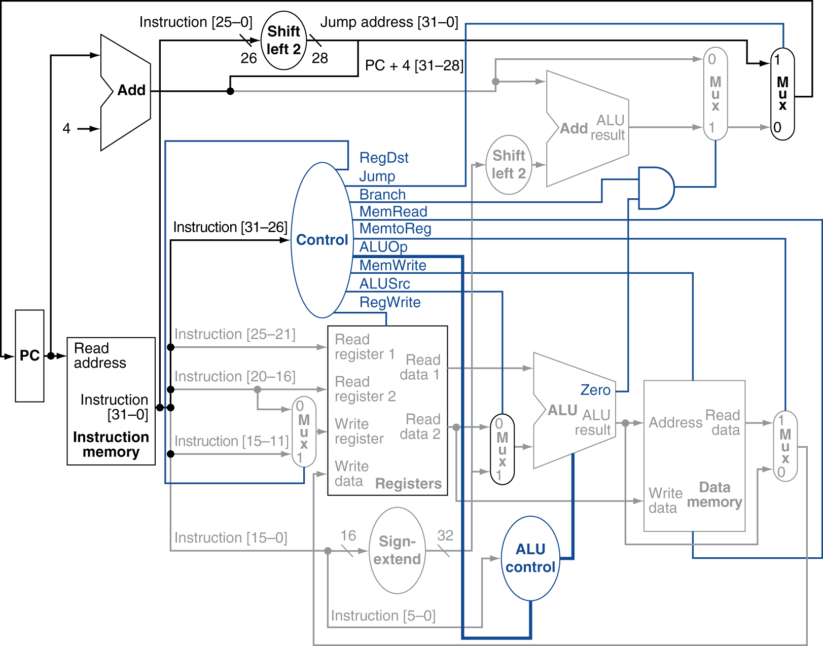
Datapath with jump support
Computer Architecture Lecture 3

Slide 29
Control signals
PCWriteCond: conditionally enables write to PC if branch condition is true (if Zero flag = 1)
PCWrite: enables write to PC; used for both normal PC increment and jump instructions
IorD: indicates if memory address is for instruction (i.e., PC) or data (i.e., ALU output)
MemRead, MemWrite: controls memory operation
MemtoReg: determines if write data comes from memory or ALU output
IRWrite: enables writing of instruction register
Computer Architecture Lecture 3

Slide 30
Control signals (cont.)
PCSource: controls multiplexer that determines if value written to PC comes from ALU (PC = PC+4), branch target (stored ALU output), or jump target
ALUOp: feeds ALU control module to determine ALU operation
ALUSrcA: controls multiplexer that chooses between PC or register as A input of ALU
ALUSrcB: controls multiplexter that chooses between register, constant ‘4’, sign-extended immediate, or shifted immediate as B input of ALU
RegWrite: enables write to register file
RegDst: determines if rt or rd field indicates destination register
Computer Architecture Lecture 3

Slide 31
Summary of execution phases
Phase | R-type | Memory (lw/sw) | Branch/Jump
Instruction fetch | IR = Mem[PC] PC = PC + 4
Instruction decode/ register fetch | A = Reg[IR[25:21]] B = Reg[IR[20:16]] ALUout = PC + (sign-extend(IR[15:0]) << 2)
Execution, address computation, branch and jump completion | ALUout = A op B | ALUout = A + sign-extend(IR[15:0]) | Branch: if (A == B) PC = ALUout Jump: PC = {PC[31:28],IR[25:0],(00)}
Memory access, R-type completion | Reg[IR[15:11]] = ALUout | Load: MDR = Mem[ALUout] Store: Mem[ALUout] = B
Memory read completion |  | Load: Reg[IR[20:16]] = MDR
Computer Architecture Lecture 3

Slide 32
Motivating pipelining
Basic performance equation:
Execution time = (inst. count) * (CPI) * (cycle time)
We’ve seen basic single-cycle datapath
  Offers 1 CPI ...
  ... but cycle time determined by longest instruction
    Load essentially uses all stages
We’d like both low CPI and a short cycle
Solution: pipelining
  Simultaneously execute multiple instructions
  Use multi-cycle “assembly line” approach
Computer Architecture Lecture 3

Slide 33
Pipelining is like …
… doing laundry (no, really)
Say 4 people (Ann, Brian, Cathy, Don) want to use a laundry service that has four components:
  Washer, which takes 30 minutes
  Dryer, which takes 30 minutes
  “Folder,” which takes 30 minutes
  “Storer,” which takes 30 minutes
Computer Architecture Lecture 3

Slide 34
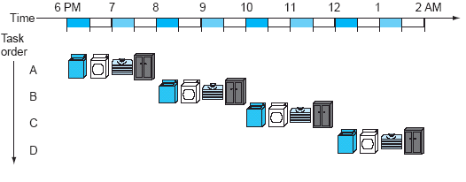
Sequential laundry service
Each person starts when previous one finishes
4 loads take 8 hours
Computer Architecture Lecture 3

Slide 35
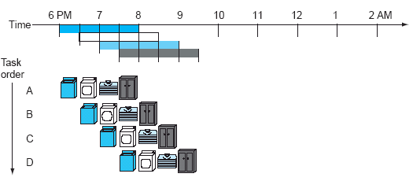
Pipelined laundry service
As soon as a particular component is free, next person can use it
4 loads take 3 ½ hours
Computer Architecture Lecture 3

Slide 36
Pipelining questions
Does pipelining improve latency or throughput?
  Throughput—time for each instruction same, but more instructions per unit time
What’s the maximum potential speedup of pipelining?
  The number of stages, N—before, each instruction took N cycles, now we can (theoretically) finish 1 instruction per cycle
If one stage can run faster, how does that affect the speedup?
  No effect—cycle time depends on longest stage, because you may be using hardware from all stages at once
Computer Architecture Lecture 3

Slide 37
Principles of pipelining
Every instruction takes same number of steps
  Pipeline stages
  1 stage per cycle
    Longest stage determines cycle time
  Basic processors have 5 stages
    IF: Instruction fetch
    ID: Instruction decode and register read
    EX: Execution / address calculation
    MEM: Memory access
    WB: Write back result to register
Modern dynamically scheduled processors different—longer, variable length pipelines
Computer Architecture Lecture 3

Slide 38
Pipeline Performance
Assume time for stages is
  100ps for register read or write
  200ps for other stages
Compare pipelined datapath with single-cycle datapath
  How long does instruction take in single-cycle?
    800 ps → longest inst. time = time for every instruction
Instr | Instr fetch | Register read | ALU op | Memory access | Register write | Total time
lw | 200ps | 100 ps | 200ps | 200ps | 100 ps | 800ps
sw | 200ps | 100 ps | 200ps | 200ps |  | 700ps
R-format | 200ps | 100 ps | 200ps |  | 100 ps | 600ps
beq | 200ps | 100 ps | 200ps |  |  | 500ps
Computer Architecture Lecture 3
Notes:
Morgan Kaufmann Publishers
Chapter 4 — The Processor

Slide 39
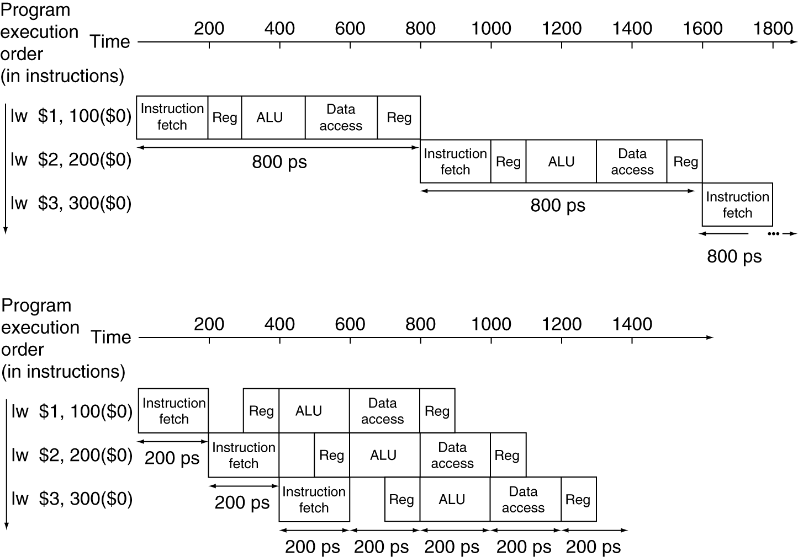
Pipeline Performance
Single-cycle (T_{c}= 800ps)
Pipelined (T_{c}= 200ps)
Computer Architecture Lecture 3
Notes:
Morgan Kaufmann Publishers
Chapter 4 — The Processor

Slide 40
Pipeline diagram
 | Cycle 1 | 2 | 3 | 4 | 5 | 6 | 7 | 8
lw | IF | ID | EX | MEM | WB
add |  | IF | ID | EX | MEM | WB
beq |  |  | IF | ID | EX | MEM | WB
sw |  |  |  | IF | ID | EX | MEM | WB
Pipeline diagram shows execution of multiple instructions
  Instructions listed vertically
  Cycles shown horizontally
  Each instruction divided into stages
  Can see what instructions are in a particular stage at any cycle
Computer Architecture Lecture 3

Slide 41
Performance example
Say we have the following code:
loop: add $t1, $t2, $t3
lw $t4, 0($t1)
beq $t4, $t3, end
sw $t3, 4($t1)
add $t2, $t2, 8
j loop
end: ...
Assume each pipeline stage takes 4 ns
How long would one loop iteration take in an ideal pipelined processor (i.e., no delays between instructions)?
How long would one loop iteration take in a single-cycle datapath?
How much faster is the pipelined datapath than the single-cycle datapath? (Express your answer as a ratio, not an absolute difference.)
Computer Architecture Lecture 3

Slide 42
Solution
 | Cycle 1 | 2 | 3 | 4 | 5 | 6 | 7 | 8 | 9 | 10
add | IF | ID | EX | MEM | WB
lw |  | IF | ID | EX | MEM | WB
beq |  |  | IF | ID | EX | MEM | WB
sw |  |  |  | IF | ID | EX | MEM | WB
add |  |  |  |  | IF | ID | EX | MEM | WB
j |  |  |  |  |  | IF | ID | EX | MEM | WB
Can draw pipelining diagram to show # cycles
In ideal pipelining, with M instructions & N pipeline stages, total time = N + (M-1)
  Here, M = 6, N = 5 → 5 + (6-1) = 10 cycles
  Total time = (10 cycles) * (4 ns/cycle) = 40 ns
Computer Architecture Lecture 3

Slide 43
Solution (continued)
Single-cycle datapath: longest instruction determines total instruction time
  Longest instruction (lw) requires all 5 stages
  5 * (4 ns) = 20 ns per instruction
  Total time = (6 instructions) * (20 ns) = 120 ns
Ratio of execution times (speedup):
  120 ns / 40 ns = 3 → pipelining is 3x faster
Computer Architecture Lecture 3

Slide 44
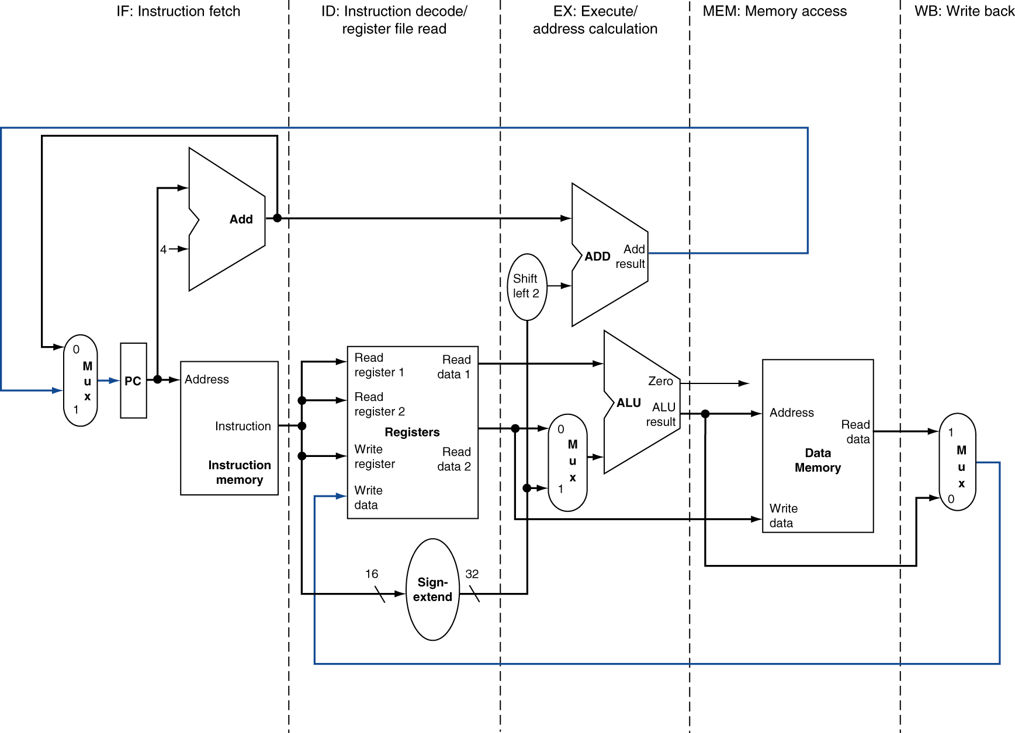
Pipelined datapath principles
MEM
Right-to-left flow leads to hazards
WB
Computer Architecture Lecture 3
Notes:
Morgan Kaufmann Publishers
Chapter 4 — The Processor

Slide 45
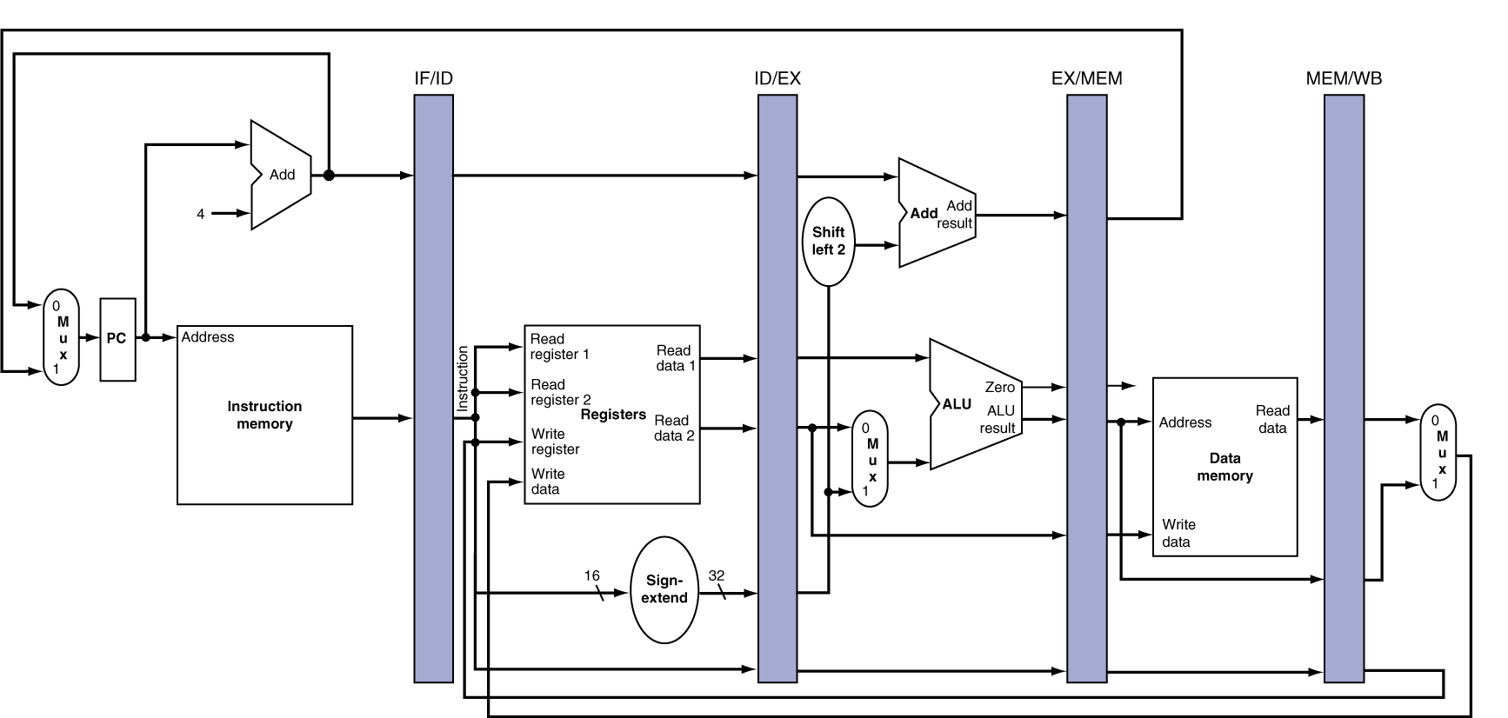
Pipeline registers
Need registers between stages for info from previous cycles
Register must be able to hold all needed info for given stage
  For example, IF/ID must be 64 bits—32 bits for instruction, 32 bits for PC+4
May need to propagate info through multiple stages for later use
  For example, destination reg. number determined in ID, but not used until WB
Computer Architecture Lecture 3
Notes:
Morgan Kaufmann Publishers
Chapter 4 — The Processor

Slide 46
Pipeline hazards
A hazard is a situation that prevents an instruction from executing during its designated clock cycle
3 types:
  Structure hazards: two instructions attempt to simultaneously use the same hardware
  Data hazards: instruction attempts to use data before it’s ready
  Control hazards: attempt to make a decision before condition is evaluated
Computer Architecture Lecture 3

Slide 47
Structure hazards
Examples in MIPS pipeline
  May need to calculate addresses and perform operations → need multiple adders + ALU
  May need to access memory for both instructions and data → need instruction & data memories (caches)
  May need to read and write register file
  → write in first half of cycle, read in second
 | Cycle 1 | 2 | 3 | 4 | 5 | 6 | 7 | 8
lw | IF | ID | EX | MEM | WB
add |  | IF | ID | EX | MEM | WB
beq |  |  | IF | ID | EX | MEM | WB
sw |  |  |  | IF | ID | EX | MEM | WB
Computer Architecture Lecture 3

Slide 48
Data Hazard Example
Consider this sequence:
  sub $2, $1,$3
  and $12,$2,$5
  or $13,$6,$2
  add $14,$2,$2
  sw $15,100($2)
Can’t use value of $2 until it’s actually computed and stored
  No hazard for sw
  Register hardware takes care of add
  What about and, or?
Computer Architecture Lecture 3
Notes:
Morgan Kaufmann Publishers
Chapter 4 — The Processor

Slide 49
Software solution: no-ops
No-ops: instructions that do nothing
Effectively “stalls” pipeline until data is ready
Compiler can recognize hazards ahead of time and insert nop instructions
 | Cycle 1 | 2 | 3 | 4 | 5 | 6 | 7 | 8
sub | IF | ID | EX | MEM | WB
nop |  | IF | ID | EX | MEM | WB
nop |  |  | IF | ID | EX | MEM | WB
and |  |  |  | IF | ID | EX | MEM | WB
Result written to reg file
Computer Architecture Lecture 3

Slide 50
No-op example
Given the following code, where are no-ops needed?
add $t2, $t3, $t4
sub $t5, $t1, $t2
or $t6, $t2, $t7
slt $t8, $t9, $t5
Computer Architecture Lecture 3

Slide 51
Solution
Given the following code, where are no-ops needed?
add $t2, $t3, $t4 ←$t2 used by sub, or
nop
nop
sub $t5, $t1, $t2 ← $t5 used by slt
or $t6, $t2, $t7
nop ← could also be before or
slt $t8, $t9, $t5
Computer Architecture Lecture 3

Slide 52
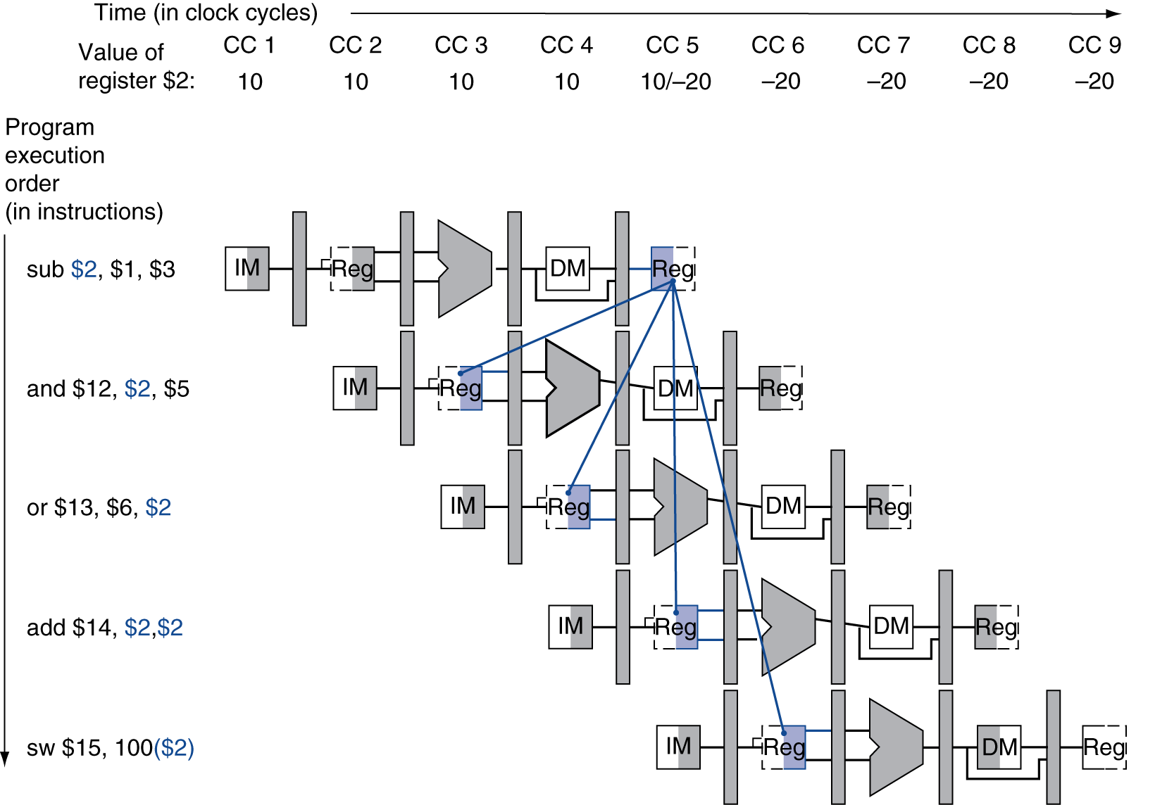
Avoiding stalls
Inserting no-ops rarely best solution
  Complicates compiler
  Reduces performance
Can we solve problem in hardware? (Hint: when do we know value of $2?)
Computer Architecture Lecture 3

Slide 53
Dependencies & Forwarding
Value computed at end of EX stage
Use pipeline registers to forward
  Add additional paths to ALU inputs from EX/MEM, MEM/WB
Computer Architecture Lecture 3
Notes:
Morgan Kaufmann Publishers
Chapter 4 — The Processor

Slide 54
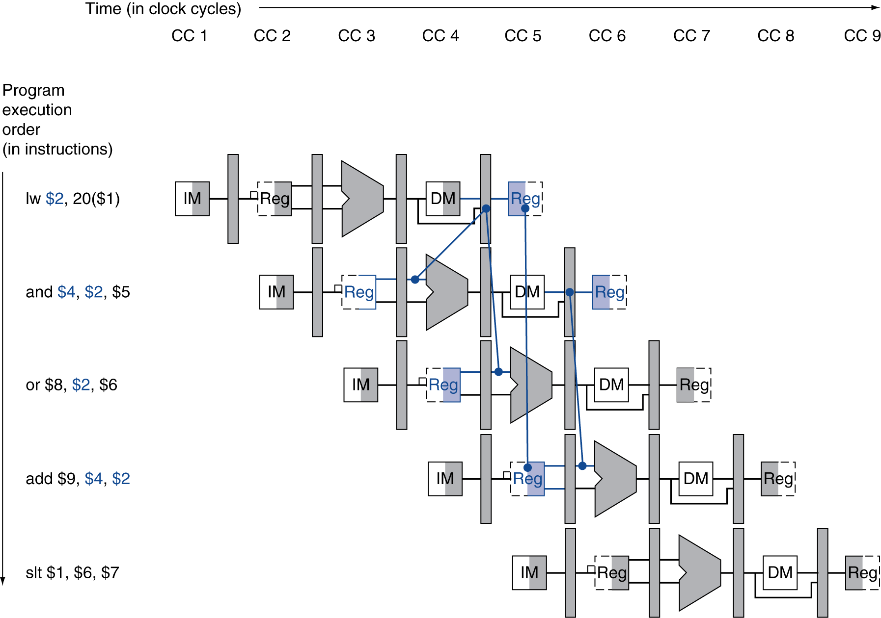
Load-Use Data Hazard
Need to stall for one cycle
Computer Architecture Lecture 3
Notes:
Morgan Kaufmann Publishers
Chapter 4 — The Processor

Slide 55
How to Stall the Pipeline
Force control values in ID/EX register
to 0
  EX, MEM and WB do nop (no-operation)
Prevent update of PC and IF/ID register
  Using instruction is decoded again
  Following instruction is fetched again
  1-cycle stall allows MEM to read data for lw
    Can subsequently forward to EX stage
Computer Architecture Lecture 3
Notes:
Morgan Kaufmann Publishers
Chapter 4 — The Processor

Slide 56
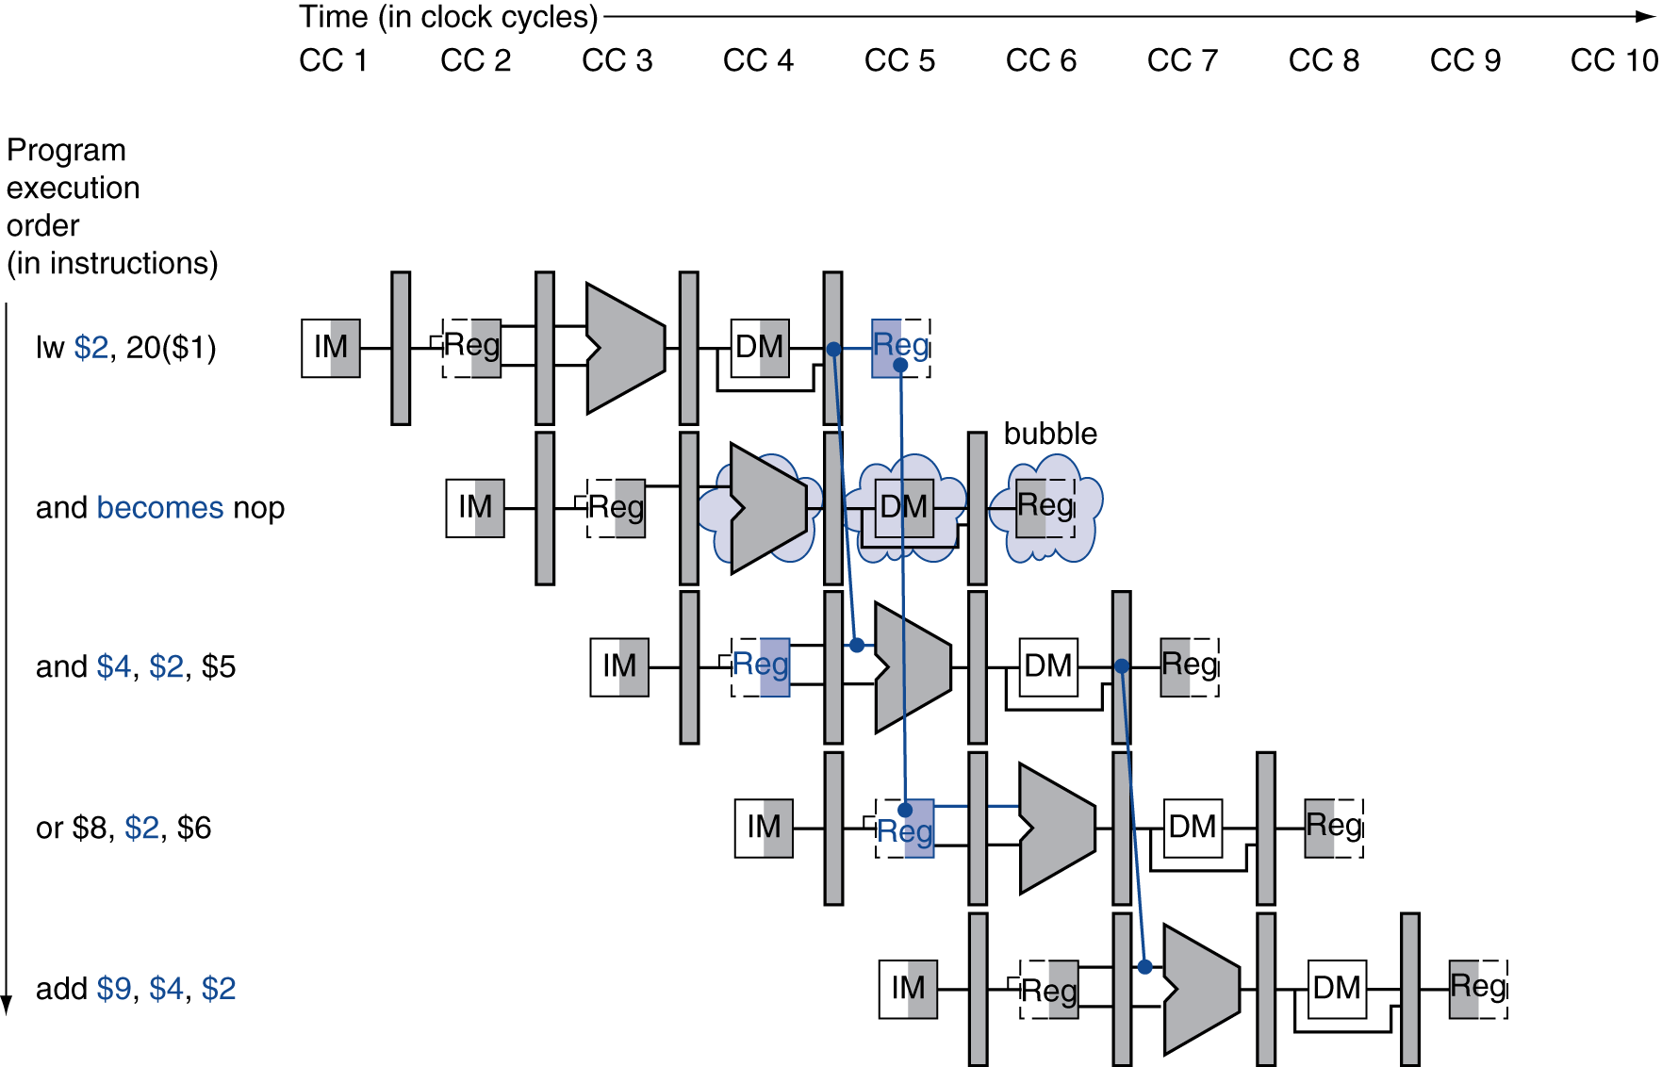
Stall/Bubble in the Pipeline
Stall inserted here
Computer Architecture Lecture 3
Notes:
Morgan Kaufmann Publishers
Chapter 4 — The Processor

Slide 57
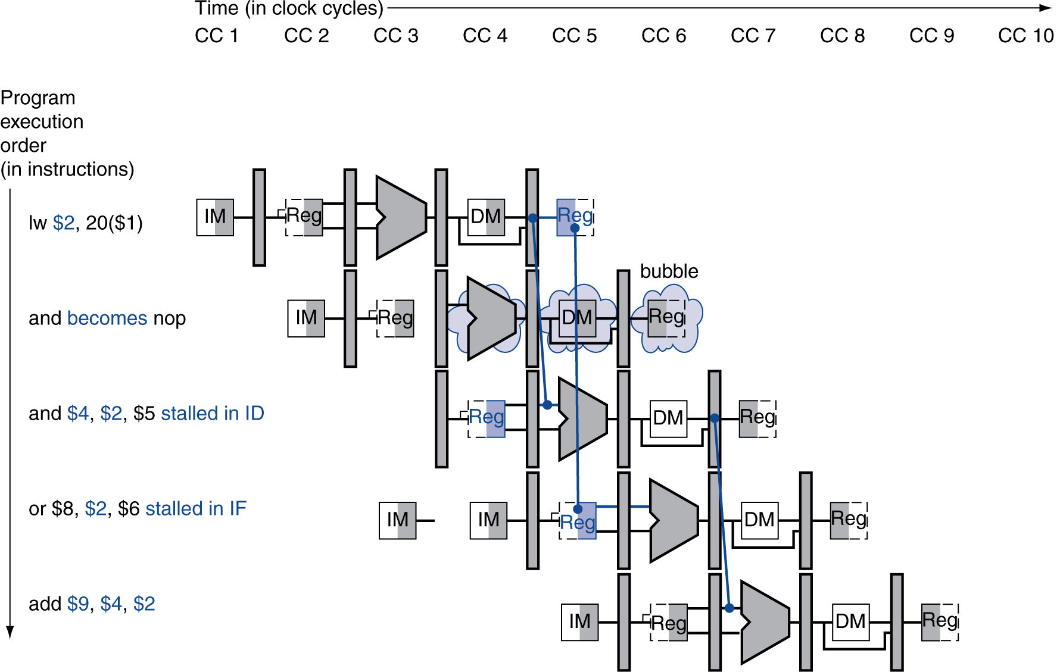
Stall/Bubble in the Pipeline
Or, more accurately…
Computer Architecture Lecture 3
Notes:
Morgan Kaufmann Publishers
Chapter 4 — The Processor

Slide 58
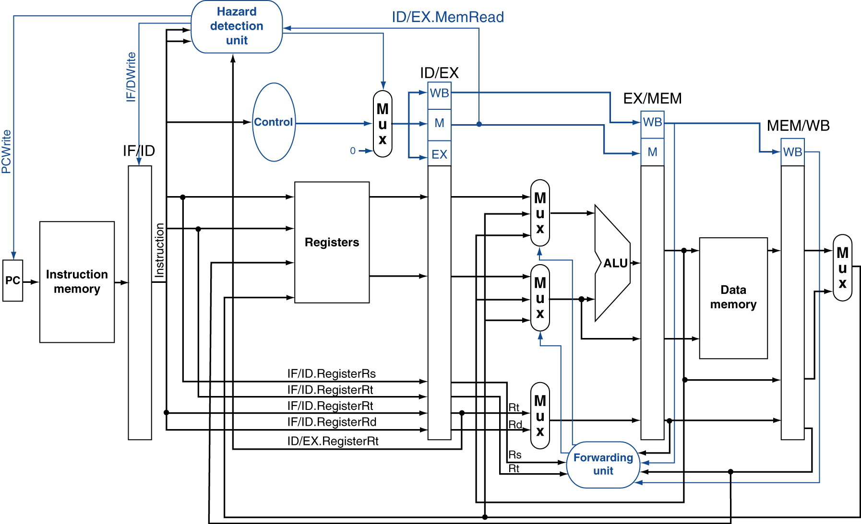
Datapath with Hazard Detection
Computer Architecture Lecture 3
Notes:
Morgan Kaufmann Publishers
Chapter 4 — The Processor

Slide 59
Performance example revisited
Let’s reevaluate the code we saw earlier:
loop: add $t1, $t2, $t3
lw $t4, 0($t1)
beq $t4, $t3, end
sw $t3, 4($t1)
add $t2, $t2, 8
j loop
end: ...
Again, assume each pipeline stage takes 4 ns
How long would one loop iteration take in a pipelined processor without forwarding?
How long would one loop iteration take in a pipelined processor with forwarding?
Computer Architecture Lecture 3

Slide 60
Solution
First, identify potential data hazards:
  lw uses $t1 generated in add
  beq uses $t4 generated in lw
  If we had multiple loop iterations, first add would use $t2 generated in second add
loop: add $t1, $t2, $t3
lw $t4, 0($t1)
beq $t4, $t3, end
sw $t3, 4($t1)
add $t2, $t2, 8
j loop
end: ...
Computer Architecture Lecture 3

Slide 61
Solution: no forwarding
 | Cycle 1 | 2 | 3 | 4 | 5 | 6 | 7 | 8 | 9 | 10 | 11 | 12 | 13 | 14
add | IF | ID | EX | MEM | WB
nop |  | IF | ID | EX | MEM | WB
nop |  |  | IF | ID | EX | MEM | WB
lw |  |  |  | IF | ID | EX | MEM | WB
nop |  |  |  |  | IF | ID | EX | MEM | WB
nop |  |  |  |  |  | IF | ID | EX | MEM | WB
beq |  |  |  |  |  |  | IF | ID | EX | MEM | WB
sw |  |  |  |  |  |  |  | IF | ID | EX | MEM | WB
add |  |  |  |  |  |  |  |  | IF | ID | EX | MEM | WB
j |  |  |  |  |  |  |  |  |  | IF | ID | EX | MEM | WB
Need 2 cycles between dependent instructions in 5 stage pipeline without forwarding
Diagram shows code takes 14 cycles
  (14 cycles) * (4 ns/cycle) = 56 ns
Computer Architecture Lecture 3

Slide 62
Solution: forwarding
 | Cycle 1 | 2 | 3 | 4 | 5 | 6 | 7 | 8 | 9 | 10 | 11
add | IF | ID | EX | MEM | WB
lw |  | IF | ID | EX | MEM | WB
nop |  |  | IF | ID | EX | MEM | WB
beq |  |  |  | IF | ID | EX | MEM | WB
sw |  |  |  |  | IF | ID | EX | MEM | WB
add |  |  |  |  |  | IF | ID | EX | MEM | WB
j |  |  |  |  |  |  | IF | ID | EX | MEM | WB
Forwarding resolves add → lw hazard
Need 1 cycle to handle lw → beq hazard
Total time: 11 cycles
  (11 cycles) * (4 ns/cycle) = 44 ns
Computer Architecture Lecture 3

Slide 63
Code Scheduling to Avoid Stalls
Reorder code to avoid use of load result in the next instruction
C code for A = B + E; C = B + F;
lw $t1, 0($t0)
lw $t2, 4($t0)
add $t3, $t1, $t2
sw $t3, 12($t0)
lw $t4, 8($t0)
add $t5, $t1, $t4
sw $t5, 16($t0)
lw $t1, 0($t0)
lw $t2, 4($t0)
lw $t4, 8($t0)
add $t3, $t1, $t2
sw $t3, 12($t0)
add $t5, $t1, $t4
sw $t5, 16($t0)
stall
stall
13 cycles
11 cycles
Computer Architecture Lecture 3
Notes:
Morgan Kaufmann Publishers
Chapter 4 — The Processor

Slide 64
Control Hazards
Branch determines flow of control
  Fetching next instruction depends on branch outcome
  Pipeline can’t always fetch correct instruction
    Still working on ID stage of branch
In MIPS pipeline
  Need to compare registers and compute target early in the pipeline
  Add hardware to do it in ID stage
Computer Architecture Lecture 3
Notes:
Morgan Kaufmann Publishers
Chapter 4 — The Processor

Slide 65
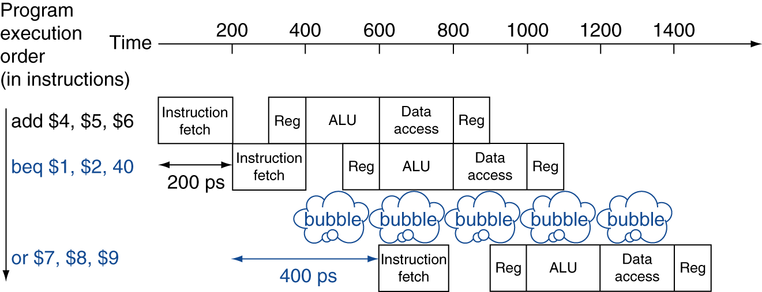
Stall on Branch
Wait until branch outcome determined before fetching next instruction
Computer Architecture Lecture 3
Notes:
Morgan Kaufmann Publishers
Chapter 4 — The Processor

Slide 66
Branch Prediction
Longer pipelines can’t readily determine branch outcome early
  Stall penalty becomes unacceptable
Predict outcome of branch
  Only stall if prediction is wrong
In MIPS pipeline
  Can predict branches not taken
  Fetch instruction after branch, with no delay
Computer Architecture Lecture 3
Notes:
Morgan Kaufmann Publishers
Chapter 4 — The Processor

Slide 67
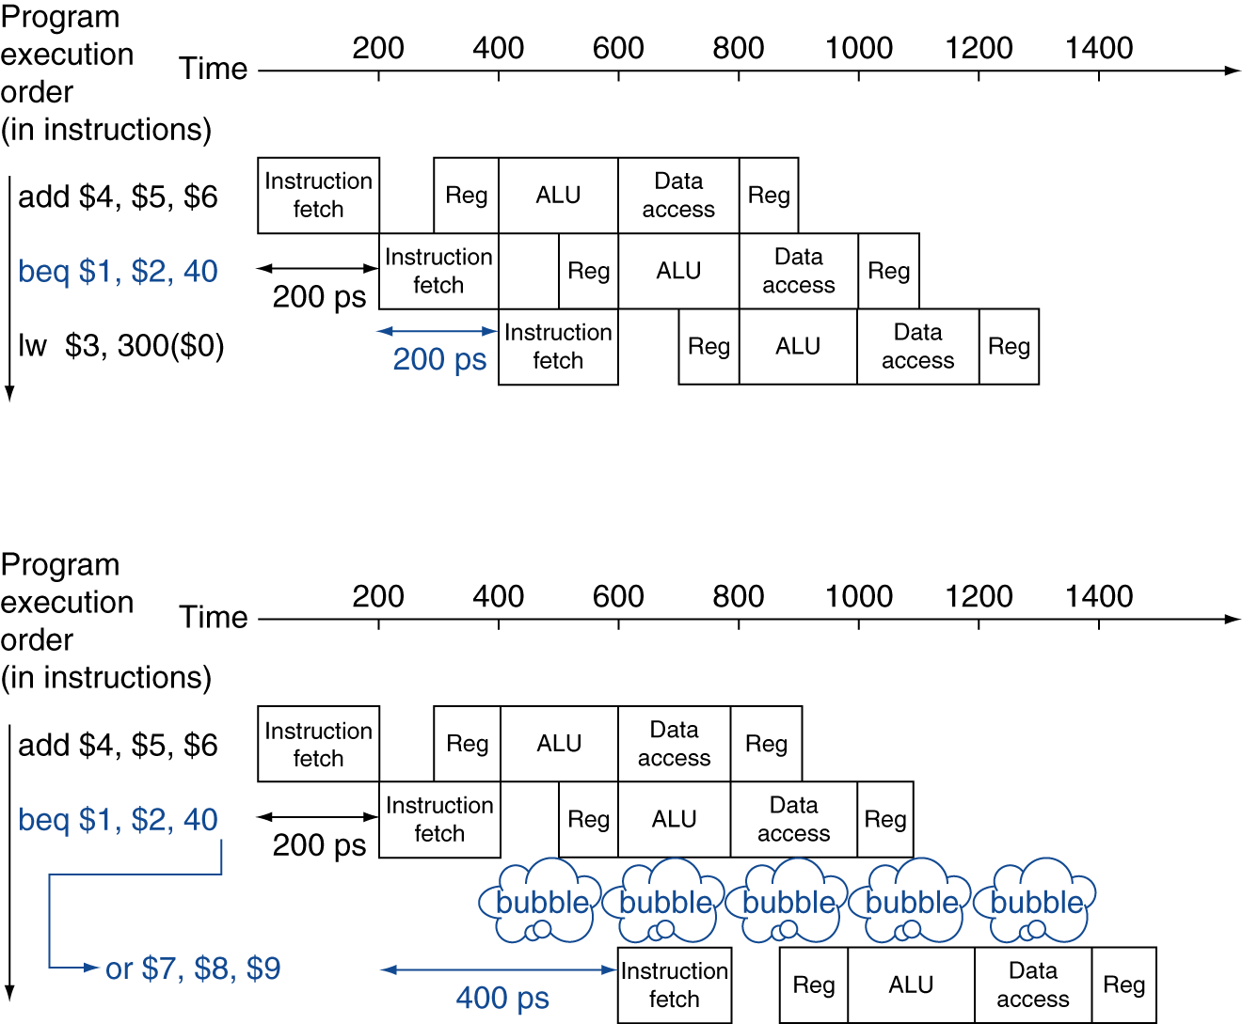
MIPS with Predict Not Taken
Prediction correct
Prediction incorrect
Computer Architecture Lecture 3
Notes:
Morgan Kaufmann Publishers
Chapter 4 — The Processor

Slide 68
More-Realistic Branch Prediction
Static branch prediction
  Based on typical branch behavior
  Example: loop and if-statement branches
    Predict backward branches taken
    Predict forward branches not taken
Dynamic branch prediction
  Hardware measures actual branch behavior
    e.g., record recent history of each branch
  Assume future behavior will continue the trend
    When wrong, stall while re-fetching, and update history
Computer Architecture Lecture 3
Notes:
Morgan Kaufmann Publishers
Chapter 4 — The Processor

Slide 69
Final notes
Next time: Dynamic branch prediction
Announcements/reminders
  HW 2 due today
  HW 3 to be posted; due 5/29
Computer Architecture Lecture 3

