Slide 1
EECE.3170 Microprocessor Systems Design I
Instructors:
Dr. Lin Li & Dr. Michael Geiger
Fall 2019
Lecture 24
Exam 2 Preview

Slide 2
Lecture outline
Announcements/reminders:
HW 4 due today—no late submissions accepted
Today’s lecture: Exam 2 Preview

Slide 3
Exam 2 notes
Please attend your registered section unless you have permission to do otherwise
Allowed
One 8.5” x 11” double-sided sheet of notes
Calculator
No other notes or electronic devices
Exam will last 50 minutes
Covers lectures 12-13, 15-23
Format similar to old exams
1 multiple choice question (instructions covered)
1 short code sequence to evaluate (logical/shift/rotate/bit scan)
1 set of short answer questions
2 short instruction sequences to write

Slide 4
Review: Logical instructions
Logical instructions (AND/OR/XOR/NOT)
Basic shift instructions
Move value by <amt> bits; add 0s to left or right
CF = last bit shifted out
SHL <src>, <amt>: Move <src> to left
SAL exactly the same
SHR <src>, <amt>: Move <src> to right
Arithmetic right shift
Move value right by <amt> bits
Copy sign bit to fill remaining bits
CF = last bit shifted out
SAR <src>, <amt>

Slide 5
Review: rotate instructions
Rotate instructions: bits that are shifted out one side are shifted back in other side
ROL <src>, <amt> or ROR <src>, <amt>
CF = last bit rotated
Rotate through carry instructions
CF acts as “extra” bit that is part of value being rotated
RCL <src>, <amt> or RCR <src>, <amt>

Slide 6
Review: bit test/scan instructions
BT → Bit test
BTR → Bit test and reset (source bit = 0)
BTS → Bit test and set (source bit = 1)
BTC → Bit test and complement (flip source bit)
Examples
BT AX, 0 → CF = bit 0 of AX
BTC BX, 3 → CF = bit 3 of BX; flip bit 3 of BX
BSF → Bit scan forward (start with bit 0)
BSR → Bit scan reverse (start with bit 1)
Example:
BSF ESI,EDX → 32-bits of EDX scanned starting from B₀
If EDX = 0x00000000 → ZF = 0 (all bits zero)
If EDX = 0x00000001 → ESI = 0x00000000, ZF = 1 (bit 0 is 1)
If EDX = 0x00003000 → ESI = 0x0000000C, ZF = 1 (bit 12 is first bit set to 1)

Slide 7
Review: compare
CMP D, S
Flags show result of (D) – (S)
Condition codes: mnemonics implying certain flag conditions

Slide 8
Review: conditional instructions
Conditional move
Move performed only if condition is true
SETcc D
Sets single byte destination to 1 (0x01) if condition true; all 0s (0x00) if condition false
Can be used to build up complex conditions

Slide 9
Review: jump, loop
Two general types of jump
Unconditional: JMP <target>
Always go to target address
Conditional: Jcc <target>
Go to target address if condition true
Loop instructions
Combines CX decrement with JNZ test
May add additional required condition
LOOPE/LOOPZ: loop if ((CX != 0) && (ZF == 1))
LOOPNE/LOOPNZ: loop if (CX != 0) && (ZF == 0))

Slide 10
Review: subroutines
Subroutines: low-level functions
When called, address of next instruction saved
Return instruction ends routine; goes to that point
May need to save state on stack
x86 specifics
CALL <proc>: call procedure
<proc> is written as label
RET: return from procedure
Saving state to stack: push instructions
Store data “above” current TOS; decrement SP
Basic PUSH stores word or double word
Directly storing flags: PUSHF
Storing all 16-/32-bit general purpose registers: PUSHA/PUSHAD
Restoring state: POP/POPF/POPA/POPAD

Slide 11
Review: HLL → assembly
Data accesses
Global variables → static; allocated in data segment
Other variables → dynamic; allocated on stack
Stack frame for each function contains (from top)
Saved variables within function
Local variables for function (starting at EBP – 4)
Saved EBP
Saved EIP
Function arguments (starting at EBP + 8)
Conditional statements (if-then-else)
Evaluate condition (CMP instruction(s))
Conditional jump (often to “else” case)
“If” case ends with unconditional jump to skip “else”
Loops
Initialize variable at start
Test loop condition (similar to if)
Change loop variable

Slide 12
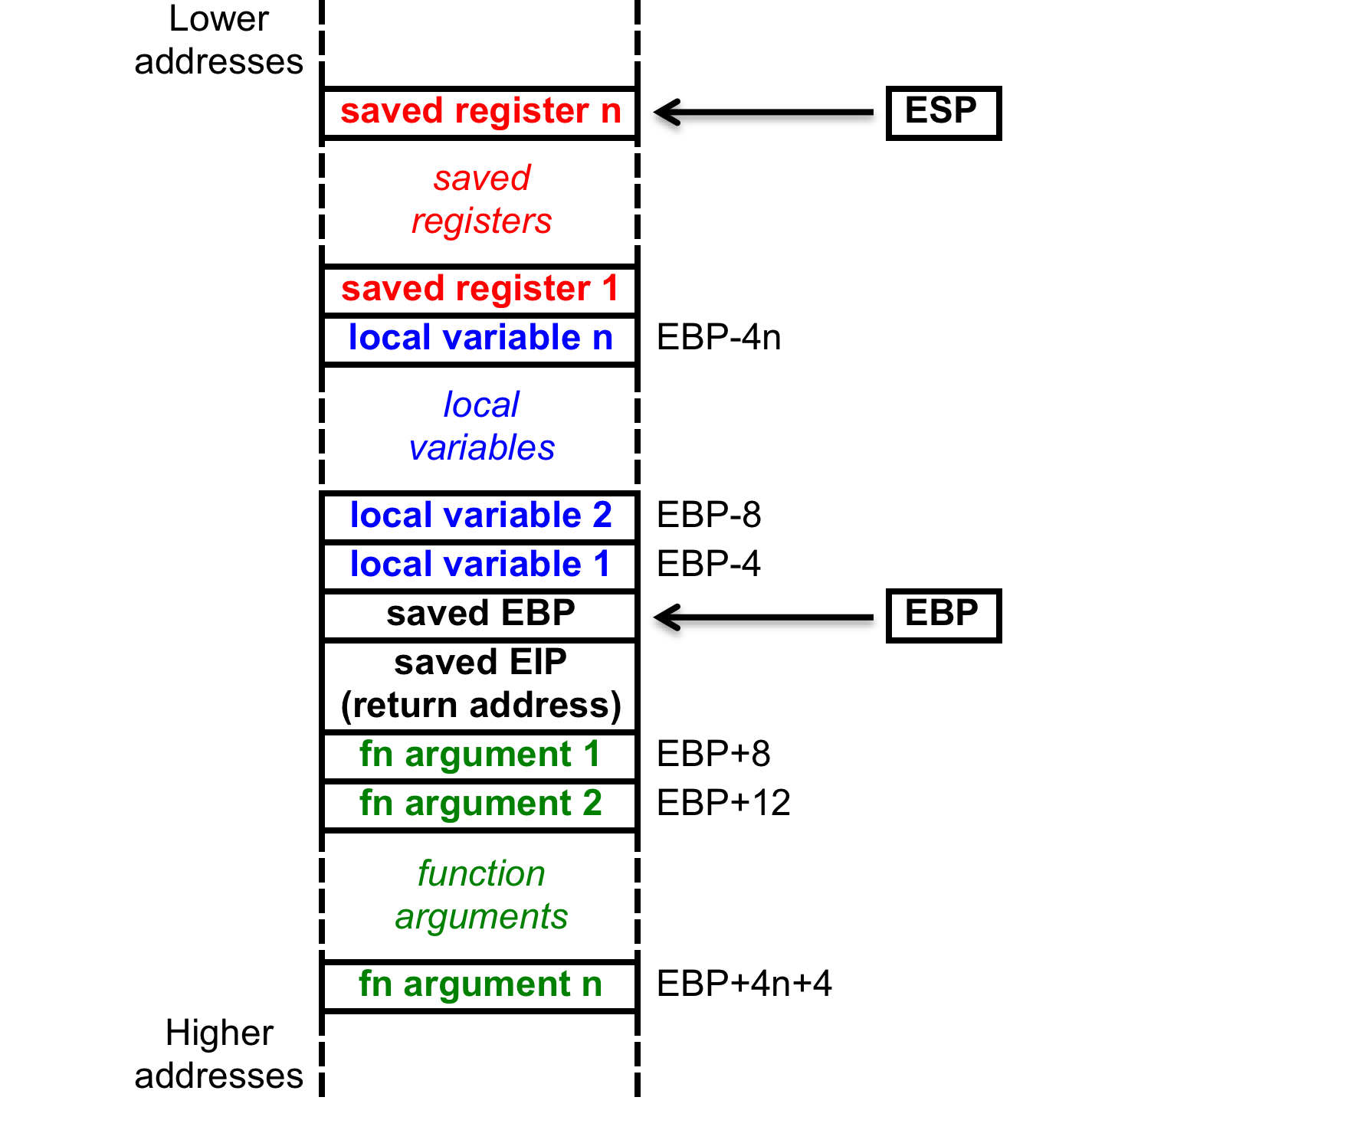
Review: Stack accesses
On function call
SP or ESP: points to current top of stack
Lowest address in current stack frame
BP or EBP: used to reference data within frame
Arguments
Local variables

Slide 13
Review: Stack accesses (cont.)
Arguments start at offset 8 from EBP
Local variables start at offset -4 from EBP
Starting offset of each variable can be defined as symbol
Ex. (testfile1.asm) _j$ = -120; size = 4
_i$ = -108; size = 4
_Y$ = -96; size = 40
_X$ = -48; size = 40
mov DWORD PTR _i$[ebp], 0
→ sets i = 0

Slide 14
Final notes
Next time:
Exam 2—PLEASE BE ON TIME
Reminders
HW 4 due today—no late submissions accepted

