Slide 1
EECE.3220 Data Structures
Instructor:
Dr. Michael Geiger
Fall 2019
Lecture 26
Exam 2 Review

Slide 2
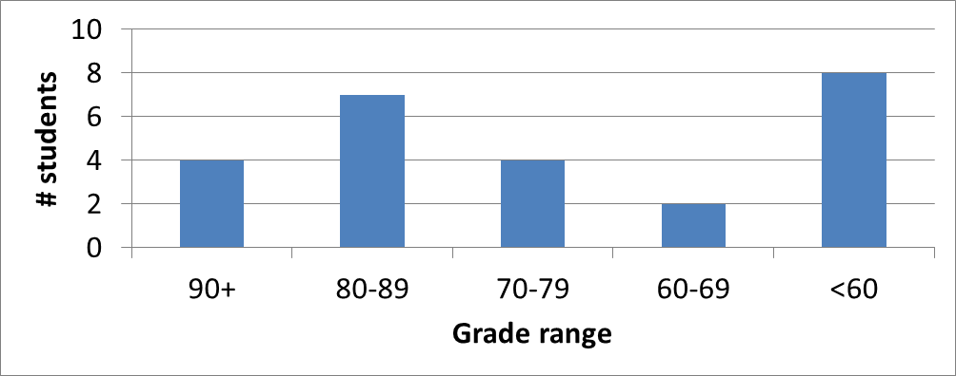
Exam stats & grade distribution
Average: 71
Median: 76
Std. deviation: 18.3
Max: 96
Section-by-section averages:
S1: 27.2 / 36 (76%)
S2: 13.2 / 16 (83%)
S3: 18.0 / 32 (56%)
S4: 12.6 / 16 (79%)
Extra credit
11 students completed
3.2 average

