Slide 1
EECE.3220 Data Structures
Instructor:
Dr. Michael Geiger
Fall 2019
Lecture 30:
Review recursion, tree basics
Binary search trees

Slide 2
Announcements/reminders
Chapter 11 exercises (recursion) due 11/25
Program 3 due 12/2
Program 4, new text exercises to be posted
Regrades: submit new style assessment for programs you’ve fixed
Email me if you need the assignments reopened in textbook

Slide 3
Lecture outline
Review
Recursion
Trees
Binary search trees

Slide 4
Review: Recursion
Some functions call other functions
Recursive functions call themselves
A recursive function has two parts
Anchor / base case: function value is defined for one or more specific argument values
Inductive / recursive case: function value for current argument value defined in terms of previously defined function values and/or arguments
Note: function may have >1 of each case

Slide 5
Review: Recursive example
Recursive power function
double power(double x, unsigned n){
if (n == 0)
return 1.0;
else
return x * power(x, n – 1);
}

Slide 6
Review: Common recursive uses
Use if, on each iteration, problem splits into 2 or more similar tasks
Don’t want to repeat work
Graph/tree traversal
Will see this with binary trees
Divide and conquer algorithms
Search, sort algorithms very common examples
Think about binary search
Test value at midpoint of array
If higher than value you’re searching for, test lower half
If lower than value you’re searching for, test upper half

Slide 7
Example: binary search
Rewrite binary search as recursive algorithm (iterative algo. below)
Arguments: array (a), item to find (item), endpoints of range (first, last)
So, if searching array list of size n for value v, call: binarySearch(list, v, 0, n – 1)
Hint: Function has 2 base cases and 2 recursive cases
Iterative version (“returns” found):
Set found = false
Set first = 0
Set last = n - 1
While first ≤ last and not found, do following:
Calculate loc = (first + last) / 2
If item < a[loc] then
Set last = loc – 1 // Search first half
Else if item > a[loc] then
Set first = loc + 1 // Search second half
Else
Set found = true // Item found

Slide 8
Example solution
Base cases (function returns)
item found
first > last
Recursive cases
item < midpoint → search left side
item > midpoint → search right side

Slide 9
Example solution (continued)
Recursive version of
binarySearch(a, item, first, last) {
if (first > last) // Base case 1—not found
return false;
else {
loc = (first + last) / 2;
if (a[loc] == item) // Base case 2—found
return true;
else if (a[loc] > item) // Search L half
return binarySearch(a, item, first, loc – 1);
else // Search R half
return binarySearch(a, item, loc + 1, last);
}

Slide 10
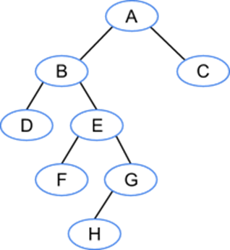
Trees
Each node may have >1 successor (child)
Binary trees: node has at most 2 children
Tree terminology
A is the root of the tree (only node w/no predecessor, or parent)
C, D, F, H are leaf nodes (nodes with no children)

Slide 11
Trees
Additional terminology
Depth: # edges between root & node
B & C have depth 1
F & G have depth 3
Height: max depth for any node
This tree has height 4 (depth of H)

Slide 12
Binary Trees
Each node has at most two children
Useful in modeling processes where
a comparison or experiment has exactly two possible outcomes
the test is performed repeatedly
Example
Multiple coin tosses
Decision trees where each decision is yes/no (example: guessing game)

Slide 13
Binary Trees as Recursive Data Structures
A binary tree is either empty …
or
Consists of
a node called the root
root has pointers to two disjoint binary (sub)trees called …
right (sub)tree
left (sub)tree
Anchor
Inductive step
Which is either empty … or …
Which is either empty … or …

Slide 14
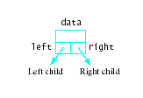

Linked Representation of Binary Trees
Uses space more efficiently
Provides additional flexibility
Each node has two links
one to the left child of the node
one to the right child of the node
if no child node exists for a node, the link is set to NULL

Slide 15
Tree Traversal is Recursive
If the binary tree is empty then do nothing
Else N: Visit the root, process data L: Traverse the left subtree R: Traverse the right subtree
Other traversal orders possible
The "anchor"
The inductive step

Slide 16
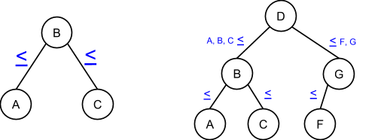
Binary search tree
Tree in which, for every node: L child ≤ node ≤ R child
Allows for efficient search
Can eliminate L or R subtree while searching

Slide 17
Binary search tree (continued)
Trees generally linked
Each node contains two pointers, left and right, to appropriate subtrees
Each pointer == NULL if no child on that side
Tree search: assume we have node pointer, n, and item to find → how can we write recursive binary search?
Function takes arguments n, item
If root is pointer to root node and v is value to find, initially call as BSTsearch(root, v);

Slide 18
Final notes
Next topics
Continue BSTs
Reminders:
Chapter 11 exercises (recursion) due 11/25
Program 3 due 12/2
Program 4, new text exercises to be posted
Regrades: submit new style assessment for programs you’ve fixed
Email me if you need the assignments reopened in textbook

