Slide 1
EECE.3220 Data Structures
Instructor:
Dr. Michael Geiger
Fall 2019
Lecture 31:
Binary search trees: operations

Slide 2
Announcements/reminders
Chapter 11 exercises (recursion) due 11/25
Program 3 due 12/2
Program 4, new text exercises to be posted
Regrades: submit new style assessment for programs you’ve fixed
Email me if you need the assignments reopened in textbook

Slide 3
Lecture outline
Review
Binary search trees
BST algorithms
Search
Insert
Delete
Balanced trees

Slide 4
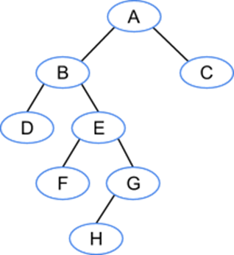
Review: Trees
Each node may have >1 successor (child)
Binary trees: node has at most 2 children
Tree terminology
A is the root of the tree (only node w/no predecessor, or parent)
C, D, F, H are leaf nodes (nodes with no children)

Slide 5
Review: Trees
Additional terminology
Depth: # edges between root & node
B & C have depth 1
F & G have depth 3
Height: max depth for any node
This tree has height 4 (depth of H)

Slide 6
Review: Binary Trees as Recursive Data Structures
A binary tree is either empty …
or
Consists of
a node called the root
root has pointers to two disjoint binary (sub)trees called …
right (sub)tree
left (sub)tree
Anchor
Inductive step
Which is either empty … or …
Which is either empty … or …

Slide 7
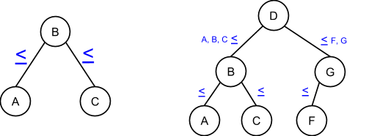
Review: Binary search tree
Tree in which, for every node: L child ≤ node ≤ R child
Allows for efficient search
Can eliminate L or R subtree while searching

Slide 8
Review: Binary search tree (continued)
Trees generally linked
Each node contains two pointers, left and right, to appropriate subtrees
Each pointer == NULL if no child on that side
Basic implementation
<type> could be templated or fixed
class BNode {
<type> key; // Data for ordering
BNode *left, *right; // Subtree ptrs
// May contain other data
}

Slide 9
BST search
Recall array binary search—tree search is similar
Could write as iterative or as recursive
Base cases are same
Stop if data found or if it isn’t present (hit NULL pointer)
Searching left half of search space → following “left” pointer in current node
Searching right half of search space → following “right” pointer in current node

Slide 10
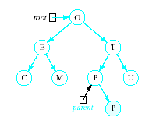
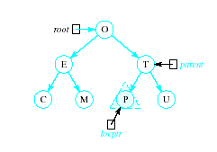
Inserting into a BST
Insert function
Uses modified version of search to locate insertion location or already existing item
Pointer parent trails search pointer locptr, keeps track of parent node
Thus new node can be attached to BST in proper place
R

Slide 11
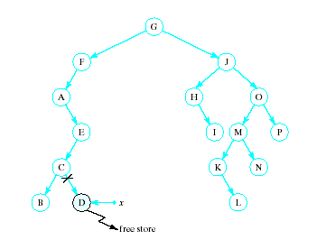
Recursive Deletion
Three possible cases to delete a node, x, from a BST
1. The node, x, is a leaf

Slide 12
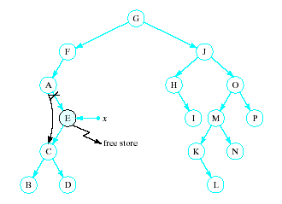
Recursive Deletion
2. The node, x has one child

Slide 13
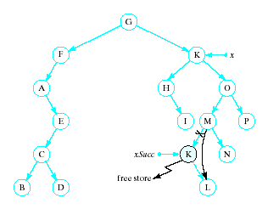
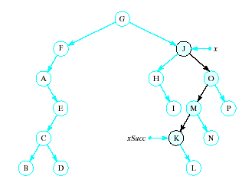
Recursive Deletion
x has two children
Delete node pointed to by xSucc as described for cases 1 and 2
Replace contents of x with inorder successor
K

Slide 14
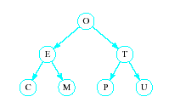
Problem of Lopsidedness
Tree can be balanced
each node except leaves has exactly 2 child nodes

Slide 15
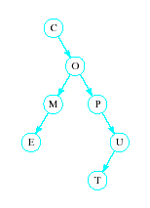
Problem of Lopsidedness
Trees can be unbalanced
not all nodes have exactly 2 child nodes

Slide 16
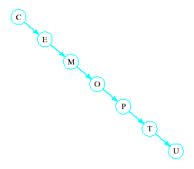
Problem of Lopsidedness
Trees can be totally lopsided
Suppose each node has a right child only
Degenerates into a linked list
Processing time affected by "shape" of tree

Slide 17
Balanced trees
Solutions to lopsidedness problem: balance tree as you insert/remove data
AVL trees
Red/black trees

Slide 18
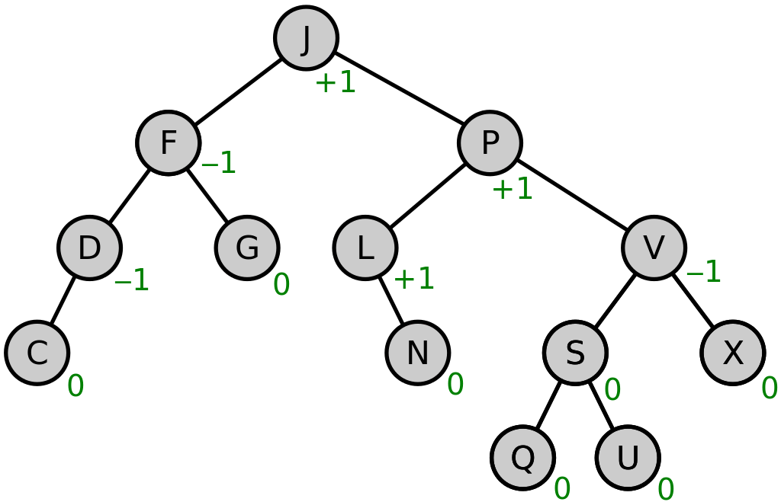
AVL Trees
A height balanced tree
Named with initials of Russian mathematicians who devised them
Defined as
Binary search tree
Balance factor of each node is 0, 1, or -1
(Balance factor of a node = height of right sub tree minus height of left subtree)
Source: https://commons.wikimedia.org/w/index.php?curid=49182185

Slide 19
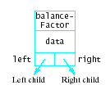
AVL Trees
Consider linked structure to represent AVL tree nodes
Includes data member for the balance factor

Slide 20
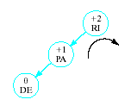

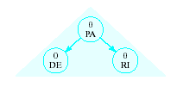
AVL Trees
Insertions may require adjustment of the tree to maintain balance
Given tree
Becomes unbalanced
Requires right rotation on subtree of RI
Producing balanced tree
Insert DE

Slide 21
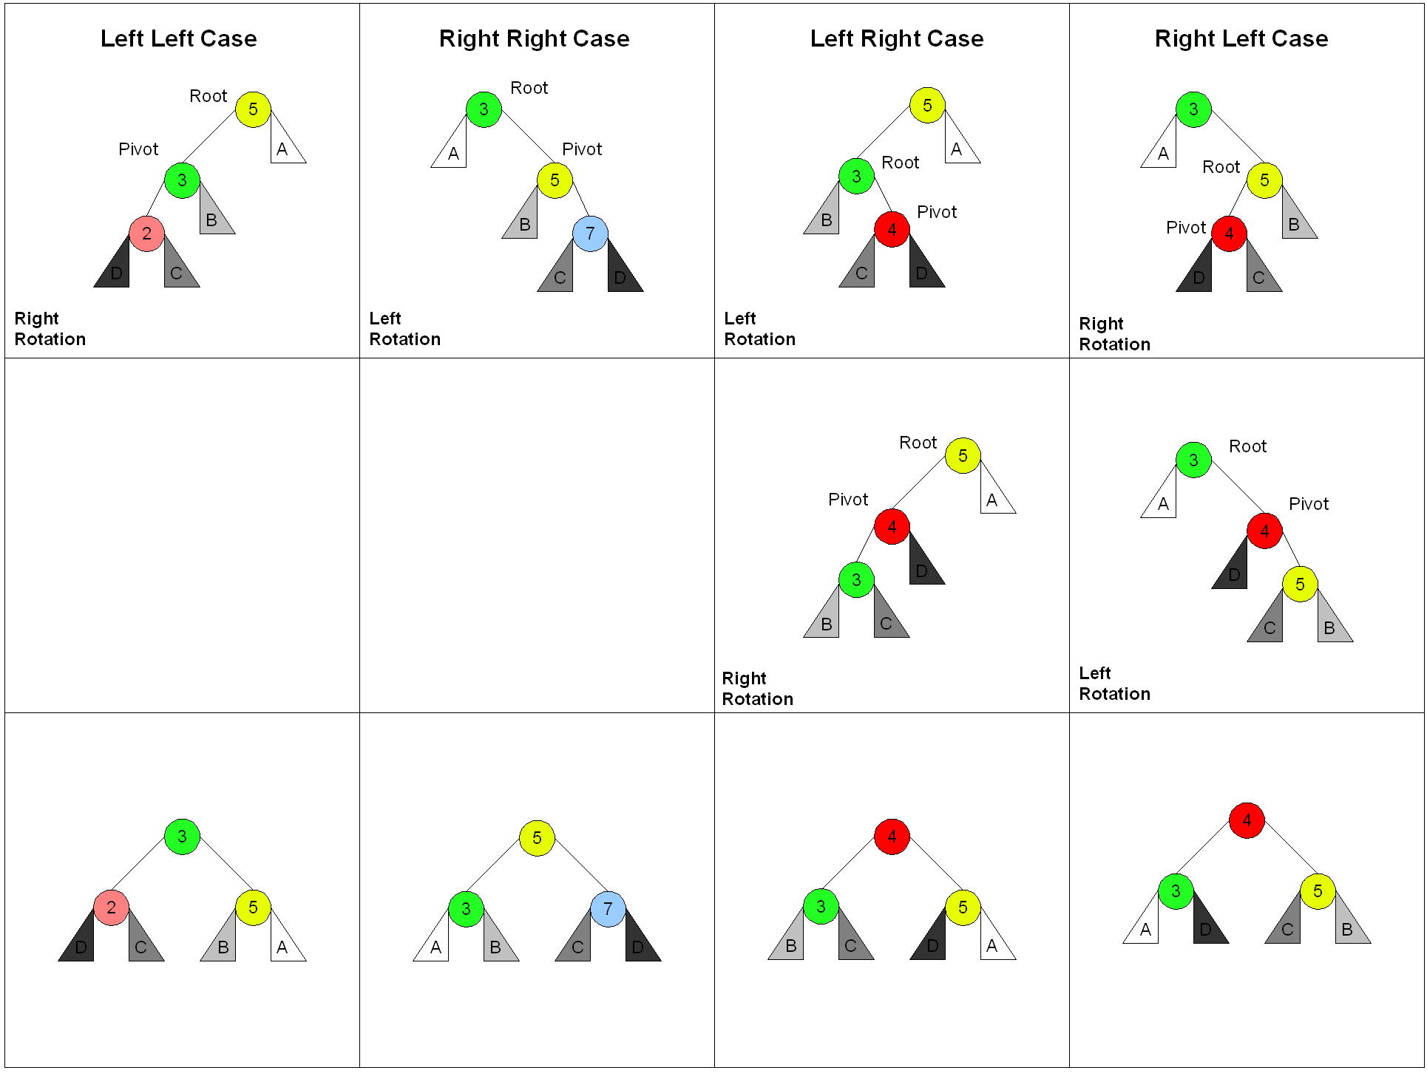
Tree rotations

Slide 22
Basic Rebalancing Rotations
Simple right rotation Use when inserted item in left subtree of left child of nearest ancestor with factor +2
Simple left rotation Use when inserted item in right subtree of right child of nearest ancestor with factor -2
Left-right rotation When inserted item in right subtree of left child of nearest ancestor with factor +2
Right-left rotation When inserted item in left subtree of right child of nearest ancestor with factor -2

Slide 23
Basic Rebalancing Rotations
Rotations carried out by resetting links
Right rotation with A = nearest ancestor of inserted item with balance factor +2 and B = left child
Reset link from parent of A to B
Set left link of A equal to right link of B
Set right link of B to point A

Slide 24
Basic Rebalancing Rotations
Right-Left rotation Item C inserted in right subtree of left child B of nearest ancestor A
Set left link of A to point to root of C
Set right link of B equal to left link of C
Set left link of C to point to B Now the right rotation
Resent link from parent of A to point to C
Set link of A equal to right link of C
Set right link of C to point to A

Slide 25
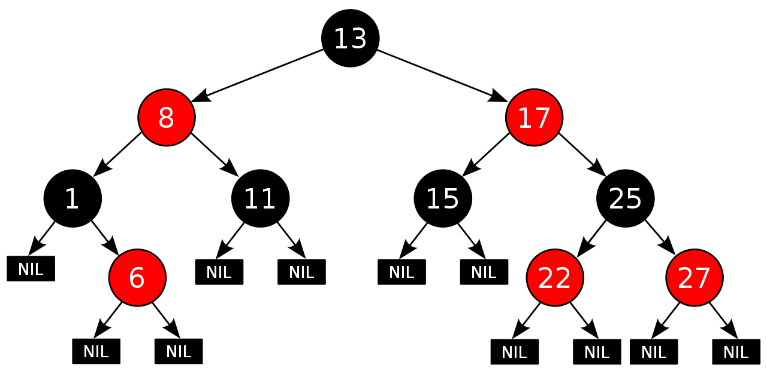
Red-black trees
BST in which each node has a color
Some implementations consider links, not nodes, w/color
Not perfectly height balanced, but path from root to furthest leaf is no more than 2x path from root to closest leaf

Slide 26
Red-black tree properties
Root node is black
All NULL pointers treated as black
If a node is red, both child nodes are black
Every path from a node to a NULL pointer contains the same number of black nodes
Source: https://commons.wikimedia.org/w/index.php?curid=31167379

Slide 27
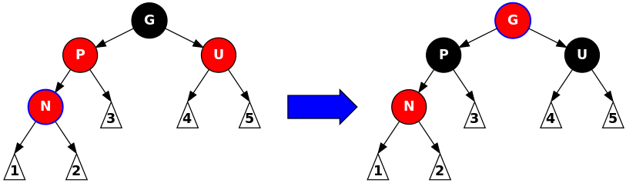
Red-black tree operations
Insertion:
Add node N as in BST and color red
Check following cases:
N is root of tree → repaint black
N’s parent is black → no change
N’s parent and “uncle” (other node with same parent) both red → recolor N’s parent, uncle, and grandparent
If grandparent is tree root, recolor black
Source: https://commons.wikimedia.org/w/index.php?curid=31167379

Slide 28
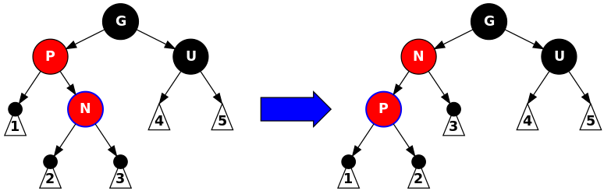
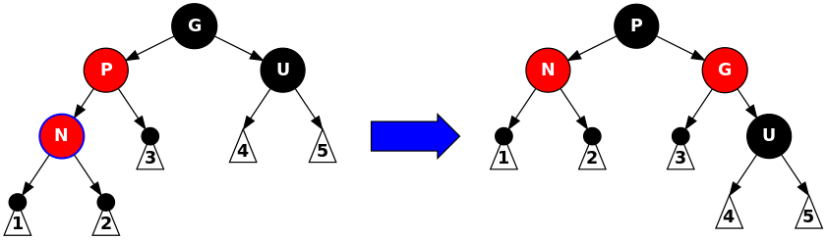
Red-black tree operations
Insertion:
Add node N as in BST and color red
Check following cases:
Parent is red, uncle is black → rotate and recolor
Source: https://commons.wikimedia.org/w/index.php?curid=31167379

Slide 29
Final notes
Next topics
Heaps
Priority queues
Reminders:
Chapter 11 exercises (recursion) due 11/25
Program 3 due 12/2
Program 4, new text exercises to be posted
Regrades: submit new style assessment for programs you’ve fixed
Email me if you need the assignments reopened in textbook

