Slide 1
EECE.3220 Data Structures
Instructor:
Dr. Michael Geiger
Fall 2019
Lecture 32:
Binary search trees: examples

Slide 2
Announcements/reminders
Chapter 11 exercises (recursion) due 11/25
Program 3 due 12/2
Program 4, new text exercises to be posted
Regrades: submit new style assessment for programs you’ve fixed
Email me if you need the assignments reopened in textbook

Slide 3
Lecture outline
Review
BST algorithms: search, insert, delete
Balanced trees
Example problems

Slide 4
Review: BST search
Recall array binary search—tree search is similar
Could write as iterative or as recursive
Base cases are same
Stop if data found or if it isn’t present (hit NULL pointer)
Searching left half of search space → following “left” pointer in current node
Searching right half of search space → following “right” pointer in current node

Slide 5
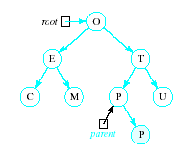
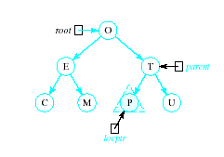
Review: Inserting into a BST
Insert function
Uses modified version of search to locate insertion location or already existing item
Pointer parent trails search pointer locptr, keeps track of parent node
Thus new node can be attached to BST in proper place
R

Slide 6
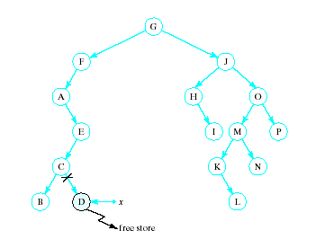
Review: Recursive Deletion
Three possible cases to delete a node, x, from a BST
1. The node, x, is a leaf

Slide 7
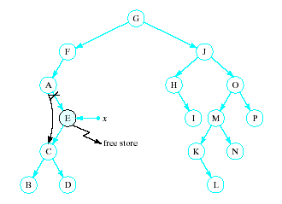
Review: Recursive Deletion
2. The node, x has one child

Slide 8
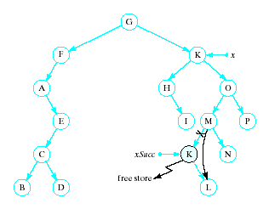
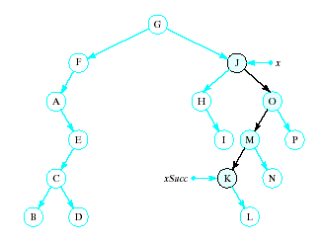
Review: Recursive Deletion
x has two children
Delete node pointed to by xSucc as described for cases 1 and 2
Replace contents of x with inorder successor
K

Slide 9
A note on deletions
Our slides so far on deletion: replace a node with 2 children with its in-order successor
The node that comes immediately after the deleted node
The smallest value in the right sub-tree
As we saw Friday, the visualization site (and the text): replace a node with two children with its in-order predecessor
The node that comes immediately before the deleted node
The largest value in the left sub-tree

Slide 10
A note on deletions (2)
Finding the in-order successor:
Go right once
Go left as far as you can
How do you find the in-order predecessor?
Go left once
Go right as far as you can
Either one is a good choice
You’re replacing a deleted node with whatever comes immediately before or after

Slide 11
BST examples
Using the previously described rules for inserting/deleting data:
Build a BST using the letters from the word “PROBLEMS”, assuming they’re added in order starting with the letter ‘P’
Show the state of the tree after deleting each of the following letters, in this order:
S
B
P

Slide 12
Example solutions
Will write out solution
Text contains link to a site for visualizing BSTs: https://www.cs.usfca.edu/~galles/visualization/BST.html

Slide 13
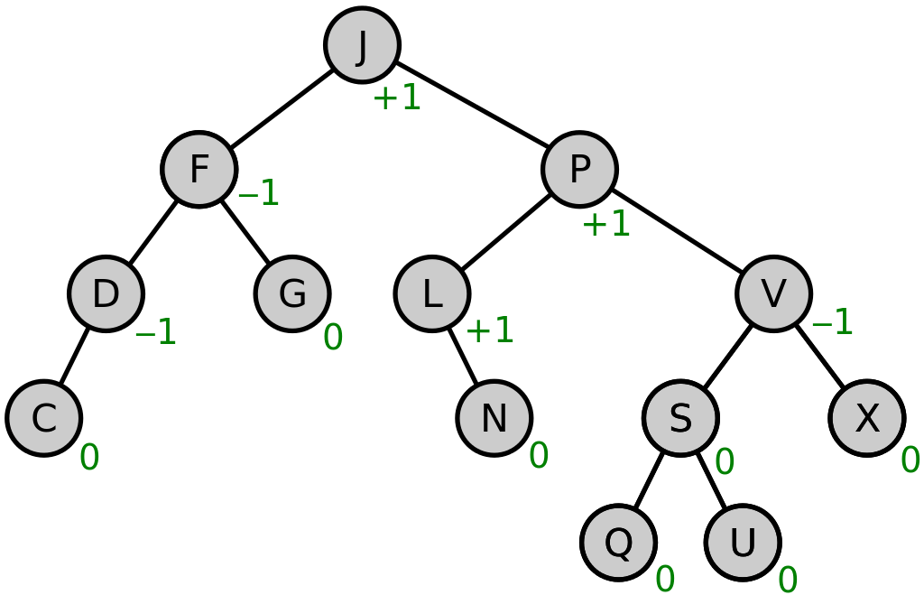
Review: AVL Trees
A height balanced tree
Named with initials of Russian mathematicians who devised them
Defined as
Binary search tree
Balance factor of each node is 0, 1, or -1
(Balance factor of a node = height of right sub tree minus height of left subtree) (unless it’s opposite)
Source: https://commons.wikimedia.org/w/index.php?curid=49182185

Slide 14
AVL Tree Clarifications
Figure from last time (Wikipedia):
Balance factor = R height – L height
Textbook examples
Balance factor = L height – R height
Doesn’t really matter, as long as it’s consistent …
… but to keep things consistent with text moving forward, we’ll use the second formula

Slide 15
Computing balance factor
Can store subtree height in each node
Height = max depth of any subtree
Could also store node balance factor
Addition/deletion can change balance factor, require rotation
After adding/removing node
Recompute balance factor for all “ancestors” up to root
Rotate if needed
How do we get from node to root?
Recursive solution
Augment node to include parent pointer

Slide 16
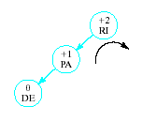

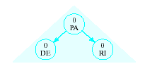
Review: AVL Tree rotations
Insertions may require adjustment of the tree to maintain balance
Given tree
Becomes unbalanced
Requires right rotation on subtree of RI
Producing balanced tree
Insert DE

Slide 17
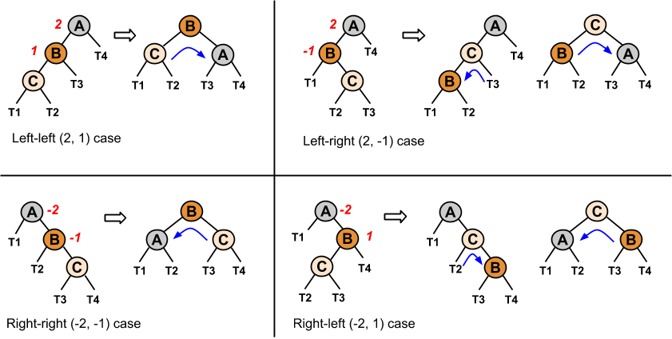
Tree rotations
T1, T2, T3, T4 all subtrees (heights differ by ≤ 1)
When node out of balance, determine which case it is, then rotate appropriately

Slide 18
AVL examples
Build an AVL tree using the letters from the word “PROBLEMS”, assuming they’re added in order starting with the letter ‘P’
Remove the letter ‘B’ and rebalance

Slide 19
Example solutions
Will write out solution
Text contains link to a site for visualizing AVL trees: https://www.cs.usfca.edu/~galles/visualization/AVLtree.html

Slide 20
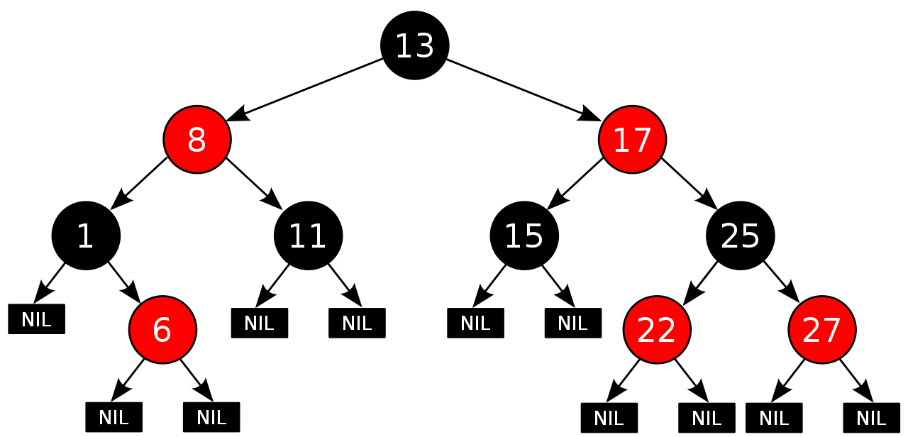
Review: Red-black trees
BST in which each node has a color
Some implementations consider links, not nodes, w/color
Not perfectly height balanced, but path from root to furthest leaf is no more than 2x path from root to closest leaf

Slide 21
Review: Red-black tree properties
Root node is black
All NULL pointers treated as black
If a node is red, both child nodes are black
Every path from a node to a NULL pointer contains the same number of black nodes
Source: https://commons.wikimedia.org/w/index.php?curid=31167379

Slide 22
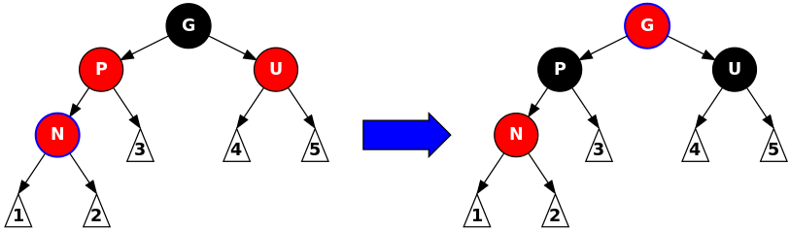
Red-black tree operations
Insertion:
Add node N as in BST and color red
Check following cases:
N is root of tree → repaint black
N’s parent is black → no change
N’s parent and “uncle” (other node with same parent) both red → recolor N’s parent, uncle, and grandparent
If grandparent is tree root, recolor black
Source: https://commons.wikimedia.org/w/index.php?curid=31167379

Slide 23
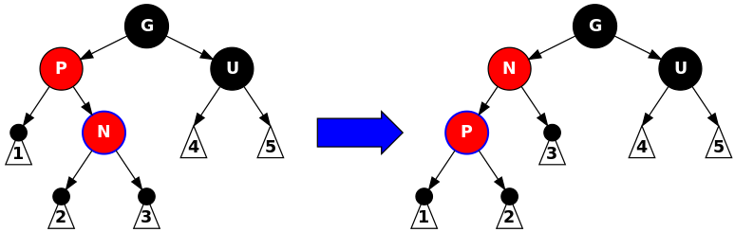
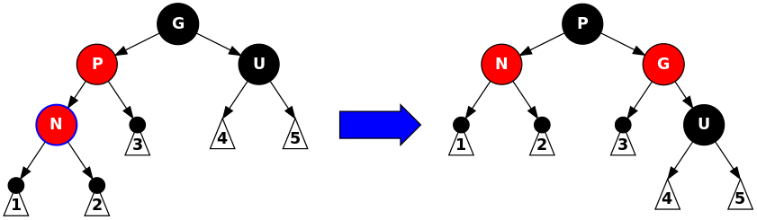
Red-black tree operations
Insertion:
Add node N as in BST and color red
Check following cases:
Parent is red, uncle is black → rotate and recolor
Source: https://commons.wikimedia.org/w/index.php?curid=31167379

Slide 24
Red-black tree example
Let’s look at the same example as before (building a tree using the letters from “PROBLEMS”)
Visualization site: https://www.cs.usfca.edu/~galles/visualization/RedBlack.html

Slide 25
Final notes
Next topics (starting Monday, 12/2)
Heaps
Priority queues
Reminders:
Chapter 11 exercises (recursion) due 11/25
Program 3 due 12/2
Program 4, new text exercises to be posted
Regrades: submit new style assessment for programs you’ve fixed
Email me if you need the assignments reopened in textbook

