Slide 1
Debugging Workshop
Data Structures and Algorithms
Michael Gilliland

Slide 2
What is a Debugger? Why Use it?
Debuggers are tools built-into (or separate from) IDEs.
A debugger's goal is to help locate bugs.
They accomplish this by allowing you to trace the execution of a program at runtime.
The Visual Studio IDE contains one of the most powerful debuggers available.

Slide 3
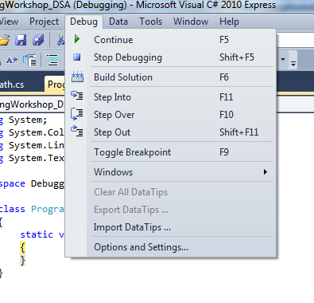
Debugging Menu
Used to control movement while debugging:

Slide 4


Follow the Yellow Arrow

Slide 5

Breakpoints
Tell the debugger where to pause execution. Pauses before executing the marked line.
Click the left margin to "toggle" (set/unset) breakpoints in Visual Studio:
Can be toggled anytime.

Slide 6
Different Movement Options
"Continue Debugging" - Next breakpoint or error.
"Step Into" - Execute statement and go to next. If another routine is called, go there.
"Step Over" - Like "Step Into" but doesn't leave current routine.
"Step Out" - Executes rest of routine and all called routines.
Note: Debugger always stops at breakpoints!

Slide 7
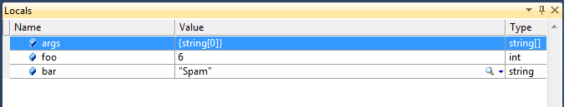
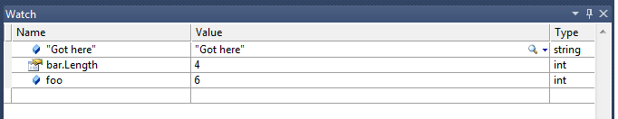
Menus for Watching Variables
Locals - Shows Local variable's values:
Watch - Programmer specified expressions:

Slide 8
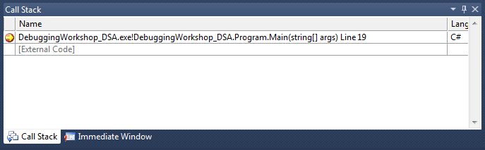
Call Stack
Shows where you are in execution (in terms of Namespaces, classes, methods/functions)

Slide 9
Demo
Slides and code available at:https://github.com/mjgpy3/DebuggingWorkshopDSA

