Slide 1
Week 7 seminar: Sentence Verification Task

Slide 2
Seminar Objectives
Get hands on experience with the Sentence Verification Task.
Generate data for use in next week’s analysis seminar
If you haven’t already you will need to download and install OpenSesame app (remember it is free)
https://osdoc.cogsci.nl/3.2/download/
Learn about counterbalancing and its importance in language research.

Slide 3
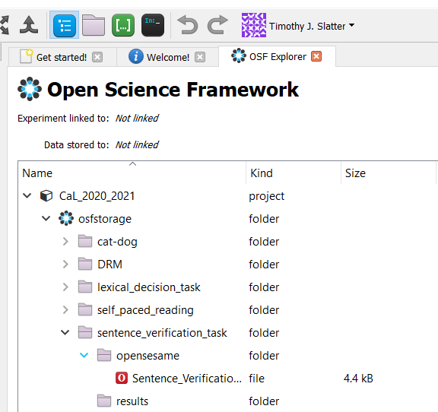
Sentence Verification Task
Log into OSF
Navigate to experiment
Double click, save and open.

Slide 4
Sentence Verification Task
Participant’s are presented with a statement and must indicate whether the statement is true or false.
Technique is used in categorisation research as well as in reasoning research.

Slide 5
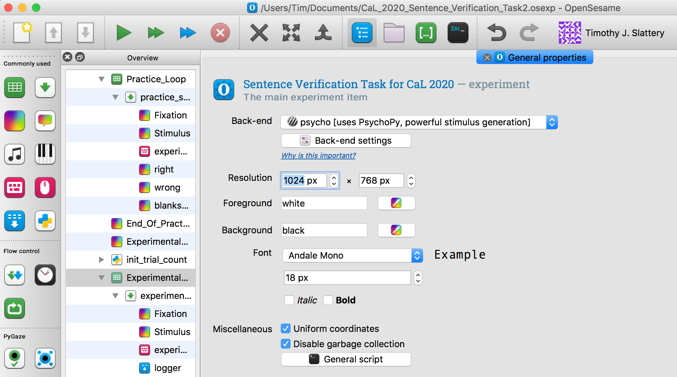
Sentence Verification Task
Click green triangle to run the experimental demo.

Slide 6
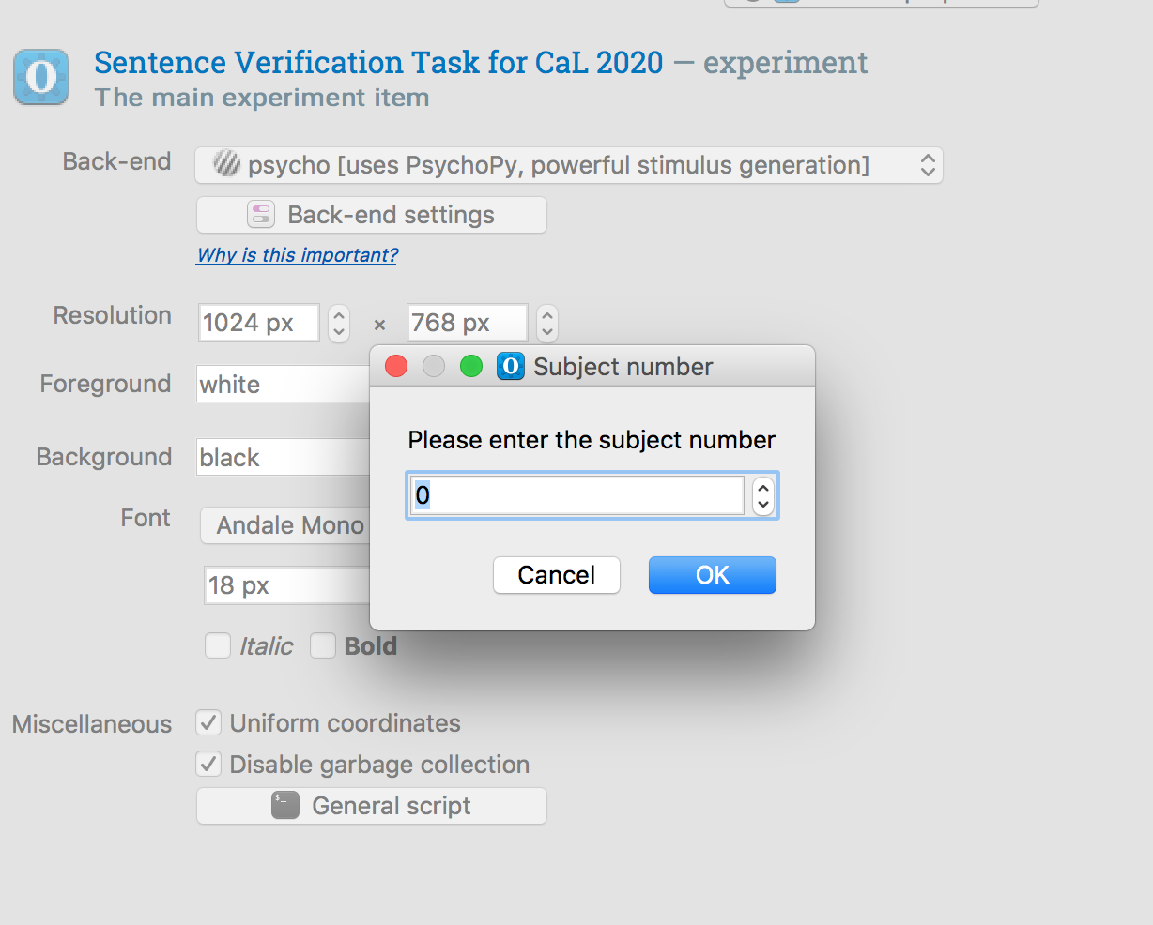
Sentence Verification Task
Use student number without the letter for attendance monitoring.
Shouldn’t take longer than 10-15 minutes.

Slide 7
OpenSesame Modification
This week we have only 1 modification to make.
We are going to change the counterbalancing of the study.
Counterbalancing is important in experimental research. If done correctly it can help researchers avoid confounds.

Slide 8
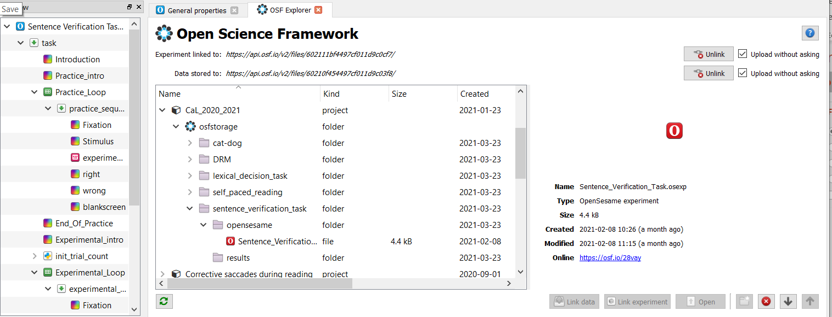
First Unlink

Slide 9
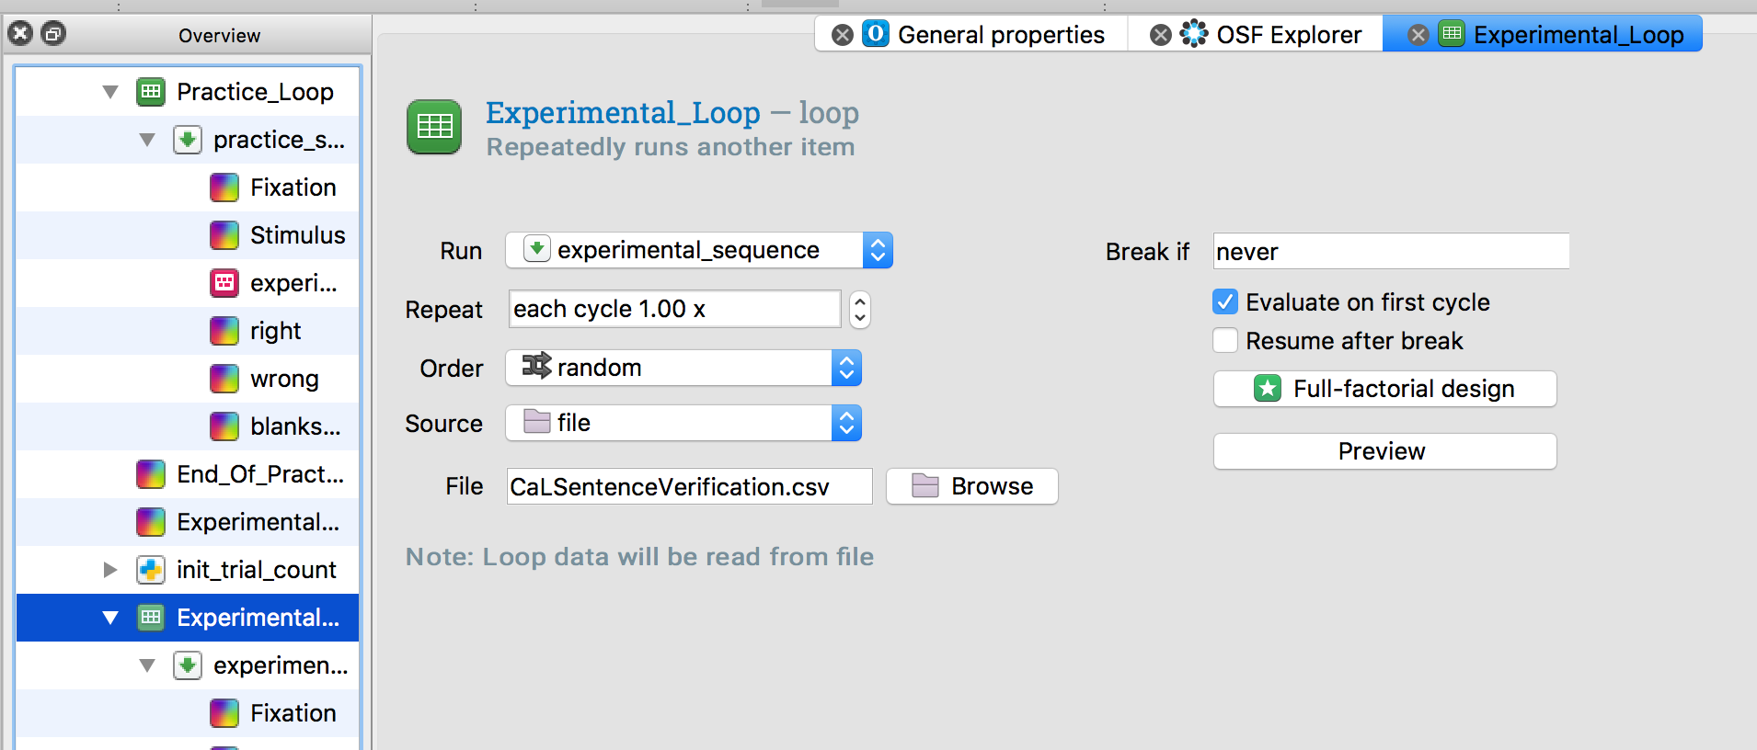
Experimental Loop

Slide 10
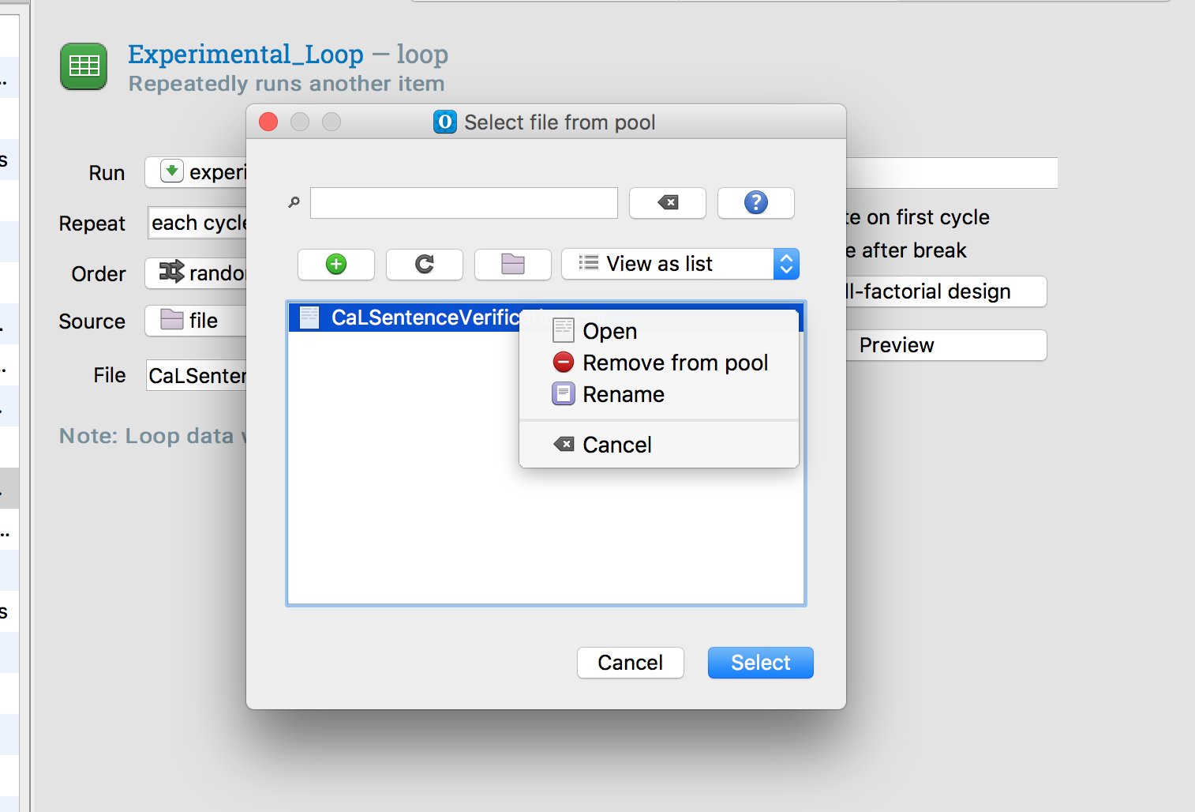
The File Pool
Clicking Browse will open the file pool.
This is a directory where OpenSesame stores files related to this experiment.
Right click on the file and open it in excel to edit it.

Slide 11
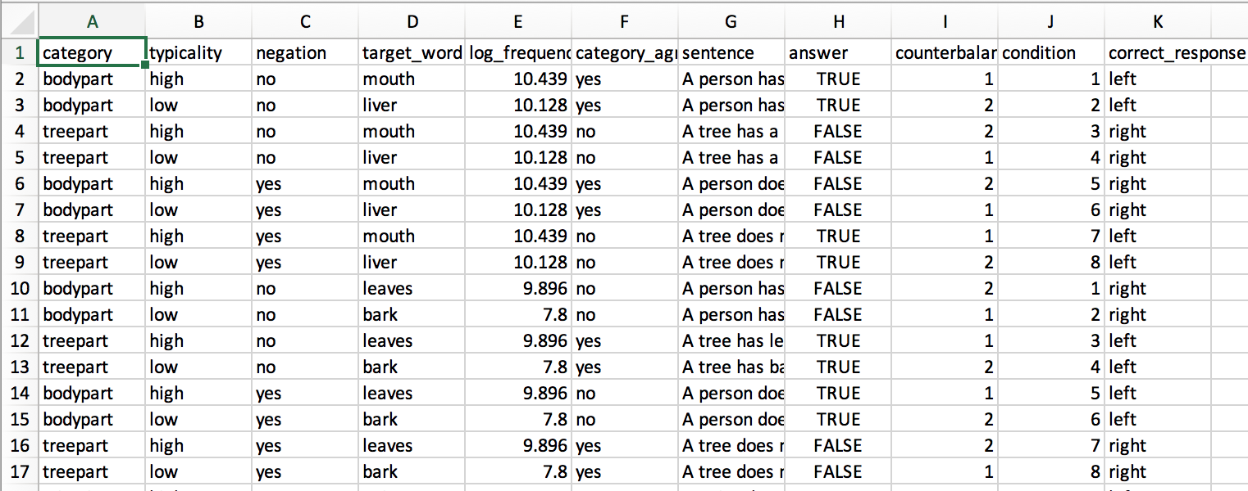
Experiment Design File
There are 8 conditions which result from the factorial combination of columns B (typicality), C (negation), and F (category_agreement).

Slide 12
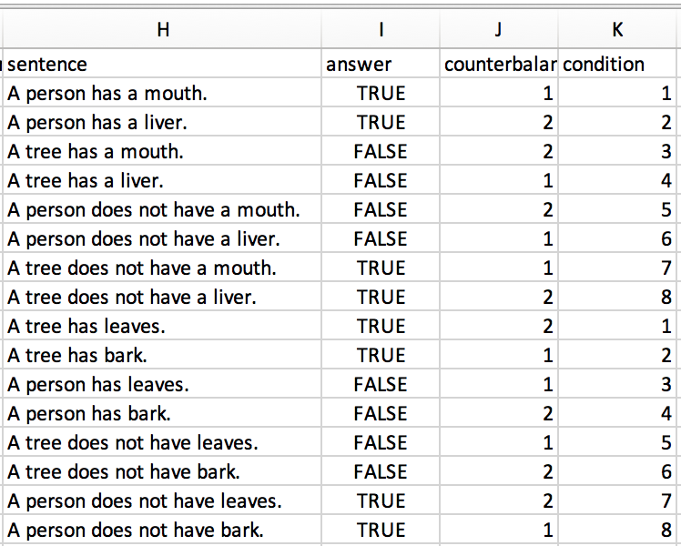
A Closer Look at the Stimuli and Counterbalancing
Usually you would have as many counterbalance “lists” as you have conditions.
This demo, has only two counterbalance “lists” so that participants see many trials without needing to write many items.
Make 4 counterbalance lists so that participants never see the same target word more than once.

Slide 13
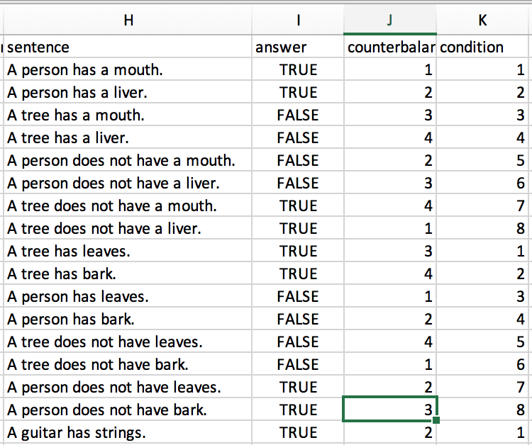
A Closer Look at the Stimuli and Counterbalancing
Usually you would have as many counterbalance “lists” as you have conditions.
This demo, has only two counterbalance “lists” so that participants see many trials without needing to write many items.
Make 4 counterbalance lists so that participants never see the same target word more than once.

Slide 14
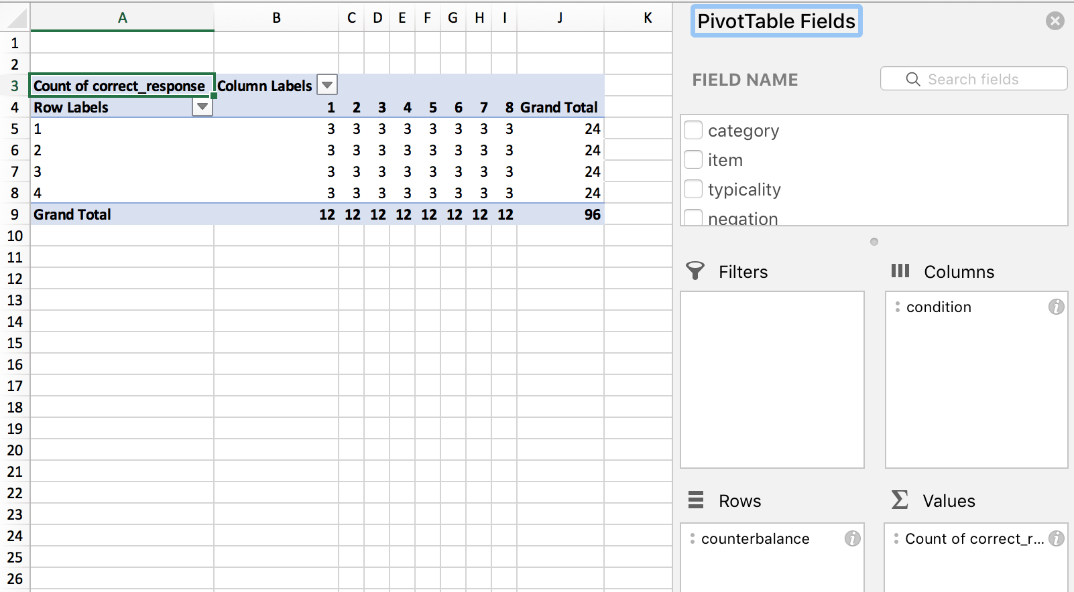
Pivot Table Check!
If you’ve done it right then each list will have 3 trials in each of the 8 conditions.

Slide 15
Change sequence “run if” statements
These statements use a modulus operator % which returns the remainder of a division operation.
When there were two lists we used the statement “﻿[counterbalance] = (([subject_nr]%2)+1)”
[Subject_nr]%2 will return a zero for participants with even student numbers and a 1 for participants with an odd student number. We add 1 to this in order to match with the counterbalance list numbers.
Yes we could have also numbered our lists 0 and 1 instead of 1 and 2.

Slide 16
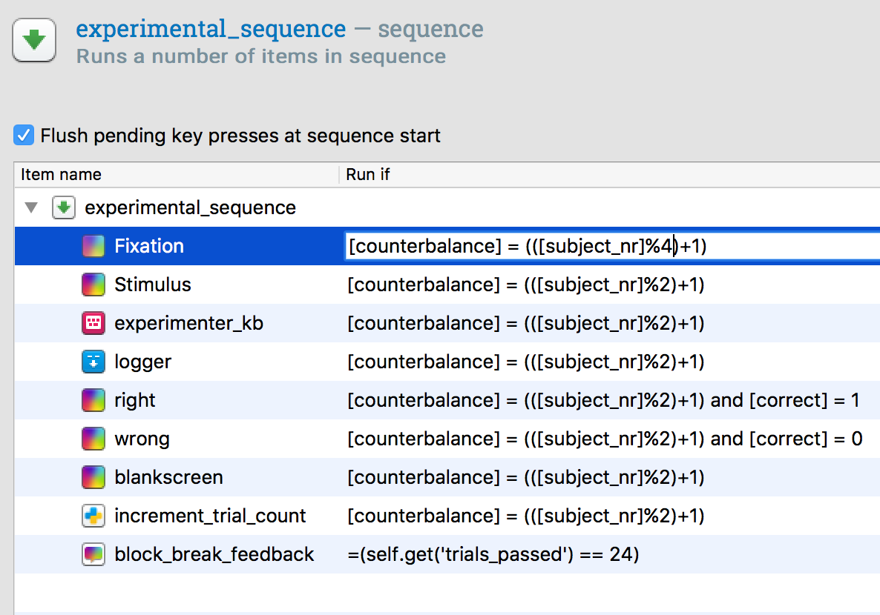
Change sequence “run if” statements
Change %2 to %4 for all run if statements that it appears in.

