Slide 1
Emotional sensory gating
Laura Renshaw-Vuillier
SCCAN meeting 11th April 2019

Slide 2
Sensory Gating
Linked to impulsivity
Inhibitory gating allows us to effectively adapt to changing environments and attend to relevant information within them.
Present in other pathologies: Schizophrenia, Bipolar disorder, OCD
Questions:
1. Do people with BN have sensory gating deficits?
2. Is it linked to impulsivity (self-report plus task measuring negative urgency)?
3. Do emotions interfere with this process?

Slide 3
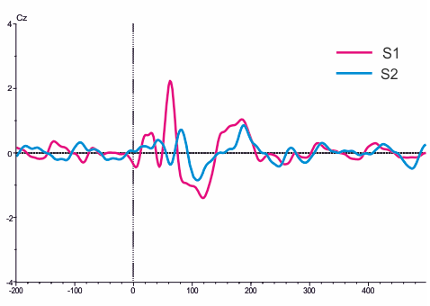

Sensory Gating
Paired click paradigm to assess neuronal reactivity to redundant stimuli.
500 ms
time
S1
S2

Slide 4
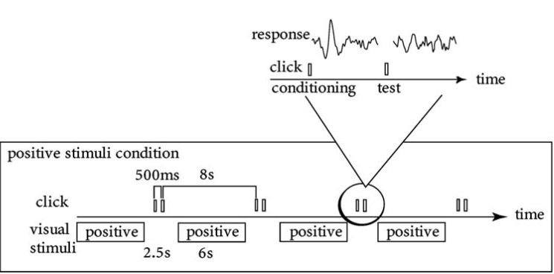
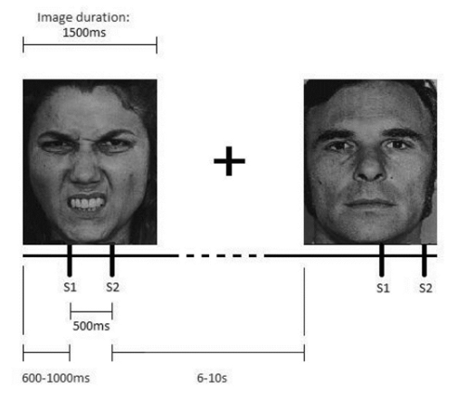
Different paradigms

Slide 5
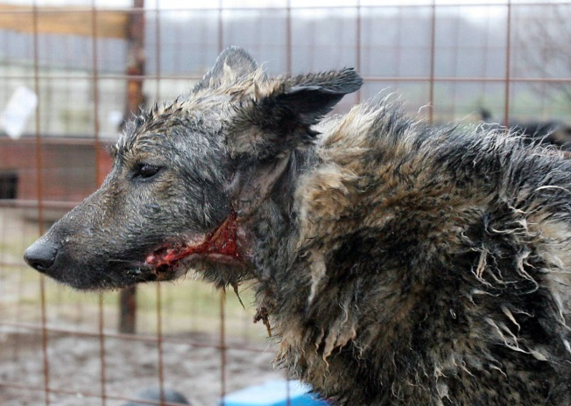
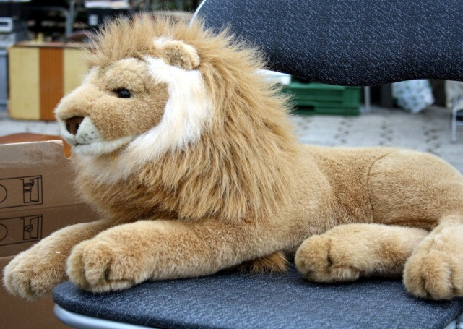
Emotional sensory gating -1
S1
S2
S1
S2
500 ms
7 to 10 seconds
How long should this be? After 400ms so after picture is fully processed?

Slide 6


Emotional sensory gating -2
1.5 s
7-10 seconds?
S1
S2
S1
S2
500 ms

Slide 7
Emotional sensory gating -3
Anger/ sadness ?
Listen to the beeps
1.5 s
7-10 seconds?
S1
S2
S1
S2
500 ms

Slide 8
Emotional sensory gating -4
Block 1
Block 2
Anger induction
Listen to the beeps
S1
S2
S1
S2
500 ms
7-10 seconds

