Slide 1
C++CG & GSL
src+slides: git@github.com:mjgrzybek/gsl_intro.git

Slide 2
C++ Core Guidelines
“a set of tried-and-true guidelines, rules, and best practices about coding in C++”
Bjarne Stroustrup & Herb Sutter, …
CppCoreGuidelines

Slide 3
C++ Core Guidelines
Examples:
  R.3: A raw pointer (a T*) is non-owning
  R.11: Avoid calling new and delete explicitly
  ES.23: Prefer the {} initializer syntax
  I.6: Prefer Expects() for expressing preconditions
  CP.4: Think in terms of tasks, rather than threads
  I.12: Declare a pointer that must not be null as not_null

Slide 4
GSL
“The Guideline Support Library (GSL) contains functions and types that are suggested for use by the C++ Core Guidelines maintained by the Standard C++ Foundation.“
A few implementations available
  MS fork is considered as the best one
  https://github.com/Microsoft/GSL

Slide 5
Aims
Memory safety
Type safety
Standardization
Compile time checks
  If impossible – static code analysis checks
    If impossible – runtime checks with overhead as low as possible yet required and reasonable

Slide 6
GSL usage examples
not_null<T>
  link, link
owner<T>
  link
narrow_cast<T>, narrow<T>
  link
span<T>
  link
finally()
  link

Slide 7
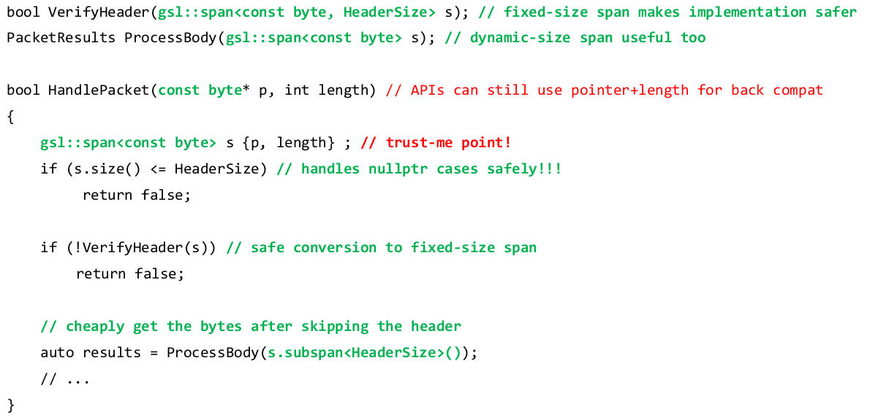
cppcon16 example

Slide 8
Other links
No littering!
CppCon 2016: Neil MacIntosh “The Guideline Support Library: One Year Later"

