Slide 1
SNPopolis
A time-forward population simulation tool for SNP sets.
Markus Heidrich

Slide 2
Motivation
SNP sets can provide insights into the history and future of populations.
Analyzing SNP sets is challenging due to complex processes and long time periods.
The time-forward population simulation tool for SNP sets solves this problem by allowing researchers to simulate and model population evolution and migration.
The tool is flexible and can be used to investigate complex questions in genetics, anthropology, and evolutionary biology.
By simulating different scenarios, researchers can gain insights into how genetic variations and population movements occur.
Markus Heidrich

Slide 3
SNPopulis
Region
distances
Calculate probabilities
Simulation
SNP Data
Mortality
Offspring
Evaluation
Markus Heidrich

Slide 4
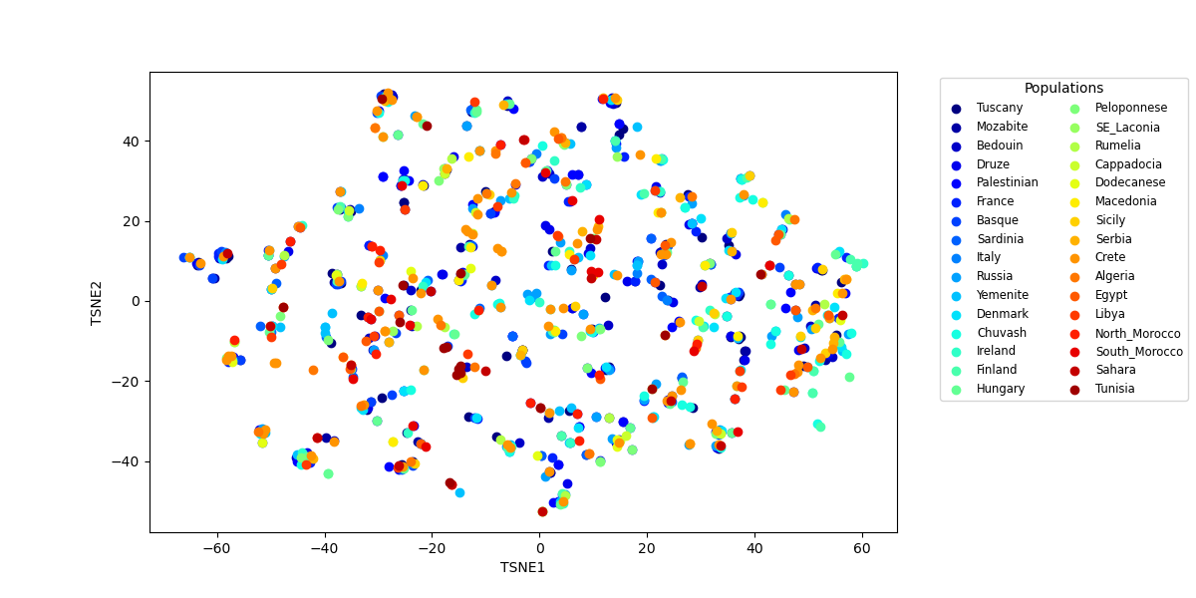
Input Population Clustering
Markus Heidrich

Slide 5
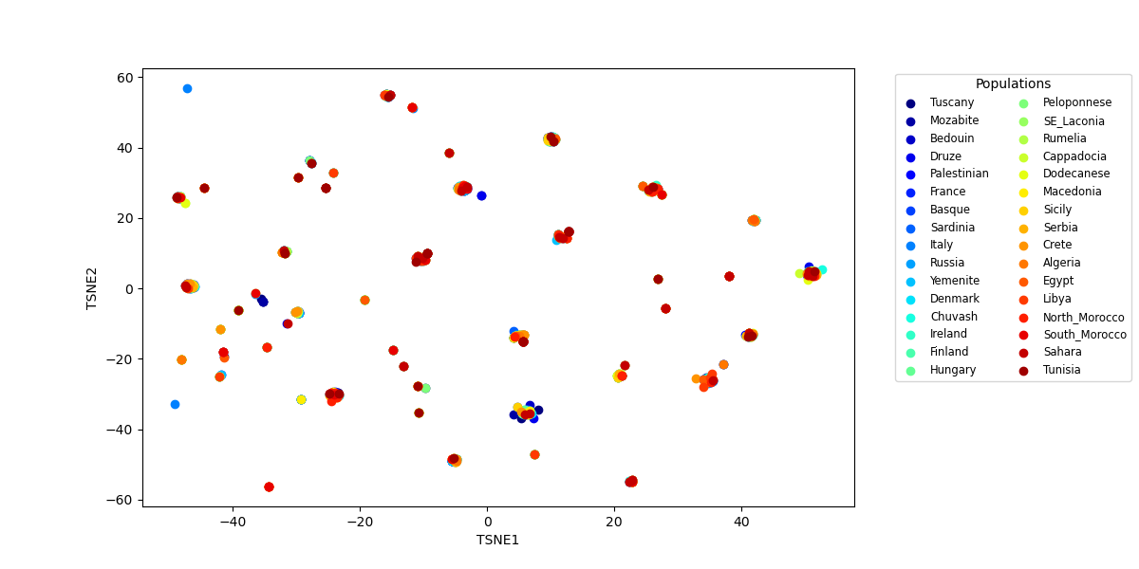
Output Population Clustering
Markus Heidrich

