Slide 1

TableTweaker
Michael Heitland

Slide 2
Tweak tabular data using C# & Macros
Use Cases
Create SQL INSERTs
Generate C# Containers
Modify spreadsheets
...

Slide 3
Building Blocks
NimbleText
WPF
Roslyn
AvalonEdit
RoslynPad

Slide 4
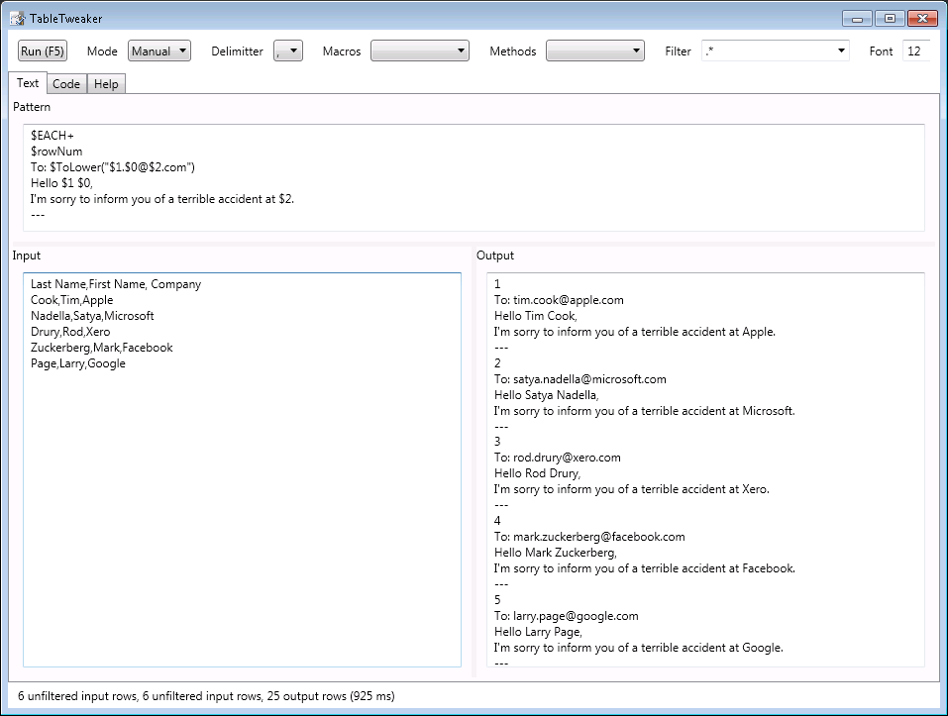

Slide 5
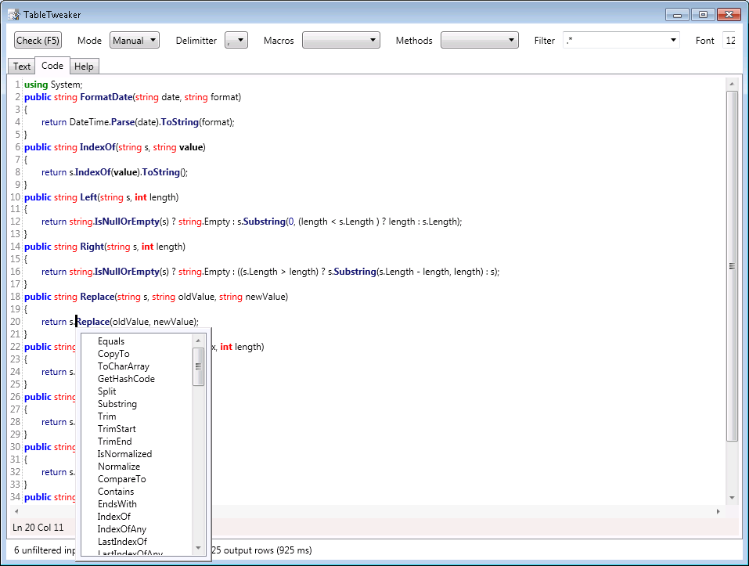

Slide 6
Demo

Slide 7
Reference
http://nimbletext.com/
https://msdn.microsoft.com/en-us/library/ms754130%28v=vs.110%29.aspx
https://github.com/dotnet/roslyn
https://github.com/aelij/roslynpad
https://github.com/icsharpcode/AvalonEdit
Source code: https://github.dev.xero.com/Labs/TableTweaker/commits/master

