Slide 1
Your Workshop Leaders!
Mt Blue Sky Workshop 2026

Slide 2
Kate Wilsterman

Slide 3
Shady Kuster

Slide 4
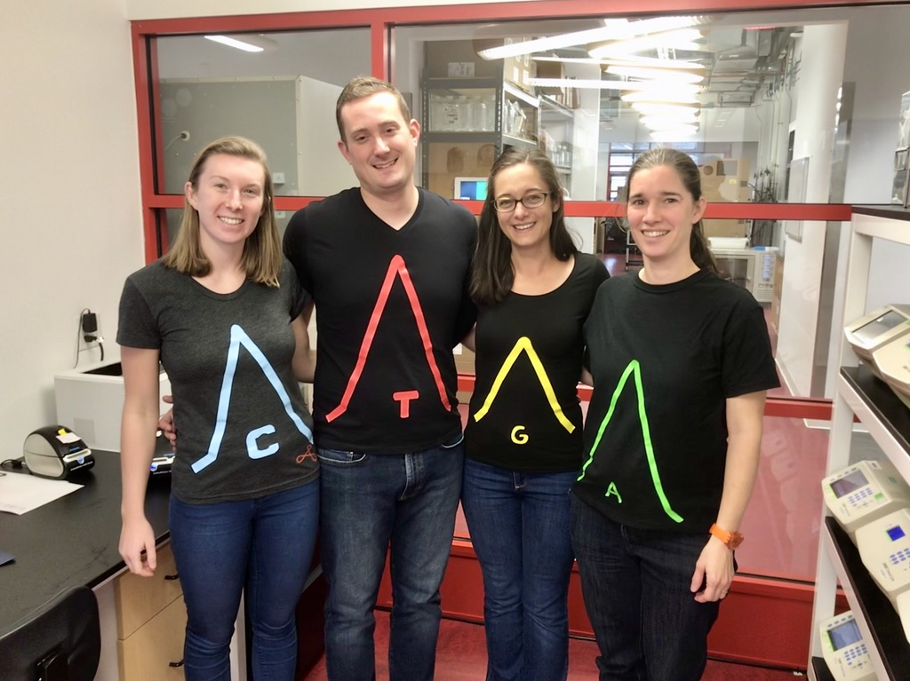

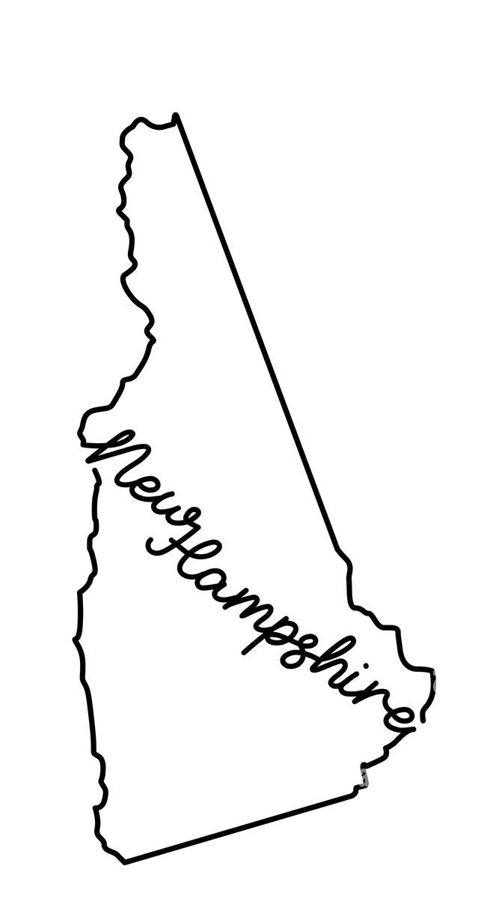
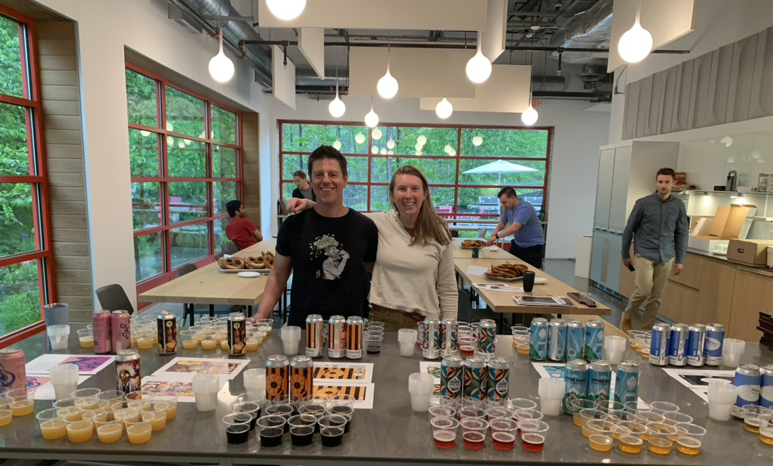


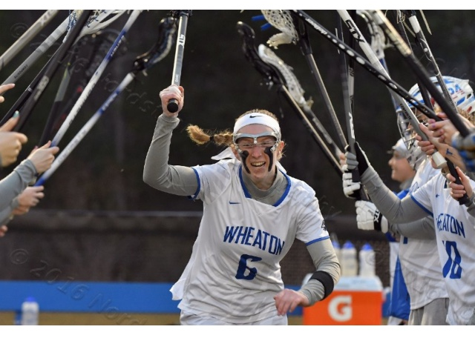

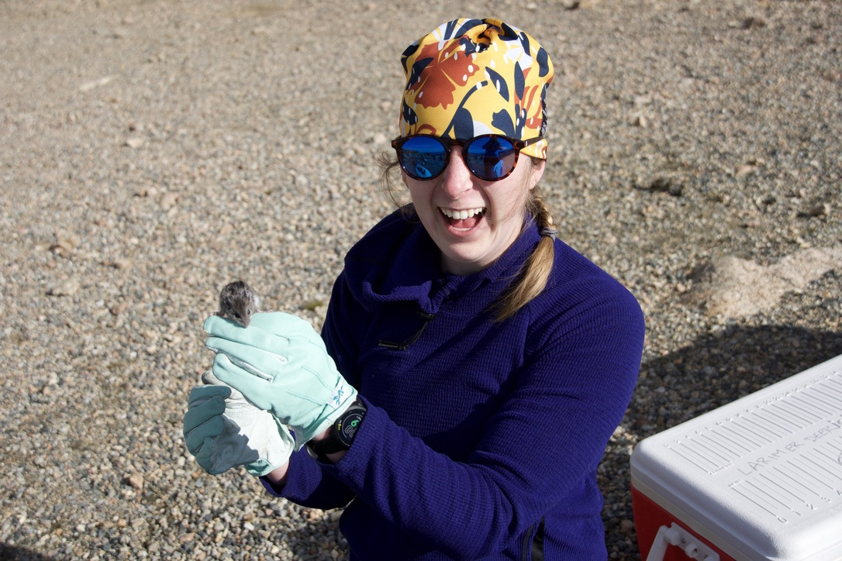
Meg Hemmerlein

Slide 5
Makenna Juergens

Slide 6
Ashley Larson

Slide 7
Iñaki Loureiro

Slide 8
Joel Rushefsky

Slide 9
Opening questions
What first sparked your interest in science?
What did you think your career would like like when you started, and how has that changed?
Educational journey
Did you ever change majors, research areas, or career goals?
What skills from school have been most valuable to your current role?

Slide 10
Challenges & growth
What was one of the biggest challenges you faced early in your career?
How did mentors or peers influence your journey?
Career exploration
How did you find your current position?
What opportunities exist in your field that students might not know about?

Slide 11
Skills & advice
What skills are most important for students to develop? (technical and soft skills)
What experiences (internships, research, volunteering) would you recommend?
Personal perspective
What keeps you motivated?
How do you balance work with your personal life?

