Slide 1

Tidy Data & Plotting
Mt Blue Sky Workshop 2026

Slide 2

Outline
Tidy data
Manipulating physiology data
Plotting physiology data

Slide 3
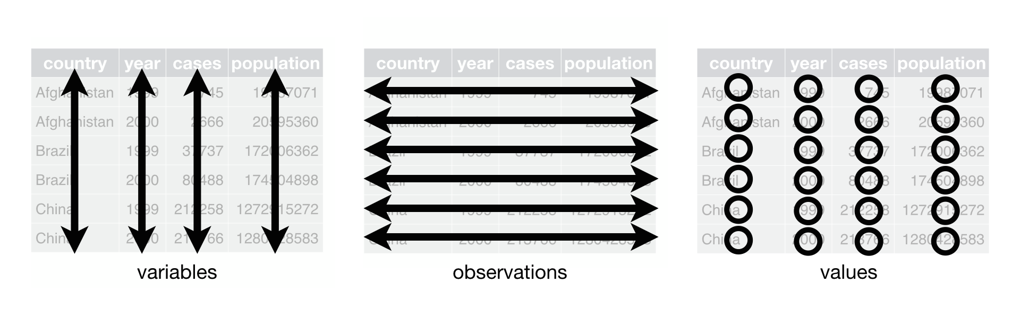
What is tidy data?
“a standardized, structured format for organizing datasets to make analysis, visualization, and manipulation easier”
Three main rules:
Each variable is a column
Each observation is a row
Each cell represents a single value

Slide 4

Common ‘untidy’ data characteristics
Multiple variables are stored in one column
27, Female
Naming variation
Status column
Preg
pregnant
P
Not preg
NA
Tidy datasets are all useable; untidy datasets are unusable in their own ways

Slide 5
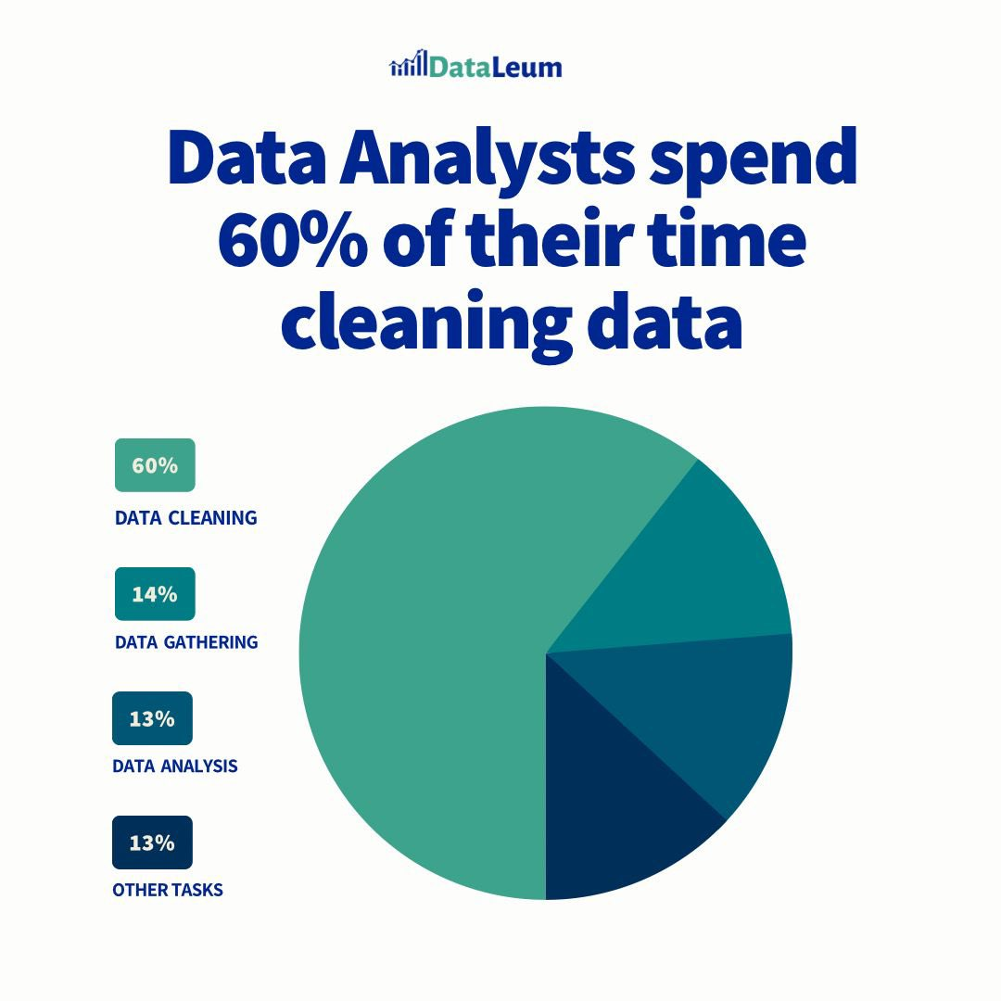
Why do we want a tidy dataset?
Easier to analyze:
Some R commands expect data to be formatted tidily
Some statistics require data to be formatted a certain way
Easier to plot
To produce a desired plot, you must know how to format your data for that plot

Slide 6

Having tidy data from the get-go
Sometimes, data must be collected in non-tidy ways
Most people haven’t heard of tidy concepts
Data is often organized to help with other things (quick entry, readability)
Think about what you want to analyze and how to format your data to answer it – before data collection begins!
Reformat data to tidy guidelines

Slide 7
Physiology Data
Review Google sheet with collected data
Why did we use Google sheets?
Is our data tidy?
What are the questions we want to answer with our data?
Did we make any previous predictions?
Road map for plotting data

Slide 8
Want to learn more?
Tidyverse Datacamp Cheat Sheet
R Project Tidydata Intro
Tidy Tuesday Github
Advanced Tidyverse by the National Socio-Environmental Synthesis Center
Examples of Tidy & Non-tidy Data

