Slide 1
Intro to Evolutionary Physiology
WITH A FOCUS ON HIGH ALTITUDE ADAPTATION
Notes:
Title slide. Framing: we're at altitude right now as we speak — use it.

Slide 2
What is Evolutionary Physiology?
Physiological traits (e.g. hemoglobin-O₂ affinity) are subject to natural selection, just like morphology
Asks why physiological traits/mechanisms exist as they do, not just how they work
Evolutionary physiology can ask about local adaptation (which we will focus on!) or lineage-specific traits and adaptation (like the very cool set-up of bird lungs!) or patterns in disease (like cancer risk!)
Also studies how physiology can change without any genetic change (i.e., the genetic and evolutionary basis of plasticity!)
Physiology asks proximate questions about how a body works.
Evolution asks ultimate questions about why organisms change and diversify through time.
Section 1
Mount Blue Sky Workshop
Notes:
Section 1. Define evolutionary physiology as the 'how' + 'why' fusion. Emphasize physiological traits are selectable traits.

Slide 3
So – what are the challenges of high altitudes?
Consider:
Physiological challenges
Environmental challenges
Potential selective pressures
Mount Blue Sky Workshop
Notes:
BLANK — let students brainstorm freely. Write on this slide or a whiteboard. Push toward completeness, not depth. Correct the '% O2 drops' misconception if it comes up: % is same, partial pressure drops.

Slide 4
So – what are the challenges of high altitudes?
Consider:
Physiological challenges
Environmental challenges
Potential selective pressures
☁
❄
••
☀
≈
⛰
Lower PO₂
(hypoxia)
Cold
Aridity /
water loss
UV
radiation
Reduced air
density
Terrain /
energetic cost
Which of these is the most salient (most important)?
Mount Blue Sky Workshop
Notes:
BLANK — let students brainstorm freely. Write on this slide or a whiteboard. Push toward completeness, not depth. Correct the '% O2 drops' misconception if it comes up: % is same, partial pressure drops.

Slide 5
Some important terminology
Term | Definition | Timescale | Example
Phenotypic plasticity
Acclimation
Acclimatization
Adaptation
Mount Blue Sky Workshop
Notes:
BLANK — let students brainstorm freely. Write on this slide or a whiteboard. Push toward completeness, not depth. Correct the '% O2 drops' misconception if it comes up: % is same, partial pressure drops.

Slide 6
So – what are the challenges of high altitudes?
Consider:
Physiological challenges
Environmental challenges
Potential selective pressures
☁
❄
••
☀
≈
⛰
Lower PO₂
(hypoxia)
Cold
Aridity /
water loss
UV
radiation
Reduced air
density
Terrain /
energetic cost
Which of these is the most salient (most important)?
Mount Blue Sky Workshop
Notes:
BLANK — let students brainstorm freely. Write on this slide or a whiteboard. Push toward completeness, not depth. Correct the '% O2 drops' misconception if it comes up: % is same, partial pressure drops.

Slide 7
What physiology or behaviors might animals be able to use to acclimate to the challenges of high altitude?
☁
❄
••
☀
≈
⛰
Lower PO₂
(hypoxia)
Cold
Aridity /
water loss
UV
radiation
Reduced air
density
Terrain /
energetic cost
Discussion — write or sketch responses here
Mount Blue Sky Workshop
Notes:
BLANK — let students generate categories of possible short-term coping mechanisms before revealing next slide.

Slide 8
SECTION 5 — CASE IN POINT
Cold Acclimation in Small Rodents
Deer mice & voles: high surface-area-to-volume ratio → strong pressure to handle cold efficiently
↑
↑
↑
Brown adipose tissue mass
Mitochondrial
density
Resting metabolic
rate
increases with cold exposure
increases in thermogenic tissue
A lab cold-chamber study (4°C vs. room temp, weeks) is a strict "acclimation" — winter is nature's version, run on every rodent every year.
Section 5
Mount Blue Sky Workshop
Notes:
Deer mice/voles as a model: high SA:V ratio drives strong selection. Classic 4C-chamber studies show these three increases. Winter = nature's cold acclimation experiment.

Slide 9
Cold Acclimation
Shivering Thermogenesis
Non-Shivering Thermogenesis
Involuntary muscle contraction
Immediate response
Energetically expensive — can't sustain indefinitely
Driven by brown adipose tissue (BAT)
UCP1 uncouples the mitochondrial proton gradient from ATP synthesis
Energy released as heat instead of ATP
Section 5
Mount Blue Sky Workshop
Notes:
Two thermogenic strategies. Shivering = fast but costly; NST = BAT/UCP1, uncouples proton gradient from ATP synthesis to release heat.

Slide 10

If acclimation already lets individuals cope with the challenges of cold, should genetic adaptation happen at all?
Perfect performance → best fitness
Discussion — write or sketch responses here
Mount Blue Sky Workshop
Notes:
BLANK — let them wrestle with why adaptation would evolve if plasticity already solves the problem.

Slide 11
What physiology or behaviors might animals be able to use to acclimate to the challenges of hypoxia at high altitudes?
☁
❄
••
☀
≈
⛰
Lower PO₂
(hypoxia)
Cold
Aridity /
water loss
UV
radiation
Reduced air
density
Terrain /
energetic cost
Discussion — write or sketch responses here
Mount Blue Sky Workshop
Notes:
BLANK — let students generate categories of possible short-term coping mechanisms before revealing next slide.

Slide 12
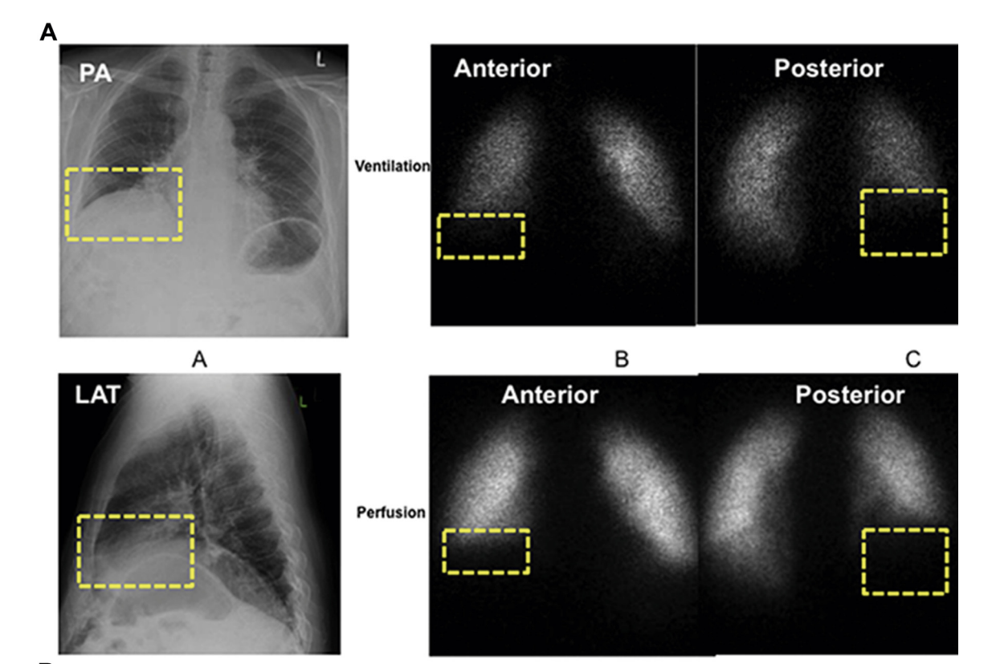
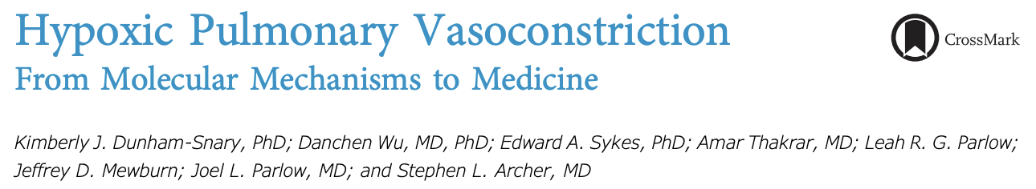
Many of our ancestral responses to hypoxia were to deal with localized hypoxia
Locally low O₂
Local vasoconstriction
(long term)
Vascular remodeling
Discussion — write or sketch responses here
Mount Blue Sky Workshop
Notes:
BLANK — let students generate categories of possible short-term coping mechanisms before revealing next slide.

Slide 13
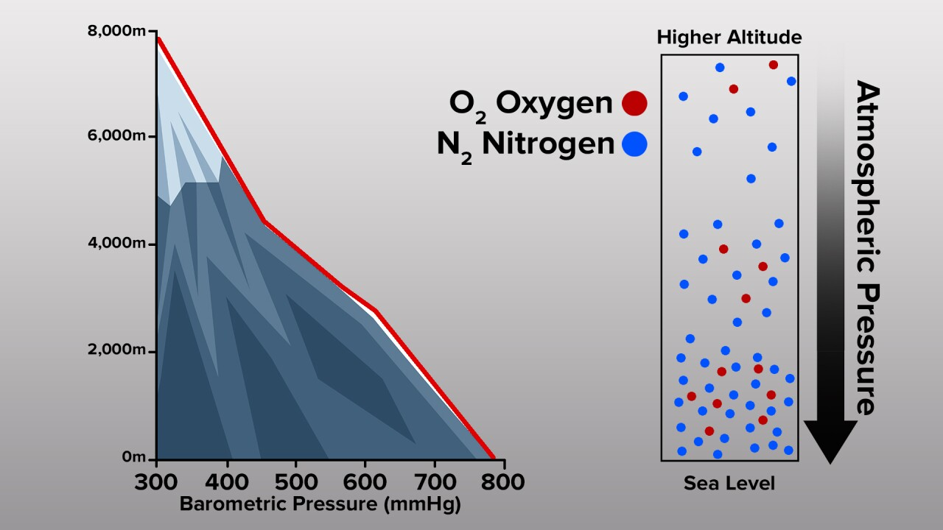
Many of our ancestral responses to hypoxia were to deal with localized hypoxia … but at high altitude, it’s the whole body!
Pervasive low O₂
Whole-lung vasoconstriction
Increased pressure in the lung circulation
(long term)
Vascular remodeling and
chronic pulmonary hypertension
Discussion — write or sketch responses here
Mount Blue Sky Workshop
Notes:
BLANK — let students generate categories of possible short-term coping mechanisms before revealing next slide.

Slide 14
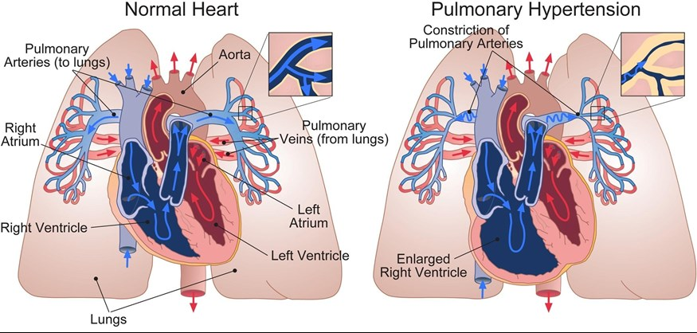
Many of our ancestral responses to hypoxia were to deal with localized hypoxia … but at high altitude, it’s the whole body!
Discussion — write or sketch responses here
Mount Blue Sky Workshop
Notes:
BLANK — let students generate categories of possible short-term coping mechanisms before revealing next slide.

Slide 15
The Hypoxia Response Cascade
A lowland-native ascending rapidly:
Minutes–
hours
Hours–
days
Days
Weeks–
months
Hyperventilation (carotid body senses low PO₂); heart rate & cardiac output rise
CO₂ washout → respiratory alkalosis; kidneys begin excreting bicarbonate
Kidney releases EPO → stimulates red blood cell production
Hematocrit rises meaningfully; capillary density & mitochondrial changes
Fast fix
The cost
Hyperventilation kicks in within minutes to raise blood O₂
Shifts blood pH (respiratory alkalosis)
Every other system is tuned to a specific pH → ripple effects
Contributes to Acute Mountain Sickness (AMS)
Section 6
Mount Blue Sky Workshop
Notes:
The core cascade for a lowland-native ascending rapidly. Emphasize the mismatch in timescales between the fast ventilatory fix and the slow EPO/RBC response.

Slide 16
Adaptation & the Cost of Plasticity
Plasticity can still be good!
When plasticity is adaptive, that trait can get “fixed” (plasticity is lost)
Genetic assimilation: a plastic response becomes constitutively expressed / genetically fixed over generations
Plasticity can simply buy time for genetic adaptation to catch up
But adaptation can out-compete it …
Many acclimatized responses carry a cost
Pulmonary hypertension leads to right ventricle hypertrophy and pulmonary edema
chronically thick blood (elevated hematocrit) raises stroke/clot risk
Genetic adaptation can generate better solutions that avoid these negative effects
Adaptation and acclimatization aren't mutually exclusive — adapted populations still acclimatize!
Section 7
Mount Blue Sky Workshop
Notes:
Recap: cost of plasticity (viscosity/hematocrit), genetic assimilation, plasticity buying time, adaptation+acclimatization coexisting.

Slide 17
Three Human Populations, Three Solutions
Population | Genetic signal | Strategy
Tibetan | EPAS1 variant (traced to Denisovan introgression) | Dampens RBC increase — avoids blood-viscosity cost; high resting ventilation
Andean | Distinct loci from Tibetan populations | Elevated hemoglobin/hematocrit, closer to typical acclimatization response
Ethiopian | Different loci again; not fully resolved | Normal hemoglobin levels despite altitude — mechanism still being studied
Section 8
Mount Blue Sky Workshop
Notes:
Three independently evolved human solutions — good comparative punchline. Prompt: what does this say about how many ways evolution can solve one problem?

Slide 18
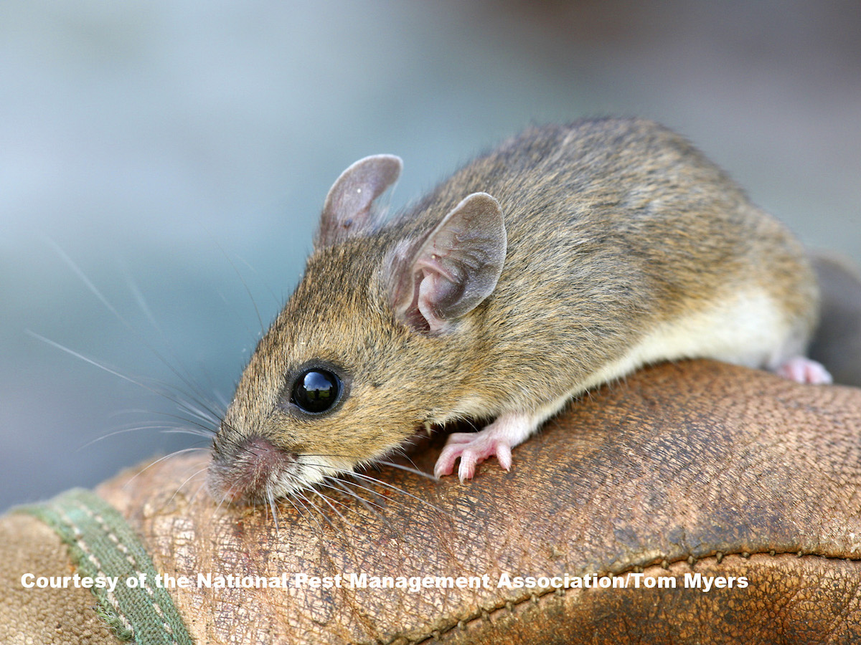
How do we study evolutionary physiology?
Common garden experiments
A scientific method where organisms from different distinct geographic locations or populations are raised together in a single, shared environment
We can then expose subjects to specific, highly controlled conditions and look at plasticity (acclimation) responses
treatment
Normoxia
Hypoxia
population
Lowlander
(Nebraska)
Highlander
(Mt Blue Sky)

Slide 19
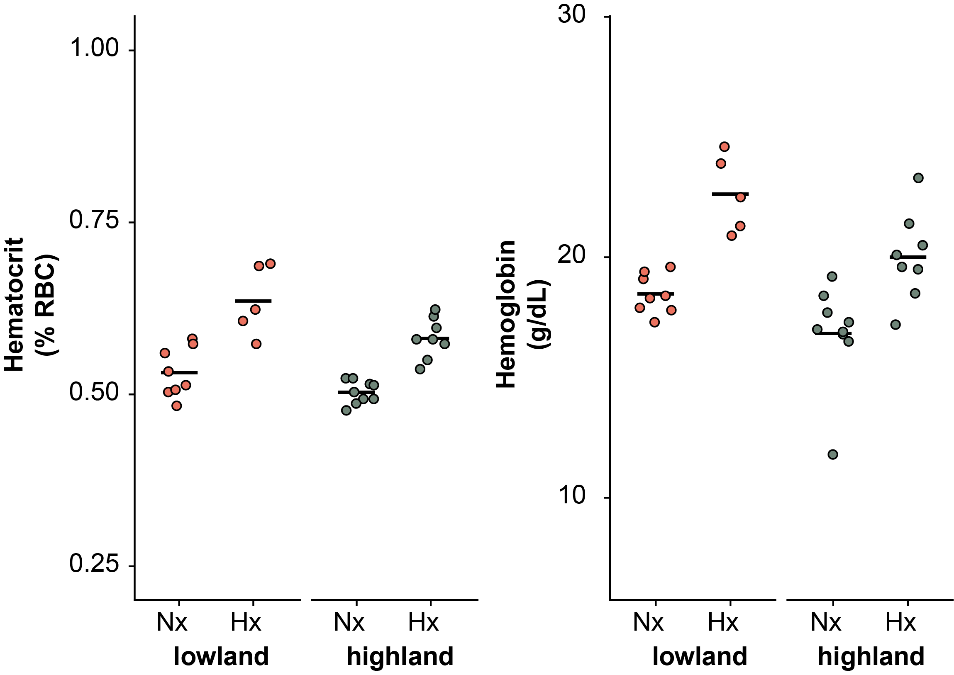
How do we study evolutionary physiology?
Common garden experiments
A scientific method where organisms from different distinct geographic locations or populations are raised together in a single, shared environment
We can then expose subjects to specific, highly controlled conditions and look at plasticity (acclimation) responses
treatment
Normoxia
Hypoxia
population
Lowlander
(Nebraska)
Highlander
(Mt Blue Sky)

Slide 20
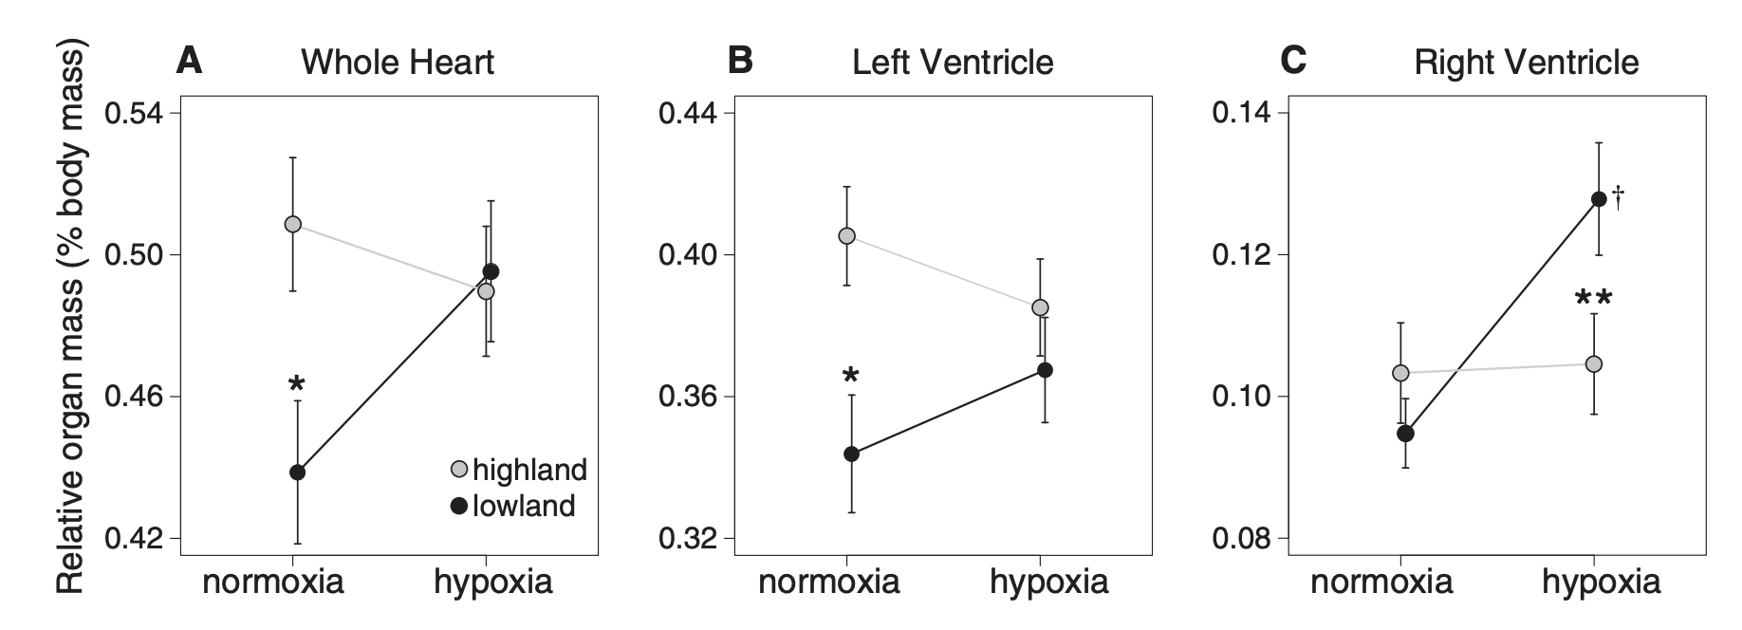
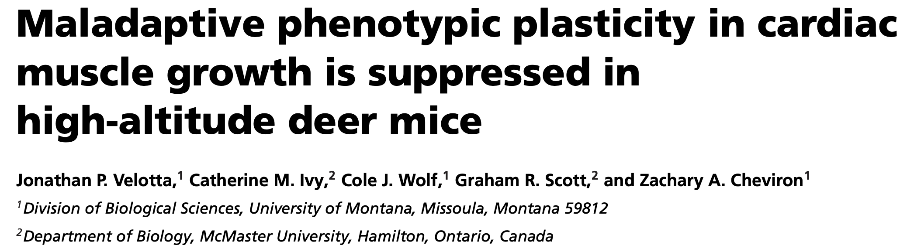
How do we study evolutionary physiology?

