Slide 1
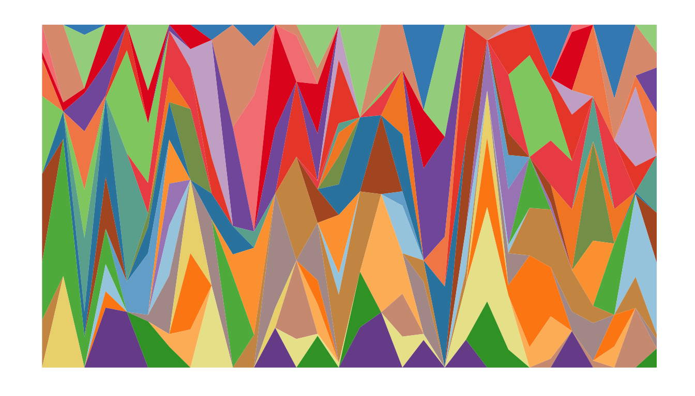
Introduction to R
Mt Blue Sky Workshop 2026

Slide 2
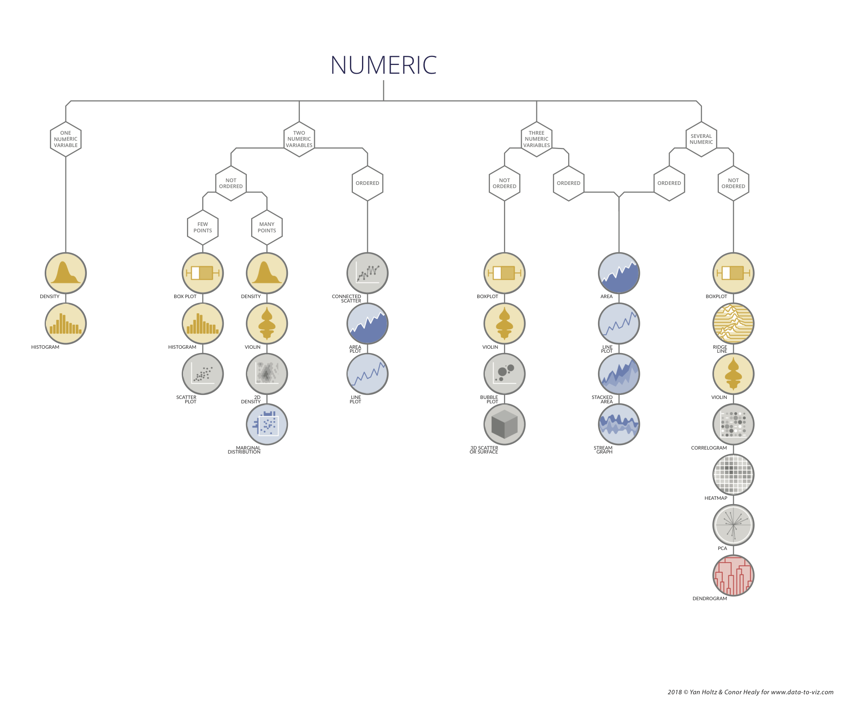
Outline
R and other coding systems
Interfacing with R
Navigating R
Data types and objects
The package system

Slide 3
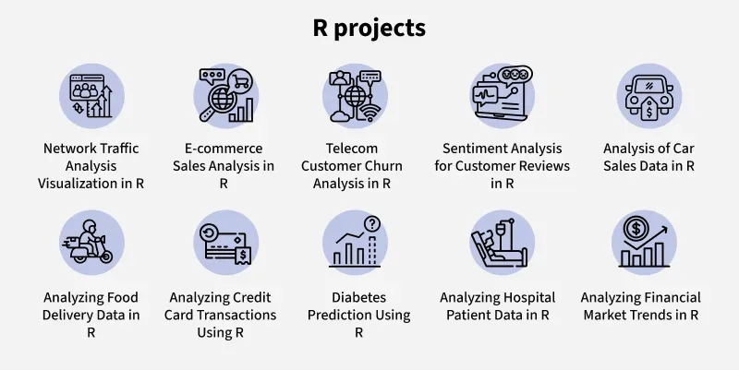
Who uses R?
Statisticians
Data scientists
Academic researchers
Bioinformaticians
Pharmaceutical and healthcare companies
Journalists and the media

Slide 4
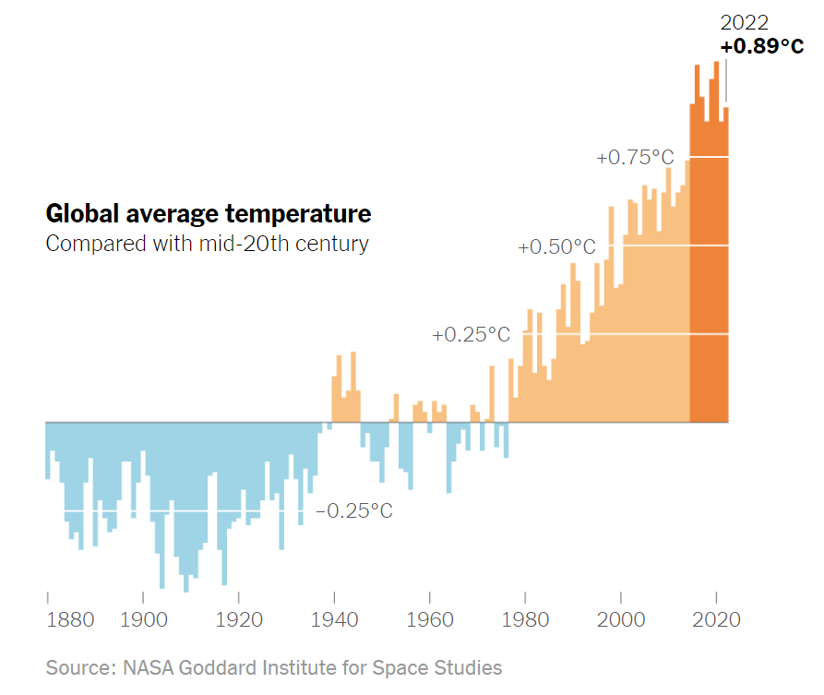
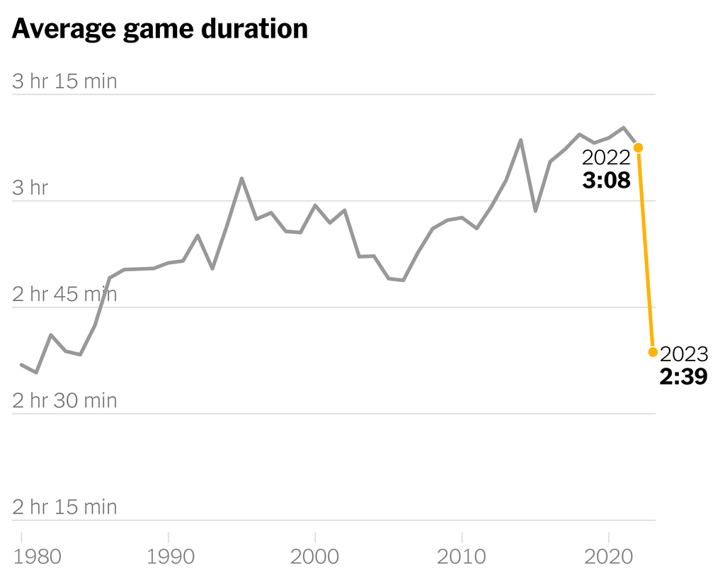
How do they use R?
Raw data
Climate and environment
Global temp change, US precipitation
Health and wellness
Vaccination records, covid herd immunity
Sports
Olympic medal counts, paying college athletes
Business and economy
Price of eggs, immigrant economic mobility
Research data
physiological data, microbiome data
Use R for plotting graphs and running statistical analyses
Example from NY Times

Slide 5
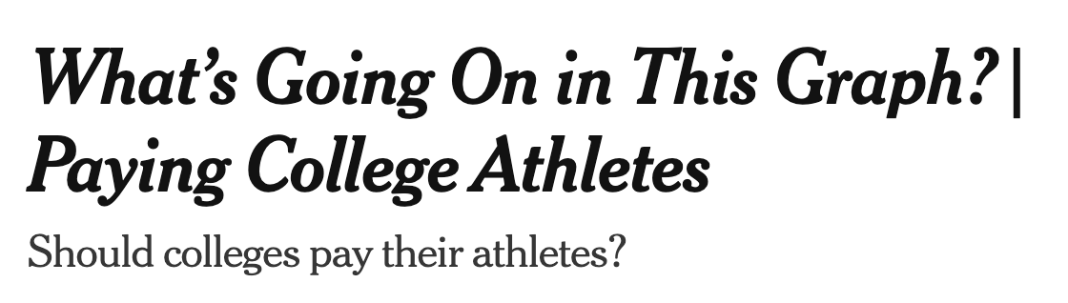
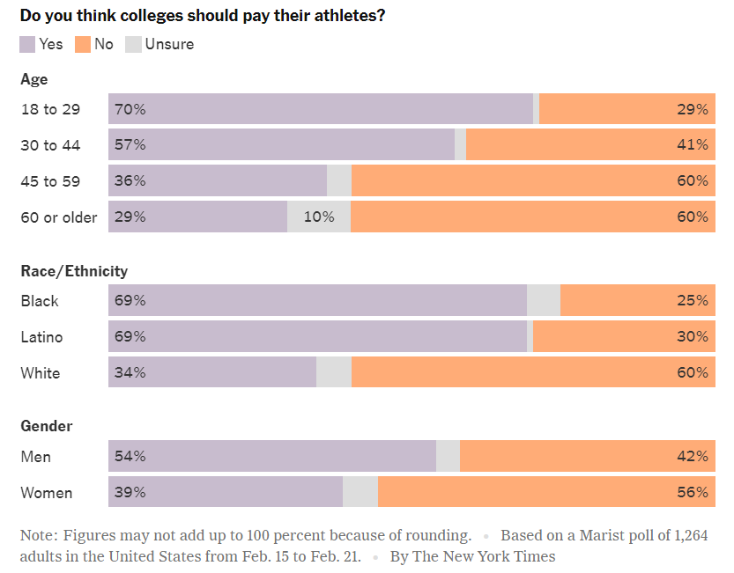
How do they use R?
What kind of data is this?
How was it collected?
How did they plot it?
What does it mean?

Slide 6
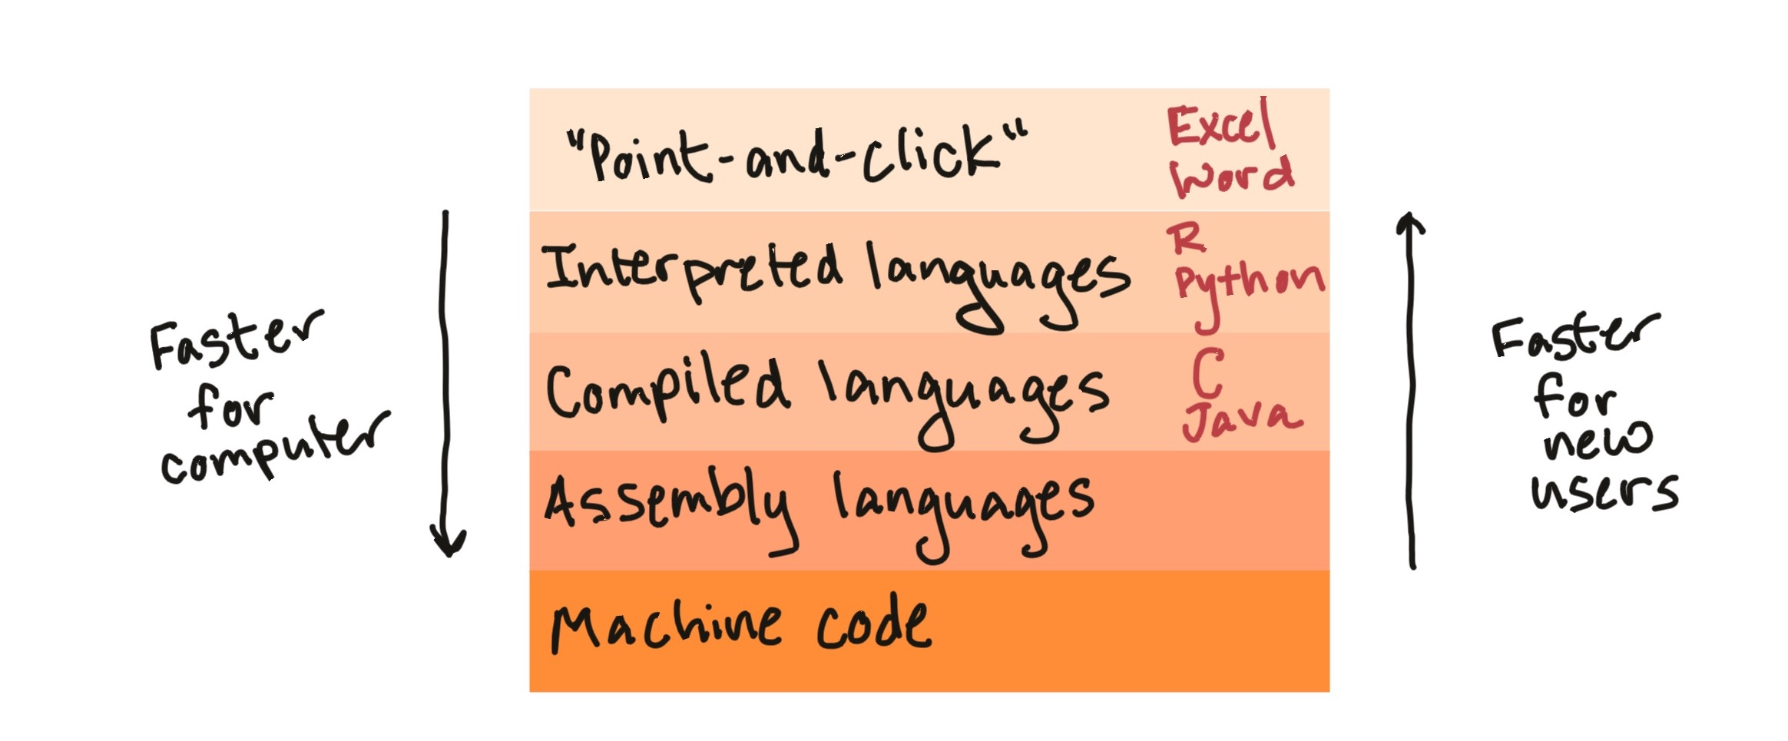
What is R?
R was developed in the 1990s-2000s at the University of Auckland
Open-source and interactive software

Slide 7
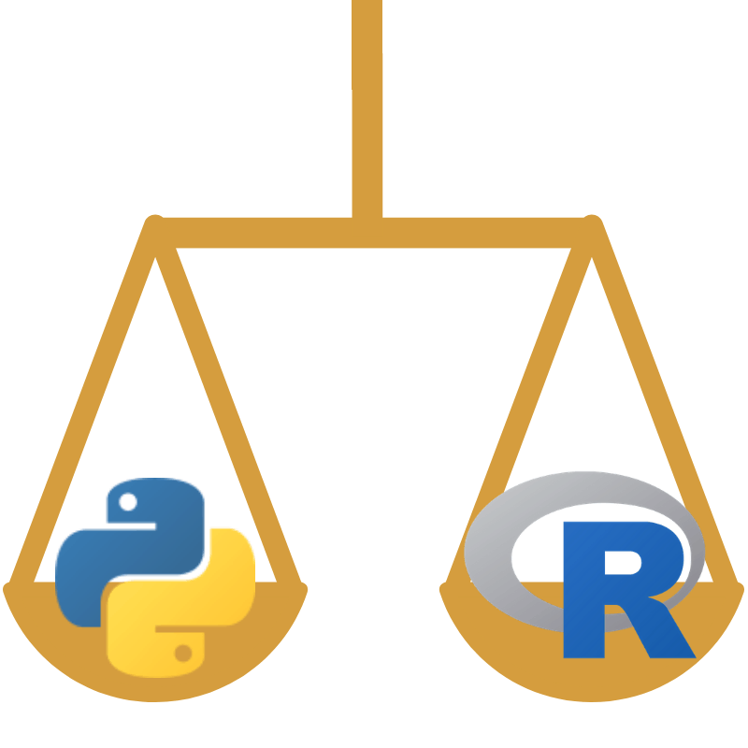
R vs Python
Criteria | R | Python
Primary design | Built by statisticians for statistics and data graphics | Built for general-purpose programming and readability
Ease of learning | Moderate | Easy
Versatility | Limited | Strong
Data visualization | Excellent | Good
Statistics | Excellent | Good
Community | Large and active | Large and active
Open-source | Yes | Yes
Cross-platform (mac/PC) | Yes | Yes

Slide 8


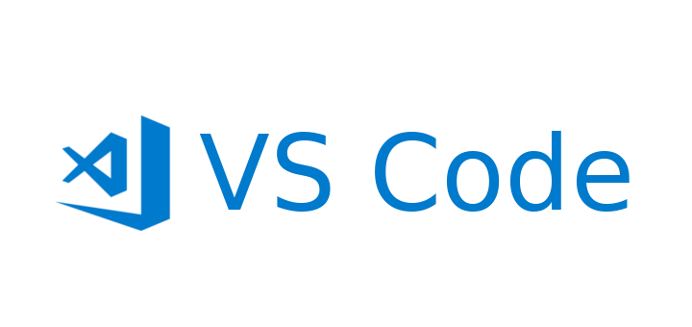

R vs Python (the engine)

Slide 9
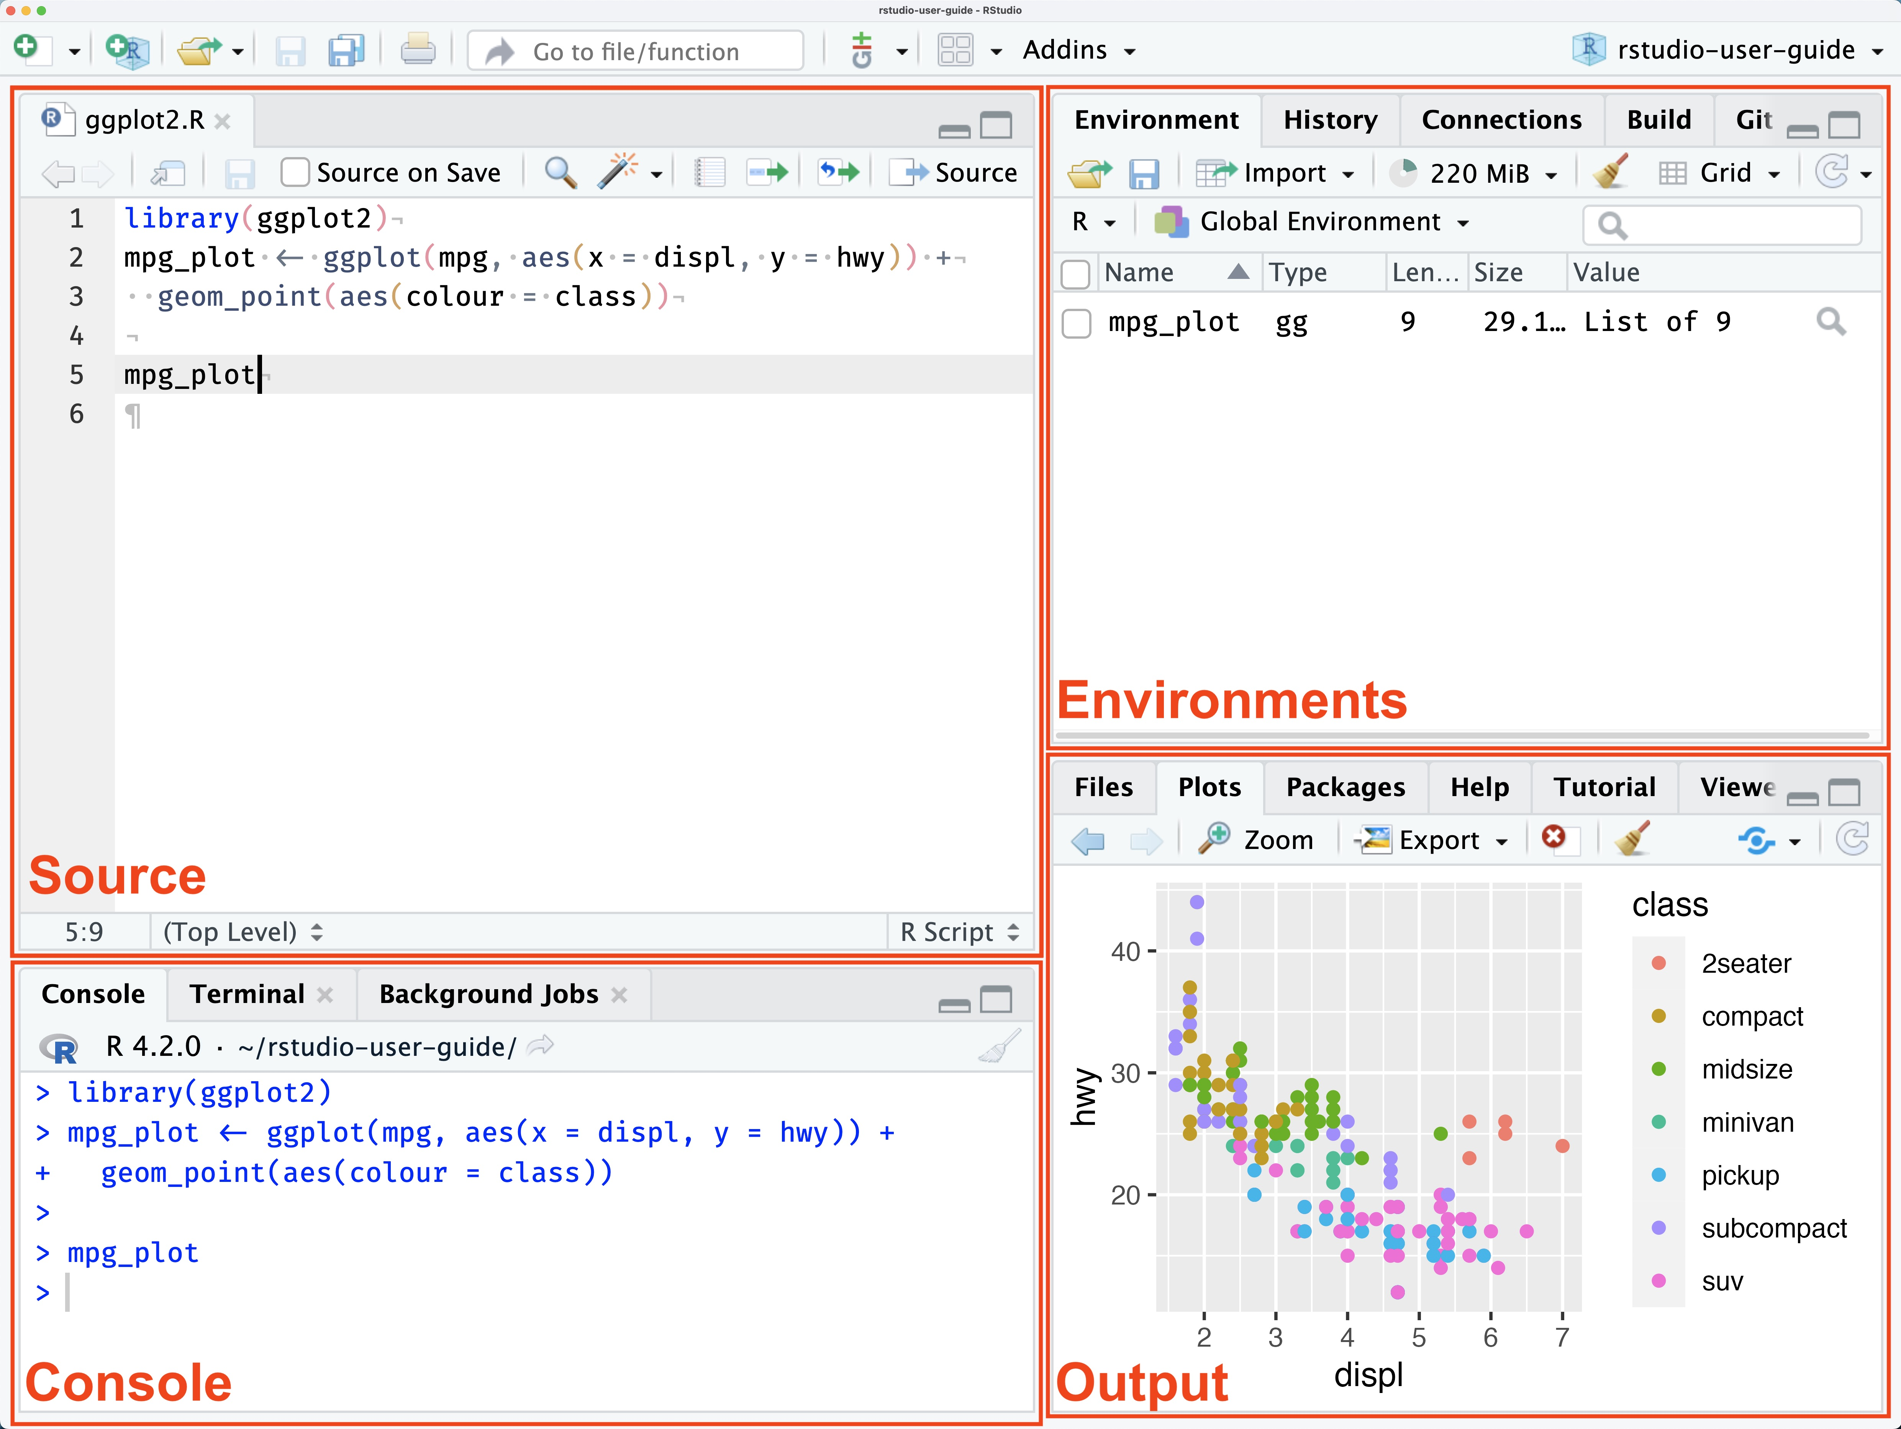
How to interface RStudio
Source: text editor (write scripts here)
Console: Interactive text editor & shows error messages
Environments: will populate with R objects
Output:
Files tab
Plots tab
Packages tab
Help tab

Slide 10
How to interface RStudio
Source: text editor (write scripts here)
Console: Interactive text editor & shows error messages
Environments: will populate with R objects
Output:
Files tab
Plots tab
Packages tab
Help tab

Slide 11
Data types
Numeric: general number; 0.111, 3, 400
Character: string of letters, characters, words; “hello”, “Y”, “,”, “3”
Factor: meaningful categories with levels; “Strain A”, “Strain B”, “Strain C”

Slide 12
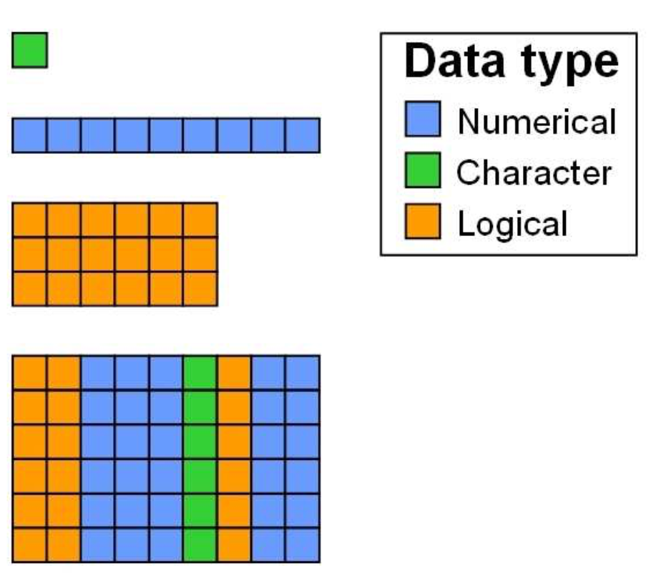
Data types
Scalar
One value, one data type
Vector
One dimension, one data type
Matrix
Two dimensions, one data type
Dataframe
Two dimensions, multiple data types (by columns)

Slide 13
Data frames
header row
ID | Class | Age | Score | Score_C
0001 | “Johnson” | 27 | 4.3 | “B”
0098 | “Johnson” | 24 | 5.0 | “A”
0070 | “Sydney” | 22 | 2.4 | “D”
rows
columns

Slide 14


The “package” system of R

Slide 15
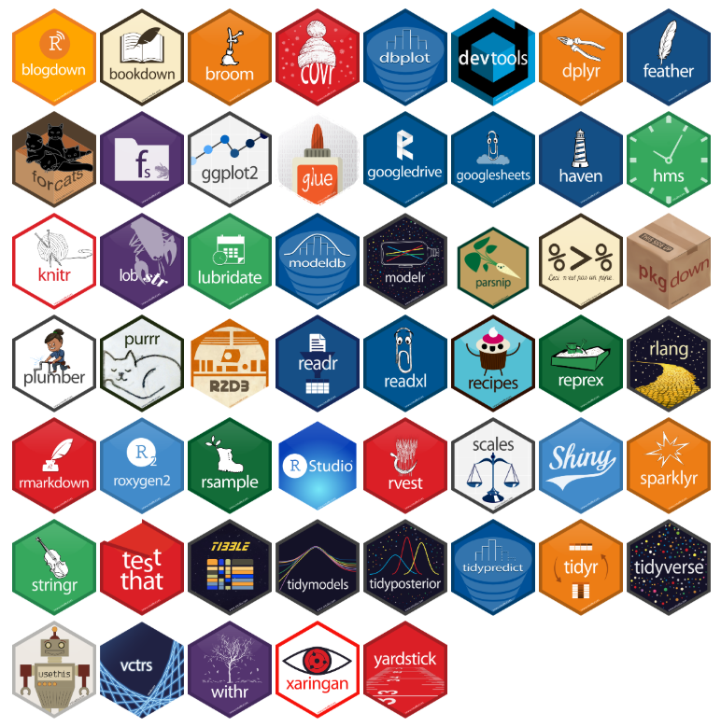

The “package” system of R

Slide 16
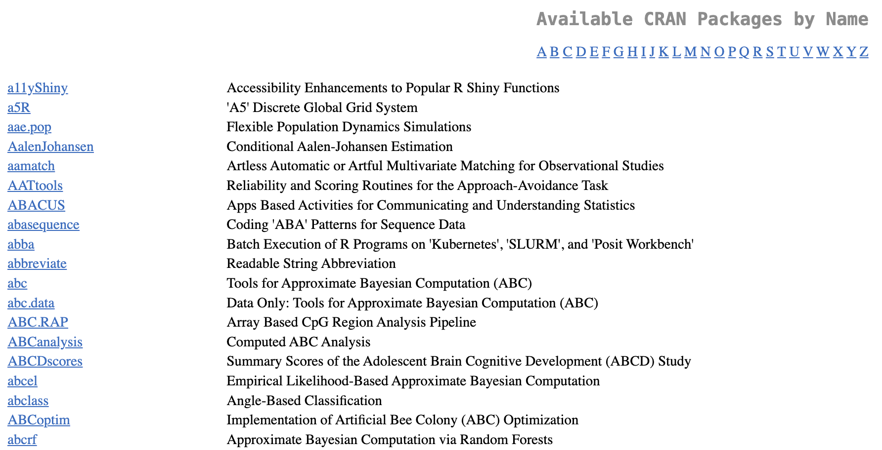
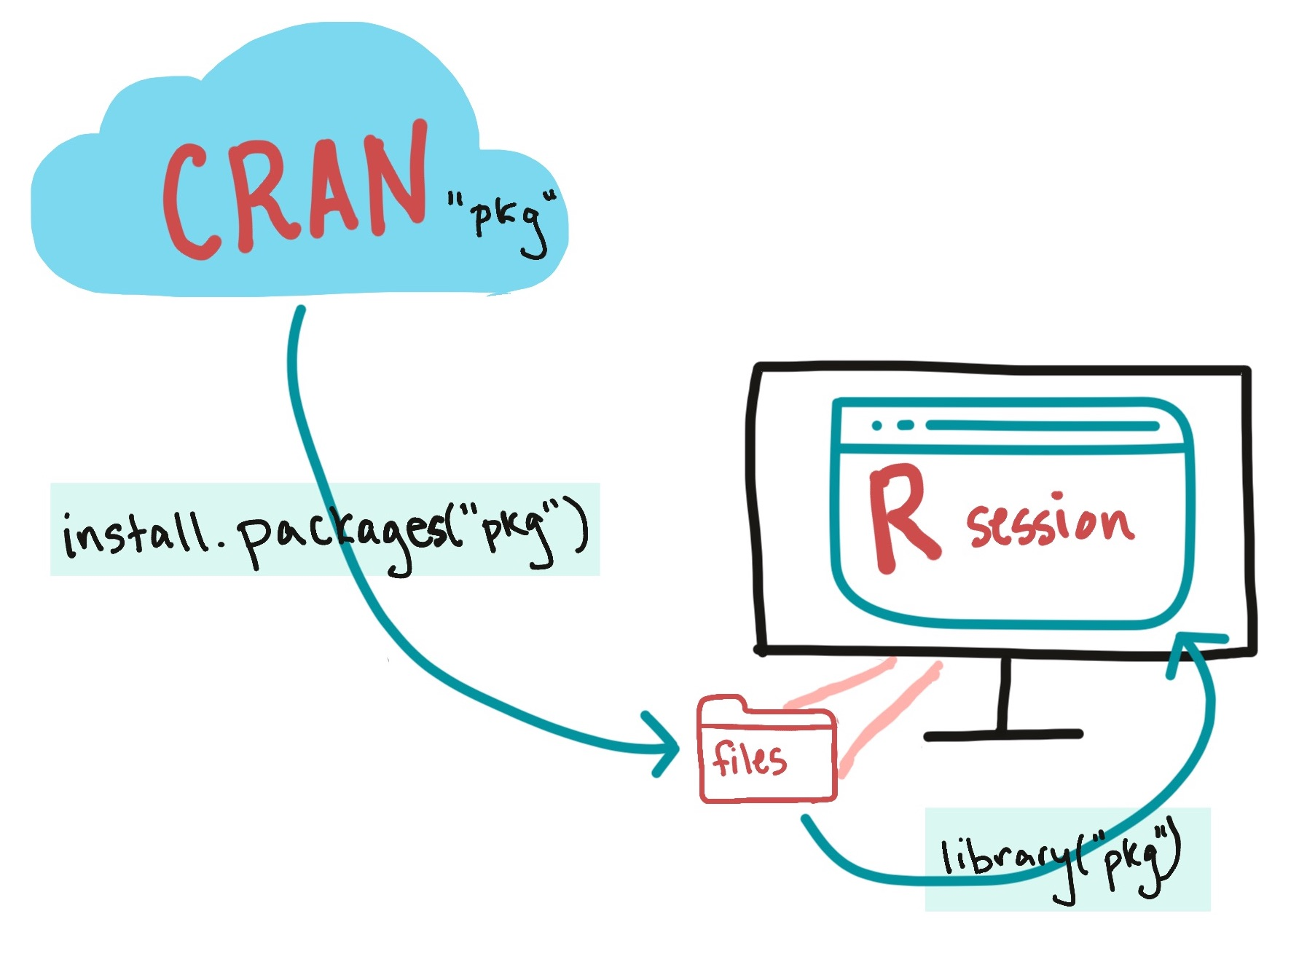
How to load packages
23,908 packages in CRAN!

Slide 17
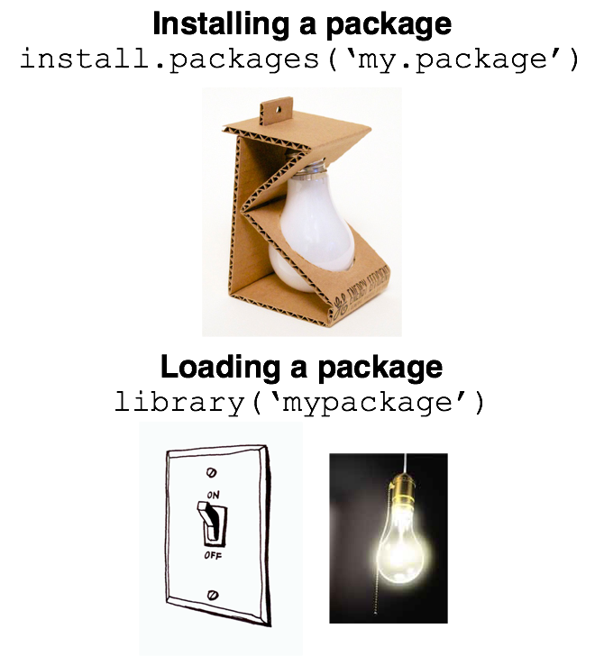
How to load packages

Slide 18
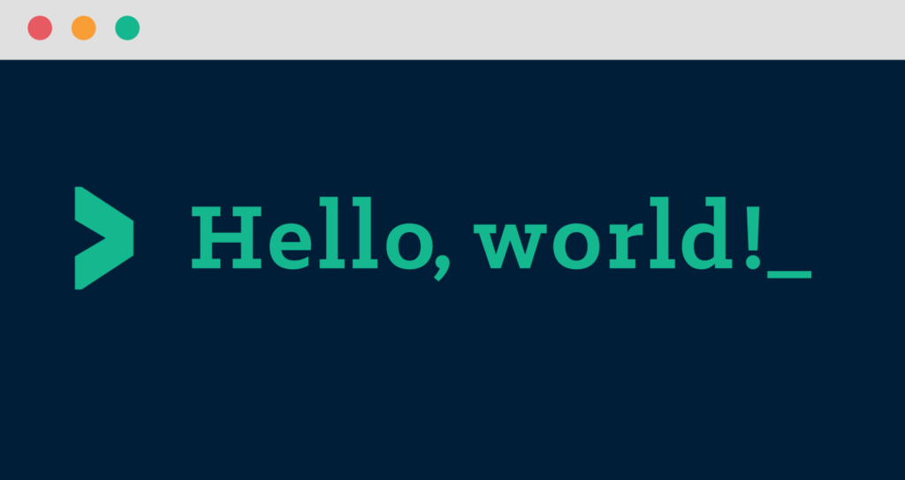
Let’s Get Started in R!

