Slide 1
Prion Deposition Analysis Pipeline
Automated quantification of PrPsc deposition in histological brain images
Team Hacking into the Brainframe
qCMB Hackaton – June 2026

Slide 2
Background

Slide 3
Biological question

Slide 4
Analytical challenge

Slide 5
Our pipeline approach
Raw images
Subset raw images
(3-5 / group)
Remaining raw images
Manual screen of segmented images
Manual scoring in Ilastik
Read into R processing pipeline
Model for segmentation
Downstream plotting and statistics
Batch processing
Segmented images

Slide 6
Segmentation using Ilastik

Slide 7
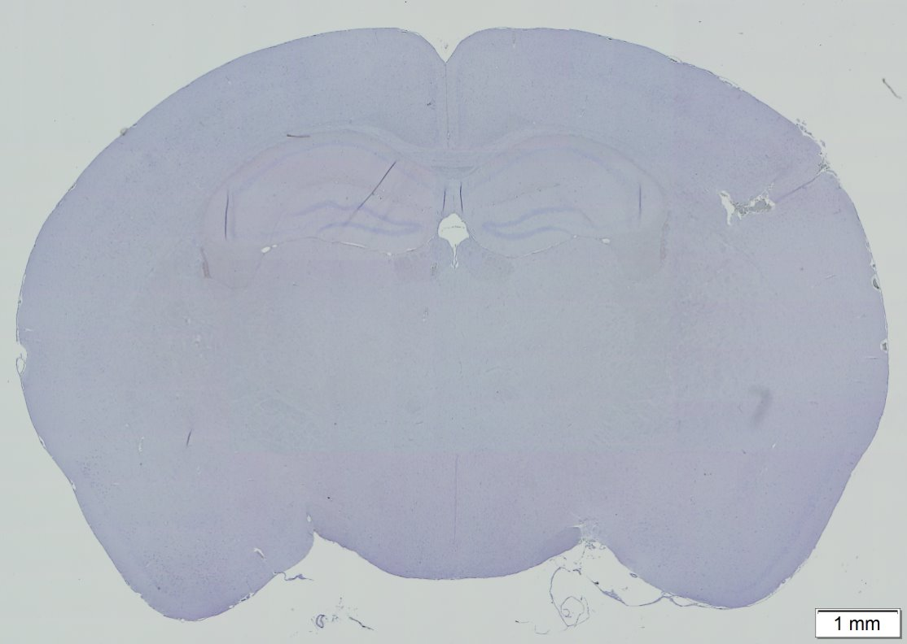
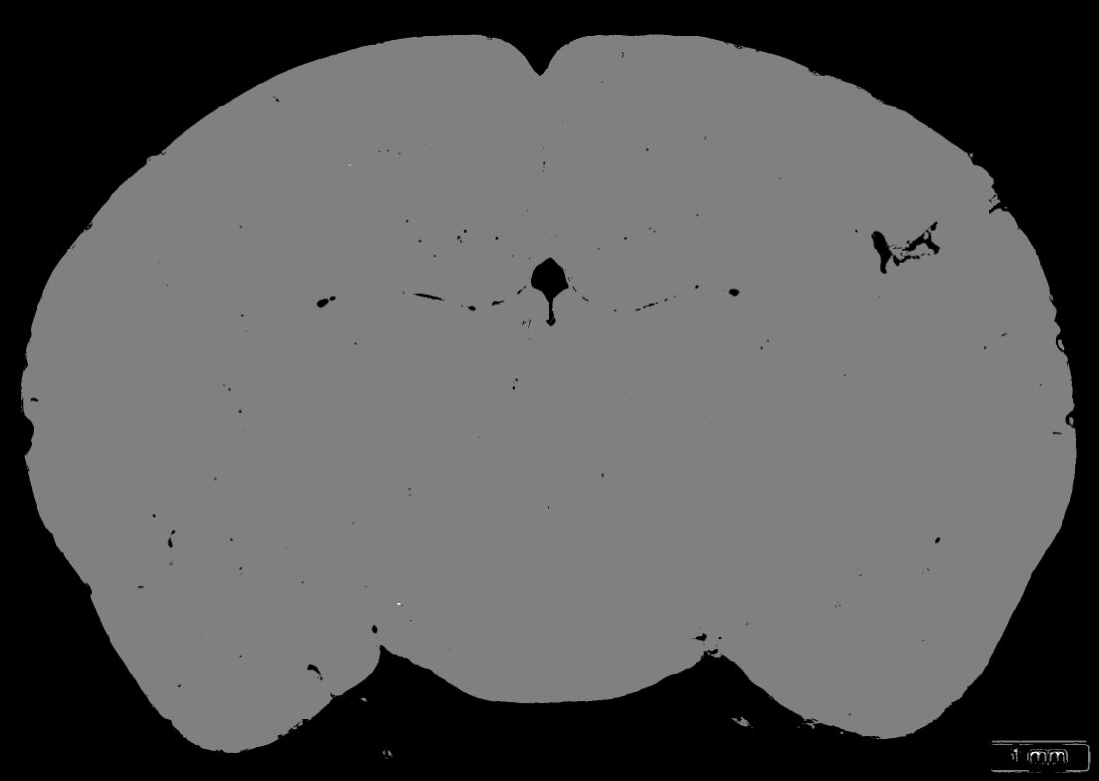
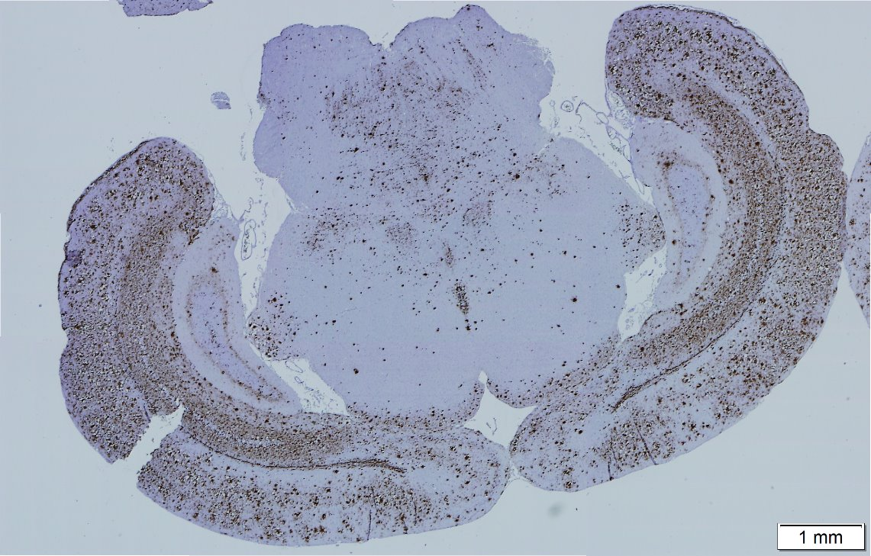
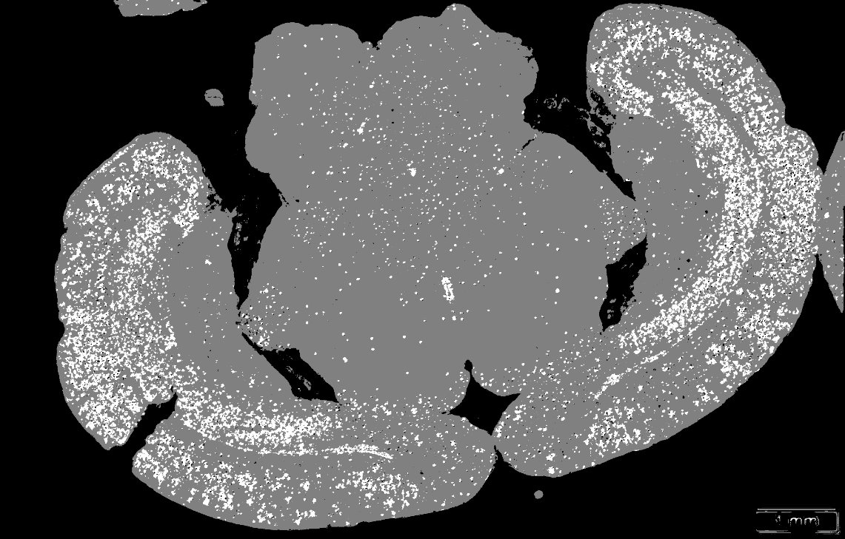
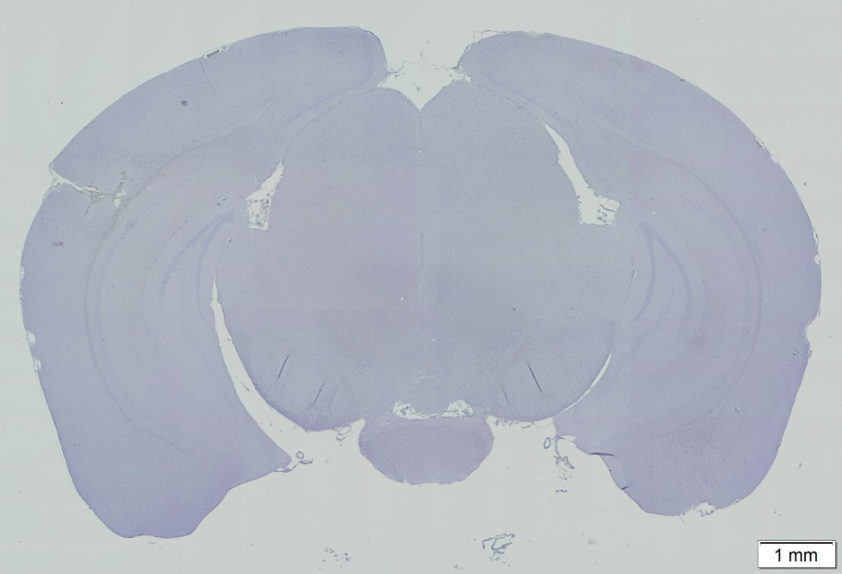
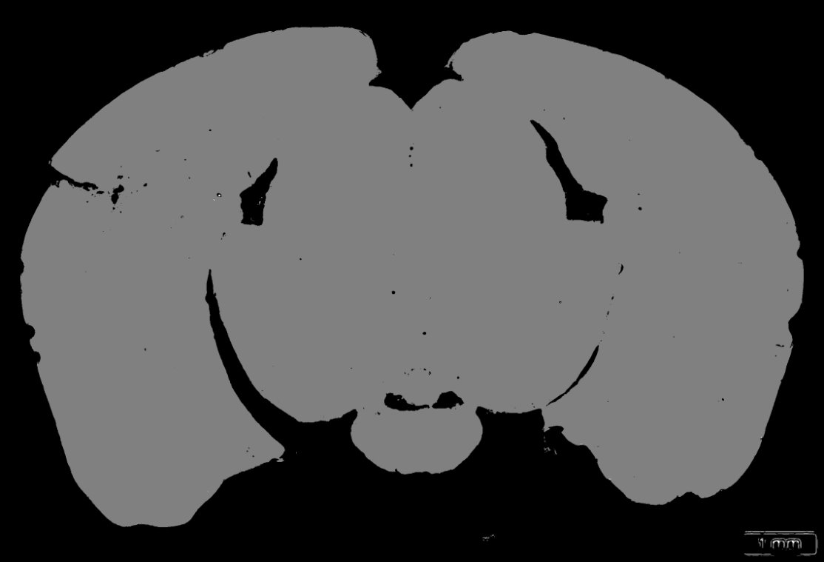
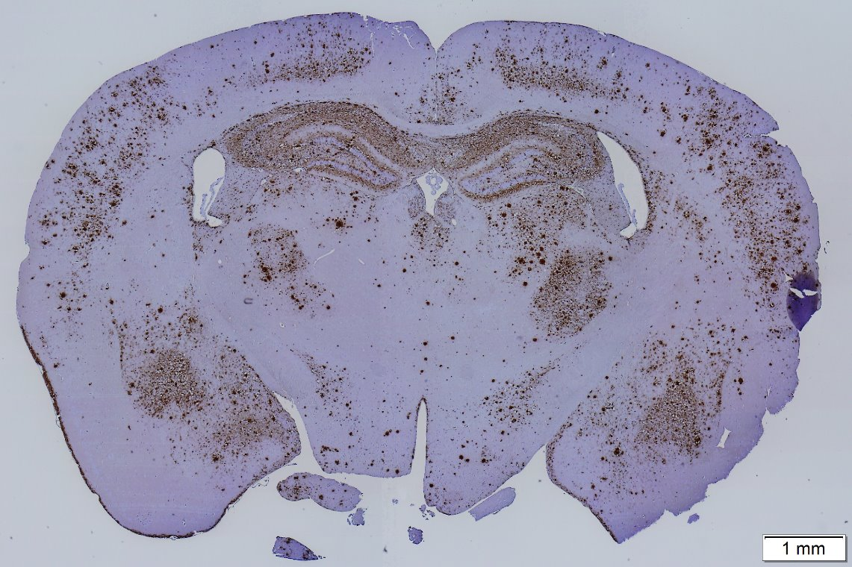
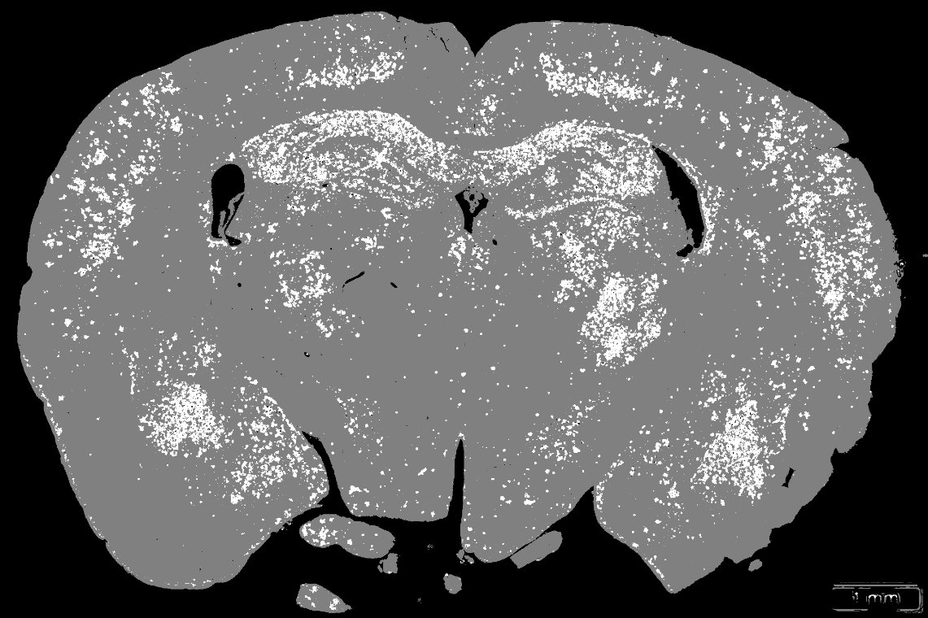
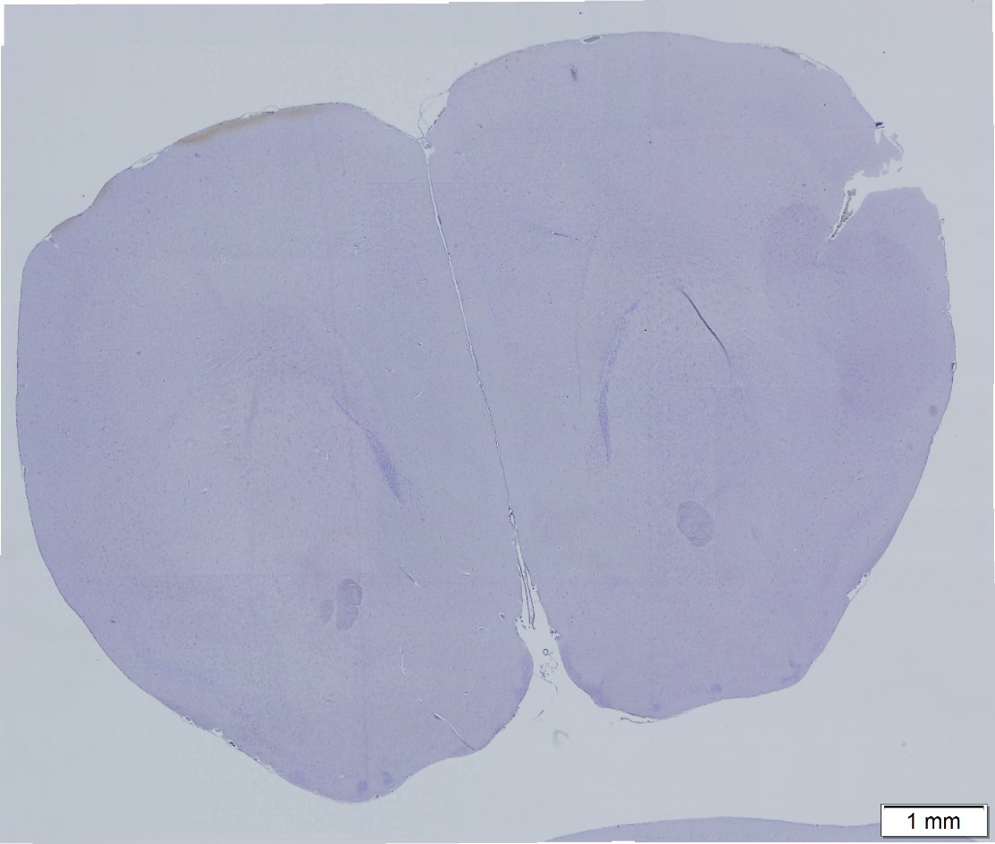

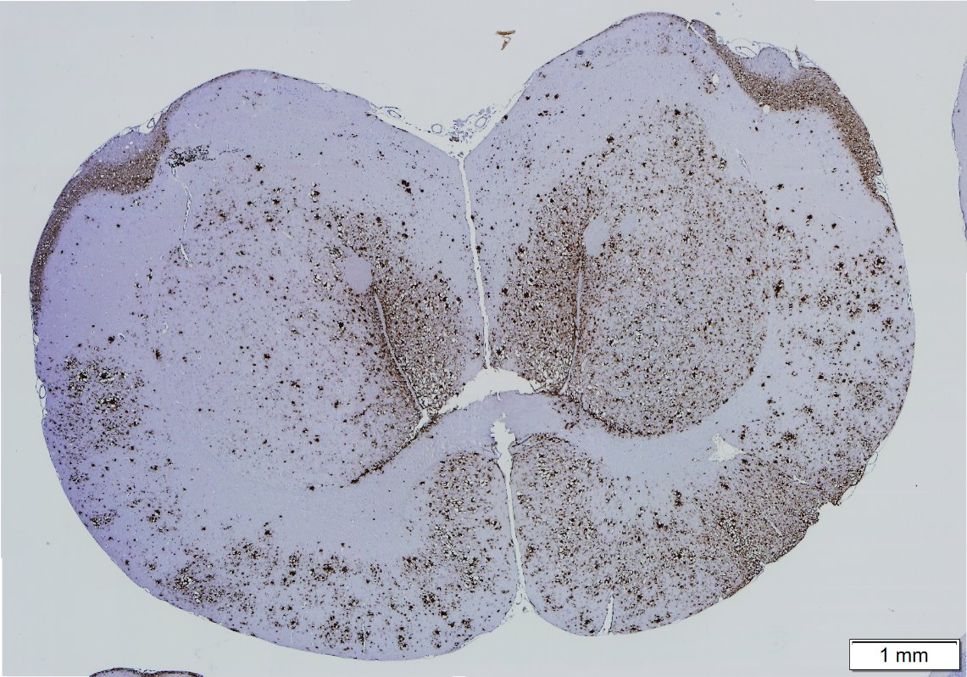
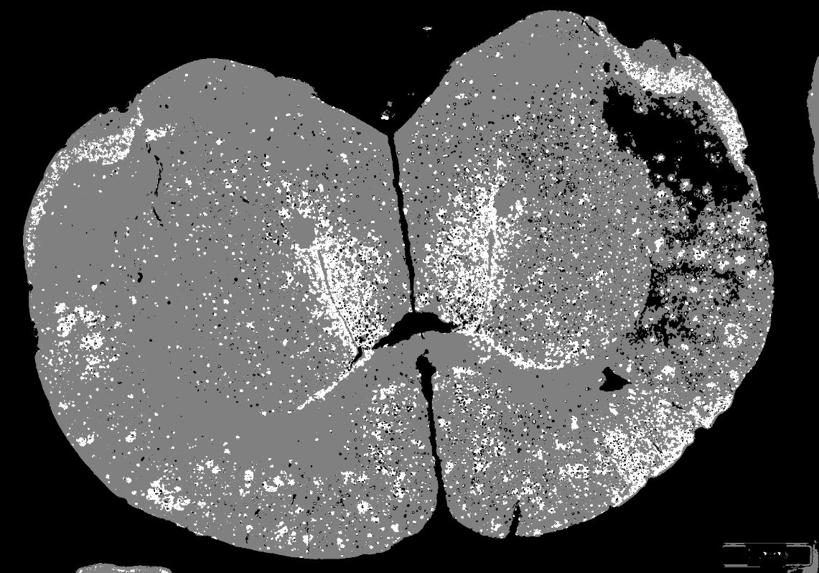
Segmentation using Ilastik
WT
Treatment Infected
Raw Image
Segmented mask
Raw Image
Segmented mask

Slide 8
Quantification pipeline

Slide 9
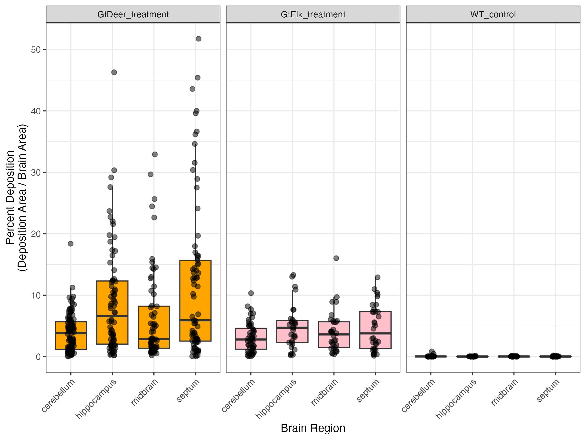
Prions deposit differently in the brain depending on the mouse genotype
c
ab
b
a
n.s.
n.s.
lm(deposition~ group * brain region)

Slide 10
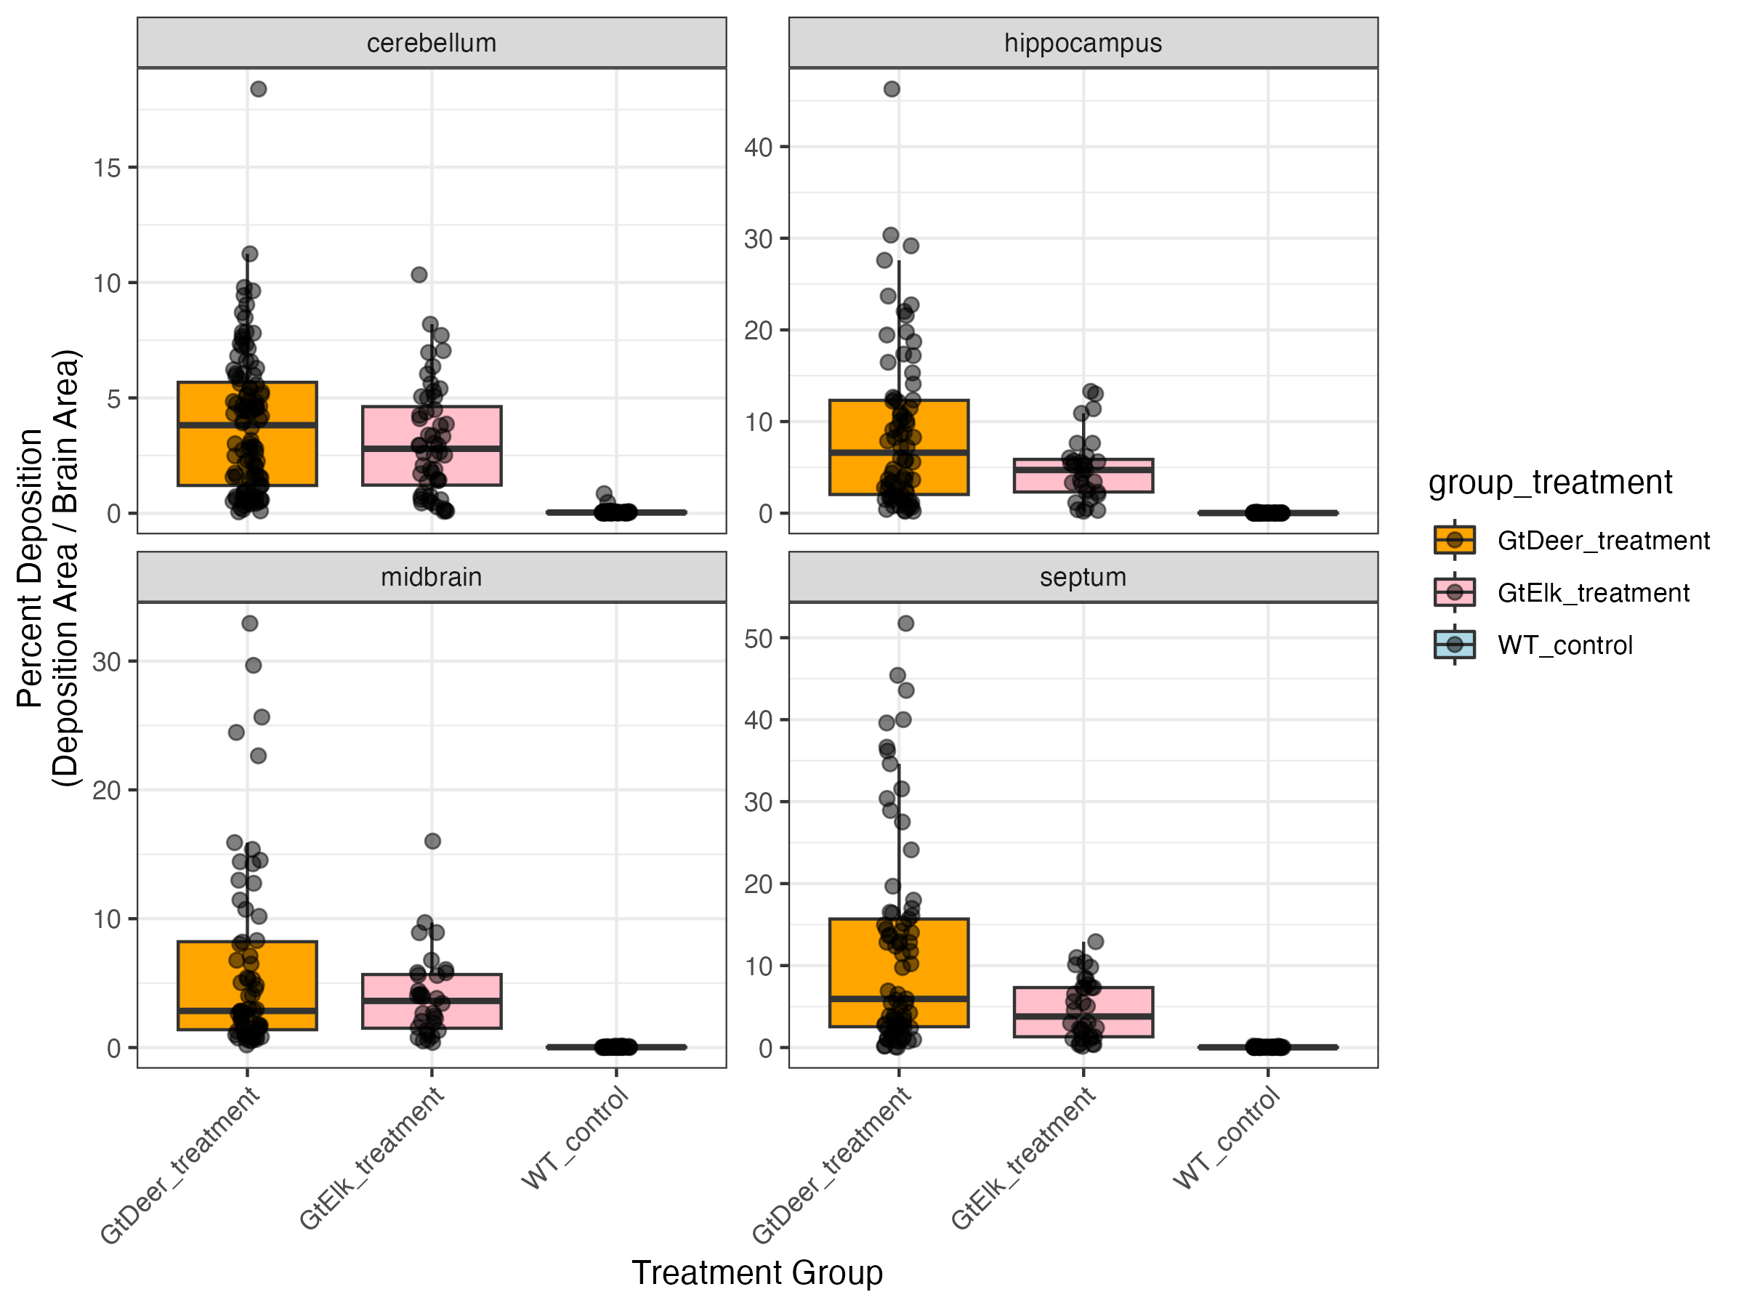
Prions deposit differently in the brain depending on the mouse genotype
a
a
b
b
c
a
a
b
b
c
lm(deposition~ group * brain region)

