Slide 1

Chapter 5. Data Cube Technology
Meng Jiang
CS412 Summer 2017:
Introduction to Data Mining

Slide 2
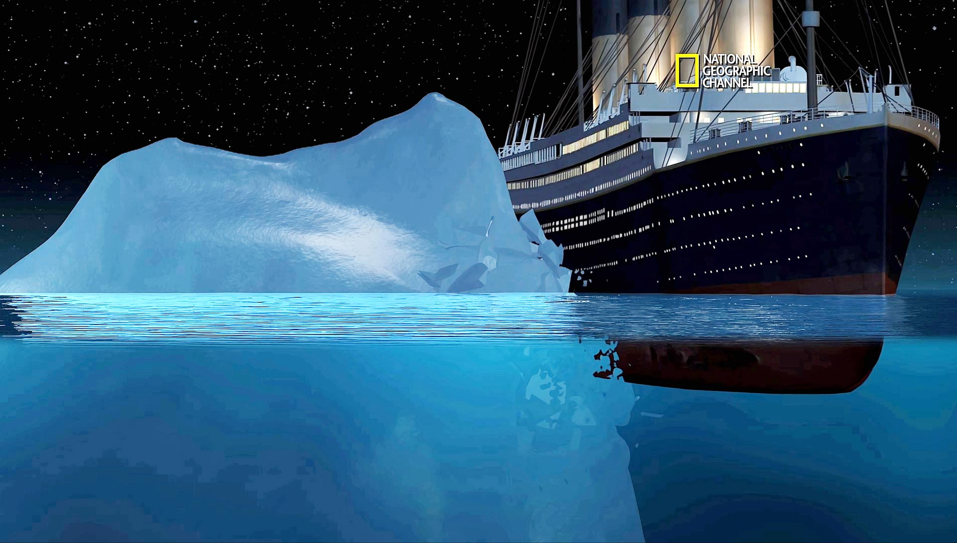
What the hell is that?!!

Slide 3
Data Cube Technology
Data Cube Computation: Basic Concepts
Data Cube Computation Methods
Multidimensional Data Analysis in Cube Space

Slide 4
Cuboids in Data Cube
all
0-D(apex) cuboid
time
item
location
supplier
1-D cuboids
time,item
time,location
item,location
location,supplier
item,supplier
2-D cuboids
time,supplier
time,location,supplier
3-D cuboids
time,item,location
time,item,supplier
item,location,supplier
time, item, location, supplier
4-D(base) cuboid

Slide 5
Cells in Data Cube across Different Dimensional Cuboids
all
Base vs. aggregate cells
(9/15, cheese, Urbana, KRAFT)
(9/15, cheese, Urbana, *)
(*, cheese, Urbana, *)
(*, cheese, *, *)
(*, *, *, *)
Parent vs. child cells
(9/15, *, Urbana, *)
(9/15, cheese, Urbana, *)
OR
(9/15, cheese, Urbana, *)
(9/15, cheese, Urbana, KRAFT)
Ancestor vs. descendant cells
(9/15, *, Urbana., *)
(9/15, cheese, Urbana, KRAFT)
time
item
location
supplier
time,item
time,location
item,location
location,supplier
time,supplier
item,supplier
time,location,supplier
time,item,location
time,item,supplier
item,location,supplier
time, item, location, supplier

Slide 6
Cells in Cuboids of the Same Dimensions
Parent vs. child cells
(9/15, cheese, Illinois, *)
(9/15, cheese, Urbana, *)
Sibling cells
(9/15, cheese, Urbana, *)
(9/15, cheese, Chicago, *)
Reference [see page 77] Multi-Dimensional, Phrase-Based Summarization in Text Cubes
http://sites.computer.org/debull/A16sept/p74.pdf
“Each parent cell is found by changing exactly one non-∗ dimension value in cell c into its parent value.
Each child cell is found by either changing one ∗ value into non-∗ or by replacing it by one of the child values.
Each sibling cell must share one parent with cell c.”

Slide 7

Cube Materialization: Full Cube vs. Iceberg Cube
Full cube vs. iceberg cube
compute cube sales iceberg as
select date, product, city, department, count(*)
from salesInfo
cube by date, product, city
having count(*) >= min support
Compute only the cells whose measure satisfies the iceberg condition
Only a small portion of cells may be “above the water’’ in a sparse cube
Ex.: Show only those cells whose count is no less than 100

Slide 8
Why Iceberg Cube?
Advantages of computing iceberg cubes
No need to save nor show those cells whose value is below the threshold (iceberg condition)
Efficient methods may even avoid computing the un-needed, intermediate cells
Avoid explosive growth
Example: A cube with 100 dimensions
Suppose it contains only 2 base cells: {(a₁, a₂, a₃, …., a₁₀₀), (a₁, a₂, b₃, …, b₁₀₀)}
How many aggregate cells if “having count >= 1”?
Notes:
For {(a₁, a₂, a₃ . . . , a₁₀₀), (a₁, a₂, b₃, . . . , b₁₀₀)}, the total # of non-base cells should be 2 * (2^{100} – 1) – 4.
This is calculated as follows:
(a1, a2, a3 . . . , a100) will generate 2^{100} - 1 non-base cells
(a1, a2, b3, . . . , b100) will generate 2^{100} - 1 non-base cells
Among these, 4 cells are overlapped and thus minus 4 so we get: 2*2^{100} - 2 - 4 = 2*2^{100} - 6
These 4 cells are:
(a1, a2, *, ..., *): 2
(a1, *, *, ..., *): 2
(*, a2, *, ..., *): 2
(*, *, *, ..., *): 2

Slide 9
Why Iceberg Cube?
Advantages of computing iceberg cubes
No need to save nor show those cells whose value is below the threshold (iceberg condition)
Efficient methods may even avoid computing the un-needed, intermediate cells
Avoid explosive growth
Example: A cube with 100 dimensions
Suppose it contains only 2 base cells: {(a₁, a₂, a₃, …., a₁₀₀), (a₁, a₂, b₃, …, b₁₀₀)}
How many aggregate cells if “having count >= 1”?
Answer: (2¹⁰¹ ─ 2) ─ 4
Notes:
For {(a₁, a₂, a₃ . . . , a₁₀₀), (a₁, a₂, b₃, . . . , b₁₀₀)}, the total # of non-base cells should be 2 * (2^{100} – 1) – 4.
This is calculated as follows:
(a1, a2, a3 . . . , a100) will generate 2^{100} - 1 non-base cells
(a1, a2, b3, . . . , b100) will generate 2^{100} - 1 non-base cells
Among these, 4 cells are overlapped and thus minus 4 so we get: 2*2^{100} - 2 - 4 = 2*2^{100} - 6
These 4 cells are:
(a1, a2, *, ..., *): 2
(a1, *, *, ..., *): 2
(*, a2, *, ..., *): 2
(*, *, *, ..., *): 2

Slide 10
Suppose it contains only 2 base cells: {(a₁, a₂, a₃, …., a₁₀₀), (a₁, a₂, b₃, …, b₁₀₀)}
How many aggregate cells if “having count >= 1”?
For {(a₁, a₂, a₃ . . . , a₁₀₀), (a₁, a₂, b₃, . . . , b₁₀₀)}, the total # of non-base cells should be 2 * (2^{100} – 1) – 4.
This is calculated as follows:
(a1, a2, a3 . . . , a100) will generate 2^{100} - 1 non-base cells
(a1, a2, b3, . . . , b100) will generate 2^{100} - 1 non-base cells
Among these, 4 cells are overlapped and thus minus 4 so we get: 2*2^{100} - 2 – 4
These 4 cells are:
(a1, a2, *, ..., *): 2
(a1, *, *, ..., *): 2
(*, a2, *, ..., *): 2
(*, *, *, ..., *): 2

Slide 11
Why Iceberg Cube?
Advantages of computing iceberg cubes
No need to save nor show those cells whose value is below the threshold (iceberg condition)
Efficient methods may even avoid computing the un-needed, intermediate cells
Avoid explosive growth
Example: A cube with 100 dimensions
Suppose it contains only 2 base cells: {(a₁, a₂, a₃, …., a₁₀₀), (a₁, a₂, b₃, …, b₁₀₀)}
How many aggregate cells if “having count >= 1”?
Answer: (2¹⁰¹ ─ 2) ─ 4
What about the iceberg cells, (i.e., with condition: “having count >= 2”)?
Notes:
For {(a₁, a₂, a₃ . . . , a₁₀₀), (a₁, a₂, b₃, . . . , b₁₀₀)}, the total # of non-base cells should be 2 * (2^{100} – 1) – 4.
This is calculated as follows:
(a1, a2, a3 . . . , a100) will generate 2^{100} - 1 non-base cells
(a1, a2, b3, . . . , b100) will generate 2^{100} - 1 non-base cells
Among these, 4 cells are overlapped and thus minus 4 so we get: 2*2^{100} - 2 - 4 = 2*2^{100} - 6
These 4 cells are:
(a1, a2, *, ..., *): 2
(a1, *, *, ..., *): 2
(*, a2, *, ..., *): 2
(*, *, *, ..., *): 2

Slide 12
Suppose it contains only 2 base cells: {(a₁, a₂, a₃, …., a₁₀₀), (a₁, a₂, b₃, …, b₁₀₀)}
How many iceberg cells if “having count >= 2”?
For {(a₁, a₂, a₃ . . . , a₁₀₀), (a₁, a₂, b₃, . . . , b₁₀₀)}, the total # of non-base cells should be 2 * (2^{100} – 1) – 4.
This is calculated as follows:
(a1, a2, a3 . . . , a100) will generate 2^{100} - 1 non-base cells
(a1, a2, b3, . . . , b100) will generate 2^{100} - 1 non-base cells
Among these, 4 cells are overlapped and thus minus 4 so we get: 2*2^{100} - 2 – 4
These 4 cells are:
(a1, a2, *, ..., *): 2
(a1, *, *, ..., *): 2
(*, a2, *, ..., *): 2
(*, *, *, ..., *): 2

Slide 13
Why Iceberg Cube?
Advantages of computing iceberg cubes
No need to save nor show those cells whose value is below the threshold (iceberg condition)
Efficient methods may even avoid computing the un-needed, intermediate cells
Avoid explosive growth
Example: A cube with 100 dimensions
Suppose it contains only 2 base cells: {(a₁, a₂, a₃, …., a₁₀₀), (a₁, a₂, b₃, …, b₁₀₀)}
How many aggregate cells if “having count >= 1”?
Answer: (2¹⁰¹ ─ 2) ─ 4
What about the iceberg cells, (i.e., with condition: “having count >= 2”)?
Answer: 4
Notes:
For {(a₁, a₂, a₃ . . . , a₁₀₀), (a₁, a₂, b₃, . . . , b₁₀₀)}, the total # of non-base cells should be 2 * (2^{100} – 1) – 4.
This is calculated as follows:
(a1, a2, a3 . . . , a100) will generate 2^{100} - 1 non-base cells
(a1, a2, b3, . . . , b100) will generate 2^{100} - 1 non-base cells
Among these, 4 cells are overlapped and thus minus 4 so we get: 2*2^{100} - 2 - 4 = 2*2^{100} - 6
These 4 cells are:
(a1, a2, *, ..., *): 2
(a1, *, *, ..., *): 2
(*, a2, *, ..., *): 2
(*, *, *, ..., *): 2

Slide 14
Is Iceberg Cube Good Enough? Closed Cube & Cube Shell
Let cube P have only 2 base cells: {(a₁, a₂, a₃ . . . , a₁₀₀):10, (a₁, a₂, b₃, . . . , b₁₀₀):10}
How many cells will the iceberg cube contain if “having count(*) ≥ 10”?
Answer: 2¹⁰¹ ─ 4 (still too big!)

Slide 15
Is Iceberg Cube Good Enough? Closed Cube & Cube Shell
Let cube P have only 2 base cells: {(a₁, a₂, a₃ . . . , a₁₀₀):10, (a₁, a₂, b₃, . . . , b₁₀₀):10}
How many cells will the iceberg cube contain if “having count(*) ≥ 10”?
Answer: 2¹⁰¹ ─ 4 (still too big!)
Close cube:
A cell c is closed if there exists no cell d, such that d is a descendant of c, and d has the same measure value as c
Ex. The same cube P has only 3 closed cells:
{(a₁, a₂, *, …, *): 20, (a₁, a₂, a₃ . . . , a₁₀₀): 10, (a₁, a₂, b₃, . . . , b₁₀₀): 10}
A closed cube is a cube consisting of only closed cells

Slide 16
Is Iceberg Cube Good Enough? Closed Cube & Cube Shell
Let cube P have only 2 base cells: {(a₁, a₂, a₃ . . . , a₁₀₀):10, (a₁, a₂, b₃, . . . , b₁₀₀):10}
How many cells will the iceberg cube contain if “having count(*) ≥ 10”?
Answer: 2¹⁰¹ ─ 4 (still too big!)
Close cube:
A cell c is closed if there exists no cell d, such that d is a descendant of c, and d has the same measure value as c
Ex. The same cube P has only 3 closed cells:
{(a₁, a₂, *, …, *): 20, (a₁, a₂, a₃ . . . , a₁₀₀): 10, (a₁, a₂, b₃, . . . , b₁₀₀): 10}
A closed cube is a cube consisting of only closed cells
Cube Shell: The cuboids involving only a small # of dimensions, e.g., 2
Idea: Only compute cube shells, other dimension combinations can be computed on the fly

Slide 17
Data Cube Technology
Data Cube Computation: Basic Concepts
Data Cube Computation Methods
Multidimensional Data Analysis in Cube Space

Slide 18
Roadmap for Efficient Computation
General computation heuristics (Agarwal et al.’96)
Computing full/iceberg cubes: 3 methodologies
Bottom-Up:
Multi-way array aggregation (Zhao, Deshpande & Naughton, SIGMOD’97)
Top-down:
BUC (Beyer & Ramarkrishnan, SIGMOD’99)
Integrating Top-Down and Bottom-Up:
Star-cubing algorithm (Xin, Han, Li & Wah: VLDB’03)
High-dimensional OLAP:
A shell-fragment approach (Li, et al. VLDB’04)
Computing alternative kinds of cubes:
Partial cube, closed cube, approximate cube, ……

Slide 19
Efficient Data Cube Computation: General Heuristics
Sorting, hashing, and grouping operations are applied to the dimension attributes in order to reorder and cluster related tuples
Aggregates may be computed from previously computed aggregates, rather than from the base fact table
Smallest-child: computing a cuboid from the smallest, previously computed cuboid
Cache-results: caching results of a cuboid from which other cuboids are computed to reduce disk I/Os
Amortize-scans: computing as many as possible cuboids at the same time to amortize disk reads
Share-sorts: sharing sorting costs cross multiple cuboids when sort-based method is used
Share-partitions: sharing the partitioning cost across multiple cuboids when hash-based algorithms are used
S. Agarwal, R. Agrawal, P. M. Deshpande, A. Gupta, J. F. Naughton, R. Ramakrishnan, S. Sarawagi. On the computation of multidimensional aggregates. VLDB’96

Slide 20
Cube Computation: Multi-Way Array Aggregation (MOLAP)
Bottom-up: Partition a huge sparse array into chunks (a small subcube which fits in memory) and aggregation.
Data addressing: Compressed sparse array addressing (chunk_id, offset)
Compute aggregates in “multiway” by visiting cube cells in the order which minimizes the # of times to visit each cell, and reduces memory access and storage cost
C
What is the best traversing order to do multi-way aggregation?
ABC → AB, BC and AC
c2
c3
61
62
63
64
c1
45
46
47
48
c 0
29
30
31
32
B
60
b3
13
14
15
16
44
-
-
-
28
b2
9
56
B
-
-
-
40
A: 40 (location),
B: 400 (item),
C: 4,000 (time)
b1
5
24
52
36
1
2
3
4
20
b0
a0
a1
a2
a3
A

Slide 21
Multi-way Array Aggregation (3-D to 2-D)
How much memory cost of computation (aggregation for AB, AC, BC planes) can we save?
4x4x4 chunks
Entire AB plane: 40 * 400
= 16,000
One chunk of BC plane:
(400/4) * (4,000/4)
= 100,000
A: 40 (location),
B: 400 (item),
C: 4,000 (time)
Min memory size: ?
< 40*400 + 400*4,000 + 40 * 4,000
= 1,776,000
One column of AC plane:
40 * (4,000/4) = 40,000

Slide 22
Multi-way Array Aggregation (3-D to 2-D)
How to minimizes the memory requirement and reduced I/Os?
Keep the smallest plane in main memory
Fetch and compute only one chunk at a time for the largest plane
The planes should be sorted and computed according to their size in ascending order
4x4x4 chunks
Entire AB plane: 40 * 400
= 16,000
One chunk of BC plane:
(400/4) * (4,000/4)
= 100,000
A: 40 (location),
B: 400 (item),
C: 4,000 (time)
Min memory size: ?
< 40*400 + 400*4,000 + 40 * 4,000
= 1,776,000
One column of AC plane:
40 * (4,000/4) = 40,000

Slide 23
BC planes: 400 * 4,000
C
(400/4) * (4,000/4)
aggregate([1][2][3][4])
B
b₀
c₀
(400/4) * (4,000/4)
aggregate([5][6][7][8])
b₁
c₀
One chunk

Slide 24
AC planes: 40 * 4,000
(40/4) * (4,000/4)
aggregate([17][21][25][29])
c₁
…
…
…
c₀
C
One column
4 * (40/4) * (4,000/4)
= 40 * (4,000/4)
(40/4) * (4,000/4)
aggregate([2][6][10][14])
(40/4) * (4,000/4)
aggregate([3][7][11][15])
(40/4) * (4,000/4)
aggregate([1][5][9][13])
(40/4) * (4,000/4)
aggregate([4][8][12][16])
c₀
A
a₀
…
a₃

Slide 25
Multi-way Array Aggregation (3-D to 2-D)
How to minimizes the memory requirement and reduced I/Os?
Keep the smallest plane in main memory
Fetch and compute only one chunk at a time for the largest plane
The planes should be sorted and computed according to their size in ascending order
4x4x4 chunks
Entire AB plane: 40 * 400
= 16,000
One chunk of BC plane:
(400/4) * (4,000/4)
= 100,000
A: 40 (location),
B: 400 (item),
C: 4,000 (time)
Min memory size: 156,000
< 40*400 + 400*4,000 + 40 * 4,000
= 1,776,000
One column of AC plane:
40 * (4,000/4) = 40,000

Slide 26
Multi-Way Array Aggregation
Array-based “bottom-up” algorithm (from ABC to AB,…)
Using multi-dimensional chunks
Simultaneous aggregation on multiple dimensions
Intermediate aggregate values are re-used for computing ancestor cuboids
Cannot do Apriori pruning: No iceberg optimization
Comments on the method
Efficient for computing the full cube for a small number of dimensions
If there are a large number of dimensions, “top-down” computation and iceberg cube computation methods (e.g., BUC) should be used
Zhao, Deshpande & Naughton. An Array-Based Algorithm for Simultaneous Multidimensional Aggregates . SIGMOD’97

Slide 27
Cube Computation: Computing in Reverse Order
BUC (Beyer & Ramakrishnan, SIGMOD’99)
BUC: acronym of Bottom-Up (cube) Computation
(Note: It is “top-down” in our view since we put Apex cuboid on the top!)
Divides dimensions into partitions and facilitates iceberg pruning (it works now!)
If a partition does not satisfy min_sup, its descendants can be pruned
If min_sup = 1 Þ compute full CUBE!
No simultaneous aggregation

Slide 28
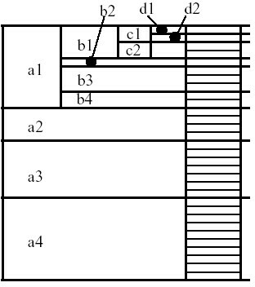
BUC: Partitioning and Aggregating
Usually, entire data set cannot fit in main memory
Sort distinct values
partition into blocks that fit
Continue processing
Optimizations
Partitioning
External Sorting, Hashing, Counting Sort
Ordering dimensions to encourage pruning
Cardinality, Skew, Correlation
Collapsing duplicates
Cannot do holistic aggregates anymore!

Slide 29
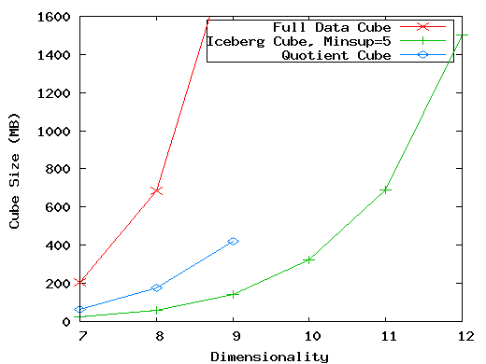
High-Dimensional OLAP? — The Curse of Dimensionality
High-D OLAP: Needed in many applications
Science and engineering analysis
Bio-data analysis: thousands of genes
Statistical surveys: hundreds of variables
None of the previous cubing method can handle high dimensionality!
Iceberg cube and compressed cubes: only delay the inevitable explosion
Full materialization: still significant overhead in accessing results on disk
A shell-fragment approach: X. Li, J. Han, and H. Gonzalez, High-Dimensional OLAP: A Minimal Cubing Approach, VLDB'04
A curse of dimensionality: A database of 600,000 tuples. Each dimension has cardinality of 100 and zipf of 2.

Slide 30
Fast High-Dimensional OLAP with Minimal Cubing
Observation: OLAP occurs only on a small subset of dimensions at a time
Semi-Online Computational Model
Partition the set of dimensions into shell fragments
Compute data cubes for each shell fragment while retaining inverted indices or value-list indices
Given the pre-computed fragment cubes, dynamically compute cube cells of the high-dimensional data cube online
Major idea: Tradeoff between the amount of pre-computation and the speed of online computation
Reducing computing high-dimensional cube into pre-computing a set of lower dimensional cubes
Online re-construction of original high-dimensional space
Lossless reduction

Slide 31
Computing a 5-D Cube with 2-Shell Fragments
Example: Let the cube aggregation function be count
Divide the 5-D table into
2 shell fragments:
(A, B, C) and (D, E)
Build traditional invert index (TID)
or RID list
tid | A | B | C | D | E
1 | a1 | b1 | c1 | d1 | e1
2 | a1 | b2 | c1 | d2 | e1
3 | a1 | b2 | c1 | d1 | e2
4 | a2 | b1 | c1 | d1 | e2
5 | a2 | b1 | c1 | d1 | e3
Attribute Value | TID List | List Size
a1 | 1 2 3 | 3
a2 | 4 5 | 2
b1 | 1 4 5 | 3
b2 | 2 3 | 2
c1 | 1 2 3 4 5 | 5
d1 | 1 3 4 5 | 4
d2 | 2 | 1
e1 | 1 2 | 2
e2 | 3 4 | 2
e3 | 5 | 1

Slide 32
Shell Fragment Cubes: Ideas
Generalize the 1-D inverted indices to multi-dimensional inverted indices in the data cube sense
Compute all cuboids for data cubes ABC and DE while retaining the inverted indices
Attribute Value | TID List | List Size
a1 | 1 2 3 | 3
a2 | 4 5 | 2
b1 | 1 4 5 | 3
b2 | 2 3 | 2
c1 | 1 2 3 4 5 | 5
d1 | 1 3 4 5 | 4
d2 | 2 | 1
e1 | 1 2 | 2
e2 | 3 4 | 2
e3 | 5 | 1
Cell | Intersection | TID List | List Size
a1 b1 | 1 2 3 ∩ 1 4 5 | 1 | 1
a1 b2 | 1 2 3 ∩ 2 3 | 2 3 | 2
a2 b1 | 4 5 ∩ 1 4 5 | 4 5 | 2
a2 b2 | 4 5 ∩ 2 3 | φ | 0
Cell | Intersection | TID List | List Size
d1 e1 | ? | ? | ?
d1 e2 | ? | ? | ?
d1 e3 | ? | ? | ?
d2 e1 | ? | ? | ?
Answer: http://hanj.cs.illinois.edu/pdf/vldb04_hdolap.pdf

Slide 33
Shell Fragment Cubes: Size and Design
Given a database of T tuples, D dimensions, and F shell fragment size, the fragment cubes’ space requirement is:
For F < 5, the growth is sub-linear
Shell fragments do not have to be disjoint
Fragment groupings can be arbitrary to allow for maximum online performance
Known common combinations (e.g.,<city, state>) should be grouped together
Shell fragment sizes can be adjusted for optimal balance between offline and online computation

Slide 34
Data Cube Technology
Data Cube Computation: Basic Concepts
Data Cube Computation Methods
Multidimensional Data Analysis in Cube Space

Slide 35
Data Mining in Cube Space
Data cube greatly increases the analysis bandwidth
Four ways to interact OLAP-styled analysis and data mining
Using cube space to define data space for mining
Using OLAP queries to generate features and targets for mining, e.g., multi-feature cube
Using data-mining models as building blocks in a multi-step mining process, e.g., prediction cube
Using data-cube computation techniques to speed up repeated model construction
Cube-space data mining may require building a model for each candidate data space
Sharing computation across model-construction for different candidates may lead to efficient mining

Slide 36
Complex Aggregation at Multiple Granularities: Multi-Feature Cubes
Multi-feature cubes (Ross, et al. 1998): Compute complex queries involving multiple dependent aggregates at multiple granularities
Ex. Grouping by all subsets of {item, region, month}, find the maximum price in 2010 for each group, and the total sales among all maximum price tuples
select item, region, month, max(price), sum(R.sales)
from purchases
where year = 2010
cube by item, region, month: R
such that R.price = max(price)
Continuing the last example, among the max price tuples, find the min and max shelf life, and find the fraction of the total sales due to tuple that have min shelf life within the set of all max price tuples

Slide 37
Discovery-Driven Exploration of Data Cubes
Discovery-driven exploration of huge cube space (Sarawagi, et al.’98)
Effective navigation of large OLAP data cubes
Pre-compute measures indicating exceptions, guide user in the data analysis, at all levels of aggregation
Exception: significantly different from the value anticipated, based on a statistical model
Visual cues such as background color are used to reflect the degree of exception of each cell
Kinds of exceptions
SelfExp: represents the surprise value of the cell relative to other cells at same level of aggregation
InExp: represents the degree of surprise somewhere beneath this cell if we drill down from the cell
PathExp: represents the degree of surprise for each drill-down path from the cell

Slide 38
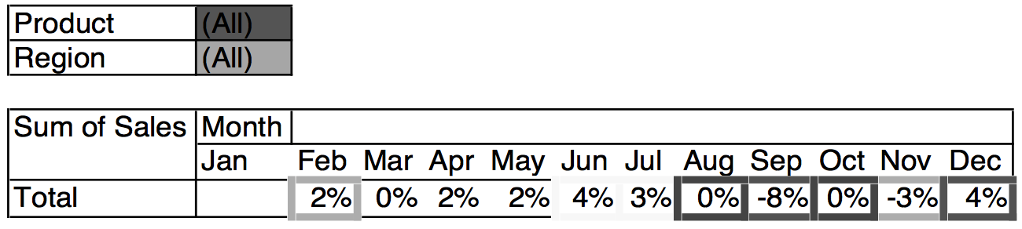
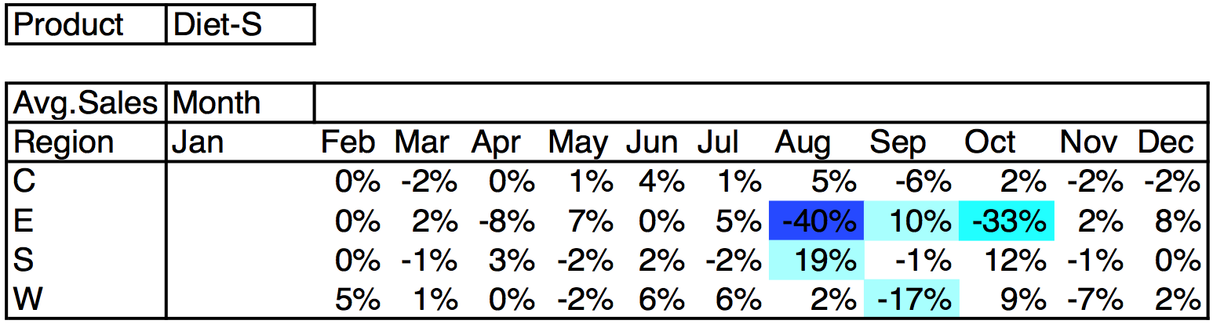
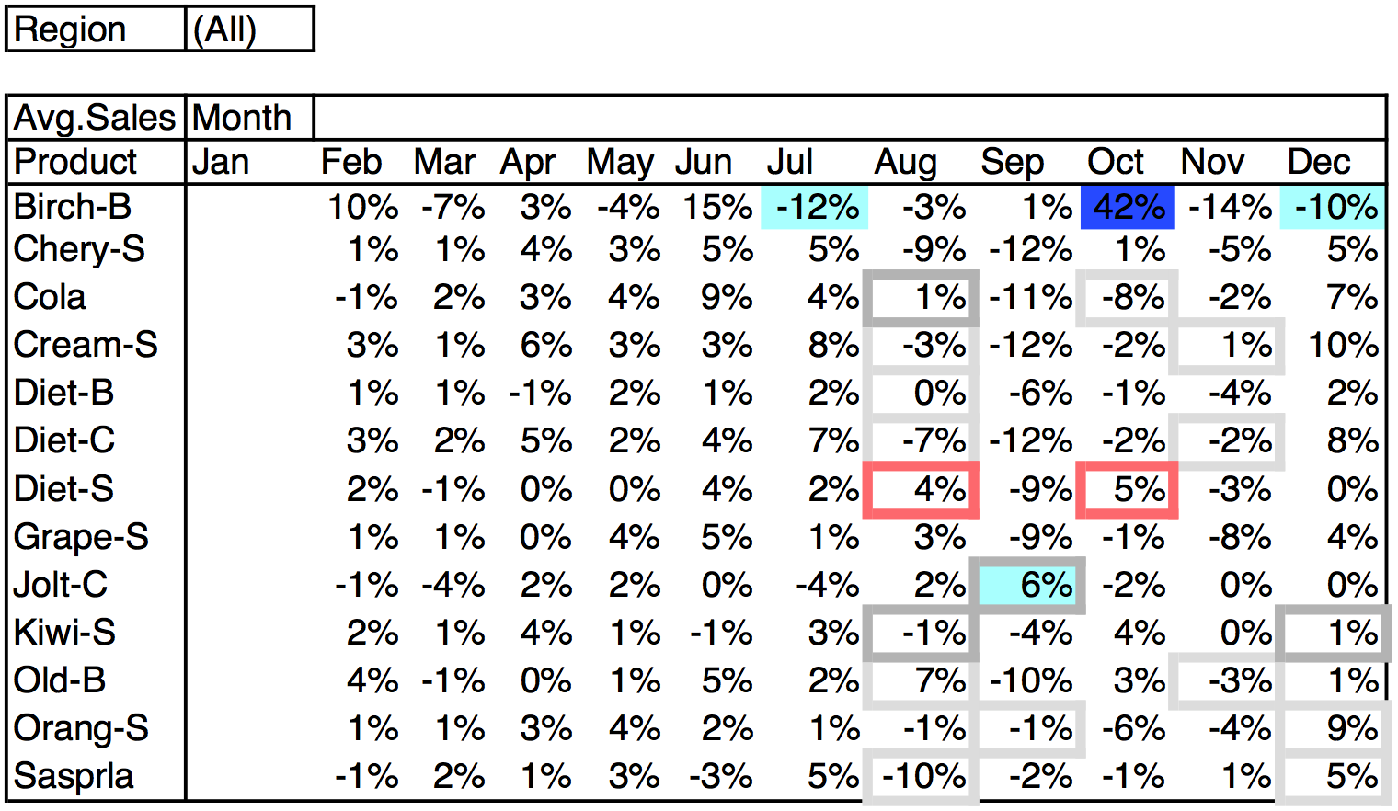
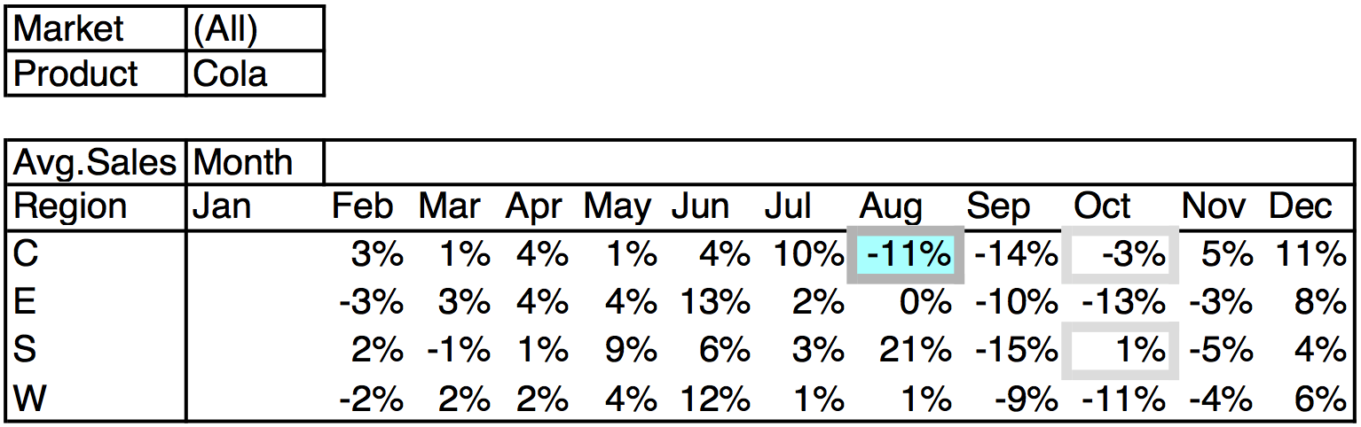
Exceptions: SelfExp, InExp, PathExp
SelfExp
InExp

Slide 39
Summary
Data Cube Computation: Preliminary Concepts
Data Cube Computation Methods
Multi-Way Array Aggregation
BUC
High-Dimensional OLAP with Shell-Fragments
Multidimensional Data Analysis in Cube Space
Multi-feature Cubes
Discovery-Driven Exploration of Data Cubes

Slide 40
References
S. Agarwal, R. Agrawal, P. M. Deshpande, A. Gupta, J. F. Naughton, R. Ramakrishnan, and S. Sarawagi. On the computation of multidimensional aggregates. VLDB’96
K. Beyer and R. Ramakrishnan. Bottom-Up Computation of Sparse and Iceberg CUBEs.. SIGMOD’99
J. Han, J. Pei, G. Dong, K. Wang. Efficient Computation of Iceberg Cubes With Complex Measures. SIGMOD’01
L. V. S. Lakshmanan, J. Pei, and J. Han, Quotient Cube: How to Summarize the Semantics of a Data Cube, VLDB'02
X. Li, J. Han, and H. Gonzalez, High-Dimensional OLAP: A Minimal Cubing Approach, VLDB'04
X. Li, J. Han, Z. Yin, J.-G. Lee, Y. Sun, “Sampling Cube: A Framework for Statistical OLAP over Sampling Data”, SIGMOD’08
K. Ross and D. Srivastava. Fast computation of sparse datacubes. VLDB’97
D. Xin, J. Han, X. Li, B. W. Wah, Star-Cubing: Computing Iceberg Cubes by Top-Down and Bottom-Up Integration, VLDB'03
Y. Zhao, P. M. Deshpande, and J. F. Naughton. An array-based algorithm for simultaneous multidimensional aggregates. SIGMOD’97
D. Burdick, P. Deshpande, T. S. Jayram, R. Ramakrishnan, and S. Vaithyanathan. OLAP over uncertain and imprecise data. VLDB’05

Slide 41
References (cont.)
R. Agrawal, A. Gupta, and S. Sarawagi. Modeling multidimensional databases. ICDE’97
B.-C. Chen, L. Chen, Y. Lin, and R. Ramakrishnan. Prediction cubes. VLDB’05
B.-C. Chen, R. Ramakrishnan, J.W. Shavlik, and P. Tamma. Bellwether analysis: Predicting global aggregates from local regions. VLDB’06
Y. Chen, G. Dong, J. Han, B. W. Wah, and J. Wang, Multi-Dimensional Regression Analysis of Time-Series Data Streams, VLDB'02
R. Fagin, R. V. Guha, R. Kumar, J. Novak, D. Sivakumar, and A. Tomkins. Multi-structural databases. PODS’05
J. Han. Towards on-line analytical mining in large databases. SIGMOD Record, 27:97–107, 1998
T. Imielinski, L. Khachiyan, and A. Abdulghani. Cubegrades: Generalizing association rules. Data Mining & Knowledge Discovery, 6:219–258, 2002.
R. Ramakrishnan and B.-C. Chen. Exploratory mining in cube space. Data Mining and Knowledge Discovery, 15:29–54, 2007.
K. A. Ross, D. Srivastava, and D. Chatziantoniou. Complex aggregation at multiple granularities. EDBT'98
S. Sarawagi, R. Agrawal, and N. Megiddo. Discovery-driven exploration of OLAP data cubes. EDBT'98
G. Sathe and S. Sarawagi. Intelligent Rollups in Multidimensional OLAP Data. VLDB'01

