Slide 1

Chapter 8. Classification: Ensembles
Meng Jiang
CSE 40647/60647 Data Science Fall 2017
Introduction to Data Mining

Slide 2
Turing Award Recipients
… | … | …
1998 | Jim Gray | For seminal contributions to database and transaction processing research…
1999 | Frederick P. Brooks, Jr. | For landmark contributions to computer architecture, operating systems, and software engineering…
2000 | Andrew Chi-Chih Yao | Theory of computation, pseudorandom number generation, cryptography, and communication complexity…
2001 | Ole-Johan Dahl Kristen Nygaard | Object-oriented programming, Simula I and Simula 67…
2002 | Ronald L. Rivest, Adi Shamir, Leonard M. Adleman | For their ingenious contribution for making public-key cryptography useful in practice.
2003 | Alan Kay | Contemporary object-oriented programming languages…
2004 | Vinton G. Cerf Robert E. Kahn | Internetworking, including the design and implementation of the Internet's basic communications protocols, TCP/IP…
2005 | Peter Naur | Programming language design, ALGOL 60, compiler design…
2006 | Frances E. Allen | Optimizing compiler techniques…

Slide 3
Turing Award Recipients (cont.)
2007 | Edmund M. Clarke, E. Allen Emerson and Joseph Sifakis | For their roles in developing model checking into a highly effective verification technology, widely adopted in the hardware and software industries…
2008 | Barbara Liskov | Programming language and system design…
2009 | Charles P. Thacker | Xerox Alto, the 1st modern PC, Ethernet and Tablet PC.…
2010 | Leslie G. Valiant | Theory of computation…
2011 | Judea Pearl | Artificial intelligence through the development of a calculus for probabilistic and causal reasoning…
2012 | Silvio Micali Shafi Goldwasser | Transformative work that laid the complexity-theoretic foundations for the science of cryptography…
2013 | Leslie Lamport | Contributed to distributed and concurrent systems…
2014 | Michael Stonebraker | Concepts underlying modern database systems…
2015 | Martin E. Hellman Whitfield Diffie | Introduced public-key cryptography, the foundation for the most regularly-used security protocols on the Internet…
2016 | Tim Berners-Lee | Invented the World Wide Web and the first web browser…

Slide 4
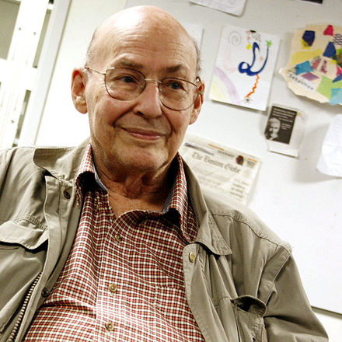
Marvin Minsky
Marvin Lee Minsky (August 9, 1927 – January 24, 2016) was an American cognitive scientist concerned largely with research of artificial intelligence (AI), co-founder of the Massachusetts Institute of Technology‘s AI laboratory, and author of several texts concerning AI and philosophy.
Awards
Turing Award (1969)
Japan Prize (1990)
IJCAI Award for Research Excellence (1991)
Benjamin Franklin Medal (2001)
Computer History Museum Fellow (2006)
BBVA Foundation Frontiers of Knowledge Award (2013)

Slide 5
Logical vs.Analogical or Symbolic vs. Connectionist or Neat vs. Scruffy
https://web.media.mit.edu/~minsky/papers/SymbolicVs.Connectionist.html
Marvin Minsky
In Artificial Intelligence at MIT, Expanding Frontiers, Patrick H. Winston (Ed.), Vol.1, MIT Press, 1990. Reprinted in AI Magazine, Summer 1991.

Slide 6
Ensembles
“To solve really hard problems, we’ll have to use several different representations…
It is time to stop arguing over which type of pattern-classification technique is best...
Instead we should work at a higher level of organization and discover how to build managerial systems to exploit the different virtues and evade the different limitations of each of these ways of comparing things.” [Minsky, 1991]

Slide 7
Ensembles (cont.)
An ensemble is a set of classifiers that learn a target function, and their individual predictions are combined (weighted or unweighted) to classify new examples
Each classifier should be more accurate than by chance, and independent of one another.
Usually more accurate than a single classifier.
Ensembles generally improve the generalization performance of a set of classifiers on a domain.

Slide 8
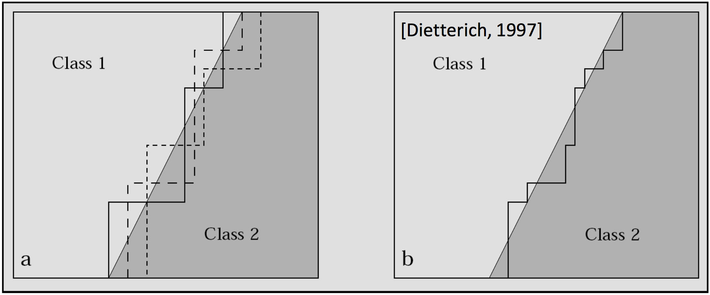
Ensemble Methods
Ensemble methods
Use a combination of models to increase accuracy
Combine a series of k learned models, M₁, M₂, …, M_{k}, with the aim of creating an improved model M*

Slide 9

Ensemble Methods (cont.)
Popular ensemble methods
Bagging: averaging the prediction over a collection of classifiers
Boosting: weighted vote with a collection of classifiers
AdaBoost (Adaptive Boosting): adaptive in the sense that subsequent weak learners are tweaked in favor of those instances misclassified by previous classifiers.

Slide 10
Bagging
Training
Given a data set D of d instances, a classifier model M_{i} is learned for a training set D_{i} of d instances that is sampled with replacement from D (i = 1…k)
As a result of the sampling-with-replacement procedure, each classifier is trained on approximately 63.2% of the training examples
For a dataset with d instances, each instance has a probability of 1 − (1 − 1/d)^{d} of being selected at least once in the d samples.
For d → ∞, this number converges to (1 − 1/𝑒) or 0.632 [Bauer and Kohavi, 1999]

Slide 11
Bagging (cont.)
Classification: classify an unknown sample X
Each classifier M_{i} returns its class prediction
The bagged classifier M* counts the votes and assigns the class with the most votes to X
Accuracy: Proved improved accuracy in prediction
Often significantly better than a single classifier derived from D
Example: (Course Project) Entity type recognition
Features: Triggers in contextual words
Each context setting as a classifier: 1/2/3 contextual words. The probability that the technical term is a “method” (“problem”, “dataset”, “metric”, etc.).
Majority voting
http://www.meng-jiang.com/teaching/TypingDemo.zip

Slide 12
Boosting
Training
Weights are assigned to each training instance
A series of k classifiers is iteratively learned
After a classifier M_{i} is learned, the weights are updated to allow the subsequent classifier, M_{i+1}, to pay more attention to the training instances that were misclassified by M_{i}
Classification
The final M* combines the votes of each individual classifier, where the weight of each classifier’s vote is a function of its accuracy on classifying training instances
Comparing with Bagging: Boosting tends to have greater accuracy, but it risks overfitting the model to misclassified data

Slide 13
AdaBoost (Adaptive Boosting)
Given a set of d class-labeled instances, (X₁, y₁), …, (X_{d}, y_{d})
Initially, all the weights of instances are set the same (1/d)
Generate k classifiers in k rounds. At round i,
Instances from D are sampled with replacement to form a training set D_{i} of the same size
Each instance’s chance of being selected is based on its weight
A classification model M_{i} is derived from D_{i}
Its error rate is calculated using D_{i} as a “test set”
If an instance is misclassified, its weight is increased, otherwise it is decreased

Slide 14
AdaBoost (cont.)
Error rate: err(X_{j}) is the misclassification error of instance X_{j}. Classifier M_{i}’s error rate is the sum of the weights of the misclassified instances:
The weight of classifier M_{i}’s vote is

Slide 15
References
C. Apte and S. Weiss. Data mining with decision trees and decision rules. Future Generation Computer Systems, 13, 1997
P. K. Chan and S. J. Stolfo. Learning arbiter and combiner trees from partitioned data for scaling machine learning. KDD'95
A. J. Dobson. An Introduction to Generalized Linear Models. Chapman & Hall, 1990.
R. O. Duda, P. E. Hart, and D. G. Stork. Pattern Classification, 2ed. John Wiley, 2001
U. M. Fayyad. Branching on attribute values in decision tree generation. AAAI’94.
Y. Freund and R. E. Schapire. A decision-theoretic generalization of on-line learning and an application to boosting. J. Computer and System Sciences, 1997.
J. Gehrke, R. Ramakrishnan, and V. Ganti. Rainforest: A framework for fast decision tree construction of large datasets. VLDB’98.
J. Gehrke, V. Gant, R. Ramakrishnan, and W.-Y. Loh, BOAT -- Optimistic Decision Tree Construction. SIGMOD'99.
T. Hastie, R. Tibshirani, and J. Friedman. The Elements of Statistical Learning: Data Mining, Inference, and Prediction. Springer-Verlag, 2001.
T.-S. Lim, W.-Y. Loh, and Y.-S. Shih. A comparison of prediction accuracy, complexity, and training time of thirty-three old and new classification algorithms. Machine Learning, 2000

Slide 16
References (cont.)
J. Magidson. The Chaid approach to segmentation modeling: Chi-squared automatic interaction detection. In R. P. Bagozzi, editor, Advanced Methods of Marketing Research, Blackwell Business, 1994
M. Mehta, R. Agrawal, and J. Rissanen. SLIQ : A fast scalable classifier for data mining. EDBT'96
T. M. Mitchell. Machine Learning. McGraw Hill, 1997
S. K. Murthy, Automatic Construction of Decision Trees from Data: A Multi-Disciplinary Survey, Data Mining and Knowledge Discovery 2(4): 345-389, 1998
J. R. Quinlan. Induction of decision trees. Machine Learning, 1:81-106, 1986.
J. R. Quinlan. C4.5: Programs for Machine Learning. Morgan Kaufmann, 1993.
J. R. Quinlan. Bagging, boosting, and c4.5. AAAI‘96.
R. Rastogi and K. Shim. Public: A decision tree classifier that integrates building and pruning. VLDB’98
J. Shafer, R. Agrawal, and M. Mehta. SPRINT : A scalable parallel classifier for data mining. VLDB’96
J. W. Shavlik and T. G. Dietterich. Readings in Machine Learning. Morgan Kaufmann, 1990
P. Tan, M. Steinbach, and V. Kumar. Introduction to Data Mining. Addison Wesley, 2005
S. M. Weiss and C. A. Kulikowski. Computer Systems that Learn: Classification and Prediction Methods from Statistics, Neural Nets, Machine Learning, and Expert Systems. Morgan Kaufman, 1991
S. M. Weiss and N. Indurkhya. Predictive Data Mining. Morgan Kaufmann, 1997
I. H. Witten and E. Frank. Data Mining: Practical Machine Learning Tools and Techniques, 2ed. Morgan Kaufmann, 2005

