Slide 1

Chapter 6. Mining Frequent Patterns, Association and Correlations: Basic Concepts and Methods
Meng Jiang
CS412 Summer 2017:
Introduction to Data Mining

Slide 2
Data warehouse (OLAP) vs operational database (OLTP)
Transactions = tuples = samples = instances…
Data cube, data cuboid, cells
Dimension, dimension levels, dimension values
Ex. 3 transactions: (9/15/16, Urbana), (9/15/16, Urbana), (9/15/16, Chicago) → data warehouse. Data cubes. One of cubes = sales
Cube: dimension tables and fact tables (measures).
Dimension = (“time”, “location”)
concept hierarchy of each dimension
time: year-month-date (dimension levels) vs dimension values
location: country-state-city (dimension levels)
One measure = count.
Two base cells: (9/15/16, Urbana): 2, (9/15/16, Chicago)
Base cuboids: (date, city) → (month, city)… not empty
Aggregate cuboids: (*, city), (year, *); Apex cuboid: (*, *)

Slide 3
Mining Frequent Patterns, Association and Correlations: Basic Concepts and Methods
Basic Concepts
Frequent Pattern (Itemset) Mining Methods
Pattern Evaluation Methods

Slide 4
Pattern Discovery: Definition
What are patterns?
Patterns: A set of items, subsequences, or substructures that occur frequently together (or strongly correlated) in a data set
Patterns represent intrinsic and important properties of datasets
Pattern discovery: Uncovering patterns from massive data
Motivation examples:
What products were often purchased together?
What are the subsequent purchases after buying an iPad?
What code segments likely contain copy-and-paste bugs?
What word sequences likely form phrases in this corpus?

Slide 5
Pattern Discovery: Why Is It Important?
Finding inherent regularities in a data set
Foundation for many essential data mining tasks
Association, correlation, and causality analysis
Mining sequential, structural (e.g., sub-graph) patterns
Pattern analysis in spatiotemporal, multimedia, time-series, and stream data
Classification: Discriminative pattern-based analysis
Cluster analysis: Pattern-based subspace clustering
Broad applications
Market basket analysis, cross-marketing, catalog design, sale campaign analysis, Web log analysis, biological sequence analysis

Slide 6
Frequent Patterns (Itemsets)
Itemset: A set of one or more items
k-itemset: X = {x₁, …, x_{k}}
(absolute) support (count) of X: Frequency or the number of occurrences of an itemset X
(relative) support, s: The fraction of transactions that contains X (i.e., the probability that a transaction contains X)
An itemset X is frequent if the support of X is no less than a minsup threshold
Tid | Items bought
10 | Beer, Nuts, Diaper
20 | Beer, Coffee, Diaper
30 | Beer, Diaper, Eggs
40 | Nuts, Eggs, Milk
50 | Nuts, Coffee, Diaper, Eggs, Milk
Let minsup = 50%
Freq. 1-itemsets:
Beer: 3 (60%); Nuts: 3 (60%)
Diaper: 4 (80%); Eggs: 3 (60%)
Freq. 2-itemsets:
{Beer, Diaper}: 3 (60%)

Slide 7
From Frequent Itemsets to Association Rules
Association rules: X → Y (s, c)
Support, s: The probability that a transaction contains X ∪ Y
Confidence, c: The conditional probability that a transaction containing X also contains Y
c = sup(X ∪ Y) / sup(X)
Association rule mining: Find all of the rules, X → Y, with minimum support and confidence
Frequent itemsets: Let minsup = 50%
Freq. 1-itemsets: Beer: 3, Nuts: 3, Diaper: 4, Eggs: 3
Freq. 2-itemsets: {Beer, Diaper}: 3
Association rules: Let minconf = 50%
Beer → Diaper (60%, 100%)
Diaper → Beer (60%, 75%)
Tid | Items bought
10 | Beer, Nuts, Diaper
20 | Beer, Coffee, Diaper
30 | Beer, Diaper, Eggs
40 | Nuts, Eggs, Milk
50 | Nuts, Coffee, Diaper, Eggs, Milk
Containing both
Containing diaper
Beer
{Beer} ∪ {Diaper}
Diaper
Containing beer
{Beer} ∪ {Diaper} = {Beer, Diaper}
Note: Itemset: X ∪ Y, a subtle notation!

Slide 8
Challenge: There Are Too Many Frequent Patterns!
A long pattern contains a combinatorial number of sub-patterns
How many frequent itemsets does the following TDB₁ contain?
TDB₁: T₁: {a₁, …, a₅₀}; T₂: {a₁, …, a₁₀₀}
Assuming (absolute) minsup = 1
Let’s have a try
1-itemsets: {a₁}: 2, {a₂}: 2, …, {a₅₀}: 2, {a₅₁}: 1, …, {a₁₀₀}: 1,
2-itemsets: {a₁, a₂}: 2, …, {a₁, a₅₀}: 2, {a₁, a₅₁}: 1 …, …, {a₉₉, a₁₀₀}: 1, …
99-itemsets: {a₁, a₂, …, a₉₉}: 1, …, {a₂, a₃, …, a₁₀₀}: 1
100-itemset: {a₁, a₂, …, a₁₀₀}: 1
In total: (¹⁰⁰₁) + (¹⁰⁰₂) + … + (¹⁰⁰₁₀₀) = 2¹⁰⁰ – 1 sub-patterns!
A too huge set for any computer to compute or store!

Slide 9
Expressing Patterns in Compressed Form: Closed Patterns
How to handle such a challenge?
Solution 1: Closed patterns: A pattern (itemset) X is closed if X is frequent, and there exists no super-pattern Y כ X, with the same support as X
Let Transaction DB TDB₁: T₁: {a₁, …, a₅₀}; T₂: {a₁, …, a₁₀₀}
Suppose minsup = 1. How many closed patterns does TDB₁ contain?
Two: P₁: “{a₁, …, a₅₀}: 2”; P₂: “{a₁, …, a₁₀₀}: 1”
Closed pattern is a lossless compression of frequent patterns
Reduces the # of patterns but does not lose the support information!
You will still be able to say: “{a₂, …, a₄₀}: 2”, “{a₅, a₅₁}: 1”

Slide 10
Expressing Patterns in Compressed Form: Max-Patterns
Solution 2: Max-patterns: A pattern X is a max-pattern if X is frequent and there exists no frequent super-pattern Y כ X, with the same support as X
Difference from close-patterns?
Do not care the real support of the sub-patterns of a max-pattern
Let Transaction DB TDB₁: T₁: {a₁, …, a₅₀}; T₂: {a₁, …, a₁₀₀}
Suppose minsup = 1. How many max-patterns does TDB₁ contain?
One: P: “{a₁, …, a₁₀₀}: 1”
Max-pattern is a lossy compression!
We only know {a₁, …, a₄₀} is frequent
But we do not know the real support of {a₁, …, a₄₀}, …, any more!
Thus in many applications, mining closed-patterns is more desirable than mining max-patterns

Slide 11
Transaction, itemset
Pattern (itemset), min_sup (abs. rel.)
Frequent pattern (itemset)
Association rules: item → item (sup, conf.)
Min_sup, min_conf
Number of frequent patterns: huge
Compression:
Closed pattern (lossless)
Max pattern (lossy)

Slide 12
Mining Frequent Patterns, Association and Correlations: Basic Concepts and Methods
Basic Concepts
Frequent Pattern (Itemset) Mining Methods
Pattern Evaluation Methods

Slide 13
Efficient Pattern Mining Methods
The Downward Closure Property of Frequent Patterns
The Apriori Algorithm
Extensions or Improvements of Apriori
Mining Frequent Patterns by Exploring Vertical Data Format
FPGrowth: A Frequent Pattern-Growth Approach

Slide 14
The Downward Closure Property of Frequent Patterns
Observation: From TDB_{1:} T₁: {a₁, …, a₅₀}; T₂: {a₁, …, a₁₀₀}
We get a frequent itemset: {a₁, …, a₅₀}
Also, its subsets are all frequent: {a₁}, {a₂}, …, {a₅₀}, {a₁, a₂}, …, {a₁, …, a₄₉}, …
There must be some hidden relationships among frequent patterns!
The downward closure (also called “Apriori”) property of frequent patterns
If {beer, diaper, nuts} is frequent, so is {beer, diaper}
Every transaction containing {beer, diaper, nuts} also contains {beer, diaper}
Apriori: Any subset of a frequent itemset must be frequent
Efficient mining methodology
If any subset of an itemset S is infrequent, then there is no chance for S to be frequent—why do we even have to consider S!?
A sharp knife for pruning!

Slide 15
Apriori Pruning and Scalable Mining Methods
Apriori pruning principle: If there is any itemset which is infrequent, its superset should not even be generated! (Agrawal & Srikant @VLDB’94, Mannila, et al. @ KDD’ 94)
Scalable mining Methods: Three major approaches
Level-wise, join-based approach: Apriori (Agrawal & Srikant@VLDB’94)
Vertical data format approach: Eclat (Zaki, Parthasarathy, Ogihara, Li @KDD’97)
Frequent pattern projection and growth: FPgrowth (Han, Pei, Yin @SIGMOD’00)

Slide 16
Apriori: A Candidate Generation & Test Approach
Outline of Apriori (level-wise, candidate generation and test)
Initially, scan DB once to get frequent 1-itemset
Repeat
Generate length-(k+1) candidate itemsets from length-k frequent itemsets
Test the candidates against DB to find frequent (k+1)-itemsets
Set k := k +1
Until no frequent or candidate set can be generated
Return all the frequent itemsets derived

Slide 17
The Apriori Algorithm (Pseudo-Code)
C_{k}: Candidate itemset of size k
F_{k} : Frequent itemset of size k
K := 1;
F_{k} := {frequent items}; // frequent 1-itemset
While (F_{k} != ∅) do { // when F_{k} is non-empty
C_{k+1} := candidates generated from F_{k}; // candidate generation
Derive F_{k+1} by counting candidates in C_{k+1} with respect to TDB at minsup;
k := k + 1
}
return ∪_{k} F_{k} // return F_{k} generated at each level

Slide 18
The Apriori Algorithm: An Example
Database TDB
minsup = 2
Itemset | sup
{A} | 2
{B} | 3
{C} | 3
{D} | 1
{E} | 3
Itemset | sup
{A} | 2
{B} | 3
{C} | 3
{E} | 3
F₁
Tid | Items
10 | A, C, D
20 | B, C, E
30 | A, B, C, E
40 | B, E
C₁
1st scan
F₂
Itemset | sup
{A, C} | 2
{B, C} | 2
{B, E} | 3
{C, E} | 2
C₂
Itemset | sup
{A, B} | 1
{A, C} | 2
{A, E} | 1
{B, C} | 2
{B, E} | 3
{C, E} | 2
C₂
Itemset
{A, B}
{A, C}
{A, E}
{B, C}
{B, E}
{C, E}
2nd scan
C₃
Itemset
{B, C, E}
3rd scan
F₃
Itemset | sup
{B, C, E} | 2

Slide 19
Apriori: Implementation Tricks
How to generate candidates?
Step 1: self-joining F_{k}
Step 2: pruning
Example of candidate-generation
F₃ = {abc, abd, acd, ace, bcd}
Self-joining: F₃*F₃
abcd from abc and abd
acde from acd and ace
Pruning:
acde is removed because ade is not in F₃
C₄ = {abcd}
self-join
self-join
abc | abd | acd | ace | bcd
abcd
acde
pruned

Slide 20
Candidate Generation: An SQL Implementation
Suppose the items in F_{k-1} are listed
in an order
Step 1: self-joining F_{k-1}
insert into C_{k}
select p.item₁, p.item₂, …, p.item_{k-1}, q.item_{k-1}
from F_{k-1} as p, F_{k-1} as q
where p.item₁= q.item₁, …, p.item_{k-2} = q.item_{k-2}, p.item_{k-1} < q.item_{k-1}
Step 2: pruning
for all itemsets c in C_{k} do
for all (k-1)-subsets s of c do
if (s is not in F_{k-1}) then delete c from C_{k}
self-join
self-join
abc | abd | acd | ace | bcd
abcd
acde
pruned

Slide 21
Apriori: Improvements and Alternatives
Reduce passes of transaction database scans
Partitioning (e.g., Savasere, et al., 1995)
Dynamic itemset counting (Brin, et al., 1997)
Shrink the number of candidates
Hashing (e.g., DHP: Park, et al., 1995)
Pruning by support lower bounding (e.g., Bayardo 1998)
Sampling (e.g., Toivonen, 1996)
Exploring special data structures
Tree projection (Agarwal, et al., 2001)
H-miner (Pei, et al., 2001)
Hypecube decomposition (e.g., LCM: Uno, et al., 2004)

Slide 22
Partitioning: Scan Database Only Twice
Theorem: Any itemset that is potentially frequent in TDB must be frequent in at least one of the partitions of TDB
Method: (A. Savasere, E. Omiecinski and S. Navathe, VLDB’95)
Scan 1: Partition database (how?) and find local frequent patterns
Scan 2: Consolidate global frequent patterns (how to?)
Why does this method guarantee to scan TDB only twice?
Here is the proof!
+
TDB₂
+
. . .
+
TDB_{k}
= TDB
TDB₁
sup₁(X) < σ|TDB₁|
sup₂(X) < σ|TDB₂|
. . .
sup_{k}(X) < σ|TDB_{k}|
sup(X) < σ|TDB|

Slide 23
Direct Hashing and Pruning (DHP)
DHP (Direct Hashing and Pruning): Reduce the number of candidates (J. Park, M. Chen, and P. Yu, SIGMOD’95)
Observation: A k-itemset whose corresponding hashing bucket count is below the threshold cannot be frequent
Candidates: a, b, c, d, e
Hash entries
{ab, ad, ae}
{bd, be, de}
…
Frequent 1-itemset: a, b, d, e
ab is not a candidate 2-itemset if the sum of count of {ab, ad, ae} is below support threshold
Itemsets | Count
{ab, ad, ae} | 35
{bd, be, de} | 298
…… | …
{yz, qs, wt} | 58
Hash Table

Slide 24
Exploring Vertical Data Format: ECLAT
ECLAT (Equivalence Class Transformation): A depth-first search algorithm using set intersection [Zaki et al. @KDD’97]
Tid-List: List of transaction-ids containing an itemset
Vertical format: t(e) = {T₁₀, T₂₀, T₃₀}; t(a) = {T_{10,} T₂₀}; t(ae) = {T_{10,} T₂₀}
A transaction DB in Horizontal Data Format
The transaction DB in Vertical Data Format
Tid | Itemset
10 | a, c, d, e
20 | a, b, e
30 | b, c, e
Item | TidList
a | 10, 20
b | 20, 30
c | 10, 30
d | 10
e | 10, 20, 30

Slide 25
Exploring Vertical Data Format: ECLAT
ECLAT (Equivalence Class Transformation): A depth-first search algorithm using set intersection [Zaki et al. @KDD’97]
Tid-List: List of transaction-ids containing an itemset
Vertical format: t(e) = {T₁₀, T₂₀, T₃₀}; t(a) = {T_{10,} T₂₀}; t(ae) = {T_{10,} T₂₀}
Properties of Tid-Lists
t(X) = t(Y): X and Y always happen together (e.g., t(ac) = t(d))
t(X) ⊂ t(Y): transaction having X always has Y (e.g., t(ac) ⊂ t(ce))
Deriving frequent patterns based on vertical intersections
Item | TidList
a | 10, 20
b | 20, 30
c | 10, 30
d | 10
e | 10, 20, 30
http://www.cs.rpi.edu/~zaki/PaperDir/SIGKDD03-diffsets.pdf

Slide 26
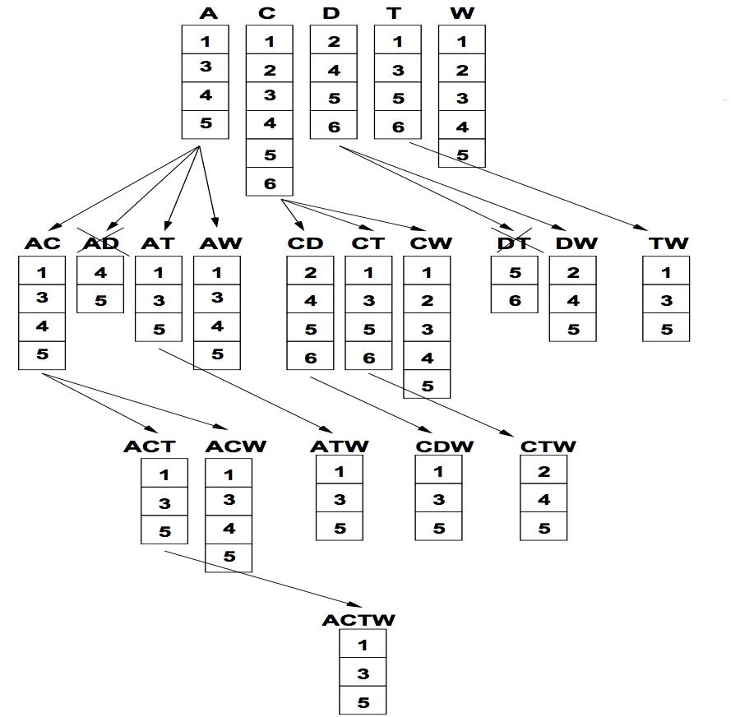
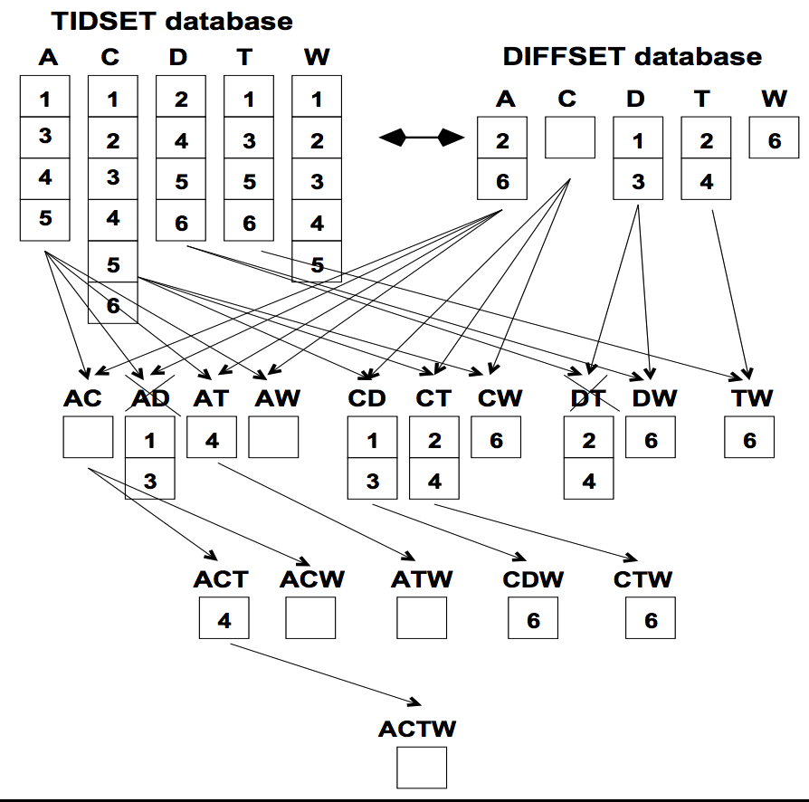
Diffset Based Mining
P: itemset; X, Y: items
d(XY) = t(X) – t(Y)
= d(Y) – d(X)
d(PXY) = t(PX) – t(PY)
= d(PY) – d(PX)
σ(PX) = σ(P) – |d(PX)|
ECLAT: Using diffset to accelerate mining
Only keep track of differences of tids
min_sup = 3
CTW
CDW

Slide 27
FPGrowth: Mining Frequent Patterns by Pattern Growth
Idea: Frequent pattern growth (FPGrowth)
Find frequent single items and partition the database based on each such item
Recursively grow frequent patterns by doing the above for each partitioned database (also called conditional database)
To facilitate efficient processing, an efficient data structure, FP-tree, can be constructed
Mining becomes
Recursively construct and mine (conditional) FP-trees
Until the resulting FP-tree is empty, or until it contains only one path—single path will generate all the combinations of its sub-paths, each of which is a frequent pattern
YouTube: https://www.youtube.com/watch?v=LXx1xKF9oDg

Slide 28
Example: Construct FP-tree from a Transactional DB
TID | Items in the Transaction | Ordered, frequent items
100 | {f, a, c, d, g, i, m, p} | {f, c, a, m, p}
200 | {a, b, c, f, l, m, o} | {f, c, a, b, m}
300 | {b, f, h, j, o, w} | {f, b}
400 | {b, c, k, s, p} | {c, b, p}
500 | {a, f, c, e, l, p, m, n} | {f, c, a, m, p}
Answer:
f:4, a:3, c:4, b:3, m:3, p:3;
fm: 3, cm: 3, am: 3, cp:3;
fcm: 3, fam:3, cam: 3;
fcam: 3.
Scan DB once, find single item frequent pattern:
Sort frequent items in frequency descending order, f-list
Scan DB again, construct FP-tree
Let min_support = 3
f:4, a:3, c:4, b:3, m:3, p:3
{}
F-list = f-c-a-b-m-p
Header Table
f:4
c:1
Item | Frequency | Header
f | 4
c | 4
a | 3
b | 3
m | 3
p | 3
c:3
b:1
b:1
a:3
p:1
m:2
b:1
p:2
m:1

Slide 29
Divide and Conquer Based on Patterns and Data
Pattern mining can be partitioned according to current patterns
Patterns containing p: p’s conditional database: fcam:2, cb:1
Patterns having m but no p: m’s conditional database: fca:2, fcab:1
…… ……
p’s conditional pattern base: transformed prefix paths of item p
{}
min_support = 3
Conditional pattern bases
Item | Frequency | Header
f | 4
c | 4
a | 3
b | 3
m | 3
p | 3
f:4
c:1
Item Conditional pattern base
c f:3
a fc:3
b fca:1, f:1, c:1
m fca:2, fcab:1
p fcam:2, cb:1
c:3
b:1
b:1
a:3
p:1
m:2
b:1
p:2
m:1

Slide 30
Mine Each Conditional Pattern-Base Recursively
Conditional pattern bases
For each conditional pattern-base
Mine single-item patterns
Construct its cond. FP-tree & mine it
item cond. pattern base
c f:3
a fc:3
b fca:1, f:1, c:1
m fca:2, fcab:1
p fcam:2, cb:1
min_support = 3
p-conditional PB: fcam:2, cb:1 → c: 3
m-conditional PB: fca:2, fcab:1 → fca: 3
b-conditional PB: fca:1, f:1, c:1 → ɸ
a-conditional PB: fc:3 → fc:3
c-conditional PB: f:3 → f:3

Slide 31
Mine Each Conditional Pattern-Base Recursively
Conditional pattern bases
For each conditional pattern-base
Mine single-item patterns
Construct its cond. FP-tree & mine it
item cond. pattern base
c f:3
a fc:3
b fca:1, f:1, c:1
m fca:2, fcab:1
p fcam:2, cb:1
min_support = 3
p-conditional PB: fcam:2, cb:1 → c: 3
m-conditional PB: fca:2, fcab:1 → fca: 3
b-conditional PB: fca:1, f:1, c:1 → ɸ
a-conditional PB: fc:3 → fc:3
{}
{}
{}
{}
c-conditional PB: f:3 → f:3
f:3
f:3
f:3
f:3
mine(<f:3, c:3, a:3>|m)
→ (am:3) + mine(<f:3, c:3>|am)
→ (cam:3) + (fam:3) + mine (<f:3>|cam)
→ (fcam:3)
→ (cm:3) + mine(<f:3>|cm)
→ (fcm:3)
→ (fm:3)
c:3
c:3
cm-cond.
FP-tree
cam-cond.
FP-tree
a:3
am-cond.
FP-tree
m-cond.
FP-tree

Slide 32
Mine Each Conditional Pattern-Base Recursively
Conditional pattern bases
For each conditional pattern-base
Mine single-item patterns
Construct its cond. FP-tree & mine it
item cond. pattern base
c f:3
a fc:3
b fca:1, f:1, c:1
m fca:2, fcab:1
p fcam:2, cb:1
min_support = 3
p-conditional PB: fcam:2, cb:1 → c: 3
m-conditional PB: fca:2, fcab:1 → fca: 3
b-conditional PB: fca:1, f:1, c:1 → ɸ
{}
{}
{}
{}
Actually, for single branch FP-tree, all frequent patterns can be generated in one shot
f:3
f:3
f:3
f:3
c:3
cm-cond.
FP-tree
cam-cond.
FP-tree
m: 3
fm: 3, cm: 3, am: 3
fcm: 3, fam:3, cam: 3
fcam: 3
c:3
a:3
am-cond.
FP-tree
m-cond.
FP-tree

Slide 33
Mine Each Conditional Pattern-Base Recursively
Conditional pattern bases
For each conditional pattern-base
Mine single-item patterns
Construct its cond. FP-tree & mine it
item cond. pattern base
c f:3
a fc:3
b fca:1, f:1, c:1
m fca:2, fcab:1
p fcam:2, cb:1
min_support = 3
p-conditional PB: fcam:2, cb:1 → c: 3
m-conditional PB: fca:2, fcab:1 → fca: 3
b-conditional PB: fca:1, f:1, c:1 → ɸ
a-conditional PB: fc:3 → fc:3
c-conditional PB: f:3 → f:3

Slide 34
Mine Each Conditional Pattern-Base Recursively
Conditional pattern bases
For each conditional pattern-base
Mine single-item patterns
Construct its cond. FP-tree & mine it
item cond. pattern base
c f:3
a fc:3
b fca:1, f:1, c:1
m fca:2, fcab:1
p fcam:2, cb:1
min_support = 3
p-conditional PB: fcam:2, cb:1 → c: 3
m-conditional PB: fca:2, fcab:1 → fca: 3
b-conditional PB: fca:1, f:1, c:1 → ɸ
a-conditional PB: fc:3 → fc:3
c-conditional PB: f:3 → f:3

Slide 35
A Special Case: Single Prefix Path in FP-tree
Suppose a (conditional) FP-tree T has a shared single prefix-path P
Mining can be decomposed into two parts
Reduction of the single prefix path into one node
Concatenation of the mining results of the two parts
{}
a₁:n₁
r₁
{}
a₂:n₂
a₁:n₁
+
a₃:n₃

r₁
=
b₁:m₁
c₁:k₁
a₂:n₂
c₁:k₁
a₃:n₃
c₂:k₂
c₃:k₃
b₁:m₁
c₂:k₂
c₃:k₃

Slide 36
Scaling FP-growth by Database Projection
YouTube: https://www.youtube.com/watch?v=LXx1xKF9oDg
What if FP-tree cannot fit in memory? — DB projection
Project the DB based on patterns
Construct & mine FP-tree for each projected DB
Parallel projection vs. partition projection
Parallel projection: Project the DB on each frequent item
Space costly, all partitions can be processed in parallel
Partition projection: Partition the DB in order
Passing the unprocessed parts to subsequent partitions
Trans. DB
Assume only f’s are freq. & the freq. item ordering is:
f₁-f₂-f₃-f₄
Parallel projection
Partition projection
f₂ f₃ f₄ g h
f₃ f₄ i j
f₂ f₄ k
f₁ f₃ h
…
f₄-proj. DB
f₃-proj. DB
f₄-proj. DB
f₃-proj. DB
f₂ f₃
f₃
f₂
…
f₂
f₁
…
f₂ f₃
f₃
f₂
…
f₁
…
f₂ will be projected to f₃-proj. DB only when processing f₄-proj. DB

Slide 37
Mining Frequent Patterns, Association and Correlations: Basic Concepts and Methods
Basic Concepts
Frequent Pattern (Itemset) Mining Methods
Pattern Evaluation Methods

Slide 38
How to Judge if a Rule/Pattern Is Interesting?
Pattern-mining will generate a large set of patterns/rules
Not all the generated patterns/rules are interesting
Interestingness measures: Objective vs. subjective
Objective interestingness measures
Support, confidence, correlation, …
Subjective interestingness measures: One man’s trash could be another man’s treasure
Query-based: Relevant to a user’s particular request
Against one’s knowledge-base: unexpected, freshness, timeliness
Visualization tools: Multi-dimensional, interactive examination

Slide 39
Limitation of the Support-Confidence Framework
Are s and c interesting in association rules: “A ⇒ B” [s, c]?
Example: Suppose one school may have the following statistics on # of students who may play basketball and/or eat cereal:
Association rule mining may generate the following:
play-basketball ⇒ eat-cereal [40%, 66.7%] (higher s & c)
But this strong association rule is misleading: The overall % of students eating cereal is 75% > 66.7%, a more telling rule:
¬ play-basketball ⇒ eat-cereal [35%, 87.5%] (high s & higher c)
Be careful!
2-way contingency table
 | play-basketball | not play-basketball | sum (row)
eat-cereal | 400 | 350 | 750
not eat-cereal | 200 | 50 | 250
sum(col.) | 600 | 400 | 1000

Slide 40
Interestingness Measure: Lift
Measure of dependent/correlated events: lift
Lift(B, C) may tell how B and C are correlated
Lift(B, C) = 1: B and C are independent
> 1: positively correlated
< 1: negatively correlated
For our example,
Thus, B and C are negatively correlated since lift(B, C) < 1;
B and ¬C are positively correlated since lift(B, ¬C) > 1
Lift is more telling than s & c
 | B | ¬B | ∑_{row}
C | 400 | 350 | 750
¬C | 200 | 50 | 250
∑_{col.} | 600 | 400 | 1000

Slide 41
Interestingness Measure: χ²
Observed value
Expected value
Another measure to test correlated events: χ²
General rules
χ² = 0: independent
χ² > 0: correlated, either positive or negative, so it needs additional test
Now,
χ² shows B and C are negatively correlated since the expected value is 450 but the observed is only 400
χ² is also more telling than the support-confidence framework
 | B | ¬B | ∑_{row}
C | 400 (450) | 350 (300) | 750
¬C | 200 (150) | 50 (100) | 250
∑_{col} | 600 | 400 | 1000

Slide 42
Lift and χ² : Are They Always Good Measures?
Null transactions: Transactions that contain neither B nor C
Let’s examine the dataset D
BC (100) is much rarer than B¬C (1000) and ¬BC (1000), but there are many ¬B¬C (100000)
Unlikely B & C will happen together!
But, Lift(B, C) = 8.44 >> 1 (Lift shows B and C are strongly positively correlated!)
χ² = 670: Observed(BC) >> expected value (11.85)
Too many null transactions may “spoil the soup”!
 | B | ¬B | ∑_{row}
C | 100 | 1000 | 1100
¬C | 1000 | 100000 | 101000
∑_{col.} | 1100 | 101000 | 102100
null transactions
Contingency table with expected values added
 | B | ¬B | ∑_{row}
C | 100 (11.85) | 1000 | 1100
¬C | 1000 (988.15) | 100000 | 101000
∑_{col.} | 1100 | 101000 | 102100

Slide 43
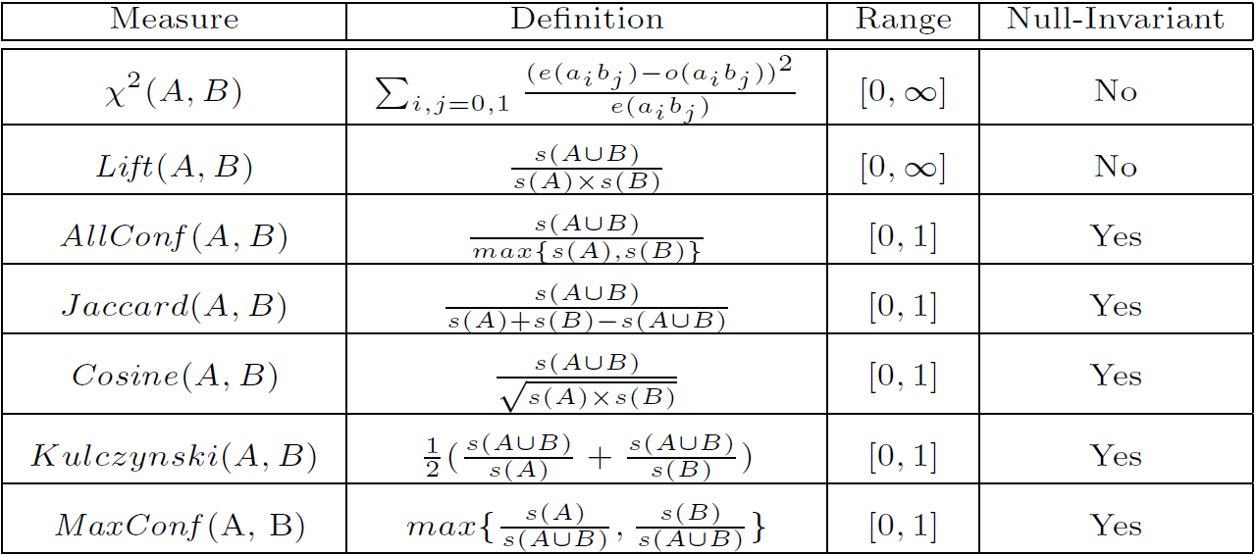
Interestingness Measures & Null-Invariance
Null invariance: Value does not change with the # of null-transactions
A few interestingness measures: Some are null invariant
Χ² and lift are not null-invariant
Jaccard, consine, AllConf, MaxConf, and Kulczynski are null-invariant measures
×
max{ s(A∪B) / s(A) , s(A∪B) / s(B) }

Slide 44
×
max{ s(A∪B) / s(A) , s(A∪B) / s(B) }
 | B | ¬B | ∑_{row}
C | 100 (11.85) | 1000 | 1100
¬C | 1000 (988.15) | 100000 | 101000
∑_{col.} | 1100 | 101000 | 102100
Lift(B, C) = 8.44 >> 1 (Lift shows B and C are strongly positively correlated!)
χ² = 670: Observed(BC) >> expected value (11.85)

Slide 45
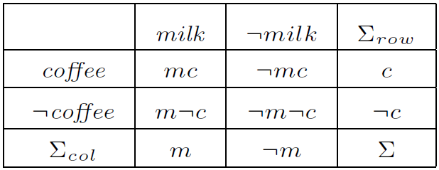
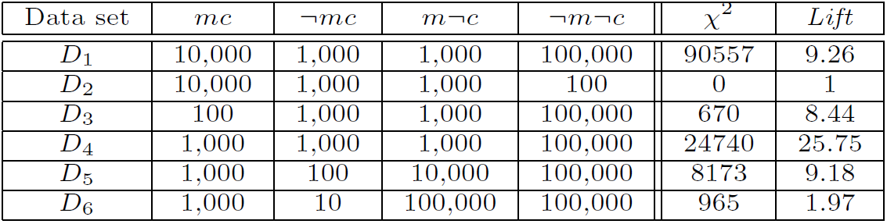
Null Invariance: An Important Property
Why is null invariance crucial for the analysis of massive transaction data?
Many transactions may contain neither milk nor coffee!
milk vs. coffee contingency table
Lift and χ² are not null-invariant: not good to evaluate data that contain too many or too few null transactions!
Many measures are not null-invariant!
Null-transactions
w.r.t. m and c

Slide 46
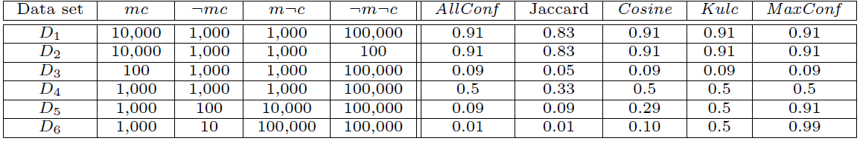
Comparison of Null-Invariant Measures
Not all null-invariant measures are created equal
Which one is better?
D₄—D₆ differentiate the null-invariant measures
Kulc (Kulczynski 1927) holds firm and is in balance of both directional implications
2-variable contingency table
All 5 are null-invariant
Subtle: They disagree on those cases

Slide 47
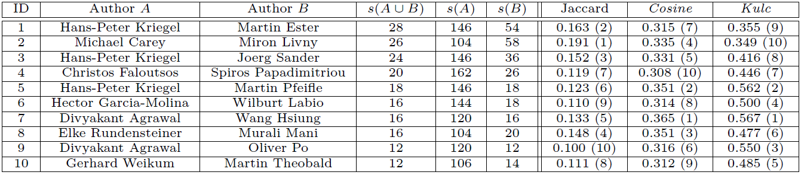
Analysis of DBLP Coauthor Relationships
Recent DB conferences, removing balanced associations, low sup, etc.
Which pairs of authors are strongly related?
Use Kulc to find Advisor-advisee, close collaborators
Advisor-advisee relation: Kulc: high, Jaccard: low, cosine: middle

Slide 48

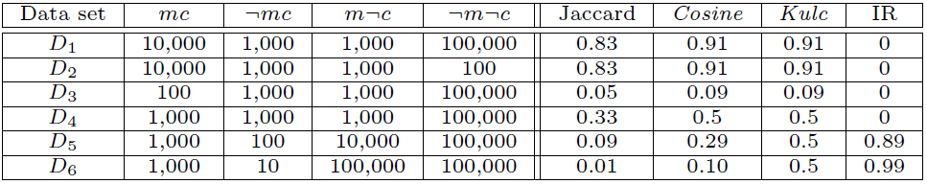
Imbalance Ratio with Kulczynski Measure
IR (Imbalance Ratio): measure the imbalance of two itemsets A and B in rule implications:
Kulczynski and Imbalance Ratio (IR) together present a clear picture for all the three datasets D₄ through D₆
D₄ is neutral & balanced; D₅ is neutral but imbalanced
D₆ is neutral but very imbalanced

Slide 49
What Measures to Choose for Effective Pattern Evaluation?
Null value cases are predominant in many large datasets
Neither milk nor coffee is in most of the baskets; neither Mike nor Jim is an author in most of the papers; ……
Null-invariance is an important property
Lift, χ² and cosine are good measures if null transactions are not predominant
Otherwise, Kulczynski + Imbalance Ratio should be used to judge the interestingness of a pattern
Exercise: 4th Credit Project?
(“Spam detection”, “SVM”)
(“Spam detection”, “Matrix factorization”)
(“Link prediction”, “SVM”)
(“Link prediction”, “Matrix factorization”)

Slide 50
Summary
Basic Concepts:
Frequent Patterns, Association Rules, Closed Patterns and Max-Patterns
Frequent Itemset Mining Methods
The Downward Closure Property and The Apriori Algorithm
Extensions or Improvements of Apriori
Mining Frequent Patterns by Exploring Vertical Data Format
FPGrowth: A Frequent Pattern-Growth Approach
Mining Closed Patterns
Which Patterns Are Interesting?—Pattern Evaluation Methods
Interestingness Measures: Lift and χ²
Null-Invariant Measures
Comparison of Interestingness Measures

Slide 51
References
R. Agrawal, T. Imielinski, and A. Swami, “Mining association rules between sets of items in large databases”, in Proc. of SIGMOD'93
R. J. Bayardo, “Efficiently mining long patterns from databases”, in Proc. of SIGMOD'98
N. Pasquier, Y. Bastide, R. Taouil, and L. Lakhal, “Discovering frequent closed itemsets for association rules”, in Proc. of ICDT'99
J. Han, H. Cheng, D. Xin, and X. Yan, “Frequent Pattern Mining: Current Status and Future Directions”, Data Mining and Knowledge Discovery, 15(1): 55-86, 2007
R. Agrawal and R. Srikant, “Fast algorithms for mining association rules”, VLDB'94
A. Savasere, E. Omiecinski, and S. Navathe, “An efficient algorithm for mining association rules in large databases”, VLDB'95
J. S. Park, M. S. Chen, and P. S. Yu, “An effective hash-based algorithm for mining association rules”, SIGMOD'95
S. Sarawagi, S. Thomas, and R. Agrawal, “Integrating association rule mining with relational database systems: Alternatives and implications”, SIGMOD'98
M. J. Zaki, S. Parthasarathy, M. Ogihara, and W. Li, “Parallel algorithm for discovery of association rules”, Data Mining and Knowledge Discovery, 1997
J. Han, J. Pei, and Y. Yin, “Mining frequent patterns without candidate generation”, SIGMOD’00

Slide 52
References (cont.)
M. J. Zaki and Hsiao, “CHARM: An Efficient Algorithm for Closed Itemset Mining”, SDM'02
J. Wang, J. Han, and J. Pei, “CLOSET+: Searching for the Best Strategies for Mining Frequent Closed Itemsets”, KDD'03
C. C. Aggarwal, M.A., Bhuiyan, M. A. Hasan, “Frequent Pattern Mining Algorithms: A Survey”, in Aggarwal and Han (eds.): Frequent Pattern Mining, Springer, 2014
C. C. Aggarwal and P. S. Yu. A New Framework for Itemset Generation. PODS’98
S. Brin, R. Motwani, and C. Silverstein. Beyond market basket: Generalizing association rules to correlations. SIGMOD'97
M. Klemettinen, H. Mannila, P. Ronkainen, H. Toivonen, and A. I. Verkamo. Finding interesting rules from large sets of discovered association rules. CIKM'94
E. Omiecinski. Alternative Interest Measures for Mining Associations. TKDE’03
P.-N. Tan, V. Kumar, and J. Srivastava. Selecting the Right Interestingness Measure for Association Patterns. KDD'02
T. Wu, Y. Chen and J. Han, Re-Examination of Interestingness Measures in Pattern Mining: A Unified Framework, Data Mining and Knowledge Discovery, 21(3):371-397, 2010

