Slide 1

Chapter 9. Classification: Advanced Methods
Meng Jiang
CS412 Summer 2017:
Introduction to Data Mining

Slide 2
Classification: Advanced Methods
Bayesian Belief Networks
Neural Networks
Support Vector Machines
Rule/Pattern-based Classification
Lazy Learners and K-Nearest Neighbors
Other Classification Methods: Genetic Algorithms, Fuzzy Sets and Rough Sets
Additional Topics: Semi-Supervised Methods, Active Learning, etc.

Slide 3
Bayesian Belief Networks
Bayesian belief network (or Bayesian network, probabilistic network):
allows class conditional independencies between subsets of variables
Two components:
A directed acyclic graph (called a structure)
A set of conditional probability tables (CPTs)
A (directed acyclic) graphical model of causal influence relationships
Represents dependency among the variables
Gives a specification of joint probability distribution
Nodes: random variables
Links: dependency
X and Y are the parents of Z, and Y is the parent of P
No dependency between Z and P
Has no loops/cycles
X
Y
Z
P

Slide 4
A Bayesian Network and Some of Its CPTs
Derivation of the probability of a particular combination of values of X, from CPT:
CPT shows the conditional probability for each possible combination of its parents
Fire (F)
Tampering (T)
CPT: Conditional Probability Tables
Fire | Smoke | Θ_{s|f}
True | True | .90
False | True | .01
Smoke (S)
Alarm (A)
Fire | Tampering | Alarm | Θ_{a|f,t}
True | True | True | .5
True | False | True | .99
False | True | True | .85
False | False | True | .0001
Leaving (L)
Report (R)

Slide 5
How Are Bayesian Networks Constructed?
F
T
S
A
Subjective construction: Identification of (direct) causal structure
People are quite good at identifying direct causes from a given set of variables & whether the set contains all relevant direct causes
Markovian assumption: Each variable becomes independent of its non-effects once its direct causes are known
E.g., S ← F → A ← T, path S → A is blocked once we know F → A
HMM (Hidden Markov Model): often used to model dynamic systems whose states are not observable, yet their outputs are
Synthesis from other specifications
E.g., from a formal system design: block diagrams & info flow
Learning from data (e.g., from medical records or student admission record)
Learn parameters give its structure or learn both structure and parms
Maximum likelihood principle: favors Bayesian networks that maximize the probability of observing the given data set

Slide 6
Training Bayesian Networks: Several Scenarios
Scenario 1: Given both the network structure and all variables observable: compute only the CPT entries
Scenario 2: Network structure known, some variables hidden: gradient descent (greedy hill-climbing) method, i.e., search for a solution along the steepest descent of a criterion function
Weights are initialized to random probability values
At each iteration, it moves towards what appears to be the best solution at the moment, w.o. backtracking
Weights are updated at each iteration & converge to local optimum
Scenario 3: Network structure unknown, all variables observable: search through the model space to reconstruct network topology
Scenario 4: Unknown structure, all hidden variables: No good algorithms known for this purpose
D. Heckerman. A Tutorial on Learning with Bayesian Networks. In Learning in Graphical Models, M. Jordan, ed. MIT Press, 1999.

Slide 7
Classification: Advanced Methods
Bayesian Belief Networks
Neural Networks
Support Vector Machines
Rule/Pattern-based Classification
Lazy Learners and K-Nearest Neighbors
Other Classification Methods: Genetic Algorithms, Fuzzy Sets and Rough Sets
Additional Topics: Semi-Supervised Methods, Active Learning, etc.

Slide 8
Neural Network for Classification
Started by psychologists and neurobiologists to develop and test computational analogues of neurons
A neural network: A set of connected input/output units where each connection has a weight associated with it
During the learning phase, the network learns by adjusting the weights so as to be able to predict the correct class label of the input tuples
Also referred to as connectionist learning due to the connections between units
Backpropagation: A neural network learning algorithm

Slide 9
Neuron: A Hidden/Output Layer Unit
An n-dimensional input vector x is mapped into variable y by means of the scalar product and a nonlinear function mapping
The inputs to unit are outputs from the previous layer. They are multiplied by their corresponding weights to form a weighted sum, which is added to the bias associated with unit. Then a nonlinear activation function is applied to it.
bias
x₀
w₀
m_{k}
x₁
w₁
å
f
output y
x_{n}
w_{n}
Input
vector x
weight
vector w
weighted
sum
Activation
function

Slide 10
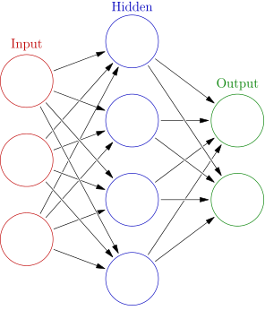
A Multi-Layer Feed-Forward Neural Network
Output vector
Output layer
Hidden layer
w_{ij}
Input layer
Input vector: X

Slide 11
How a Multi-Layer Neural Network Works
The inputs to the network correspond to the attributes measured for each training tuple
Inputs are fed simultaneously into the units making up the input layer
They are then weighted and fed simultaneously to a hidden layer
The number of hidden layers is arbitrary, although usually only one
The weighted outputs of the last hidden layer are input to units making up the output layer, which emits the network's prediction
The network is feed-forward: None of the weights cycles back to an input unit or to an output unit of a previous layer
From a statistical point of view, networks perform nonlinear regression
Given enough hidden units and enough training samples, they can closely approximate any function

Slide 12
Defining a Network Topology
Decide the network topology
Specify # of units in the input layer, # of hidden layers (if > 1), # of units in each hidden layer, and # of units in the output layer
Normalize the input values for each attribute measured in the training tuples to [0.0—1.0]
One input unit per domain value, each initialized to 0
Output, if for classification and more than two classes, one output unit per class is used
Once a network has been trained and its accuracy is unacceptable, repeat the training process with a different network topology or a different set of initial weights

Slide 13
Back Propagation
Back propagation: Reset weights on the "front" neural units and this is sometimes done in combination with training where the correct result is known
Iteratively process a set of training tuples & compare the network's prediction with the actual known target value
For each training tuple, the weights are modified to minimize the mean squared error between the network's prediction and the actual target value
Modifications are made in the “backwards” direction: from the output layer, through each hidden layer down to the first hidden layer, hence “backpropagation”
Steps
Initialize weights to small random numbers, associated with biases
Propagate the inputs forward (by applying activation function)
Backpropagate the error (by updating weights and biases)
Terminating condition (when error is very small, etc.)

Slide 14
From Neural Networks to Deep Learning
Train networks with many layers (vs. shallow nets with just a couple of layers)
Multiple layers work to build an improved feature space
First layer learns 1st order features (e.g., edges, …)
2nd layer learns higher order features (combinations of first layer features, combinations of edges, etc.)
In current models, layers often learn in an unsupervised mode and discover general features of the input space—serving multiple tasks related to the unsupervised instances (image recognition, etc.)
Then final layer features are fed into supervised layer(s)
And entire network is often subsequently tuned using supervised training of the entire net, using the initial weightings learned in the unsupervised phase
Could also do fully supervised versions (back-propagation)

Slide 15
Classification: Advanced Methods
Bayesian Belief Networks
Neural Networks
Support Vector Machines
Rule/Pattern-based Classification
Lazy Learners and K-Nearest Neighbors
Other Classification Methods: Genetic Algorithms, Fuzzy Sets and Rough Sets
Additional Topics: Semi-Supervised Methods, Active Learning, etc.

Slide 16
Classification: A Mathematical Mapping
Classification: predicts categorical class labels
E.g., Personal homepage classification
x_{i} = (x₁, x₂, x₃, …), y_{i} = +1 or –1
x₁ : # of word “homepage”
x₂ : # of word “welcome”
Mathematically, x ∈ X = ℜ^{n}, y ∈ Y = {+1, –1},
We want to derive a function f: X → Y
Linear Classification
Binary Classification problem
Data above the red line belongs to class ‘x’
Data below red line belongs to class ‘o’
Examples: SVM, Perceptron, Probabilistic Classifiers
x
x
x
x
x
x
x
x
x
o
o
x
o
o
o
o
o
o
o
o
o
o
o

Slide 17
Discriminative Classifiers
Advantages
Prediction accuracy is generally high
As compared to Bayesian methods
Robust, works when training examples contain errors
Fast evaluation of the learned target function
Bayesian networks are normally slow
Criticism
Long training time
Difficult to understand the learned function (weights)
Bayesian networks can be used easily for pattern discovery
Not easy to incorporate domain knowledge
Easy in the form of priors on the data or distributions

Slide 18
SVM: Support Vector Machines
A relatively new classification method for both linear and nonlinear data
It uses a nonlinear mapping to transform the original training data into a higher dimension
With the new dimension, it searches for the linear optimal separating hyperplane (i.e., “decision boundary”)
With an appropriate nonlinear mapping to a sufficiently high dimension, data from two classes can always be separated by a hyperplane
SVM finds this hyperplane using support vectors (“essential” training tuples) and margins (defined by the support vectors)

Slide 19
SVM: History and Applications
Vapnik and colleagues (1992)—groundwork from Vapnik & Chervonenkis’ statistical learning theory in 1960s
Features: training can be slow but accuracy is high owing to their ability to model complex nonlinear decision boundaries (margin maximization)
Used for: classification and numeric prediction
Applications:
handwritten digit recognition, object recognition, speaker identification, benchmarking time-series prediction tests

Slide 20
SVM: General Philosophy
Small Margin
Large Margin
Support Vectors

Slide 21
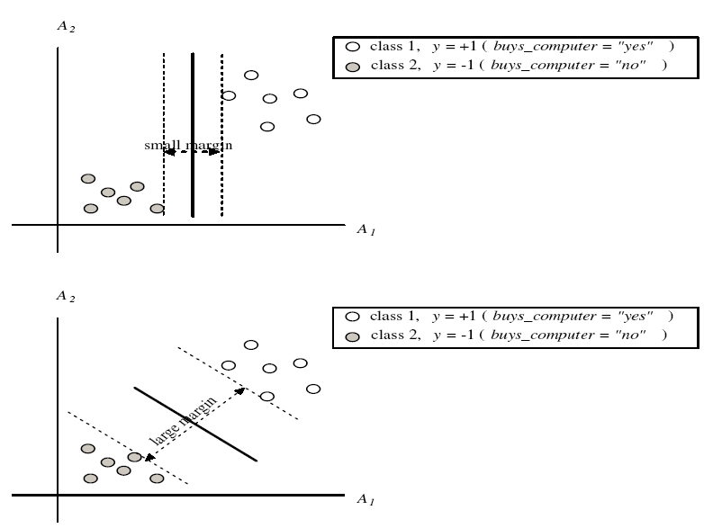
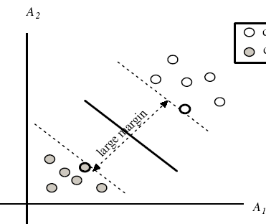
SVM: Margins and Support Vectors

Slide 22
SVM: When Data Is Linearly Separable
Let data D be (X₁, y₁), …, (X_{|D|}, y_{|D|}), where X_{i} is the set of training tuples associated with the class labels y_{i}
There are infinite lines (hyperplanes) separating the two classes but we want to find the best one (the one that minimizes classification error on unseen data)
SVM searches for the hyperplane with the largest margin, i.e., maximum marginal hyperplane (MMH)
m

Slide 23
SVM: Linearly Separable
A separating hyperplane can be written as
W ● X + b = 0
where W={w₁, w₂, …, w_{n}} is a weight vector and b a scalar (bias)
For 2-D it can be written as: w₀ + w₁ x₁ + w₂ x₂ = 0
The hyperplane defining the sides of the margin:
H₁: w₀ + w₁ x₁ + w₂ x₂ ≥ 1 for y_{i} = +1, and
H₂: w₀ + w₁ x₁ + w₂ x₂ ≤ – 1 for y_{i} = –1
Any training tuples that fall on hyperplanes H₁ or H₂ (i.e., the sides defining the margin) are support vectors
This becomes a constrained (convex) quadratic optimization problem:
Quadratic objective function and linear constraints → Quadratic Programming (QP) → Lagrangian multipliers

Slide 24
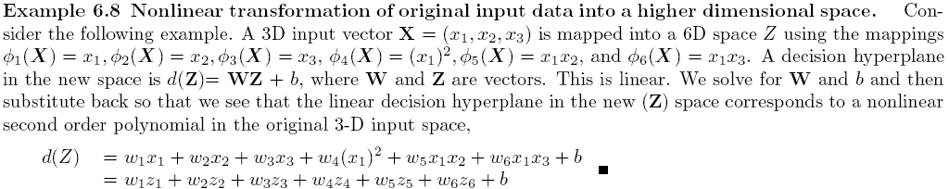
SVM: Linearly Inseparable
Transform the original input data into a higher dimensional space
Search for a linear separating hyperplane in the new space

Slide 25
Why is SVM Effective on High Dimensional Data?
The complexity of trained classifier is characterized by the # of support vectors rather than the dimensionality of the data
The support vectors are the essential or critical training examples —they lie closest to the decision boundary (MMH)
If all other training examples are removed and the training is repeated, the same separating hyperplane would be found
The number of support vectors found can be used to compute an (upper) bound on the expected error rate of the SVM classifier, which is independent of the data dimensionality
Thus, an SVM with a small number of support vectors can have good generalization, even when the dimensionality of the data is high

Slide 26
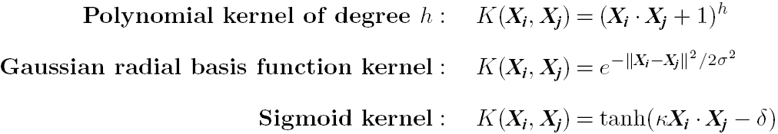
Kernel Functions for Nonlinear Classification
Instead of computing the dot product on the transformed data, it is mathatically equivalent to applying a kernel function K(X_{i}, X_{j}) to the original data, i.e.,
K(X_{i}, X_{j}) = Φ(X_{i}) Φ(X_{j})
Typical Kernel Functions
SVM can also be used for classifying multiple (> 2) classes and for regression analysis (with additional parameters)

Slide 27
Scaling SVM by Hierarchical Micro-Clustering
SVM is not scalable to # of data objects in terms of training time and memory usage
CB-SVM (Clustering-Based SVM): H. Yu, J. Yang, and J. Han, “Classifying Large Data Sets Using SVM with Hierarchical Clusters”, KDD'03
Clustering-Based SVM: Algorithm outline
Construct two CF-trees (hierarchical clusters)
Train an SVM from the centroids of the root entries
De-cluster the entries near the boundary into the next level
The children entries de-clustered from the parent entries are accumulated into the training set with the non-declustered parent entries
Repeat until nothing is accumulated
At deriving support vectors, de-cluster micro-clusters near “candidate vector” to ensure high classification accuracy

Slide 28
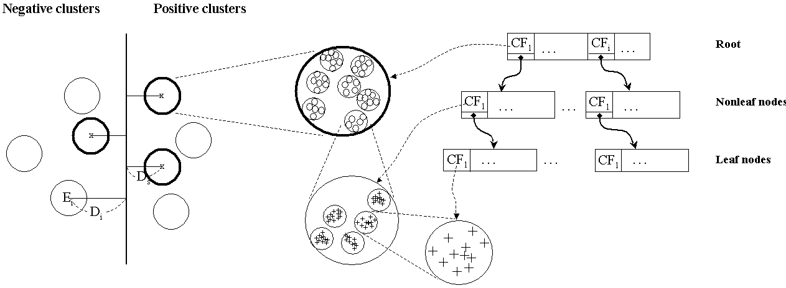
CF-Tree: Hierarchical Micro-cluster
One scan of the data set: Construct two CF-trees (i.e., statistical summary of the data) from positive and negative data sets independently
Micro-clustering: Hierarchical indexing structure
Provide finer samples closer to the boundary and coarser samples farther from the boundary

Slide 29
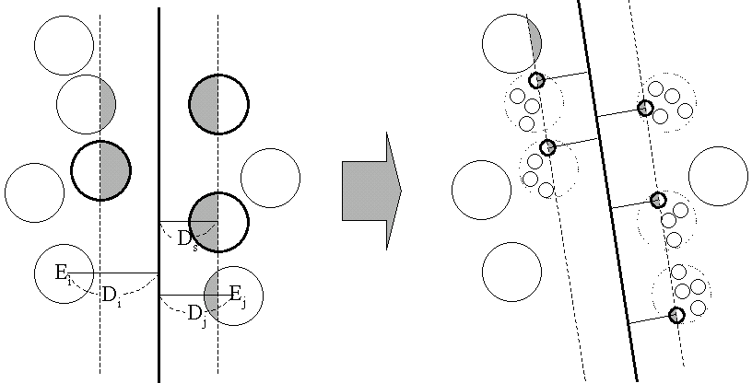
Selective Declustering: Ensure High Accuracy
CF tree is a suitable base structure for selective declustering
De-cluster only the cluster E_{i} such that
D_{i} – R_{i} < D_{s}, where D_{i} is the distance from the boundary to the center point of E_{i} and R_{i} is the radius of E_{i}
Decluster only the cluster whose subclusters have possibilities to be the support cluster of the boundary
“Support cluster”: The cluster whose centroid is a support vector

Slide 30
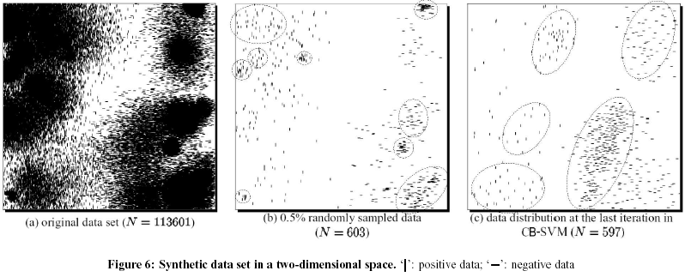
Accuracy and Scalability on Synthetic Dataset
Experiments on large synthetic data sets shows better accuracy than random sampling approaches and far more scalable than the original SVM algorithm

Slide 31
SVM Related Links
SVM Website: http://www.kernel-machines.org/
Representative implementations
LIBSVM: an efficient implementation of SVM, multi-class classifications, nu-SVM, one-class SVM, including also various interfaces with java, python, etc.
SVM-light: simpler but performance is not better than LIBSVM, support only binary classification and only in C
SVM-torch: another recent implementation also written in C

Slide 32
Classification: Advanced Methods
Bayesian Belief Networks
Neural Networks
Support Vector Machines
Rule/Pattern-based Classification
Lazy Learners and K-Nearest Neighbors
Other Classification Methods: Genetic Algorithms, Fuzzy Sets and Rough Sets
Additional Topics: Semi-Supervised Methods, Active Learning, etc.

Slide 33
Using IF-THEN Rules for Classification
Represent the knowledge in the form of IF-THEN rules
R₁: IF age = youth AND student = yes THEN buys_computer = yes
Rule antecedent/precondition vs. rule consequent
Assessment of a rule: coverage and accuracy
n_{covers} = # of tuples covered by R₁
n_{correct} = # of tuples correctly classified by R₁
coverage(R₁) = n_{covers} /|D| /* D: training data set */
accuracy(R₁) = n_{correct} / n_{covers}
If more than one rule are triggered, need conflict resolution
Size ordering: assign the highest priority to the triggering rules that has the “toughest” requirement (i.e., with the most attribute tests)
Class-based ordering: decreasing order of prevalence or misclassification cost per class
Rule-based ordering (decision list): rules are organized into one long priority list, according to some measure of rule quality or by experts

Slide 34
Rule Extraction from a Decision Tree
Rules are easier to understand than large trees
One rule is created for each path from the root to a leaf
Each attribute-value pair along a path forms a conjunction: the leaf holds the class prediction
Rules are mutually exclusive and exhaustive
Example: Rule extraction from our buys_computer decision-tree
age?
<=30
31..40
>40
student?
credit rating?
yes
no
yes
excellent
fair
no
yes
no
yes
IF age = young AND student = no THEN buys_computer = no
IF age = young AND student = yes THEN buys_computer = yes
IF age = mid-age THEN buys_computer = yes
IF age = old AND credit_rating = excellent THEN buys_computer = no
IF age = old AND credit_rating = fair THEN buys_computer = yes

Slide 35
Rule Induction: Sequential Covering Method
Sequential covering algorithm: Extracts rules directly from training data
Typical sequential covering algorithms: FOIL, AQ, CN2, RIPPER
Rules are learned sequentially, each for a given class C_{i} will cover many tuples of C_{i} but none (or few) of the tuples of other classes
Steps:
Rules are learned one at a time
Each time a rule is learned, the tuples covered by the rules are removed
Repeat the process on the remaining tuples until termination condition, e.g., when no more training examples or when the quality of a rule returned is below a user-specified threshold
Comp. w. decision-tree induction: learning a set of rules simultaneously

Slide 36
Pattern-Based Classification, Why?
Pattern-based classification: An integration of both themes
Why pattern-based classification?
Feature construction
Higher order; compact; discriminative
E.g., single word → phrase (Apple pie, Apple i-pad)
Complex data modeling
Graphs (no predefined feature vectors)
Sequences
Semi-structured/unstructured Data
Frequent Pattern
Mining
Pattern-Based
Classification
Classification

Slide 37
Pattern-Based Classification on Graphs
Inactive
Frequent subgraphs
Use frequent patterns as features for classification
g₁
Active
g₁ | g₂ | Class
1 | 1 | 0
0 | 0 | 1
1 | 1 | 0
Mining
Transform
g₂
min_sup=2
Inactive
Inactive

Slide 38
Associative or Pattern-Based Classification
Data: Transactions, microarray data, … → Patterns or association rules
Classification Methods (Some interesting work):
CBA [Liu, Hsu & Ma, KDD’98]: Use high-conf., high-support class association rules to build classifiers
Emerging patterns [Dong & Li, KDD’99]: Patterns whose support changes significantly between the two classes
CMAR [Li, Han & Pei, ICDM’01]: Multiple rules in prediction
CPAR [Yin & Han, SDM’03]: Beam search on multiple prediction rules
RCBT [Cong et al., SIGMOD’05]: Build classifier based on mining top-k covering rule groups with row enumeration (for high-dimensional data)
Lazy classifier [Veloso, Meira & Zaki, ICDM’06]: For a test t, project training data D on t, mine rules from D_{t} , predict on the best rule
Discriminative pattern-based classification [Cheng et al., ICDE’07]

Slide 39
CBA: Classification Based on Associations
CBA [Liu, Hsu and Ma, KDD’98]
Method
Mine high-confidence, high-support class association rules
LHS: conjunctions of attribute-value pairs); RHS: class labels
p₁ ^ p₂ … ^ p_{l} → “A_{class-label} = C” (confidence, support)
Rank rules in descending order of confidence and support
Classification: Apply the first rule that matches a test case; o.w. apply the default rule
Effectiveness: Often found more accurate than some traditional classification methods, such as C4.5
Why? — Exploring high confident associations among multiple attributes may overcome some constraints introduced by some classifiers that consider only one attribute at a time

Slide 40
CMAR: Classification Based on Multiple Association Rules
Rule pruning whenever a rule is inserted into the tree
Given two rules, R₁ and R₂, if the antecedent of R₁ is more general than that of R₂ and conf(R₁) ≥ conf(R₂), then prune R₂
Prunes rules for which the rule antecedent and class label are not positively correlated, based on the χ² test of statistical significance
Classification based on generated/pruned rules
If only one rule satisfies tuple X, assign the class label of the rule
If a rule set S satisfies X
Divide S into groups according to class labels
Use a weighted χ² measure to find the strongest group of rules, based on the statistical correlation of rules within a group
Assign X the class label of the strongest group
CMAR improves model construction efficiency and classification accuracy

Slide 41
Discriminative Pattern-Based Classification
Discriminative patterns as features for classification [Cheng et al., ICDE’07]
Principle: Mining discriminative frequent patterns as high-quality features and then apply any classifier
Framework (PatClass)
Feature construction by frequent itemset mining
Feature selection (e.g., using Maximal Marginal Relevance (MMR))
Select discriminative features (i.e., that are relevant but minimally similar to the previously selected ones)
Remove redundant or closely correlated features
Model learning
Apply a general classifier, such as SVM or C4.5, to build a classification model

Slide 42
On the Power of Discriminative Patterns
K-itemsets are often more informative than single features (1-itemsets) in classification
Computation on real datasets shows: The discriminative power of k-itemsets (for k > 1 but often ≤ 10) is higher than that of single features
(a) Austral
(b) Cleve
(c) Sonar
Information Gain vs. Pattern Length

Slide 43
Information Gain vs. Pattern Frequency
Computation on real datasets shows: Pattern frequency (but not too frequent) is strongly tied with the discriminative power (information gain)
Information gain upper bound monotonically increases with pattern frequency
Info Gain
Frequency
Frequency
Low support,
low info gain
Frequency
(a) Austral
(b) Breast
(c) Sonar
Information Gain Formula:
Conditional entropy of study focus
Entropy of given data

Slide 44
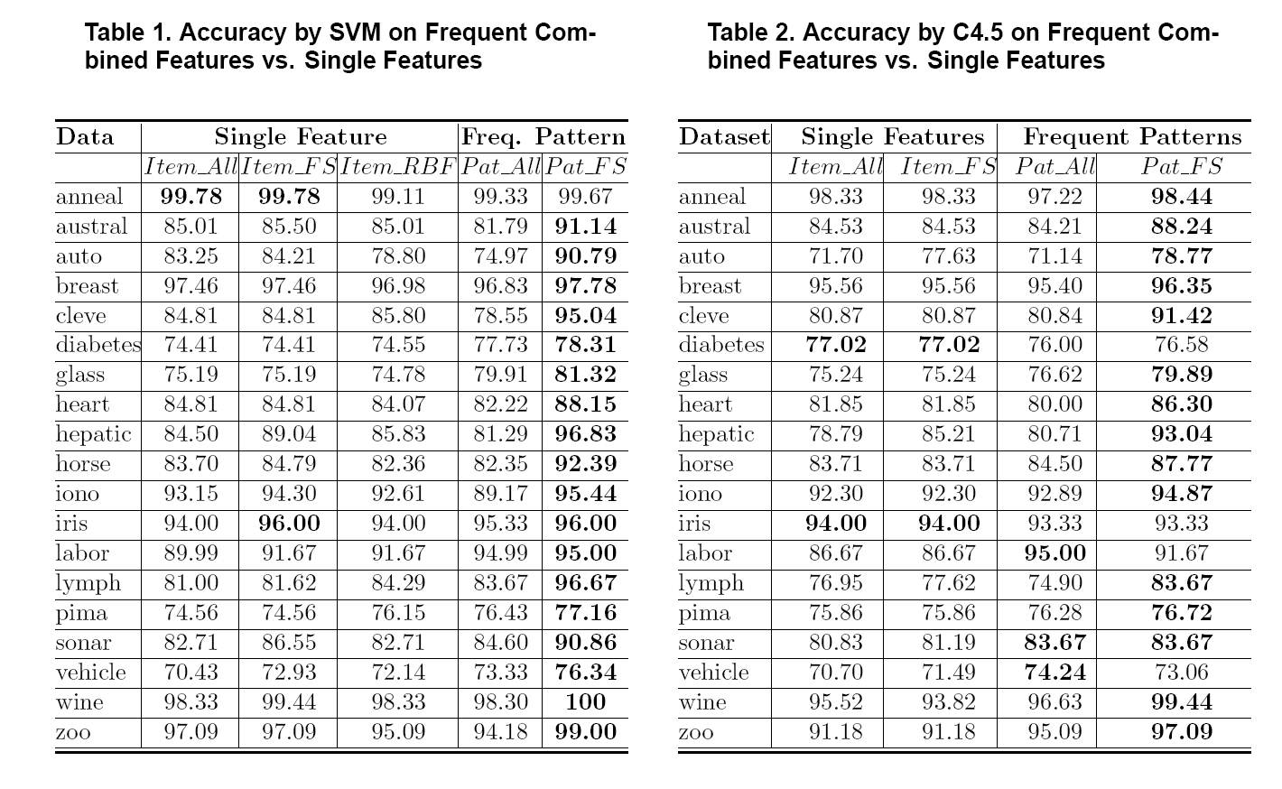
Discriminative Pattern-Based Classification: Experimental Results

Slide 45
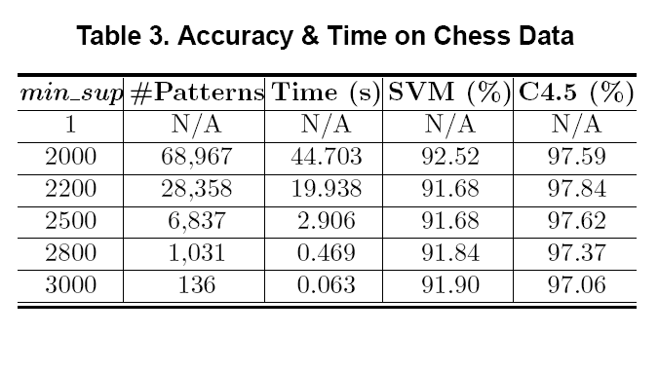
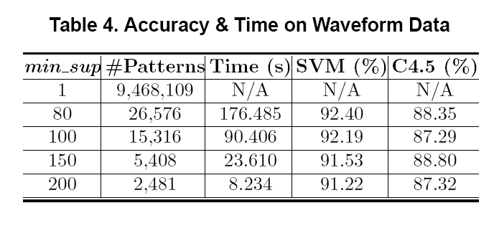
Discriminative Pattern-Based Classification: Scalability Tests

Slide 46
Mining Concise Set of Discriminative Patterns
Frequent pattern mining, then getting discriminative patterns: Expensive, large model
Frequent Patterns
10⁴~10⁶
Data
Mining
Filtering
Discriminative
Patterns
DDPMine [Cheng et al., ICDE’08]: Direct mining of discriminative patterns: Efficient
Data
FP-tree
Direct Mining
Transform
Discriminative
Patterns
Still generates 10²~10³ patterns
DPClass [Shang et al, SDM’16]: A better solution — Efficient, effective, and generating a very limited number of (such as only 20 or so) patterns

Slide 47
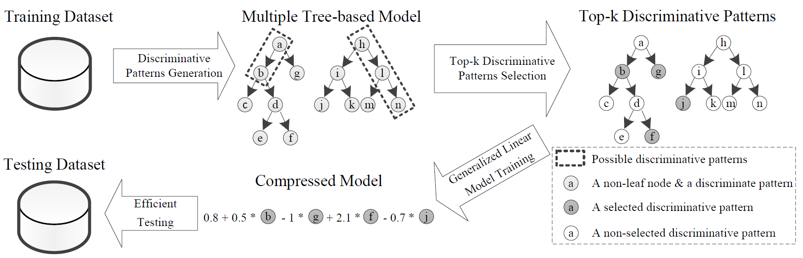
DPClass: Discriminative Pattern-based Classification
Input: A feature table for training data
Adopt every prefix path in an (extremely) random forest as a candidate pattern
The split points of continuous variables are automatically chosen by random forest → No discretization!
Run top-k (e.g., top-20) pattern selection based on training data
Train a generalized linear model (e.g., logistic regression) based on “bag-of-patterns” representations of training data

Slide 48
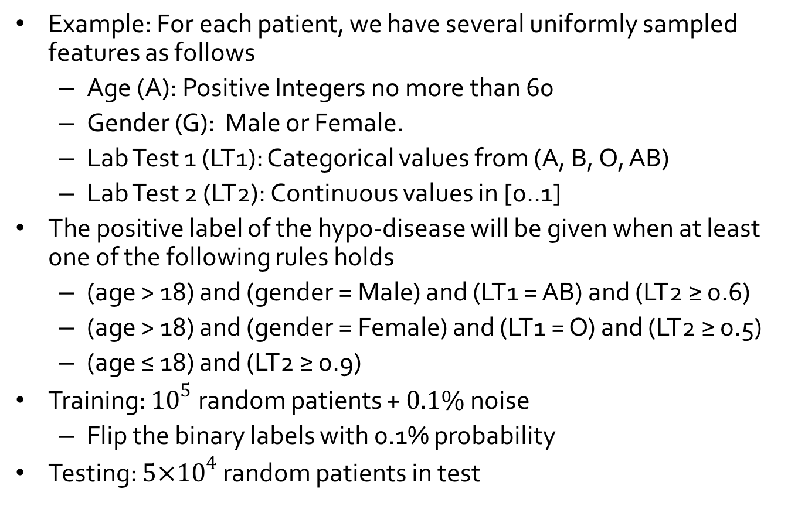
Explanatory Discriminative Patterns: Generation
Example: For each patient, we have several uniformly sampled features as follows
Age (A): Positive Integers no more than 60
Gender (G): Male or Female.
Lab Test 1 (LT1): Categorical values from (A, B, O, AB)
Lab Test 2 (LT2): Continuous values in [0..1]
The positive label of the hypo-disease will be given when at least one of the following rules holds
(age > 18) and (gender = Male) and (LT1 = AB) and (LT2 ≥ 0.6)
(age > 18) and (gender = Female) and (LT1 = O) and (LT2 ≥ 0.5)
(age ≤ 18) and (LT2 ≥ 0.9)
Training: ${10}^{5}$ random patients + $0.1\%$ noise
Flip the binary labels with 0.1% probability
Testing: $5×{10}^{4}$ random patients in test

Slide 49
Explanatory Discriminative Patterns: Evaluation
Accuracy:
DPClass 99.99% (perfect)
DDPMine 95.64% (reasonable)
Top-3 Discriminative Patterns:
DPClass (perfect):
(age > 18) and (gender = Female) and (LT1 = O) and (LT2 ≥ 0.496)
(age ≤ 18) and (LT2 ≥ 0.900)
(age > 18) and (gender = Male) and (LT1 = AB) and (LT2 ≥ 0.601)
DDPMine (poor):
(LT2 > 0.8)
(gender = Male) and (LT1 = AB) and (LT2 ≥ 0.6) and (LT2 < 0.8)
(gender = Female) and (LT1 = O) and (LT2 ≥ 0.6) and (LT2 < 0.8)

Slide 50
A Comparison on Classification Accuracy
DPClass: Discriminative & frequent at the same time, then select top-k
Only top-20 patterns are used in DPClass
Two methods on pattern selection
Forward vs. LASSO
In comparison with DDPMine and Random Forest, DPClass maintains high accuracy
An extension of DPClass has been applied to health study
Cheng et al, "Mining Discriminative Patterns to Predict Health Status for Cardiopulmonary Patients", ACM-BCB'16
 | Dataset | DPClass (Forward) | DPClass (LASSO) | DDPMine | Random Forest
low- dimensional data | adult | 85.66% | 84.33% | 83.42% | 85.45%
 | hypo | 99.58% | 99.28% | 92.69% | 97.22%
 | sick | 98.35% | 98.87% | 93.82% | 94.03%
 | crx | 89.35% | 87.96% | 87.96% | 89.35%
 | sonar | 85.29% | 83.82% | 73.53% | 83.82%
 | chess | 92.25% | 92.05% | 90.04% | 94.22%
high- dimensional data | namao | 97.17% | 96.94% | 96.83% | 97.86%
 | musk | 95.92% | 95.71% | 93.29% | 96.60%
 | madelon | 74.50% | 76.00% | 59.84% | 56.50%

Slide 51
Classification: Advanced Methods
Bayesian Belief Networks
Neural Networks
Support Vector Machines
Rule/Pattern-based Classification
Lazy Learners and K-Nearest Neighbors
Other Classification Methods: Genetic Algorithms, Fuzzy Sets and Rough Sets
Additional Topics: Semi-Supervised Methods, Active Learning, etc.

Slide 52
Lazy vs. Eager Learning
Lazy vs. eager learning
Lazy learning (e.g., instance-based learning): Simply stores training data (or only minor processing) and waits until it is given a test tuple
Eager learning (the above discussed methods): Given a set of training tuples, constructs a classification model before receiving new (e.g., test) data to classify
Lazy: less time in training but more time in predicting
Accuracy
Lazy method effectively uses a richer hypothesis space since it uses many local linear functions to form an implicit global approximation to the target function
Eager: must commit to a single hypothesis that covers the entire instance space

Slide 53
Lazy Learner: Instance-Based Methods
Instance-based learning:
Store training examples and delay the processing (“lazy evaluation”) until a new instance must be classified
Typical approaches
k-nearest neighbor approach
Instances represented as points in a Euclidean space.
Locally weighted regression
Constructs local approximation
Case-based reasoning
Uses symbolic representations and knowledge-based inference

Slide 54
The k-Nearest Neighbor Algorithm
All instances correspond to points in the n-D space
The nearest neighbor are defined in terms of Euclidean distance, dist(X₁, X₂)
Target function could be discrete- or real- valued
For discrete-valued, k-NN returns the most common value among the k training examples nearest to x_{q}
Vonoroi diagram: the decision surface induced by 1-NN for a typical set of training examples
_
.
.
_
_
+
_
.
.
+
.
_
x_{q}
+
_
.
+

Slide 55
Discussion on the k-NN Algorithm
k-NN for real-valued prediction for a given unknown tuple
Returns the mean values of the k nearest neighbors
Distance-weighted nearest neighbor algorithm
Weight the contribution of each of the k neighbors according to their distance to the query x_{q}
Give greater weight to closer neighbors
Robust to noisy data by averaging k-nearest neighbors
Curse of dimensionality: distance between neighbors could be dominated by irrelevant attributes
To overcome it, axes stretch or elimination of the least relevant attributes

Slide 56
Case-Based Reasoning (CBR)
CBR: Uses a database of problem solutions to solve new problems
Store symbolic description (tuples or cases)—not points in a Euclidean space
Applications: Customer-service (product-related diagnosis), legal ruling
Methodology
Instances represented by rich symbolic descriptions (e.g., function graphs)
Search for similar cases, multiple retrieved cases may be combined
Tight coupling between case retrieval, knowledge-based reasoning, and problem solving
Challenges
Find a good similarity metric
Indexing based on syntactic similarity measure, and when failure, backtracking, and adapting to additional cases

Slide 57
Classification: Advanced Methods
Bayesian Belief Networks
Neural Networks
Support Vector Machines
Rule/Pattern-based Classification
Lazy Learners and K-Nearest Neighbors
Other Classification Methods: Genetic Algorithms, Fuzzy Sets and Rough Sets
Additional Topics: Semi-Supervised Methods, Active Learning, etc.

Slide 58
Genetic Algorithms (GA)
Genetic Algorithm: based on an analogy to biological evolution
An initial population is created consisting of randomly generated rules
Each rule is represented by a string of bits
E.g., if A₁ and ¬A₂ then C₂ can be encoded as 100
If an attribute has k > 2 values, k bits can be used
Based on the notion of survival of the fittest, a new population is formed to consist of the fittest rules and their offspring
The fitness of a rule is represented by its classification accuracy on a set of training examples
Offspring are generated by crossover and mutation
The process continues until a population P evolves when each rule in P satisfies a pre-specified threshold
Slow but easily parallelizable

Slide 59
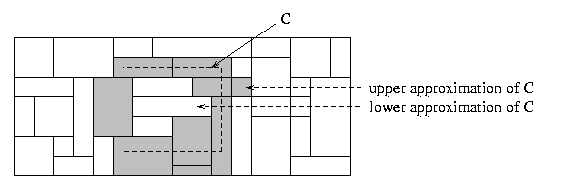
Rough Set Approach
Rough sets are used to approximately or “roughly” define equivalent classes
A rough set for a given class C is approximated by two sets: a lower approximation (certain to be in C) and an upper approximation (cannot be described as not belonging to C)
Finding the minimal subsets (reducts) of attributes for feature reduction is NP-hard but a discernibility matrix (which stores the differences between attribute values for each pair of data tuples) is used to reduce the computation intensity

Slide 60
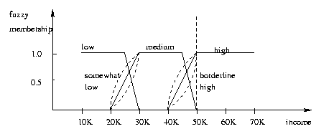
Fuzzy Set Approaches
Fuzzy logic uses truth values between 0.0 and 1.0 to represent the degree of membership (such as in a fuzzy membership graph)
Attribute values are converted to fuzzy values. Ex.:
Income, x, is assigned a fuzzy membership value to each of the discrete categories {low, medium, high}, e.g. $49K belongs to “medium income” with fuzzy value 0.15 but belongs to “high income” with fuzzy value 0.96
Fuzzy membership values do not have to sum to 1.
Each applicable rule contributes a vote for membership in the categories
Typically, the truth values for each predicted category are summed, and these sums are combined

Slide 61
Classification: Advanced Methods
Bayesian Belief Networks
Neural Networks
Support Vector Machines
Rule/Pattern-based Classification
Lazy Learners and K-Nearest Neighbors
Other Classification Methods: Genetic Algorithms, Fuzzy Sets and Rough Sets
Additional Topics: Semi-Supervised Methods, Active Learning, etc.

Slide 62
Multiclass Classification
Classification involving more than two classes (i.e., > 2 Classes)
Method 1. One-vs.-all (OVA): Learn a classifier one at a time
Given m classes, train m classifiers: one for each class
Classifier j: treat tuples in class j as positive & all others as negative
To classify a tuple X, the set of classifiers vote as an ensemble
Method 2. All-vs.-all (AVA): Learn a classifier for each pair of classes
Given m classes, construct m(m-1)/2 binary classifiers
A classifier is trained using tuples of the two classes
To classify a tuple X, each classifier votes
X is assigned to the class with maximal vote
Comparison
All-vs.-all tends to be superior to one-vs.-all
Problem: Binary classifier is sensitive to errors, and errors affect vote count

Slide 63
Error-Correcting Codes for Multiclass Classification
Originally designed to correct errors during data transmission for communication tasks by exploring data redundancy
Example
A 7-bit codeword associated with classes 1-4
Given a unknown tuple X, the 7-trained classifiers output: 0001010
Hamming distance: # of different bits between two codewords
H(X, C₁) = 5, by checking # of bits between [1111111] & [0001010]
H(X, C₂) = 3, H(X, C₃) = 3, H(X, C₄) = 1, thus C₄ as the label for X
Error-correcting codes can correct up to (h ̶ 1)/2 1-bit error, where h is the minimum Hamming distance between any two codewords
If we use 1-bit per class, it is equiv. to one-vs.-all approach, the code are insufficient to self-correct
When selecting error-correcting codes, there should be good row-wise and col.-wise separation between the codewords
Class | Error-Corr. Codeword
C₁ | 1 | 1 | 1 | 1 | 1 | 1 | 1
C₂ | 0 | 0 | 0 | 0 | 1 | 1 | 1
C₃ | 0 | 0 | 1 | 1 | 0 | 0 | 1
C₄ | 0 | 1 | 0 | 1 | 0 | 1 | 0

Slide 64
Semi-Supervised Classification
Semi-supervised: Uses labeled and unlabeled data to build a classifier
Self-training:
Build a classifier using the labeled data
Use it to label the unlabeled data, and those with the most confident label prediction are added to the set of labeled data
Repeat the above process
Adv: easy to understand; disadv: may reinforce errors
Co-training: Use two or more classifiers to teach each other
Each learner uses a mutually independent set of features of each tuple to train a good classifier, say f₁
Then f₁ and f₂ are used to predict the class label for unlabeled data X
Teach each other: The tuple having the most confident prediction from f₁ is added to the set of labeled data for f₂ & vice versa
Other methods, e.g., joint probability distribution of features and labels
+
unlabeled
labeled
̶

Slide 65
Active Learning
Class labels are expensive to obtain
Active learner: query human (oracle) for labels
Pool-based approach: Uses a pool of unlabeled data
L: a small subset of D is labeled, U: a pool of unlabeled data in D
Use a query function to carefully select one or more tuples from U and request labels from an oracle (a human annotator)
The newly labeled samples are added to L, and learn a model
Goal: Achieve high accuracy using as few labeled data as possible
Evaluated using learning curves: Accuracy as a function of the number of instances queried (# of tuples to be queried should be small)
Research issue: How to choose the data tuples to be queried?
Uncertainty sampling: choose the least certain ones
Reduce version space, the subset of hypotheses consistent w. the training data
Reduce expected entropy over U: Find the greatest reduction in the total number of incorrect predictions

Slide 66
Transfer Learning: Conceptual Framework
Transfer learning: Extract knowledge from one or more source tasks and apply the knowledge to a target task
Traditional learning: Build a new classifier for each new task
Transfer learning: Build new classifier by applying existing knowledge learned from source tasks
Traditional Learning Framework
Transfer Learning Framework

Slide 67
Transfer Learning: Methods and Applications
Applications: Especially useful when data is outdated or distribution changes, e.g., Web document classification, e-mail spam filtering
Instance-based transfer learning: Reweight some of the data from source tasks and use it to learn the target task
TrAdaBoost (Transfer AdaBoost)
Assume source and target data each described by the same set of attributes (features) & class labels, but rather diff. distributions
Require only labeling a small amount of target data
Use source data in training: When a source tuple is misclassified, reduce the weight of such tupels so that they will have less effect on the subsequent classifier
Research issues
Negative transfer: When it performs worse than no transfer at all
Heterogeneous transfer learning: Transfer knowledge from different feature space or multiple source domains
Large-scale transfer learning

Slide 68
Summary
Effective and advanced classification methods
Bayesian belief network (probabilistic networks)
Backpropagation (Neural networks)
Support Vector Machine (SVM)
Pattern-based classification
Other classification methods: lazy learners (KNN, case-based reasoning), genetic algorithms, rough set and fuzzy set approaches
Additional Topics on Classification
Multiclass classification
Semi-supervised classification
Active learning
Transfer learning

Slide 69
References
C. M. Bishop, Neural Networks for Pattern Recognition. Oxford University Press, 1995
L. Breiman, J. Friedman, R. Olshen, and C. Stone. Classification and Regression Trees. Wadsworth International Group, 1984
C. J. C. Burges. A Tutorial on Support Vector Machines for Pattern Recognition. Data Mining and Knowledge Discovery, 2(2): 121-168, 1998
N. Cristianini and J. Shawe-Taylor, Introduction to Support Vector Machines and Other Kernel-Based Learning Methods, Cambridge University Press, 2000
H. Yu, J. Yang, and J. Han. Classifying large data sets using SVM with hierarchical clusters. KDD'03
A. J. Dobson. An Introduction to Generalized Linear Models. Chapman & Hall, 1990
R. O. Duda, P. E. Hart, and D. G. Stork. Pattern Classification, 2ed. John Wiley, 2001
T. Hastie, R. Tibshirani, and J. Friedman. The Elements of Statistical Learning: Data Mining, Inference, and Prediction. Springer-Verlag, 2001
S. Haykin, Neural Networks and Learning Machines, Prentice Hall, 2008
D. Heckerman, D. Geiger, and D. M. Chickering. Learning Bayesian networks: The combination of knowledge and statistical data. Machine Learning, 1995
H. Cheng, X. Yan, J. Han & C.-W. Hsu, Discriminative Frequent Pattern Analysis for Effective Classification, ICDE‘07
W. Cohen. Fast effective rule induction. ICML'95

Slide 70
References (cont.)
H. Cheng, X. Yan, J. Han & P. S. Yu, Direct Discriminative Pattern Mining for Effective Classification, ICDE’08
G. Cong, K. Tan, A. Tung & X. Xu. Mining Top-k Covering Rule Groups for Gene Expression Data, SIGMOD’05
M. Deshpande, M. Kuramochi, N. Wale & G. Karypis. Frequent Substructure-based Approaches for Classifying Chemical Compounds, TKDE’05
G. Dong & J. Li. Efficient Mining of Emerging Patterns: Discovering Trends and Differences, KDD’99
W. Fan, K. Zhang, H. Cheng, J. Gao, X. Yan, J. Han, P. S. Yu & O. Verscheure. Direct Mining of Discriminative and Essential Graphical and Itemset Features via Model-based Search Tree, KDD’08
W. Li, J. Han & J. Pei. CMAR: Accurate and Efficient Classification based on Multiple Class-association Rules, ICDM’01
B. Liu, W. Hsu & Y. Ma. Integrating Classification and Association Rule Mining, KDD’98
J. R. Quinlan and R. M. Cameron-Jones. FOIL: A midterm report. ECML’93
Jingbo Shang, Wenzhu Tong, Jian Peng, and Jiawei Han, "DPClass: An Effective but Concise Discriminative Patterns-Based Classification Framework", SDM’16
J. Wang and G. Karypis. HARMONY: Efficiently Mining the Best Rules for Classification, SDM’05
X. Yin & J. Han. CPAR: Classification Based on Predictive Association Rules, SDM’03

