Slide 1
Announcement
HW1 score out; TA office hour Tue 3:30-4:30 pm
Min 23, Max 100, Mode 80
Mean 85.1, Median 87, Std Dev 12.9
Carefully read questions, come to class, read slides/textbook
Next HWs
We will have fewer questions
PDF version!!! NDID-HWx.pdf
No extension!!!
Type your answers!!! Explain your answers!!!
Our TA was really really nice on grading HW1 ❤❤❤
Expect to see good project results: Surprise me!

Slide 2
Announcement (cont.)
Oct. 3: Course Review
Intro, Data Processing, Data Cube, Frequent Pattern Mining
Part of questions in HW1, HW2
Oct. 5: Mid-term Exam in class
2pm-3:15pm, 75 minutes
4 questions, 100 points (20%)
One-piece two-page (double-sided) A4/Letter-size cheat sheet
Bring a pen!!!
No electronic devices (laptop, phone, etc.), no calculator, no textbook, no more than one piece

Slide 3
How to Work
If you want to do something,
Be Determined and Work Hard!
and Work Smart!

Slide 4
Q-Q plot
Data object and attributes
Scatter plot
Q-Q plot
An application

Slide 5

Chapter 4&5. Data Cube: Data Warehousing and OLAP
Meng Jiang
CSE 40647/60647 Data Science Fall 2017
Introduction to Data Mining

Slide 6
Review: Data Cube
Concepts
Cell, Cuboid, Cube
Dimension Value, Dimension Level, Dimension
Base/Aggregate Cell/Cuboid
Components
Dimension tables and Fact tables
Concept hierarchy and Measures
Schemas: Star, Snowflake, Constellation
Operations: Roll-up, drill-down, dice, slide, pivot…
Materialization: Full, no, partial
Cells: Iceberg cube
Dimensions: Aggregation?

Slide 7
Efficient Computation
General computation heuristics (Agarwal et al.’96)
Computing full/iceberg cubes: 3 methodologies
Bottom-Up:
Multi-way array aggregation (Zhao, Deshpande & Naughton, SIGMOD’97)
Top-down:
BUC (Beyer & Ramarkrishnan, SIGMOD’99)
Integrating Top-Down and Bottom-Up:
Star-cubing algorithm (Xin, Han, Li & Wah: VLDB’03)
High-dimensional OLAP:
A shell-fragment approach (Li, et al. VLDB’04)
Computing alternative kinds of cubes:
Partial cube, closed cube, approximate cube, ……

Slide 8
Multi-Way Array Aggregation
Bottom-up: Partition a huge sparse array into chunks (a small subcube which fits in memory) and aggregation.
Data addressing: Compressed sparse array addressing (chunk_id, offset)
Compute aggregates in “multiway” by visiting cube cells in the order which minimizes the # of times to visit each cell, and reduces memory access and storage cost
C
What is the best traversing order to do multi-way aggregation?
ABC → AB, BC and AC
c2
c3
61
62
63
64
c1
45
46
47
48
c 0
29
30
31
32
B
60
b3
13
14
15
16
44
-
-
-
28
b2
9
56
B
-
-
-
40
A: 40 (location),
B: 400 (item),
C: 4,000 (time)
b1
5
24
52
36
1
2
3
4
20
b0
a0
a1
a2
a3
A

Slide 9
Multi-way Array Aggregation (3-D to 2-D)
How much memory cost of computation (aggregation for AB, AC, BC planes) can we save?
4x4x4 chunks
A: 40 (location),
B: 400 (item),
C: 4,000 (time)
Min memory size: ?
< 40*400 + 400*4,000 + 40 * 4,000
= 1,776,000

Slide 10
Multi-way Array Aggregation (3-D to 2-D)
How to minimizes the memory requirement and reduced I/Os?
Keep the smallest plane in main memory
Fetch and compute only one chunk at a time for the largest plane
The planes should be sorted and computed according to their size in ascending order
4x4x4 chunks
Entire AB plane: 40 * 400
= 16,000
One chunk of BC plane:
(400/4) * (4,000/4)
= 100,000
A: 40 (location),
B: 400 (item),
C: 4,000 (time)
Min memory size: 156,000
< 40*400 + 400*4,000 + 40 * 4,000
= 1,776,000
One column of AC plane:
40 * (4,000/4) = 40,000

Slide 11
Multi-Way Array Aggregation
Array-based “bottom-up” algorithm (from ABC to AB,…)
Using multi-dimensional chunks
Simultaneous aggregation on multiple dimensions
Cannot do Apriori pruning: No iceberg optimization
Comments on the method
Efficient for computing the full cube for a small number of dimensions
If there are a large number of dimensions, “top-down” computation and iceberg cube computation methods should be used
Zhao, Deshpande & Naughton. An Array-Based Algorithm for Simultaneous Multidimensional Aggregates. SIGMOD’97

Slide 12
BUC (Top Down: From AB to ABC)
BUC (Beyer & Ramakrishnan, SIGMOD’99)
BUC: acronym of Bottom-Up (cube) Computation
(Note: It is “top-down” in our view since we put Apex cuboid on the top!)
Divides dimensions into partitions and facilitates iceberg pruning (it works now!)
If a partition does not satisfy min_sup, its descendants can be pruned
K. Beyer and R. Ramakrishnan. Bottom-Up Computation of Sparse and Iceberg CUBEs. SIGMOD’99

Slide 13
Data Warehouse: From Tables and Spreadsheets to Data Cubes
A data warehouse is based on a multidimensional data model which views data in the form of a data cube
A data cube, such as sales, allows data to be modeled and viewed in multiple dimensions
Dimension tables, such as item (item_name, brand, type), or time (day, week, month, quarter, year)
Fact table contains measures (such as dollars_sold) and keys to each of the related dimension tables
Data cube: A lattice of cuboids
In data warehousing literature, an n-D base cube is called a base cuboid
The top most 0-D cuboid, which holds the highest-level of summarization, is called the apex cuboid
The lattice of cuboids forms a data cube

Slide 14
Data Warehouse
Defined in many different ways, but not rigorously
A decision support database that is maintained separately from the organization’s operational database

Slide 15

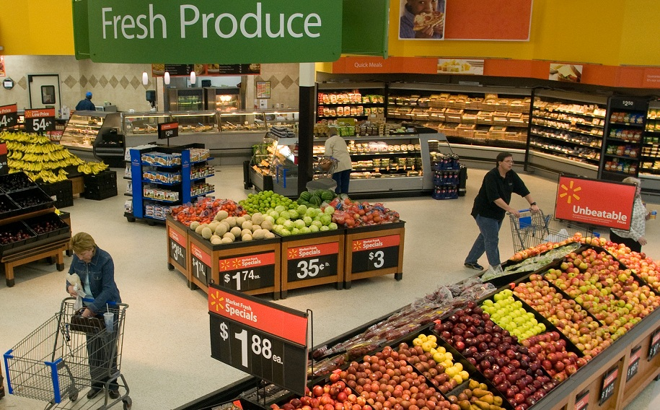
Operational Databases
(Data) Marts
(Data) Warehouse

Slide 16

Data Warehouse
Defined in many different ways, but not rigorously
A decision support database that is maintained separately from the organization’s operational database
Support information processing by providing a solid platform of consolidated, historical data for analysis

Slide 17

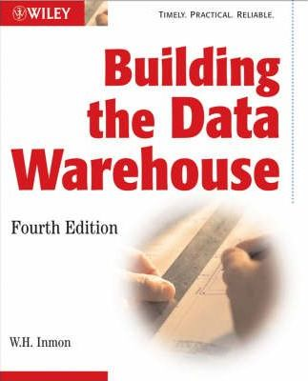
Data Warehouse
“A data warehouse is a subject-oriented, integrated, time-variant, and nonvolatile collection of data in support of management’s decision-making process.”—William H. (Bill) Inmon
Data warehousing:
The process of constructing and using data warehouses

Slide 18
(1) Subject-Oriented
Organized around major subjects, such as customer, product, sales
Focusing on the modeling and analysis of data for decision makers, NOT on daily operations or transaction processing
Provide a simple and concise view around particular subject issues by excluding data that are not useful in the decision support process

Slide 19
(2) Integrated
Constructed by integrating multiple, heterogeneous data sources
relational databases, flat files, on-line transaction records
Data cleaning and data integration techniques are applied
Ensure consistency in naming conventions, encoding structures, attribute measures, etc. among different data sources
Ex. Hotel price: differences on currency, tax, breakfast covered, and parking
Notes:
Walmart: Bentonville, Arkansas

Slide 20
(3) Time-Variant
The time horizon for the data warehouse is significantly longer than that of operational systems
Operational database: current value data
Data warehouse data: provide information from a historical perspective (e.g., past 5-10 years)
Every key structure in the data warehouse
Contains an element of time, explicitly or implicitly
But the key of operational data may or may not contain “time element”

Slide 21
(4) Nonvolatile
Independence
A physically separate store of data transformed from the operational environment
Static: Operational update of data does NOT occur in the data warehouse environment
Does not require transaction processing, recovery, and concurrency control mechanisms
Requires only two operations in data accessing:
initial loading of data and access of data

Slide 22
OLTP vs OLAP
OLTP: Online transactional processing
DBMS operations
Query and transactional processing
OLAP: Online analytical processing
Data warehouse operations (drilling, slicing, dicing, etc.)
Data analysis to support decision making

Slide 23
OLTP vs OLAP

Slide 24
Data Warehouse: A Multi-Tiered Architecture
Top Tier: Front-End Tools
Middle Tier: OLAP Server
Bottom Tier: Data Warehouse Server
Data

Slide 25
From Data to Data Warehouse: Extraction, Transformation, and Loading (ETL)
Data extraction
get data from multiple, heterogeneous, and external sources
Data cleaning
detect errors in the data and rectify them when possible
Data transformation
convert data from legacy or host format to warehouse format
Load
sort, summarize, consolidate, compute views, check integrity, and build indices and partitions
Refresh
propagate the updates from the data sources to the warehouse

Slide 26
Data Warehouse Usage
Three kinds of data warehouse applications
Information processing
supports querying, basic statistical analysis, and reporting using crosstabs, tables, charts and graphs
Analytical processing
multidimensional analysis of data warehouse data
supports basic OLAP operations, slice-dice, drilling, pivoting
Data mining
knowledge discovery from hidden patterns
supports associations, constructing analytical models, performing classification and prediction, and presenting the mining results using visualization tools

Slide 27
Efficient Processing OLAP Queries
Determine which operations should be performed on the available cuboids
Transform drill, roll, etc. into corresponding SQL and/or OLAP operations, e.g., dice = selection + projection
Determine which materialized cuboid(s) should be selected for OLAP op.
Let the query to be processed be on {brand, province_or_state} with the condition “year = 2004”, and there are 4 materialized cuboids available:
1) {year, item_name, city}
2) {year, brand, country}
3) {year, brand, province_or_state}
4) {item_name, province_or_state} where year = 2004
Which should be selected to process the query?

Slide 28
Efficient Processing OLAP Queries
Determine which operations should be performed on the available cuboids
Transform drill, roll, etc. into corresponding SQL and/or OLAP operations, e.g., dice = selection + projection
Determine which materialized cuboid(s) should be selected for OLAP op.
Let the query to be processed be on {brand, province_or_state} with the condition “year = 2004”, and there are 4 materialized cuboids available:
1) {year, item_name, city}
2) {year, brand, country}
3) {year, brand, province_or_state} √
4) {item_name, province_or_state} where year = 2004
Which should be selected to process the query?

Slide 29
References
S. Agarwal, R. Agrawal, P. M. Deshpande, A. Gupta, J. F. Naughton, R. Ramakrishnan, and S. Sarawagi. On the computation of multidimensional aggregates. VLDB’96
D. Agrawal, A. E. Abbadi, A. Singh, and T. Yurek. Efficient view maintenance in data warehouses. SIGMOD’97
R. Agrawal, A. Gupta, and S. Sarawagi. Modeling multidimensional databases. ICDE’97
S. Chaudhuri and U. Dayal. An overview of data warehousing and OLAP technology. ACM SIGMOD Record, 26:65-74, 1997
J. Gray, et al. Data cube: A relational aggregation operator generalizing group-by, cross-tab and sub-totals. Data Mining and Knowledge Discovery, 1:29-54, 1997.
A. Gupta and I. S. Mumick. Materialized Views: Techniques, Implementations, and Applications. MIT Press, 1999
J. Han. Towards on-line analytical mining in large databases. SIGMOD Record, 1998
V. Harinarayan, A. Rajaraman, and J. D. Ullman. Implementing data cubes efficiently. SIGMOD’96

Slide 30
References (cont.)
C. Imhoff, N. Galemmo, and J. G. Geiger. Mastering Data Warehouse Design: Relational and Dimensional Techniques. John Wiley, 2003
W. H. Inmon. Building the Data Warehouse. John Wiley, 1996
R. Kimball and M. Ross. The Data Warehouse Toolkit: The Complete Guide to Dimensional Modeling. 2ed. John Wiley, 2002
P. O'Neil and D. Quass. Improved query performance with variant indexes. SIGMOD'97
S. Sarawagi and M. Stonebraker. Efficient organization of large multidimensional arrays. ICDE'94
P. Valduriez. Join indices. ACM Trans. Database Systems, 12:218-246, 1987.
J. Widom. Research problems in data warehousing. CIKM’95.
K. Wu, E. Otoo, and A. Shoshani, Optimal Bitmap Indices with Efficient Compression, ACM Trans. on Database Systems (TODS), 31(1), 2006, pp. 1-38.

