Slide 1

Chapter 6. Frequent Pattern Mining: FP-Growth
Meng Jiang
CSE 40647/60647 Data Science Fall 2017
Introduction to Data Mining

Slide 2
Frequent Pattern Mining Methods
Apriori
ECLAT
FP-Growth

Slide 3
Exploring Vertical Data Format: ECLAT
ECLAT (Equivalence Class Transformation): A depth-first search algorithm using set intersection [Zaki et al. @KDD’97]
Tid-List: List of transaction-ids containing an itemset
Vertical format: t(e) = {T₁₀, T₂₀, T₃₀}; t(a) = {T_{10,} T₂₀}; t(ae) = {T_{10,} T₂₀}
Deriving frequent patterns based on vertical intersections
A transaction DB in Horizontal Data Format
The transaction DB in Vertical Data Format
Tid | Itemset
10 | a, c, d, e
20 | a, b, e
30 | b, c, e
Item | TidList
a | 10, 20
b | 20, 30
c | 10, 30
d | 10
e | 10, 20, 30
http://www.cs.rpi.edu/~zaki/PaperDir/SIGKDD03-diffsets.pdf

Slide 4
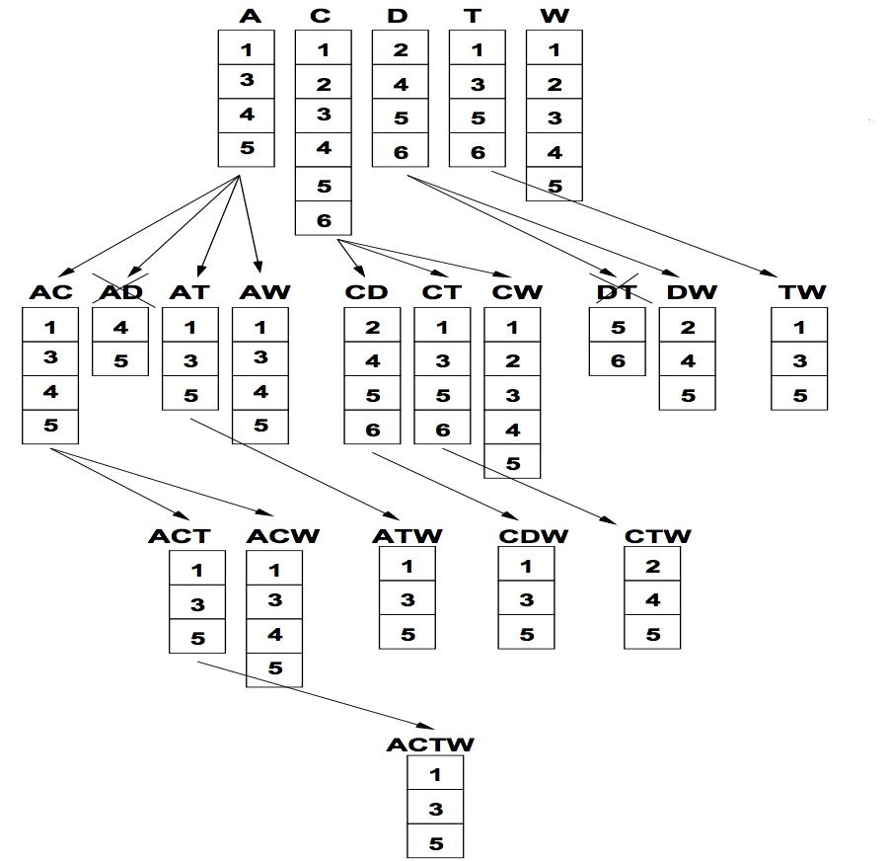
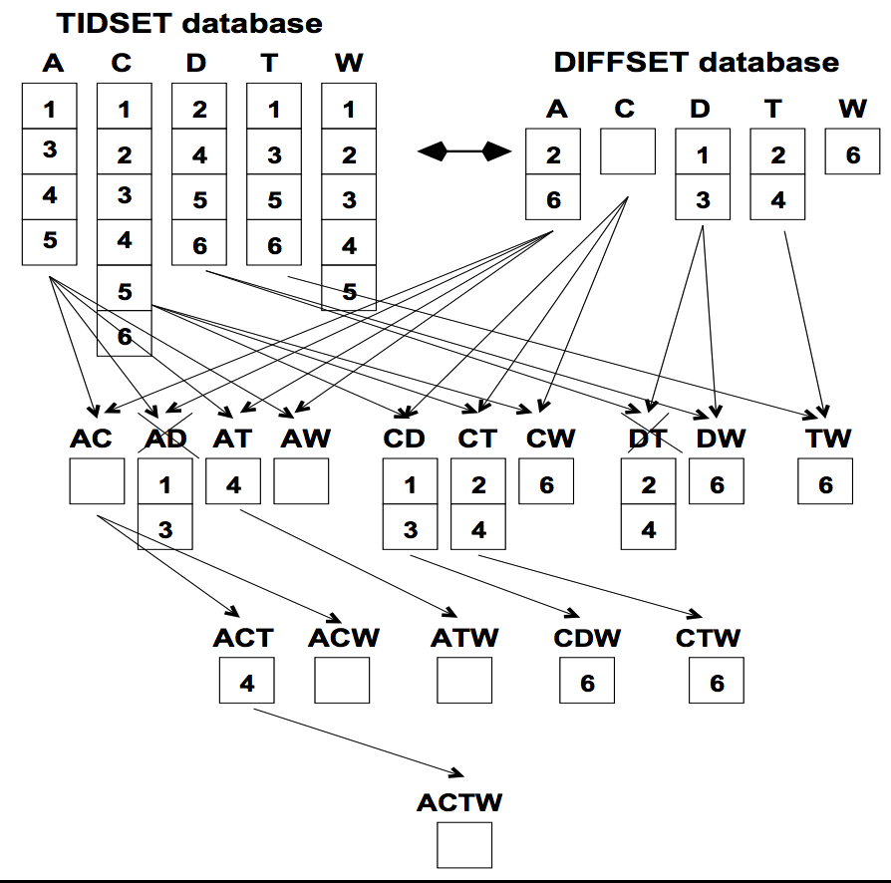
ECLAT: Diffset Based Mining
P: itemset; X, Y: items; d: diffset;
t: transaction set/list; σ: support
d(XY) = t(X) – t(Y)
= d(Y) – d(X)
d(PXY) = t(PX) – t(PY)
= d(PY) – d(PX)
σ(PX) = σ(P) – |d(PX)|
Using diffset to accelerate mining
Only keep track of differences of tids
min_sup = 3
CTW
CDW
Set minus is faster than set intersection.
Set minus requires less memory space.

Slide 5
FPGrowth: Mining Frequent Patterns by Pattern Growth
Idea: Frequent pattern growth (FPGrowth)
Find frequent single items and partition the database based on each such item
Recursively grow frequent patterns by doing the above for each partitioned database (also called conditional database)
To facilitate efficient processing, an efficient data structure, FP-tree, can be constructed
Mining becomes
Recursively construct and mine (conditional) FP-trees
Until the resulting FP-tree is empty, or until it contains only one path—single path will generate all the combinations of its sub-paths, each of which is a frequent pattern
YouTube: https://www.youtube.com/watch?v=LXx1xKF9oDg

Slide 6
Example: Construct FP-tree from a Transactional DB
TID | Items in the Transaction | Ordered, frequent items
100 | {f, a, c, d, g, i, m, p} | {f, c, a, m, p}
200 | {a, b, c, f, l, m, o} | {f, c, a, b, m}
300 | {b, f, h, j, o, w} | {f, b}
400 | {b, c, k, s, p} | {c, b, p}
500 | {a, f, c, e, l, p, m, n} | {f, c, a, m, p}
Answer:
f:4, a:3, c:4, b:3, m:3, p:3;
fm: 3, cm: 3, am: 3, cp:3;
fcm: 3, fam:3, cam: 3;
fcam: 3.
Scan DB once, find single item frequent pattern:
Sort frequent items in frequency descending order, f-list
Scan DB again, construct FP-tree
Let min_support = 3
f:4, a:3, c:4, b:3, m:3, p:3
{}
F-list = f-c-a-b-m-p
Header Table
f:4
c:1
Item | Frequency | Header
f | 4
c | 4
a | 3
b | 3
m | 3
p | 3
c:3
b:1
b:1
a:3
p:1
m:2
b:1
p:2
m:1

Slide 7
Divide and Conquer Based on Patterns and Data
Pattern mining can be partitioned according to current patterns
Patterns containing p: p’s conditional database: fcam:2, cb:1
Patterns having m but no p: m’s conditional database: fca:2, fcab:1
…… ……
p’s conditional pattern base: transformed prefix paths of item p
{}
min_support = 3
Conditional pattern bases
Item | Frequency | Header
f | 4
c | 4
a | 3
b | 3
m | 3
p | 3
f:4
c:1
Item Conditional pattern base
c f:3
a fc:3
b fca:1, f:1, c:1
m fca:2, fcab:1
p fcam:2, cb:1
c:3
b:1
b:1
a:3
p:1
m:2
b:1
p:2
m:1

Slide 8
Mine Each Conditional Pattern-Base Recursively
Conditional pattern bases
For each conditional pattern-base
Mine single-item patterns
Construct its cond. FP-tree & mine it
item cond. pattern base
c f:3
a fc:3
b fca:1, f:1, c:1
m fca:2, fcab:1
p fcam:2, cb:1
min_support = 3
p-conditional PB: fcam:2, cb:1 → c: 3
m-conditional PB: fca:2, fcab:1 → fca: 3
b-conditional PB: fca:1, f:1, c:1 → ɸ
a-conditional PB: fc:3 → fc:3
c-conditional PB: f:3 → f:3

Slide 9
Mine Each Conditional Pattern-Base Recursively
Conditional pattern bases
For each conditional pattern-base
Mine single-item patterns
Construct its cond. FP-tree & mine it
item cond. pattern base
c f:3
a fc:3
b fca:1, f:1, c:1
m fca:2, fcab:1
p fcam:2, cb:1
min_support = 3
p-conditional PB: fcam:2, cb:1 → c: 3
m-conditional PB: fca:2, fcab:1 → fca: 3
b-conditional PB: fca:1, f:1, c:1 → ɸ
a-conditional PB: fc:3 → fc:3
{}
{}
{}
{}
c-conditional PB: f:3 → f:3
f:3
f:3
f:3
f:3
mine(<f:3, c:3, a:3>|m)
→ (am:3) + mine(<f:3, c:3>|am)
→ (cam:3) + (fam:3) + mine (<f:3>|cam)
→ (fcam:3)
→ (cm:3) + mine(<f:3>|cm)
→ (fcm:3)
→ (fm:3)
c:3
c:3
cm-cond.
FP-tree
cam-cond.
FP-tree
a:3
am-cond.
FP-tree
m-cond.
FP-tree

Slide 10
Mine Each Conditional Pattern-Base Recursively
Conditional pattern bases
For each conditional pattern-base
Mine single-item patterns
Construct its cond. FP-tree & mine it
item cond. pattern base
c f:3
a fc:3
b fca:1, f:1, c:1
m fca:2, fcab:1
p fcam:2, cb:1
min_support = 3
p-conditional PB: fcam:2, cb:1 → c: 3
m-conditional PB: fca:2, fcab:1 → fca: 3
b-conditional PB: fca:1, f:1, c:1 → ɸ
{}
{}
{}
{}
Actually, for single branch FP-tree, all frequent patterns can be generated in one shot
f:3
f:3
f:3
f:3
c:3
cm-cond.
FP-tree
cam-cond.
FP-tree
m: 3
fm: 3, cm: 3, am: 3
fcm: 3, fam:3, cam: 3
fcam: 3
c:3
a:3
am-cond.
FP-tree
m-cond.
FP-tree

Slide 11
Mine Each Conditional Pattern-Base Recursively
Conditional pattern bases
For each conditional pattern-base
Mine single-item patterns
Construct its cond. FP-tree & mine it
item cond. pattern base
c f:3
a fc:3
b fca:1, f:1, c:1
m fca:2, fcab:1
p fcam:2, cb:1
min_support = 3
p-conditional PB: fcam:2, cb:1 → c: 3
m-conditional PB: fca:2, fcab:1 → fca: 3
b-conditional PB: fca:1, f:1, c:1 → ɸ
a-conditional PB: fc:3 → fc:3
c-conditional PB: f:3 → f:3

Slide 12
Mine Each Conditional Pattern-Base Recursively
Conditional pattern bases
For each conditional pattern-base
Mine single-item patterns
Construct its cond. FP-tree & mine it
item cond. pattern base
c f:3
a fc:3
b fca:1, f:1, c:1
m fca:2, fcab:1
p fcam:2, cb:1
min_support = 3
p-conditional PB: fcam:2, cb:1 → c: 3
m-conditional PB: fca:2, fcab:1 → fca: 3
b-conditional PB: fca:1, f:1, c:1 → ɸ
a-conditional PB: fc:3 → fc:3
c-conditional PB: f:3 → f:3

Slide 13
A Special Case: Single Prefix Path in FP-tree
Suppose a (conditional) FP-tree T has a shared single prefix-path P
Mining can be decomposed into two parts
Reduction of the single prefix path into one node
Concatenation of the mining results of the two parts
{}
a₁:n₁
r₁
{}
a₂:n₂
a₁:n₁
+
a₃:n₃

r₁
=
b₁:m₁
c₁:k₁
a₂:n₂
c₁:k₁
a₃:n₃
c₂:k₂
c₃:k₃
b₁:m₁
c₂:k₂
c₃:k₃

Slide 14
Scaling FP-growth by Database Projection
What if FP-tree cannot fit in memory? — DB projection
Project the DB based on patterns
Construct & mine FP-tree for each projected DB
Parallel projection vs. partition projection
Parallel projection: Project the DB on each frequent item
Space costly, all partitions can be processed in parallel
Partition projection: Partition the DB in order
Passing the unprocessed parts to subsequent partitions
Trans. DB
Assume only f’s are freq. & the freq. item ordering is:
f₁-f₂-f₃-f₄
Parallel projection
Partition projection
f₂ f₃ f₄ g h
f₃ f₄ i j
f₂ f₄ k
f₁ f₃ h
…
f₄-proj. DB
f₃-proj. DB
f₄-proj. DB
f₃-proj. DB
f₂ f₃
f₃
f₂
…
f₂
f₁
…
f₂ f₃
f₃
f₂
…
f₁
…
f₂ will be projected to f₃-proj. DB only when processing f₄-proj. DB

Slide 15
Discussion
Compare Apriori, ECLAT, and FP-Growth.
Strong points of each
Weak points of each

Slide 16
References
R. Agrawal, T. Imielinski, and A. Swami, “Mining association rules between sets of items in large databases”, in Proc. of SIGMOD'93
R. J. Bayardo, “Efficiently mining long patterns from databases”, in Proc. of SIGMOD'98
N. Pasquier, Y. Bastide, R. Taouil, and L. Lakhal, “Discovering frequent closed itemsets for association rules”, in Proc. of ICDT'99
J. Han, H. Cheng, D. Xin, and X. Yan, “Frequent Pattern Mining: Current Status and Future Directions”, Data Mining and Knowledge Discovery, 15(1): 55-86, 2007
R. Agrawal and R. Srikant, “Fast algorithms for mining association rules”, VLDB'94
A. Savasere, E. Omiecinski, and S. Navathe, “An efficient algorithm for mining association rules in large databases”, VLDB'95
J. S. Park, M. S. Chen, and P. S. Yu, “An effective hash-based algorithm for mining association rules”, SIGMOD'95
S. Sarawagi, S. Thomas, and R. Agrawal, “Integrating association rule mining with relational database systems: Alternatives and implications”, SIGMOD'98
M. J. Zaki, S. Parthasarathy, M. Ogihara, and W. Li, “Parallel algorithm for discovery of association rules”, Data Mining and Knowledge Discovery, 1997
J. Han, J. Pei, and Y. Yin, “Mining frequent patterns without candidate generation”, SIGMOD’00

Slide 17
References (cont.)
M. J. Zaki and Hsiao, “CHARM: An Efficient Algorithm for Closed Itemset Mining”, SDM'02
J. Wang, J. Han, and J. Pei, “CLOSET+: Searching for the Best Strategies for Mining Frequent Closed Itemsets”, KDD'03
C. C. Aggarwal, M.A., Bhuiyan, M. A. Hasan, “Frequent Pattern Mining Algorithms: A Survey”, in Aggarwal and Han (eds.): Frequent Pattern Mining, Springer, 2014
C. C. Aggarwal and P. S. Yu. A New Framework for Itemset Generation. PODS’98
S. Brin, R. Motwani, and C. Silverstein. Beyond market basket: Generalizing association rules to correlations. SIGMOD'97
M. Klemettinen, H. Mannila, P. Ronkainen, H. Toivonen, and A. I. Verkamo. Finding interesting rules from large sets of discovered association rules. CIKM'94
E. Omiecinski. Alternative Interest Measures for Mining Associations. TKDE’03
P.-N. Tan, V. Kumar, and J. Srivastava. Selecting the Right Interestingness Measure for Association Patterns. KDD'02
T. Wu, Y. Chen and J. Han, Re-Examination of Interestingness Measures in Pattern Mining: A Unified Framework, Data Mining and Knowledge Discovery, 21(3):371-397, 2010

