Slide 1

Chapter 7. Advanced Frequent Pattern Mining: Diverse Patterns
Meng Jiang
CSE 40647/60647 Data Science Fall 2017
Introduction to Data Mining

Slide 2
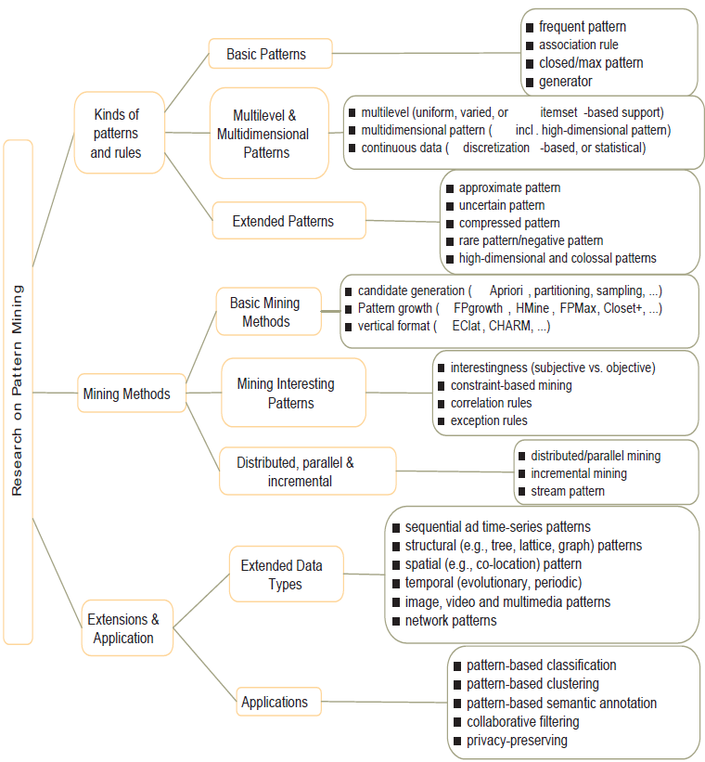
Research on Pattern Mining: A Road Map

Slide 3
Advanced Frequent Pattern Mining
Mining Diverse Patterns
Constraint-Based Frequent Pattern Mining
Sequential Pattern Mining
Graph Pattern Mining

Slide 4
Mining Diverse Patterns
Mining Multiple-Level Associations
Mining Multi-Dimensional Associations
Mining Quantitative Associations
Mining Negative Correlations

Slide 5
Mining Multiple-Level Frequent Patterns
Items often form hierarchies
Ex.: Dairyland 2% milk; Wonder wheat bread
How to set min-support thresholds?
Uniform min-support across multiple levels (reasonable?)
Level-reduced min-support: Items at the lower level are expected to have lower support
Uniform support
Reduced support
Level 1
min_sup = 5%
Milk
[support = 10%]
Level 1
min_sup = 5%
Level 2
min_sup = 1%
Level 2
min_sup = 5%
2% Milk
[support = 6%]
Skim Milk
[support = 2%]

Slide 6
Redundancy Filtering at Mining Multi-Level Associations
Multi-level association mining may generate many redundant rules
Redundancy filtering: Some rules may be redundant due to “ancestor” relationships between items
(Suppose the 2% milk sold is about ¼ of milk sold in gallons)
milk ⇒ wheat bread [support = 8%, confidence = 70%] (1)
2% milk ⇒ wheat bread [support = 2%, confidence = 72%] (2)
A rule is redundant if its support is close to the “expected” value, according to its “ancestor” rule, and it has a similar confidence as its “ancestor”
Rule (1) is an ancestor of rule (2), which one to prune?

Slide 7
Customized Min-Supports for Different Kinds of Items
We have used the same min-support threshold for all the items or item sets to be mined in each association mining
In reality, some items (e.g., diamond, watch, …) are valuable but less frequent
It is necessary to have customized min-support settings for different kinds of items
One Method: Use group-based “individualized” min-support
E.g., {diamond, watch}: 0.05%; {bread, milk}: 5%; …

Slide 8
Mining Multi-Dimensional Associations
Single-dimensional rules (e.g., items are all in “product” dimension)
buys(X, “milk”) ⇒ buys(X, “bread”)
Multi-dimensional rules (i.e., items in ≥ 2 dimensions or predicates)
Inter-dimension association rules (no repeated predicates)
age(X, “18-25”) ∧ occupation(X, “student”) ⇒ buys(X, “coke”)
Hybrid-dimension association rules (repeated predicates)
age(X, “18-25”) ∧ buys(X, “popcorn”) ⇒ buys(X, “coke”)
Attributes can be categorical or numerical
Categorical Attributes (e.g., profession, product: no ordering among values): Data cube for inter-dimension association
Quantitative Attributes: Numeric, implicit ordering among values—discretization, clustering, and gradient approaches

Slide 9
Mining Quantitative Associations
Mining quantitative associations
Ex.: Gender = female ⇒ Wage: mean=$7/hr (overall mean = $9)
LHS: a subset of the population
RHS: an extraordinary behavior of this subset
Rule condition can be categorical or numerical
Ex.: (Gender = female) ^ (South = yes) ⇒ mean wage = $6.3/hr
Ex.: Education in [14-18] (yrs) ⇒ mean wage = $11.64/hr
Data cube technology?

Slide 10
Rare Patterns vs. Negative Patterns
Rare patterns
Very low support but interesting (e.g., buying Rolex watches)
How to mine them? Setting individualized, group-based min-support thresholds for different groups of items
Negative patterns
Negatively correlated: Unlikely to happen together
Ex.: Since it is unlikely that the same customer buys both a Ford Expedition (an SUV car) and a Ford Fusion (a hybrid car), buying a Ford Expedition and buying a Ford Fusion are likely negatively correlated patterns
How to define negative patterns?

Slide 11
Defining Negative Correlated Patterns
A support-based definition
If itemsets A and B are both frequent but rarely occur together, i.e., sup(A U B) << sup (A) × sup(B)
Then A and B are negatively correlated
Is this a good definition for large transaction datasets?
Ex.: Suppose a store sold two needle packages A and B 100 times each, but only one transaction contained both A and B
When there are in total 200 transactions, we have
s(A U B) = 0.005, s(A) × s(B) = 0.25, s(A U B) << s(A) × s(B)
But when there are 10⁵ transactions, we have
s(A U B) = 1/10⁵, s(A) × s(B) = 1/10³ × 1/10³, s(A U B) > s(A) × s(B)
What is the problem? — Null transactions: The support-based definition is not null-invariant!
Does this remind you the definition of lift?

Slide 12
Defining Negative Correlation: Need Null-Invariance in Definition
A good definition on negative correlation should take care of the null-invariance problem
Whether two itemsets A and B are negatively correlated should not be influenced by the number of null-transactions
A Kulczynski measure-based definition
If itemsets A and B are frequent but (P(A|B) + P(B|A))/2 < є, where є is a negative pattern threshold, then A and B are negatively correlated
For the same needle package problem:
No matter there are in total 200 or 10⁵ transactions
If є = 0.01, we have (P(A|B) + P(B|A))/2 = (0.01 + 0.01)/2 < є

Slide 13
Advanced Frequent Pattern Mining
Mining Diverse Patterns
Constraint-Based Frequent Pattern Mining
Sequential Pattern Mining
Graph Pattern Mining

Slide 14
Why Constraint-Based Mining?
Finding all the patterns in a dataset autonomously? — unrealistic!
Too many patterns but not necessarily user-interested!
Pattern mining should be an interactive process
User directs what to be mined using a data mining query language (or a graphical user interface)
Constraint-based mining
User flexibility: provides constraints on what to be mined
Optimization: explores such constraints for efficient mining
Constraint-based mining: Constraint-pushing, similar to push selection first in DB query processing

Slide 15
Meta-Rule Guided Mining
A meta-rule can contain partially instantiated predicates & constants
P₁(X, Y) ^ P₂(X, W) ⇒ buys(X, “iPad”)
The resulting mined rule can be
age(X, “15-25”) ^ profession(X, “student”) ⇒ buys(X, “iPad”)
In general, (meta) rules can be in the form of
P₁ ^ P₂ ^ … ^ P_{l} ⇒ Q₁ ^ Q₂ ^ … ^ Q_{r}
Method to find meta-rules
Find frequent (l + r) predicates (based on min-support)
Push constants deeply when possible into the mining process
Also, push min_sup, min_conf, and other measures as early as possible (measures acting as constraints)

Slide 16
Different Kinds of Constraints Lead to Different Pruning Strategies
Constraints can be categorized as
Pattern space pruning constraints vs. data space pruning constraints
Pattern space pruning constraints
Data space pruning constraints

Slide 17
Pattern Space Pruning with Pattern Anti-Monotonicity
Constraint c is anti-monotone
If an itemset S violates constraint c, so does any of its superset
That is, mining on itemset S can be terminated
Ex. 1: c1: sum(S.price) ≤ v is anti-monotone
Ex. 2: c2: range(S.profit) ≤ 15 is anti-monotone
Itemset ab violates c2 (range(ab) = 40)
So does every superset of ab
Ex. 3. c3: sum(S.Price) ≥ v is not anti-monotone
Ex. 4. Is c4: support(S) ≥ σ anti-monotone?
Yes! Apriori pruning is essentially pruning with an anti-monotonic constraint!
TID | Transaction
10 | a, b, c, d, f, h
20 | b, c, d, f, g, h
30 | b, c, d, f, g
40 | a, c, e, f, g
Item | Profit
a | 40
b | 0
c | -20
d | -15
e | -30
f | -10
g | 20
h | 5
min_sup = 2
price(item) > 0

Slide 18
Pattern Monotonicity and Its Roles
A constraint c is monotone: if an itemset S satisfies the constraint c, so does any of its superset
That is, we do not need to check c in subsequent mining
Ex. 1: c1: sum(S.Price) ≥ v is monotone
Ex. 2: c2: min(S.Price) ≤ v is monotone
Ex. 3: c3: range(S.profit) ≥ 15 is monotone
Itemset ab satisfies c3
So does every superset of ab
TID | Transaction
10 | a, b, c, d, f, h
20 | b, c, d, f, g, h
30 | b, c, d, f, g
40 | a, c, e, f, g
Item | Profit
a | 40
b | 0
c | -20
d | -15
e | -30
f | -10
g | 20
h | 5
min_sup = 2
price(item) > 0

Slide 19
Data Space Pruning with Data Anti-Monotonicity
A constraint c is data anti-monotone: In the mining process, if a data entry (transaction) t cannot satisfy constraint c, t cannot satisfy any pattern p under c
Data space pruning: Data entry t can be pruned
Ex. 1: c₁: sum(S.Profit) ≥ v is data anti-monotone
Let constraint c₁ be: sum{S.Profit} ≥ 25
T₃₀: {b, c, d, f, g} can be removed since none of their combinations can make an S whose sum of the profit is ≥ 25
Ex. 2: c₂: min(S.Price) ≤ v is data anti-monotone
Consider v = 5 but every item in transaction T₅₀ has a price higher than 10
TID | Transaction
10 | a, b, c, d, f, h
20 | b, c, d, f, g, h
30 | b, c, d, f, g
40 | a, c, e, f, g
Item | Profit
a | 40
b | 0
c | -20
d | -15
e | -30
f | -10
g | 20
h | 5
min_sup = 2
price(item) > 10

Slide 20
Different Kinds of Constraints Lead to Different Pruning Strategies
Constraints can be categorized as
Pattern space pruning constraints vs. data space pruning constraints
Pattern space pruning constraints
Anti-monotonic: If constraint c is violated, its further mining can be terminated (=no superset)
Monotonic: If c is satisfied, no need to check c again (=all supersets)
Succinct: If c can be enforced by directly manipulating the data
Convertible: c can be converted to monotonic or anti-monotonic if items can be properly ordered in processing
Data space pruning constraints
Data anti-monotonic: If a transaction t does not satisfy c, then t can be pruned to reduce data processing effort (=no that transaction)
Data succinct: Data space can be pruned at the initial pattern mining process

Slide 21
Pattern Mining Methods
Pattern | Closed Pattern (Concepts) | Idea 1: Pattern candidate generation and pruning | Idea 2: Vertical format to accelerate mining | Idea 3: Pattern growth
Frequent pattern (itemset) | ? | ? | ? | ?
Sequential pattern | ? | ? | ? | ?
Graph pattern | ? | ? | x | ?

Slide 22
Pattern Mining Methods
Pattern | Closed Pattern (Concepts) | Idea 1: Pattern candidate generation and pruning | Idea 2: Vertical format to accelerate mining | Idea 3: Pattern growth
Frequent pattern (itemset) | Closed frequent itemset | Apriori | ECLAT | FP-Growth
Sequential pattern | Closed seq. pattern | ? | ? | ?
Graph pattern | Closed graph pattern | ? | x | ?

Slide 23
Advanced Frequent Pattern Mining
Mining Diverse Patterns
Constraint-Based Frequent Pattern Mining
Sequential Pattern Mining
Graph Pattern Mining

Slide 24
Sequential Patterns: Applications
Sequential pattern mining has broad applications
Customer shopping sequences
Purchase a laptop first, then a digital camera, and then a smartphone, within 6 months
Medical treatments, natural disasters (e.g., earthquakes), science & engineering processes, stocks and markets, ...
Weblog click streams, calling patterns, …
Software engineering: Program execution sequences, …
Biological sequences: DNA, protein, …

Slide 25
Sequential Pattern and Sequential Pattern Mining
Sequential pattern mining: Given a set of sequences, find the complete set of frequent subsequences (i.e., satisfying the min_sup threshold)
An element may contain a set of items (also called events)
Items within an element are unordered and we list them alphabetically
Given support threshold min_sup = 2, <(ab)c> is a sequential pattern
A sequence database
SID | Sequence
10 | <a(abc)(ac)d(cf)>
20 | <(ad)c(bc)(ae)>
30 | <(ef)(ab)(df)cb>
40 | <eg(af)cbc>
A sequence: < (ef) (ab) (df) c b >
<a(bc)dc> is a subsequence of <a(abc)(ac)d(cf)>
http://hanj.cs.illinois.edu/pdf/span01.pdf

Slide 26
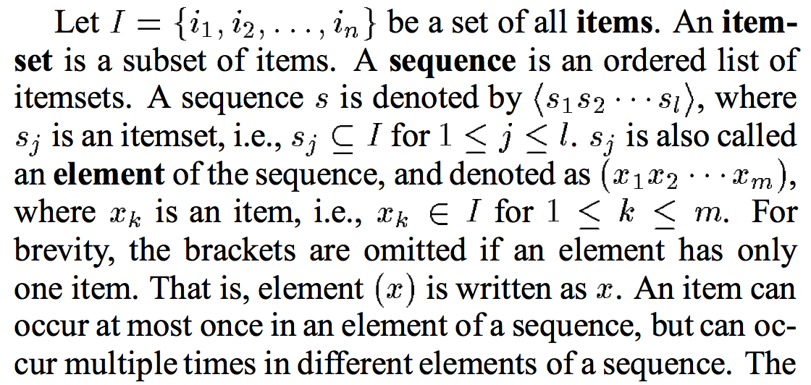
Sequence vs Element/Itemset/Event vs Item/Instance

Slide 27
Sequential Pattern Mining Algorithms
Algorithm requirement: Efficient, scalable, finding complete set, incorporating various kinds of user-specific constraints
The Apriori property still holds: If a subsequence s₁ is infrequent, none of s₁’s super-sequences can be frequent
Representative algorithms
Apriori-based Generalized Sequential Patterns: GSP (Srikant & Agrawal @ EDBT’96)
Vertical format-based mining: SPADE (Zaki@Machine Leanining’00)
Pattern-growth methods: PrefixSpan (Pei, et al. @TKDE’04)
Mining closed sequential patterns: CloSpan (Yan, et al. @SDM’03)
Constraint-based sequential pattern mining

Slide 28
GSP: Apriori-Based Sequential Pattern Mining
SID | Sequence
10 | <(bd)cb(ac)>
20 | <(bf)(ce)b(fg)>
30 | <(ah)(bf)abf>
40 | <(be)(ce)d>
50 | <a(bd)bcb(ade)>
Initial candidates: All singleton sequences
<a>, <b>, <c>, <d>, <e>, <f>, <g>, <h>
Scan DB once, count support for each candidate
Generate length-2 candidate sequences
min_sup = 2
 | <a> | <b> | <c> | <d> | <e> | <f>
<a> | <aa> | <ab> | <ac> | <ad> | <ae> | <af>
<b> | <ba> | <bb> | <bc> | <bd> | <be> | <bf>
<c> | <ca> | <cb> | <cc> | <cd> | <ce> | <cf>
<d> | <da> | <db> | <dc> | <dd> | <de> | <df>
<e> | <ea> | <eb> | <ec> | <ed> | <ee> | <ef>
<f> | <fa> | <fb> | <fc> | <fd> | <fe> | <ff>
Length-2 candidates:
36 + 15= 51
Without Apriori pruning:
8*8+8*7/2=92 candidates
Cand. | sup
<a> | 3
<b> | 5
<c> | 4
<d> | 3
<e> | 3
<f> | 2
<g> | 1
<h> | 1
 | <a> | <b> | <c> | <d> | <e> | <f>
<a> |  | <(ab)> | <(ac)> | <(ad)> | <(ae)> | <(af)>
<b> |  |  | <(bc)> | <(bd)> | <(be)> | <(bf)>
<c> |  |  |  | <(cd)> | <(ce)> | <(cf)>
<d> |  |  |  |  | <(de)> | <(df)>
<e> |  |  |  |  |  | <(ef)>
<f>
GSP (Generalized Sequential Patterns): Srikant & Agrawal @ EDBT’96)

Slide 29
GSP Mining and Pruning
Repeat (for each level (i.e., length-k))
Scan DB to find length-k frequent sequences
Generate length-(k+1) candidate sequences from length-k frequent sequences using Apriori
set k = k+1
Until no frequent sequence or no candidate can be found

Slide 30
Sequential Pattern Mining in Vertical Data Format: The SPADE Algorithm
A sequence database is mapped to: <SID, EID>
Grow the subsequences (patterns) one item at a time by Apriori candidate generation
SID | Sequence
1 | <a(abc)(ac)d(cf)>
2 | <(ad)c(bc)(ae)>
3 | <(ef)(ab)(df)cb>
4 | <eg(af)cbc>
min_sup = 2
Ref: SPADE (Sequential PAttern Discovery using Equivalent Class) [M. Zaki 2001]
https://pdfs.semanticscholar.org/39a0/80c17dec400a6f04af5fe5746dab3a5eb0dc.pdf

Slide 31
PrefixSpan: A Pattern-Growth Approach
Prefix and suffix
Given <a(abc)(ac)d(cf)>
Prefixes: <a>, <aa>, <a(ab)>, <a(abc)>, …
Prefixes-based projection
PrefixSpan Mining: Prefix Projections
Step 1: Find length-1 sequential patterns
<a>, <b>, <c>, <d>, <e>, <f>
Step 2: Divide search space and mine each projected DB
<a>-projected DB,
<b>-projected DB,
…
<f>-projected DB, …
SID | Sequence
10 | <a(abc)(ac)d(cf)>
20 | <(ad)c(bc)(ae)>
30 | <(ef)(ab)(df)cb>
40 | <eg(af)cbc>
Prefix | Suffix (Projection)
<a> | <(abc)(ac)d(cf)>
<aa> | <(_bc)(ac)d(cf)>
<ab> | <(_c)(ac)d(cf)>
PrefixSpan (Prefix-projected Sequential pattern mining) Pei, et al. @TKDE’04
http://hanj.cs.illinois.edu/pdf/span01.pdf

Slide 32
Advanced Frequent Pattern Mining
Mining Diverse Patterns
Constraint-Based Frequent Pattern Mining
Sequential Pattern Mining
Graph Pattern Mining

Slide 33
Frequent (Sub)Graph Patterns
Given a labeled graph dataset D = {G₁, G₂, …, G_{n}}, the supporting graph set of a subgraph g is D_{g} = {G_{i} | g ⊆ G_{i}, G_{i} ∈D}.
support(g) = |D_{g}|/ |D|
A (sub)graph g is frequent if support(g) ≥ min_sup Ex.: Chemical structures
Alternative:
Mining frequent subgraph patterns from a single large graph or network
Graph Dataset
(A)
(B)
(C)
min_sup = 2
Frequent Graph Patterns
(1)
(2)

Slide 34
Graph Pattern Mining: Applications
Bioinformatics
Gene networks, protein interactions, metabolic pathways
Chem-informatics: Mining chemical compound structures
Social networks, web communities, tweets, …
Cell phone networks, computer networks, …
Web graphs, XML structures, semantic Web, information networks
Software engineering: program execution flow analysis
Building blocks for graph classification, clustering, compression, comparison, and correlation analysis
Graph indexing and graph similarity search

Slide 35
Graph Pattern Mining Algorithms: Different Methodologies
Generation of candidate subgraphs
Apriori vs. pattern growth (e.g., FSG vs. gSpan)
Search order
Breadth vs. depth
Elimination of duplicate subgraphs
Passive vs. active (e.g., gSpan (Yan&Han’02))
Order of pattern discovery
Path → tree → graph (e.g., GASTON (Nijssen&Kok’04))

Slide 36
Apriori-Based Approach
The Apriori property (anti-monotonicity): A size-k subgraph is frequent if and only if all of its subgraphs are frequent
A candidate size-(k+1) edge/vertex subgraph is generated if its corresponding two k-edge/vertex subgraphs are frequent
Iterative mining process:
Candidate-generation → candidate pruning → support counting → candidate elimination
(k+1)-edge
k-edge
G₁
G
G₂
G’
…
G’’
G_{n}
Join

Slide 37
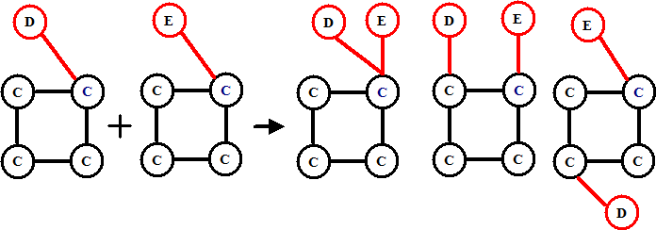
Candidate Generation: Vertex Growing vs. Edge Growing
Methodology: breadth-search, Apriori joining two size-k graphs
Many possibilities at generating size-(k+1) candidate graphs
Generating new graphs with one more vertex
AGM (Inokuchi, et al., PKDD’00)
Generating new graphs with one more edge
FSG (Kuramochi and Karypis, ICDM’01)
Performance shows via edge growing is more efficient

Slide 38
Pattern-Growth Approach
Depth-first growth of subgraphs from k-edge to (k+1)-edge, then (k+2)-edge subgraphs
Major challenge
Generating many duplicate subgraphs
Major idea to solve the problem
Define an order to generate subgraphs
DFS spanning tree: Flatten a graph into a sequence using depth-first search
gSpan (Yan & Han: ICDM’02)
(k+2)-edge
(k+1)-edge
…
G₁
k-edge
duplicate
graphs
G₂
G
…
G_{n}
…
http://cs.ucsb.edu/~xyan/papers/gSpan-short.pdf

Slide 39
Why Mining Closed Graph Patterns?
Challenge: An n-edge frequent graph may have 2^{n} subgraphs
Motivation: Explore closed frequent subgraphs to handle graph pattern explosion problem
A frequent graph G is closed if there exists no supergraph of G that carries the same support as G
Lossless compression: Does not contain non-closed graphs, but still ensures that the mining result is complete
Algorithm CloseGraph: Mines closed graph patterns directly
If this subgraph is closed in the graph dataset, it implies that none of its frequent super-graphs carries the same support

Slide 40
CloseGraph: Directly Mining Closed Graph Patterns
CloseGraph: Mining closed graph patterns by extending gSpan
Suppose G and G₁ are frequent, and G is a subgraph of G₁
If in any part of the graph in the dataset where G occurs, G₁ also occurs, then we need not grow G (except some special, subtle cases), since none of G’s children will be closed except those of G₁
G₁
At what condition can we
stop searching their children,
i.e., early termination?
k-edge
G₂
G
…
https://pdfs.semanticscholar.org/a1c1/5e63690c774b725fc91dcc77a629d01c3733.pdf
G_{n}
(k+1)-edge

Slide 41
Experiment and Performance Comparison
The AIDS antiviral screen compound dataset from NCI/NIH
The dataset contains 43,905 chemical compounds
Discovered Patterns: The smaller minimum support, the bigger and more interesting subgraph patterns discovered
20%
10%
5%
# of Patterns: Frequent vs. Closed
Runtime: Frequent vs. Closed
Run time (sec)
Number of patterns
Minimum support
Minimum support

Slide 42
References: Mining Diverse Patterns
R. Srikant and R. Agrawal, “Mining generalized association rules”, VLDB'95
Y. Aumann and Y. Lindell, “A Statistical Theory for Quantitative Association Rules”, KDD'99
K. Wang, Y. He, J. Han, “Pushing Support Constraints Into Association Rules Mining”, IEEE Trans. Knowledge and Data Eng. 15(3): 642-658, 2003
D. Xin, J. Han, X. Yan and H. Cheng, "On Compressing Frequent Patterns", Knowledge and Data Engineering, 60(1): 5-29, 2007
D. Xin, H. Cheng, X. Yan, and J. Han, "Extracting Redundancy-Aware Top-K Patterns", KDD'06
J. Han, H. Cheng, D. Xin, and X. Yan, "Frequent Pattern Mining: Current Status and Future Directions", Data Mining and Knowledge Discovery, 15(1): 55-86, 2007
F. Zhu, X. Yan, J. Han, P. S. Yu, and H. Cheng, “Mining Colossal Frequent Patterns by Core Pattern Fusion”, ICDE'07

Slide 43
References: Constraint-Based Frequent Pattern Mining
R. Srikant, Q. Vu, and R. Agrawal, “Mining association rules with item constraints”, KDD'97
R. Ng, L.V.S. Lakshmanan, J. Han & A. Pang, “Exploratory mining and pruning optimizations of constrained association rules”, SIGMOD’98
G. Grahne, L. Lakshmanan, and X. Wang, “Efficient mining of constrained correlated sets”, ICDE'00
J. Pei, J. Han, and L. V. S. Lakshmanan, “Mining Frequent Itemsets with Convertible Constraints”, ICDE'01
J. Pei, J. Han, and W. Wang, “Mining Sequential Patterns with Constraints in Large Databases”, CIKM'02
F. Bonchi, F. Giannotti, A. Mazzanti, and D. Pedreschi, “ExAnte: Anticipated Data Reduction in Constrained Pattern Mining”, PKDD'03
F. Zhu, X. Yan, J. Han, and P. S. Yu, “gPrune: A Constraint Pushing Framework for Graph Pattern Mining”, PAKDD'07

Slide 44
References: Sequential Pattern Mining
R. Srikant and R. Agrawal, “Mining sequential patterns: Generalizations and performance improvements”, EDBT’96
M. Zaki, “SPADE: An Efficient Algorithm for Mining Frequent Sequences”, Machine Learning, 2001
J. Pei, J. Han, B. Mortazavi-Asl, J. Wang, H. Pinto, Q. Chen, U. Dayal, and M.-C. Hsu, "Mining Sequential Patterns by Pattern-Growth: The PrefixSpan Approach", IEEE TKDE, 16(10), 2004
X. Yan, J. Han, and R. Afshar, “CloSpan: Mining Closed Sequential Patterns in Large Datasets”, SDM'03
J. Pei, J. Han, and W. Wang, "Constraint-based sequential pattern mining: the pattern-growth methods", J. Int. Inf. Sys., 28(2), 2007
M. N. Garofalakis, R. Rastogi, K. Shim: Mining Sequential Patterns with Regular Expression Constraints. IEEE Trans. Knowl. Data Eng. 14(3), 2002
H. Mannila, H. Toivonen, and A. I. Verkamo, “Discovery of frequent episodes in event sequences”, Data Mining and Knowledge Discovery, 1997

Slide 45
References: Graph Pattern Mining
C. Borgelt and M. R. Berthold, Mining molecular fragments: Finding relevant substructures of molecules, ICDM'02
J. Huan, W. Wang, and J. Prins. Efficient mining of frequent subgraph in the presence of isomorphism, ICDM'03
A. Inokuchi, T. Washio, and H. Motoda. An apriori-based algorithm for mining frequent substructures from graph data, PKDD'00
M. Kuramochi and G. Karypis. Frequent subgraph discovery, ICDM'01
S. Nijssen and J. Kok. A Quickstart in Frequent Structure Mining can Make a Difference. KDD'04
N. Vanetik, E. Gudes, and S. E. Shimony. Computing frequent graph patterns from semistructured data, ICDM'02
X. Yan and J. Han, gSpan: Graph-Based Substructure Pattern Mining, ICDM'02
X. Yan and J. Han, CloseGraph: Mining Closed Frequent Graph Patterns, KDD'03
X. Yan, P. S. Yu, J. Han, Graph Indexing: A Frequent Structure-based Approach, SIGMOD'04
X. Yan, P. S. Yu, and J. Han, Substructure Similarity Search in Graph Databases, SIGMOD'05

