Slide 1
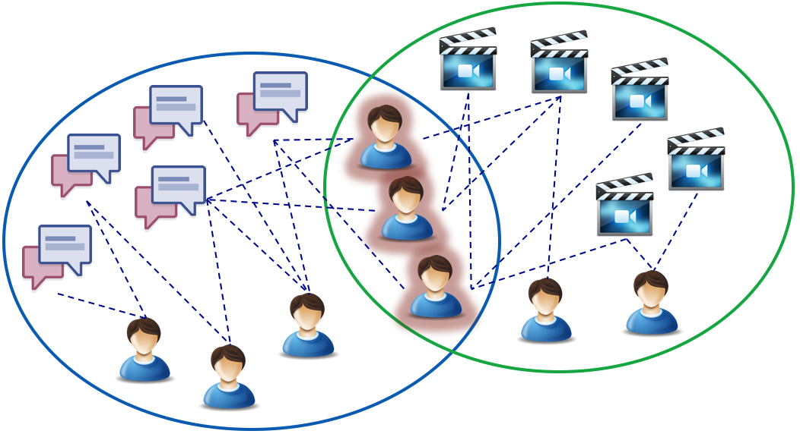
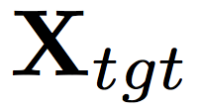
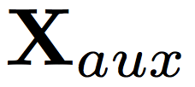
Little is Much: Bridging Cross-Platform
Behaviors through Overlapped Crowds
Meng Jiang, Peng Cui, Shiqiang Yang (Tsinghua U),
Nicholas Jing Yuan, Xing Xie (MSRA)
Q: Can we transfer the auxiliary big data A
to improve the performance on sparse data B
as good as richer but small data C?
B
A
C
Cross-platform:
We register Uber with our
Facebook accounts.
Can we improve the prediction
with auxiliary data?

