Slide 1
Data-Driven Behavioral Analytics: Observations, Representations and Models
Meng Jiang (UIUC)
Peng Cui (Tsinghua)
Jiawei Han (UIUC)
http://www.meng-jiang.com/tutorial-cikm16.html
Tutorial in CIKM 2016, October 24, Indianapolis, IN
Notes:
[University]

Slide 2
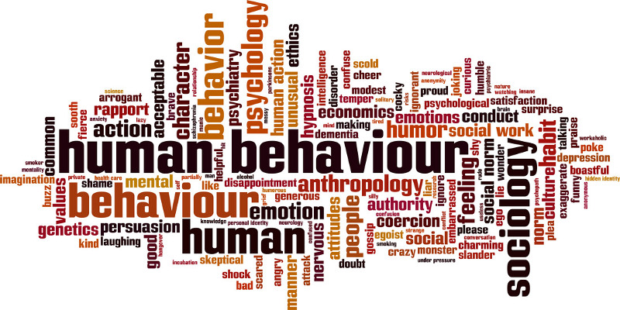
What is Behavior?
Definition. Interactions made by individuals in conjunction with themselves or their environment. (Wikipedia)

Slide 3
Behavioral Analysis
Significance. What can we discover from behavioral data?
Ex. Given every phone call/message between military leaders, scientists, businesspersons, find…
Observations
Who, what, where, when, why, how…
(scientific view)
Representations
Graph, network, matrix, tensor…
(mathematical view)
Models
Prediction, recommendation, anomaly detection… (application view)

Slide 4

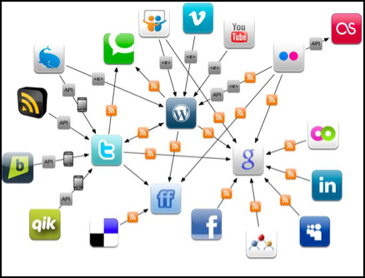
Why Behavioral Analysis Today?
Today. The human behaviors are broadly recorded in an unprecedented level. Insights of sciences and society?
Physical World
Online Applications

Slide 7
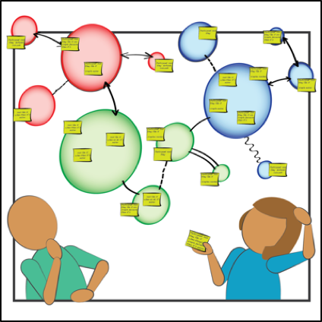
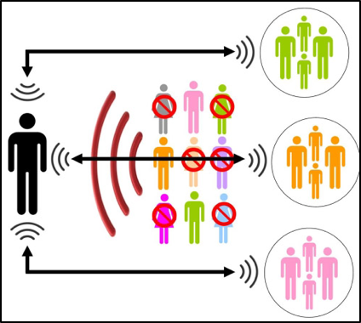
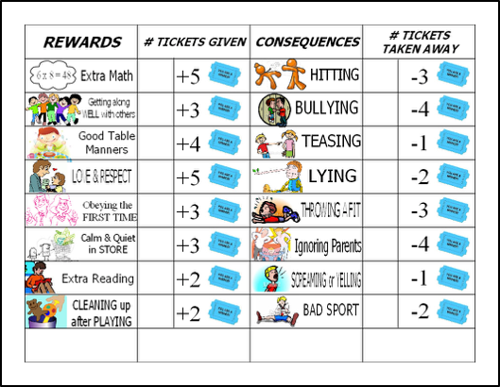
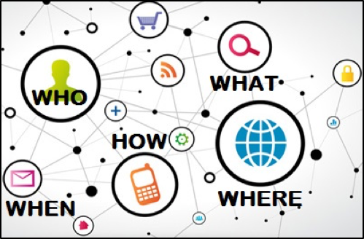
Challenges in Behavioral Analysis
Content
(preference)
Social context
(influence)
Behavioral Analysis
Spatiotemporal context
Intention
(suspiciousness)

Slide 8

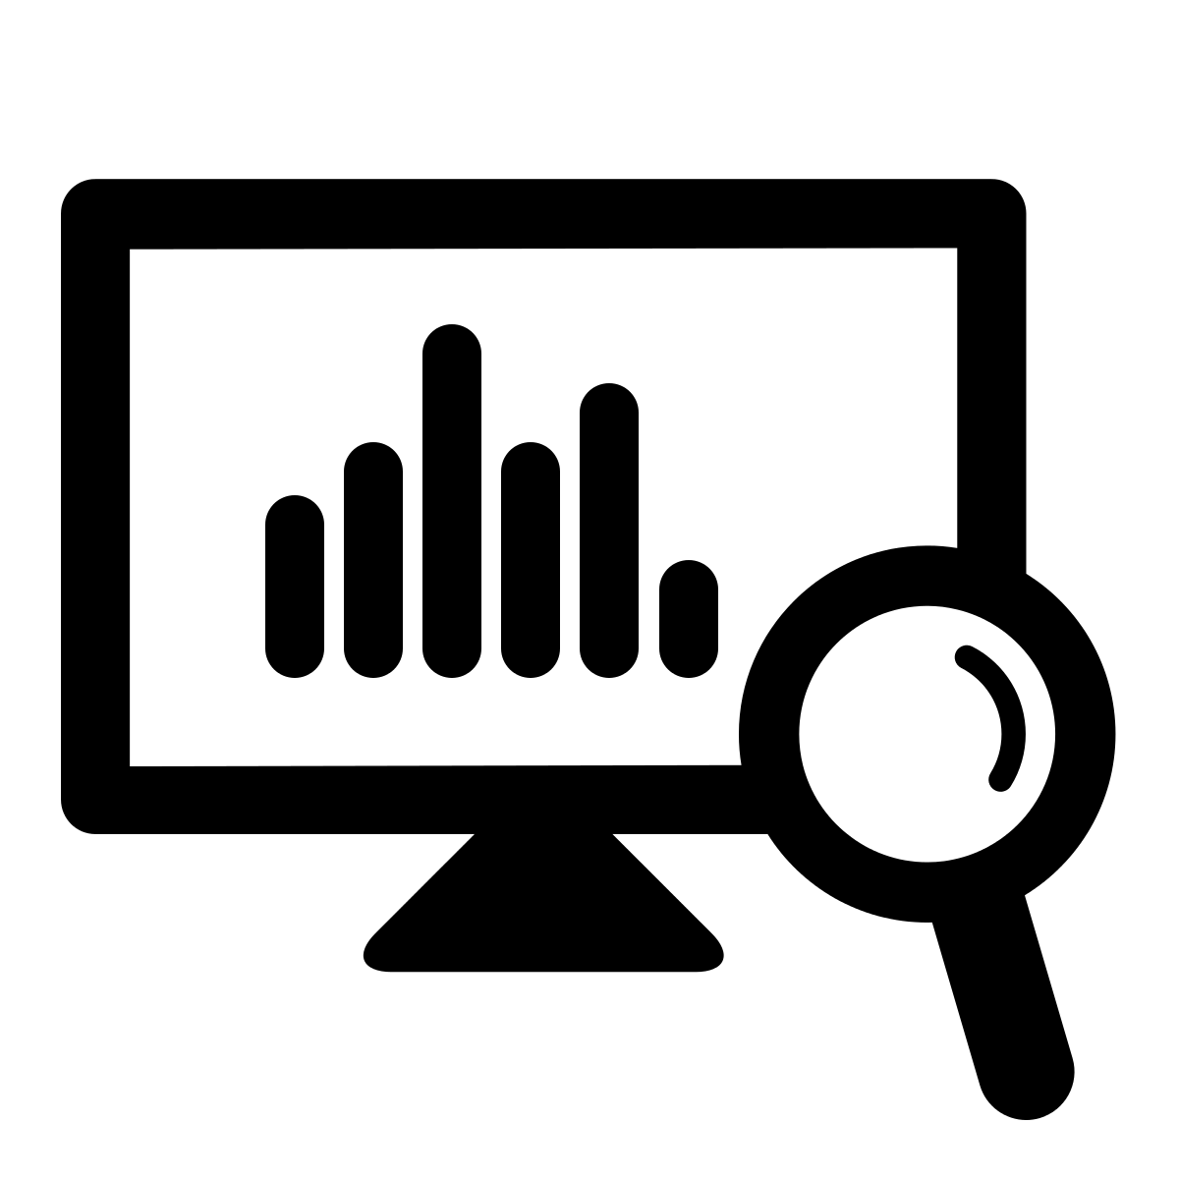





Methodology: Why Data-Driven?
Experience-Driven
Data-Driven
Applications. Recommender systems, fraud/spam detection.
Representation. Behavior Network for interaction.
Nodes: users/authors, items (e.g., products, tweets, papers), etc.
Links: (interaction) following, purchasing, tweeting, publishing, etc.
Node attributes: user profiles, item properties/features, etc.
Link attributes: similarity, distance, weight, etc.
Observation
Representation
Models/Algorithms

Slide 9




Data to Network to Knowledge
Information Network
(entities, attributes, relationships)
Structuring
Integration
Rich unstructured text data
Behavior Network
tweets, news, msgs…
u
t
product/restaurant review…
i
l
publications (abstract/full text):
PubMed, dblp, acmdl
a
Structured data
h
@

Slide 10
Outline: Data-Driven Behavioral Analytics
Mining behavior networks with social and spatiotemporal contexts to support intelligent and trustworthy systems
Mining for behavior prediction and recommendation
Mining for suspicious behavior detection
Intelligent and Trustworthy Systems
Structured Data
Behavior Networks
Behavior Prediction
& Recommendation
Summarization
Suspicious Behavior Detection

Slide 11
Outline: Data-Driven Behavioral Analytics
Mining behavior networks with social and spatiotemporal contexts to support intelligent and trustworthy systems
Mining for behavior prediction and recommendation
Mining for suspicious behavior detection
Structuring behavioral content and integrating behavioral analysis with information networks
Intelligent and Trustworthy Systems
Structured Data
Behavior Networks
Behavior Prediction
& Recommendation
+
Information Networks
Summarization
Unstructured Data
Suspicious Behavior Detection

