Slide 1

Chapter 4&5. Data Cube: Cube Computation
Meng Jiang
CSE 40647/60647 Data Science Fall 2017
Introduction to Data Mining

Slide 2
Previously on Data Science …
Chapter 1. Introduction.
Datasets
Data Cleaning
Data Integration
Application Problems
Informal Problem (Task) Definition
Notations
Formal (Learning?) Problem Definition
Task-Relevant Data Selection
Data Mining/Machine Learning
Knowledge (patterns, etc.)
Pattern evaluation

Slide 3
Previously on Data Science …
Chapter 2. Get to Know Your Data.
Data Objects and Attribute Types
Basic Statistical Descriptions
Central tendency (mean, median, mode, etc.)
Outlierness (variance, standard deviation, z-score, etc.)
Data Visualization
Box plot, Histogram, Bar chart, Q plot, Q-Q plot, Scatter plot, etc.
Measuring Data Similarity and Dissimilarity
Minkowski distances
Jaccard/cosine similarity
KL divergence

Slide 4
Previously on Data Science …
Chapter 3. Data Processing.
Data cleaning: Missing data, Noisy data
Data integration: Redundant data
Correlation analysis: Chi-square test, Covariance
Data reduction
Regression analysis: Linear, non-Linear
Histogram, Clustering, Sampling
Normalization: Min-max, Z-score, Decimal scaling
Dimensionality reduction
Feature selection
Feature extraction: PCA (eigenvectors), etc.

Slide 5
Concrete Learning Goals
Can process raw data: data cleaning, data integration, data reduction, dimension reduction
Can describe data warehouse, OLAP, data cube concepts and technology that work on multi-dimensional datasets
Can use Apriori and FP-Growth for frequent pattern mining
Can describe diverse patterns, sequential patterns, graph patterns
Can use Decision Tree, Naïve Bayes, Ensembles for classification
Can describe SVMs and Neural Networks for classification
Can use K-Partitioning Methods (K-Means, etc.) for clustering
Can describe Kernel-based Clustering and Density-based Clustering
Can use appropriate measures to evaluate results of different functionalities

Slide 6
Cells: Dimension, Dimension Level and Dimension Value
A cell of transactions:
Time
Date
09/16
milk
Product
Item
South Bend
City
Location
A cell of papers:
Dataset
-
Twitter
matrix factorization
-
Method
social spam detection
-
Problem

Slide 7
Cells: Dimension Level and Concept Hierarchy
A cell of transactions:
Time: Year-Quarter-Month-Week-Day
Location: Country-State-City-Street
Item: Department-Product-Model
Time
Date
09/16
milk
Product
Item
South Bend
City
Location
A cell of papers:
Dataset
-
Twitter
matrix factorization
-
Method
social spam detection
-
Problem

Slide 8
Cells: Facts or Measures
A cell of transactions:
{TID45, TID137, TID451},
count=3,
dollars_sold=157
Time
Date
09/16
milk
Product
Item
South Bend
City
{PID31, PID217},
count=2,
citations=3317
Location
A cell of papers:
Dataset
-
Twitter
matrix factorization
-
Method
social spam detection
-
Problem

Slide 9
Cuboids: Dimension, Dimension Level
Time
Date
09/16
Product
Item
milk
South Bend
City
Location

Slide 10
Base Cells and Aggregate Cells
Suppose a cuboid has 3 dimensions (time, location, item) at specific dimension levels (date, city, product).
Base cells
(09/16, South Bend, milk)
Aggregate cells
(*, South Bend, milk)
(09/16, *, milk)
(09/16, South Bend, *)
(*, *, milk)
(*, South Bend, *)
(09/16, *, *)
(*, *, *), called the Apex cell
parent vs child cells
ancestor vs descendant cells
sibling cell:
(09/16, Mishawaka, milk)

Slide 11
Base Cuboids and Aggregate Cuboids
Time
Date
Time
Month
Product
Item
Department
City
Country
Item
(Date, City, Product)
Location
Location
(Month, Country, Department)
Time
Date
Apex cuboid: (*, *, *)
City
(Date, City, *)
Location

Slide 12
(N-Dimensional) Data Cube
Data cube can be viewed as a lattice of cuboids
The bottom-most cuboid is the base cuboid
The top-most cuboid (apex) contains only one cell
How many cuboids in an n-dimensional cube with L_{i} levels (at the i-th dimension)?
all
0-D (apex) cuboid
time
item
location
supplier
1-D cuboids
time, item
time,location
item,location
location,supplier
2-D cuboids
3-D cuboids
4-D (base) cuboid
Notes:
Li = I, T = 16

Slide 13
(N-Dimensional) Data Cube
Data cube can be viewed as a lattice of cuboids
The bottom-most cuboid is the base cuboid
The top-most cuboid (apex) contains only one cell
How many cuboids in an n-dimensional cube with L_{i} levels (at the i-th dimension)?
all
0-D (apex) cuboid
time
item
location
supplier
1-D cuboids
time, item
time,location
item,location
location,supplier
2-D cuboids
3-D cuboids
4-D (base) cuboid
Notes:
Li = I, T = 16

Slide 14
Data Cube: Definition
Data cube: A lattice of cuboids
In data warehousing literature, an n-D base cube is called a base cuboid
The top most 0-D cuboid, which holds the highest-level of summarization, is called the apex cuboid
The lattice of cuboids forms a data cube
A data cube, such as sales, allows data to be modeled and viewed in multiple dimensions
Dimension tables, such as item (item_name, brand, type), or time (day, week, month, quarter, year)
Fact table contains measures (such as dollars_sold) and keys to each of the related dimension tables
Schemas: Dimension tables and Fact tables

Slide 15
Star Schema
time
Sales Dimension Tables
time_key
day
day_of_the_week
month
quarter
year
item
item_key
item_name
brand
type
supplier_type
Sales Fact Table
time_key
item_key
branch_key
branch
location
location_key
branch_key
branch_name
branch_type
location_key
street
city
state_or_province
country
units_sold
dollars_sold
avg_sales
Measures

Slide 16
Snowflake Schema
time
item
time_key
day
day_of_the_week
month
quarter
year
item_key
item_name
brand
type
supplier_key
supplier
Sales Fact Table
supplier_key
supplier_type
time_key
item_key
branch_key
branch
location
Sales Dimension Tables
location_key
location_key
street
city_key
branch_key
branch_name
branch_type
units_sold
dollars_sold
city
city_key
city
state_or_province
country
avg_sales
Measures

Slide 17
Fact Constellation
time
time_key
day
day_of_the_week
month
quarter
year
item
Shipping Fact Table
item_key
item_name
brand
type
supplier_type
Sales Fact Table
time_key
time_key
item_key
shipper_key
item_key
branch_key
from_location
branch
location_key
to_location
location
branch_key
branch_name
branch_type
units_sold
location_key
street
city
province_or_state
country
dollars_cost
dollars_sold
units_shipped
avg_sales
shipper
Measures
shipper_key
shipper_name
location_key
shipper_type
Sales Dimension Tables

Slide 18
Modeling of Data Cubes
Modeling data cubes: dimensions & measures
Star schema: A fact table in the middle connected to a set of dimension tables
Snowflake schema: A refinement of star schema where some dimensional hierarchy is normalized into a set of smaller dimension tables, forming a shape similar to snowflake
Fact constellations: Multiple fact tables share dimension tables, viewed as a collection of stars, therefore called galaxy schema or fact constellation

Slide 19
Concept Hierarchy: Dimension Level and Dimension Value
all
all
region
Europe
...
North_America
country
Germany
...
Spain
Canada
...
Mexico
city
Frankfurt
...
Vancouver
...
Toronto
office
L. Chan
...
M. Wind

Slide 20
Data Cube Measures: Three Categories
Distributive: if the result derived by applying the function to n aggregate values is the same as that derived by applying the function on all the data without partitioning
E.g., count(), sum(), min(), max()
Algebraic: if it can be computed by an algebraic function with M arguments (where M is a bounded integer), each of which is obtained by applying a distributive aggregate function
avg(x) = sum(x) / count(x)
Holistic: if there is no constant bound on the storage size needed to describe a sub-aggregate.
E.g., median(), mode(), rank()
Q: How about standard_deviation(), Q1(), Q3()?
Notes:
stddev: algebraic
Q1, Q3: holistic

Slide 21
Typical Data Cube Operations
Roll up (drill up): summarize data
by climbing up hierarchy or by dimension reduction
Drill down (roll down): reverse of roll-up
from higher level summary to lower level summary or detailed data, or introducing new dimensions
Slice and dice: project and select
Pivot (rotate): reorient the cube, visualization

Slide 22
dicing
roll-up

Slide 23
slicing
drill-down
pivot

Slide 24
The “Compute Cube” Operator
Cube definition and computation
define cube sales [item, city, year]: sum (sales_in_dollars)
compute cube sales
Transform it into a SQL-like language (with a new operator cube by, introduced by Gray et al.’97)
SELECT item, city, year, SUM (amount)
FROM SALES
CUBE BY item, city, year
Need compute the following Group-Bys
(year, product, customer),
(year, product), (year, customer), (product, customer),
(year), (product), (customer)
()
()
(city)
(item)
(year)
(city, item)
(city, year)
(item, year)
(city, item, year)

Slide 25
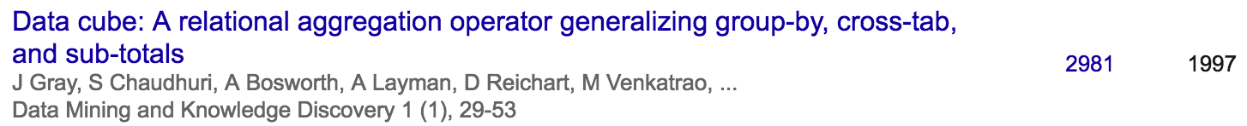
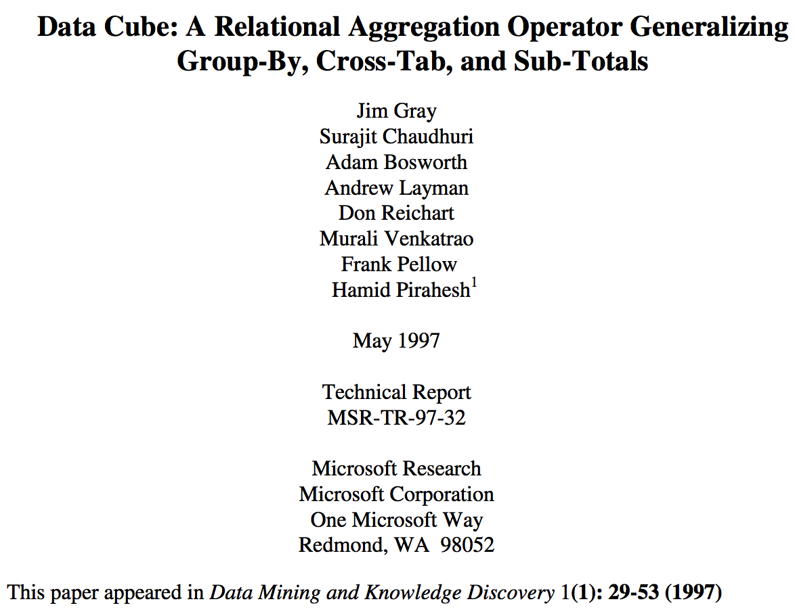
Data Cube History
Surajit Chaudhuri is a computer scientist best known for his contributions to database management systems. He is currently a distinguished scientist at Microsoft Research, where he leads the Data Management, Exploration and Mining group.
Adam Bosworth is a former Vice President of Product Management at Google Inc. from 2004–2007; prior to that, he was senior VP Engineering and Chief Software Architect at BEA Systems responsible for ...
Hamid Pirahesh, Ph.D., is an IBM fellow, ACM Fellow and a senior manager responsible for the exploratory database department at IBM Research - Almaden in San Jose, California. Dr. Hamid Pirahesh is the senior manager at IBM Almaden Research Center in San Jose, California.

Slide 26

https://jimgray.azurewebsites.net/

Slide 27

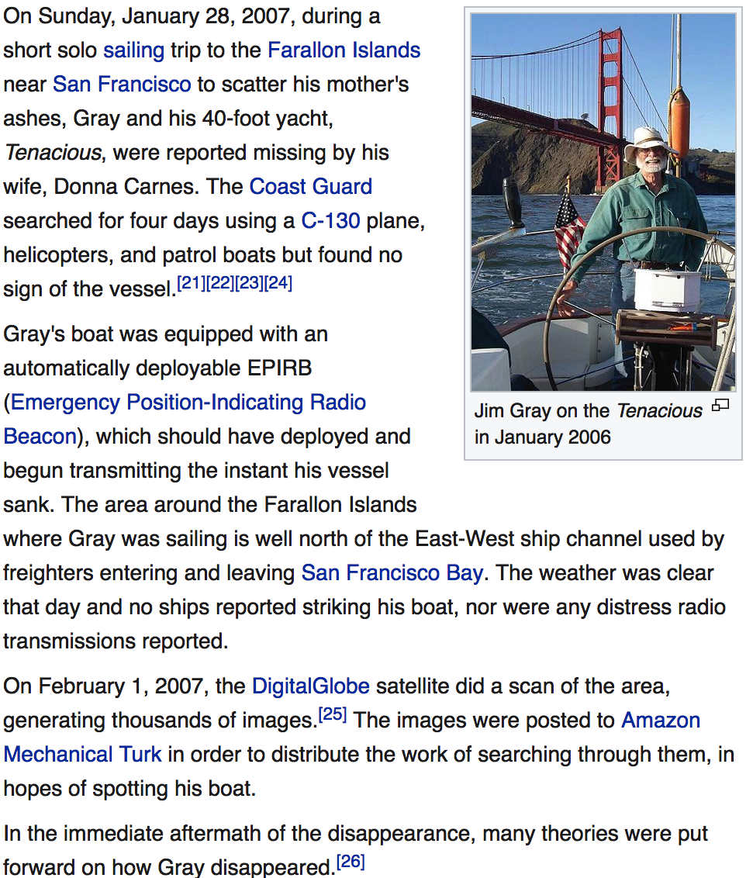
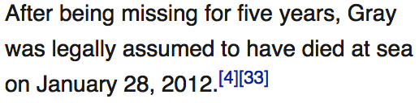
https://en.wikipedia.org/wiki/Jim_Gray_(computer_scientist)

Slide 28
Efficient Data Cube Computation
Data cube can be viewed as a lattice of cuboids
The bottom-most cuboid is the base cuboid
The top-most cuboid (apex) contains only one cell
How many cuboids in an n-dimensional cube with L_{i} levels?
Materialization of data cube
Full materialization: Materialize every (cuboid)
No materialization: Materialize none (cuboid)
Partial materialization: Materialize some cuboids
Which cuboids to materialize?
Selection based on size, sharing, access frequency, etc.

Slide 29
Review: Data Cube
Concepts
Cell, Cuboid, Cube
Dimension, Dimension Level, Dimension Value
Base/Aggregate Cell/Cuboid
Components
Dimension tables and Fact tables
Concept hierarchy and Measures
Schemas
Operations
Materialization
Partial materialization:
Which cuboids to materialize?

Slide 30

Q: What do they hate the most?

Slide 31
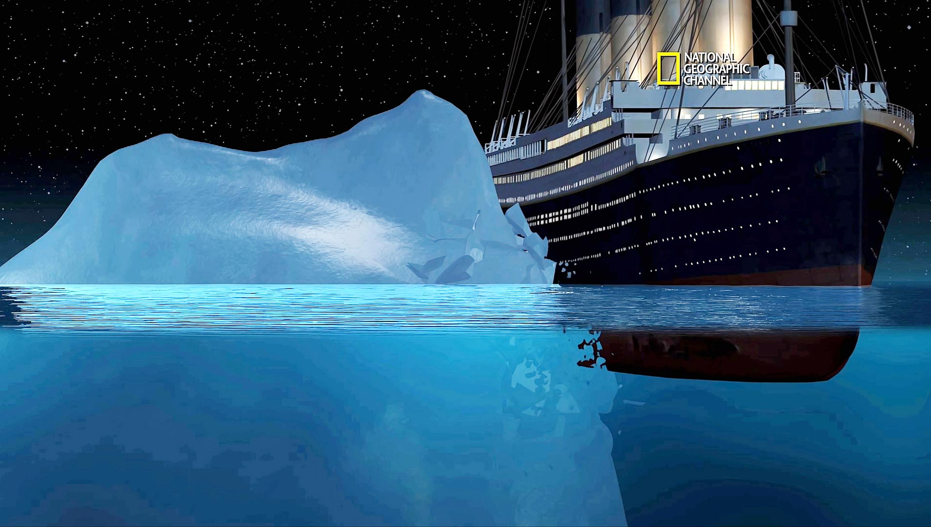
Iceberg

Slide 32

Cube Materialization: Full Cube vs. Iceberg Cube
Full cube vs. iceberg cube
compute cube sales iceberg as
select date, product, city, department, count(*)
from salesInfo
cube by date, product, city
having count(*) >= min support
Compute only the cells whose measure satisfies the iceberg condition
Only a small portion of cells may be “above the water’’ in a sparse cube
Ex.: Show only those cells whose count is no less than 100

Slide 33
Why Iceberg Cube?
Advantages of computing iceberg cubes
No need to save nor show those cells whose value is below the threshold (iceberg condition)
Efficient methods may even avoid computing the un-needed, intermediate cells
Avoid explosive growth
Example: A cube with 100 dimensions
Suppose it contains only 2 base cells and the count of each cell is 1:
{(a₁, a₂, a₃, …., a₁₀₀) : 1, (a₁, a₂, b₃, …, b₁₀₀) : 1}
How many aggregate cells if “having count >= 1” (non-empty)?
What are the iceberg cells with condition “having count >= 2”?
Notes:
For {(a₁, a₂, a₃ . . . , a₁₀₀), (a₁, a₂, b₃, . . . , b₁₀₀)}, the total # of non-base cells should be 2 * (2^{100} – 1) – 4.
This is calculated as follows:
(a1, a2, a3 . . . , a100) will generate 2^{100} - 1 non-base cells
(a1, a2, b3, . . . , b100) will generate 2^{100} - 1 non-base cells
Among these, 4 cells are overlapped and thus minus 4 so we get: 2*2^{100} - 2 - 4 = 2*2^{100} - 6
These 4 cells are:
(a1, a2, *, ..., *): 2
(a1, *, *, ..., *): 2
(*, a2, *, ..., *): 2
(*, *, *, ..., *): 2

Slide 34
Suppose it contains only 2 base cells: {(a₁, a₂, a₃, …., a₁₀₀), (a₁, a₂, b₃, …, b₁₀₀)}
How many non-empty aggregate cells?
For {(a₁, a₂, a₃ . . . , a₁₀₀), (a₁, a₂, b₃, . . . , b₁₀₀)}, the total # of non-base cells should be 2 * (2^{100} – 1) – 4.
This is calculated as follows:
(a1, a2, a3 . . . , a100) will generate 2^{100} - 1 non-base cells
(a1, a2, b3, . . . , b100) will generate 2^{100} - 1 non-base cells
Among these, 4 cells are overlapped and thus minus 4 so we get: 2*2^{100} - 2 – 4
These 4 cells are:
(a1, a2, *, ..., *): 2
(a1, *, *, ..., *): 2
(*, a2, *, ..., *): 2
(*, *, *, ..., *): 2

Slide 35
Is Iceberg Cube Good Enough? Closed Cube & Cube Shell
Let cube P have only 2 base cells: {(a₁, a₂, a₃ . . . , a₁₀₀):10, (a₁, a₂, b₃, . . . , b₁₀₀):10}
How many cells will the iceberg cube contain if “having count(*) ≥ 10”?
Answer: 2¹⁰¹ ─ 4 (base+aggregate; still too big!)
Close cube:
A cell c is closed if there exists no cell d, such that d is a descendant of c, and d has the same measure value as c
Ex. The same cube P has only 3 closed cells:
{(a₁, a₂, *, …, *): 20, (a₁, a₂, a₃ . . . , a₁₀₀): 10, (a₁, a₂, b₃, . . . , b₁₀₀): 10}
A closed cube is a cube consisting of only closed cells

Slide 36
References
S. Agarwal, R. Agrawal, P. M. Deshpande, A. Gupta, J. F. Naughton, R. Ramakrishnan, and S. Sarawagi. On the computation of multidimensional aggregates. VLDB’96
K. Beyer and R. Ramakrishnan. Bottom-Up Computation of Sparse and Iceberg CUBEs.. SIGMOD’99
J. Han, J. Pei, G. Dong, K. Wang. Efficient Computation of Iceberg Cubes With Complex Measures. SIGMOD’01
L. V. S. Lakshmanan, J. Pei, and J. Han, Quotient Cube: How to Summarize the Semantics of a Data Cube, VLDB'02
X. Li, J. Han, and H. Gonzalez, High-Dimensional OLAP: A Minimal Cubing Approach, VLDB'04
X. Li, J. Han, Z. Yin, J.-G. Lee, Y. Sun, “Sampling Cube: A Framework for Statistical OLAP over Sampling Data”, SIGMOD’08
K. Ross and D. Srivastava. Fast computation of sparse datacubes. VLDB’97
D. Xin, J. Han, X. Li, B. W. Wah, Star-Cubing: Computing Iceberg Cubes by Top-Down and Bottom-Up Integration, VLDB'03
Y. Zhao, P. M. Deshpande, and J. F. Naughton. An array-based algorithm for simultaneous multidimensional aggregates. SIGMOD’97
D. Burdick, P. Deshpande, T. S. Jayram, R. Ramakrishnan, and S. Vaithyanathan. OLAP over uncertain and imprecise data. VLDB’05

Slide 37
References (cont.)
R. Agrawal, A. Gupta, and S. Sarawagi. Modeling multidimensional databases. ICDE’97
B.-C. Chen, L. Chen, Y. Lin, and R. Ramakrishnan. Prediction cubes. VLDB’05
B.-C. Chen, R. Ramakrishnan, J.W. Shavlik, and P. Tamma. Bellwether analysis: Predicting global aggregates from local regions. VLDB’06
Y. Chen, G. Dong, J. Han, B. W. Wah, and J. Wang, Multi-Dimensional Regression Analysis of Time-Series Data Streams, VLDB'02
R. Fagin, R. V. Guha, R. Kumar, J. Novak, D. Sivakumar, and A. Tomkins. Multi-structural databases. PODS’05
J. Han. Towards on-line analytical mining in large databases. SIGMOD Record, 27:97–107, 1998
T. Imielinski, L. Khachiyan, and A. Abdulghani. Cubegrades: Generalizing association rules. Data Mining & Knowledge Discovery, 6:219–258, 2002.
R. Ramakrishnan and B.-C. Chen. Exploratory mining in cube space. Data Mining and Knowledge Discovery, 15:29–54, 2007.
K. A. Ross, D. Srivastava, and D. Chatziantoniou. Complex aggregation at multiple granularities. EDBT'98
S. Sarawagi, R. Agrawal, and N. Megiddo. Discovery-driven exploration of OLAP data cubes. EDBT'98
G. Sathe and S. Sarawagi. Intelligent Rollups in Multidimensional OLAP Data. VLDB'01

