Slide 1

Chapter 3. Data Processing: Data Cleaning
Meng Jiang
Data Science

Slide 2
Why? Data Quality Issues
Measures for data quality: A multidimensional view
________________
________________
Completeness: not recorded, unavailable, …
________________
________________
________________

Slide 3
Why? Data Quality Issues
Measures for data quality: A multidimensional view
Accuracy: correct or wrong, accurate or not
Believability: how trustable the data are correct?
Completeness: not recorded, unavailable, …
Consistency: some modified but some not, …
Timeliness: timely update?
Interpretability: how easily the data can be understood?

Slide 4
Data Preprocessing
Data cleaning
Data integration
Data reduction
Dimensionality reduction

Slide 5
Data Cleaning
Data in the Real World Is Dirty: Lots of potentially incorrect data, e.g., instrument faulty, human or computer error, and transmission error
Incomplete: lacking attribute values, lacking certain attributes of interest, or containing only aggregate data
e.g., Occupation = “ ” (missing data)
______________
______________
______________

Slide 6
Data Cleaning
Data in the Real World Is Dirty: Lots of potentially incorrect data, e.g., instrument faulty, human or computer error, and transmission error
Incomplete: lacking attribute values, lacking certain attributes of interest, or containing only aggregate data
e.g., Occupation = “ ” (missing data)
Noisy: containing noise, errors, or outliers
e.g., Salary = “−10” (an error)
Inconsistent: containing discrepancies in codes or names, e.g.,
Age = “42”, Birthday = “03/07/2010”
Was rating “1, 2, 3”, now rating “A, B, C”
Intentional (e.g., disguised missing data)
Jan. 1 as everyone’s birthday?

Slide 7
Incomplete (Missing) Data
Data is not always available
E.g., many tuples have no recorded value for several attributes, such as customer income in sales data
Missing data may be due to
Equipment malfunction
Inconsistent with other recorded data and thus deleted
Data were not entered due to misunderstanding
Missing data may need to be inferred

Slide 8
How to Handle Missing Data?
Ignore the tuple
Fill in the missing value manually: tedious + infeasible?

Slide 9
How to Handle Missing Data?
Ignore the tuple
Fill in the missing value manually: tedious + infeasible?
Fill in it automatically with
___________
___________
___________
___________

Slide 10
How to Handle Missing Data?
Ignore the tuple
Fill in the missing value manually: tedious + infeasible?
Fill in it automatically with
a global constant : e.g., “unknown”, a new class?!
the attribute mean
the attribute mean for all samples belonging to the same class: smarter
the most probable value: inference-based such as Bayesian formula or decision tree

Slide 11
Noisy Data
Noise: random error or variance in a measured variable
Incorrect attribute values may be due to
Faulty data collection instruments
Data transmission problems
Technology limitation
Inconsistency in naming convention
Other data problems
Duplicate records
Incomplete data
Inconsistent data
Notes:
Sensors

Slide 12
How to Handle Noisy Data?
Binning
First sort data and partition into (equal-frequency) bins
Then one can smooth by bin means, smooth by bin median, smooth by bin boundaries, etc.
Regression
Smooth by fitting the data into regression functions
Clustering
Detect and remove outliers
Semi-supervised: Combined computer and human inspection
Detect suspicious values and check by human (e.g., deal with possible outliers)

Slide 13
Data Preprocessing
Data cleaning
Data integration
Data reduction
Dimensionality reduction

Slide 14
Data Integration
Data integration
Combining data from multiple sources into a coherent store
Schema integration: e.g., A.cust-id ≡ B.cust-#
Integrate metadata from different sources
Entity identification:
Identify real world entities from multiple data sources, e.g., Bill Clinton = William Clinton
Detecting and resolving data value conflicts
For the same real world entity, attribute values from different sources are different
Possible reasons: different representations, different scales, e.g., metric vs. British units

Slide 15
Handling Redundancy in Data Integration
Redundant data occur often when integration of multiple databases
Object identification: The same attribute or object may have different names in different databases
Derivable data: One attribute may be a “derived” attribute in another table, e.g., annual revenue
Redundant attributes may be able to be detected by correlation analysis (often for categorical attributes) and covariance analysis (often for numerical attributes)
Careful integration of the data from multiple sources may help reduce/avoid redundancies and inconsistencies and improve mining speed and quality

Slide 16
Correlation Analysis
 | Play chess | Not play chess | Sum (row)
Like science fiction |  |  | 450
Not like science fiction |  |  | 1050
Sum(col.) | 300 | 1200 | 1500

Slide 17
Correlation Analysis
 | Play chess | Not play chess | Sum (row)
Like science fiction | 90 | 360 | 450
Not like science fiction | 210 | 840 | 1050
Sum(col.) | 300 | 1200 | 1500
How to derive “90”?
450/1500 * 300 = 90

Slide 18
Correlation Analysis
 | Play chess | Not play chess | Sum (row)
Like science fiction | 250 (90) | 200 (360) | 450
Not like science fiction | 50 (210) | 1000 (840) | 1050
Sum(col.) | 300 | 1200 | 1500

Slide 19
Correlation Analysis
Χ² (chi-square) test:
Null hypothesis: The two distributions are independent
The cells that contribute the most to the Χ² value are those whose actual count is different from the expected count
The larger the Χ² value, the more the null hypothesis of independence is rejected, and the more likely the variables are related
 | Play chess | Not play chess | Sum (row)
Like science fiction | 250 (90) | 200 (360) | 450
Not like science fiction | 50 (210) | 1000 (840) | 1050
Sum(col.) | 300 | 1200 | 1500

Slide 20
Example: Chi-Square Calculation
 | Play chess | Not play chess | Sum (row)
Like science fiction | 250 (90) | 200 (360) | 450
Not like science fiction | 50 (210) | 1000 (840) | 1050
Sum(col.) | 300 | 1200 | 1500
Χ² (chi-square) calculation (numbers in parenthesis are expected counts calculated based on the data distribution in the two categories)
It shows that like_science_fiction and play_chess are correlated.
We can reject the null hypothesis of independence at a confidence level of 0.001.

Slide 21
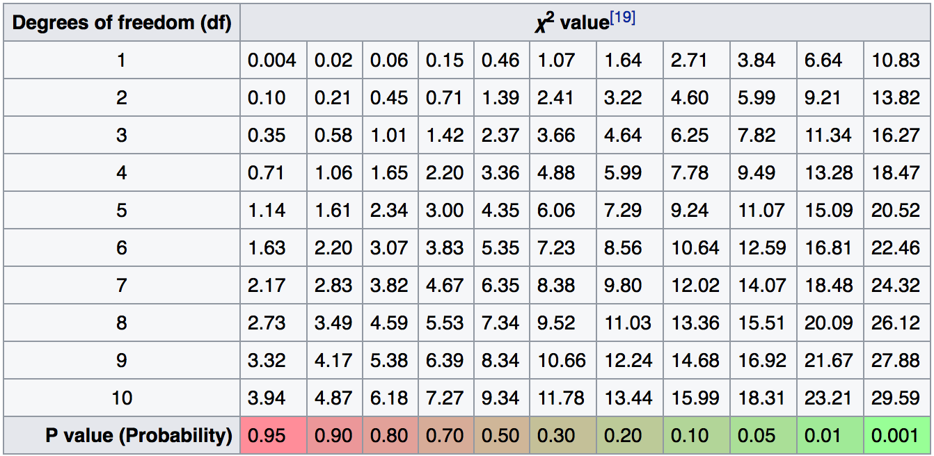
Example: Chi-Square Calculation

Slide 22
Correlation Analysis
Note: Correlation does not imply causality
# of hospitals and # of car-theft in a city are correlated
Both are causally linked to the third variable: population
Causal analysis
Effective Promotional Strategies Selection in Social Media: A Data-Driven Approach by K. Kuang, M. Jiang, P. Cui, J. Sun, S. Yang. IEEE Transactions on Big Data (TBD), 2017.
Estimating Treatment Effect in the Wild via Differentiated Confounder Balancing by K. Kuang, P. Cui, B. Li, M. Jiang, S. Yang. ACM SIGKDD International Conference on Knowledge Discovery and Data Mining (KDD), 2017.

Slide 23
Variance for Single Variable (Numerical Data)
The variance of a random variable X provides a measure of how much the value of X deviates from the mean or expected value of X:
where σ² is the variance of X, σ is called standard deviation
µ is the mean, and µ = E[X] is the expected value of X
That is, variance is the expected value of the square deviation from the mean
It can also be written as:

Slide 24
Covariance for Two Variables
Covariance between two variables X₁ and X₂
where µ₁ = E[X₁] is the respective mean or expected value of X₁; similarly for µ₂
Positive covariance: If σ₁₂ > 0
Negative covariance: If σ₁₂ < 0
Independence: If X₁ and X₂ are independent, σ₁₂ = 0 but the reverse is not true
Some pairs of random variables may have a covariance 0 but are not independent
Only under some additional assumptions (e.g., the data follow multivariate normal distributions) does a covariance of 0 imply independence

Slide 25
Example: Calculation of Covariance
Suppose two stocks X₁ and X₂ have the following values in one week:
(2, 5), (3, 8), (5, 10), (4, 11), (6, 14)
Question: If the stocks are affected by the same industry trends, will their prices rise or fall together?

Slide 26
Example: Calculation of Covariance
Suppose two stocks X₁ and X₂ have the following values in one week:
(2, 5), (3, 8), (5, 10), (4, 11), (6, 14)
Question: If the stocks are affected by the same industry trends, will their prices rise or fall together?
Covariance formula
Its computation can be simplified as:
E(X₁) = (2 + 3 + 5 + 4 + 6) / 5 = 20/5 = 4
E(X₂) = (5 + 8 + 10 + 11 + 14) / 5 = 48/5 = 9.6
σ₁₂ = (2×5 + 3×8 + 5×10 + 4×11 + 6×14) / 5 − 4 × 9.6 = 4
Thus, X₁ and X₂ rise together since σ₁₂ > 0

Slide 27
Correlation between Two Numerical Variables
Correlation between two variables X1 and X2 is the standard covariance, obtained by normalizing the covariance with the standard deviation of each variable
If ρ12 > 0: A and B are positively correlated (X1’s values increase as X2’s)
The higher, the stronger correlation
If ρ12 = 0: independent (under the same assumption as discussed in co-variance)
If ρ12 < 0: negatively correlated

Slide 28
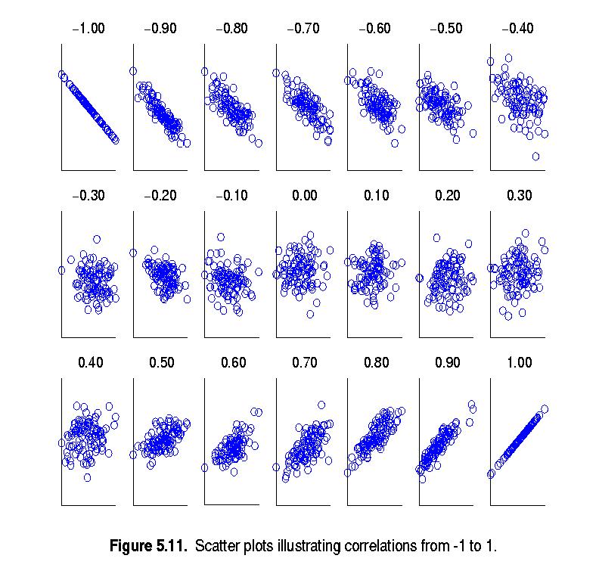
Visualizing Changes of Correlation Coefficient
Can you prove the range?
Correlation coefficient value range: [–1, 1]
A set of scatter plots shows sets of points and their correlation coefficients changing from –1 to 1

Slide 29
Covariance Matrix
The variance and covariance information for the two variables X₁ and X₂ can be summarized as 2 * 2 covariance matrix as
Generalizing it to d dimensions, we have,

Slide 30
Discussion
Can you use Chi-Square or p-value (doing correlation analysis) to select meta paths (as features) for relationship prediction?

Slide 31
References
D. P. Ballou and G. K. Tayi. Enhancing data quality in data warehouse environments. Comm. of ACM, 42:73-78, 1999
T. Dasu and T. Johnson. Exploratory Data Mining and Data Cleaning. John Wiley, 2003
T. Dasu, T. Johnson, S. Muthukrishnan, V. Shkapenyuk. Mining Database Structure; Or, How to Build a Data Quality Browser. SIGMOD’02
H. V. Jagadish et al., Special Issue on Data Reduction Techniques. Bulletin of the Technical Committee on Data Engineering, 20(4), Dec. 1997
D. Pyle. Data Preparation for Data Mining. Morgan Kaufmann, 1999
E. Rahm and H. H. Do. Data Cleaning: Problems and Current Approaches. IEEE Bulletin of the Technical Committee on Data Engineering. Vol.23, No.4
V. Raman and J. Hellerstein. Potters Wheel: An Interactive Framework for Data Cleaning and Transformation, VLDB’2001
T. Redman. Data Quality: Management and Technology. Bantam Books, 1992
R. Wang, V. Storey, and C. Firth. A framework for analysis of data quality research. IEEE Trans. Knowledge and Data Engineering, 7:623-640, 1995

