Slide 1
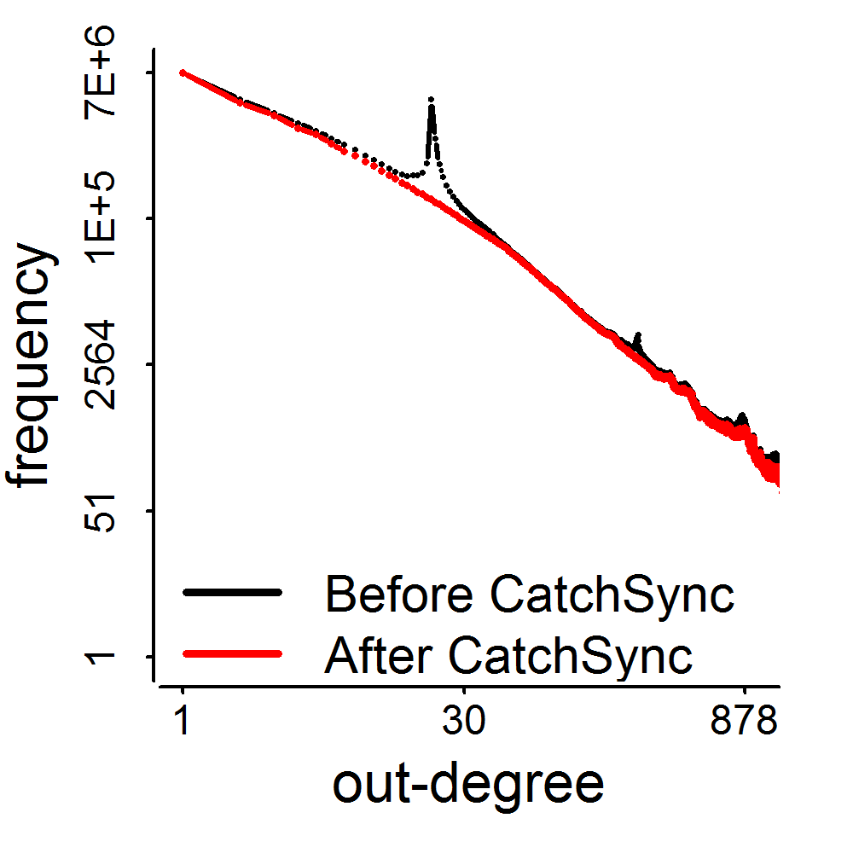
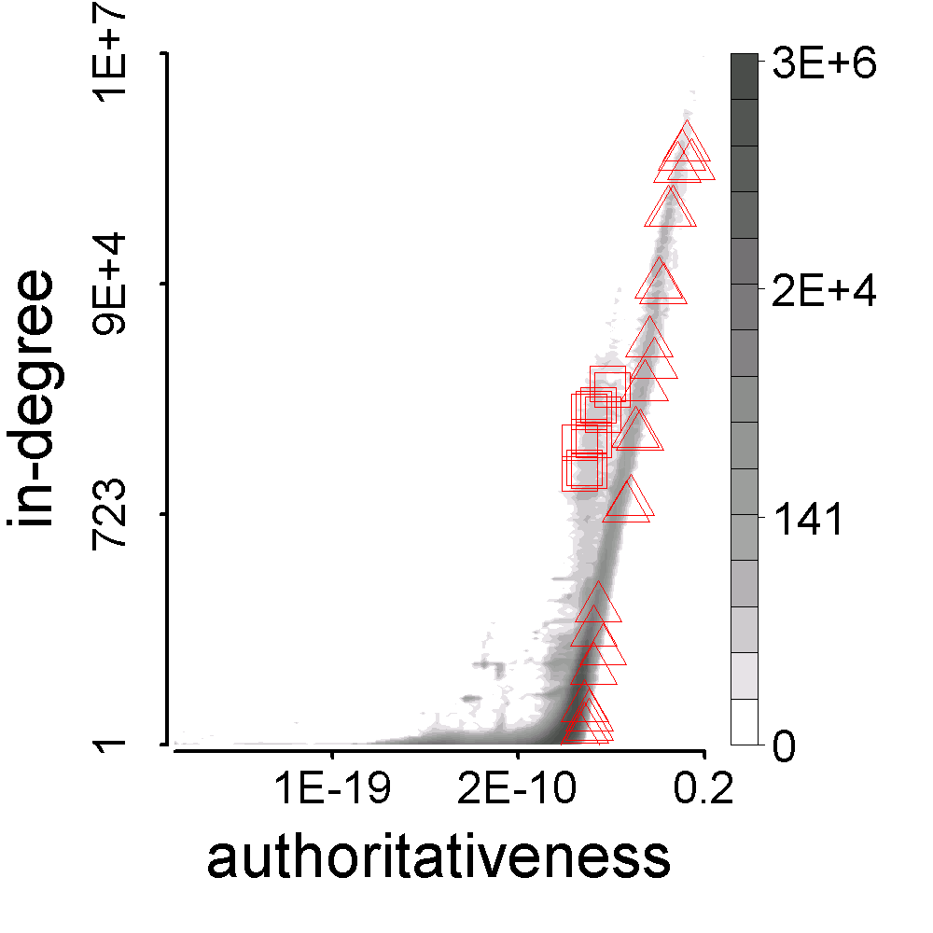
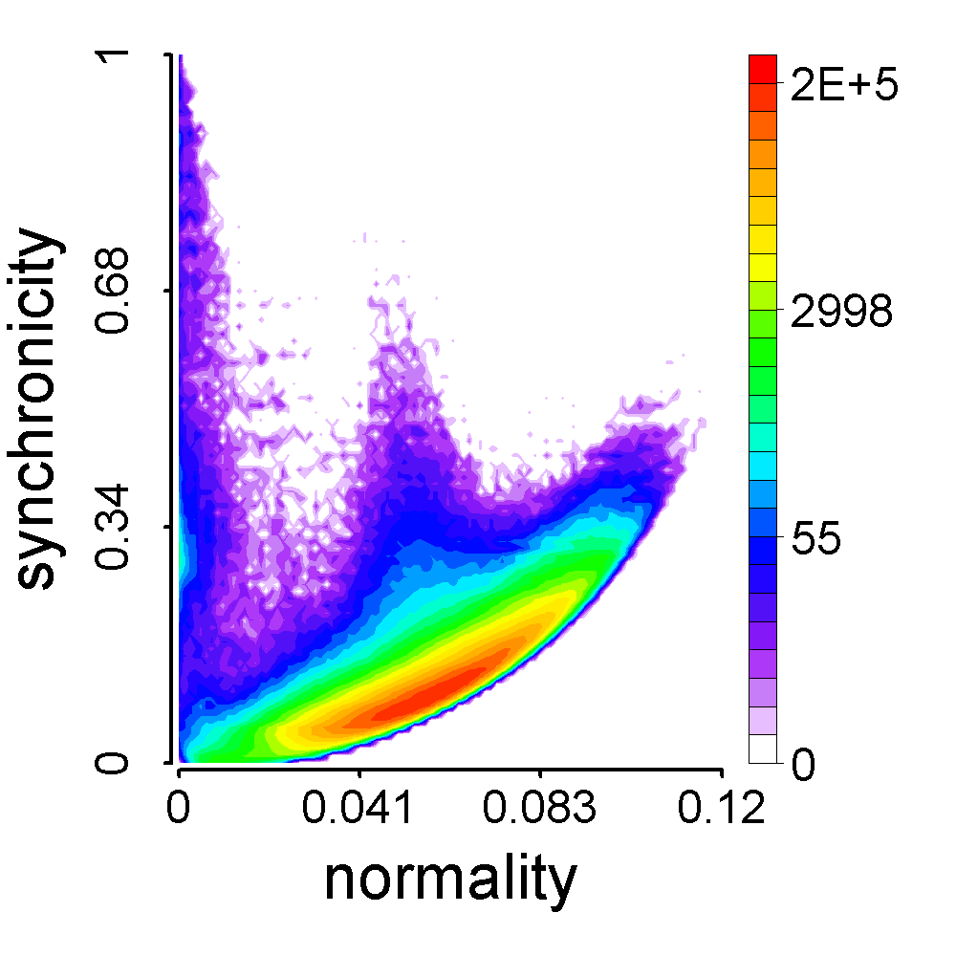
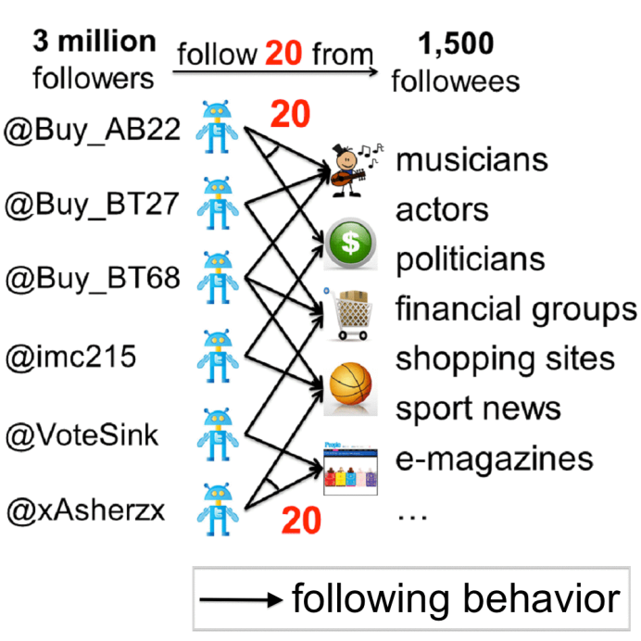
Observation
Representation & CatchSync Algorithm
What CatchSync Caught
3.17M
Meng Jiang
#followee=117
BuyAB22
0.41M
BuyAB22
#followee=20
d=20
Meng
Jiang

