Slide 1
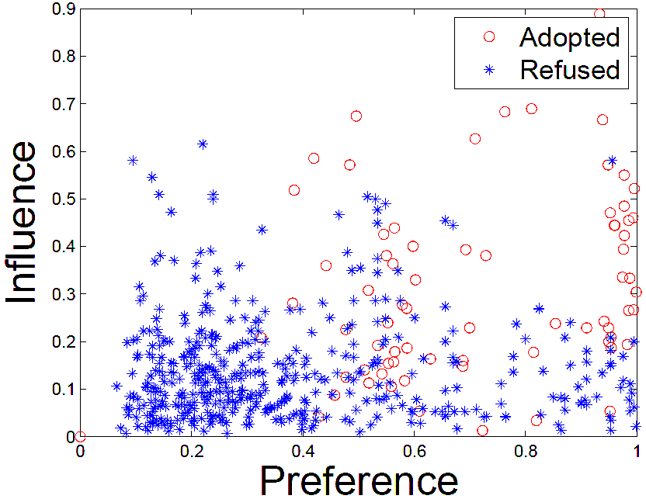
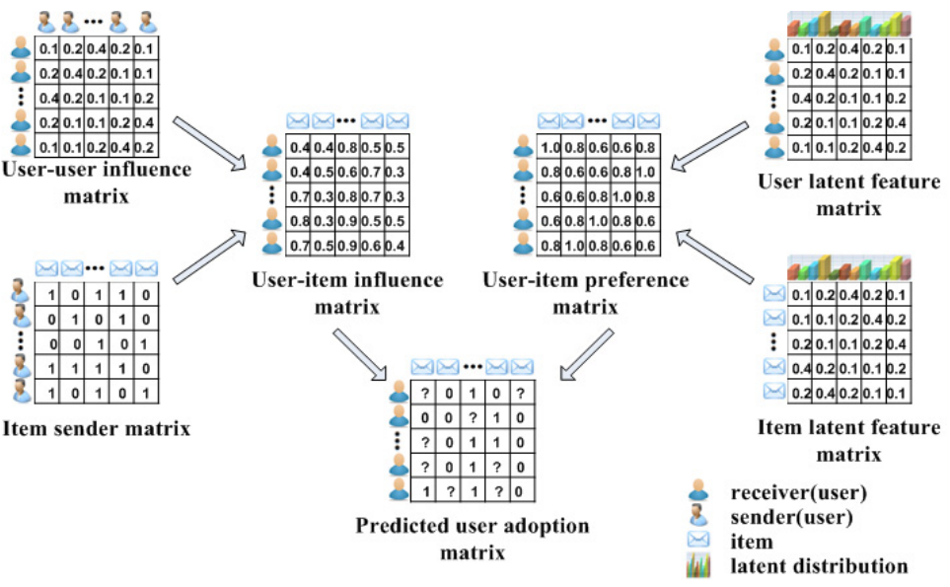
Network
Observation: Social Contextual Factors
Representation & ContextMF Model:
Social Contextual Recommendation
send
u
i
follow
receive
and retweet
u
adopted
send
u
i
Influence
Preference
×
follow
receive
but ignore
u
refused

