Slide 1


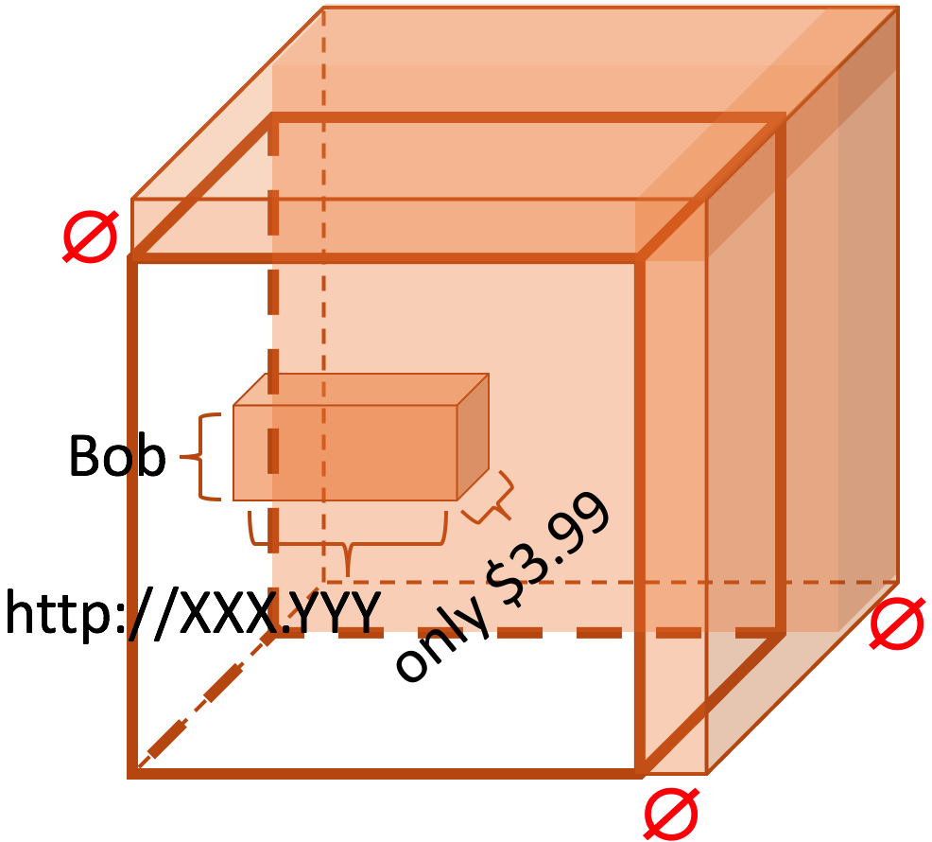
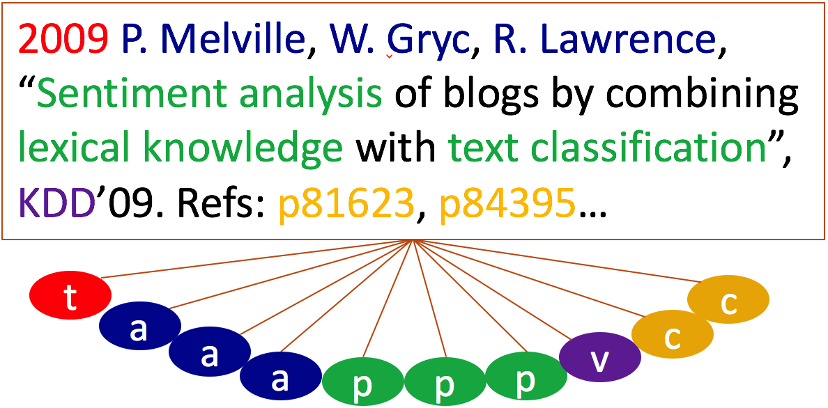
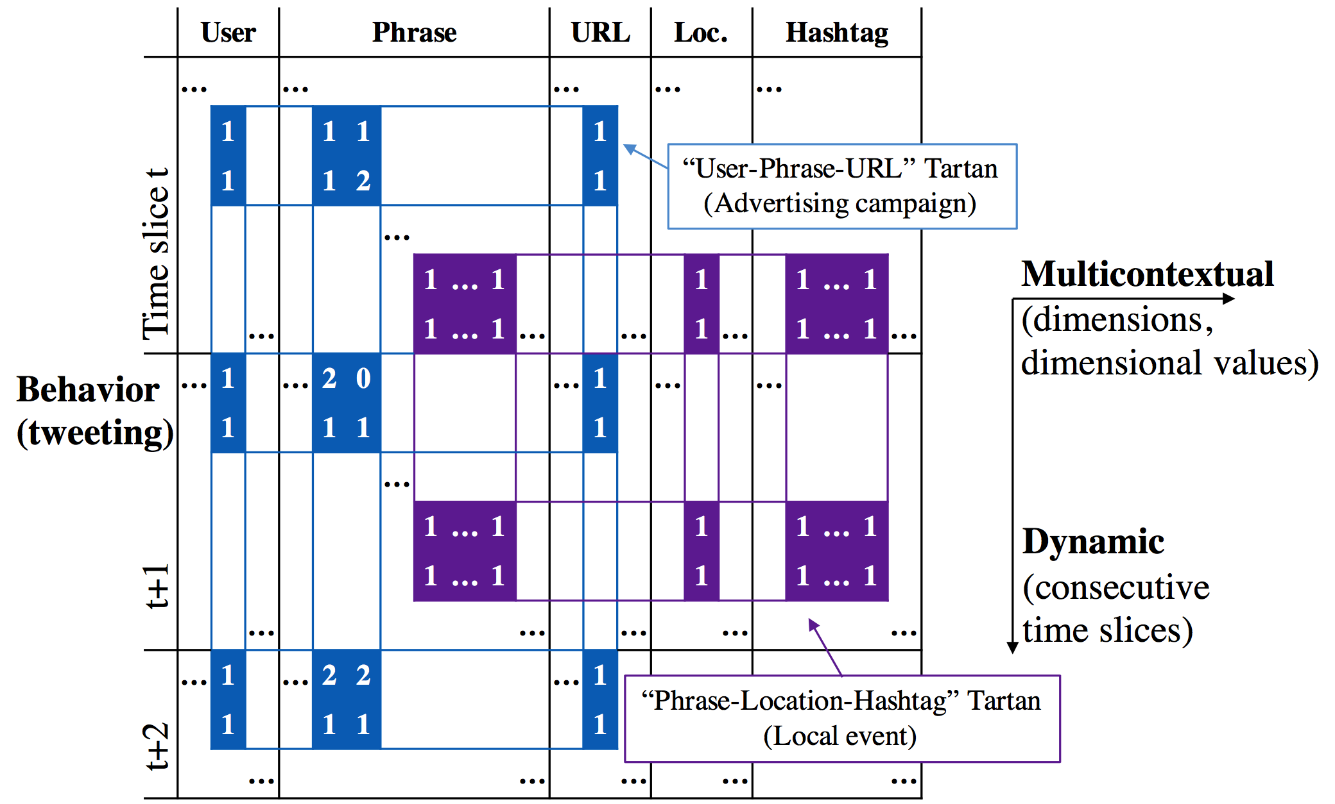
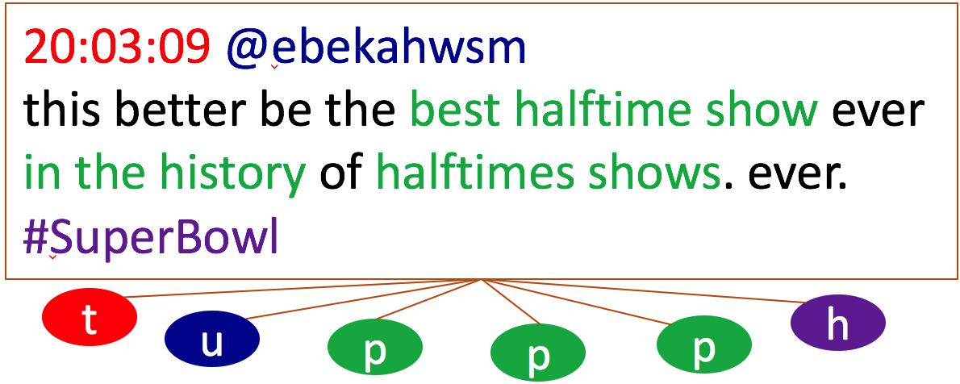
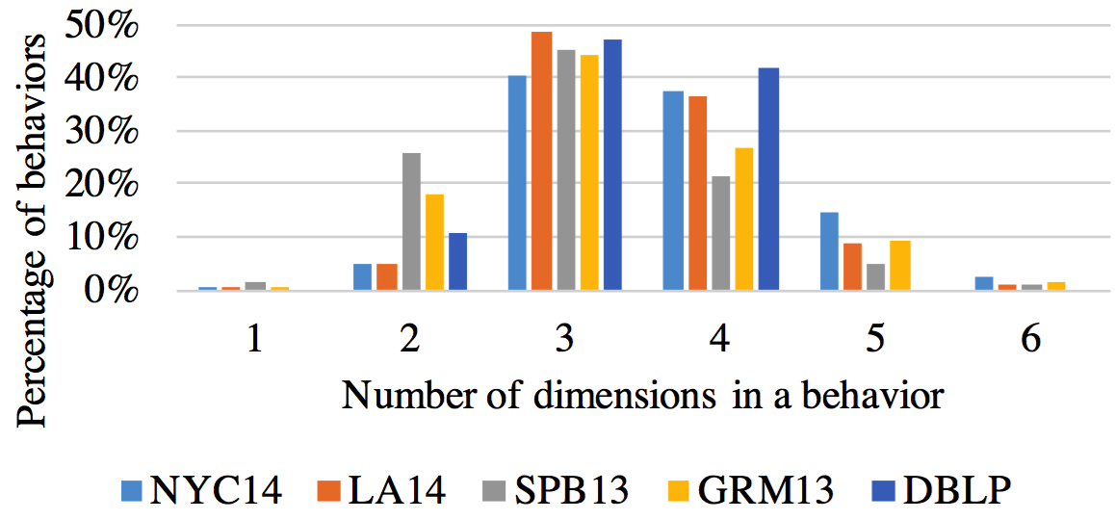
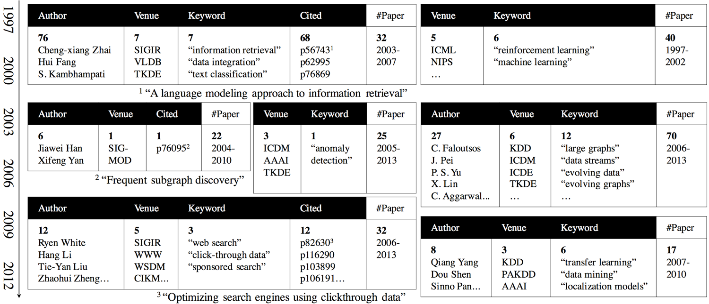
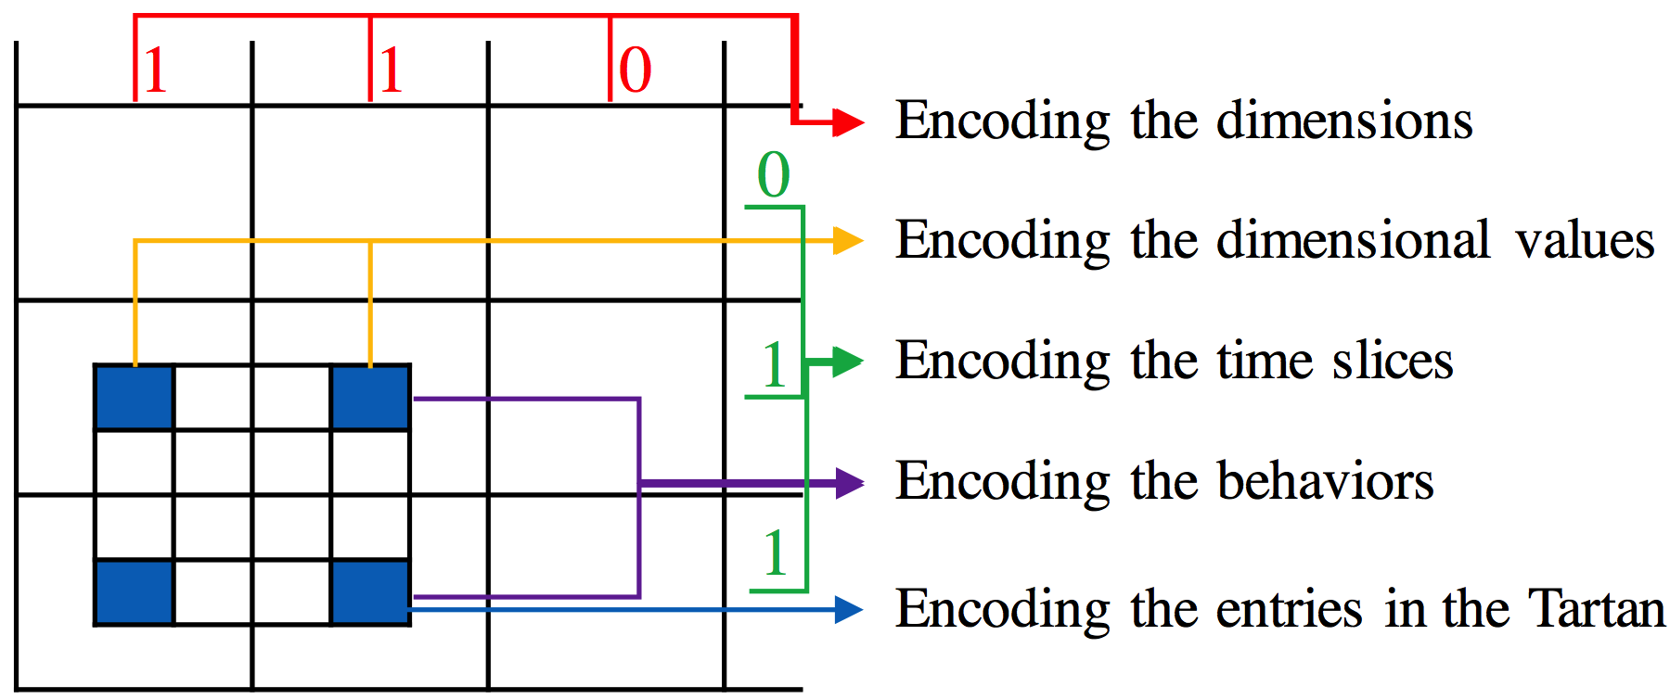
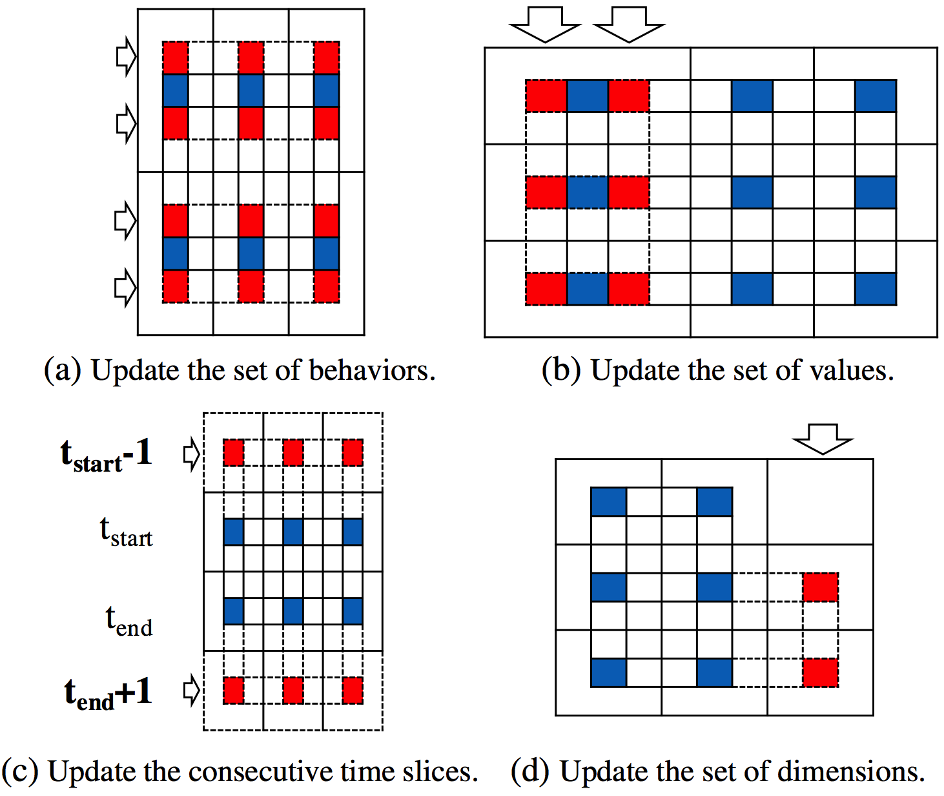
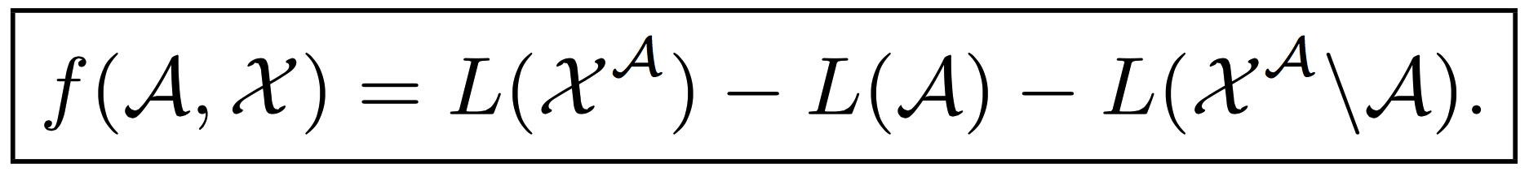
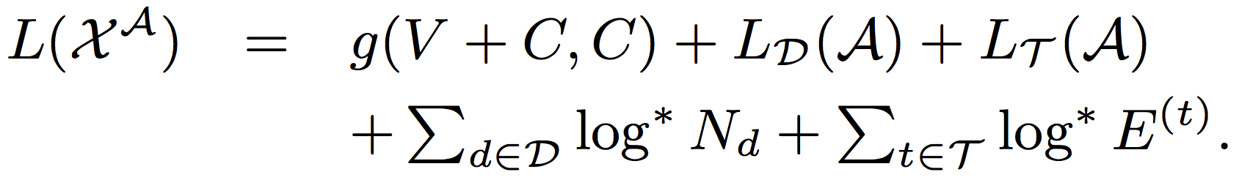
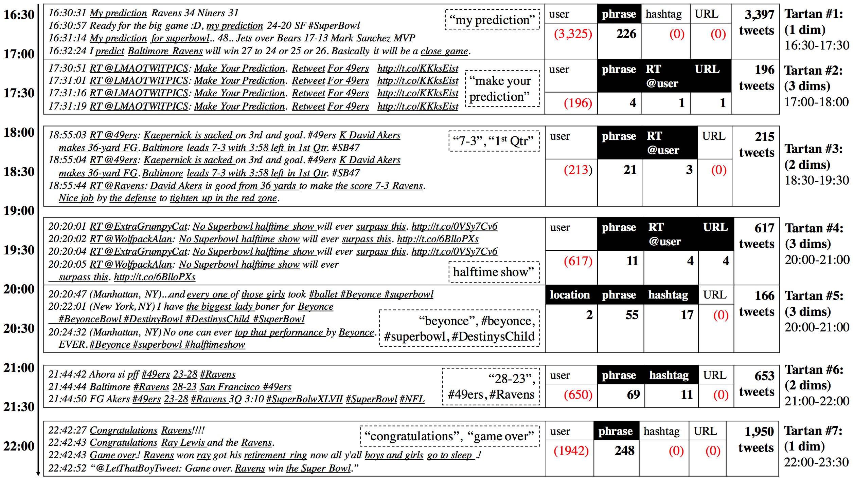
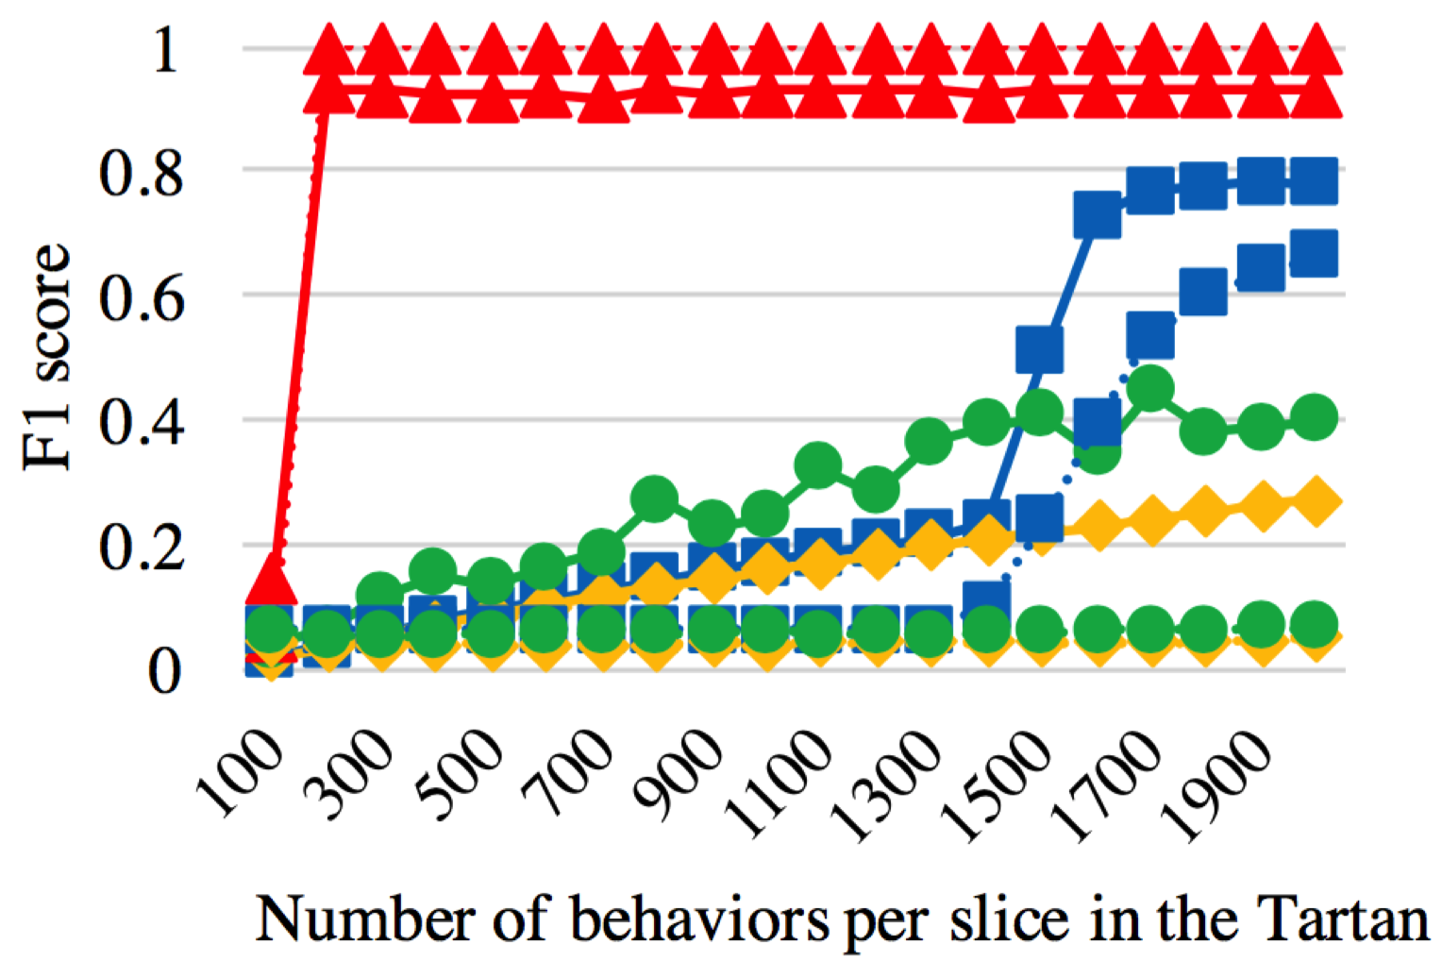
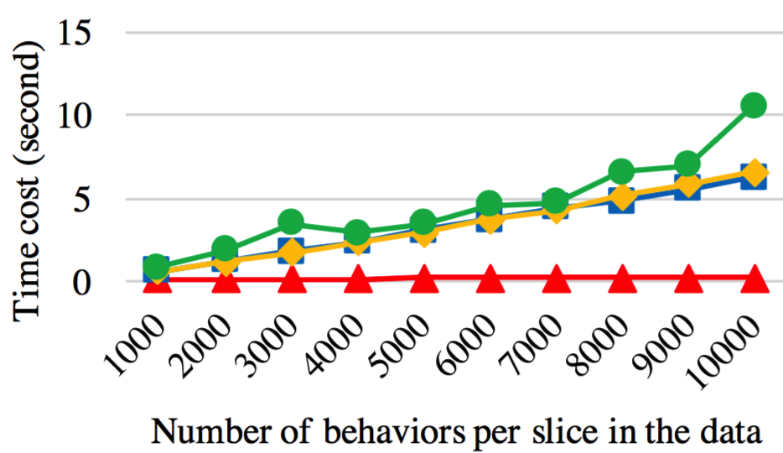

CatchTartan: Representing and Summarizing Dynamic Multicontextual Behaviors Meng Jiang¹, Christos Faloutsos², Jiawei Han¹ ¹ Department of Computer Science, University of Illinois at Urbana-Champaign, IL, USA ² Computer Science Department, SCS, Carnegie Mellon University, PA, USA
Behavior and Behavioral Summary
What is Behavior?
Publishing-paper behavior
Tweeting behavior
What is Behavioral Summary?
Summarizing research trends
Summarizing “Super Bowl” tweets (see below)
Representation of Behavior
Tensor fails…
Require one value each dimension!
Empty values?
Set values?
Timestamps?
Our Proposed Novel Representations
Behavior is dynamically generated with rich contextual information of different types.
Q1: How to represent dynamic multicontextual behaviors?
A1: “Two-Level Matrix” for Behavior.
A2: “Tartan” for Behavioral Summary.
Q3: How to catch the Tartans?
CatchTartan: MDL Principle-driven Algorithm
How many bits encoding a Tartan from the matrix can save?
Q2: How to represent behavioral summary?
Contact Meng Jiang (mjiang89@gmail.com): www.meng-jiang.com
CatchTartan-Behavior
FSG-Behavior
EigenSpoke-Behavior
NMF-Behavior
CatchTartan-DimValue
FSG-DimValue
EigenSpoke-DimValue
NMF-DimValue

