Slide 1
Mid-Semester Survey
https://www.surveymonkey.com/r/G32K2PT
Please complete/submit the survey after this lecture (that we will finish all chapters before mid-term).
If >25 students submitted survey before Oct. 3 11:59pm (HW3 due), we would have the only question of this Chapter (on advanced pattern mining) off the mid-term exam.
Short talk today: “SciBot” Project: Task 1 to 4 in 75 minutes

Slide 2

Chapter 7. Advanced Frequent Pattern Mining: Diverse Patterns
Meng Jiang
CSE 40647/60647 Data Science Fall 2017
Introduction to Data Mining

Slide 3
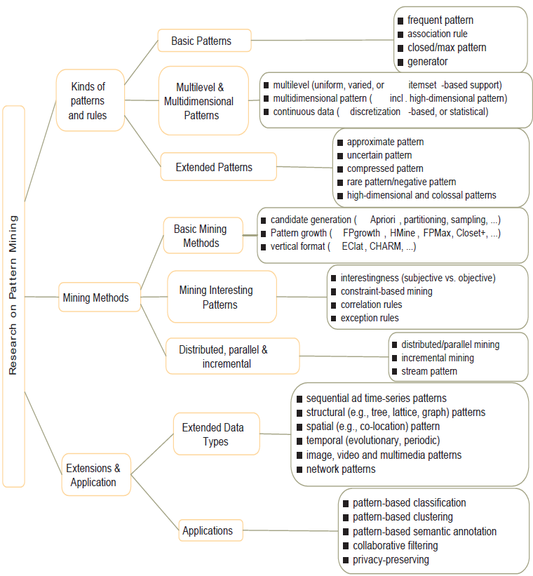
Research on Pattern Mining: A Road Map

Slide 4
Advanced Frequent Pattern Mining
Mining Diverse Patterns
Constraint-Based Frequent Pattern Mining
Sequential Pattern Mining
Graph Pattern Mining

Slide 5
Mining Diverse Patterns
Mining Multiple-Level Associations
Mining Multi-Dimensional Associations
Mining Quantitative Associations
Mining Negative Correlations

Slide 6
Mining Multiple-Level Frequent Patterns
Items often form hierarchies
Ex.: Dairyland 2% milk; Wonder wheat bread
How to set min-support thresholds?
Uniform min-support across multiple levels (reasonable?)
Level-reduced min-support: Items at the lower level are expected to have lower support
Uniform support
Reduced support
Level 1
min_sup = 5%
Milk
[support = 10%]
Level 1
min_sup = 5%
Level 2
min_sup = 1%
Level 2
min_sup = 5%
2% Milk
[support = 6%]
Skim Milk
[support = 2%]

Slide 7
Redundancy Filtering at Mining Multi-Level Associations
Multi-level association mining may generate many redundant rules
Redundancy filtering: Some rules may be redundant due to “ancestor” relationships between items
(Suppose the 2% milk sold is about ¼ of milk sold in gallons)
milk ⇒ wheat bread [support = 8%, confidence = 70%] (1)
2% milk ⇒ wheat bread [support = 2%, confidence = 72%] (2)
A rule is redundant if its support is close to the “expected” value, according to its “ancestor” rule, and it has a similar confidence as its “ancestor”
Rule (1) is an ancestor of rule (2), which one to prune?

Slide 8
Customized Min-Supports for Different Kinds of Items
We have used the same min-support threshold for all the items or item sets to be mined in each association mining
In reality, some items (e.g., diamond, watch, …) are valuable but less frequent
It is necessary to have customized min-support settings for different kinds of items
One Method: Use group-based “individualized” min-support
E.g., {diamond, watch}: 0.05%; {bread, milk}: 5%; …

Slide 9
Mining Multi-Dimensional Associations
Single-dimensional rules (e.g., items are all in “product” dimension)
buys(X, “milk”) ⇒ buys(X, “bread”)
Multi-dimensional rules (i.e., items in ≥ 2 dimensions or predicates)
Inter-dimension association rules (no repeated predicates)
age(X, “18-25”) ∧ occupation(X, “student”) ⇒ buys(X, “coke”)
Hybrid-dimension association rules (repeated predicates)
age(X, “18-25”) ∧ buys(X, “popcorn”) ⇒ buys(X, “coke”)

Slide 10
Mining Quantitative Associations
Mining quantitative associations
Ex.: Gender = female ⇒ Wage: mean=$7/hr (overall mean = $9)
LHS: a subset of the population
RHS: an extraordinary behavior of this subset
Rule condition can be categorical or numerical
Ex.: (Gender = female) ^ (South = yes) ⇒ mean wage = $6.3/hr
Ex.: Education in [14-18] (yrs) ⇒ mean wage = $11.64/hr
Data cube technology?

Slide 11
Rare Patterns vs. Negative Patterns
Rare patterns
Very low support but interesting (e.g., buying Rolex watches)
Negative patterns
Negatively correlated: Unlikely to happen together
Ex.: Since it is unlikely that the same customer buys both a Ford Expedition (an SUV car) and a Ford Fusion (a hybrid car), buying a Ford Expedition and buying a Ford Fusion are likely negatively correlated patterns
How to define negative patterns?

Slide 12
Defining Negative Correlated Patterns
A support-based definition
If itemsets A and B are both frequent but rarely occur together, i.e., sup(A U B) << sup (A) × sup(B)
Then A and B are negatively correlated
Is this a good definition for large transaction datasets?
Ex.: Suppose a store sold two needle packages A and B 100 times each, but only one transaction contained both A and B
When there are in total 200 transactions, we have
s(A U B) = 0.005, s(A) × s(B) = 0.25, s(A U B) << s(A) × s(B)
But when there are 10⁵ transactions, we have
s(A U B) = 1/10⁵, s(A) × s(B) = 1/10³ × 1/10³, s(A U B) > s(A) × s(B)
What is the problem? — Null transactions: The support-based definition is not null-invariant!
Does this remind you the definition of lift?

Slide 13
Defining Negative Correlation: Need Null-Invariance in Definition
A good definition on negative correlation should take care of the null-invariance problem
Whether two itemsets A and B are negatively correlated should not be influenced by the number of null-transactions
A Kulczynski measure-based definition
If itemsets A and B are frequent but (P(A|B) + P(B|A))/2 < є, where є is a negative pattern threshold, then A and B are negatively correlated
For the same needle package problem:
No matter there are in total 200 or 10⁵ transactions
If є = 0.01, we have (P(A|B) + P(B|A))/2 = (0.01 + 0.01)/2 < є

Slide 14
Advanced Frequent Pattern Mining
Mining Diverse Patterns
Constraint-Based Frequent Pattern Mining
Sequential Pattern Mining
Graph Pattern Mining

Slide 15
Pattern Mining Methods
Pattern | Closed Pattern (Concepts) | Idea 1: Pattern candidate generation and pruning | Idea 2: Pattern growth
Frequent pattern (itemset) | ? | ? | ?
Sequential pattern | ? | ? | ?
Graph pattern | ? | ? | ?

Slide 16
Pattern Mining Methods
Pattern | Closed Pattern (Concepts) | Idea 1: Pattern candidate generation and pruning | Idea 2: Pattern growth
Frequent pattern (itemset) | Closed frequent itemset | Apriori (1994) | FP-Growth (2000)
Sequential pattern | Closed seq. pattern | GSP (1996) | PrefixSpan (2004)
Graph pattern | Closed graph pattern | FSG (2000-2001) | gSpan (2002)

Slide 17
Sequential Patterns: Applications
Sequential pattern mining has broad applications
Customer shopping sequences
Purchase a laptop first, then a digital camera, and then a smartphone, within 6 months
Medical treatments, natural disasters (e.g., earthquakes), science & engineering processes, stocks and markets, ...
Weblog click streams, calling patterns, …
Software engineering: Program execution sequences, …
Biological sequences: DNA, protein, …

Slide 18
Sequential Pattern and Sequential Pattern Mining
Sequential pattern mining: Given a set of sequences, find the complete set of frequent subsequences (i.e., satisfying the min_sup threshold)
An element may contain a set of items (also called events)
Items within an element are unordered and we list them alphabetically
Given support threshold min_sup = 2, <(ab)c> is a sequential pattern
A sequence database
SID | Sequence
10 | <a(abc)(ac)d(cf)>
20 | <(ad)c(bc)(ae)>
30 | <(ef)(ab)(df)cb>
40 | <eg(af)cbc>
A sequence: < (ef) (ab) (df) c b >
<a(bc)dc> is a subsequence of <a(abc)(ac)d(cf)>
http://hanj.cs.illinois.edu/pdf/span01.pdf

Slide 19
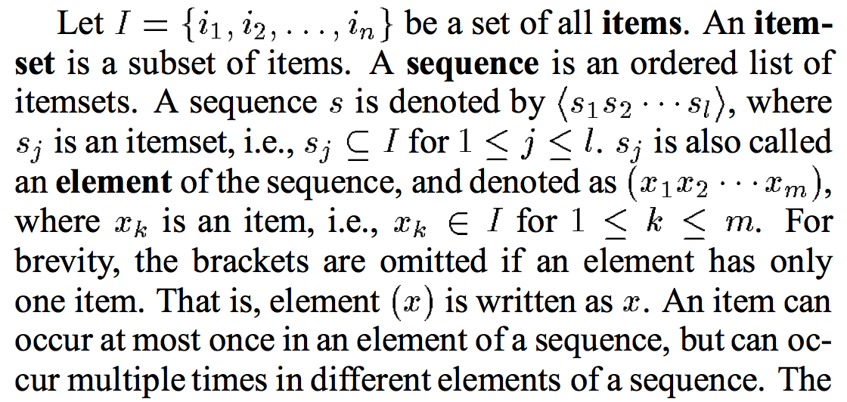
Sequence vs Element/Itemset/Event vs Item/Instance

Slide 20
Sequential Pattern Mining Algorithms
Algorithm requirement: Efficient, scalable, finding complete set, incorporating various kinds of user-specific constraints
The Apriori property still holds: If a subsequence s₁ is infrequent, none of s₁’s super-sequences can be frequent
Representative algorithms
Apriori-based Generalized Sequential Patterns: GSP (Srikant & Agrawal @ EDBT’96)
Pattern-growth methods: PrefixSpan (Pei, et al. @TKDE’04)
Mining closed sequential patterns: CloSpan (Yan, et al. @SDM’03)
Constraint-based sequential pattern mining

Slide 21
GSP: Apriori-Based Sequential Pattern Mining
SID | Sequence
10 | <(bd)cb(ac)>
20 | <(bf)(ce)b(fg)>
30 | <(ah)(bf)abf>
40 | <(be)(ce)d>
50 | <a(bd)bcb(ade)>
Initial candidates: All singleton sequences
<a>, <b>, <c>, <d>, <e>, <f>, <g>, <h>
Scan DB once, count support for each candidate
Generate length-2 candidate sequences
min_sup = 2
 | <a> | <b> | <c> | <d> | <e> | <f>
<a> | <aa> | <ab> | <ac> | <ad> | <ae> | <af>
<b> | <ba> | <bb> | <bc> | <bd> | <be> | <bf>
<c> | <ca> | <cb> | <cc> | <cd> | <ce> | <cf>
<d> | <da> | <db> | <dc> | <dd> | <de> | <df>
<e> | <ea> | <eb> | <ec> | <ed> | <ee> | <ef>
<f> | <fa> | <fb> | <fc> | <fd> | <fe> | <ff>
Length-2 candidates:
36 + 15= 51
Without Apriori pruning:
8*8+8*7/2=92 candidates
Cand. | sup
<a> | 3
<b> | 5
<c> | 4
<d> | 3
<e> | 3
<f> | 2
<g> | 1
<h> | 1
 | <a> | <b> | <c> | <d> | <e> | <f>
<a> |  | <(ab)> | <(ac)> | <(ad)> | <(ae)> | <(af)>
<b> |  |  | <(bc)> | <(bd)> | <(be)> | <(bf)>
<c> |  |  |  | <(cd)> | <(ce)> | <(cf)>
<d> |  |  |  |  | <(de)> | <(df)>
<e> |  |  |  |  |  | <(ef)>
<f>
GSP (Generalized Sequential Patterns): Srikant & Agrawal @ EDBT’96)

Slide 22
GSP Mining and Pruning
Repeat (for each level (i.e., length-k))
Scan DB to find length-k frequent sequences
Generate length-(k+1) candidate sequences from length-k frequent sequences using Apriori
set k = k+1
Until no frequent sequence or no candidate can be found

Slide 23
PrefixSpan: A Pattern-Growth Approach
Prefix and suffix
Given <a(abc)(ac)d(cf)>
Prefixes: <a>, <aa>, <a(ab)>, <a(abc)>, …
Prefixes-based projection
PrefixSpan Mining: Prefix Projections
Step 1: Find length-1 sequential patterns
<a>, <b>, <c>, <d>, <e>, <f>
Step 2: Divide search space and mine each projected DB
<a>-projected DB,
<b>-projected DB,
…
<f>-projected DB, …
SID | Sequence
10 | <a(abc)(ac)d(cf)>
20 | <(ad)c(bc)(ae)>
30 | <(ef)(ab)(df)cb>
40 | <eg(af)cbc>
Prefix | Suffix (Projection)
<a> | <(abc)(ac)d(cf)>
<aa> | <(_bc)(ac)d(cf)>
<ab> | <(_c)(ac)d(cf)>
PrefixSpan (Prefix-projected Sequential pattern mining) Pei, et al. @TKDE’04
http://hanj.cs.illinois.edu/pdf/span01.pdf

Slide 24
Advanced Frequent Pattern Mining
Mining Diverse Patterns
Constraint-Based Frequent Pattern Mining
Sequential Pattern Mining
Graph Pattern Mining

Slide 25
Frequent (Sub)Graph Patterns
Given a labeled graph dataset D = {G₁, G₂, …, G_{n}}, the supporting graph set of a subgraph g is D_{g} = {G_{i} | g ⊆ G_{i}, G_{i} ∈D}.
support(g) = |D_{g}|/ |D|
A (sub)graph g is frequent if support(g) ≥ min_sup Ex.: Chemical structures
Alternative:
Mining frequent subgraph patterns from a single large graph or network
Graph Dataset
(A)
(B)
(C)
min_sup = 2
Frequent Graph Patterns
(1)
(2)

Slide 26
Graph Pattern Mining: Applications
Bioinformatics
Gene networks, protein interactions, metabolic pathways
Chem-informatics: Mining chemical compound structures
Social networks, web communities, tweets, …
Cell phone networks, computer networks, …
Web graphs, XML structures, semantic Web, information networks
Software engineering: program execution flow analysis
Building blocks for graph classification, clustering, compression, comparison, and correlation analysis
Graph indexing and graph similarity search

Slide 27
Apriori-Based Approach
The Apriori property (anti-monotonicity): A size-k subgraph is frequent if and only if all of its subgraphs are frequent
A candidate size-(k+1) edge/vertex subgraph is generated if its corresponding two k-edge/vertex subgraphs are frequent
Iterative mining process:
Candidate-generation → candidate pruning → support counting → candidate elimination
(k+1)-edge
k-edge
G₁
G
G₂
G’
…
G’’
G_{n}
Join

Slide 28
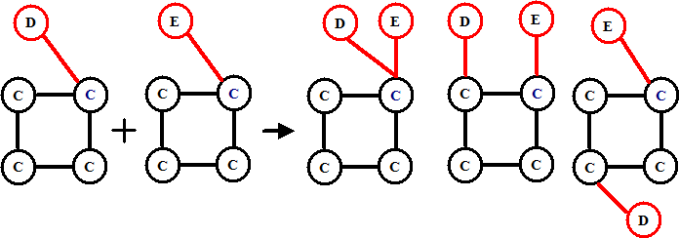
Candidate Generation: Vertex Growing vs. Edge Growing
Methodology: breadth-search, Apriori joining two size-k graphs
Many possibilities at generating size-(k+1) candidate graphs
Generating new graphs with one more vertex
AGM (Inokuchi, et al., PKDD’00)
Generating new graphs with one more edge
FSG (Kuramochi and Karypis, ICDM’01)
Performance shows via edge growing is more efficient

Slide 29
Why Mining Closed Graph Patterns?
Challenge: An n-edge frequent graph may have 2^{n} subgraphs
Motivation: Explore closed frequent subgraphs to handle graph pattern explosion problem
A frequent graph G is closed if there exists no supergraph of G that carries the same support as G
Lossless compression: Does not contain non-closed graphs, but still ensures that the mining result is complete
Algorithm CloseGraph: Mines closed graph patterns directly
If this subgraph is closed in the graph dataset, it implies that none of its frequent super-graphs carries the same support

Slide 30
Experiment and Performance Comparison
The AIDS antiviral screen compound dataset from NCI/NIH
The dataset contains 43,905 chemical compounds
Discovered Patterns: The smaller minimum support, the bigger and more interesting subgraph patterns discovered
20%
10%
5%
# of Patterns: Frequent vs. Closed
Runtime: Frequent vs. Closed
Run time (sec)
Number of patterns
Minimum support
Minimum support

Slide 31
References: Mining Diverse Patterns
R. Srikant and R. Agrawal, “Mining generalized association rules”, VLDB'95
Y. Aumann and Y. Lindell, “A Statistical Theory for Quantitative Association Rules”, KDD'99
K. Wang, Y. He, J. Han, “Pushing Support Constraints Into Association Rules Mining”, IEEE Trans. Knowledge and Data Eng. 15(3): 642-658, 2003
D. Xin, J. Han, X. Yan and H. Cheng, "On Compressing Frequent Patterns", Knowledge and Data Engineering, 60(1): 5-29, 2007
D. Xin, H. Cheng, X. Yan, and J. Han, "Extracting Redundancy-Aware Top-K Patterns", KDD'06
J. Han, H. Cheng, D. Xin, and X. Yan, "Frequent Pattern Mining: Current Status and Future Directions", Data Mining and Knowledge Discovery, 15(1): 55-86, 2007
F. Zhu, X. Yan, J. Han, P. S. Yu, and H. Cheng, “Mining Colossal Frequent Patterns by Core Pattern Fusion”, ICDE'07

Slide 32
References: Constraint-Based Frequent Pattern Mining
R. Srikant, Q. Vu, and R. Agrawal, “Mining association rules with item constraints”, KDD'97
R. Ng, L.V.S. Lakshmanan, J. Han & A. Pang, “Exploratory mining and pruning optimizations of constrained association rules”, SIGMOD’98
G. Grahne, L. Lakshmanan, and X. Wang, “Efficient mining of constrained correlated sets”, ICDE'00
J. Pei, J. Han, and L. V. S. Lakshmanan, “Mining Frequent Itemsets with Convertible Constraints”, ICDE'01
J. Pei, J. Han, and W. Wang, “Mining Sequential Patterns with Constraints in Large Databases”, CIKM'02
F. Bonchi, F. Giannotti, A. Mazzanti, and D. Pedreschi, “ExAnte: Anticipated Data Reduction in Constrained Pattern Mining”, PKDD'03
F. Zhu, X. Yan, J. Han, and P. S. Yu, “gPrune: A Constraint Pushing Framework for Graph Pattern Mining”, PAKDD'07

Slide 33
References: Sequential Pattern Mining
R. Srikant and R. Agrawal, “Mining sequential patterns: Generalizations and performance improvements”, EDBT’96
M. Zaki, “SPADE: An Efficient Algorithm for Mining Frequent Sequences”, Machine Learning, 2001
J. Pei, J. Han, B. Mortazavi-Asl, J. Wang, H. Pinto, Q. Chen, U. Dayal, and M.-C. Hsu, "Mining Sequential Patterns by Pattern-Growth: The PrefixSpan Approach", IEEE TKDE, 16(10), 2004
X. Yan, J. Han, and R. Afshar, “CloSpan: Mining Closed Sequential Patterns in Large Datasets”, SDM'03
J. Pei, J. Han, and W. Wang, "Constraint-based sequential pattern mining: the pattern-growth methods", J. Int. Inf. Sys., 28(2), 2007
M. N. Garofalakis, R. Rastogi, K. Shim: Mining Sequential Patterns with Regular Expression Constraints. IEEE Trans. Knowl. Data Eng. 14(3), 2002
H. Mannila, H. Toivonen, and A. I. Verkamo, “Discovery of frequent episodes in event sequences”, Data Mining and Knowledge Discovery, 1997

Slide 34
References: Graph Pattern Mining
C. Borgelt and M. R. Berthold, Mining molecular fragments: Finding relevant substructures of molecules, ICDM'02
J. Huan, W. Wang, and J. Prins. Efficient mining of frequent subgraph in the presence of isomorphism, ICDM'03
A. Inokuchi, T. Washio, and H. Motoda. An apriori-based algorithm for mining frequent substructures from graph data, PKDD'00
M. Kuramochi and G. Karypis. Frequent subgraph discovery, ICDM'01
S. Nijssen and J. Kok. A Quickstart in Frequent Structure Mining can Make a Difference. KDD'04
N. Vanetik, E. Gudes, and S. E. Shimony. Computing frequent graph patterns from semistructured data, ICDM'02
X. Yan and J. Han, gSpan: Graph-Based Substructure Pattern Mining, ICDM'02
X. Yan and J. Han, CloseGraph: Mining Closed Frequent Graph Patterns, KDD'03
X. Yan, P. S. Yu, J. Han, Graph Indexing: A Frequent Structure-based Approach, SIGMOD'04
X. Yan, P. S. Yu, and J. Han, Substructure Similarity Search in Graph Databases, SIGMOD'05

Slide 35
“SciBot” Project: Task 1 to 4 in 75 minutes
This is just a base.

Slide 36
Task 1 to 4
Task 1: Data Cleaning and Integration (10 minutes)
Task 2: Entity name recognition (30 minutes)
2-1: Entity name candidate generation (20 minutes)
2-2: Entity name quality assessment (10 minutes)
Task 3: Entity typing (15 minutes)
Task 4: Collaboration discovery (20 minutes)

Slide 37
Task 1 (10 minutes)
def task_1(files):
…
return
pid2txt
pid2title_year_conf
pid2keyword
pid2authorseq
… word2pidlist
… aid2pidlist
aid2authorname
PID | PDFID
… | …
PDFID | PDF | TXT
… | … | …
PID | TITLE | YEAR | CONF
… | … | … | …
PID | KEYWORD
… | …
PID | AID | FID | AFF | SID
… | … | … | … | …
AID | AUT
… | …

Slide 38
An Integrated and Cleaned Database
PID | PDFID
… | …
PDFID | PDF | TXT
… | … | …
PID | TITLE | YEAR | CONF
… | … | … | …
PID | KEYWORD
… | …
PID | AID | FID | AFF | SID
… | … | … | … | …
AID | AUT
… | …

Slide 39
Qs in HW3 on Task 1
a) How many unique papers and how many unique authors are there in your integrated and cleaned dataset?
b) Find “matrix” experts: List the top three authors who published at least 3 papers AND used the word “matrix” the most frequently in their papers (i.e., the highest average number of “matrix” in their publications).
c) Find “long-title” authors: List the top three authors who published at least 3 papers AND preferred long titles in their papers (i.e., the highest average length of paper titles).

Slide 40
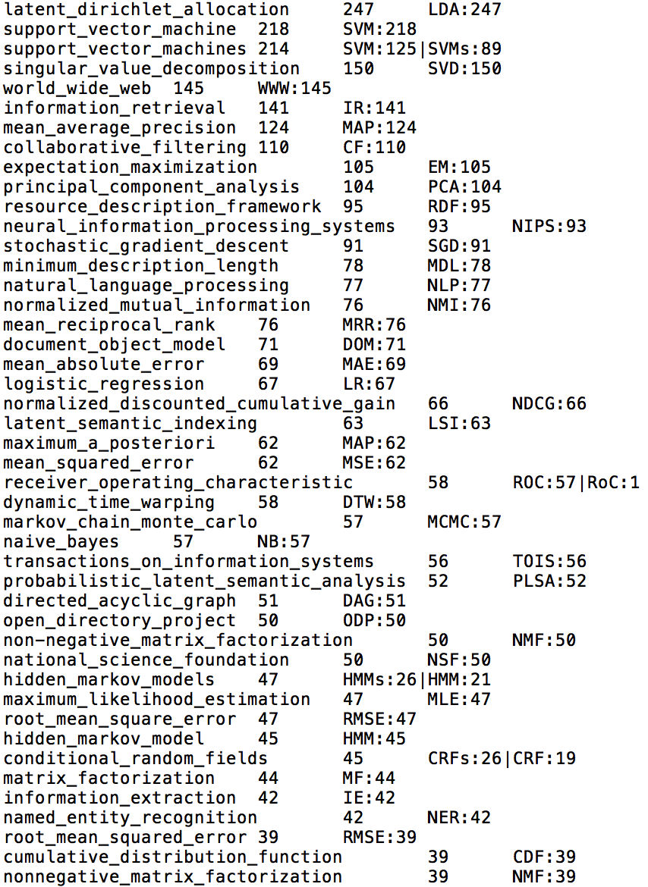
Task 2-1: Entity Name Candidate Generation (20 minutes)
Tech 1: Hand-crafted Rules
20 minutes
def tech_1(pid2txt):
…
return
name2abbr2count
… Support Vector Machines ( SVMs ) …

Slide 41
Task 2-1: Entity Name Candidate Generation (20-60 minutes)
Tech 2: Frequent pattern mining
40 minutes
def tech_2(pid2txt, name2abbr2count, min_sup):
name2abbr2count → {“vector”:16, “support”:3, “machine”:20…}
pid2txt →
“…. use feature vector …”: > min_sup!
“… vector efficiently …”: < min_sup
“ … into vector space …”: > min_sup!
“ … into vector space …”: > min_sup, but “into” is a stopword ☹
name_sup = [[“feature vector”, 251], [“vector space”, 176]…]
2-grams to 3-grams to 4…
[Apriori+: write code? call package?]
return name_sup
seed words: Number of entity names containing the word
Find a stopword list on the web (Google, GitHub…)

Slide 42
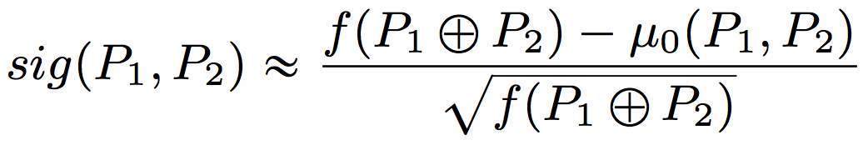
Task 2-2: Entity name quality assessment (10-30 minutes)
Support (0-10 minutes): #sentences (paragraphs/documents)
Outlier-ness measure (a significance score): (10 minutes)
We have 10000 words.
“feature”: 300, “vector”: 200
“feature vector”:100
sig(“feature”,”vector”)
= (100 - 10000 * 300/10000 * 200/10000) / sqrt(100)
= (100 – 6)/10 = 9.4
How about 3-grams?

Slide 43
Qs in HW3 on Task 2
d) How many unique case-insensitive entity names (like “support vector machines”) have you discovered in the dataset?
List the top 20 entity names and their support (i.e., the number of papers that have at least one such entity name) if you have.
e) Briefly explain your technique(s).

Slide 44
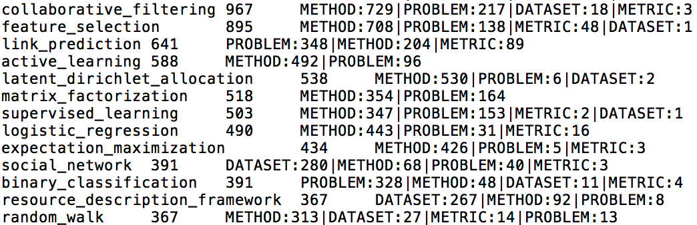
Task 3: Entity Typing (15 minutes)
Trigger words
METHOD: method algorithm model approach framework process scheme implementation procedure strategy architecture
PROBLEM: problem technique process system application task evaluation tool paradigm benchmark software
DATASET: data dataset database
METRIC: value score measure metric function parameter
Classification using trigger-word features: Majority-voting
equivalent to
a simple Multi-class Decision Tree

Slide 45
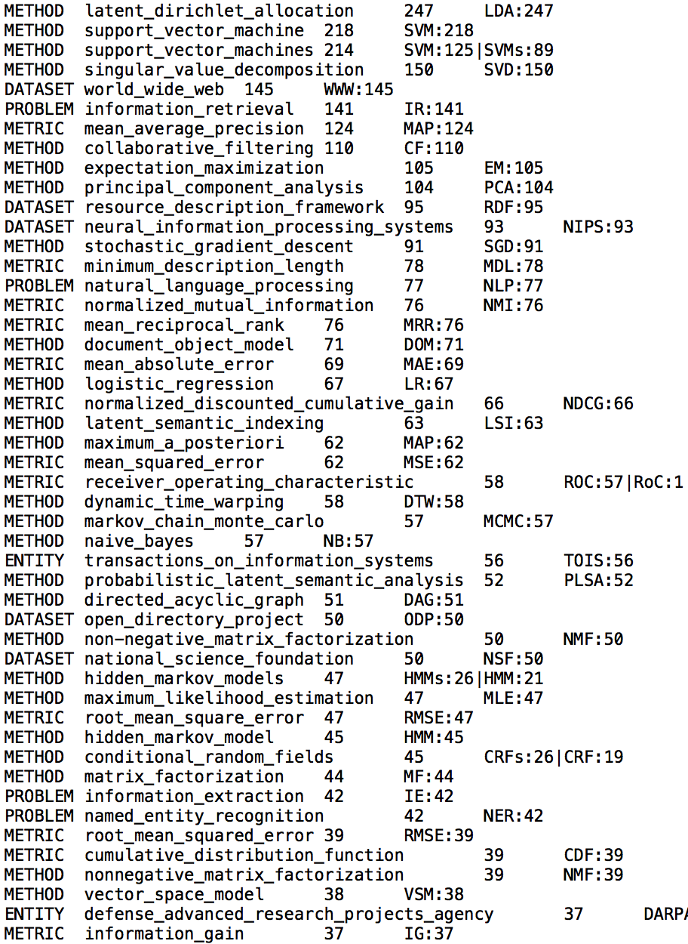
Some Entity Typing Results: Clustering and then typing? (+40 minutes): “s_v_m” and “s_v_ms” OR Pattern-based classification? (+40 minutes): more features “problem of $PROBLEM”

Slide 46
Task 4: Collaboration Discovery (15 minutes)
pid2aidlist, keyword2aidlist, conference2aidlist
Frequent pattern mining: Apriori or FP-Growth
Transactions: Papers
Items: Authors
min_sup?
Given the paper/keyword/conference-author data, find frequent author-sets (as patterns) : which two/three/four authors often collaborate together?
Advisor-Advisee Discovery (+5 minutes):
- Ranking 2-itemsets by Kulc measure.
Evaluation: Subjective: top 10 item-pairs?

Slide 47
Time and Performance
 |  | Time
Task 1 | Cleaning and Integration | 10 mins
Task 2 | Entity name candidate generation | 20 mins (Abbreviation rules) | +40 mins (Apriori)
 | Entity name quality assessment | 10 mins (support + 2-gram sig.) | +20 mins (n-gram sig.)
Task 3 | Entity typing | 15 mins (majority voting) | +40 mins (clustering+typing) OR (pattern-based typing)
Task 4 | Collaboration discovery | 20 mins (FP-Growth) | +5 mins (Kulc for 2-itemsets)
 |  | 75 mins | +105 mins = 180 mins = 3 hours
Grading |  | A, B+, A-, B+, A- | A, A, A, A, A
 | × (professor/student): 0.5 to 3.0 | 38 mins – 3h 45mins | 1h 30mins – 9 hours

