Slide 1

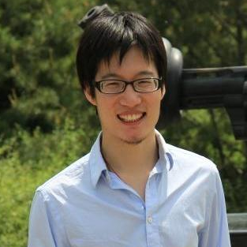
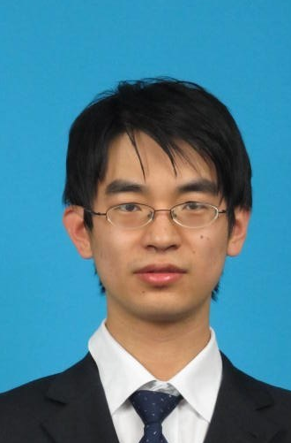

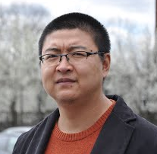
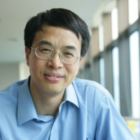


Social contextual recommendation
Meng Jiang
Joint work with Peng Cui, Rui Liu, Qiang Yang,
Fei Wang, Wenwu Zhu and Shiqiang Yang
October 30, 2012 – Maui, HI, USA

Slide 2
Recommender Systems
Predict missing “user-item” links
Predict missing values in “user-item” matrix
Challenge:
High sparsity
Bob
Amy
Tom
Nick
 | Amy | Bob | … | User M
Post 1 | 1 | 1 | … | 0
Post 2 | ? | 0 | … | ?
… | … | … | …
Post N | 0 | ? | … | 1
Post 1
Post 3
Post 2

Slide 3
Our Goals
Given: Links on social networks
Find: A social recommendation framework that best fit users’ adopting behaviors
Goals:
G1. Understand user intention of adoption
G2. A framework for social recommendation
G3. Predict the missing “user-item” links

Slide 4
Outline
1. Background
2. Understanding Intention
3. The Framework
4. ContextMF Algorithm
5. Experiments

Slide 5
Links on Social Networks
Target: “user-item” links
Nature: “user-user” links
Can social relation help?
How to use social contextual information?
Bob
social relation
Amy
Tom
user-user
interaction
Nick
user-item
interaction
item content
Post 1
Post 3
Post 2

Slide 6
Related Works
Content-based filtering
Collaborative filtering
Bob
Amy
Tom
Nick
user-item
interaction
item content
Post 1
Post 3
Post 2

Slide 7
Related Works
Content-based filtering
Collaborative filtering
Trust-based recommendation
Influenced-based recommendation
Bob
Amy
Tom
user-user
interaction
Nick
user-item
interaction
Post 1
Post 3
Post 2

Slide 8
Related Works
Content-based filtering
Collaborative filtering
Trust-based recommendation
Influenced-based recommendation
Social recommendation with MF/Social Regularization
Bob
social relation
Amy
Tom
Nick
user-item
interaction
item content
Post 1
Post 3
Post 2

Slide 9
Related Works
Can we fully use social contextual information?
Q: “Large-scale”? A: “Relational”!
Q: “Relational”? A: “Intention”!
 | Social relation | User-user interaction | User-item interaction | Item content
Content-based & CF | × | × | √ | √
Trust & Influence | × | √ | √ | ×
SoRec & SoReg | √ | × | √ | √
? | √ | √ | √ | √

Slide 10
Outline
1. Background
2. Understanding Intention
3. The Framework
4. ContextMF Algorithm
5. Experiments

Slide 11
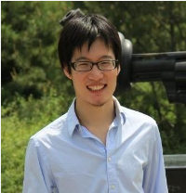
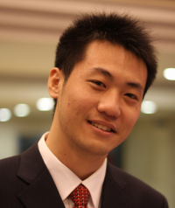
User Intention of Adopting Messages
Peng Cui : Is there anyone who call for paper via Renren? Hah!
http://media.cs.tsinghua.edu.cn/~multimedia/cuipeng/IR_SI_SocialMedia.htm
2011-01-05 13:47 Reply | Share
Call for paper? About social media? Wow!
Personal Preference
This is my best friend and co-author!
Interpersonal influence
Meng Jiang : Support! //Peng Cui : Is there anyone who call for paper via Renren? Hah!
http://media.cs.tsinghua.edu.cn/~multimedia/cuipeng/IR_SI_SocialMedia.htm
2011-01-05 14:05 Reply | Share

Slide 12
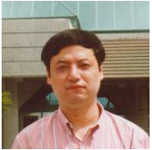
User Intention of Adopting Messages
Maosong Sun : KDD Summer School on Mining the Big Data will be held in Tsinghua. This is the first time for KDD to hold Summer School. Dean Xiaoyong Du, Dr. Hang Li and me are the Chairs. Today Jiawei Han(UIUC), Christos Faloutsos(CMU) and Bing Liu(UIC) gave lectures for 2 hours each.
2012-08-10 21:47 Retweet | Save | Reply
Amazing! Summer school! It is KDD!
Jiawei Han! Christos Faloutsos! Bin Liu!
Personal Preference
This is the Dean of my Department!
His research area is Artificial Intelligence and Data Mining!
Interpersonal influence
Meng Jiang : Amazing! //Maosong Sun : KDD Summer School on Mining the Big Data will be held in Tsinghua. This is the first time for KDD to hold Summer School. Dean Xiaoyong Du, Dr. Hang Li and me are the Chairs. Today Jiawei Han(UIUC), Christos Faloutsos(CMU) and Bing Liu(UIC) gave lectures for 2 hours each.
2012-08-11 09:35 Retweet | Save | Reply

Slide 13
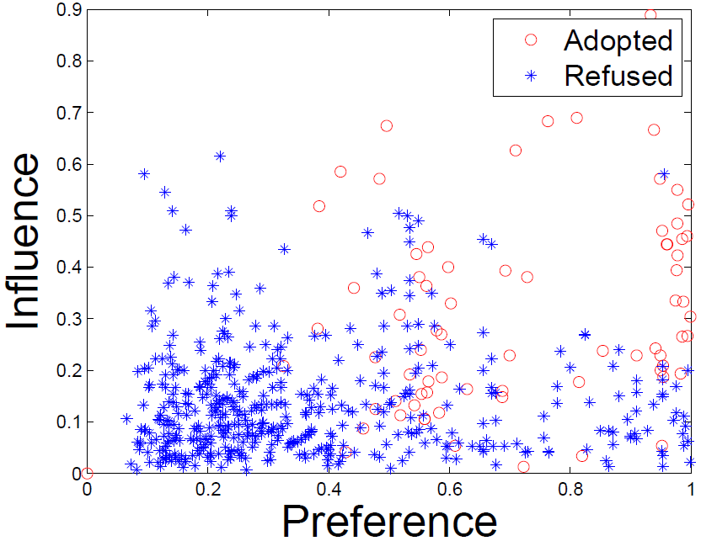
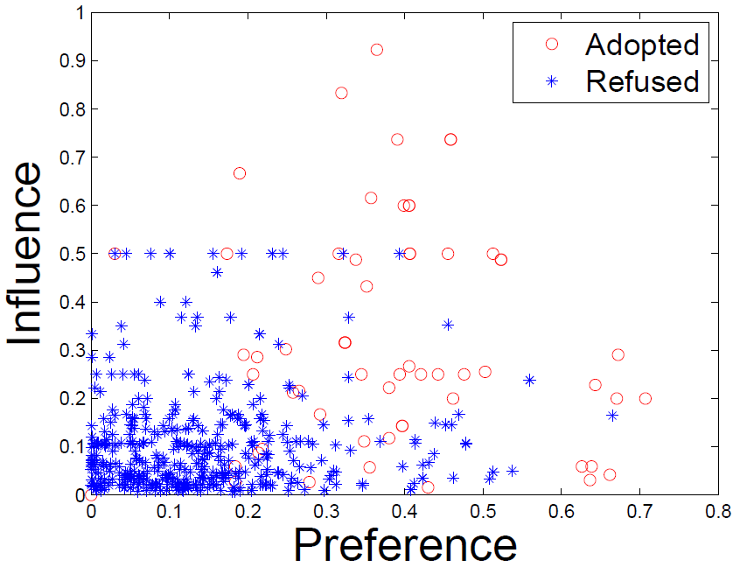
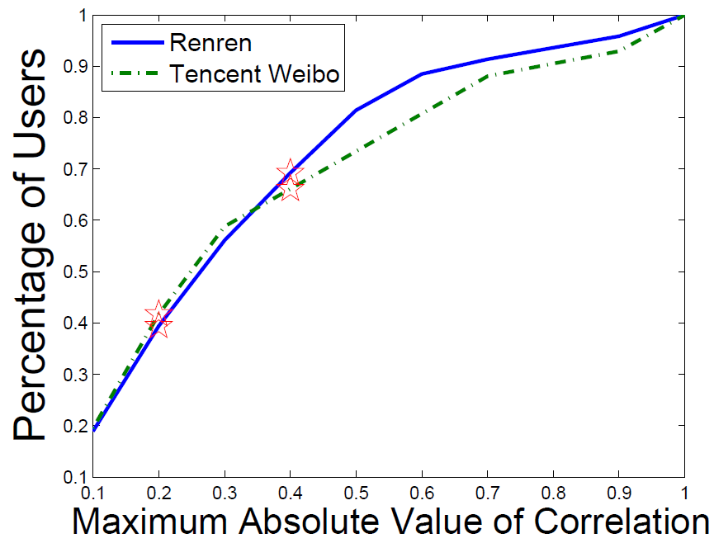
User Intention of Adopting Messages
What is the item content? Who is the sender?
Preference: topic-level user-item similarity
Influence: user-sender interaction frequency
Renren
Tencent Weibo
Correlation(Preference,
Influence) is small.

Slide 14
Outline
1. Background
2. Understanding Intention
3. The Framework
4. ContextMF Algorithm
5. Experiments

Slide 15
Social Contextual Information/Factors
item content
item latent feature V
user preference on given item
user-item interaction
user latent feature U
social relation
item sender G
social influence from sender of given item
user-user interaction
user-user influence S

Slide 16

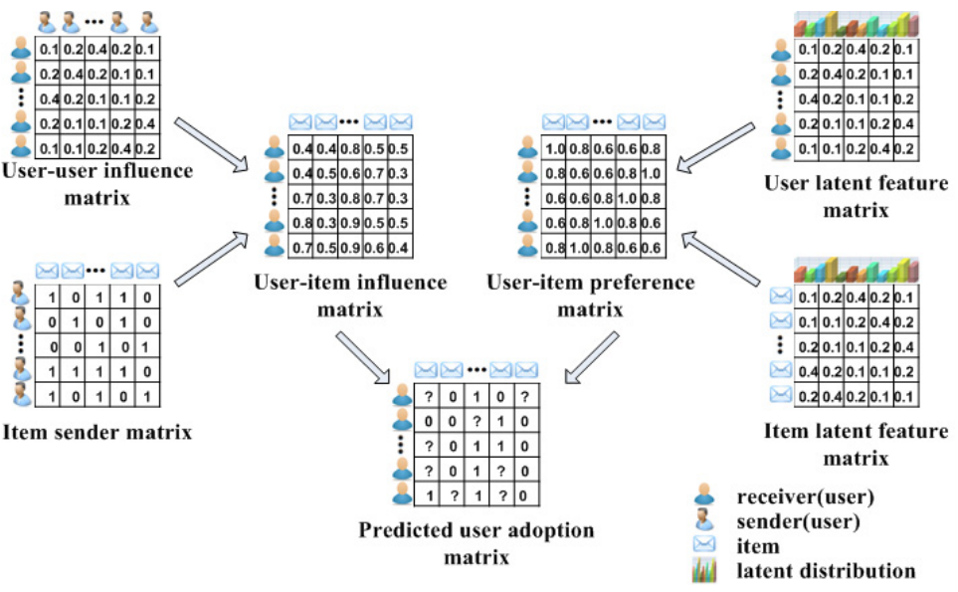
Social Contextual Recommendation
S
U
G
V
R

Slide 17
Outline
1. Background
2. Understanding Intention
3. The Framework
4. ContextMF Algorithm
5. Experiments

Slide 18
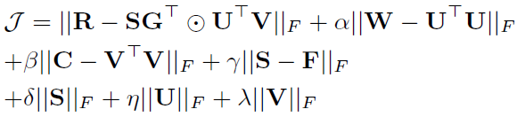
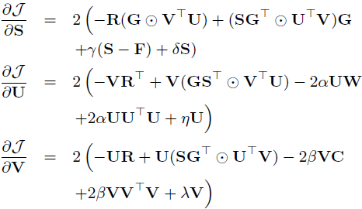
ContextMF Algorithm
Minimize sum-of-squared errors function
Block coordinate descent scheme with gradients.

Slide 19
Outline
1. Background
2. Understanding Intention
3. The Framework
4. ContextMF Algorithm
5. Experiments

Slide 20
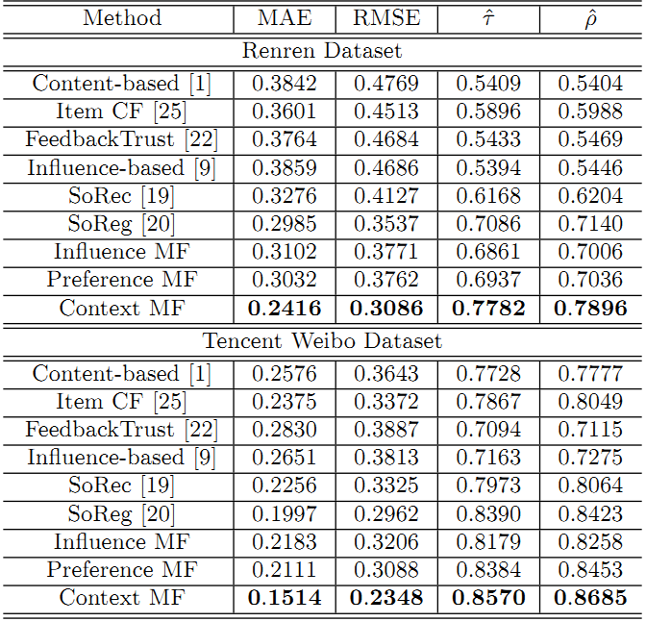
Effectiveness in Predicting Missing Links
 | Renren | Tencent Weibo
MAE | -19.1% | -24.2%
RMSE | -12.8% | -20.7%
Kendall’s | +9.82% | +2.1%
Spearman’s | +10.6% | +3.1%

Slide 21
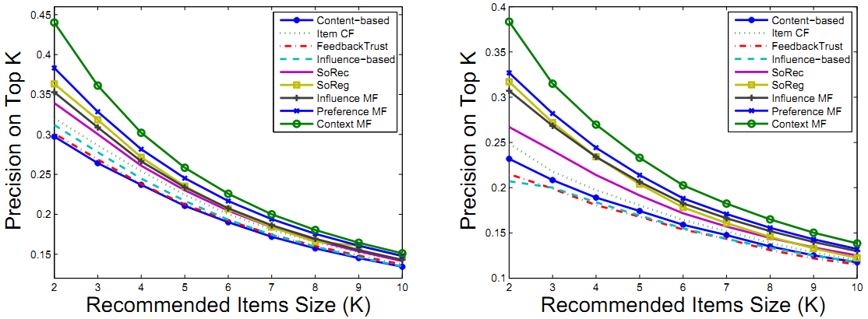
Effectiveness in Ranking Feeds/Tweets
ContextMF
ContextMF
Renren
Tencent Weibo
 | Renren | Tencent Weibo
Top-5 Precision | +21.7% | +12.3%
Top-10 Precision | +10.8% | +6.85%

Slide 22
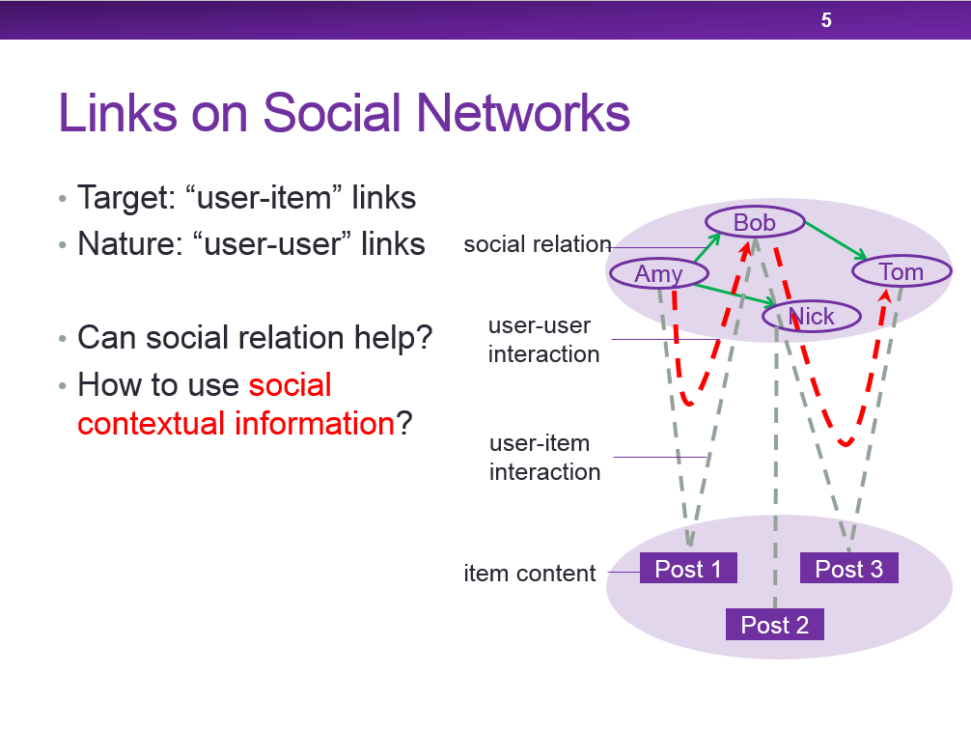
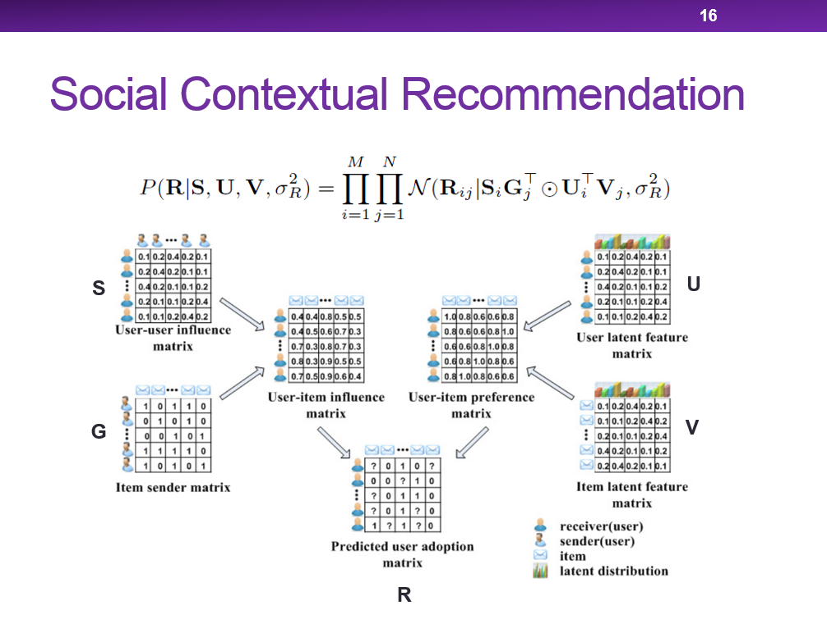
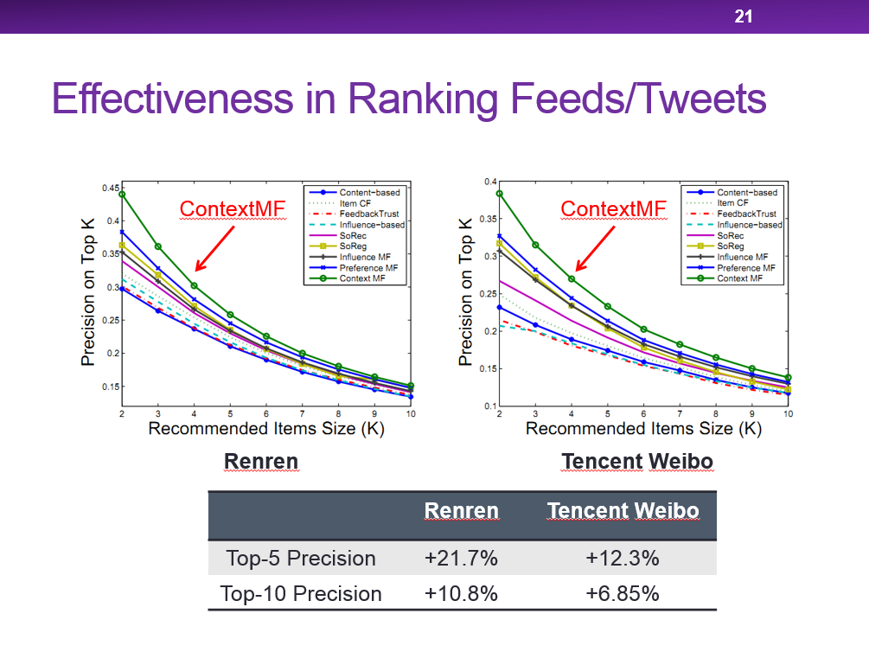
Questions?
Meng Jiang
mjiang89@gmail.com
http://www.meng-jiang.com

Slide 23

Scalable recommendation with Social contextual information
Meng Jiang
Joint work with Peng Cui, Fei Wang, Wenwu Zhu and Shiqiang Yang
TKDE 2014 (IF=1.815, 5-year IF=2.573)

Slide 24
Our Goals
Given: Links on social networks
Find: A social recommendation framework that fast and best fit adopting behaviors
Goals:
G1. Understand user intention of adoption
G2. A scalable framework for recommendation
G3. Fast predict the missing “user-item” links

Slide 25

New Users Coming
 | Old N items | New ΔN items
Old M users | Done! O(k²L(M+N)²) | O(k²LΔNN) << O(k²LN(M+N))
New ΔM users | O(k²LΔMM) << O(k²LM(M+N)) | Sorry… Cold-start problem
item
user+new user
user+new user
^{adoption}
item
user
^{item content}
^{social relation}
interaction frequency
item
user+new user
user+new user
new user
?

Slide 26
New Items Coming
 | Old N items | New ΔN items
Old M users | Done! O(k²L(M+N)²) | O(k²LΔNN) << O(k²LN(M+N))
New ΔM users | O(k²LΔMM) << O(k²LM(M+N)) | Sorry… Cold-start problem
item
new item
item+new item
user
user
^{adoption}
?
^{item content}
^{social relation}
^{interaction frequency}
user
item+new item
user
user

Slide 27
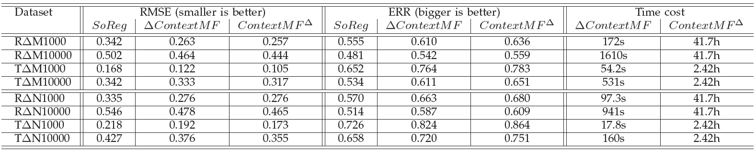
Efficiency in Incremental Data
Better than SoReg [Ma et al. WSDM 2011]
A little bit worse than offline learning (re-training)
Save time from hours to minutes when (M,N ~ million) and (ΔM,ΔN ~ thousand)

Slide 28
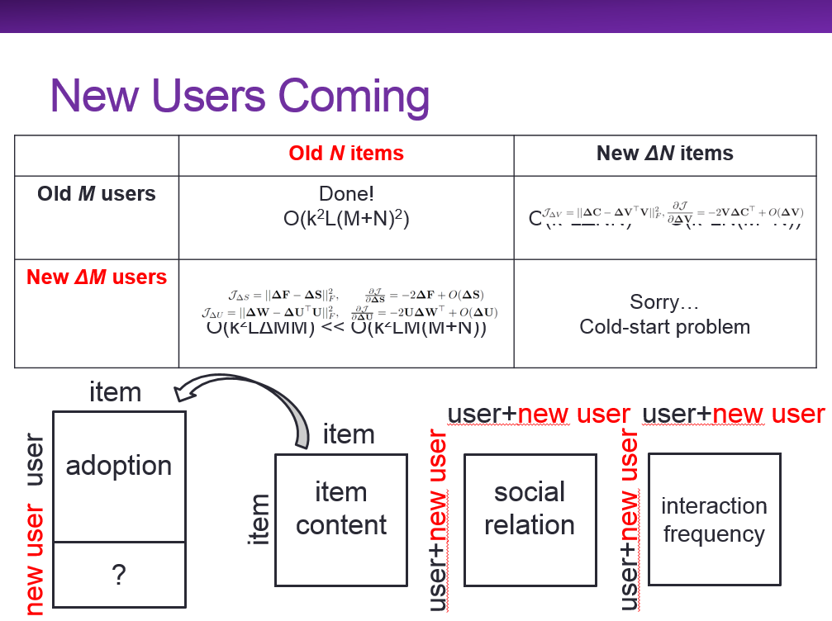
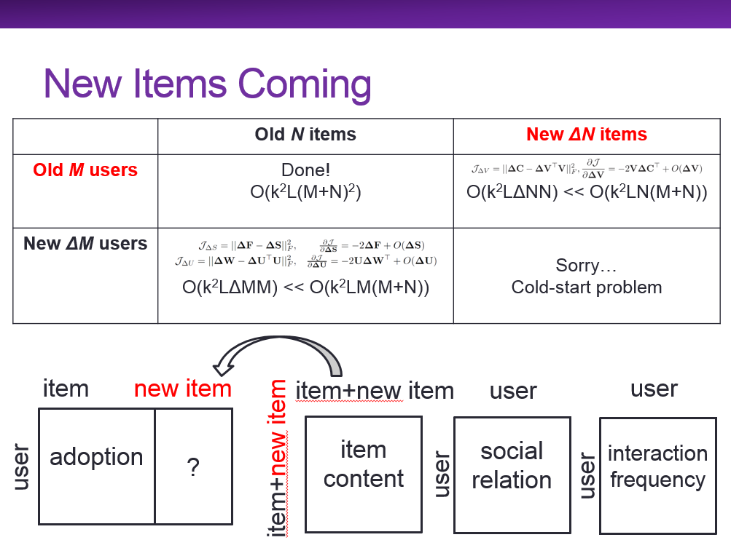
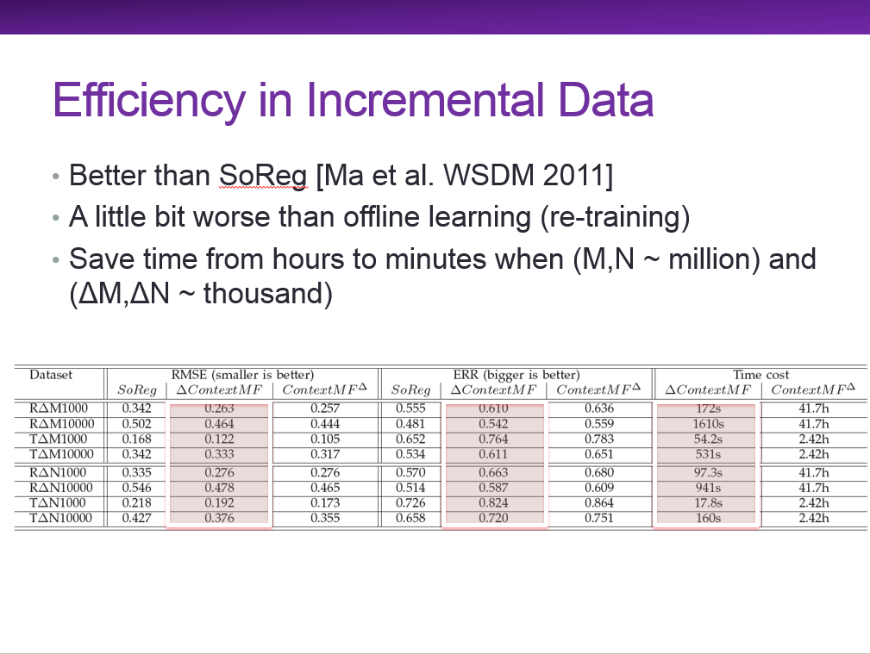
Questions?
Meng Jiang
mjiang89@gmail.com
http://www.meng-jiang.com

