Slide 1
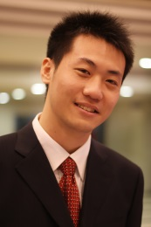
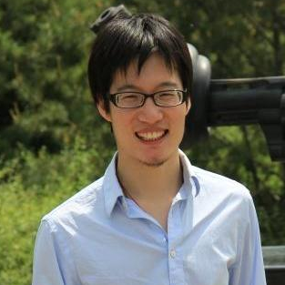
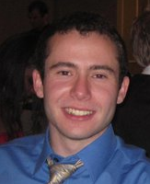
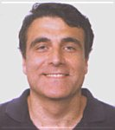
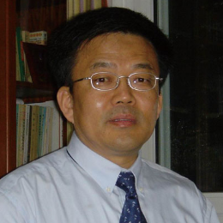


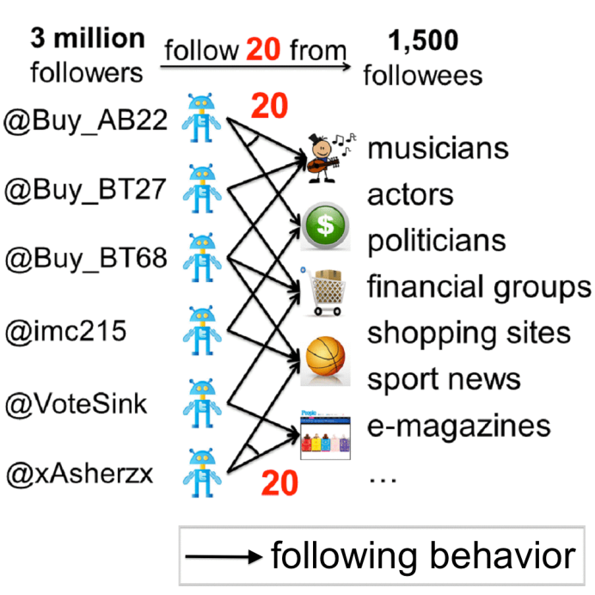
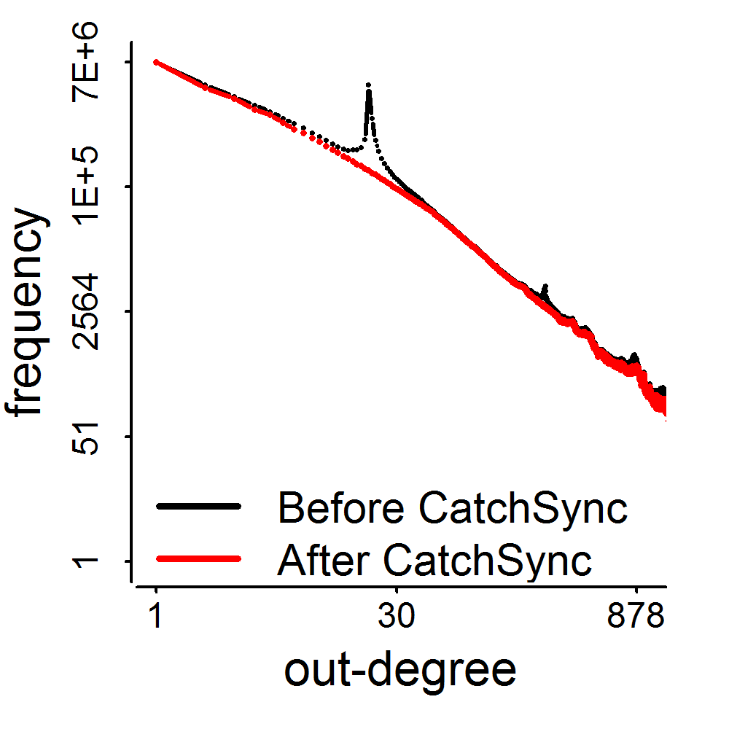
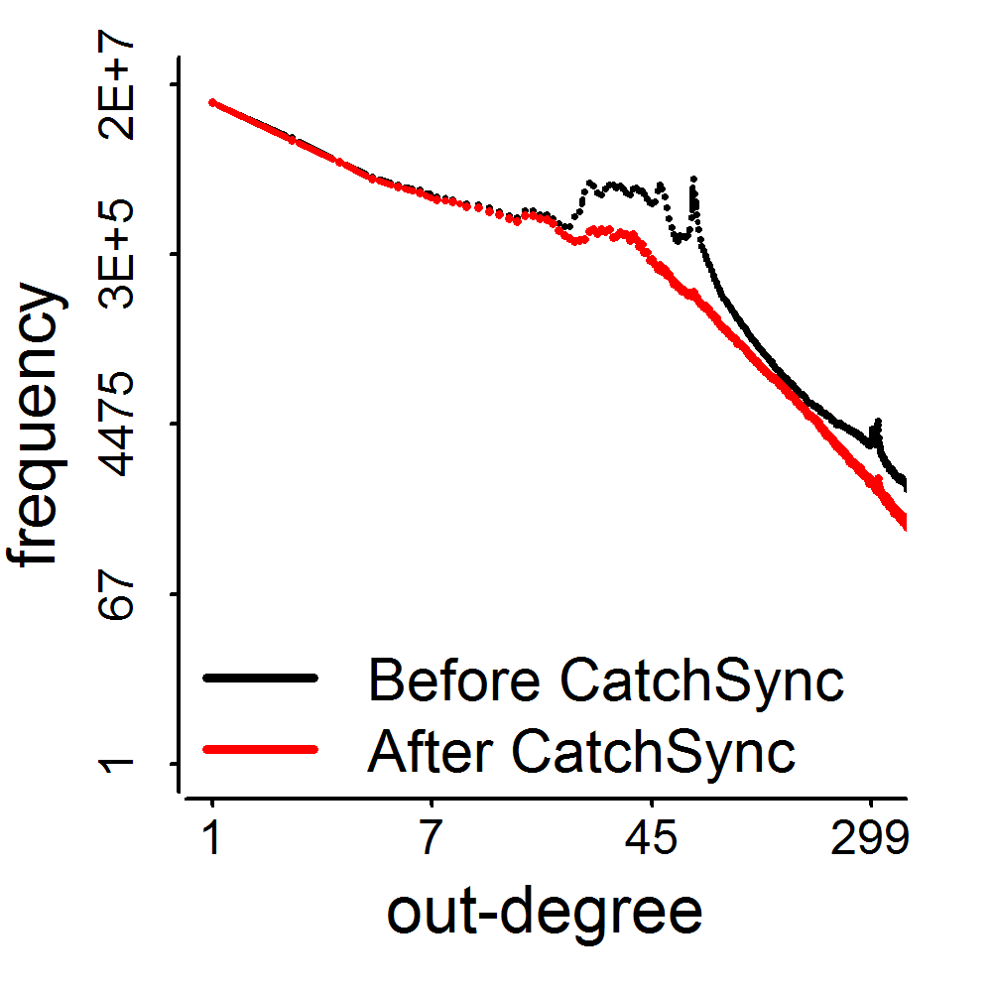
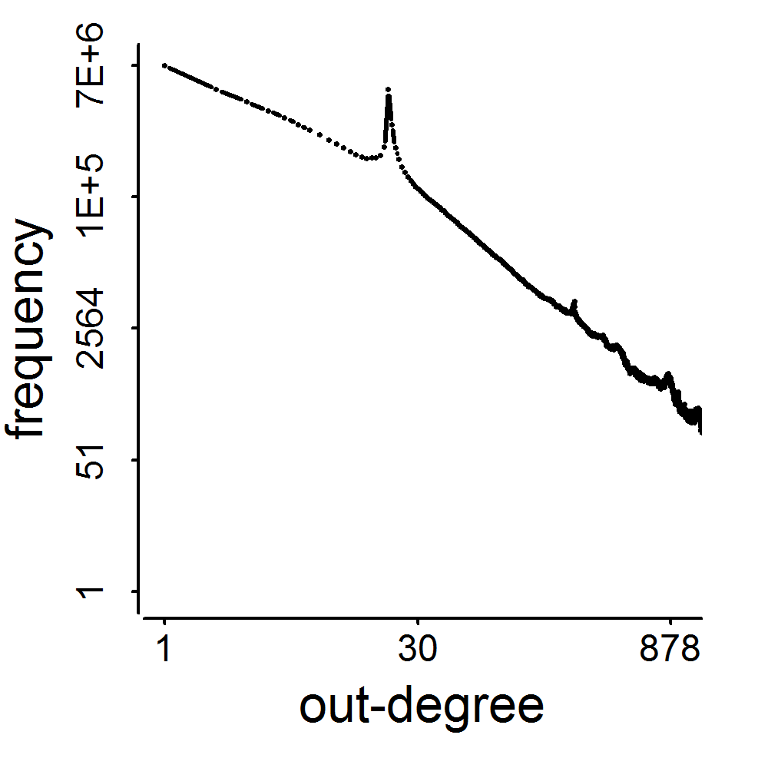
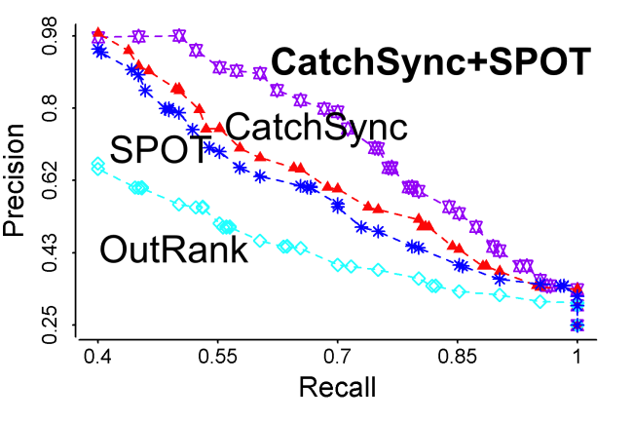
CatchSync: Catch Synchronized Behavior in Large Directed Graph Meng Jiang, Peng Cui, Alex Beutel, Christos Faloutsos, Shiqiang Yang
Security and Privacy Session: Fraud Detection
Why spikes?
Synchronized!
Smooth & Win!
Twitter’09 41M nodes
Weibo’11
3.17M
0.41M
d=20
Notes:
Hi, my name is Meng Jiang and I am presenting CatchSync - a new graph algorithm for detecting fraudulent behavior. We noticed that social graphs often have unnaturally spiky degree distributions. So, we developed a new algorithm to detect users who act suspiciously synchronized. Our algorithm has caught millions of accounts with high precision. Come to our talk at 10:30am in Empire West.

