Slide 1
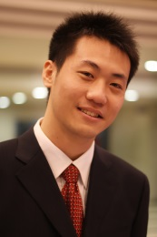
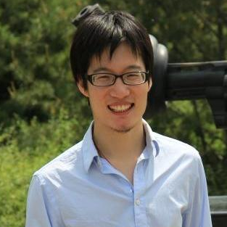
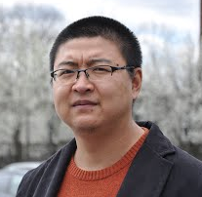

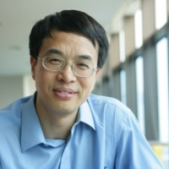
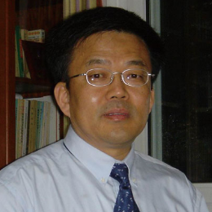

FEMA: Flexible Evolutionary Multi-faceted Analysis for Dynamic Behavior Pattern Discovery Meng Jiang, Peng Cui, Fei Wang, Xinran Xu, Wenwu Zhu, Shiqiang Yang
Dynamic Graph Analysis Session: Behavior Modeling
Challenges
Problem
Tensor sequence
Sparsity: high-order
Complexity: long seq.
Multi-faceted
Behavior modeling
Dynamic
Pattern discovery
Decomposition
Completion
time
t₃
Human behavior
Behavior prediction
t₂
item
t₁
≈
x
x
user
Notes:
Hi, my name is Meng Jiang and I am presenting FEMA - a new framework for user behavior analysis. We noticed that user behaviors are multi-faceted and dynamic. So, we use tensor sequence to model, decomposition for pattern mining and completion to predict. This brings us high sparsity and high complexity. We show novel techniques to solve these problems in our framework FEMA. The results are accurate with little loss. Come to our talk at 1:30pm in New York Ballroom West.

