Slide 1
Mining behavioral networks modeling complex behaviors in Social media
Meng Jiang
mjiang89@gmail.com
www.meng-jiang.com

Slide 2
ROadmap
Background
Previous works (6 problems)
Thinking & Future works

Slide 3



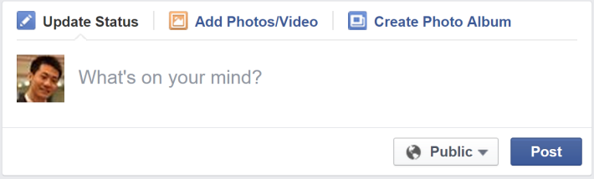
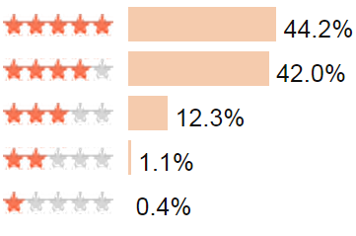

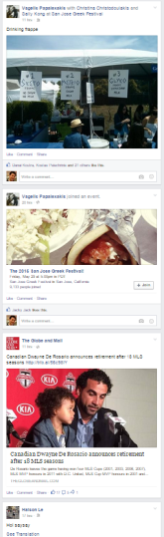
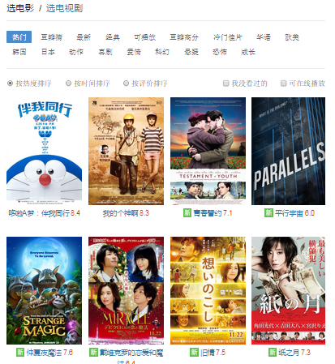
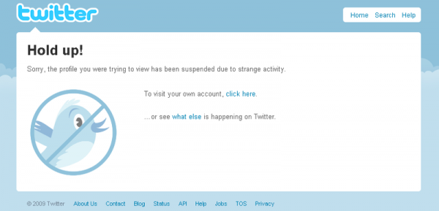
Behavior-based Applications/Systems
Values, benefits and profits in social media
Post, forward text/image
Give ratings to movies
Zombie followers, fraud
News feed ranking
Recommender systems
Anti-spam, anti-fraud

Slide 4
Behavior Modeling in Social Media
Data
Service
Modeling
user
social media
Mining
Behavior-based applications/systems
information

Slide 5
ROadmap
Background
Previous works (6 problems)
Thinking & Future works

Slide 6




FROM Behavior Modeling TO Mining Behavioral Networks
Problem 1. Information adoption behavior prediction (predicting who will retweet/share which message) [CIKM’12a, TKDE’14]
Tweet
User
t₃
Semantic
t₁
t₂
Social

Slide 7
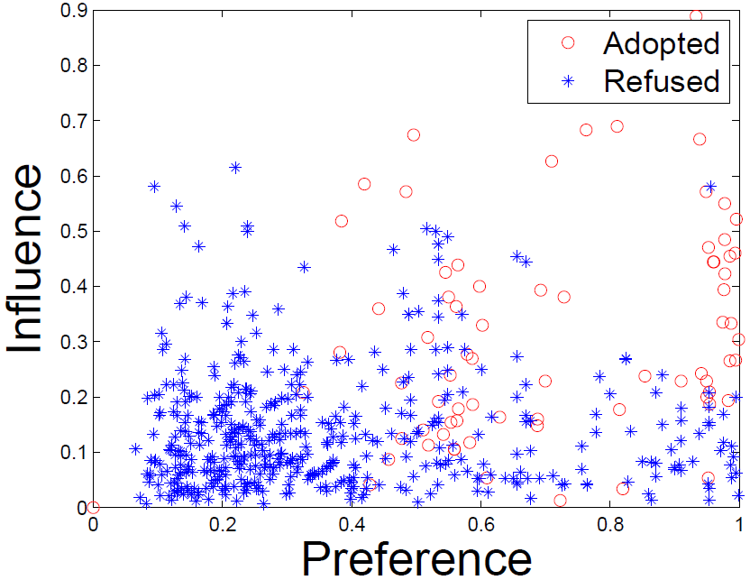
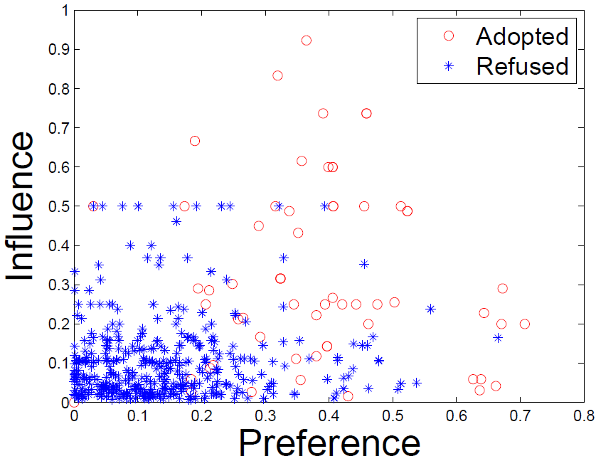
Social Contextual Behavioral Pattern
Renren
Tencent Weibo
item content
item latent feature V
user preference on given item
user-item interaction
user latent feature U
social relation
item sender G
social influence from sender of given item
user-user interaction
user-user influence S

Slide 8
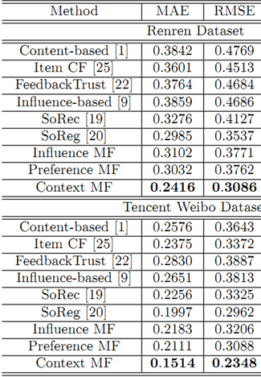
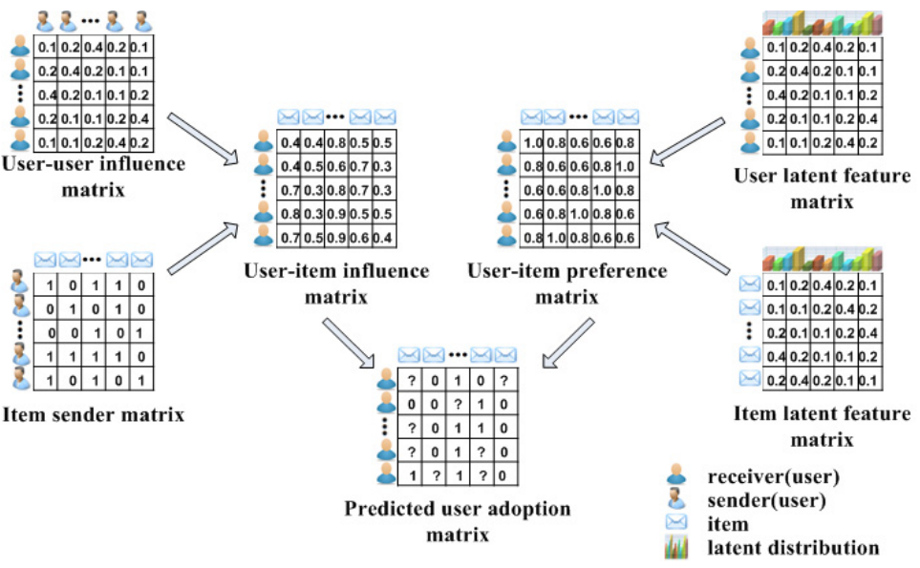
ContextMF: Social Contextual Model

Slide 9



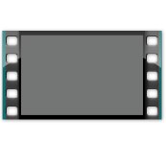


FROM Behavior Modeling TO Mining Behavioral Networks
Problem 2. Content generation behavior prediction (predicting who will generate what content) [KDD’14]
Location
Tweet
User
Social
Items
time
time

Slide 10
Spatial Temporal Contextual Behavioral Pattern
time
Tasks
Who post
Text
Behavior
Location
Behavior modeling
Tensor sequence
Space:
Multi-faceted
Time:
Dynamic
Pattern discovery
Decomposition & Completion
Behavior prediction
≈
x
x

Slide 11
FEMA: Flexible Evolutionary Multi-faceted Analysis on Tensor Perturbation Theory
0~t
Δt
0~(t+Δt)
X
+
ΔX
item
item
user
√
user
×
matricize
update
item
cluster
λ
core tensor
X⁽¹⁾
user
cluster
user
decompose
user
cluster
X⁽²⁾
A⁽¹⁾
item
user
projection
matrix
item
cluster
L⁽¹⁾
L⁽²⁾
user
item
A⁽²⁾
regularize
item
user
item

Slide 12


FROM Behavior Modeling TO Mining Behavioral Networks
Problem 3. Cross-domain behavior prediction (addressing cold-start problems if users adopt multiple types of items) [CIKM’12b, TKDE’15]
Tweet
Tag
User
Social
Image
Video

Slide 13
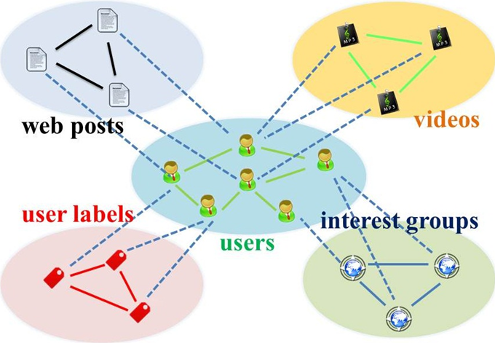
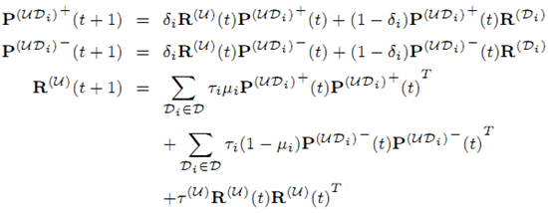
Hybrid Random Walk
Star-structured graph with social domain in the center
Auxiliary domain → Social domain → Target domain

Slide 14
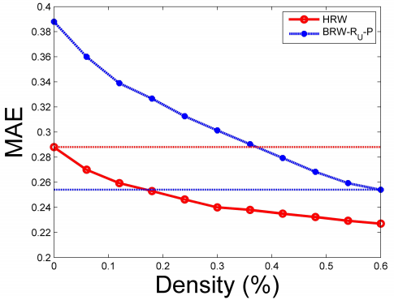
Performance on Cold-start Users
Performance(“social label” data + 3-day “web post” data) = Performance(10-day “web post” data)
35% user-post
0 user-label
0 user-post
100% user-label
60% user-post
0 user-label
18% user-post
100% user-label

Slide 15

FROM Behavior Modeling TO Mining Behavioral Networks
Problem 4. Cross-platform behavior prediction (addressing cold-start problems if platform A and platform B have overlapped users) [New]
User
Movie
Tweet
Retweeting
Rating

Slide 16
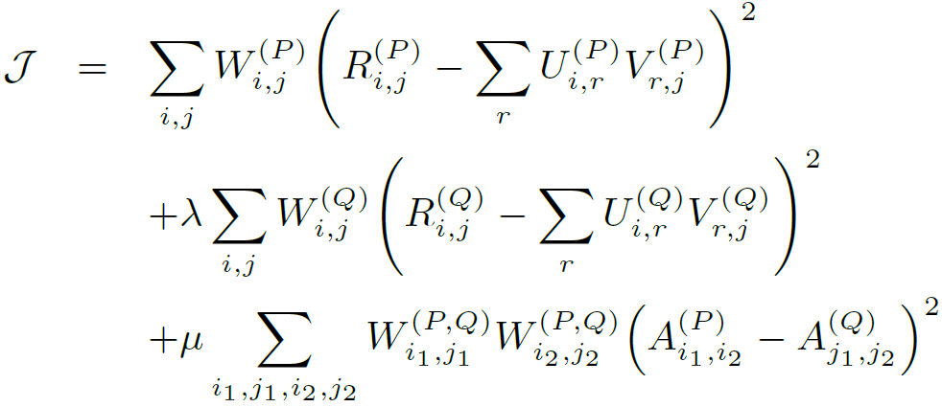
Cross-platform Behavior Modeling with Semi-Supervised MF
Input
Tgt./Aux. platform P/Q;
Behavior data R^{(P)}/R^{(Q)};
Observation W^{(P)}/W^{(Q)};
Overlapping indicator W^{(P,Q)},
Output
User latent representation U^{(P)}/U^{(Q)};
Item latent representation V^{(P)}/V^{(Q)};
Missing values in R^{(P)}
Objective function
Target platform
Auxiliary platform
Pair-wise similarity
of overlapped users
Supervised term

Slide 17


FROM Behavior Modeling TO Mining Behavioral Networks
Problem 5. Synchronized behavior detection (inferring zombie followers in Twitter networks) [PAKDD’14, KDD’14 best paper finalist, TKDD’15]
User
Social

Slide 18
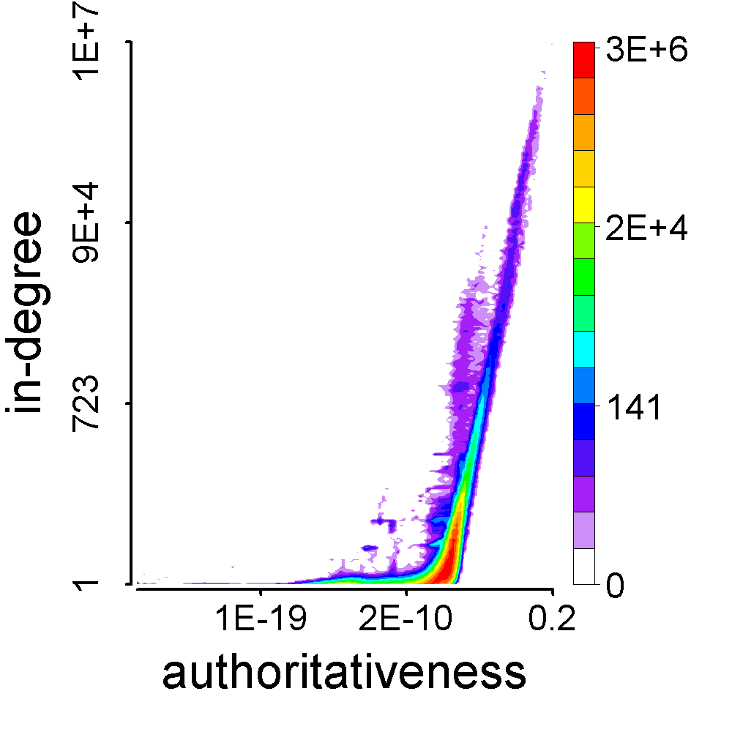
Synchronized Behavioral Patterns

Slide 19

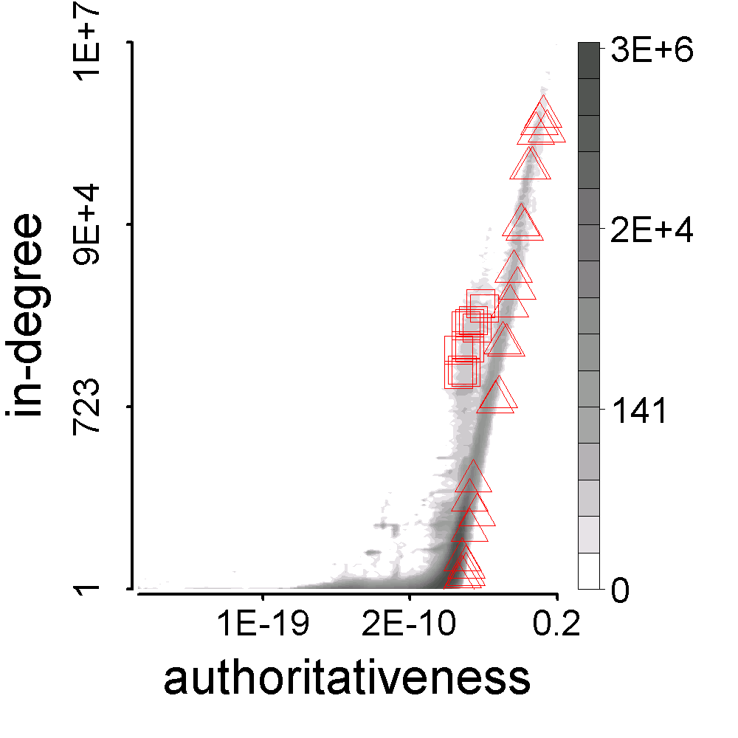



Synchronized Behavioral Patterns

Slide 20

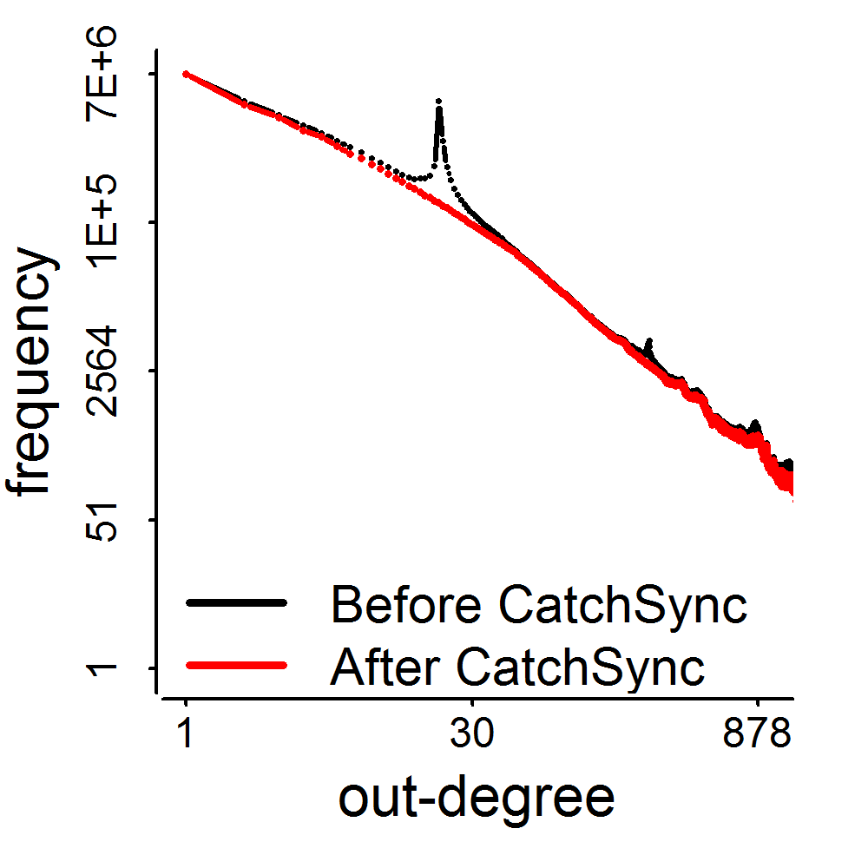
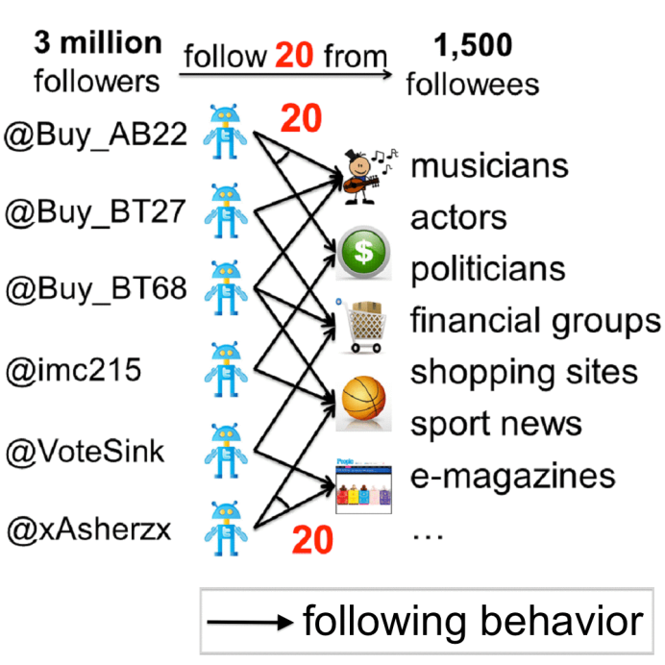
Recovering Distorted Out-degree Distribution
2009
3.17M
41M
0.41M
d=20

Slide 21









FROM Behavior Modeling TO Mining Behavioral Networks
Problem 6. Suspicious behavior detection (catching astroturfing in Twitter retweeting and trending networks) [New]
Tweet
Device
Trend
Time
User

Slide 22


Measuring Suspiciousness: Multi-modal Dense Blocks
2 modes, and 3 modes, which is more suspicious?
Dense
block:
200 minutes
120 minutes
time
time
225
user
40
user
IP
12,375
2
27,313
Data：

Slide 23
Measuring Suspiciousness: Multi-modal Dense Blocks
2 modes, and 3 modes, which is more suspicious?
Dense
block:
200 minutes
120 minutes
time
time
225
user
40
user
IP
12,375
2
27,313
Data：
Probability
0.9%
0.05%

Slide 24
ROadmap
Background
Previous works (6 problems)
Thinking & Future works

Slide 25
Challenges in Mining Behavioral Networks (Behavior Modeling)
Sparse, massive, complex behavioral data
Social, spatial, temporal contexts (Problem 1,2)
Walking across domains and platforms (Problem 3,4)
Anomalies/Suspiciousness (Problem 5,6)
Unified, structured, heterogeneous networks
Construction and integration
OLAP and mining
Network-based anomaly detection
Effective, scalable algorithms
Practical solutions: We are changing users’ behaviors.
Mining “plans”, “strategies” instead of “missing links”?

Slide 26
Construction and Integration of Behavioral Networks: Human-centered
Context
Location
Device
Text
Photo
Time
Social networks
Item A1
(tweet)
Item B1
(movie)
Item A2
(tag)
User
Platform A
User
Platform B
Item A3
(game)
Overlapped users
User
Platform C
Item B2
(book)
Item C1
(app)

Slide 27
Construction and Integration of Behavioral Networks: Human-centered
DBLP networks
Affiliation
Context
Year
Role
Latent representation?
Venue
Authoritative?
Author
Term
Professional?
Context
1st author?
Context
Location
Year
Association
Length
Award
Context
Abstract
Introduction
Methodology
Experiment
Conclusion
Paper
Cite?

Slide 28









OLAP and Mining Behavioral Networks
Affiliation
Author
Paper
Explainable citation recommendation (DBLP)
Venue
professor
student
Term
5/5
student
student
3/3
7/7
TopMine
One-step explanation:
-Co-authored students’?
-Co-authored advisors’?
-Same affiliation?
-Same venues?
-Same terms?
-Well-cited paper? (Award?)
1/5
1/3
1/4
1/7
2/7
Survey
Entity Linking
ClusType
APOLLO
2015
2014
KnowledgeVault
(Cited by >70)
“Clustering”
SIGKDD
“Entity”
“KnowledgeBase”

Slide 29
OLAP and Mining Behavioral Networks
Explainable submission recommendation (DBLP)
For paper, recommending venues:
Paper-Author-Paper-Venue
Paper-Term-Paper-Venue
For venue, recommending papers (“related to this conference?”):
Paper-Author-Paper-Venue
Paper-Term-Paper-Venue
Explainable content/item recommendation (Social media)
User-ItemA-ItemA
User-User-ItemA
User-ItemB-ItemA
User-ItemB-User-ItemA
User-Context(Social, Spatial, Temporal, Domains, Platforms)-Item
Explainable APP recommendation (Tencent App Store)
User-Context(?)-APP

Slide 30
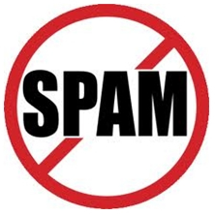
Network-based Anomaly Detection
Natural outbreaks vs. Artificial promotions
News
User
Power-law
Rank-size distribution
Frequency
Out-degree
Out-degree
Rank
Frequency
Out-degree
Out-degree
Rank

Slide 31
Practical Solutions
Promotional strategy
How to promote a policy/news/product (“ObamaCare”/“Rh- Blood”/“Earthquake”) on social media?
Given an item, a set of promoters, a network, contexts (time, etc.)
Find a set of strategies (what, how, when the promoters operate)
Maximize #infected_users_who_adopt_the_item
How to promote a research topic/area/direction (“heterogeneous networks”, “cascade prediction”, “deep learning”, etc.) in academic communities?
Given a topic, a set of authors (students, friends, etc.), contexts (conferences, journals, time, etc.)
Propose a set of papers
Maximize #infected_researchers_who_work_on_the_topic

Slide 32
THANk you
References coming …

Slide 33
References: Journal Papers
Meng Jiang, Peng Cui, Fei Wang, Wenwu Zhu and Shiqiang Yang. “Social Recommendation with Cross-Domain Transferable Knowledge”, in IEEE TKDE 2015. (to appear. Regular. IF=1.815. CCF A)
Meng Jiang, Peng Cui, Alex Beutel, Christos Faloutsos and Shiqiang Yang. “Catching Synchronized Behaviors in Large Networks: A Graph Mining Approach”, in ACM TKDD 2015. (to appear. Full. IF=1.147. CCF B)
Meng Jiang, Peng Cui, Fei Wang, Wenwu Zhu and Shiqiang Yang. “Scalable Recommendation with Social Contextual Information”, in IEEE TKDE 2014. (Regular. IF=1.815. CCF A)
Lu Liu, Feida Zhu, Meng Jiang, Jiawei Han, Lifeng Sun and Shiqiang Yang. “Mining Diversity on Social Media Networks”, in Multimedia Tools and Applications 2012. (CCF B)

Slide 34
References: Conference Papers
Meng Jiang, Peng Cui, Alex Beutel, Christos Faloutsos and Shiqiang Yang. “CatchSync: Catching Synchronized Behavior in Large Directed Graph”, in ACM SIGKDD 2014. (Full. Best paper finalist. Acc. rate=14.6%. CCF A)
Meng Jiang, Peng Cui, Fei Wang, Xinran Xu, Wenwu Zhu and Shiqiang Yang. “FEMA: Flexible Evolutionary Multi-faceted Analysis for Dynamic Behavioral Pattern Discovery”, in ACM SIGKDD 2014. (Full. Acc. rate=14.6%. CCF A)
Meng Jiang, Peng Cui, Alex Beutel, Christos Faloutsos and Shiqiang Yang. “Inferring Strange Behavior from Connectivity Pattern in Social Networks”, in PAKDD 2014. (Full. Acc. rate=10.8%. CCF C)
Meng Jiang, Peng Cui, Alex Beutel, Christos Faloutsos and Shiqiang Yang. “Detecting Suspicious Following Behavior in Multimillion-Node Social Networks”, in WWW 2014. (Poster. CCF B)

Slide 35
References: Conference Papers
Meng Jiang, Peng Cui, Rui Liu, Qiang Yang, Fei Wang, Wenwu Zhu and Shiqiang Yang. “Social Contextual Recommendation”, in CIKM 2012. (Full. Acc. rate=13.4%. 65 citations till 06/2015. CCF B)
Meng Jiang, Peng Cui, Fei Wang, Qiang Yang, Wenwu Zhu and Shiqiang Yang. “Social Recommendation across Multiple Relational Domains”, in CIKM 2012. (Full. Acc. rate=13.4%. 26 citations till 06/2015. CCF B)
Lu Liu, Jie Tang, Jiawei Han, Meng Jiang and Shiqiang Yang. “Mining Topic-Level Influence in Heterogeneous Networks”, in CIKM 2010. (CCF B)

Slide 36
References: Submitted Papers
Meng Jiang, Peng Cui, and Christos Faloutsos. “Suspicious Behavior Detection: Current Trends and Future Directions”, to IEEE Intelligent Systems Magazine Special Issue on Online Behavioral Analysis and Modeling.
Meng Jiang, Alex Beutel, Peng Cui, Bryan Hooi, Shiqiang Yang, and Christos Faloutsos. “A General Suspiciousness Metric for Dense Blocks in Multi-Modal Data”, to IEEE ICDM, 2015.
Meng Jiang, Peng Cui, Nicholas Jing Yuan, Xing Xie, and Shiqiang Yang. “Little is Much: Bridging Cross-Platform Behaviors Through Small Overlapped Crowds”, to IEEE ICDM, 2015.
Meng Jiang, Peng Cui, Alex Beutel, Christos Faloutsos and Shiqiang Yang. “Inferring Lockstep Behavior from Connectivity Pattern in Large Graphs”, to Knowledge and Information Systems (KAIS).

