Slide 1

Chapter 7. Advanced Frequent Pattern Mining
Meng Jiang
CS412 Summer 2017:
Introduction to Data Mining

Slide 2
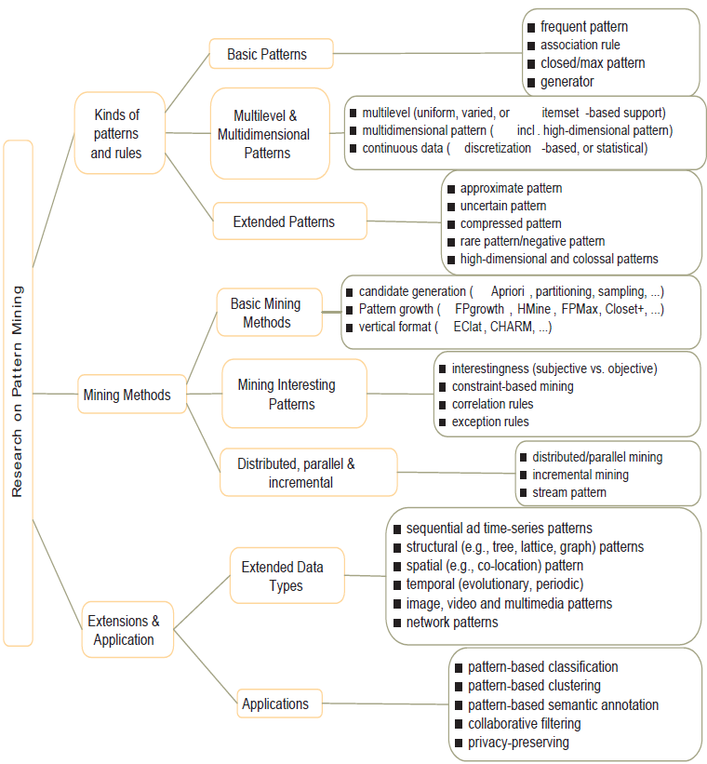
Research on Pattern Mining: A Road Map

Slide 3
Advanced Frequent Pattern Mining
Mining Diverse Patterns
Constraint-Based Frequent Pattern Mining
Mining High-Dimensional Data and Colossal Patterns
Sequential Pattern Mining
Graph Pattern Mining

Slide 4
Mining Diverse Patterns
Mining Multiple-Level Associations
Mining Multi-Dimensional Associations
Mining Quantitative Associations
Mining Negative Correlations
Mining Compressed Patterns

Slide 5
Mining Multiple-Level Frequent Patterns
Items often form hierarchies
Ex.: Dairyland 2% milk; Wonder wheat bread
How to set min-support thresholds?
Uniform min-support across multiple levels (reasonable?)
Level-reduced min-support: Items at the lower level are expected to have lower support
Uniform support
Reduced support
Level 1
min_sup = 5%
Milk
[support = 10%]
Level 1
min_sup = 5%
Level 2
min_sup = 1%
Level 2
min_sup = 5%
2% Milk
[support = 6%]
Skim Milk
[support = 2%]

Slide 6
Redundancy Filtering at Mining Multi-Level Associations
Multi-level association mining may generate many redundant rules
Redundancy filtering: Some rules may be redundant due to “ancestor” relationships between items
(Suppose the 2% milk sold is about ¼ of milk sold in gallons)
milk ⇒ wheat bread [support = 8%, confidence = 70%] (1)
2% milk ⇒ wheat bread [support = 2%, confidence = 72%] (2)
A rule is redundant if its support is close to the “expected” value, according to its “ancestor” rule, and it has a similar confidence as its “ancestor”
Rule (1) is an ancestor of rule (2), which one to prune?

Slide 7
Customized Min-Supports for Different Kinds of Items
We have used the same min-support threshold for all the items or item sets to be mined in each association mining
In reality, some items (e.g., diamond, watch, …) are valuable but less frequent
It is necessary to have customized min-support settings for different kinds of items
One Method: Use group-based “individualized” min-support
E.g., {diamond, watch}: 0.05%; {bread, milk}: 5%; …

Slide 8
Mining Multi-Dimensional Associations
Single-dimensional rules (e.g., items are all in “product” dimension)
buys(X, “milk”) ⇒ buys(X, “bread”)
Multi-dimensional rules (i.e., items in ≥ 2 dimensions or predicates)
Inter-dimension association rules (no repeated predicates)
age(X, “18-25”) ∧ occupation(X, “student”) ⇒ buys(X, “coke”)
Hybrid-dimension association rules (repeated predicates)
age(X, “18-25”) ∧ buys(X, “popcorn”) ⇒ buys(X, “coke”)
Attributes can be categorical or numerical
Categorical Attributes (e.g., profession, product: no ordering among values): Data cube for inter-dimension association
Quantitative Attributes: Numeric, implicit ordering among values—discretization, clustering, and gradient approaches

Slide 9
Mining Quantitative Associations
Mining associations with numerical attributes
Ex.: Numerical attributes: age and salary
Methods
Static discretization based on predefined concept hierarchies
Data cube-based aggregation
Dynamic discretization based on data distribution
Clustering: Distance-based association
First one-dimensional clustering, then association
Deviation analysis:
Gender = female ⇒ Wage: mean=$7/hr (overall mean = $9)
()
(age)
(income)
(buys)
(age, income)
(age,buys)
(income, buys)
(age, income, buys)

Slide 10
Mining Extraordinary Phenomena in Quantitative Association Mining
Mining extraordinary (i.e., interesting) phenomena
Ex.: Gender = female ⇒ Wage: mean=$7/hr (overall mean = $9)
LHS: a subset of the population
RHS: an extraordinary behavior of this subset
The rule is accepted only if a statistical test (e.g., Z-test) confirms the inference with high confidence
Subrule: Highlights the extraordinary behavior of a subset of the population of the super rule
Ex.: (Gender = female) ^ (South = yes) ⇒ mean wage = $6.3/hr
Rule condition can be categorical or numerical (quantitative rules)
Ex.: Education in [14-18] (yrs) ⇒ mean wage = $11.64/hr
Efficient methods have been developed for mining such extraordinary rules (e.g., Aumann and Lindell@KDD’99)

Slide 11
Last Lecture
Mining multi-level frequent patterns
Reduced support
Redundancy filtering
Group-based individualized min-support
Mining multi-dimensional association rules
X→Y, variables. X: antecedent (condition) or left-hand-side (LHS); Y: consequent or right-hand-side (RHS)
Inter-dimension, hybrid-dimension
Attributes: categorical, numerical
Mining quantitative association rules
Mean, deviation, minimum, maximum as variables: Data cube
TODAY: Mining negative patterns, mining compressed patterns…

Slide 12
Rare Patterns vs. Negative Patterns
Rare patterns
Very low support but interesting (e.g., buying Rolex watches)
How to mine them? Setting individualized, group-based min-support thresholds for different groups of items
Negative patterns
Negatively correlated: Unlikely to happen together
Ex.: Since it is unlikely that the same customer buys both a Ford Expedition (an SUV car) and a Ford Fusion (a hybrid car), buying a Ford Expedition and buying a Ford Fusion are likely negatively correlated patterns
How to define negative patterns?

Slide 13
Defining Negative Correlated Patterns
A support-based definition
If itemsets A and B are both frequent but rarely occur together, i.e., sup(A U B) << sup (A) × sup(B)
Then A and B are negatively correlated
Is this a good definition for large transaction datasets?
Ex.: Suppose a store sold two needle packages A and B 100 times each, but only one transaction contained both A and B
When there are in total 200 transactions, we have
s(A U B) = 0.005, s(A) × s(B) = 0.25, s(A U B) << s(A) × s(B)
But when there are 10⁵ transactions, we have
s(A U B) = 1/10⁵, s(A) × s(B) = 1/10³ × 1/10³, s(A U B) > s(A) × s(B)
What is the problem? — Null transactions: The support-based definition is not null-invariant!
Does this remind you the definition of lift?

Slide 14
Defining Negative Correlation: Need Null-Invariance in Definition
A good definition on negative correlation should take care of the null-invariance problem
Whether two itemsets A and B are negatively correlated should not be influenced by the number of null-transactions
A Kulczynski measure-based definition
If itemsets A and B are frequent but (P(A|B) + P(B|A))/2 < є, where є is a negative pattern threshold, then A and B are negatively correlated
For the same needle package problem:
No matter there are in total 200 or 10⁵ transactions
If є = 0.01, we have (P(A|B) + P(B|A))/2 = (0.01 + 0.01)/2 < є

Slide 15

Mining Compressed Patterns
Why mining compressed patterns?
Too many scattered patterns but not so meaningful
Pattern distance measure
δ-clustering: For each pattern P, find all patterns which can be expressed by P and whose distance to P is within δ (δ-cover)
All patterns in the cluster can be represented by P
Method for efficient, direct mining of compressed frequent patterns (e.g., D. Xin, J. Han, X. Yan, H. Cheng, "On Compressing Frequent Patterns", Knowledge and Data Engineering, 60:5-29, 2007)
Pat-ID | Item-Sets | Support
P1 | {38,16,18,12} | 205227
P2 | {38,16,18,12,17} | 205211
P3 | {39,38,16,18,12,17} | 101758
P4 | {39,16,18,12,17} | 161563
P5 | {39,16,18,12} | 161576
Closed patterns
P1, P2, P3, P4, P5
Emphasizes too much on support
There is no compression
Max-patterns
P3: information loss
Desired output (a good balance):
P2, P3, P4

Slide 16
Advanced Frequent Pattern Mining
Mining Diverse Patterns
Constraint-Based Frequent Pattern Mining
Mining High-Dimensional Data and Colossal Patterns
Sequential Pattern Mining
Graph Pattern Mining

Slide 17
Why Constraint-Based Mining?
Finding all the patterns in a dataset autonomously? — unrealistic!
Too many patterns but not necessarily user-interested!
Pattern mining should be an interactive process
User directs what to be mined using a data mining query language (or a graphical user interface)
Constraint-based mining
User flexibility: provides constraints on what to be mined
Optimization: explores such constraints for efficient mining
Constraint-based mining: Constraint-pushing, similar to push selection first in DB query processing

Slide 18
Constraints in General Data Mining
A data mining query can be in the form of a meta-rule or with the following language primitives.
Knowledge type constraint:
Ex.: classification, association, clustering, outlier finding, ....
Data constraint — using SQL-like queries
Ex.: find products sold together in NY stores this year
Dimension/level constraint
Ex.: in relevance to region, price, brand, customer category
Rule (or pattern) constraint
Ex.: small sales (price < $10) triggers big sales (sum > $200)
Interestingness constraint
Ex.: strong rules: min_sup ≥ 0.02, min_conf ≥ 0.6, min_correlation ≥ 0.7

Slide 19
Meta-Rule Guided Mining
A meta-rule can contain partially instantiated predicates & constants
P₁(X, Y) ^ P₂(X, W) ⇒ buys(X, “iPad”)
The resulting mined rule can be
age(X, “15-25”) ^ profession(X, “student”) ⇒ buys(X, “iPad”)
In general, (meta) rules can be in the form of
P₁ ^ P₂ ^ … ^ P_{l} ⇒ Q₁ ^ Q₂ ^ … ^ Q_{r}
Method to find meta-rules
Find frequent (l + r) predicates (based on min-support)
Push constants deeply when possible into the mining process
Also, push min_conf, min_correlation, and other measures as early as possible (measures acting as constraints)

Slide 20
Different Kinds of Constraints Lead to Different Pruning Strategies
Constraints can be categorized as
Pattern space pruning constraints vs. data space pruning constraints
Pattern space pruning constraints
Anti-monotonic: If constraint c is violated, its further mining can be terminated (=no superset)
Monotonic: If c is satisfied, no need to check c again (=all supersets)
Succinct: if the constraint c can be enforced by directly manipulating the data (e.g., data pruning)
Convertible: c can be converted to monotonic or anti-monotonic if items can be properly ordered in processing
Data space pruning constraints
Data succinct: Data space can be pruned at the initial pattern mining process
Data anti-monotonic: If a transaction t does not satisfy c, then t can be pruned to reduce data processing effort

Slide 21
Pattern Space Pruning with Pattern Anti-Monotonicity
Constraint c is anti-monotone
If an itemset S violates constraint c, so does any of its superset
That is, mining on itemset S can be terminated
Ex. 1: c1: sum(S.price) ≤ v is anti-monotone
Ex. 2: c2: range(S.profit) ≤ 15 is anti-monotone
Itemset ab violates c2 (range(ab) = 40)
So does every superset of ab
Ex. 3. c3: sum(S.Price) ≥ v is not anti-monotone
Ex. 4. Is c4: support(S) ≥ σ anti-monotone?
Yes! Apriori pruning is essentially pruning with an anti-monotonic constraint!
TID | Transaction
10 | a, b, c, d, f, h
20 | b, c, d, f, g, h
30 | b, c, d, f, g
40 | a, c, e, f, g
Item | Profit
a | 40
b | 0
c | -20
d | -15
e | -30
f | -10
g | 20
h | 5
min_sup = 2
price(item)>0

Slide 22
Pattern Monotonicity and Its Roles
A constraint c is monotone: if an itemset S satisfies the constraint c, so does any of its superset
That is, we do not need to check c in subsequent mining
Ex. 1: c1: sum(S.Price) ≥ v is monotone
Ex. 2: c2: min(S.Price) ≤ v is monotone
Ex. 3: c3: range(S.profit) ≥ 15 is monotone
Itemset ab satisfies c3
So does every superset of ab
TID | Transaction
10 | a, b, c, d, f, h
20 | b, c, d, f, g, h
30 | b, c, d, f, g
40 | a, c, e, f, g
Item | Profit
a | 40
b | 0
c | -20
d | -15
e | -30
f | -10
g | 20
h | 5
min_sup = 2
price(item)>0

Slide 23
Different Kinds of Constraints Lead to Different Pruning Strategies
Constraints can be categorized as
Pattern space pruning constraints vs. data space pruning constraints
Pattern space pruning constraints
Anti-monotonic: If constraint c is violated, its further mining can be terminated (=no superset)
Monotonic: If c is satisfied, no need to check c again (=all supersets)
Succinct: if the constraint c can be enforced by directly manipulating the data (e.g., data pruning)
Convertible: c can be converted to monotonic or anti-monotonic if items can be properly ordered in processing
Data space pruning constraints
Data succinct: Data space can be pruned at the initial pattern mining process
Data anti-monotonic: If a transaction t does not satisfy c, then t can be pruned to reduce data processing effort

Slide 24
Data Space Pruning with Data Anti-Monotonicity
A constraint c is data anti-monotone: In the mining process, if a data entry t cannot satisfy a pattern p under c, t cannot satisfy p’s superset either if a data entry (transaction) t cannot satisfy constraint c, t cannot satisfy any pattern p under c
Data space pruning: Data entry t can be pruned
Ex. 1: c₁: sum(S.Profit) ≥ v is data anti-monotone
Let constraint c₁ be: sum{S.Profit} ≥ 25
T₃₀: {b, c, d, f, g} can be removed since none of their combinations can make an S whose sum of the profit is ≥ 25
Ex. 2: c₂: min(S.Price) ≤ v is data anti-monotone
Consider v = 5 but every item in transaction T₅₀ has a price higher than 10
TID | Transaction
10 | a, b, c, d, f, h
20 | b, c, d, f, g, h
30 | b, c, d, f, g
40 | a, c, e, f, g
Item | Profit
a | 40
b | 0
c | -20
d | -15
e | -30
f | -10
g | 20
h | 5
min_sup = 2
price(item)>0

Slide 25
Succinctness: Pruning Both Data and Pattern Spaces
Succinctness: if the constraint c can be enforced by directly manipulating the data
Ex. 1: To find those patterns without item i
Remove i from DB and then mine (pattern space pruning)
Ex. 2: To find those patterns containing item i
Mine only i-projected DB (data space pruning)
Ex. 3: c₃: min(S.Price) ≤ v is succinct
Start with only items whose price ≤ v (pattern space pruning) and remove transactions with high-price items only (data space pruning)
Ex. 4: c₄: sum(S.Price) ≥ v is not succinct
It cannot be determined beforehand since sum of the price of itemset S keeps increasing

Slide 26
Convertible Constraints: Ordering Data in Transactions
Convert tough constraints into (anti-) monotone by proper ordering of items in transactions
Examine c1: avg(S.profit) > 20
Order items in value-descending order
<a, g, f, h, b, d, c, e>
An itemset ab violates c1 (avg(ab) = 20)
So does ab* (i.e., ab-projected DB)
C1: anti-monotone if patterns grow in the right order!
Can item-reordering work for Apriori?
Does not work for level-wise candidate generation!
avg(agf) = 23.3 > 20, but avg(gf) = 15 < 20
Item | Profit
a | 40
b | 0
c | -20
d | -15
e | -30
f | 10
g | 20
h | 5
min_sup = 2
price(item)>0
TID | Transaction
10 | a, b, c, d, f, h
20 | b, c, d, f, g, h
30 | b, c, d, f, g
40 | a, c, e, f, g

Slide 27
How to Handle Multiple Constraints?
It is beneficial to use multiple constraints in pattern mining
But different constraints may require potentially conflicting item-ordering
If there exists an order R making both c1 and c2 convertible, try to sort items in the order that benefits pruning most
If there exists conflict ordering between c1 and c2
Try to sort data and enforce one constraint first (which one?)
Then enforce the other when mining the projected databases
Ex. c₁: avg(S.profit) > 20, and c₂: avg(S.price) < 50
Sorted in profit descending order and use c1 first (assuming c₁ has more pruning power)
For each project DB, sort trans. in price ascending order and use c₂ at mining

Slide 28
Different Kinds of Constraints Lead to Different Pruning Strategies
Constraints can be categorized as
Pattern space pruning constraints vs. data space pruning constraints
Pattern space pruning constraints
Anti-monotonic: If constraint c is violated, its further mining can be terminated (=no superset)
Monotonic: If c is satisfied, no need to check c again (=all supersets)
Succinct: if the constraint c can be enforced by directly manipulating the data (e.g., data pruning)
Convertible: c can be converted to monotonic or anti-monotonic if items can be properly ordered in processing
Data space pruning constraints
Data succinct: Data space can be pruned at the initial pattern mining process
Data anti-monotonic: If a transaction t does not satisfy c, then t can be pruned to reduce data processing effort

Slide 29
Advanced Frequent Pattern Mining
Mining Diverse Patterns
Constraint-Based Frequent Pattern Mining
Mining High-Dimensional Data and Colossal Patterns
Sequential Pattern Mining
Graph Pattern Mining

Slide 30
Mining Long Patterns: Challenges
Mining long patterns is needed in bioinformatics, social network analysis, software engineering, …
But the methods introduced so far mine only short patterns (e.g., length < 10)
Challenges of mining long patterns
The curse of “downward closure” property of frequent patterns
Any sub-pattern of a frequent pattern is frequent
If {a₁, a₂, …, a₁₀₀} is frequent, then {a₁}, {a₂}, …, {a₁₀₀}, {a₁, a₂}, {a₁, a₃}, …, {a₁, a₁₀₀}, {a₁, a₂, a₃}, … are all frequent! There are about 2¹⁰⁰ such frequent itemsets!
No matter searching in breadth-first (e.g., Apriori) or depth-first (e.g., FPgrowth), if we still adopt the “small to large” step-by-step growing paradigm, we have to examine so many patterns, which leads to combinatorial explosion!

Slide 31
Colossal Patterns: A Motivating Example
Let min-support σ= 20
# of closed/maximal patterns of size 20: about
But there is only one pattern with size close to 40 (i.e., long or colossal)
α= {41,42,…,79} of size 39
Q: How to find it without generating an exponential number of size-20 patterns?
T1 = 2 3 4 ….. 39 40
T2 = 1 3 4 ….. 39 40
: .
: .
T40=1 2 3 4 …… 39
T41= 41 42 43 ….. 79
T42= 41 42 43 ….. 79
: .
: .
T60= 41 42 43 … 79
The existing fastest mining algorithms (e.g., FPClose, LCM) fail to complete running
A new algorithm, Pattern-Fusion, outputs this colossal pattern in seconds

Slide 32
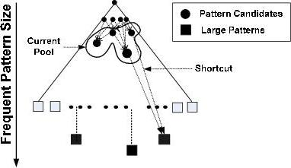
What Is Pattern-Fusion?
Not strive for completeness (why?)
Jump out of the swamp of the mid-sized intermediate “results”
Strive for mining almost complete and representative colossal patterns: identify “short-cuts” and take “leaps”
Key observation
The larger the pattern or the more distinct the pattern, the greater chance it will be generated from small ones
Philosophy: Collection of small patterns hints at the larger patterns
Pattern fusion strategy (“not crawl but jump”): Fuse small patterns together in one step to generate new pattern candidates of significant sizes
swamp of mid-sized patterns
small # of colossal patterns

Slide 33
Observation: Colossal Patterns and Core Patterns
Suppose dataset D contains 4 colossal patterns (below) plus many small patterns
{a₁, a₂, …, a₅₀}: 40, {a₃, a₆, …, a₉₉}: 60, {a₅, a₁₀, …, a₉₅}: 80, {a₁₀, a₂₀, …, a₁₀₀}: 100
If you check the pattern pool of size-3, you may likely find
{a₂, a₄, a₄₅}: ~40; {a₃, a₃₄, a₃₉}: ~40; …, {a₅, a₁₅, a₈₅}: ~80, …, {a₂₀, a₄₀, a₈₅}: ~80, …
If you merge the patterns with similar support, you may obtain candidates of much bigger size and easily validate whether they are true patterns
Core patterns of a colossal pattern α: A set of subpatterns of α that cluster around α by sharing a similar support
A colossal pattern has far more core patterns than a small-sized pattern
A random draw from a complete set of pattern of size c would be more likely to pick a core pattern (or its descendant) of a colossal pattern
A colossal pattern can be generated by merging a set of core patterns

Slide 34
Robustness of Colossal Patterns
Core Patterns: For a frequent pattern α, a subpattern β is a τ-core pattern of α if β shares a similar support set with α, i.e.,
where τ is called the core ratio
(d, τ)-robustness: A pattern α is (d, τ)-robust if d is the maximum number of items that can be removed from α for the resulting pattern to remain a τ-core pattern of α
For a (d, τ)-robust pattern α, it has core patterns
Robustness of Colossal Patterns: A colossal pattern tends to have much more core patterns than small patterns
Such core patterns can be clustered together to form “dense balls” based on pattern distance defined by
A random draw in the pattern space will hit somewhere in the ball with high probability

Slide 35
The Pattern-Fusion Algorithm
Initialization (Creating initial pool): Use an existing algorithm to mine all frequent patterns up to a small size, e.g., 3
Iteration (Iterative Pattern Fusion):
At each iteration, K seed patterns are randomly picked from the current pattern pool
For each seed pattern thus picked, we find all the patterns within a bounding ball centered at the seed pattern
All these patterns found are fused together to generate a set of super-patterns
All the super-patterns thus generated form a new pool for the next iteration
Termination: when the current pool contains no more than K patterns at the beginning of an iteration

Slide 36
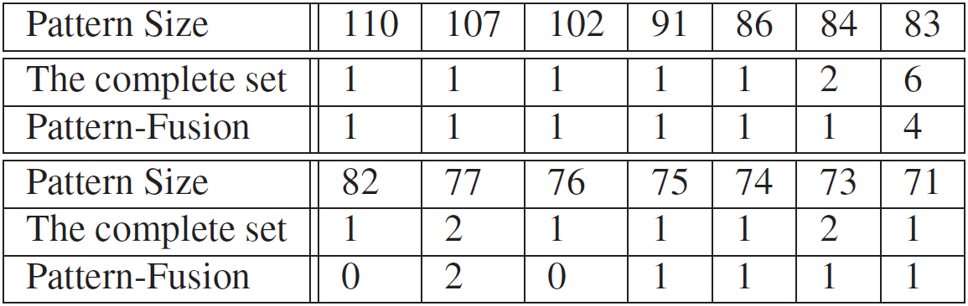
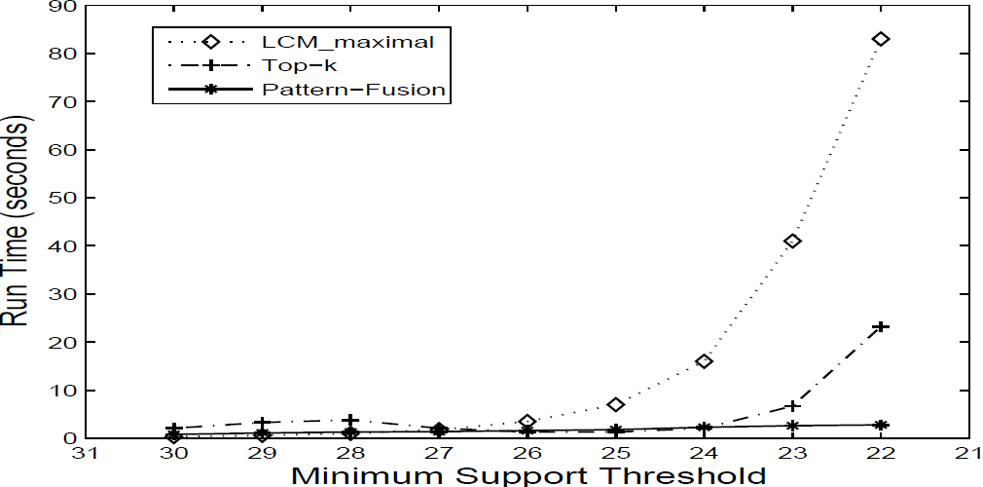
Experimental Results on Data Set: ALL
ALL: A popular gene expression clinical data set on ALL-AML leukemia, with 38 transactions, each with 866 columns. There are 1,736 items in total.
When minimum support is high (e.g., 30), Pattern-Fusion gets all the largest colossal patterns with size greater than 85
Mining colossal patterns on a Leukemia dataset
Algorithm runtime comparison on another dataset

Slide 37
Advanced Frequent Pattern Mining
Mining Diverse Patterns
Constraint-Based Frequent Pattern Mining
Mining High-Dimensional Data and Colossal Patterns
Sequential Pattern Mining
Graph Pattern Mining

Slide 38
Mining Methods
Pattern | Closed Pattern | Idea 1: Pattern candidate generation and pruning | Idea 2: Vertical format | Idea 3: Pattern growth
Frequent pattern (itemset) | Closed frequent itemset | ? | ? | ?
Sequential pattern | Closed seq. pattern | ? | ? | ?
Graph pattern | Closed graph pattern | ? | x | ?
Ideas, method names, why and how they work.
- How were the ideas applied to mining different kinds of patterns?

Slide 39
Sequence Databases and Sequential Patterns
Sequential pattern mining has broad applications
Customer shopping sequences
Purchase a laptop first, then a digital camera, and then a smartphone, within 6 months
Medical treatments, natural disasters (e.g., earthquakes), science & engineering processes, stocks and markets, ...
Weblog click streams, calling patterns, …
Software engineering: Program execution sequences, …
Biological sequences: DNA, protein, …
Transaction DB, sequence DB vs. time-series DB
Gapped vs. non-gapped sequential patterns
Shopping sequences, clicking streams vs. biological sequences

Slide 40
Sequential Pattern and Sequential Pattern Mining
Sequential pattern mining: Given a set of sequences, find the complete set of frequent subsequences (i.e., satisfying the min_sup threshold)
An element may contain a set of items (also called events)
Items within an element are unordered and we list them alphabetically
Given support threshold min_sup = 2, <(ab)c> is a sequential pattern
A sequence database
SID | Sequence
10 | <a(abc)(ac)d(cf)>
20 | <(ad)c(bc)(ae)>
30 | <(ef)(ab)(df)cb>
40 | <eg(af)cbc>
A sequence: < (ef) (ab) (df) c b >
<a(bc)dc> is a subsequence of <a(abc)(ac)d(cf)>
http://hanj.cs.illinois.edu/pdf/span01.pdf

Slide 41
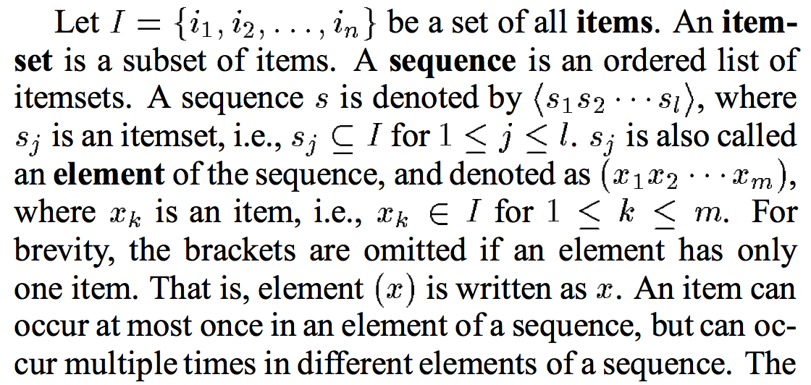
Sequence vs Element/Itemset/Event vs Item/Instance

Slide 42
Sequential Pattern Mining Algorithms
Algorithm requirement: Efficient, scalable, finding complete set, incorporating various kinds of user-specific constraints
The Apriori property still holds: If a subsequence s₁ is infrequent, none of s₁’s super-sequences can be frequent
Representative algorithms
GSP (Generalized Sequential Patterns): Srikant & Agrawal @ EDBT’96)
Vertical format-based mining: SPADE (Zaki@Machine Leanining’00)
Pattern-growth methods: PrefixSpan (Pei, et al. @TKDE’04)
Mining closed sequential patterns: CloSpan (Yan, et al. @SDM’03)
Constraint-based sequential pattern mining

Slide 43
GSP: Apriori-Based Sequential Pattern Mining
SID | Sequence
10 | <(bd)cb(ac)>
20 | <(bf)(ce)b(fg)>
30 | <(ah)(bf)abf>
40 | <(be)(ce)d>
50 | <a(bd)bcb(ade)>
Initial candidates: All singleton sequences
<a>, <b>, <c>, <d>, <e>, <f>, <g>, <h>
Scan DB once, count support for each candidate
Generate length-2 candidate sequences
min_sup = 2
 | <a> | <b> | <c> | <d> | <e> | <f>
<a> | <aa> | <ab> | <ac> | <ad> | <ae> | <af>
<b> | <ba> | <bb> | <bc> | <bd> | <be> | <bf>
<c> | <ca> | <cb> | <cc> | <cd> | <ce> | <cf>
<d> | <da> | <db> | <dc> | <dd> | <de> | <df>
<e> | <ea> | <eb> | <ec> | <ed> | <ee> | <ef>
<f> | <fa> | <fb> | <fc> | <fd> | <fe> | <ff>
Length-2 candidates:
36 + 15= 51
Without Apriori pruning:
8*8+8*7/2=92 candidates
Cand. | sup
<a> | 3
<b> | 5
<c> | 4
<d> | 3
<e> | 3
<f> | 2
<g> | 1
<h> | 1
 | <a> | <b> | <c> | <d> | <e> | <f>
<a> |  | <(ab)> | <(ac)> | <(ad)> | <(ae)> | <(af)>
<b> |  |  | <(bc)> | <(bd)> | <(be)> | <(bf)>
<c> |  |  |  | <(cd)> | <(ce)> | <(cf)>
<d> |  |  |  |  | <(de)> | <(df)>
<e> |  |  |  |  |  | <(ef)>
<f>
GSP (Generalized Sequential Patterns): Srikant & Agrawal @ EDBT’96)

Slide 44
GSP Mining and Pruning
Repeat (for each level (i.e., length-k))
Scan DB to find length-k frequent sequences
Generate length-(k+1) candidate sequences from length-k frequent sequences using Apriori
set k = k+1
Until no frequent sequence or no candidate can be found

Slide 45
Sequential Pattern Mining in Vertical Data Format: The SPADE Algorithm
A sequence database is mapped to: <SID, EID>
Grow the subsequences (patterns) one item at a time by Apriori candidate generation
SID | Sequence
1 | <a(abc)(ac)d(cf)>
2 | <(ad)c(bc)(ae)>
3 | <(ef)(ab)(df)cb>
4 | <eg(af)cbc>
min_sup = 2
Ref: SPADE (Sequential PAttern Discovery using Equivalent Class) [M. Zaki 2001]
https://pdfs.semanticscholar.org/39a0/80c17dec400a6f04af5fe5746dab3a5eb0dc.pdf

Slide 46
PrefixSpan: A Pattern-Growth Approach
Prefix and suffix
Given <a(abc)(ac)d(cf)>
Prefixes: <a>, <aa>, <a(ab)>, <a(abc)>, …
Suffix: Prefixes-based projection
PrefixSpan Mining: Prefix Projections
Step 1: Find length-1 sequential patterns
<a>, <b>, <c>, <d>, <e>, <f>
Step 2: Divide search space and mine each projected DB
<a>-projected DB,
<b>-projected DB,
…
<f>-projected DB, …
SID | Sequence
10 | <a(abc)(ac)d(cf)>
20 | <(ad)c(bc)(ae)>
30 | <(ef)(ab)(df)cb>
40 | <eg(af)cbc>
Prefix | Suffix (Projection)
<a> | <(abc)(ac)d(cf)>
<aa> | <(_bc)(ac)d(cf)>
<ab> | <(_c)(ac)d(cf)>
PrefixSpan (Prefix-projected Sequential pattern mining) Pei, et al. @TKDE’04
http://hanj.cs.illinois.edu/pdf/span01.pdf

Slide 47
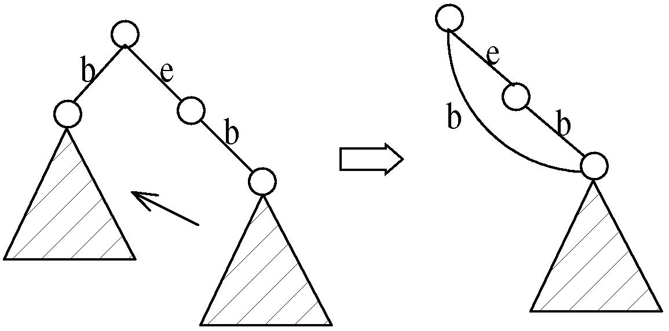
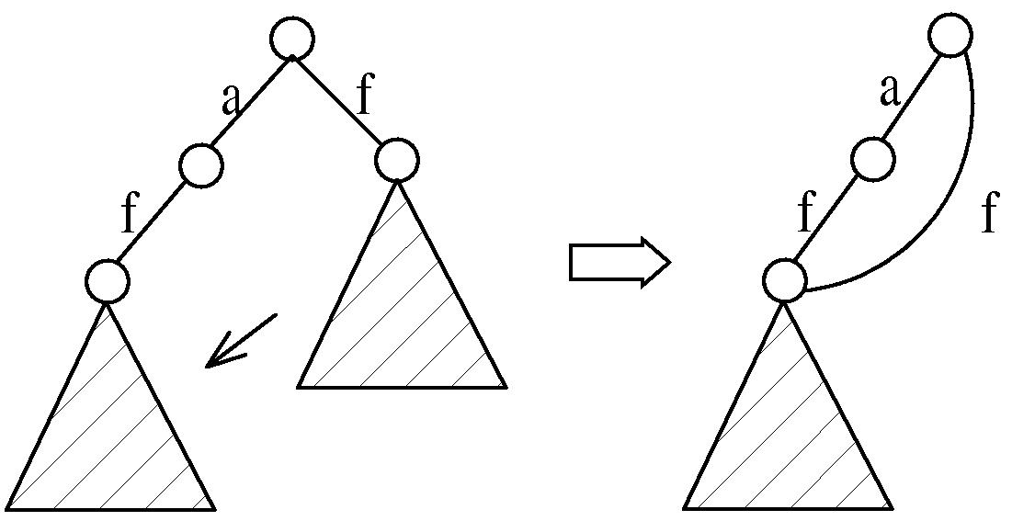
CloSpan: Mining Closed Sequential Patterns
A closed sequential pattern s: There exists no superpattern s’ such that s’ כ s, and s’ and s have the same support
Which ones are closed? <abc>: 20, <abcd>:20, <abcde>: 15
Why directly mine closed sequential patterns?
Reduce # of (redundant) patterns
Attain the same expressive power
Property P₁: If s כ s₁, s is closed iff two project DBs have the same size
Explore Backward Subpattern and Backward Superpattern pruning to prune redundant search space
Greatly enhances efficiency (Yan, et al., SDM’03)
Backward subpattern pruning
Backward superpattern pruning
https://www.cs.ucsb.edu/~xyan/papers/cloSpan.pdf

Slide 48
Constraint-Based Sequential-Pattern Mining
Share many similarities with constraint-based itemset mining
Anti-monotonic: If S violates c, the super-sequences of S also violate c
sum(S.price) < 150; min(S.value) > 10
Monotonic: If S satisfies c, the super-sequences of S also do so
element_count (S) > 5; S ⊇ {PC, digital_camera}
Data anti-monotonic: If a sequence s₁ with respect to S violates c₃, s₁ can be removed
c₃: sum(S.price) ≥ v
Succinct: Enforce constraint c by explicitly manipulating data
S ⊇ {i-phone, MacAir}
Convertible: Projection based on the sorted value not sequence order
value_avg(S) < 25; profit_sum (S) > 160
max(S)/avg(S) < 2; median(S) – min(S) > 5

Slide 49
Timing-Based Constraints in Seq.-Pattern Mining
Order constraint: Some items must happen before the other
{algebra, geometry} → {calculus} (where “→” indicates ordering)
Anti-monotonic: Constraint-violating sub-patterns pruned
Min-gap/max-gap constraint: Confines two elements in a pattern
E.g., mingap = 1, maxgap = 4
Succinct: Enforced directly during pattern growth
Max-span constraint: Maximum allowed time difference between the 1st and the last elements in the pattern
E.g., maxspan (S) = 60 (days)
Succinct: Enforced directly when the 1st element is determined
Window size constraint: Events in an element do not have to occur at the same time: Enforce max allowed time difference
E.g., window-size = 2: Various ways to merge events into elements

Slide 50
Episodes and Episode Pattern Mining
Episodes and regular expressions: Alternative to seq. patterns
Serial episodes: A → B
Parallel episodes: A | B
Regular expressions: (A|B)C*(D → E)
Methods for episode pattern mining
Variations of Apriori/GSP-like algorithms
Projection-based pattern growth
Q₁: Can you work out the details?
Q₂: What are the differences between mining episodes and constraint-based pattern mining?
Indicating partial order relationships

Slide 51
Advanced Frequent Pattern Mining
Mining Diverse Patterns
Constraint-Based Frequent Pattern Mining
Mining High-Dimensional Data and Colossal Patterns
Sequential Pattern Mining
Graph Pattern Mining

Slide 52
Frequent (Sub)Graph Patterns
Given a labeled graph dataset D = {G₁, G₂, …, G_{n}}, the supporting graph set of a subgraph g is D_{g} = {G_{i} | g ⊆ G_{i}, G_{i} ∈D}.
support(g) = |D_{g}|/ |D|
A (sub)graph g is frequent if support(g) ≥ min_sup Ex.: Chemical structures
Alternative:
Mining frequent subgraph patterns from a single large graph or network
Graph Dataset
(A)
(B)
(C)
min_sup = 2
Frequent Graph Patterns
(1)
(2)

Slide 53
Applications of Graph Pattern Mining
Bioinformatics
Gene networks, protein interactions, metabolic pathways
Chem-informatics: Mining chemical compound structures
Social networks, web communities, tweets, …
Cell phone networks, computer networks, …
Web graphs, XML structures, semantic Web, information networks
Software engineering: program execution flow analysis
Building blocks for graph classification, clustering, compression, comparison, and correlation analysis
Graph indexing and graph similarity search

Slide 54
Graph Pattern Mining Algorithms: Different Methodologies
Generation of candidate subgraphs
Apriori vs. pattern growth (e.g., FSG vs. gSpan)
Search order
Breadth vs. depth
Elimination of duplicate subgraphs
Passive vs. active (e.g., gSpan (Yan&Han’02))
Support calculation
Store embeddings (e.g., GASTON (Nijssen&Kok’04, FFSM (Huan, et al.’03), MoFa (Borgelt and Berthold ICDM’02))
Order of pattern discovery
Path → tree → graph (e.g., GASTON (Nijssen&Kok’04))

Slide 55
Apriori-Based Approach
The Apriori property (anti-monotonicity): A size-k subgraph is frequent if and only if all of its subgraphs are frequent
A candidate size-(k+1) edge/vertex subgraph is generated if its corresponding two k-edge/vertex subgraphs are frequent
Iterative mining process:
Candidate-generation → candidate pruning → support counting → candidate elimination
(k+1)-edge
k-edge
G₁
G
G₂
G’
…
G’’
G_{n}
Join

Slide 56
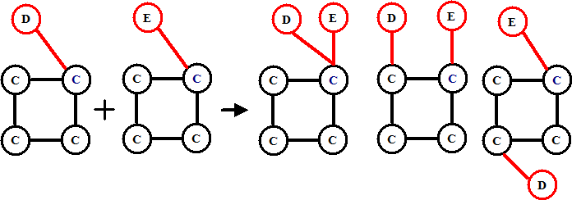
Candidate Generation: Vertex Growing vs. Edge Growing
Methodology: breadth-search, Apriori joining two size-k graphs
Many possibilities at generating size-(k+1) candidate graphs
Generating new graphs with one more vertex
AGM (Inokuchi, et al., PKDD’00)
Generating new graphs with one more edge
FSG (Kuramochi and Karypis, ICDM’01)
Performance shows via edge growing is more efficient

Slide 57
Pattern-Growth Approach
Depth-first growth of subgraphs from k-edge to (k+1)-edge, then (k+2)-edge subgraphs
Major challenge
Generating many duplicate subgraphs
Major idea to solve the problem
Define an order to generate subgraphs
DFS spanning tree: Flatten a graph into a sequence using depth-first search
gSpan (Yan & Han: ICDM’02)
(k+2)-edge
(k+1)-edge
…
G₁
k-edge
duplicate
graphs
G₂
G
…
G_{n}
…
http://cs.ucsb.edu/~xyan/papers/gSpan-short.pdf

Slide 58
gSPAN: Graph Pattern Growth in Order
Right-most path extension in subgraph pattern growth
Right-most path: The path from root to the right-most leaf (choose the vertex w. the smallest index at each step)
Reduce generation of duplicate subgraphs
Completeness: The Enumeration of graphs using right-most path extension is complete
DFS Code: Flatten a graph into a sequence using depth-first search
e₀: (0,1)
0
e₁: (1,2)
1
e₂: (2,0)
e₃: (2,3)
2
e₄: (3,0)
4
e₅: (2,4)
3

Slide 59
Why Mining Closed Graph Patterns?
Challenge: An n-edge frequent graph may have 2^{n} subgraphs
Motivation: Explore closed frequent subgraphs to handle graph pattern explosion problem
A frequent graph G is closed if there exists no supergraph of G that carries the same support as G
Lossless compression: Does not contain non-closed graphs, but still ensures that the mining result is complete
Algorithm CloseGraph: Mines closed graph patterns directly
If this subgraph is closed in the graph dataset, it implies that none of its frequent super-graphs carries the same support

Slide 60
CloseGraph: Directly Mining Closed Graph Patterns
CloseGraph: Mining closed graph patterns by extending gSpan
Suppose G and G₁ are frequent, and G is a subgraph of G₁
If in any part of the graph in the dataset where G occurs, G₁ also occurs, then we need not grow G (except some special, subtle cases), since none of G’s children will be closed except those of G₁
G₁
At what condition can we
stop searching their children,
i.e., early termination?
k-edge
G₂
G
…
https://pdfs.semanticscholar.org/a1c1/5e63690c774b725fc91dcc77a629d01c3733.pdf
G_{n}
(k+1)-edge

Slide 61
Experiment and Performance Comparison
The AIDS antiviral screen compound dataset from NCI/NIH
The dataset contains 43,905 chemical compounds
Discovered Patterns: The smaller minimum support, the bigger and more interesting subgraph patterns discovered
20%
10%
5%
# of Patterns: Frequent vs. Closed
Runtime: Frequent vs. Closed
Run time (sec)
Number of patterns
Minimum support
Minimum support

Slide 62

Mid-term exam:
July 6th (Thursday)
11:00 a.m. – 12:30 p.m.
(90 minutes)
0216 SC
Take a pen/pencil!!!
You are only allowed to have an A4-size paper double-sided for reference.
I believe you can write a lot a lot on it…
Good luck!!!
Happy holiday!!!
Today’s office hours:
12:15 p.m. – 2:00 p.m. 2130 SC
Today’s TA hour:
3 p.m. – 4 p.m. 2113 SC (Sheng Wang)

Slide 63
References: Mining Diverse Patterns
R. Srikant and R. Agrawal, “Mining generalized association rules”, VLDB'95
Y. Aumann and Y. Lindell, “A Statistical Theory for Quantitative Association Rules”, KDD'99
K. Wang, Y. He, J. Han, “Pushing Support Constraints Into Association Rules Mining”, IEEE Trans. Knowledge and Data Eng. 15(3): 642-658, 2003
D. Xin, J. Han, X. Yan and H. Cheng, "On Compressing Frequent Patterns", Knowledge and Data Engineering, 60(1): 5-29, 2007
D. Xin, H. Cheng, X. Yan, and J. Han, "Extracting Redundancy-Aware Top-K Patterns", KDD'06
J. Han, H. Cheng, D. Xin, and X. Yan, "Frequent Pattern Mining: Current Status and Future Directions", Data Mining and Knowledge Discovery, 15(1): 55-86, 2007
F. Zhu, X. Yan, J. Han, P. S. Yu, and H. Cheng, “Mining Colossal Frequent Patterns by Core Pattern Fusion”, ICDE'07

Slide 64
References: Constraint-Based Frequent Pattern Mining
R. Srikant, Q. Vu, and R. Agrawal, “Mining association rules with item constraints”, KDD'97
R. Ng, L.V.S. Lakshmanan, J. Han & A. Pang, “Exploratory mining and pruning optimizations of constrained association rules”, SIGMOD’98
G. Grahne, L. Lakshmanan, and X. Wang, “Efficient mining of constrained correlated sets”, ICDE'00
J. Pei, J. Han, and L. V. S. Lakshmanan, “Mining Frequent Itemsets with Convertible Constraints”, ICDE'01
J. Pei, J. Han, and W. Wang, “Mining Sequential Patterns with Constraints in Large Databases”, CIKM'02
F. Bonchi, F. Giannotti, A. Mazzanti, and D. Pedreschi, “ExAnte: Anticipated Data Reduction in Constrained Pattern Mining”, PKDD'03
F. Zhu, X. Yan, J. Han, and P. S. Yu, “gPrune: A Constraint Pushing Framework for Graph Pattern Mining”, PAKDD'07

Slide 65
References: Sequential Pattern Mining
R. Srikant and R. Agrawal, “Mining sequential patterns: Generalizations and performance improvements”, EDBT’96
M. Zaki, “SPADE: An Efficient Algorithm for Mining Frequent Sequences”, Machine Learning, 2001
J. Pei, J. Han, B. Mortazavi-Asl, J. Wang, H. Pinto, Q. Chen, U. Dayal, and M.-C. Hsu, "Mining Sequential Patterns by Pattern-Growth: The PrefixSpan Approach", IEEE TKDE, 16(10), 2004
X. Yan, J. Han, and R. Afshar, “CloSpan: Mining Closed Sequential Patterns in Large Datasets”, SDM'03
J. Pei, J. Han, and W. Wang, "Constraint-based sequential pattern mining: the pattern-growth methods", J. Int. Inf. Sys., 28(2), 2007
M. N. Garofalakis, R. Rastogi, K. Shim: Mining Sequential Patterns with Regular Expression Constraints. IEEE Trans. Knowl. Data Eng. 14(3), 2002
H. Mannila, H. Toivonen, and A. I. Verkamo, “Discovery of frequent episodes in event sequences”, Data Mining and Knowledge Discovery, 1997

Slide 66
References: Graph Pattern Mining
C. Borgelt and M. R. Berthold, Mining molecular fragments: Finding relevant substructures of molecules, ICDM'02
J. Huan, W. Wang, and J. Prins. Efficient mining of frequent subgraph in the presence of isomorphism, ICDM'03
A. Inokuchi, T. Washio, and H. Motoda. An apriori-based algorithm for mining frequent substructures from graph data, PKDD'00
M. Kuramochi and G. Karypis. Frequent subgraph discovery, ICDM'01
S. Nijssen and J. Kok. A Quickstart in Frequent Structure Mining can Make a Difference. KDD'04
N. Vanetik, E. Gudes, and S. E. Shimony. Computing frequent graph patterns from semistructured data, ICDM'02
X. Yan and J. Han, gSpan: Graph-Based Substructure Pattern Mining, ICDM'02
X. Yan and J. Han, CloseGraph: Mining Closed Frequent Graph Patterns, KDD'03
X. Yan, P. S. Yu, J. Han, Graph Indexing: A Frequent Structure-based Approach, SIGMOD'04
X. Yan, P. S. Yu, and J. Han, Substructure Similarity Search in Graph Databases, SIGMOD'05

