Slide 1







Social recommendation across multiple relational domains
Meng Jiang
Joint work with Peng Cui, Fei Wang, Qiang Yang,
Wenwu Zhu and Shiqiang Yang
November 1, 2012 – Maui, HI, USA

Slide 2


Recommender Systems
Predict missing “user-item” links
Challenge:
Cold-start and extremely high sparsity
cold-start
new item
cold-start
new user
web posts
?
?
users
?
high sparsity

Slide 3
Outline
1. Background
2. The Framework
3. HRW Algorithm
4. Experiments
5. Insights

Slide 4


Multiple Domains
User label domain
Choose < 10 from 200+ labels like ‘iPhone fan’
Peng Cui
Haidian, Beijing
Company: Tsinghua
User labels (5)
Tsinghua, Ph.D., World Wide Web,
Social Network, Social Media
Meng Jiang
Haidian, Beijing
University: Tsinghua
User labels (9)
Chinese food, World Wide Web,
Social Network, Data Mining, Liverpool Football Club, NBA, Humors, Sports, Ph.D. Candidates

Slide 5

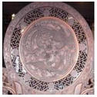

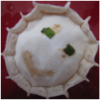
Multiple Domains
Interest group domain
Interest Groups (2)
Interest Groups (3)
Tsinghua University
I love sing!
Tsinghua University
Social Media & Reputation
World Wide Web Team

Slide 6
Our Goals
Given: Links on social networks
Find: A framework that use auxiliary knowledge in multiple domains to best predict “user-item” (target) links when the training set is too small.
Goals:
G1. Understand link formations on social networks
G2. A social network framework with multiple domains
G3. Solve the cold-start problem

Slide 7
Challenges: Multiple Domains
Relational
Within-domain links and cross-domain links
Heterogeneous
Different types of item domains
Sparse
Different sparsity levels

Slide 8
Outline
1. Background
2. The Framework
3. HRW Algorithm
4. Experiments
5. Insights

Slide 9

Reframe Social Networks
We have user-user, post-post and label-label links (social relation + item similarity).
web posts
users
user labels

Slide 10
Reframe Social Networks
We have user-post and user-label links.
web posts
users
user labels

Slide 11
Reframe Social Networks
No relations between item domains.
No post-label links in nature.
web posts
users
X
user labels

Slide 12
Reframe Social Networks
Stronger social relations help collaborate user-item links.
web posts
users
?
?
user labels

Slide 13
Reframe Social Networks
More collaborating in user-item links strengthen the social relations.
web posts
users
?
user labels

Slide 14
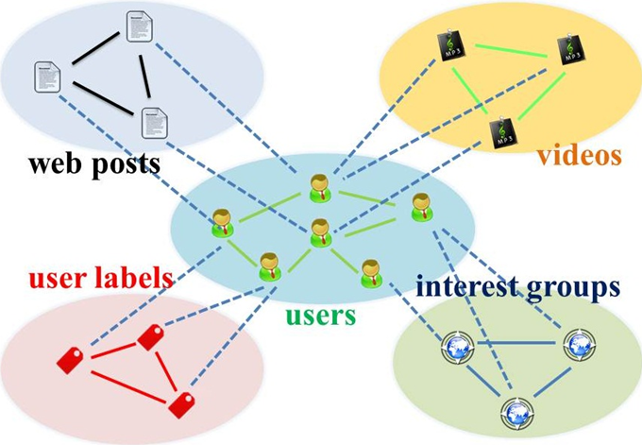
Star-structured Graph
Key idea: use “social relation” domain as bridge

Slide 15
Outline
1. Background
2. The Framework
3. HRW Algorithm
4. Experiments
5. Insights

Slide 16
Star-structured Graph
Method: Transfer learning + Random walk with restarts

Slide 17
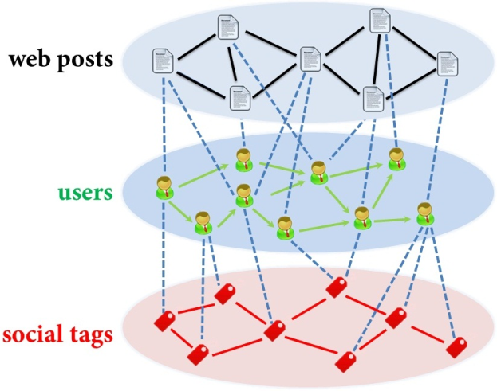
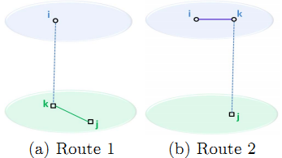
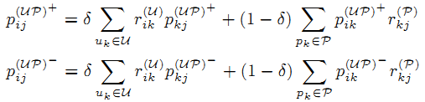

Hybrid Random Walk
On second-order star-structured graph
Update cross-domain links

Slide 18
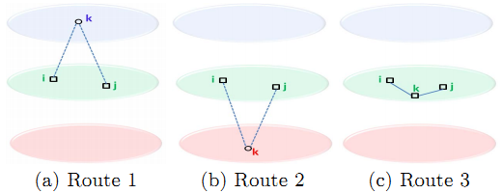
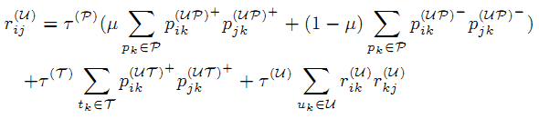
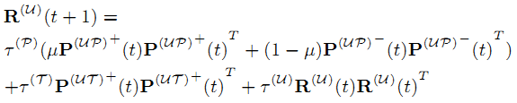
Hybrid Random Walk
Update within-domain links

Slide 19
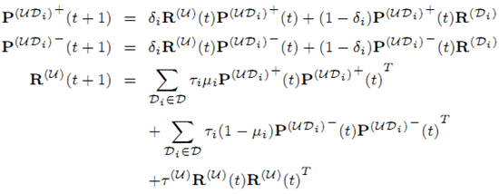
Hybrid Random Walk
On high-order star-structured graph

Slide 20
Outline
1. Background
2. The Framework
3. HRW Algorithm
4. Experiments
5. Insights

Slide 21
Data Set
Tencent Weibo (January 2011)
Domain | Size | Cross-domain links
 |  | Accept | Refuse
User | 53.4K | — | —
Web post | 142K | 1.47M (0.02%) | 3.40M (0.04%)
User label | 111 | 330K (5.57%) | —

Slide 22
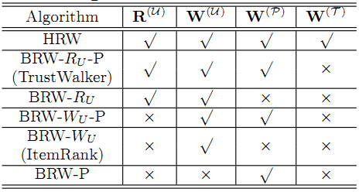
Good to Transfer?
Comparative Algorithms (RWR)
W^{(P)} : Use web post similarity?
W^{(U)} : Use social relation?
R^{(U)} : Update tie strength?
W^{(T)} : Use user label similarity?

Slide 23
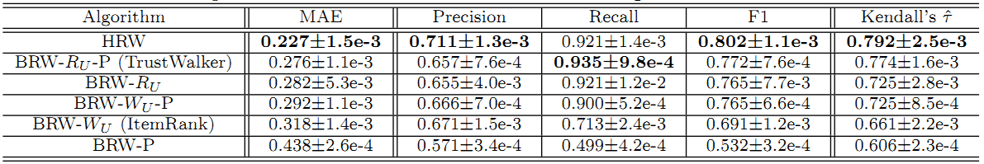
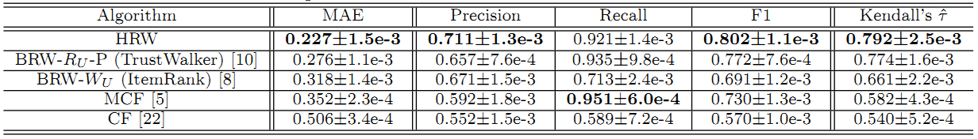
Good to Transfer!
Compare with RWR models
Compare with Baselines

Slide 24
Outline
1. Background
2. The Framework
3. HRW Algorithm
4. Experiments
5. Insights

Slide 25
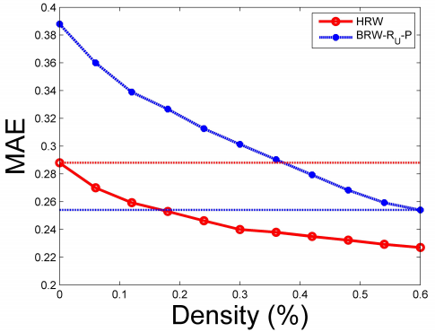
Insights
If we do transfer (from user-label domain), we need only ~30% to reach the same performance.
Advice: build more apps for new users to give more info.
0 user-post
100% user-label
35% user-post
60% user-post
18% user-post
100% user-label

Slide 26
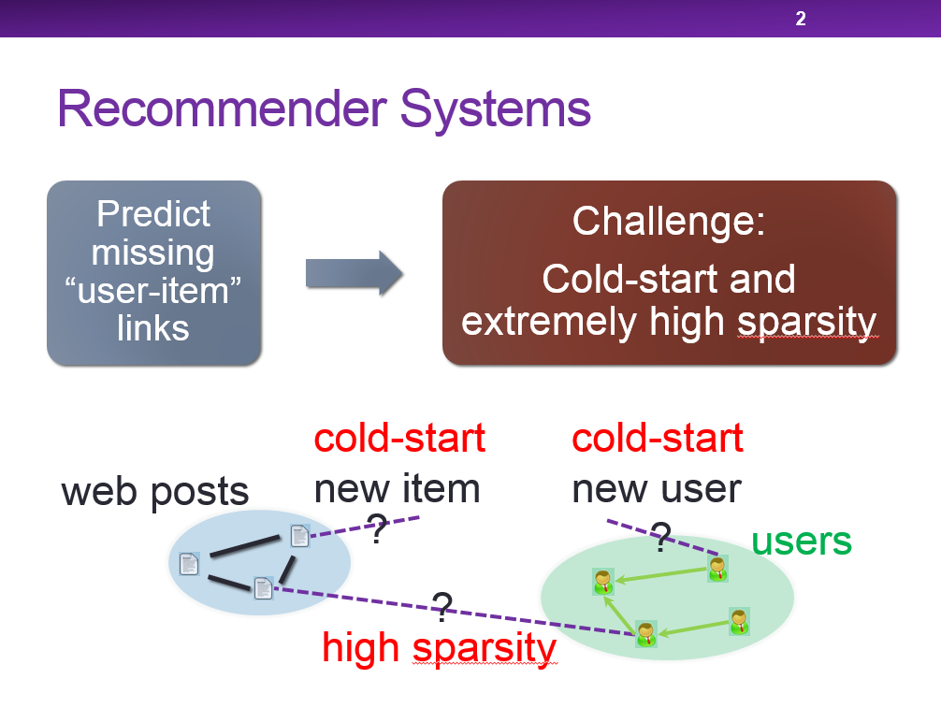
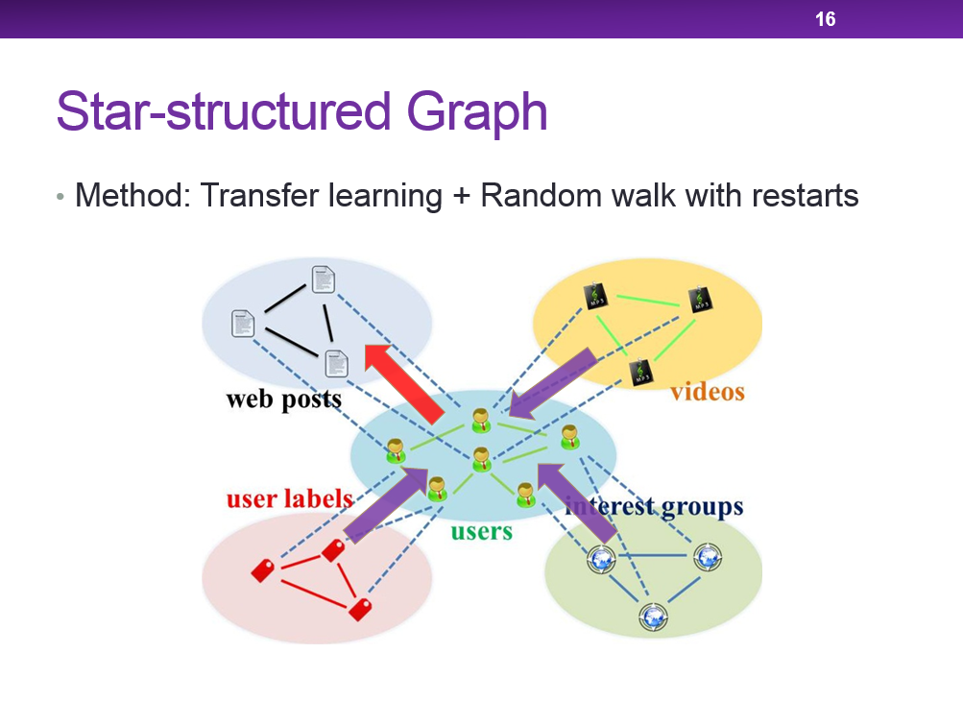
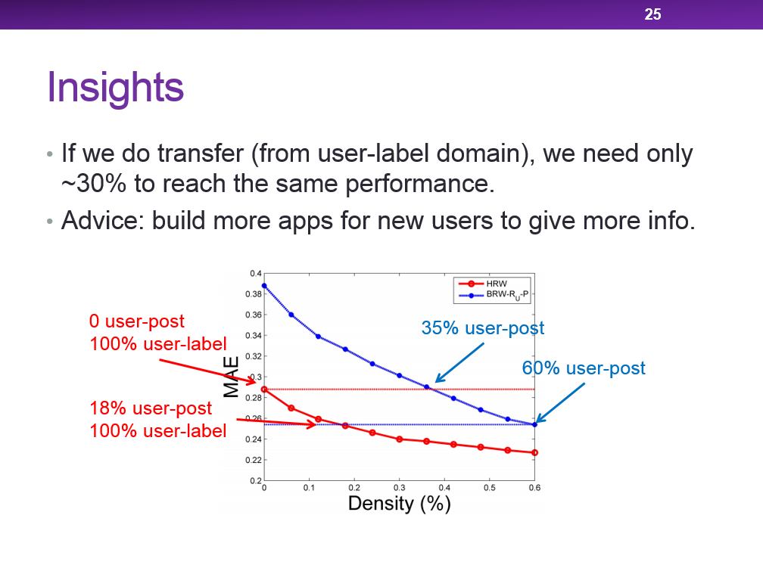
Questions?
Meng Jiang
mjiang89@gmail.com
http://www.meng-jiang.com

