Slide 1


Inferring Strange Behavior from Connectivity Pattern in Social Networks
Meng Jiang, Peng Cui, Shiqiang Yang
(Tsinghua, Beijing)
Alex Beutel, Christos Faloutsos (CMU)

Slide 2
What is Strange Behavior?
“Who-follows-whom” network with billions of edges: Twitter, Weibo, etc.

Slide 3


What is Strange Behavior?
Sell followers: “Become a Twitter Rockstar”
$
$
$
0.9 TWD per edge

Slide 4


What is Strange Behavior?
botnet
customer
$
$
connect
× 1,000
× 100
$

Slide 5

What is Strange Behavior?
botnet
customer
$
$
connect
× 1,000
× 100
$
#follower↑+1,000

Slide 6
What is Strange Behavior?
botnet
customer
$
$
connect
× 1,000
× 100
$
×
Unsafe!
More customers…
× 100

Slide 7
What is Strange Behavior?
botnet
customer
$
$
connect
× 1,000
× 100
$
More customers…
connect
× 5,000
× 100

Slide 8
What is Strange Behavior?
botnet
customer
$
$
connect
× 1,000
× 100
$
I want more followers…
connect
× 5,000
× 100

Slide 9
What is Strange Behavior?
botnet
customer
$
$
connect
× 1,000
× 100
$
connect
connect
× 5,000
× 100

Slide 10


What is Strange Behavior?
botnet
customer
$
connect
$
× 1,000
× 100
$
× 5,000
× 100
× ….
× ….
More groups of customers
More groups of botnets
More companies….

Slide 11
What is Strange Behavior?
botnet
customer
$
$
connect
$
Detect dense biparitite cores!
How can we evade detection?
Some other activity!

Slide 12


What is Strange Behavior?
botnet
customer
$
$
connect
$
“Camouflage”:
may connect
to popular idols
to look normal

Slide 13


What is Strange Behavior?
botnet
customer
$
$
connect
$
“Fame”:
may have
a few honest
followers

Slide 14
Adjacency Matrix Reminder
followee
×
×
follower
×
×
Graph Structure
Adjacency Matrix

Slide 15
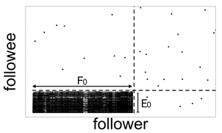
Strange Lockstep Behavior
botnet
customer
Groups
Acting together
Little other activity
connect
camouflage
fame

Slide 16


More Applications
eBay reviews

Slide 17

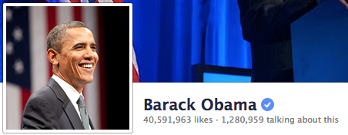
More Applications
Facebook “Likes”

Slide 18
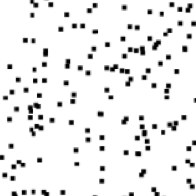
Problem Definition
Given adjacency matrix
Find Strange = “Lockstep” Behavior
reordering

Slide 19
Outline
Method
SVD Reminder
“Spectral Subspace Plot”
BP-based Algorithm
Experiments
Dataset
Real Data
Synthetic Data

Slide 20
SVD Reminder
followee
1
×
×
follow
follower
×
2
×
Graph Structure
Adjacency Matrix
Pairs of singular vectors:
SVD: A=USV^{T}
U₂
V₂
followee
U₁U₂
…
V₁V₂
U₁
V₁
follower
“Spectral Subspace Plot”

Slide 21
Outline
Method
SVD Reminder
“Spectral Subspace Plot”
BP-based Algorithm
Experiments
Dataset
Real Data
Synthetic Data

Slide 22
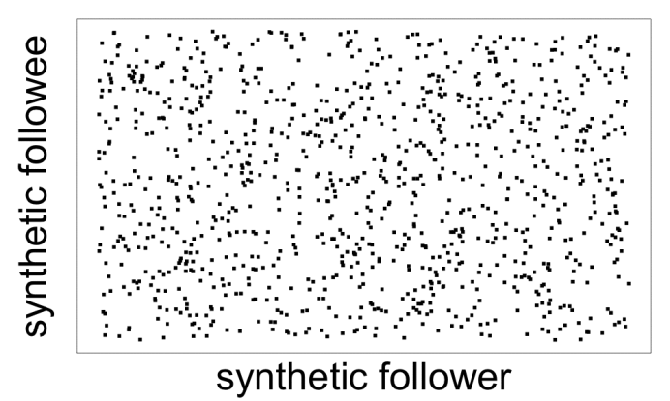
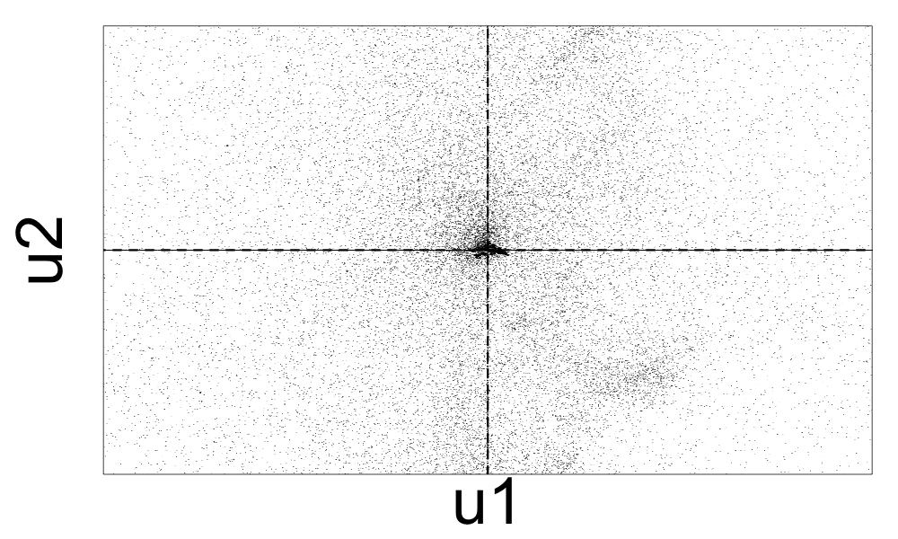
Lockstep and Spectral Subspace Plot
Case #0: No lockstep behavior in random power law graph of 1M nodes, 3M edges
Random “Scatter”
Adjacency Matrix
Spectral Subspace Plot

Slide 23
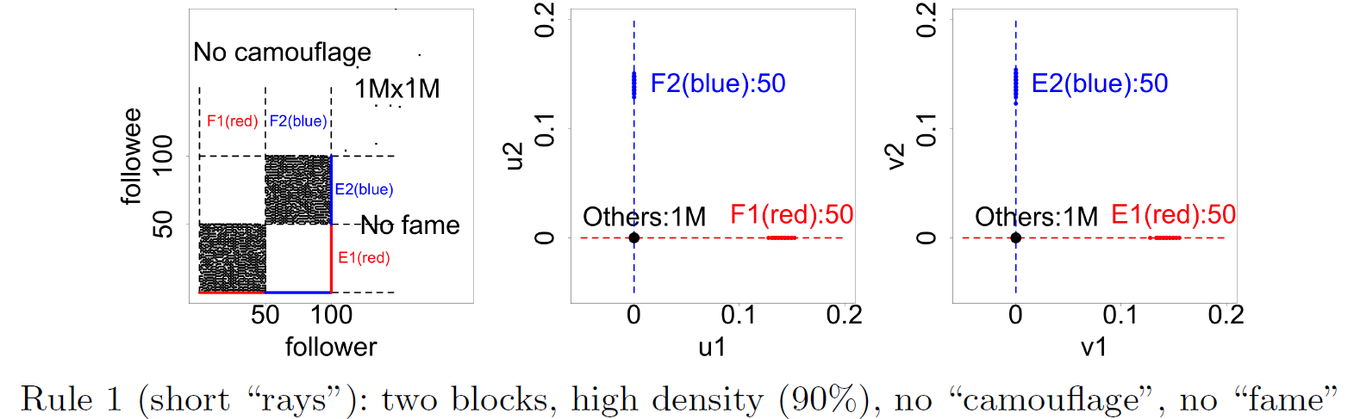
Lockstep and Spectral Subspace Plot
Case #1: non-overlapping lockstep
“Blocks” “Rays”
Adjacency Matrix
Spectral Subspace Plot

Slide 24
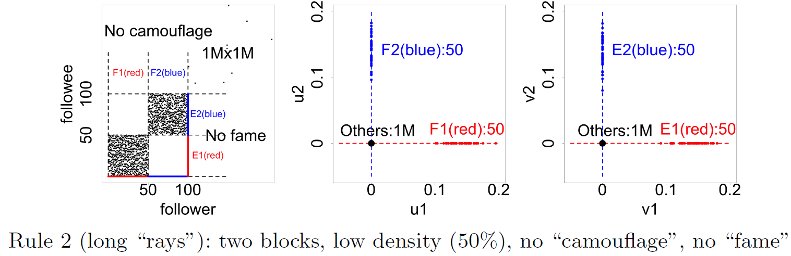
Lockstep and Spectral Subspace Plot
Case #2: non-overlapping lockstep
“Blocks; low density” Elongation
Adjacency Matrix
Spectral Subspace Plot

Slide 25
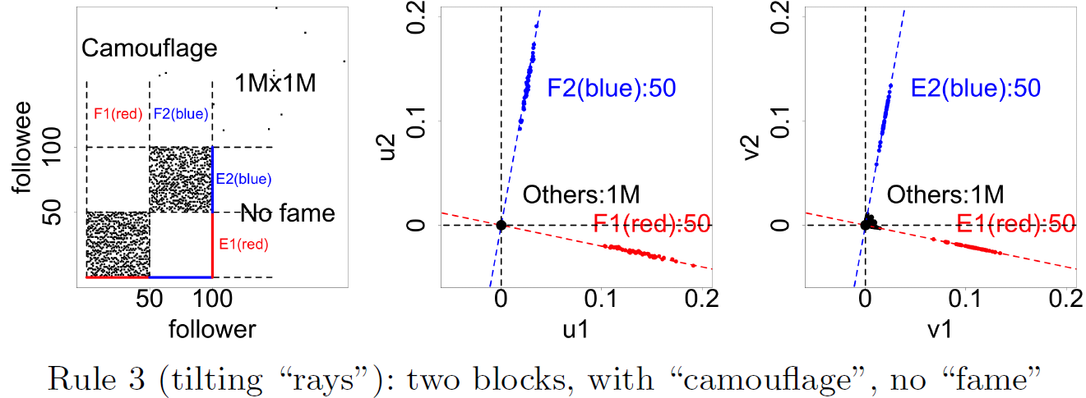
Lockstep and Spectral Subspace Plot
Case #3: non-overlapping lockstep
“Camouflage” (or “Fame”) Tilting “Rays”
Adjacency Matrix
Spectral Subspace Plot

Slide 26
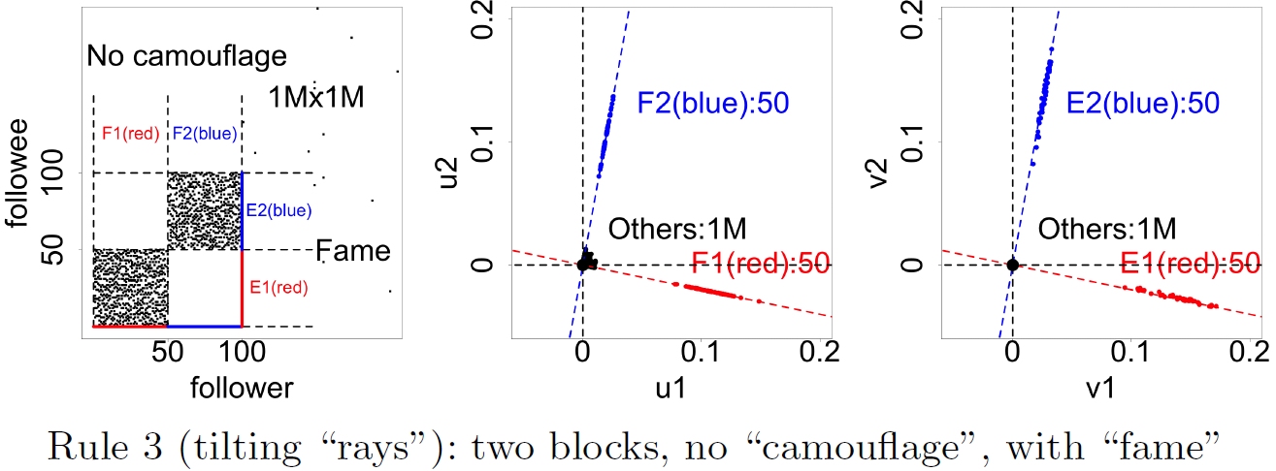
Lockstep and Spectral Subspace Plot
Case #3: non-overlapping lockstep
“Camouflage” (or “Fame”) Tilting “Rays”
Adjacency Matrix
Spectral Subspace Plot

Slide 27
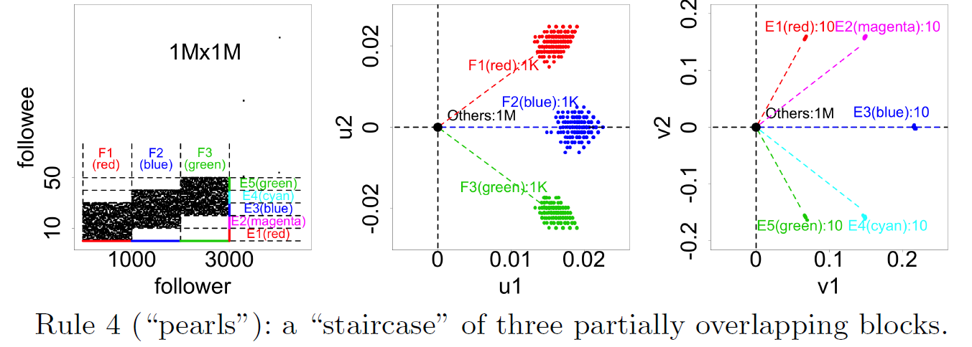
Lockstep and Spectral Subspace Plot
Case #4: ? lockstep
“?” “Pearls”
Adjacency Matrix
Spectral Subspace Plot
?

Slide 28
Lockstep and Spectral Subspace Plot
Case #4: overlapping lockstep
“Staircase” “Pearls”
Adjacency Matrix
Spectral Subspace Plot

Slide 29
Outline
Method
SVD Reminder
“Spectral Subspace Plot”
BP-based Algorithm
Experiments
Dataset
Real Data
Synthetic Data

Slide 30
Algorithm
Step 1: Seed selection
Spot “Rays” and “Pearls”
Catch seed followers
Step 2: Belief Propagation
Blame followees with strange followers
Blame followers with strange followees

Slide 31
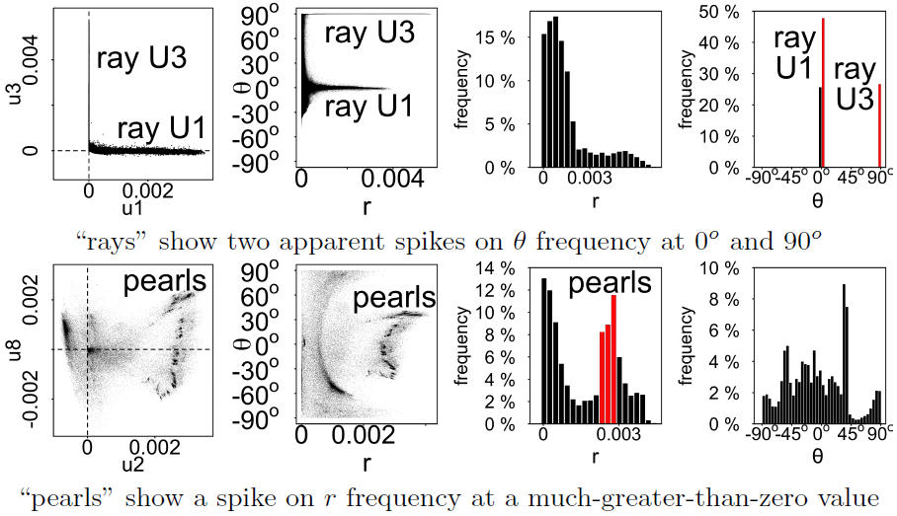
Automatically Spot “Rays” and “Pearls”
Spectral
Subspace Plot
Polar Coordinate
Transform
Histograms

Slide 32
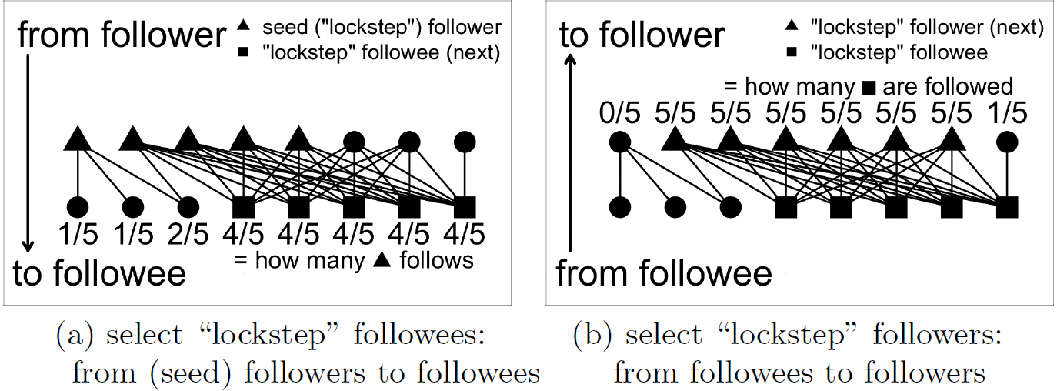
BP-based Algorithm
Blame followees with strange followers
Blame followers with strange followees

Slide 33
Outline
Method
SVD Reminder
“Spectral Subspace Plot”
BP-based Algorithm
Experiments
Dataset
Real Data
Synthetic Data

Slide 34


Dataset
Tencent Weibo
117 million nodes (users)
3.33 billion directed edges

Slide 35
Outline
Method
SVD Reminder
“Spectral Subspace Plot”
BP-based Algorithm
Experiments
Dataset
Real Data
Synthetic Data

Slide 36
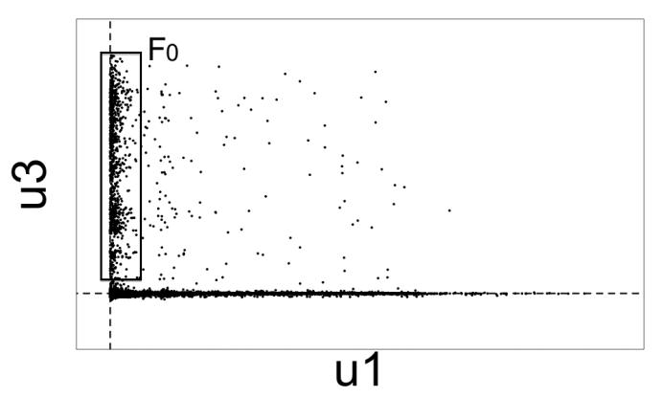

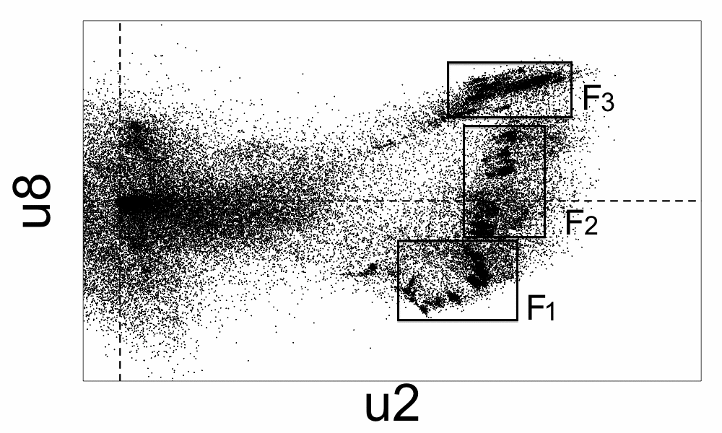
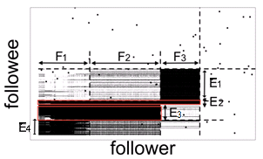
Real Data
“Rays”
“Block”
“Pearls”
“Staircase”

Slide 37
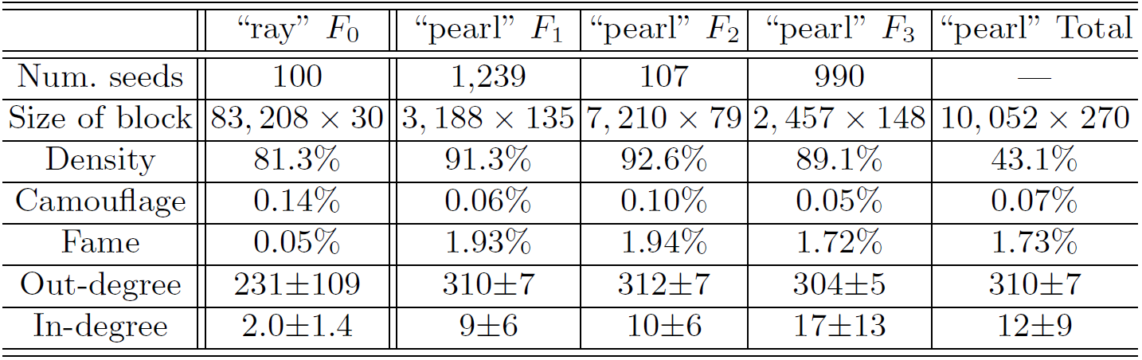
Real Data
“Rays”
“Block”

Slide 38
Real Data
“Pearls”
3,188
in F₁
7,210
in F₂
2,457
in F₃
“Staircase”
E₁ E₂ E₃ E₄
“F-E” | F₁-… | F₂-… | F₃-…
Density | 91.3% | 92.6% | 89.1%

Slide 39
Real Data
“Pearls”
“Staircase”
“Staircase”

Slide 40
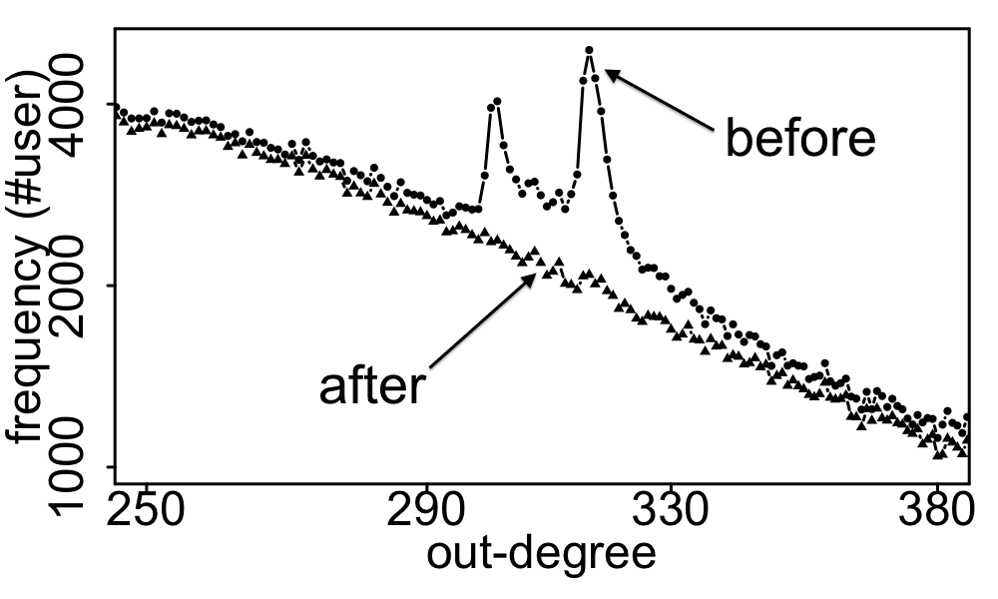
Real Data
Spikes on the out-degree distribution
×
×

Slide 41
Outline
Method
SVD Reminder
“Spectral Subspace Plot”
BP-based Algorithm
Experiments
Dataset
Real Data
Synthetic Data

Slide 42
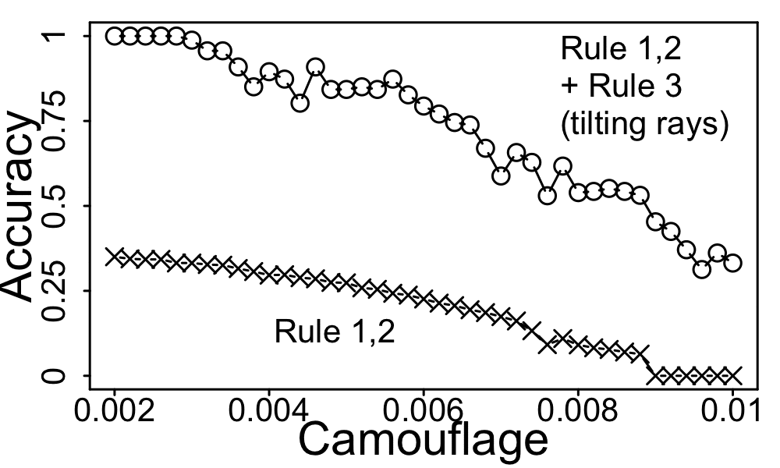
Synthetic Data
Inject lockstep behavior with “camouflage”
perfect

Slide 43
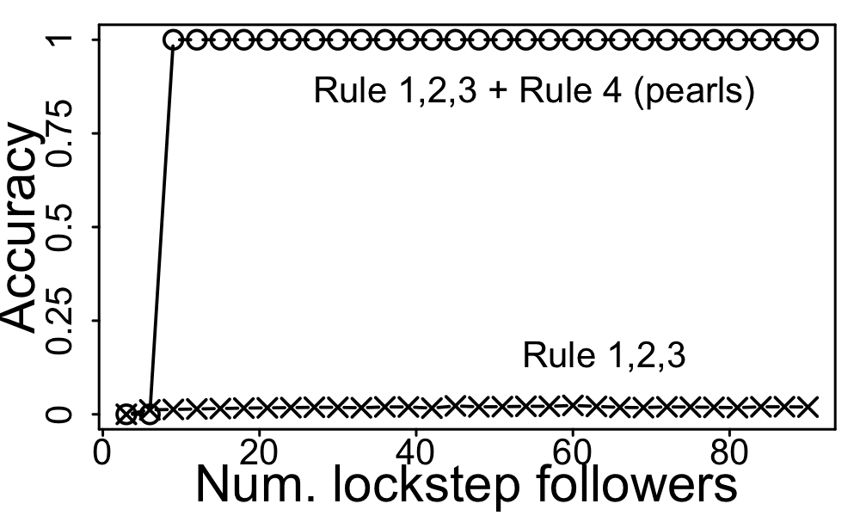
Synthetic Data
Inject overlapping lockstep behavior
perfect

Slide 44
Contributions
Different types of lockstep behavior
A handbook (rules) to infer lockstep behavior with connectivity patterns
An algorithm to catch the suspicious nodes
Remove spikes on out-degree distribution

Slide 45
Thank you!

