Slide 1


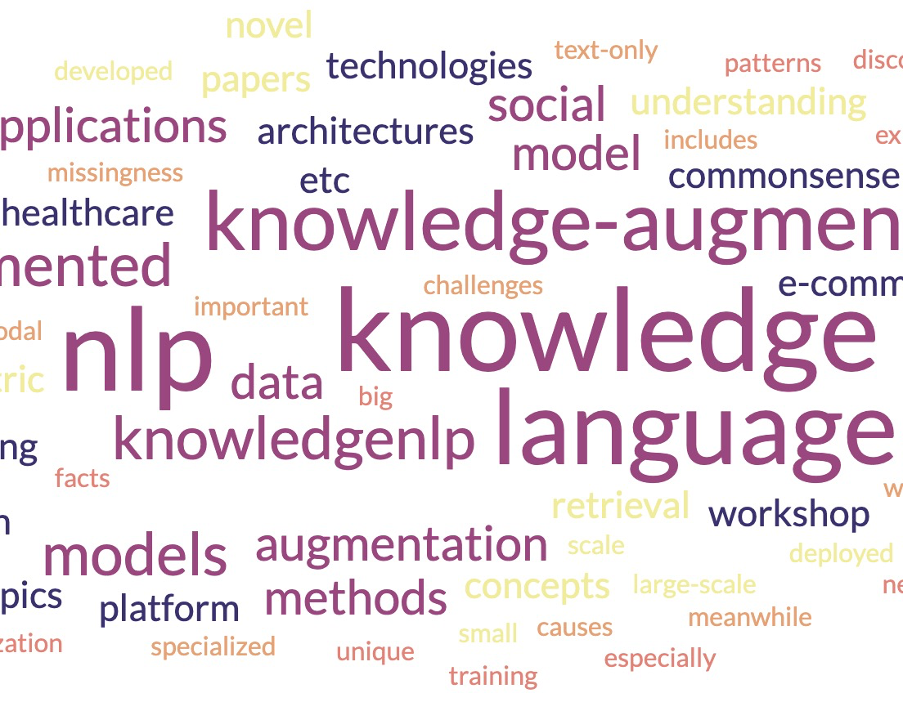




The 2nd Workshop on Knowledge Augmented Methods for NLP
(1-5PM Aug 6th, Room: Grand A)
Introduction Language models are being developed and deployed in many applications, “small”-scale and large-scale, generic and specialized, text-only and multimodal, etc. Meanwhile, the missingness of important knowledge causes limitations and safety challenges. The knowledge includes common sense, world facts, domain expertise, and especially the unique patterns that need to be discovered from big data applications.
Keynote Talks
Oral Presentations (02:30-03:00PM & 04:10-04:40PM)
Poster Presentations (3:00-3:30PM@CoffeeBreak & 04:40-05:00PM)
Organizers
Wenhao Yu, Lingbo Tong, Meng Jiang (ND); Weijia Shi (UW); Nanyun Peng (UCLA)
Towards Automatic Construction Theme-Specific Knowledge-Bases Assisted with LLMs (1:10-1:50PM)
Han, Jiawei
UIUC
Website:
(schedule/papers can be found)
How Knowledgeable are LLMs?
Will Knowledge Graphs be replaced with LLMs? (1:50-2:30PM)
Dong, Xin Luna
Meta Reality Lab
The Importance of “In the Moment” Knowledge: Contextualizing NLP Models with Time, Location and Weather Information (3:30-4:10PM)
Barbieri, Francesco Snap
Website https://knowledge-nlp.github.io/kdd2023 Twitter @knowledgenlp

