Slide 1
Announcement
For HWs: If the number you provided was wrong, you would more likely have more points to give detailed answers than brief answers. Correlation!!!
I found three not-just-100 but surprisingly great HW1s!
Sept. 21 (Thu): (Apriori and) FP-Growth
Sept. 26 (Tue): Pattern evaluation
Getting to know each other: Data Science: Bachelor, M.S., Ph.D.? Industry or Academia?
Sept. 28 (Thu): Beyond itemset
How to do Task 1, 2, 3, 4 (of course project) in 75 minutes?
Oct. 3 (Tue): Course review 1
Oct. 5 (Thu): Mid-term exam

Slide 2
How to Work with Data?
When a dataset is in your hand,
Watch it! Touch it!
Smell it! Taste it!
Be preparing for long … Get ready!
Find the target – application problem.
Solve the problem! Go! Go! Go!

Slide 3

Chapter 6. Frequent Pattern Mining: FP-Growth
Meng Jiang
CSE 40647/60647 Data Science Fall 2017
Introduction to Data Mining

Slide 4
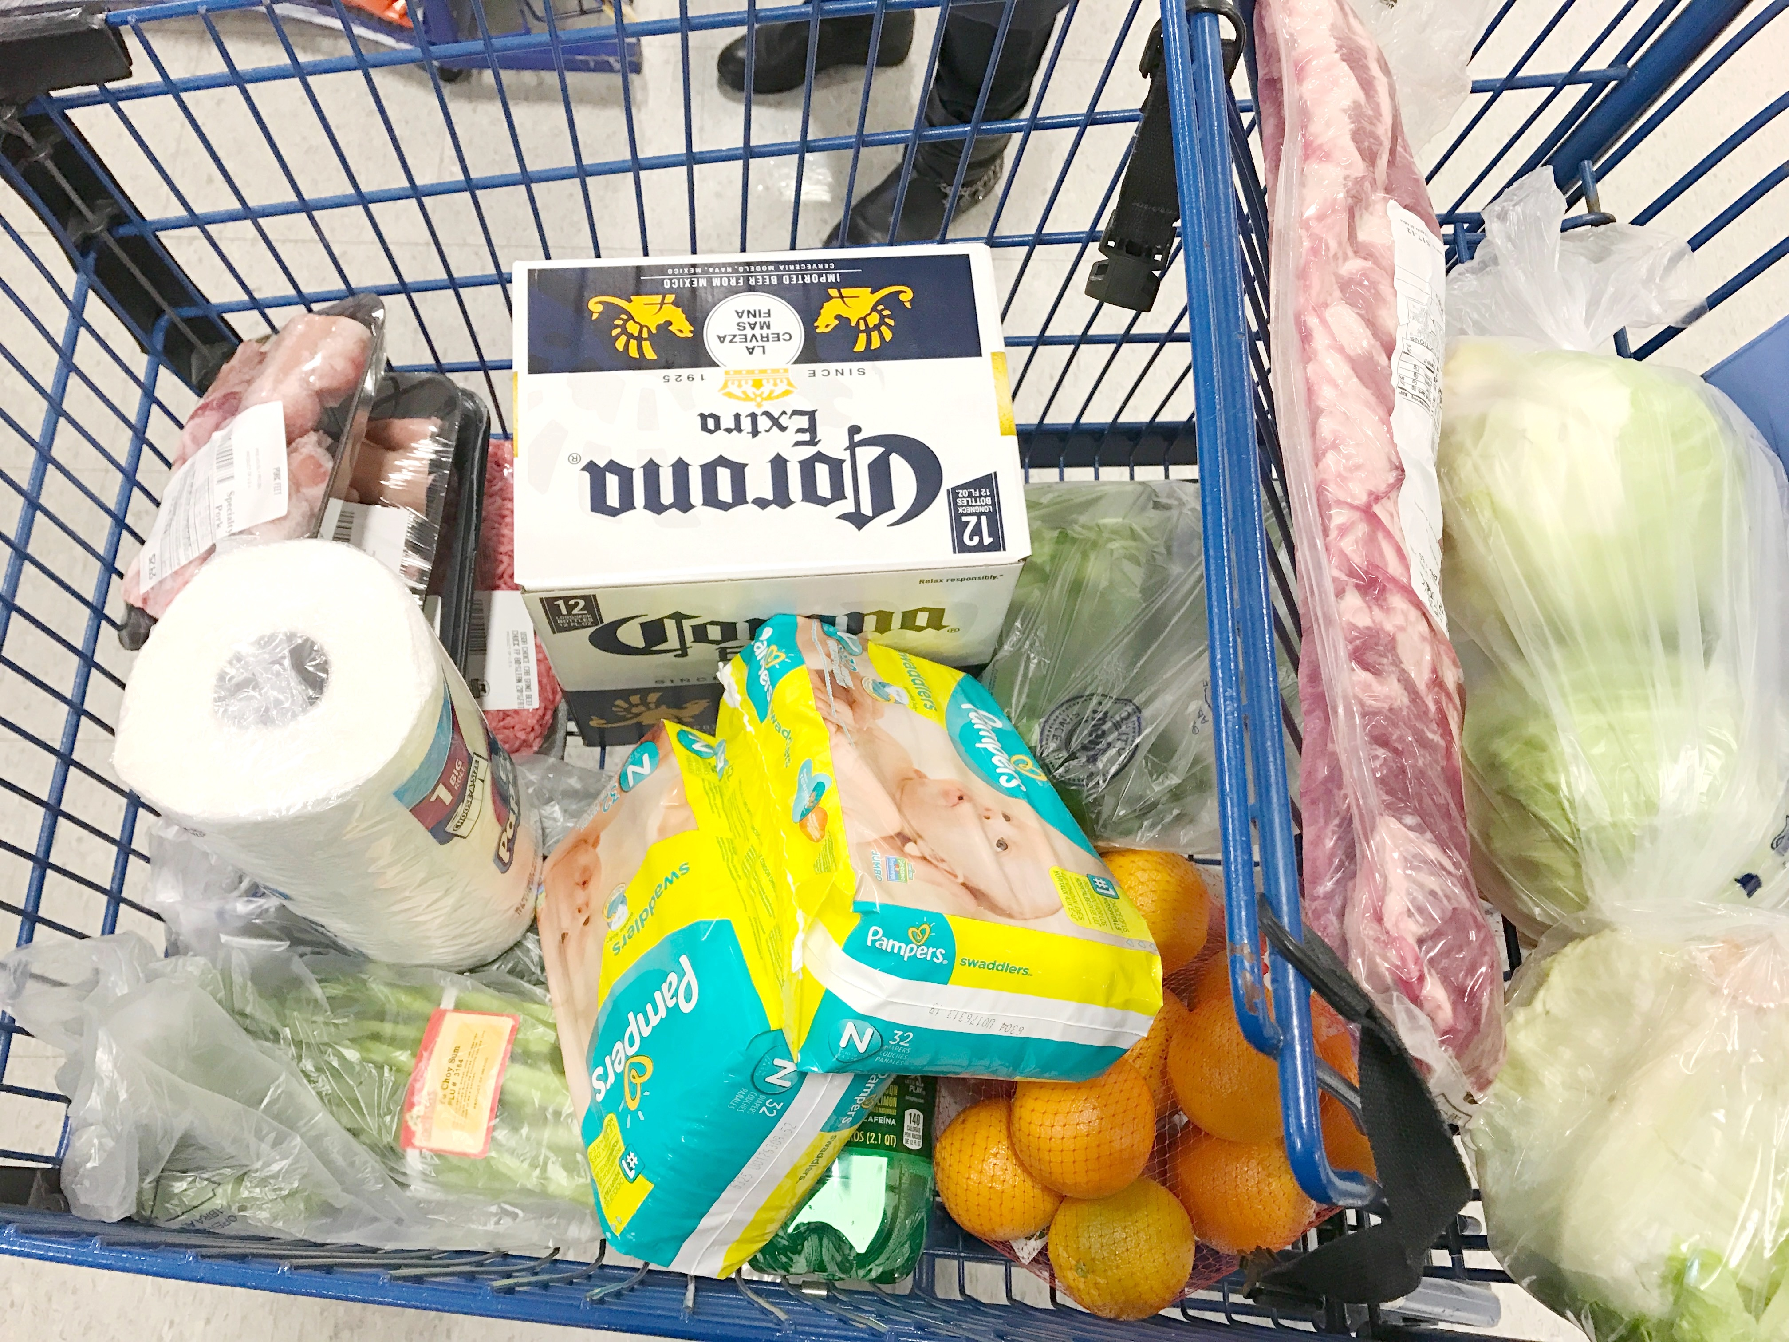

Slide 5
Pattern Discovery: Definition
What are patterns?
Patterns: A set of items, subsequences, or substructures that occur frequently together (or strongly correlated) in a data set
Patterns represent intrinsic and important properties of datasets
Pattern discovery: Uncovering patterns from massive data
Motivation examples:
What products were often purchased together?
What are the subsequent purchases after buying an iPad?
What code segments likely contain copy-and-paste bugs?
What word sequences likely form phrases in this corpus?

Slide 6
Frequent Patterns (Itemsets)
Itemset: A set of one or more items
k-itemset: X = {x₁, …, x_{k}}
(absolute) support (count) of X: Frequency or the number of occurrences of an itemset X
(relative) support, s: The fraction of transactions that contains X (i.e., the probability that a transaction contains X)
An itemset X is frequent if the support of X is no less than a minsup threshold
Tid | Items bought
10 | Beer, Nuts, Diaper
20 | Beer, Coffee, Diaper
30 | Beer, Diaper, Eggs
40 | Nuts, Eggs, Milk
50 | Nuts, Coffee, Diaper, Eggs, Milk
Let minsup = 50%
Freq. 1-itemsets:
Beer: 3 (60%); Nuts: 3 (60%)
Diaper: 4 (80%); Eggs: 3 (60%)
Freq. 2-itemsets:
{Beer, Diaper}: 3 (60%)

Slide 7
From Frequent Itemsets to Association Rules
Association rules: X → Y (s, c)
Support, s: The probability that a transaction contains X ∪ Y
Confidence, c: The conditional probability that a transaction containing X also contains Y
c = sup(X ∪ Y) / sup(X)
Association rule mining: Find all of the rules, X → Y, with minimum support and confidence
Frequent itemsets: Let minsup = 50%
Freq. 1-itemsets: Beer: 3, Nuts: 3, Diaper: 4, Eggs: 3
Freq. 2-itemsets: {Beer, Diaper}: 3
Association rules: Let minconf = 50%
Beer → Diaper (60%, 100%)
Diaper → Beer (60%, 75%)
Tid | Items bought
10 | Beer, Nuts, Diaper
20 | Beer, Coffee, Diaper
30 | Beer, Diaper, Eggs
40 | Nuts, Eggs, Milk
50 | Nuts, Coffee, Diaper, Eggs, Milk
Containing both
Containing diaper
Beer
{Beer} ∪ {Diaper}
Diaper
Containing beer
{Beer} ∪ {Diaper} = {Beer, Diaper}
Note: Itemset: X ∪ Y, a subtle notation!

Slide 8
Challenge: There Are Too Many Frequent Patterns!
A long pattern contains a combinatorial number of sub-patterns
How many frequent itemsets does the following TDB₁ contain?
TDB₁: T₁: {a₁, …, a₅₀}; T₂: {a₁, …, a₁₀₀}
Assuming (absolute) minsup = 1
Let’s have a try
1-itemsets: {a₁}: 2, {a₂}: 2, …, {a₅₀}: 2, {a₅₁}: 1, …, {a₁₀₀}: 1,
2-itemsets: {a₁, a₂}: 2, …, {a₁, a₅₀}: 2, {a₁, a₅₁}: 1 …, …, {a₉₉, a₁₀₀}: 1, …
99-itemsets: {a₁, a₂, …, a₉₉}: 1, …, {a₂, a₃, …, a₁₀₀}: 1
100-itemset: {a₁, a₂, …, a₁₀₀}: 1
In total: (¹⁰⁰₁) + (¹⁰⁰₂) + … + (¹⁰⁰₁₀₀) = 2¹⁰⁰ – 1 sub-patterns!
A too huge set for any computer to compute or store!

Slide 9
Expressing Patterns in Compressed Form: Closed Patterns
How to handle such a challenge?
Solution 1: Closed patterns: A pattern (itemset) X is closed if X is frequent, and there exists no super-pattern Y כ X, with the same support as X
Let Transaction DB TDB₁: T₁: {a₁, …, a₅₀}; T₂: {a₁, …, a₁₀₀}
Suppose minsup = 1. How many closed patterns does TDB₁ contain?
Two: P₁: “{a₁, …, a₅₀}: 2”; P₂: “{a₁, …, a₁₀₀}: 1”
Closed pattern is a lossless compression of frequent patterns
Reduces the # of patterns but does not lose the support information!
You will still be able to say: “{a₂, …, a₄₀}: 2”, “{a₅, a₅₁}: 1”

Slide 10
Expressing Patterns in Compressed Form: Max-Patterns
Solution 2: Max-patterns: A pattern X is a max-pattern if X is frequent and there exists no frequent super-pattern Y כ X, with the same support as X
Difference from close-patterns?
Do not care the real support of the sub-patterns of a max-pattern
Let Transaction DB TDB₁: T₁: {a₁, …, a₅₀}; T₂: {a₁, …, a₁₀₀}
Suppose minsup = 1. How many max-patterns does TDB₁ contain?
One: P: “{a₁, …, a₁₀₀}: 1”
Max-pattern is a lossy compression!
We only know {a₁, …, a₄₀} is frequent
But we do not know the real support of {a₁, …, a₄₀}, …, any more!
Thus in many applications, mining closed-patterns is more desirable than mining max-patterns

Slide 11
The Downward Closure Property of Frequent Patterns: Apriori
Observation: From TDB_{1:} T₁: {a₁, …, a₅₀}; T₂: {a₁, …, a₁₀₀}
We get a frequent itemset: {a₁, …, a₅₀}
Also, its subsets are all frequent: {a₁}, {a₂}, …, {a₅₀}, {a₁, a₂}, …, {a₁, …, a₄₉}, …
There must be some hidden relationships among frequent patterns!
The downward closure (also called “Apriori”) property of frequent patterns
If {beer, diaper, nuts} is frequent, so is {beer, diaper}
Every transaction containing {beer, diaper, nuts} also contains {beer, diaper}
Apriori: Any subset of a frequent itemset must be frequent
Efficient mining methodology
If any subset of an itemset S is infrequent, then there is no chance for S to be frequent—why do we even have to consider S!?
A sharp knife for pruning!

Slide 12
Apriori: A Candidate Generation & Test Approach
Outline of Apriori (level-wise, candidate generation and test)
Initially, scan DB once to get frequent 1-itemset
Repeat
Generate length-(k+1) candidate itemsets from length-k frequent itemsets
Test the candidates against DB to find frequent (k+1)-itemsets
Set k := k +1
Until no frequent or candidate set can be generated
Return all the frequent itemsets derived

Slide 13
The Apriori Algorithm: An Example
Database TDB
minsup = 2
Itemset | sup
{A} | 2
{B} | 3
{C} | 3
{D} | 1
{E} | 3
Itemset | sup
{A} | 2
{B} | 3
{C} | 3
{E} | 3
F₁
Tid | Items
10 | A, C, D
20 | B, C, E
30 | A, B, C, E
40 | B, E
C₁
1st scan
F₂
Itemset | sup
{A, C} | 2
{B, C} | 2
{B, E} | 3
{C, E} | 2
C₂
Itemset | sup
{A, B} | 1
{A, C} | 2
{A, E} | 1
{B, C} | 2
{B, E} | 3
{C, E} | 2
C₂
Itemset
{A, B}
{A, C}
{A, E}
{B, C}
{B, E}
{C, E}
2nd scan
C₃
Itemset
{B, C, E}
3rd scan
F₃
Itemset | sup
{B, C, E} | 2

Slide 14
The Apriori Algorithm (Pseudo-Code)
C_{k}: Candidate itemset of size k
F_{k} : Frequent itemset of size k
K := 1;
F_{k} := {frequent items}; // frequent 1-itemset
While (F_{k} != ∅) do { // when F_{k} is non-empty
C_{k+1} := candidates generated from F_{k}; // candidate generation
Derive F_{k+1} by counting candidates in C_{k+1} with respect to TDB at minsup;
k := k + 1
}
return ∪_{k} F_{k} // return F_{k} generated at each level

Slide 15
FPGrowth: Mining Frequent Patterns by Pattern Growth
Idea: Frequent pattern growth (FPGrowth)
Find frequent single items and partition the database based on each such item
Recursively grow frequent patterns by doing the above for each partitioned database (also called conditional database)
To facilitate efficient processing, an efficient data structure, FP-tree, can be constructed
Mining becomes
Recursively construct and mine (conditional) FP-trees
Until the resulting FP-tree is empty, or until it contains only one path—single path will generate all the combinations of its sub-paths, each of which is a frequent pattern
YouTube: https://www.youtube.com/watch?v=LXx1xKF9oDg

Slide 16
Example: Construct FP-tree from a Transactional DB
TID | Items in the Transaction | Ordered, frequent items
100 | {f, a, c, d, g, i, m, p} | {f, c, a, m, p}
200 | {a, b, c, f, l, m, o} | {f, c, a, b, m}
300 | {b, f, h, j, o, w} | {f, b}
400 | {b, c, k, s, p} | {c, b, p}
500 | {a, f, c, e, l, p, m, n} | {f, c, a, m, p}
Answer:
f:4, a:3, c:4, b:3, m:3, p:3;
fa:3, fc:3, fm:3, ac:3, am:3,
cm: 3, cp:3;
fcm: 3, fam:3, cam: 3;
fcam: 3.
Scan DB once, find single item frequent pattern:
Sort frequent items in frequency descending order, f-list
Scan DB again, construct FP-tree
Let min_support = 3
f:4, a:3, c:4, b:3, m:3, p:3
{}
F-list = f-c-a-b-m-p
Header Table
f:4
c:1
Item | Frequency | Header
f | 4
c | 4
a | 3
b | 3
m | 3
p | 3
c:3
b:1
b:1
a:3
p:1
m:2
b:1
p:2
m:1

Slide 17
Divide and Conquer Based on Patterns and Data
Pattern mining can be partitioned according to current patterns
Patterns containing p: p’s conditional database: fcam:2, cb:1
Patterns having m but no p: m’s conditional database: fca:2, fcab:1
…… ……
p’s conditional pattern base: transformed prefix paths of item p
{}
min_support = 3
Conditional pattern bases
Item | Frequency | Header
f | 4
c | 4
a | 3
b | 3
m | 3
p | 3
f:4
c:1
Item Conditional pattern base
c f:3
a fc:3
b fca:1, f:1, c:1
m fca:2, fcab:1
p fcam:2, cb:1
c:3
b:1
b:1
a:3
p:1
m:2
b:1
p:2
m:1

Slide 18
Mine Each Conditional Pattern-Base Recursively
Conditional pattern bases
For each conditional pattern-base
Mine single-item patterns
Construct its cond. FP-tree & mine it
item cond. pattern base
c f:3
a fc:3
b fca:1, f:1, c:1
m fca:2, fcab:1
p fcam:2, cb:1
min_support = 3
p-conditional PB: fcam:2, cb:1 → c: 3
m-conditional PB: fca:2, fcab:1 → fca: 3
b-conditional PB: fca:1, f:1, c:1 → ɸ
a-conditional PB: fc:3 → fc:3
c-conditional PB: f:3 → f:3

Slide 19
Mine Each Conditional Pattern-Base Recursively
Conditional pattern bases
For each conditional pattern-base
Mine single-item patterns
Construct its cond. FP-tree & mine it
item cond. pattern base
c f:3
a fc:3
b fca:1, f:1, c:1
m fca:2, fcab:1
p fcam:2, cb:1
min_support = 3
p-conditional PB: fcam:2, cb:1 → c: 3
m-conditional PB: fca:2, fcab:1 → fca: 3
b-conditional PB: fca:1, f:1, c:1 → ɸ
a-conditional PB: fc:3 → fc:3
{}
{}
{}
{}
c-conditional PB: f:3 → f:3
f:3
f:3
f:3
f:3
mine(<f:3, c:3, a:3>|m)
→ (am:3) + mine(<f:3, c:3>|am)
→ (cam:3) + (fam:3) + mine (<f:3>|cam)
→ (fcam:3)
→ (cm:3) + mine(<f:3>|cm)
→ (fcm:3)
→ (fm:3)
c:3
c:3
cm-cond.
FP-tree
cam-cond.
FP-tree
a:3
am-cond.
FP-tree
m-cond.
FP-tree

Slide 20
Mine Each Conditional Pattern-Base Recursively
Conditional pattern bases
For each conditional pattern-base
Mine single-item patterns
Construct its cond. FP-tree & mine it
item cond. pattern base
c f:3
a fc:3
b fca:1, f:1, c:1
m fca:2, fcab:1
p fcam:2, cb:1
min_support = 3
p-conditional PB: fcam:2, cb:1 → c: 3
m-conditional PB: fca:2, fcab:1 → fca: 3
b-conditional PB: fca:1, f:1, c:1 → ɸ
{}
{}
{}
{}
Actually, for single branch FP-tree, all frequent patterns can be generated in one shot
f:3
f:3
f:3
f:3
c:3
cm-cond.
FP-tree
cam-cond.
FP-tree
m: 3
fm: 3, cm: 3, am: 3
fcm: 3, fam:3, cam: 3
fcam: 3
c:3
a:3
am-cond.
FP-tree
m-cond.
FP-tree

Slide 21
Try FP-Growth?
Database TDB
minsup = 2
Itemset | sup
{A} | 2
{B} | 3
{C} | 3
{D} | 1
{E} | 3
Itemset | sup
{A} | 2
{B} | 3
{C} | 3
{E} | 3
F₁
Tid | Items
10 | A, C, D
20 | B, C, E
30 | A, B, C, E
40 | B, E
C₁
1st scan
F₂
Itemset | sup
{A, C} | 2
{B, C} | 2
{B, E} | 3
{C, E} | 2
C₂
Itemset | sup
{A, B} | 1
{A, C} | 2
{A, E} | 1
{B, C} | 2
{B, E} | 3
{C, E} | 2
C₂
Itemset
{A, B}
{A, C}
{A, E}
{B, C}
{B, E}
{C, E}
2nd scan
C₃
Itemset
{B, C, E}
3rd scan
F₃
Itemset | sup
{B, C, E} | 2
Notes:
A:2 B:3 C:3 D:1 E:3
Answer: B:3, C:3, E:3, A:2 (sorted)
AC; BCE; ABCE; BE
Tree:
C(1)-A(1)
C(2)-B(2)-E(2)-A(1)
B(1)-E(1)
A-conditional:
C:1
C-B-E:1
C:2,B:1,E:1 => C:2
Answer: CA:2
CA-conditional:
Empty
B-conditional:
C:2
Answer: BC:2
BC-conditional:
Empty
C-conditional:
Empty
E-conditional:
C-B:2
B:1
B:3,C:2 => B:3,C:2
Answer: BE:3, CE:2
BE-conditional:
C:2
Answer: CBE:2
CE-conditional:
Empty
Answer: CE:2

Slide 22
Try WikiBooks’ Example
https://en.wikibooks.org/wiki/Data_Mining_Algorithms_In_R/Frequent_Pattern_Mining/The_FP-Growth_Algorithm

Slide 23
References
R. Agrawal, T. Imielinski, and A. Swami, “Mining association rules between sets of items in large databases”, in Proc. of SIGMOD'93
R. J. Bayardo, “Efficiently mining long patterns from databases”, in Proc. of SIGMOD'98
N. Pasquier, Y. Bastide, R. Taouil, and L. Lakhal, “Discovering frequent closed itemsets for association rules”, in Proc. of ICDT'99
J. Han, H. Cheng, D. Xin, and X. Yan, “Frequent Pattern Mining: Current Status and Future Directions”, Data Mining and Knowledge Discovery, 15(1): 55-86, 2007
R. Agrawal and R. Srikant, “Fast algorithms for mining association rules”, VLDB'94
A. Savasere, E. Omiecinski, and S. Navathe, “An efficient algorithm for mining association rules in large databases”, VLDB'95
J. S. Park, M. S. Chen, and P. S. Yu, “An effective hash-based algorithm for mining association rules”, SIGMOD'95
S. Sarawagi, S. Thomas, and R. Agrawal, “Integrating association rule mining with relational database systems: Alternatives and implications”, SIGMOD'98
M. J. Zaki, S. Parthasarathy, M. Ogihara, and W. Li, “Parallel algorithm for discovery of association rules”, Data Mining and Knowledge Discovery, 1997
J. Han, J. Pei, and Y. Yin, “Mining frequent patterns without candidate generation”, SIGMOD’00

Slide 24
References (cont.)
M. J. Zaki and Hsiao, “CHARM: An Efficient Algorithm for Closed Itemset Mining”, SDM'02
J. Wang, J. Han, and J. Pei, “CLOSET+: Searching for the Best Strategies for Mining Frequent Closed Itemsets”, KDD'03
C. C. Aggarwal, M.A., Bhuiyan, M. A. Hasan, “Frequent Pattern Mining Algorithms: A Survey”, in Aggarwal and Han (eds.): Frequent Pattern Mining, Springer, 2014
C. C. Aggarwal and P. S. Yu. A New Framework for Itemset Generation. PODS’98
S. Brin, R. Motwani, and C. Silverstein. Beyond market basket: Generalizing association rules to correlations. SIGMOD'97
M. Klemettinen, H. Mannila, P. Ronkainen, H. Toivonen, and A. I. Verkamo. Finding interesting rules from large sets of discovered association rules. CIKM'94
E. Omiecinski. Alternative Interest Measures for Mining Associations. TKDE’03
P.-N. Tan, V. Kumar, and J. Srivastava. Selecting the Right Interestingness Measure for Association Patterns. KDD'02
T. Wu, Y. Chen and J. Han, Re-Examination of Interestingness Measures in Pattern Mining: A Unified Framework, Data Mining and Knowledge Discovery, 21(3):371-397, 2010

