Slide 1

Chapter 2. Getting to Know Your Data: Data Visualization
Meng Jiang
CSE 40647/60647 Data Science Fall 2017
Introduction to Data Mining

Slide 2
Chapter 2. Getting to Know Your Data
Data Objects and Attribute Types
Basic Statistical Descriptions
Data Visualization
Measuring Data Similarity and Dissimilarity

Slide 3
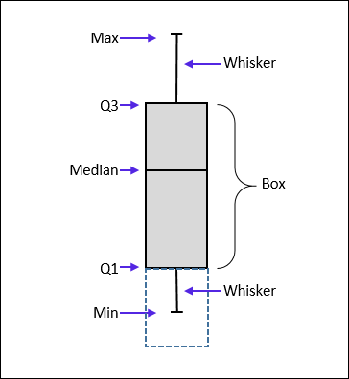
Measuring the Dispersion of Data: (1) Quartiles & Boxplots
Quartiles: Q₁ (25th percentile), Q₃ (75th percentile)
Inter-quartile range: IQR = Q₃ – Q₁
Five number summary: min, Q₁, median, Q₃, max
Boxplot: Data is represented with a box
Q₁, Q₃, IQR: The ends of the box are at the first and third quartiles, i.e., the height of the box is IQR
Median (Q₂) is marked by a line within the box
Whiskers: Two lines outside the box extended to Minimum and Maximum

Slide 4
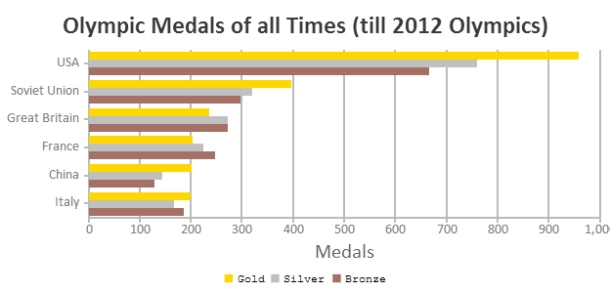
(2) Histogram Analysis
Histogram: Graph display of tabulated frequencies, shown as bars
Between histograms and bar charts
Histograms are used to show distributions of variables while bar charts are used to compare variables
Histograms plot binned quantitative data while bar charts plot categorical data
Bars can be reordered in bar charts but not in histograms

Slide 5
Histograms Often Tell More than Boxplots
The two histograms may have the same boxplot
The same values for: min, Q1, median, Q3, max
But they have rather different data distributions

Slide 6
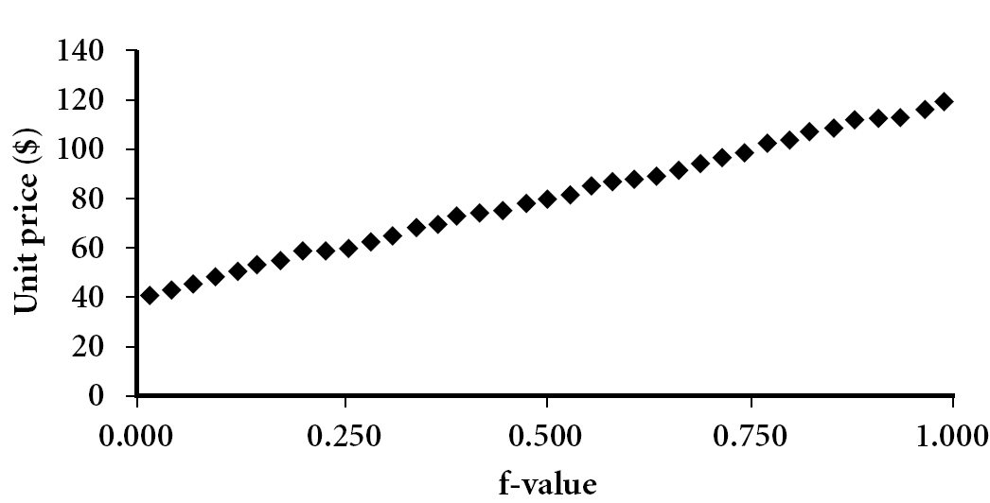
(3) Quantile Plot
Displays all of the data (allowing the user to assess both the overall behavior and unusual occurrences)
Plots quantile information
For a data x_{i} data sorted in increasing order, f_{i} indicates that approximately 100 f_{i}% of the data are below or equal to the value x_{i}

Slide 7
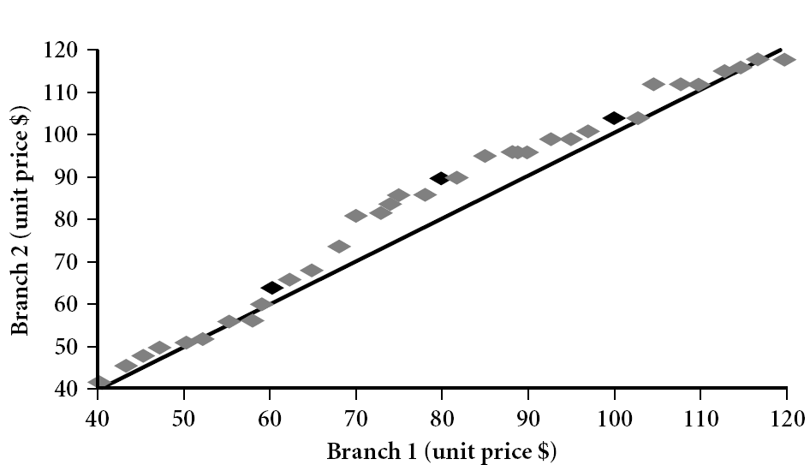
(4) Quantile-Quantile (Q-Q) Plot
Graphs the quantiles of one univariate distribution against the corresponding quantiles of another
Example shows unit price of items sold at Branch 1 vs. Branch 2 for each quantile. Unit prices of items sold at Branch 1 tend to be lower than those at Branch 2

Slide 8
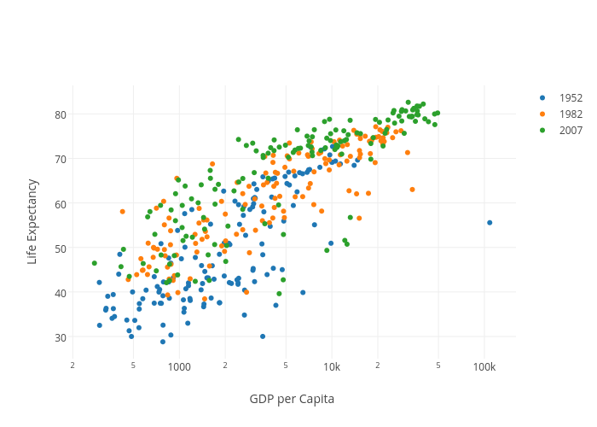
(5) Scatter plot
Provides a first look at data to see clusters of points, outliers
Each pair of values is treated as a pair of coordinates and plotted as points in the plane

Slide 9
Summary: Graphic Displays of Basic Statistical Descriptions
Boxplot: graphic display of five-number summary
Histogram: x-axis are values, y-axis representative frequencies
Quantile plot: each value x_{i} is paired with f_{i} indicating that approximately 100 f_{i} % of data are ≤ x_{i}
Quantile-Quantile (q-q) plot: graphs the quantiles of one univariant distribution against the corresponding quantiles of another
Scatter plot: each pair of values is a pair of coordinates and plotted as points in the plane

Slide 10

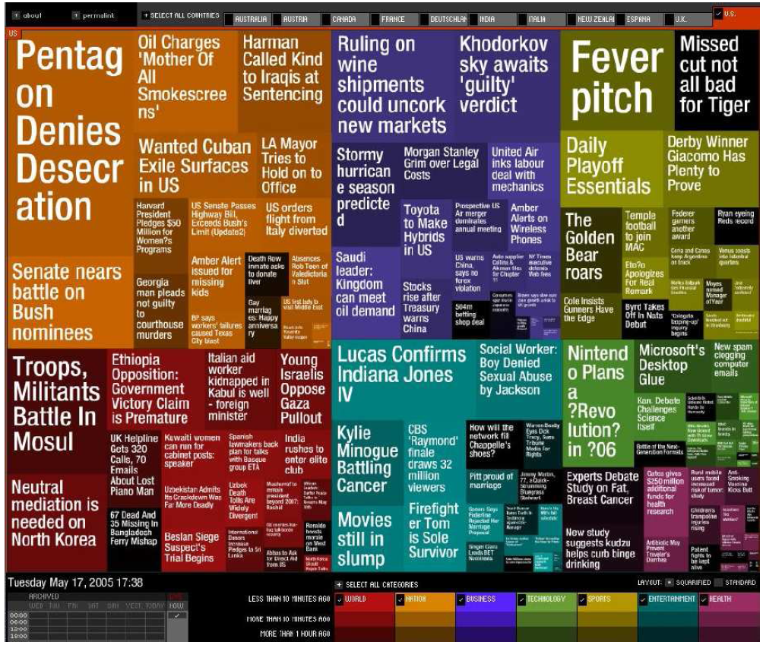
Other Visualization: Tag Cloud
KDD 2013 Research Paper Title
Newsmap: Google News Stories in 2005

Slide 11
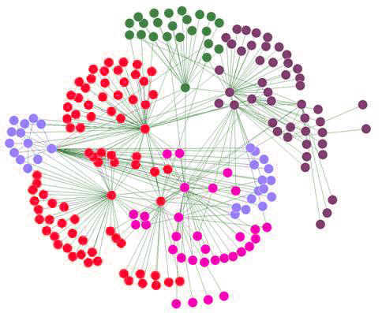
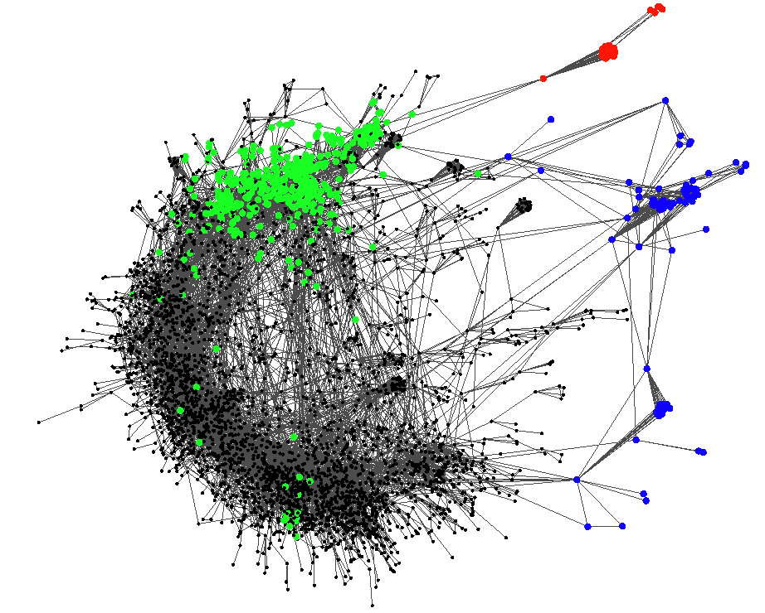
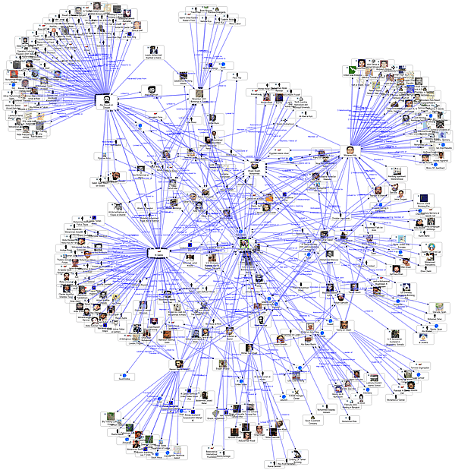
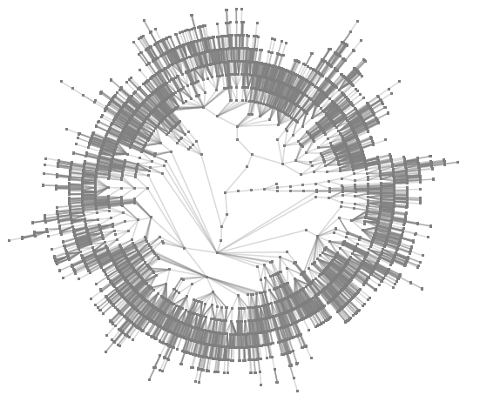
Other Visualization: Networks
A typical network structure
organizing information networks
A social network

Slide 12
Chapter 2. Getting to Know Your Data
Data Objects and Attribute Types
Basic Statistical Descriptions
Data Visualization
Measuring Data Similarity and Dissimilarity

Slide 13
Similarity, Dissimilarity, and Proximity
Similarity measure or similarity function
A real-valued function that quantifies the similarity between two objects
Measure how two data objects are alike: The higher value, the more alike
Often falls in the range [0,1]: 0: no similarity; 1: completely similar
Dissimilarity (or distance) measure
Numerical measure of how different two data objects are
In some sense, the inverse of similarity: The lower, the more alike
Minimum dissimilarity is often 0 (i.e., completely similar)
Range [0, 1] or [0, ∞) , depending on the definition
Proximity usually refers to either similarity or dissimilarity

Slide 14
Data Matrix and Dissimilarity Matrix
Data matrix
A data matrix of n data points with l dimensions
Dissimilarity (distance) matrix
n data points, but registers only the distance d(i, j)
Usually symmetric, thus a triangular matrix
Distance functions are usually different for real, boolean, categorical, ordinal variables
Weights can be associated with different variables based on applications and data semantics
…
…

Slide 15
Example: Euclidean Distance
Data Matrix
Dissimilarity Matrix (by Euclidean Distance)

Slide 16
Minkowski Distance
Minkowski distance: A popular distance measure
where i = (x_{i1}, x_{i2}, …, x_{il}) and j = (x_{j1}, x_{j2}, …, x_{jl}) are two l-dimensional data objects, and p is the order (the distance so defined is called L-p norm)
Properties
d(i, j) > 0 if i ≠ j, and d(i, i) = 0 (Positivity)
d(i, j) = d(j, i) (Symmetry)
d(i, j) ≤ d(i, k) + d(k, j) (Triangle Inequality)
A distance that satisfies these properties is a metric
Note: There are nonmetric dissimilarities, e.g., set difference
…

Slide 17
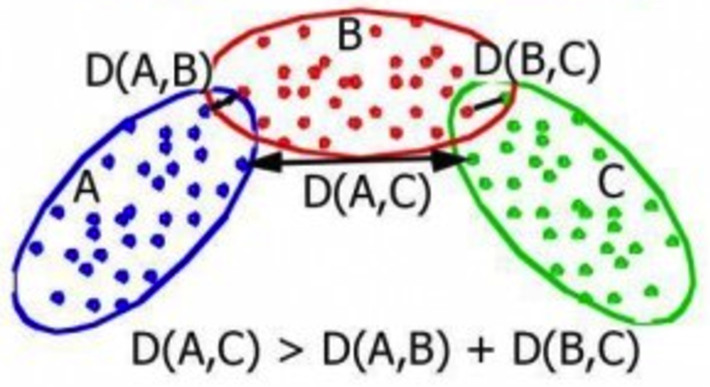
Non Metric Dissimilarity: Triangle Inequality

Slide 18
Special Cases of Minkowski Distance
p = 1: (L₁ norm) Manhattan (or city block) distance
E.g., the Hamming distance: the number of bits that are different between two binary vectors
p = 2: (L₂ norm) Euclidean distance
p → ∞: (L_{max} norm, L∞ norm) “supremum” distance
The maximum difference between any component (attribute) of the vectors
…
…
…

Slide 19
Example: Minkowski Distance at Special Cases
Manhattan (L₁)
Euclidean (L₂)
Supremum (L∞)

Slide 20
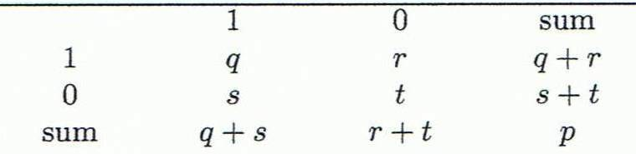
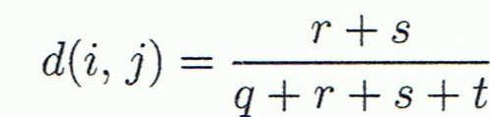
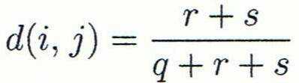

Proximity Measure for Binary Attributes
A contingency table for binary data
Distance measure for symmetric binary variables:
Distance measure for asymmetric binary variables:
Jaccard coefficient (similarity measure for asymmetric binary variables):
Note: Jaccard coefficient is the same as “coherence”:
Object j
Object i
Notes:
Jaccard coefficient: Facebook mutual friends of two users.

Slide 21
Proximity Measure for Categorical Attributes
Categorical data, also called nominal attributes
Example: Color (red, yellow, blue, green), profession, etc.
Method 1: Simple matching
m: # of matches, p: total # of variables
Method 2: Use a large number of binary attributes
Creating a new binary attribute for each of the M nominal states

Slide 22
Ordinal Variables
An ordinal variable can be discrete or continuous
Order is important, e.g., rank (e.g., freshman, sophomore, junior, senior)
Can be treated like interval-scaled
Replace an ordinal variable value by its rank and map the range of each variable onto [0, 1]:
Example: freshman: 0; sophomore: 1/3; junior: 2/3; senior 1
Then distance: d(freshman, senior) = 1, d(junior, senior) = 1/3
Compute the dissimilarity using methods for interval-scaled variables

Slide 23
Attributes of Mixed Types
A dataset may contain all attribute types
Nominal, symmetric binary, asymmetric binary, numeric, and ordinal
One may use a weighted formula to combine their effects:
If f is numeric: Use the normalized distance
If f is binary or nominal: d_{ij}^{(f)} = 0 if x_{if} = x_{jf}; or d_{ij}^{(f)} = 1 otherwise
If f is ordinal
Compute ranks z_{if} (where )
Treat z_{if} as interval-scaled

Slide 24
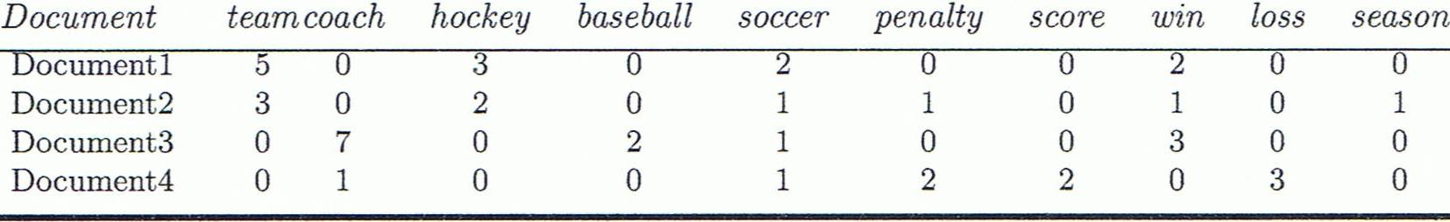
Cosine Similarity of Two Vectors
A document can be represented by a bag of terms or a long vector, with each attribute recording the frequency of a particular term (such as word, keyword, or phrase) in the document
Other vector objects: Gene features in micro-arrays
Applications: Information retrieval, biologic taxonomy, gene feature mapping, etc.
Cosine measure: If d₁ and d₂ are two vectors (e.g., term-frequency vectors), then
where • indicates vector dot product, ||d||: the length of vector d

Slide 25
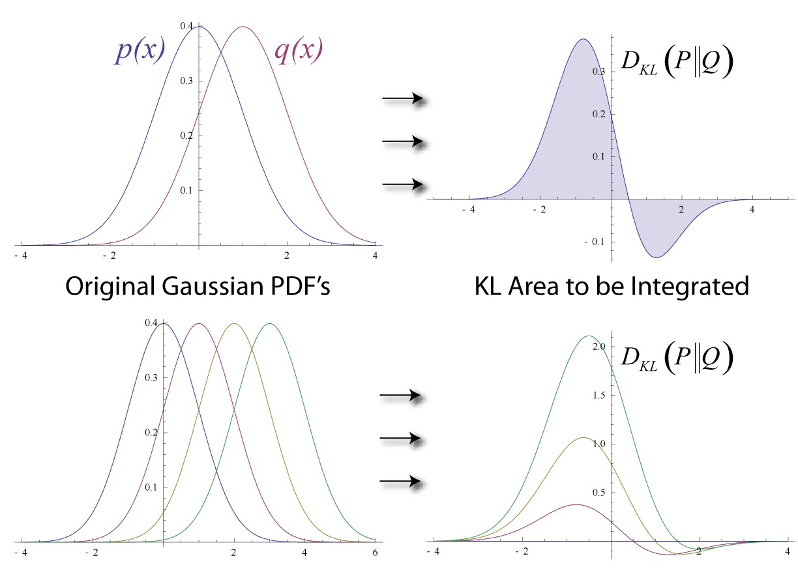
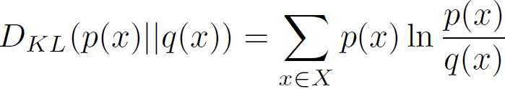
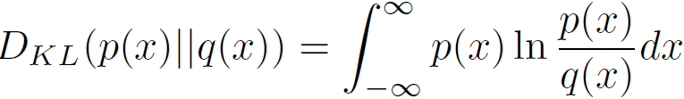
KL Divergence: Comparing Two Probability Distributions
The Kullback-Leibler (KL) divergence: Measure the difference between two probability distributions over the same variable x
From information theory, closely related to relative entropy, information divergence, and information for discrimination
D_{KL}(p(x) || q(x)): divergence of q(x) from p(x), measuring the information lost when q(x) is used to approximate p(x)
Discrete form
Continuous form
Notes:
>= 0

Slide 26
Discussion
Can you use Matrix Multiplication to compute Cosine Similarity between every pair of objects?
Can you use KL divergence to find suspiciousness?
Can you use KL divergence to find representative phrases for specific topics?

Slide 27
Summary
Data attribute types: nominal, binary, ordinal …
Many types of data sets, e.g., numerical, text
Gain insight into the data by:
Basic data description: central tendency, outlierness
Data visualization
Measure data similarity and dissimilarity
Above steps are the beginning of data preprocessing

Slide 28
References
W. Cleveland, Visualizing Data, Hobart Press, 1993
T. Dasu and T. Johnson. Exploratory Data Mining and Data Cleaning. John Wiley, 2003
U. Fayyad, G. Grinstein, and A. Wierse. Information Visualization in Data Mining and Knowledge Discovery, Morgan Kaufmann, 2001
L. Kaufman and P. J. Rousseeuw. Finding Groups in Data: an Introduction to Cluster Analysis. John Wiley & Sons, 1990.
H. V. Jagadish et al., Special Issue on Data Reduction Techniques. Bulletin of the Tech. Committee on Data Eng., 20(4), Dec. 1997
D. A. Keim. Information visualization and visual data mining, IEEE trans. on Visualization and Computer Graphics, 8(1), 2002
D. Pyle. Data Preparation for Data Mining. Morgan Kaufmann, 1999
S. Santini and R. Jain,” Similarity measures”, IEEE Trans. on Pattern Analysis and Machine Intelligence, 21(9), 1999
E. R. Tufte. The Visual Display of Quantitative Information, 2nd ed., Graphics Press, 2001
C. Yu, et al., Visual data mining of multimedia data for social and behavioral studies, Information Visualization, 8(1), 2009

