Slide 1

Chapter 3. Data Processing: Data Reduction
Meng Jiang
CSE 40647/60647 Data Science Fall 2017
Introduction to Data Mining

Slide 2
Data Preprocessing
Data cleaning
Data integration
Data reduction
Reduce data objects
Dimensionality reduction
Reduce dimensions and attributes

Slide 3
Data Reduction
Data reduction
Obtain a reduced representation of the data set
Why? Complex analysis may take a very long time to run on the complete data set
Methods for data reduction
Regression and Log-Linear Models
Histograms, Clustering, Sampling
Data normalization

Slide 4
Regression Analysis
Regression analysis: A collective name for techniques for the modeling and analysis of numerical data consisting of values
of a dependent variable (also called response variable or measurement): Y
and of one or more independent variables (also known as explanatory variables or predictors): X, or X₁, X₂, …X_{n}
Parameters are estimated to give a “best fit” of the data
Data: (x₁, y₁)
Fit of the data: (x₁, y₁’)
Ex. y₁’ = x₁ + 1
Y
y₁
y₁’
y = x + 1
x₁
X

Slide 5
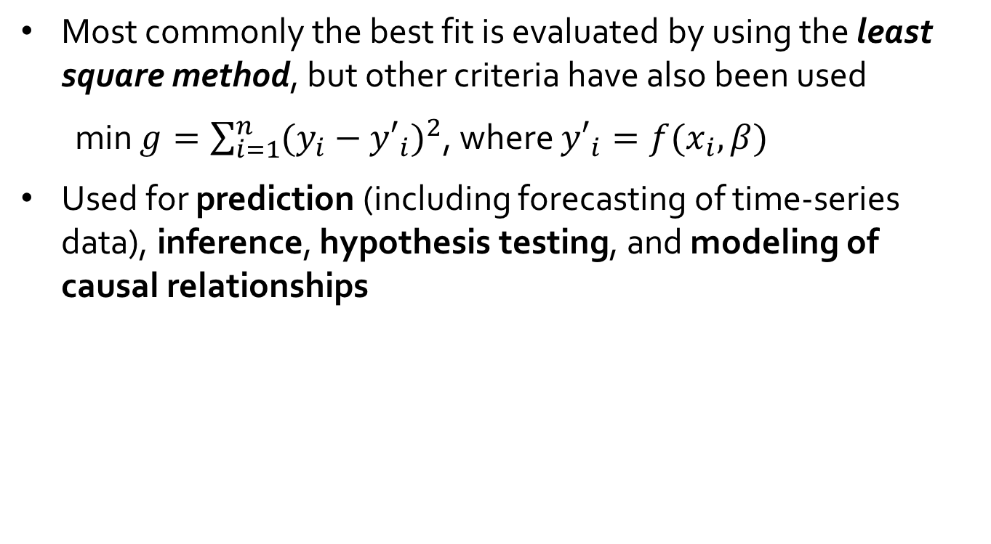
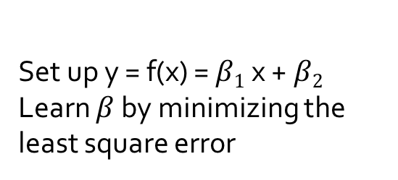
Regression Analysis
Most commonly the best fit is evaluated by using the least square method, but other criteria have also been used
min $g=\sum_{i=1}^{n}{{(y_{i}−{y′}_{i})}^{2}}$, where ${y′}_{i}=f(x_{i}, β)$
Used for prediction (including forecasting of time-series data), inference, hypothesis testing, and modeling of causal relationships
Y
y₁
Set up y = f(x) = $β1$x +$β2$
Learn $β$ by minimizing the least square error
y₁’
y = x + 1
x₁
X

Slide 6
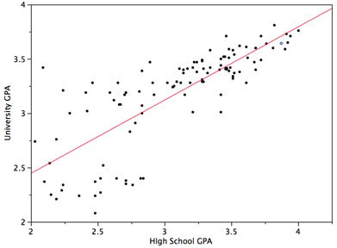
Linear Regression
Linear regression: Y = w X + b
Data modeled to fit a straight line
Often uses the least-square method to fit the line
Two regression coefficients, w and b, specify the line and are to be estimated by using the data at hand

Slide 7
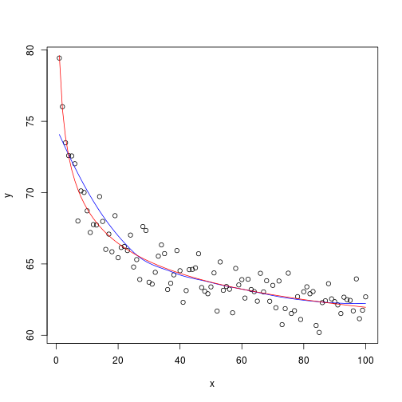
Nonlinear Regression
Nonlinear regression:
Data are modeled by a function which is a nonlinear combination of the model parameters and depends on one or more independent variables

Slide 8
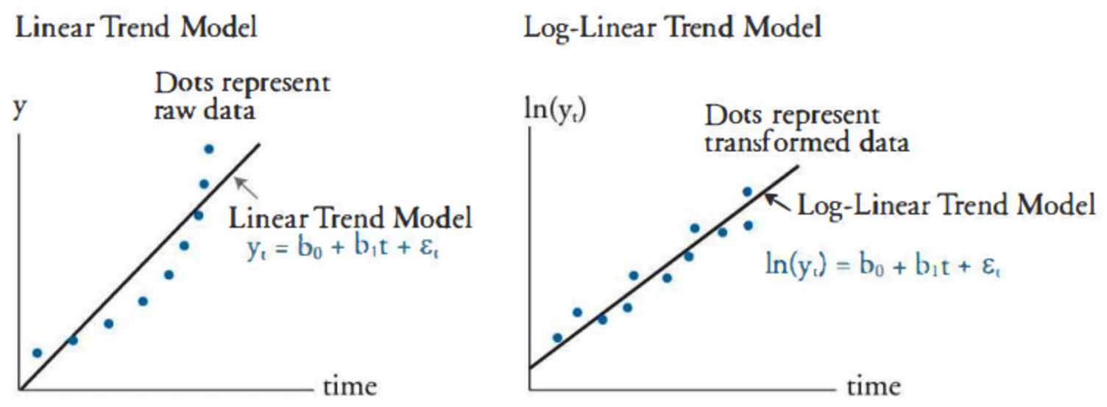
Log-Linear Model
Log-linear model
A math model that takes the form of a function whose logarithm is a linear combination of the parameters of the model

Slide 9
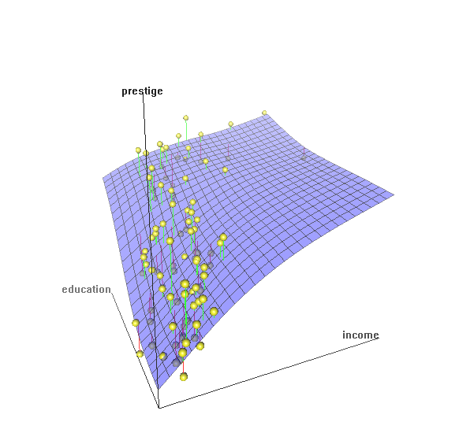
Multiple Regression
Multiple regression: Y = b₀ + b₁ X₁ + b₂ X₂
Allows a response variable Y to be modeled as a linear function of multidimensional feature vector
Many nonlinear functions can be transformed into the above

Slide 10
Histogram Analysis
Divide data into buckets and store average (sum) for each bucket
One popular partitioning rules - Equal-width: equal bucket range
(10,000 , 10,001] = 10,001
…
to
(10,000 , 11,000]
(11,000 , 12,000]
…

Slide 11
Clustering
Partition data set into clusters based on similarity, and store cluster representation (e.g., centroid and diameter) only
Can be very effective if data is clustered but not if data is “smeared”
There are many choices of clustering definitions and clustering algorithms
Cluster analysis will be studied in depth in Chapter 10

Slide 12
Sampling
Sampling: obtaining a small sample s to represent the whole data set N
Key principle: Choose a representative subset of the data
Simple random sampling may have very poor performance in the presence of skew
Simple random sampling:
Equal probability of selecting any particular item
Sampling without replacement:
Once an object is selected, it is removed from the population
Sampling with replacement:
A selected object is not removed from the population
Raw Data
SRSWOR
(simple random
sample without
replacement)
SRSWR

Slide 13
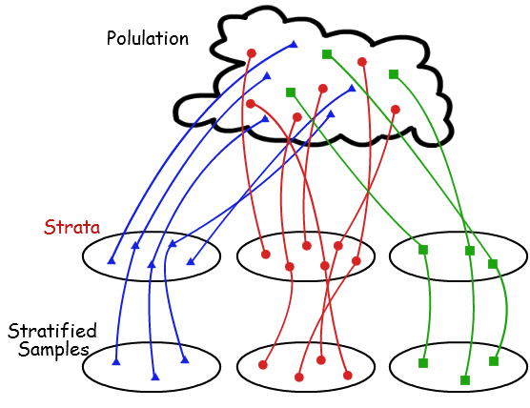
Stratified Sampling
Stratified sampling
Partition (or cluster) the data set, and draw samples from each partition (proportionally, i.e., approximately the same percentage of the data)

Slide 14
Recall: Data Reduction
Methods for data reduction
Regression and Log-Linear Models
Histograms, Clustering, Sampling
Data normalization

Slide 15
Parametric vs. Non-Parametric Data Reduction Methods
Parametric methods (e.g., regression)
Assume the data fits some model, estimate model parameters, store only the parameters, and discard the data (except possible outliers)
Non-parametric methods
Do not assume models
Major families: histograms, clustering, sampling, …

Slide 16
Normalization
Min-max normalization: to [new_min_{A}, new_max_{A}]
Ex. Let income range $12,000 to $98,000 normalized to [0.0, 1.0]
Then $73,600 is mapped to

Slide 17
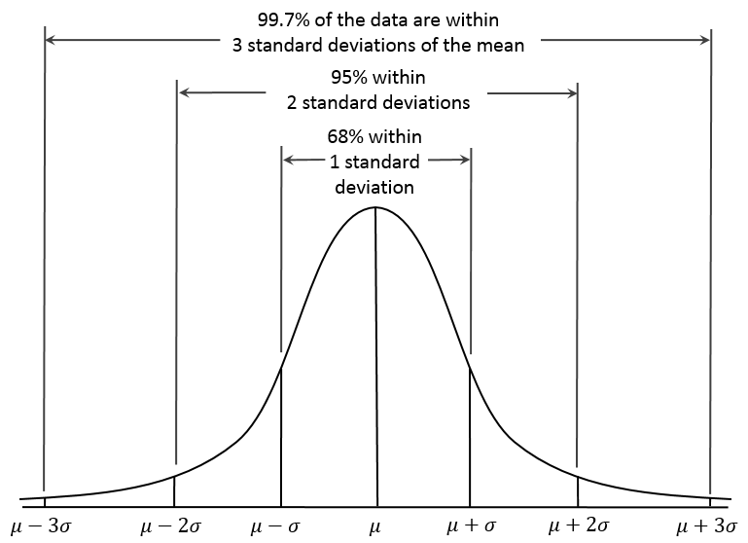
Normalization
Z-score normalization (μ: mean, σ: standard deviation):
Ex. Let μ = 54,000, σ = 16,000. Then
Z-score: The distance between the raw score and the population mean in the unit of the standard deviation

Slide 18
Normalization
Normalization by decimal scaling
Where j is the smallest integer such that Max(|ν’|) < 1

Slide 19
Data Preprocessing
Data cleaning
Data integration
Data reduction
Dimensionality reduction

Slide 20
Dimensionality Reduction
Curse of dimensionality
When dimensionality increases, data becomes increasingly sparse
Density and distance between points, which is critical to clustering, outlier analysis, becomes less meaningful
The possible combinations of subspaces will grow exponentially
Dimensionality reduction
Reducing the number of random variables under consideration, via obtaining a set of principal variables
Advantages of dimensionality reduction
Avoid the curse of dimensionality
Help eliminate irrelevant features and reduce noise
Reduce time and space required in data mining
Allow easier visualization

Slide 21
Dimensionality Reduction Techniques
Dimensionality reduction methodologies
Feature selection (FS): Find a subset of the original variables (or features, attributes)
Feature extraction (FE): Transform the data in the high-dimensional space to a space of fewer dimensions
Some typical dimensionality methods
FE: Principal Component Analysis
FS: Attribute Subset Selection = Attribute Selection

Slide 22
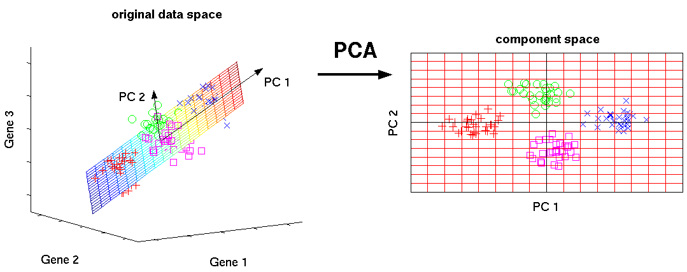
Principal Component Analysis (PCA)
PCA: A statistical procedure that uses an orthogonal transformation to convert a set of observations of possibly correlated variables into a set of values of linearly uncorrelated variables called principal components
The original data are projected onto a much smaller space, resulting in dimensionality reduction (e.g., n=3 to k=2)

Slide 23
PCA (cont.)
Given N data vectors from n-dimensions, find k ≤ n orthogonal vectors (principal components) best used to represent data
n
k
...
N
n

Slide 24
PCA (cont.)
Given N data vectors from n-dimensions, find k ≤ n orthogonal vectors (principal components) best used to represent data
Normalize input data: Each attribute falls within the same range
Compute k orthonormal (unit) vectors, i.e., principal components
Each input data (vector) is a linear combination of the k principal component vectors
normalized eigenvector
n
k
k
...
N
n
N

Slide 25
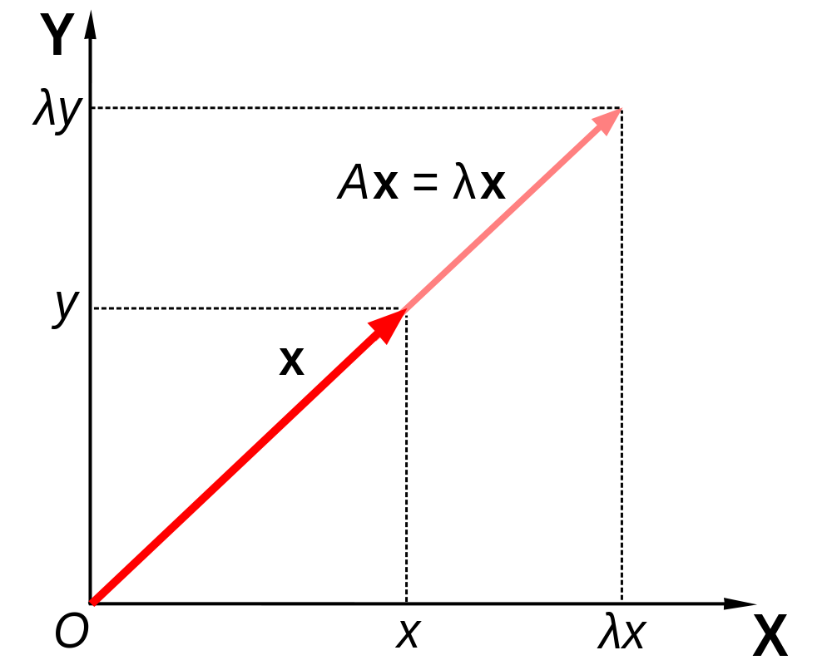
Eigenvectors (cont.)
For a square matrix A (n*n), find the eigenvector x (n*1).
A represents the linear transformation (from n to n)
Matrix A acts by stretching the vector x, not changing its direction, so x is an eigenvector of A.

Slide 26
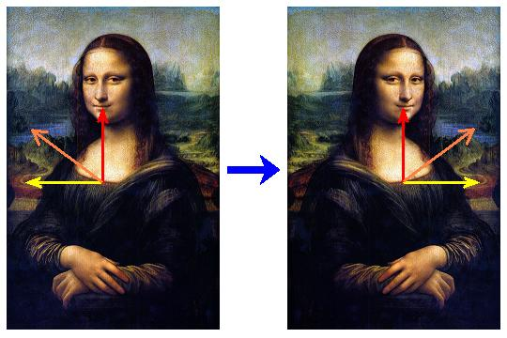
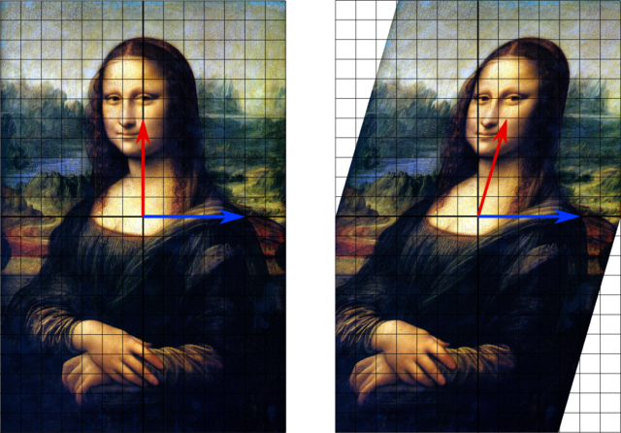
Eigenvectors (cont.)
A1
Which vectors are eigenvectors?
Red
Blue
Which vectors are eigenvectors?
Red
Orange
Yellow
What are the eigenvalues?
A2

Slide 27
PCA and Eigenvectors
For Square Matrix: Data matrix to Covariance matrix
The principal components are sorted in order of decreasing “significance” or strength
From n to k: Since the components are sorted, the size of the data can be reduced by eliminating the weak components (i.e., using the strongest principal components, to reconstruct a good approximation of the original data)
n
n
k
Covariance matrix
A = D^{T}D
D (normalized)
...
N
n
n

Slide 28
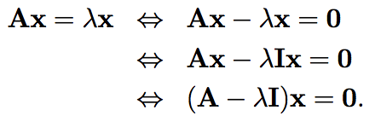

PCA and Eigenvectors (cont.)
Method: Find the eigenvectors of covariance (square) matrix, and these eigenvectors define the new space

Slide 29
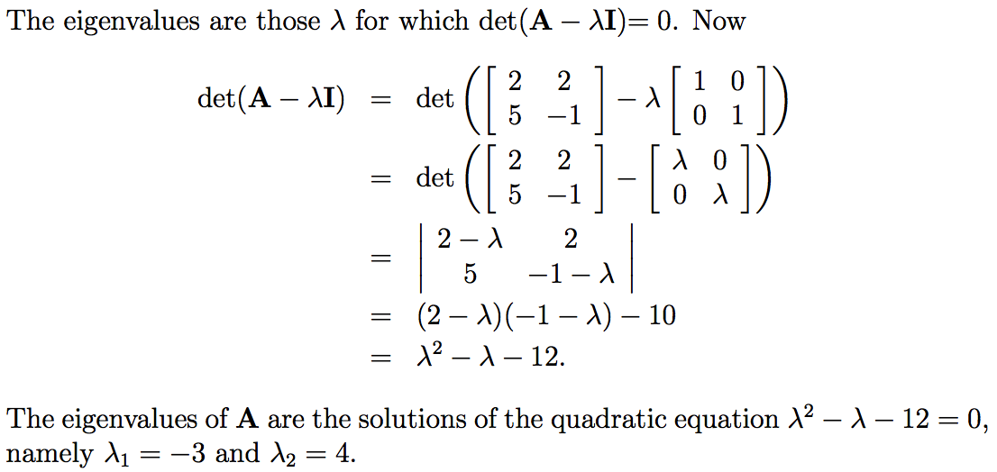
Ex. Eigenvalues

Slide 30
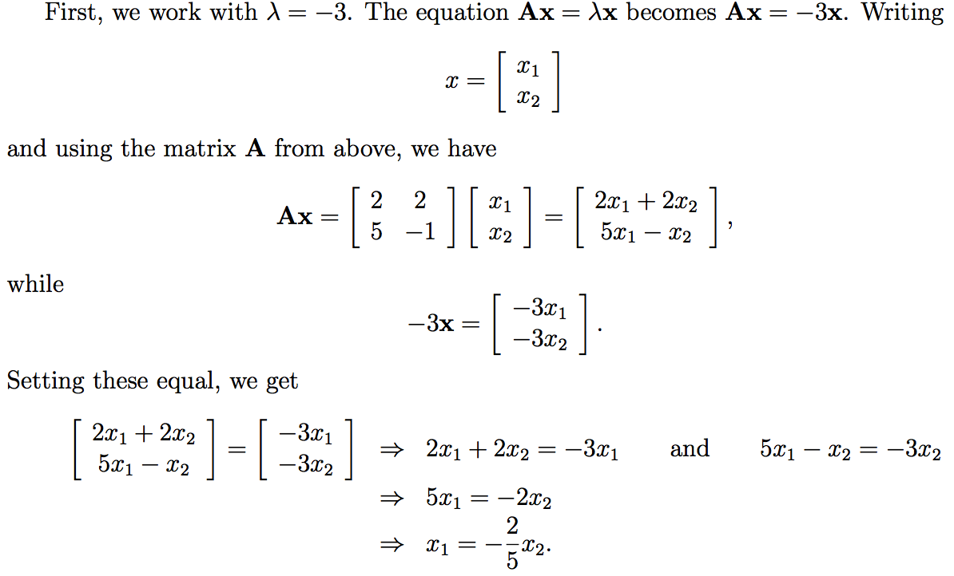
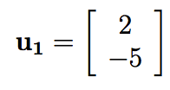
Ex. Eigenvectors

Slide 31
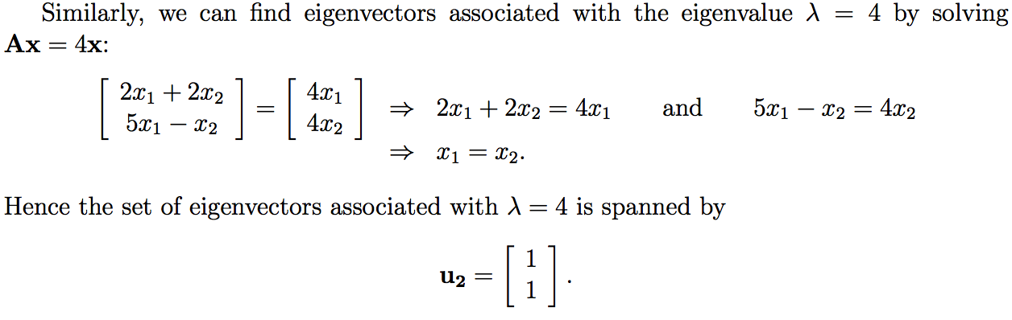
Ex. Eigenvectors (cont.)

Slide 32
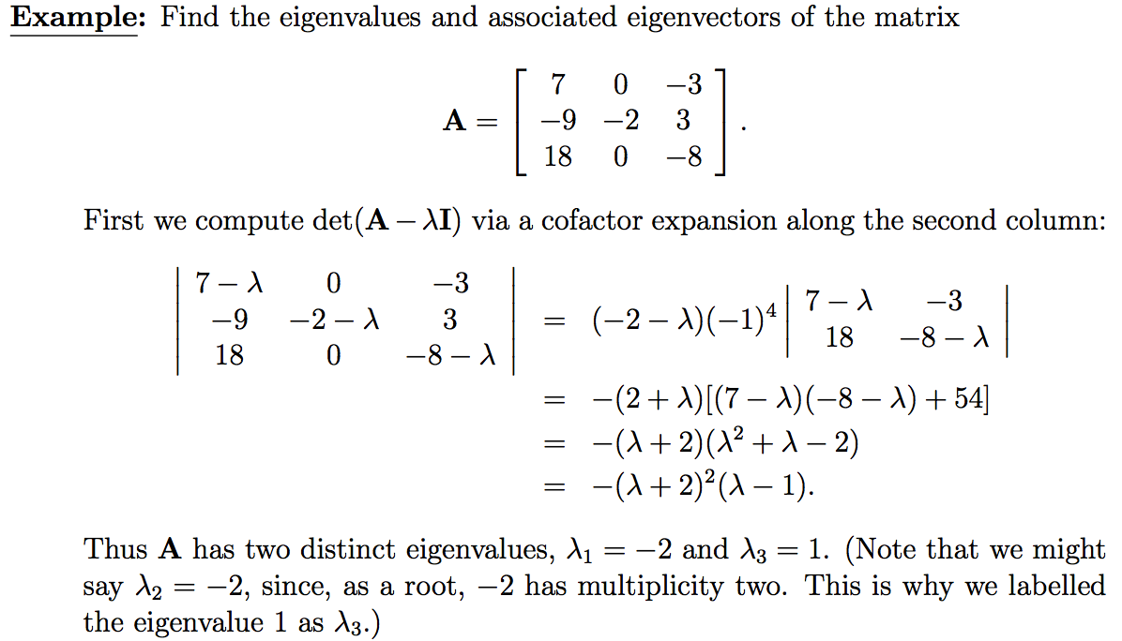
Ex. Eigenvalues (cont.)

Slide 33
Attribute Subset Selection
Another way to reduce dimensionality of data
Redundant attributes
Duplicate much or all of the information contained in one or more other attributes
E.g., purchase price of a product and the amount of sales tax paid
Irrelevant attributes
Contain no information that is useful for the data mining task at hand
Ex. A student’s ID is often irrelevant to the task of predicting his/her GPA

Slide 34
Heuristic Search in Attribute Selection
There are 2^{d} possible attribute combinations of d attributes
Typical heuristic attribute selection methods:
Best single attribute under the attribute independence assumption: choose by significance tests
Best step-wise feature selection:
The best single-attribute is picked first
Then next best attribute condition to the first, ...
Step-wise attribute elimination:
Repeatedly eliminate the worst attribute
Best combined attribute selection and elimination

Slide 35
Summary
Data quality: accuracy, completeness, consistency, timeliness, believability, interpretability
Data cleaning: e.g. missing/noisy values, outliers
Data integration from multiple sources:
Correlation analysis: Chi-Square test, Covariance
Data reduction and data transformation
Normalization: Z-score normalization
Dimensionality reduction
PCA, Heuristic Search in Attribute Selection

Slide 36
References
D. P. Ballou and G. K. Tayi. Enhancing data quality in data warehouse environments. Comm. of ACM, 42:73-78, 1999
T. Dasu and T. Johnson. Exploratory Data Mining and Data Cleaning. John Wiley, 2003
T. Dasu, T. Johnson, S. Muthukrishnan, V. Shkapenyuk. Mining Database Structure; Or, How to Build a Data Quality Browser. SIGMOD’02
H. V. Jagadish et al., Special Issue on Data Reduction Techniques. Bulletin of the Technical Committee on Data Engineering, 20(4), Dec. 1997
D. Pyle. Data Preparation for Data Mining. Morgan Kaufmann, 1999
E. Rahm and H. H. Do. Data Cleaning: Problems and Current Approaches. IEEE Bulletin of the Technical Committee on Data Engineering. Vol.23, No.4
V. Raman and J. Hellerstein. Potters Wheel: An Interactive Framework for Data Cleaning and Transformation, VLDB’2001
T. Redman. Data Quality: Management and Technology. Bantam Books, 1992
R. Wang, V. Storey, and C. Firth. A framework for analysis of data quality research. IEEE Trans. Knowledge and Data Engineering, 7:623-640, 1995

