Slide 1
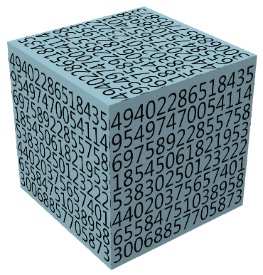
Chapter 4&5. Data Cube: Concepts and Operations
Meng Jiang
CSE 40647/60647 Data Science Fall 2017
Introduction to Data Mining

Slide 2
Cells: Dimension, Dimension Level and Dimension Value
A cell of transactions:
Time
Date
09/16
milk
Product
Item
South Bend
City
Location
A cell of papers:
Dataset
-
Twitter
matrix factorization
-
Method
social spam detection
-
Problem

Slide 3
Cells: Dimension Level and Concept Hierarchy
A cell of transactions:
Time: Year-Quarter-Month-Week-Day
Location: Country-State-City-Street
Item: Department-Product-Model
Time
Date
09/16
milk
Product
Item
South Bend
City
Location
A cell of papers:
Dataset
-
Twitter
matrix factorization
-
Method
social spam detection
-
Problem

Slide 4
Cells: Facts or Measures
A cell of transactions:
{TID45,TID137, TID451},
count=3,
dollars_sold=157
Time
Date
09/16
milk
Product
Item
South Bend
City
{PID31, PID217},
count=2,
citations=3317
Location
A cell of papers:
Dataset
-
Twitter
matrix factorization
-
Method
social spam detection
-
Problem

Slide 5
Cuboids: Dimension, Dimension Level
Time
Date
09/16
Product
Item
milk
South Bend
City
Location

Slide 6
Base Cells and Aggregate Cells
Suppose a cuboid has 3 dimensions (time, location, item) at specific dimension levels (date, city, product).
Base cells
(09/16, South Bend, milk)
Aggregate cells
(*, South Bend, milk)
(09/16, *, milk)
(09/16, South Bend, *)
(*, *, milk)
(*, South Bend, *)
(09/16, *, *)
(*, *, *), called the Apex cell
parent vs child cells
ancestor vs descendant cells
sibling cell:
(09/16, Mishawaka, milk)

Slide 7
Base Cuboids and Aggregate Cuboids
Time
Date
Time
Month
Product
Item
Department
City
Country
Item
(Date, City, Product)
Location
Location
(Month, Country, Department)
Time
Date
Apex cuboid: (*, *, *)
City
(Date, City, *)
Location

Slide 8
(N-Dimensional) Data Cube
Data cube can be viewed as a lattice of cuboids
The bottom-most cuboid is the base cuboid
The top-most cuboid (apex) contains only one cell
How many cuboids in an n-dimensional cube with L_{i} levels (at the i-th dimension)?
all
0-D (apex) cuboid
time
item
location
supplier
1-D cuboids
time,location
item,location
location,supplier
2-D cuboids
time,supplier
item,supplier
time,location,supplier
3-D cuboids
time,item,supplier
item,location,supplier
4-D (base) cuboid
Notes:
Li = I, T = 16

Slide 9
Data Cube
Data cube: A lattice of cuboids
In data warehousing literature, an n-D base cube is called a base cuboid
The top most 0-D cuboid, which holds the highest-level of summarization, is called the apex cuboid
The lattice of cuboids forms a data cube
A data cube, such as sales, allows data to be modeled and viewed in multiple dimensions
Dimension tables, such as item (item_name, brand, type), or time (day, week, month, quarter, year)
Fact table contains measures (such as dollars_sold) and keys to each of the related dimension tables
Schemas: Dimension tables and Fact tables

Slide 10
Star Schema
time
Sales Dimension Tables
time_key
day
day_of_the_week
month
quarter
year
item
item_key
item_name
brand
type
supplier_type
Sales Fact Table
time_key
item_key
branch_key
branch
location
location_key
branch_key
branch_name
branch_type
location_key
street
city
state_or_province
country
units_sold
dollars_sold
avg_sales
Measures

Slide 11
Snowflake Schema
time
item
time_key
day
day_of_the_week
month
quarter
year
item_key
item_name
brand
type
supplier_key
supplier
Sales Fact Table
supplier_key
supplier_type
time_key
item_key
branch_key
branch
location
Sales Dimension Tables
location_key
location_key
street
city_key
branch_key
branch_name
branch_type
units_sold
dollars_sold
city
city_key
city
state_or_province
country
avg_sales
Measures

Slide 12
Fact Constellation
time
time_key
day
day_of_the_week
month
quarter
year
item
Shipping Fact Table
item_key
item_name
brand
type
supplier_type
Sales Fact Table
time_key
time_key
item_key
shipper_key
item_key
branch_key
from_location
branch
location_key
to_location
location
branch_key
branch_name
branch_type
units_sold
location_key
street
city
province_or_state
country
dollars_cost
dollars_sold
units_shipped
avg_sales
shipper
Measures
shipper_key
shipper_name
location_key
shipper_type
Sales Dimension Tables

Slide 13
Modeling of Data Cubes
Modeling data cubes: dimensions & measures
Star schema: A fact table in the middle connected to a set of dimension tables
Snowflake schema: A refinement of star schema where some dimensional hierarchy is normalized into a set of smaller dimension tables, forming a shape similar to snowflake
Fact constellations: Multiple fact tables share dimension tables, viewed as a collection of stars, therefore called galaxy schema or fact constellation

Slide 14
Concept Hierarchy: Dimension Level and Dimension Value
all
all
region
Europe
...
North_America
country
Germany
...
Spain
Canada
...
Mexico
city
Frankfurt
...
Vancouver
...
Toronto
office
L. Chan
...
M. Wind

Slide 15
Data Cube Measures: Three Categories
Distributive: if the result derived by applying the function to n aggregate values is the same as that derived by applying the function on all the data without partitioning
E.g., count(), sum(), min(), max()
Algebraic: if it can be computed by an algebraic function with M arguments (where M is a bounded integer), each of which is obtained by applying a distributive aggregate function
avg(x) = sum(x) / count(x)
Holistic: if there is no constant bound on the storage size needed to describe a sub-aggregate.
E.g., median(), mode(), rank()
Q: How about standard_deviation(), Q1(), Q3()?

Slide 16
Typical Data Cube Operations
Roll up (drill-up): summarize data
by climbing up hierarchy or by dimension reduction
Drill down (roll down): reverse of roll-up
from higher level summary to lower level summary or detailed data, or introducing new dimensions
Slice and dice: project and select
Pivot (rotate): reorient the cube, visualization

Slide 17
dicing
roll-up

Slide 18
slicing
drill-down
pivot

Slide 19
The “Compute Cube” Operator
Cube definition and computation
define cube sales [item, city, year]: sum (sales_in_dollars)
compute cube sales
Transform it into a SQL-like language (with a new operator cube by, introduced by Gray et al.’97)
SELECT item, city, year, SUM (amount)
FROM SALES
CUBE BY item, city, year
Need compute the following Group-Bys
(year, product, customer),
(year, product), (year, customer), (product, customer),
(year), (product), (customer)
()
()
(city)
(item)
(year)
(city, item)
(city, year)
(item, year)
(city, item, year)

Slide 20
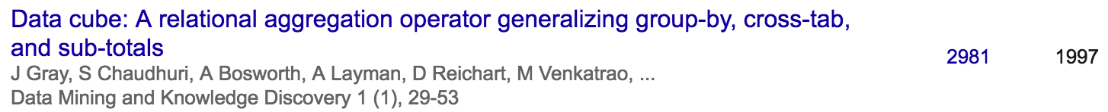
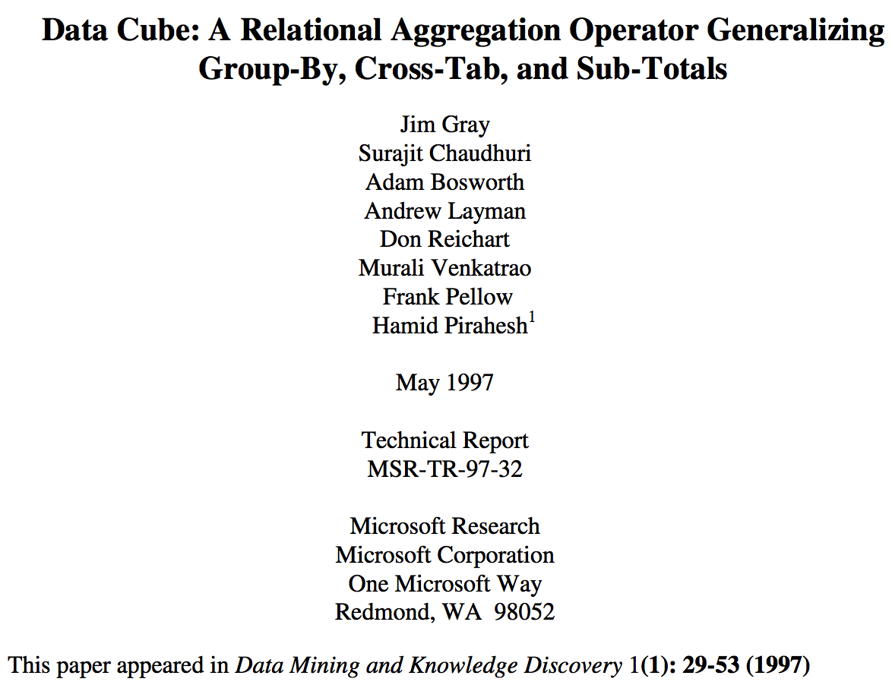
Data Cube History
Surajit Chaudhuri is a computer scientist best known for his contributions to database management systems. He is currently a distinguished scientist at Microsoft Research, where he leads the Data Management, Exploration and Mining group.
Adam Bosworth is a former Vice President of Product Management at Google Inc. from 2004–2007; prior to that, he was senior VP Engineering and Chief Software Architect at BEA Systems responsible for ...
Hamid Pirahesh, Ph.D., is an IBM fellow, ACM Fellow and a senior manager responsible for the exploratory database department at IBM Research - Almaden in San Jose, California. Dr. Hamid Pirahesh is the senior manager at IBM Almaden Research Center in San Jose, California.

Slide 21
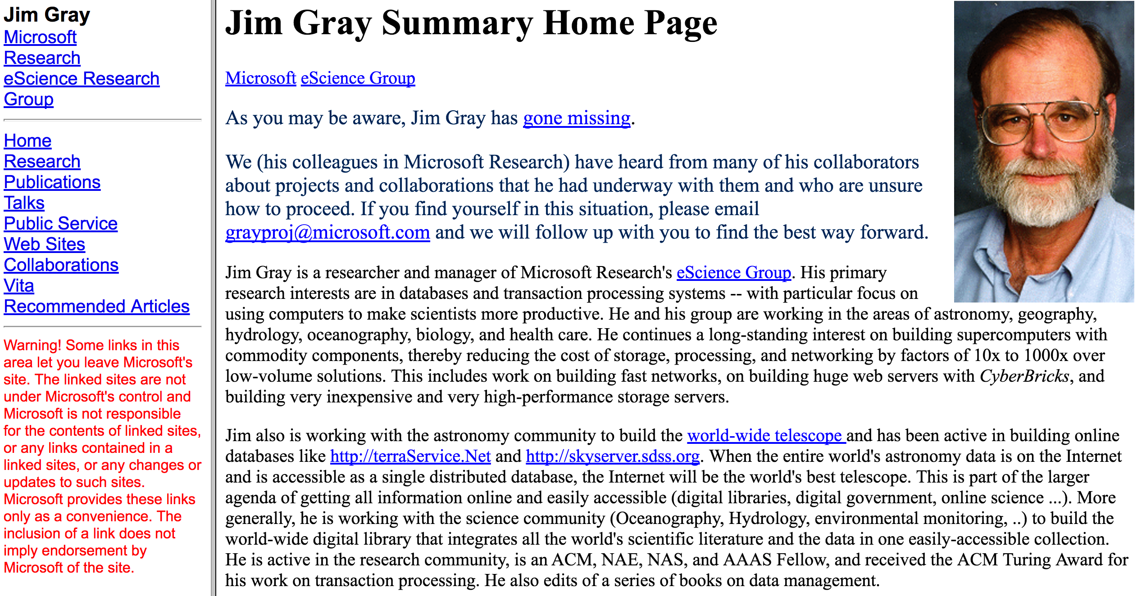
https://jimgray.azurewebsites.net/

Slide 22
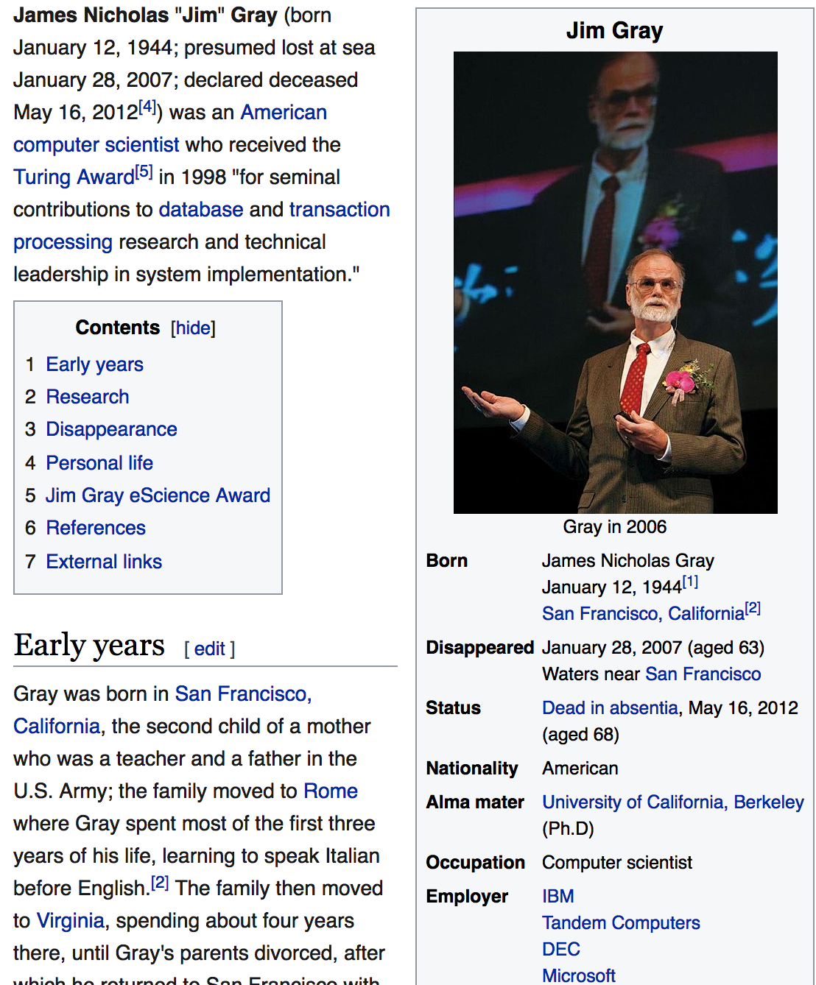
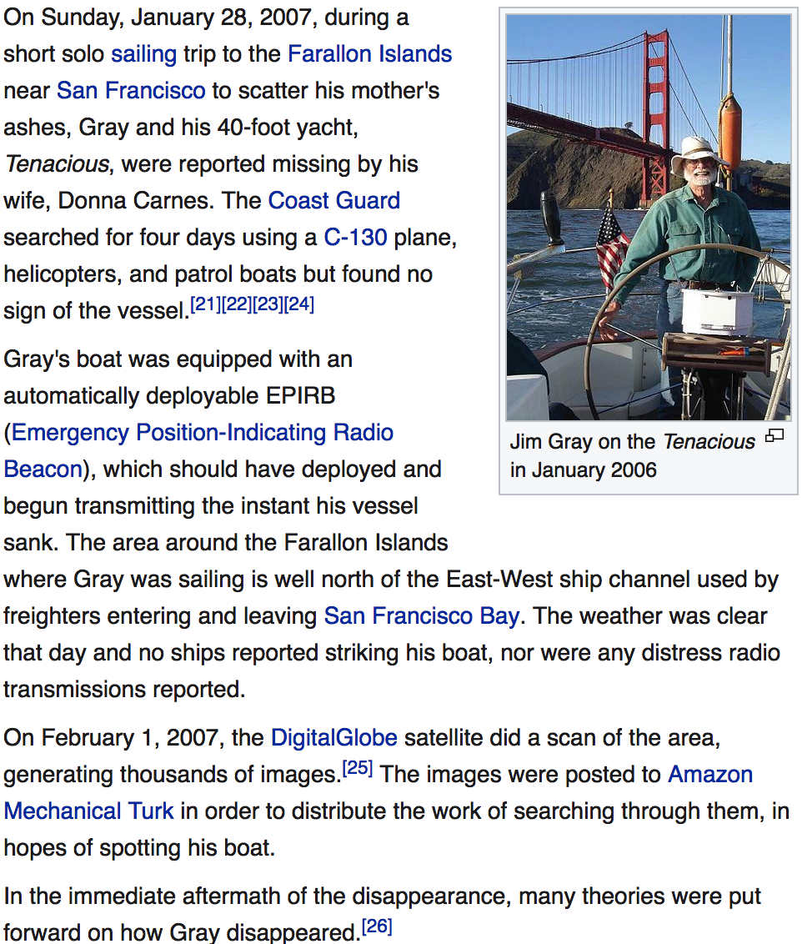
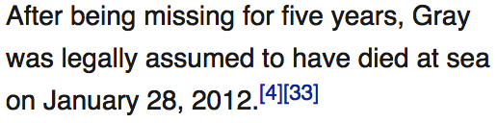
https://en.wikipedia.org/wiki/Jim_Gray_(computer_scientist)

Slide 23
Discussion
Why do you look for aggregate cells/cuboids to analyze structured paper datasets?

Slide 24
References
S. Agarwal, R. Agrawal, P. M. Deshpande, A. Gupta, J. F. Naughton, R. Ramakrishnan, and S. Sarawagi. On the computation of multidimensional aggregates. VLDB’96
K. Beyer and R. Ramakrishnan. Bottom-Up Computation of Sparse and Iceberg CUBEs.. SIGMOD’99
J. Han, J. Pei, G. Dong, K. Wang. Efficient Computation of Iceberg Cubes With Complex Measures. SIGMOD’01
L. V. S. Lakshmanan, J. Pei, and J. Han, Quotient Cube: How to Summarize the Semantics of a Data Cube, VLDB'02
X. Li, J. Han, and H. Gonzalez, High-Dimensional OLAP: A Minimal Cubing Approach, VLDB'04
X. Li, J. Han, Z. Yin, J.-G. Lee, Y. Sun, “Sampling Cube: A Framework for Statistical OLAP over Sampling Data”, SIGMOD’08
K. Ross and D. Srivastava. Fast computation of sparse datacubes. VLDB’97
D. Xin, J. Han, X. Li, B. W. Wah, Star-Cubing: Computing Iceberg Cubes by Top-Down and Bottom-Up Integration, VLDB'03
Y. Zhao, P. M. Deshpande, and J. F. Naughton. An array-based algorithm for simultaneous multidimensional aggregates. SIGMOD’97
D. Burdick, P. Deshpande, T. S. Jayram, R. Ramakrishnan, and S. Vaithyanathan. OLAP over uncertain and imprecise data. VLDB’05

Slide 25
References (cont.)
R. Agrawal, A. Gupta, and S. Sarawagi. Modeling multidimensional databases. ICDE’97
B.-C. Chen, L. Chen, Y. Lin, and R. Ramakrishnan. Prediction cubes. VLDB’05
B.-C. Chen, R. Ramakrishnan, J.W. Shavlik, and P. Tamma. Bellwether analysis: Predicting global aggregates from local regions. VLDB’06
Y. Chen, G. Dong, J. Han, B. W. Wah, and J. Wang, Multi-Dimensional Regression Analysis of Time-Series Data Streams, VLDB'02
R. Fagin, R. V. Guha, R. Kumar, J. Novak, D. Sivakumar, and A. Tomkins. Multi-structural databases. PODS’05
J. Han. Towards on-line analytical mining in large databases. SIGMOD Record, 27:97–107, 1998
T. Imielinski, L. Khachiyan, and A. Abdulghani. Cubegrades: Generalizing association rules. Data Mining & Knowledge Discovery, 6:219–258, 2002.
R. Ramakrishnan and B.-C. Chen. Exploratory mining in cube space. Data Mining and Knowledge Discovery, 15:29–54, 2007.
K. A. Ross, D. Srivastava, and D. Chatziantoniou. Complex aggregation at multiple granularities. EDBT'98
S. Sarawagi, R. Agrawal, and N. Megiddo. Discovery-driven exploration of OLAP data cubes. EDBT'98
G. Sathe and S. Sarawagi. Intelligent Rollups in Multidimensional OLAP Data. VLDB'01

