Slide 1
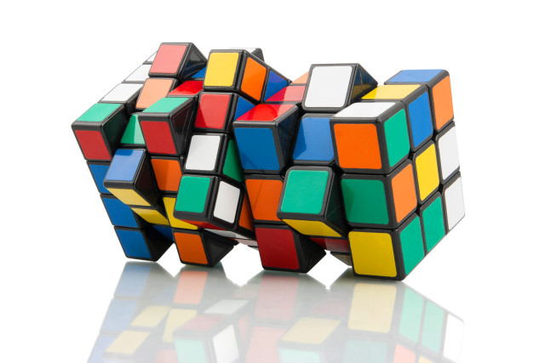
Chapter 4&5. Data Cube: Cube Computation
Meng Jiang
CSE 40647/60647 Data Science Fall 2017
Introduction to Data Mining

Slide 2
Data Cube Technology
Data Cube Computation: Basic Concepts
Data Cube Computation Methods

Slide 3
Efficient Data Cube Computation
Data cube can be viewed as a lattice of cuboids
The bottom-most cuboid is the base cuboid
The top-most cuboid (apex) contains only one cell
How many cuboids in an n-dimensional cube with L_{i} levels?
Materialization of data cube
Full materialization: Materialize every (cuboid)
No materialization: Materialize none (cuboid)
Partial materialization: Materialize some cuboids
Which cuboids to materialize?
Selection based on size, sharing, access frequency, etc.

Slide 4

Q: What do they dislike the most?

Slide 5
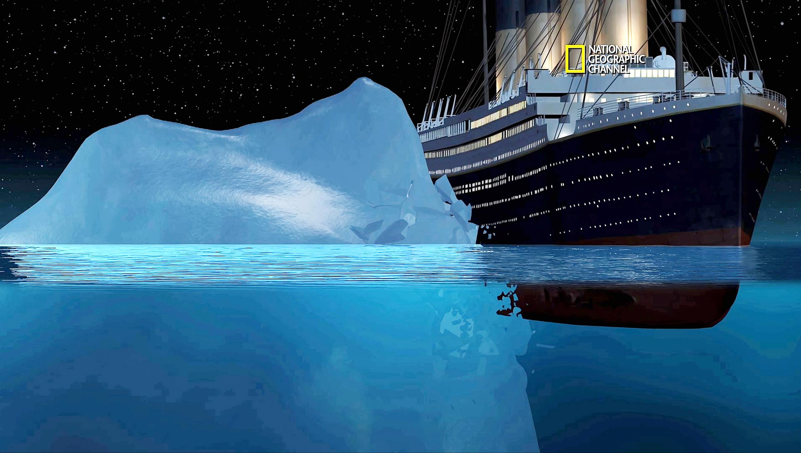
Iceberg

Slide 6

Cube Materialization: Full Cube vs. Iceberg Cube
Full cube vs. iceberg cube
compute cube sales iceberg as
select date, product, city, department, count(*)
from salesInfo
cube by date, product, city
having count(*) >= min support
Compute only the cells whose measure satisfies the iceberg condition
Only a small portion of cells may be “above the water’’ in a sparse cube
Ex.: Show only those cells whose count is no less than 100

Slide 7
Why Iceberg Cube?
Advantages of computing iceberg cubes
No need to save nor show those cells whose value is below the threshold (iceberg condition)
Efficient methods may even avoid computing the un-needed, intermediate cells
Avoid explosive growth
Example: A cube with 100 dimensions
Suppose it contains only 2 base cells: {(a₁, a₂, a₃, …., a₁₀₀), (a₁, a₂, b₃, …, b₁₀₀)}
How many aggregate cells if “having count >= 1” (“non-empty”?
Answer: (2¹⁰¹ ─ 2) ─ 4
Notes:
For {(a₁, a₂, a₃ . . . , a₁₀₀), (a₁, a₂, b₃, . . . , b₁₀₀)}, the total # of non-base cells should be 2 * (2^{100} – 1) – 4.
This is calculated as follows:
(a1, a2, a3 . . . , a100) will generate 2^{100} - 1 non-base cells
(a1, a2, b3, . . . , b100) will generate 2^{100} - 1 non-base cells
Among these, 4 cells are overlapped and thus minus 4 so we get: 2*2^{100} - 2 - 4 = 2*2^{100} - 6
These 4 cells are:
(a1, a2, *, ..., *): 2
(a1, *, *, ..., *): 2
(*, a2, *, ..., *): 2
(*, *, *, ..., *): 2

Slide 8
Suppose it contains only 2 base cells: {(a₁, a₂, a₃, …., a₁₀₀), (a₁, a₂, b₃, …, b₁₀₀)}
How many aggregate cells if “having count >= 1”?
For {(a₁, a₂, a₃ . . . , a₁₀₀), (a₁, a₂, b₃, . . . , b₁₀₀)}, the total # of non-base cells should be 2 * (2^{100} – 1) – 4.
This is calculated as follows:
(a1, a2, a3 . . . , a100) will generate 2^{100} - 1 non-base cells
(a1, a2, b3, . . . , b100) will generate 2^{100} - 1 non-base cells
Among these, 4 cells are overlapped and thus minus 4 so we get: 2*2^{100} - 2 – 4
These 4 cells are:
(a1, a2, *, ..., *): 2
(a1, *, *, ..., *): 2
(*, a2, *, ..., *): 2
(*, *, *, ..., *): 2

Slide 9
Why Iceberg Cube?
Advantages of computing iceberg cubes
No need to save nor show those cells whose value is below the threshold (iceberg condition)
Efficient methods may even avoid computing the un-needed, intermediate cells
Avoid explosive growth
Example: A cube with 100 dimensions
Suppose it contains only 2 base cells: {(a₁, a₂, a₃, …., a₁₀₀), (a₁, a₂, b₃, …, b₁₀₀)}
How many aggregate cells if “having count >= 1” (“non-empty”?
Answer: (2¹⁰¹ ─ 2) ─ 4
What are the iceberg cells, (i.e., with condition: “having count >= 2”)?
Answer: 4
Notes:
For {(a₁, a₂, a₃ . . . , a₁₀₀), (a₁, a₂, b₃, . . . , b₁₀₀)}, the total # of non-base cells should be 2 * (2^{100} – 1) – 4.
This is calculated as follows:
(a1, a2, a3 . . . , a100) will generate 2^{100} - 1 non-base cells
(a1, a2, b3, . . . , b100) will generate 2^{100} - 1 non-base cells
Among these, 4 cells are overlapped and thus minus 4 so we get: 2*2^{100} - 2 - 4 = 2*2^{100} - 6
These 4 cells are:
(a1, a2, *, ..., *): 2
(a1, *, *, ..., *): 2
(*, a2, *, ..., *): 2
(*, *, *, ..., *): 2

Slide 10
Suppose it contains only 2 base cells: {(a₁, a₂, a₃, …., a₁₀₀), (a₁, a₂, b₃, …, b₁₀₀)}
How many iceberg cells if “having count >= 2”?
For {(a₁, a₂, a₃ . . . , a₁₀₀), (a₁, a₂, b₃, . . . , b₁₀₀)}, the total # of non-base cells should be 2 * (2^{100} – 1) – 4.
This is calculated as follows:
(a1, a2, a3 . . . , a100) will generate 2^{100} - 1 non-base cells
(a1, a2, b3, . . . , b100) will generate 2^{100} - 1 non-base cells
Among these, 4 cells are overlapped and thus minus 4 so we get: 2*2^{100} - 2 – 4
These 4 cells are:
(a1, a2, *, ..., *): 2
(a1, *, *, ..., *): 2
(*, a2, *, ..., *): 2
(*, *, *, ..., *): 2

Slide 11
Is Iceberg Cube Good Enough? Closed Cube & Cube Shell
Let cube P have only 2 base cells: {(a₁, a₂, a₃ . . . , a₁₀₀):10, (a₁, a₂, b₃, . . . , b₁₀₀):10}
How many cells will the iceberg cube contain if “having count(*) ≥ 10”?
Answer: 2¹⁰¹ ─ 4 (still too big!)
Close cube:
A cell c is closed if there exists no cell d, such that d is a descendant of c, and d has the same measure value as c
Ex. The same cube P has only 3 closed cells:
{(a₁, a₂, *, …, *): 20, (a₁, a₂, a₃ . . . , a₁₀₀): 10, (a₁, a₂, b₃, . . . , b₁₀₀): 10}
A closed cube is a cube consisting of only closed cells

Slide 12
Data Cube Technology
Data Cube Computation: Basic Concepts
Data Cube Computation Methods

Slide 13
Roadmap for Efficient Computation
General computation heuristics (Agarwal et al.’96)
Computing full/iceberg cubes: 3 methodologies
Bottom-Up:
Multi-way array aggregation (Zhao, Deshpande & Naughton, SIGMOD’97)
Top-down:
BUC (Beyer & Ramarkrishnan, SIGMOD’99)
Integrating Top-Down and Bottom-Up:
Star-cubing algorithm (Xin, Han, Li & Wah: VLDB’03)
High-dimensional OLAP:
A shell-fragment approach (Li, et al. VLDB’04)
Computing alternative kinds of cubes:
Partial cube, closed cube, approximate cube, ……

Slide 14
Multi-Way Array Aggregation
Bottom-up: Partition a huge sparse array into chunks (a small subcube which fits in memory) and aggregation.
Data addressing: Compressed sparse array addressing (chunk_id, offset)
Compute aggregates in “multiway” by visiting cube cells in the order which minimizes the # of times to visit each cell, and reduces memory access and storage cost
C
What is the best traversing order to do multi-way aggregation?
ABC → AB, BC and AC
c2
c3
61
62
63
64
c1
45
46
47
48
c 0
29
30
31
32
B
60
b3
13
14
15
16
44
-
-
-
28
b2
9
56
B
-
-
-
40
A: 40 (location),
B: 400 (item),
C: 4,000 (time)
b1
5
24
52
36
1
2
3
4
20
b0
a0
a1
a2
a3
A

Slide 15
Multi-way Array Aggregation (3-D to 2-D)
How much memory cost of computation (aggregation for AB, AC, BC planes) can we save?
4x4x4 chunks
A: 40 (location),
B: 400 (item),
C: 4,000 (time)
Min memory size: ?
< 40*400 + 400*4,000 + 40 * 4,000
= 1,776,000

Slide 16
Multi-way Array Aggregation (3-D to 2-D)
How to minimizes the memory requirement and reduced I/Os?
Keep the smallest plane in main memory
Fetch and compute only one chunk at a time for the largest plane
The planes should be sorted and computed according to their size in ascending order
4x4x4 chunks
Entire AB plane: 40 * 400
= 16,000
One chunk of BC plane:
(400/4) * (4,000/4)
= 100,000
A: 40 (location),
B: 400 (item),
C: 4,000 (time)
Min memory size: ?
< 40*400 + 400*4,000 + 40 * 4,000
= 1,776,000
One column of AC plane:
40 * (4,000/4) = 40,000

Slide 17
BC planes: 400 * 4,000
C
(400/4) * (4,000/4)
aggregate([1][2][3][4])
B
b₀
c₀
(400/4) * (4,000/4)
aggregate([5][6][7][8])
b₁
c₀
One chunk

Slide 18
AC planes: 40 * 4,000
(40/4) * (4,000/4)
aggregate([17][21][25][29])
c₁
…
…
…
c₀
C
One column
4 * (40/4) * (4,000/4)
= 40 * (4,000/4)
(40/4) * (4,000/4)
aggregate([2][6][10][14])
(40/4) * (4,000/4)
aggregate([3][7][11][15])
(40/4) * (4,000/4)
aggregate([1][5][9][13])
(40/4) * (4,000/4)
aggregate([4][8][12][16])
c₀
A
a₀
…
a₃

Slide 19
Multi-way Array Aggregation (3-D to 2-D)
How to minimizes the memory requirement and reduced I/Os?
Keep the smallest plane in main memory
Fetch and compute only one chunk at a time for the largest plane
The planes should be sorted and computed according to their size in ascending order
4x4x4 chunks
Entire AB plane: 40 * 400
= 16,000
One chunk of BC plane:
(400/4) * (4,000/4)
= 100,000
A: 40 (location),
B: 400 (item),
C: 4,000 (time)
Min memory size: 156,000
< 40*400 + 400*4,000 + 40 * 4,000
= 1,776,000
One column of AC plane:
40 * (4,000/4) = 40,000

Slide 20
Multi-Way Array Aggregation
Array-based “bottom-up” algorithm (from ABC to AB,…)
Using multi-dimensional chunks
Simultaneous aggregation on multiple dimensions
Cannot do Apriori pruning: No iceberg optimization
Comments on the method
Efficient for computing the full cube for a small number of dimensions
If there are a large number of dimensions, “top-down” computation and iceberg cube computation methods should be used
Zhao, Deshpande & Naughton. An Array-Based Algorithm for Simultaneous Multidimensional Aggregates . SIGMOD’97

Slide 21
Summary
Data Cube Computation: Preliminary Concepts
Data Cube Computation Methods
Multi-Way Array Aggregation

Slide 22
References
S. Agarwal, R. Agrawal, P. M. Deshpande, A. Gupta, J. F. Naughton, R. Ramakrishnan, and S. Sarawagi. On the computation of multidimensional aggregates. VLDB’96
K. Beyer and R. Ramakrishnan. Bottom-Up Computation of Sparse and Iceberg CUBEs.. SIGMOD’99
J. Han, J. Pei, G. Dong, K. Wang. Efficient Computation of Iceberg Cubes With Complex Measures. SIGMOD’01
L. V. S. Lakshmanan, J. Pei, and J. Han, Quotient Cube: How to Summarize the Semantics of a Data Cube, VLDB'02
X. Li, J. Han, and H. Gonzalez, High-Dimensional OLAP: A Minimal Cubing Approach, VLDB'04
X. Li, J. Han, Z. Yin, J.-G. Lee, Y. Sun, “Sampling Cube: A Framework for Statistical OLAP over Sampling Data”, SIGMOD’08
K. Ross and D. Srivastava. Fast computation of sparse datacubes. VLDB’97
D. Xin, J. Han, X. Li, B. W. Wah, Star-Cubing: Computing Iceberg Cubes by Top-Down and Bottom-Up Integration, VLDB'03
Y. Zhao, P. M. Deshpande, and J. F. Naughton. An array-based algorithm for simultaneous multidimensional aggregates. SIGMOD’97
D. Burdick, P. Deshpande, T. S. Jayram, R. Ramakrishnan, and S. Vaithyanathan. OLAP over uncertain and imprecise data. VLDB’05

Slide 23
References (cont.)
R. Agrawal, A. Gupta, and S. Sarawagi. Modeling multidimensional databases. ICDE’97
B.-C. Chen, L. Chen, Y. Lin, and R. Ramakrishnan. Prediction cubes. VLDB’05
B.-C. Chen, R. Ramakrishnan, J.W. Shavlik, and P. Tamma. Bellwether analysis: Predicting global aggregates from local regions. VLDB’06
Y. Chen, G. Dong, J. Han, B. W. Wah, and J. Wang, Multi-Dimensional Regression Analysis of Time-Series Data Streams, VLDB'02
R. Fagin, R. V. Guha, R. Kumar, J. Novak, D. Sivakumar, and A. Tomkins. Multi-structural databases. PODS’05
J. Han. Towards on-line analytical mining in large databases. SIGMOD Record, 27:97–107, 1998
T. Imielinski, L. Khachiyan, and A. Abdulghani. Cubegrades: Generalizing association rules. Data Mining & Knowledge Discovery, 6:219–258, 2002.
R. Ramakrishnan and B.-C. Chen. Exploratory mining in cube space. Data Mining and Knowledge Discovery, 15:29–54, 2007.
K. A. Ross, D. Srivastava, and D. Chatziantoniou. Complex aggregation at multiple granularities. EDBT'98
S. Sarawagi, R. Agrawal, and N. Megiddo. Discovery-driven exploration of OLAP data cubes. EDBT'98
G. Sathe and S. Sarawagi. Intelligent Rollups in Multidimensional OLAP Data. VLDB'01

