Slide 1

Chapter 7. Advanced Frequent Pattern Mining: Diverse Patterns
Meng Jiang
CSE 40647/60647 Data Science Fall 2017
Introduction to Data Mining

Slide 2
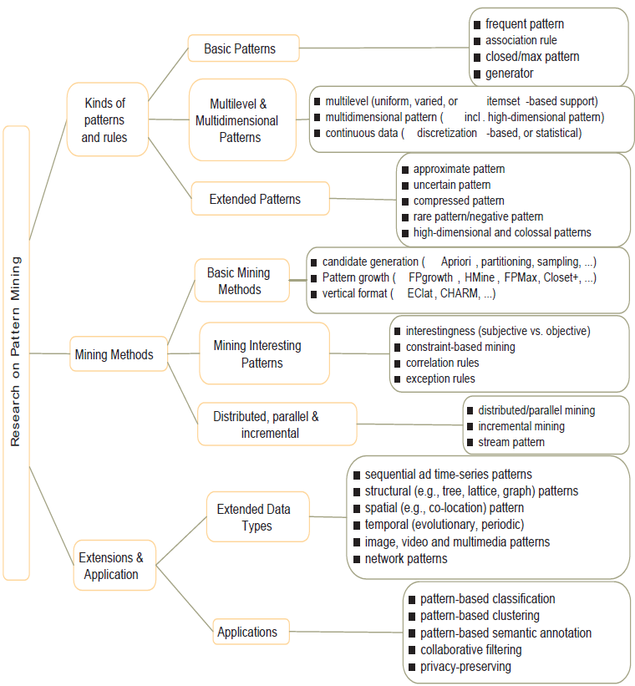
Research on Pattern Mining: A Road Map

Slide 3
Advanced Frequent Pattern Mining
Mining Diverse Patterns
Constraint-Based Frequent Pattern Mining
Sequential Pattern Mining
Graph Pattern Mining

Slide 4
Mining Diverse Patterns
Mining Multiple-Level Associations
Mining Multi-Dimensional Associations
Mining Quantitative Associations
Mining Negative Correlations

Slide 5
Mining Multiple-Level Frequent Patterns
Items often form hierarchies
Ex.: Dairyland 2% milk; Wonder wheat bread
How to set min-support thresholds?
Uniform min-support across multiple levels (reasonable?)
Level-reduced min-support: Items at the lower level are expected to have lower support
Uniform support
Reduced support
Level 1
min_sup = 5%
Milk
[support = 10%]
Level 1
min_sup = 5%
Level 2
min_sup = 1%
Level 2
min_sup = 5%
2% Milk
[support = 6%]
Skim Milk
[support = 2%]

Slide 6
Redundancy Filtering at Mining Multi-Level Associations
Multi-level association mining may generate many redundant rules
Redundancy filtering: Some rules may be redundant due to “ancestor” relationships between items
(Suppose the 2% milk sold is about ¼ of milk sold in gallons)
milk ⇒ wheat bread [support = 8%, confidence = 70%] (1)
2% milk ⇒ wheat bread [support = 2%, confidence = 72%] (2)
A rule is redundant if its support is close to the “expected” value, according to its “ancestor” rule, and it has a similar confidence as its “ancestor”
Rule (1) is an ancestor of rule (2), which one to prune?

Slide 7
Customized Min-Supports for Different Kinds of Items
We have used the same min-support threshold for all the items or item sets to be mined in each association mining
In reality, some items (e.g., diamond, watch, …) are valuable but less frequent
It is necessary to have customized min-support settings for different kinds of items
One Method: Use group-based “individualized” min-support
E.g., {diamond, watch}: 0.05%; {bread, milk}: 5%; …

Slide 8
Mining Multi-Dimensional Associations
Single-dimensional rules (e.g., items are all in “product” dimension)
buys(X, “milk”) ⇒ buys(X, “bread”)
Multi-dimensional rules (i.e., items in ≥ 2 dimensions or predicates)
Inter-dimension association rules (no repeated predicates)
age(X, “18-25”) ∧ occupation(X, “student”) ⇒ buys(X, “coke”)
Hybrid-dimension association rules (repeated predicates)
age(X, “18-25”) ∧ buys(X, “popcorn”) ⇒ buys(X, “coke”)
Attributes can be categorical or numerical
Categorical Attributes (e.g., profession, product: no ordering among values): Data cube for inter-dimension association
Quantitative Attributes: Numeric, implicit ordering among values—discretization, clustering, and gradient approaches

Slide 9
Mining Quantitative Associations
Mining quantitative associations
Ex.: Gender = female ⇒ Wage: mean=$7/hr (overall mean = $9)
LHS: a subset of the population
RHS: an extraordinary behavior of this subset
Rule condition can be categorical or numerical
Ex.: (Gender = female) ^ (South = yes) ⇒ mean wage = $6.3/hr
Ex.: Education in [14-18] (yrs) ⇒ mean wage = $11.64/hr
Data cube technology?

Slide 10
Rare Patterns vs. Negative Patterns
Rare patterns
Very low support but interesting (e.g., buying Rolex watches)
How to mine them? Setting individualized, group-based min-support thresholds for different groups of items
Negative patterns
Negatively correlated: Unlikely to happen together
Ex.: Since it is unlikely that the same customer buys both a Ford Expedition (an SUV car) and a Ford Fusion (a hybrid car), buying a Ford Expedition and buying a Ford Fusion are likely negatively correlated patterns
How to define negative patterns?

Slide 11
Defining Negative Correlated Patterns
A support-based definition
If itemsets A and B are both frequent but rarely occur together, i.e., sup(A U B) << sup (A) × sup(B)
Then A and B are negatively correlated
Is this a good definition for large transaction datasets?
Ex.: Suppose a store sold two needle packages A and B 100 times each, but only one transaction contained both A and B
When there are in total 200 transactions, we have
s(A U B) = 0.005, s(A) × s(B) = 0.25, s(A U B) << s(A) × s(B)
But when there are 10⁵ transactions, we have
s(A U B) = 1/10⁵, s(A) × s(B) = 1/10³ × 1/10³, s(A U B) > s(A) × s(B)
What is the problem? — Null transactions: The support-based definition is not null-invariant!
Does this remind you the definition of lift?

Slide 12
Defining Negative Correlation: Need Null-Invariance in Definition
A good definition on negative correlation should take care of the null-invariance problem
Whether two itemsets A and B are negatively correlated should not be influenced by the number of null-transactions
A Kulczynski measure-based definition
If itemsets A and B are frequent but (P(A|B) + P(B|A))/2 < є, where є is a negative pattern threshold, then A and B are negatively correlated
For the same needle package problem:
No matter there are in total 200 or 10⁵ transactions
If є = 0.01, we have (P(A|B) + P(B|A))/2 = (0.01 + 0.01)/2 < є

Slide 13
Advanced Frequent Pattern Mining
Mining Diverse Patterns
Constraint-Based Frequent Pattern Mining
Sequential Pattern Mining
Graph Pattern Mining

Slide 14
Why Constraint-Based Mining?
Finding all the patterns in a dataset autonomously? — unrealistic!
Too many patterns but not necessarily user-interested!
Pattern mining should be an interactive process
User directs what to be mined using a data mining query language (or a graphical user interface)
Constraint-based mining
User flexibility: provides constraints on what to be mined
Optimization: explores such constraints for efficient mining
Constraint-based mining: Constraint-pushing, similar to push selection first in DB query processing

Slide 15
Meta-Rule Guided Mining
A meta-rule can contain partially instantiated predicates & constants
P₁(X, Y) ^ P₂(X, W) ⇒ buys(X, “iPad”)
The resulting mined rule can be
age(X, “15-25”) ^ profession(X, “student”) ⇒ buys(X, “iPad”)
In general, (meta) rules can be in the form of
P₁ ^ P₂ ^ … ^ P_{l} ⇒ Q₁ ^ Q₂ ^ … ^ Q_{r}
Method to find meta-rules
Find frequent (l + r) predicates (based on min-support)
Push constants deeply when possible into the mining process
Also, push min_sup, min_conf, and other measures as early as possible (measures acting as constraints)

Slide 16
Different Kinds of Constraints Lead to Different Pruning Strategies
Constraints can be categorized as
Pattern space pruning constraints vs. data space pruning constraints
Pattern space pruning constraints
Data space pruning constraints

Slide 17
Pattern Space Pruning with Pattern Anti-Monotonicity
Constraint c is anti-monotone
If an itemset S violates constraint c, so does any of its superset
That is, mining on itemset S can be terminated
Ex. 1: c1: sum(S.price) ≤ v is anti-monotone
Ex. 2: c2: range(S.profit) ≤ 15 is anti-monotone
Itemset ab violates c2 (range(ab) = 40)
So does every superset of ab
Ex. 3. c3: sum(S.Price) ≥ v is not anti-monotone
Ex. 4. Is c4: support(S) ≥ σ anti-monotone?
Yes! Apriori pruning is essentially pruning with an anti-monotonic constraint!
TID | Transaction
10 | a, b, c, d, f, h
20 | b, c, d, f, g, h
30 | b, c, d, f, g
40 | a, c, e, f, g
Item | Profit
a | 40
b | 0
c | -20
d | -15
e | -30
f | -10
g | 20
h | 5
min_sup = 2
price(item) > 0

Slide 18
Pattern Monotonicity and Its Roles
A constraint c is monotone: if an itemset S satisfies the constraint c, so does any of its superset
That is, we do not need to check c in subsequent mining
Ex. 1: c1: sum(S.Price) ≥ v is monotone
Ex. 2: c2: min(S.Price) ≤ v is monotone
Ex. 3: c3: range(S.profit) ≥ 15 is monotone
Itemset ab satisfies c3
So does every superset of ab
TID | Transaction
10 | a, b, c, d, f, h
20 | b, c, d, f, g, h
30 | b, c, d, f, g
40 | a, c, e, f, g
Item | Profit
a | 40
b | 0
c | -20
d | -15
e | -30
f | -10
g | 20
h | 5
min_sup = 2
price(item) > 0

Slide 19
Data Space Pruning with Data Anti-Monotonicity
A constraint c is data anti-monotone: In the mining process, if a data entry (transaction) t cannot satisfy constraint c, t cannot satisfy any pattern p under c
Data space pruning: Data entry t can be pruned
Ex. 1: c₁: sum(S.Profit) ≥ v is data anti-monotone
Let constraint c₁ be: sum{S.Profit} ≥ 25
T₃₀: {b, c, d, f, g} can be removed since none of their combinations can make an S whose sum of the profit is ≥ 25
Ex. 2: c₂: min(S.Price) ≤ v is data anti-monotone
Consider v = 5 but every item in transaction T₅₀ has a price higher than 10
TID | Transaction
10 | a, b, c, d, f, h
20 | b, c, d, f, g, h
30 | b, c, d, f, g
40 | a, c, e, f, g
Item | Profit
a | 40
b | 0
c | -20
d | -15
e | -30
f | -10
g | 20
h | 5
min_sup = 2
price(item) > 10

Slide 20
Different Kinds of Constraints Lead to Different Pruning Strategies
Constraints can be categorized as
Pattern space pruning constraints vs. data space pruning constraints
Pattern space pruning constraints
Anti-monotonic: If constraint c is violated, its further mining can be terminated (=no superset)
Monotonic: If c is satisfied, no need to check c again (=all supersets)
Succinct: If c can be enforced by directly manipulating the data
Convertible: c can be converted to monotonic or anti-monotonic if items can be properly ordered in processing
Data space pruning constraints
Data anti-monotonic: If a transaction t does not satisfy c, then t can be pruned to reduce data processing effort (=no that transaction)
Data succinct: Data space can be pruned at the initial pattern mining process

Slide 21
References: Mining Diverse Patterns
R. Srikant and R. Agrawal, “Mining generalized association rules”, VLDB'95
Y. Aumann and Y. Lindell, “A Statistical Theory for Quantitative Association Rules”, KDD'99
K. Wang, Y. He, J. Han, “Pushing Support Constraints Into Association Rules Mining”, IEEE Trans. Knowledge and Data Eng. 15(3): 642-658, 2003
D. Xin, J. Han, X. Yan and H. Cheng, "On Compressing Frequent Patterns", Knowledge and Data Engineering, 60(1): 5-29, 2007
D. Xin, H. Cheng, X. Yan, and J. Han, "Extracting Redundancy-Aware Top-K Patterns", KDD'06
J. Han, H. Cheng, D. Xin, and X. Yan, "Frequent Pattern Mining: Current Status and Future Directions", Data Mining and Knowledge Discovery, 15(1): 55-86, 2007
F. Zhu, X. Yan, J. Han, P. S. Yu, and H. Cheng, “Mining Colossal Frequent Patterns by Core Pattern Fusion”, ICDE'07

Slide 22
References: Constraint-Based Frequent Pattern Mining
R. Srikant, Q. Vu, and R. Agrawal, “Mining association rules with item constraints”, KDD'97
R. Ng, L.V.S. Lakshmanan, J. Han & A. Pang, “Exploratory mining and pruning optimizations of constrained association rules”, SIGMOD’98
G. Grahne, L. Lakshmanan, and X. Wang, “Efficient mining of constrained correlated sets”, ICDE'00
J. Pei, J. Han, and L. V. S. Lakshmanan, “Mining Frequent Itemsets with Convertible Constraints”, ICDE'01
J. Pei, J. Han, and W. Wang, “Mining Sequential Patterns with Constraints in Large Databases”, CIKM'02
F. Bonchi, F. Giannotti, A. Mazzanti, and D. Pedreschi, “ExAnte: Anticipated Data Reduction in Constrained Pattern Mining”, PKDD'03
F. Zhu, X. Yan, J. Han, and P. S. Yu, “gPrune: A Constraint Pushing Framework for Graph Pattern Mining”, PAKDD'07

