Slide 1
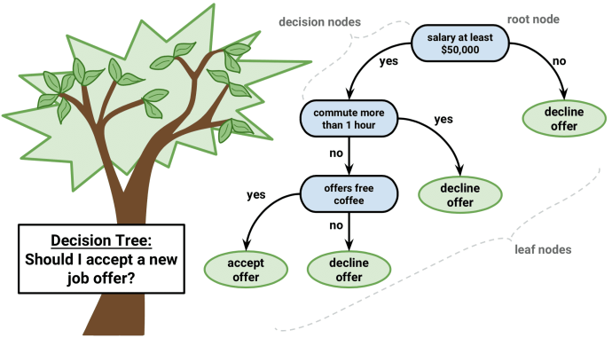
Chapter 8. Classification: Decision Tree
Meng Jiang
CSE 40647/60647 Data Science Fall 2017
Introduction to Data Mining

Slide 2
Classification
Classification: Basic Concepts
Decision Tree Induction
Bayes Classification Methods
Model Evaluation and Selection
Techniques to Improve Classification Accuracy: Ensemble Methods

Slide 3
Supervised vs. Unsupervised Learning
Supervised learning (classification)
Supervision: The training data (observations, measurements, etc.) are accompanied by labels indicating the class of the observations
New data is classified based on the training set
Unsupervised learning (clustering)
The class labels of training data is unknown
Given a set of measurements, observations, etc. with the aim of establishing the existence of classes or clusters in the data

Slide 4
Prediction Problems: Classification vs. Numeric Prediction
Classification
Predicts categorical class labels (discrete or nominal)
Classifies data (constructs a model) based on the training set (tuples/samples/objects and their attributes/features; attributes: measurements, observations, etc.) and the class labels
Numeric Prediction
Models continuous-valued functions, i.e., predicts unknown or missing values
Typical applications
Credit/loan approval
Medical diagnosis: if a tumor is cancerous or benign
Fraud detection: if a transaction is fraudulent
Web page categorization: which category it is

Slide 5
Classification: A Two-Step Process
Model construction: describing a set of predetermined classes
Each tuple/sample is assumed to belong to a predefined class, as determined by the class label attributes
The set of tuples used for model construction is training set
Model: represented as classification rules, decision trees, or mathematical formulae
Model usage: for classifying future or unknown objects
Estimate accuracy of the model
The known label of test sample is compared with the classified result from the model
Accuracy: % of test set samples that are correctly classified by the model
Test set is independent of training set (otherwise overfitting)
If the accuracy is acceptable, use the model to classify new data
Note: If the test set is used to select/refine models, it is called validation (test) set or development test set

Slide 6
(1) Model Construction
Classification
Algorithms
Training
Data
Classifier
(Model)
IF rank = ‘professor’
OR years > 6
THEN tenured = ‘yes’

Slide 7
(2) Using the Model in Prediction
Classifier
Testing
Data
Unseen Data
(Jeff, Professor, 4)
Tenured?

Slide 8
Classification
Classification: Basic Concepts
Decision Tree Induction
Bayes Classification Methods
Model Evaluation and Selection
Techniques to Improve Classification Accuracy: Ensemble Methods

Slide 9
Decision Tree Induction: An Example
Training data set: Buys_computer
The data set follows an example of Quinlan’s ID3 (Playing Tennis)
Resulting tree:
age?
<=30
31..40
>40
student?
yes
credit rating?
no
yes
excellent
fair
no
yes
no
yes

Slide 10
Quinlan’s Example – Playing Tennis?
outlook
sunny
overcast
rain
humidity
P
windy
high
normal
true
false
N
P
N
P

Slide 11
Algorithm for Decision Tree Induction
Basic algorithm (a greedy algorithm)
Tree is constructed in a top-down recursive divide-and-conquer manner
At start, all the training examples are at the root
Attributes are categorical (if continuous-valued, they are discretized in advance)
Examples are partitioned recursively based on selected attributes
Test attributes are selected on the basis of a heuristic or statistical measure (e.g., information gain)
Conditions for stopping partitioning
All samples for a given node belong to the same class
There are no remaining attributes for further partitioning—majority voting is employed for classifying the leaf
There are no samples left

Slide 12
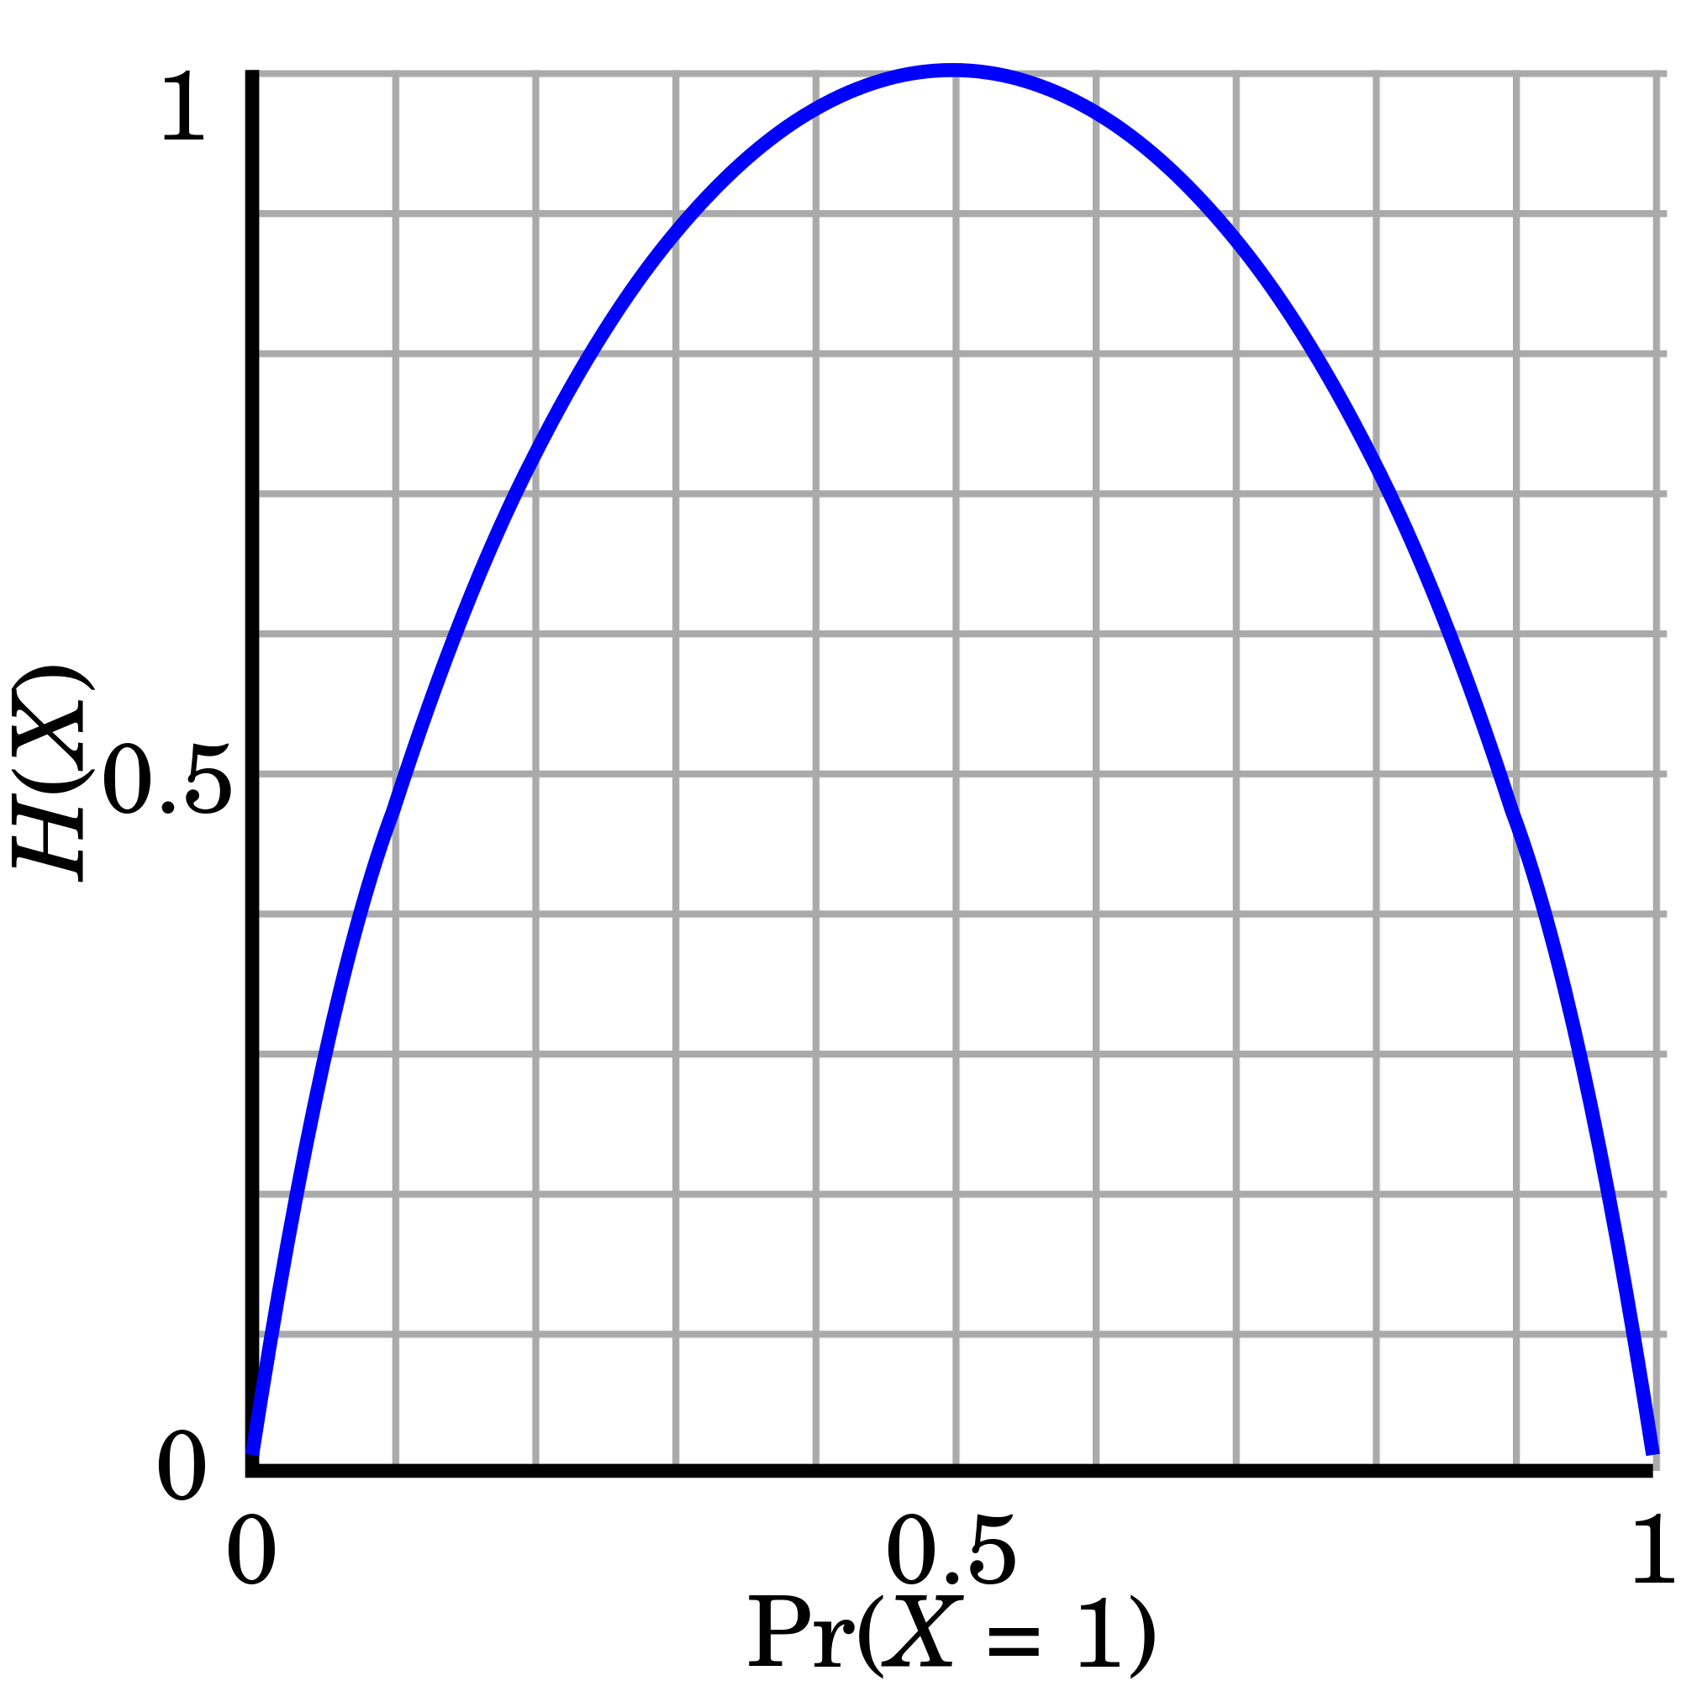
Brief Review of Entropy
Entropy (Information Theory)
A measure of uncertainty associated with a random number
Calculation: For a discrete random variable Y taking m distinct values {y₁, y₂, …, y_{m}}
Interpretation
Higher entropy → higher uncertainty
Lower entropy → lower uncertainty
Conditional entropy
m = 2

Slide 13
Attribute Selection Measure: Information Gain (ID3/C4.5)
Select the attribute with the highest information gain
Let p_{i} be the probability that an arbitrary tuple in D belongs to class C_{i}, estimated by |C_{i, D}|/|D|
Expected information (entropy) needed to classify a tuple in D:
Information needed (after using A to split D into v partitions) to classify D:
Information gained by branching on attribute A

Slide 14
Attribute Selection: Information Gain
#total (#positive, #negative)
14 (9,5)
Gain(age), Gain(income),
Gain(student), Gain(credit rating)
age?
5 (2,3)
4 (4,0)
5 (3,2)
<=30
31..40
>40
Gain(income),
Gain(student),
Gain(credit rating)
Gain(income),
Gain(student),
Gain(credit rating)
student?
yes
credit rating?
no
yes
excellent
fair
3 (0,3)
2 (2,0)
2 (0,2)
3 (3, 0)
no
yes
no
yes

Slide 15
Attribute Selection: Information Gain
Class P: buys_computer = “yes”
Class N: buys_computer = “no”
means “age <=30” has 5 out of 14 samples, with 2 yes’es and 3 no’s. Hence
Similarly,

Slide 16
Gain Ratio for Attribute Selection (C4.5)
Information gain measure is biased towards attributes with a large number of values (Why?)
C4.5 (a successor of ID3) uses gain ratio to overcome the problem (normalization to information gain)
GainRatio(A) = Gain(A)/SplitInfo(A)
Ex.
gain_ratio(income) = 0.029/1.557 = 0.019
The attribute with the maximum gain ratio is selected as the splitting attribute

Slide 17
Gini Index (CART): Numerical Attribute?
If a data set D contains examples from n classes, gini index, gini(D) is defined as
where p_{j} is the relative frequency of class j in D
If a data set D is split on A into two subsets D₁ and D₂, the gini index gini(D) is defined as
Reduction in Impurity:
The attribute provides the smallest gini_{split}(D) (or the largest reduction in impurity) is chosen to split the node (need to enumerate all the possible splitting points for each attribute)

Slide 18
IG vs Gini

Slide 19
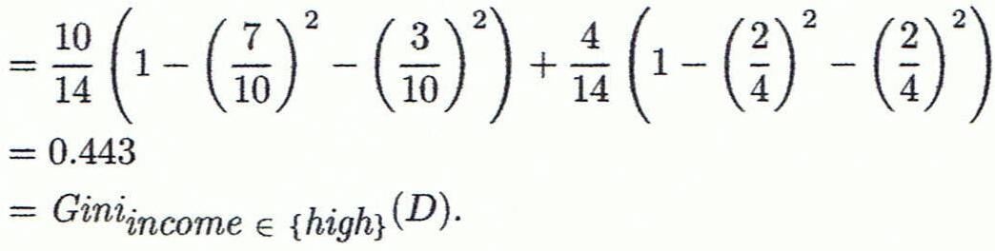
Computation of Gini Index on An Ordinal Attribute
Ex. D has 9 tuples in buys_computer = “yes” and 5 in “no”
Suppose the attribute income partitions D into 10 in D₁: {low, medium} and 4 in D₂: {high}
Gini_{{medium,high}} is 0.450. Thus, split on the {low,medium} (and {high}) since it has the lowest Gini index.

Slide 20
Comparing Attribute Selection Measures
The three measures, in general, return good results but
Information gain:
biased towards multivalued attributes
Gain ratio:
tends to prefer unbalanced splits in which one partition is much smaller than the others
Gini index:
biased to multivalued attributes
tends to favor tests that result in equal-sized partitions and purity in both partitions

Slide 21
Overfitting and Tree Pruning
Overfitting: An induced tree may overfit the training data
Too many branches, some may reflect anomalies due to noise or outliers
Poor accuracy for unseen samples
Two approaches to avoid overfitting
Prepruning: Halt tree construction early ̵ do not split a node if this would result in the goodness measure falling below a threshold
Difficult to choose an appropriate threshold
Postpruning: Remove branches from a “fully grown” tree—get a sequence of progressively pruned trees
Use a set of data different from the training data to decide which is the “best pruned tree”

Slide 22
References
C. Apte and S. Weiss. Data mining with decision trees and decision rules. Future Generation Computer Systems, 13, 1997
P. K. Chan and S. J. Stolfo. Learning arbiter and combiner trees from partitioned data for scaling machine learning. KDD'95
A. J. Dobson. An Introduction to Generalized Linear Models. Chapman & Hall, 1990.
R. O. Duda, P. E. Hart, and D. G. Stork. Pattern Classification, 2ed. John Wiley, 2001
U. M. Fayyad. Branching on attribute values in decision tree generation. AAAI’94.
Y. Freund and R. E. Schapire. A decision-theoretic generalization of on-line learning and an application to boosting. J. Computer and System Sciences, 1997.
J. Gehrke, R. Ramakrishnan, and V. Ganti. Rainforest: A framework for fast decision tree construction of large datasets. VLDB’98.
J. Gehrke, V. Gant, R. Ramakrishnan, and W.-Y. Loh, BOAT -- Optimistic Decision Tree Construction. SIGMOD'99.
T. Hastie, R. Tibshirani, and J. Friedman. The Elements of Statistical Learning: Data Mining, Inference, and Prediction. Springer-Verlag, 2001.
T.-S. Lim, W.-Y. Loh, and Y.-S. Shih. A comparison of prediction accuracy, complexity, and training time of thirty-three old and new classification algorithms. Machine Learning, 2000

Slide 23
References (cont.)
J. Magidson. The Chaid approach to segmentation modeling: Chi-squared automatic interaction detection. In R. P. Bagozzi, editor, Advanced Methods of Marketing Research, Blackwell Business, 1994
M. Mehta, R. Agrawal, and J. Rissanen. SLIQ : A fast scalable classifier for data mining. EDBT'96
T. M. Mitchell. Machine Learning. McGraw Hill, 1997
S. K. Murthy, Automatic Construction of Decision Trees from Data: A Multi-Disciplinary Survey, Data Mining and Knowledge Discovery 2(4): 345-389, 1998
J. R. Quinlan. Induction of decision trees. Machine Learning, 1:81-106, 1986.
J. R. Quinlan. C4.5: Programs for Machine Learning. Morgan Kaufmann, 1993.
J. R. Quinlan. Bagging, boosting, and c4.5. AAAI‘96.
R. Rastogi and K. Shim. Public: A decision tree classifier that integrates building and pruning. VLDB’98
J. Shafer, R. Agrawal, and M. Mehta. SPRINT : A scalable parallel classifier for data mining. VLDB’96
J. W. Shavlik and T. G. Dietterich. Readings in Machine Learning. Morgan Kaufmann, 1990
P. Tan, M. Steinbach, and V. Kumar. Introduction to Data Mining. Addison Wesley, 2005
S. M. Weiss and C. A. Kulikowski. Computer Systems that Learn: Classification and Prediction Methods from Statistics, Neural Nets, Machine Learning, and Expert Systems. Morgan Kaufman, 1991
S. M. Weiss and N. Indurkhya. Predictive Data Mining. Morgan Kaufmann, 1997
I. H. Witten and E. Frank. Data Mining: Practical Machine Learning Tools and Techniques, 2ed. Morgan Kaufmann, 2005

