Slide 1
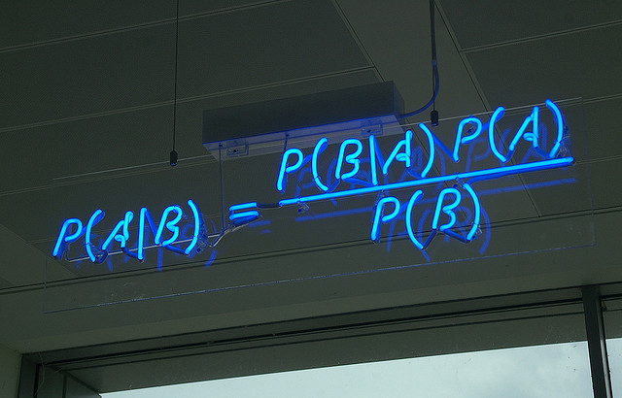
Chapter 8. Classification: Naïve Bayes
Meng Jiang
CSE 40647/60647 Data Science Fall 2017
Introduction to Data Mining

Slide 2
Classification: Basic Concepts
Classification: Basic Concepts
Decision Tree Induction
Bayes Classification Methods
Model Evaluation and Selection
Techniques to Improve Classification Accuracy: Ensemble Methods

Slide 3
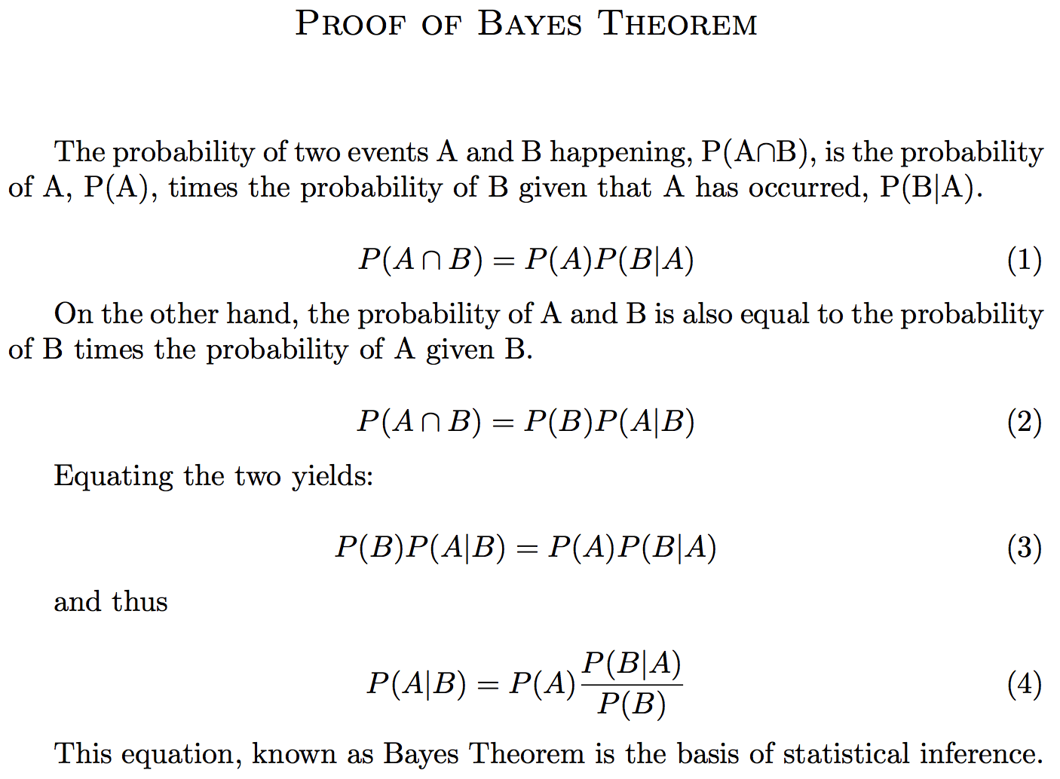
Bayes’ Theorem: Basics

Slide 4
Bayesian Classification: Why?
A statistical classifier: performs probabilistic prediction, i.e., predicts class membership probabilities
Foundation: Based on Bayes’ Theorem.
Performance: A simple Bayesian classifier, naïve Bayesian classifier, has comparable performance with decision tree and selected neural network classifiers
Incremental: Each training example can incrementally increase/decrease the probability that a hypothesis is correct — prior knowledge can be combined with observed data

Slide 5
Bayes’ Theorem: Basics
Bayes’ Theorem:
Let X be a data sample (“evidence”): class label is unknown
Let H be a hypothesis that X belongs to class C
Classification is to determine P(H|X), (i.e., posteriori probability): the probability that the hypothesis holds given the observed data sample X
P(H) (prior probability): the initial probability
E.g., X will buy computer, regardless of age, income, …
P(X): probability that sample data is observed
P(X|H) (likelihood): the probability of observing the sample X, given that the hypothesis holds
E.g., Given that X will buy computer, the prob. that X is 31..40, medium income

Slide 6
Prediction Based on Bayes’ Theorem
Given training data X, posteriori probability of a hypothesis H, P(H|X), follows the Bayes’ theorem
Informally, this can be viewed as
posteriori = likelihood x prior/evidence
Predicts X belongs to C_{i} iff the probability P(C_{i}|X) is the highest among all the P(C_{k}|X) for all the k classes
Practical difficulty: It requires initial knowledge of many probabilities, involving significant computational cost

Slide 7
Classification is to Derive the Maximum Posteriori
Let D be a training set of tuples and their associated class labels, and each tuple is represented by an n-D attribute vector X = (x₁, x₂, …, x_{n})
Suppose there are m classes C₁, C₂, …, C_{m}.
Classification is to derive the maximum posteriori, i.e., the maximal P(C_{i}|X)
This can be derived from Bayes’ theorem
Since P(X) is constant for all classes, only
needs to be maximized

Slide 8
Naïve Bayes Classifier
A simplified assumption: attributes are conditionally independent (i.e., no dependence relation between attributes):
This greatly reduces the computation cost: Only counts the class distribution
If A_{k} is categorical, P(x_{k}|C_{i}) is the # of tuples in C_{i} having value x_{k} for A_{k} divided by |C_{i, D}| (# of tuples of C_{i} in D)
If A_{k} is continous-valued, P(x_{k}|C_{i}) is usually computed based on Gaussian distribution with a mean μ and standard deviation σ
and P(x_{k}|C_{i}) is

Slide 9
Naïve Bayes Classifier: Training Dataset
Class:
C1: buys_computer = ‘yes’
C2: buys_computer = ‘no’
Data to be classified:
X = (age <=30, Income = medium, Student = yes, Credit_rating = Fair)

Slide 10
Naïve Bayes Classifier: An Example
P(C_{i}): P(buys_computer = “yes”) = 9/14 = 0.643
P(buys_computer = “no”) = 5/14= 0.357
Compute P(X|C_{i}) for each class
P(age = “<=30”|buys_computer = “yes”) = 2/9 = 0.222
P(age = “<= 30”|buys_computer = “no”) = 3/5 = 0.6
P(income = “medium” | buys_computer = “yes”) = 4/9 = 0.444
P(income = “medium” | buys_computer = “no”) = 2/5 = 0.4
P(student = “yes” | buys_computer = “yes) = 6/9 = 0.667
P(student = “yes” | buys_computer = “no”) = 1/5 = 0.2
P(credit_rating = “fair” | buys_computer = “yes”) = 6/9 = 0.667
P(credit_rating = “fair” | buys_computer = “no”) = 2/5 = 0.4
X = (age <= 30 , income = medium, student = yes, credit_rating = fair)
P(X|C_{i}) : P(X|buys_computer = “yes”) = 0.222 x 0.444 x 0.667 x 0.667 = 0.044
P(X|buys_computer = “no”) = 0.6 x 0.4 x 0.2 x 0.4 = 0.019
P(X|C_{i})*P(C_{i}) : P(X|buys_computer = “yes”) * P(buys_computer = “yes”) = 0.028
P(X|buys_computer = “no”) * P(buys_computer = “no”) = 0.007
Therefore, X belongs to class (“buys_computer = yes”)

Slide 11
Avoiding the Zero-Probability Problem
Naïve Bayesian prediction requires each conditional prob. be non-zero. Otherwise, the predicted prob. will be zero
Ex. Suppose a dataset with 1000 tuples, income=low (0), income= medium (990), and income = high (10)
Use Laplacian correction (or Laplacian estimator)
Adding 1 to each case
Prob(income = low) = 1/1003
Prob(income = medium) = 991/1003
Prob(income = high) = 11/1003
The “corrected” prob. estimates are close to their “uncorrected” counterparts

Slide 12
Naïve Bayes Classifier: Comments
Advantages
Easy to implement
Good results obtained in most of the cases
Disadvantages
Assumption: class conditional independence, therefore loss of accuracy
Practically, dependencies exist among variables
E.g.,
hospitals: patients: Profile: age, family history, etc.
Symptoms: fever, cough etc.
Disease: lung cancer, diabetes, etc.
Dependencies among these cannot be modeled by Naïve Bayes Classifier

Slide 13
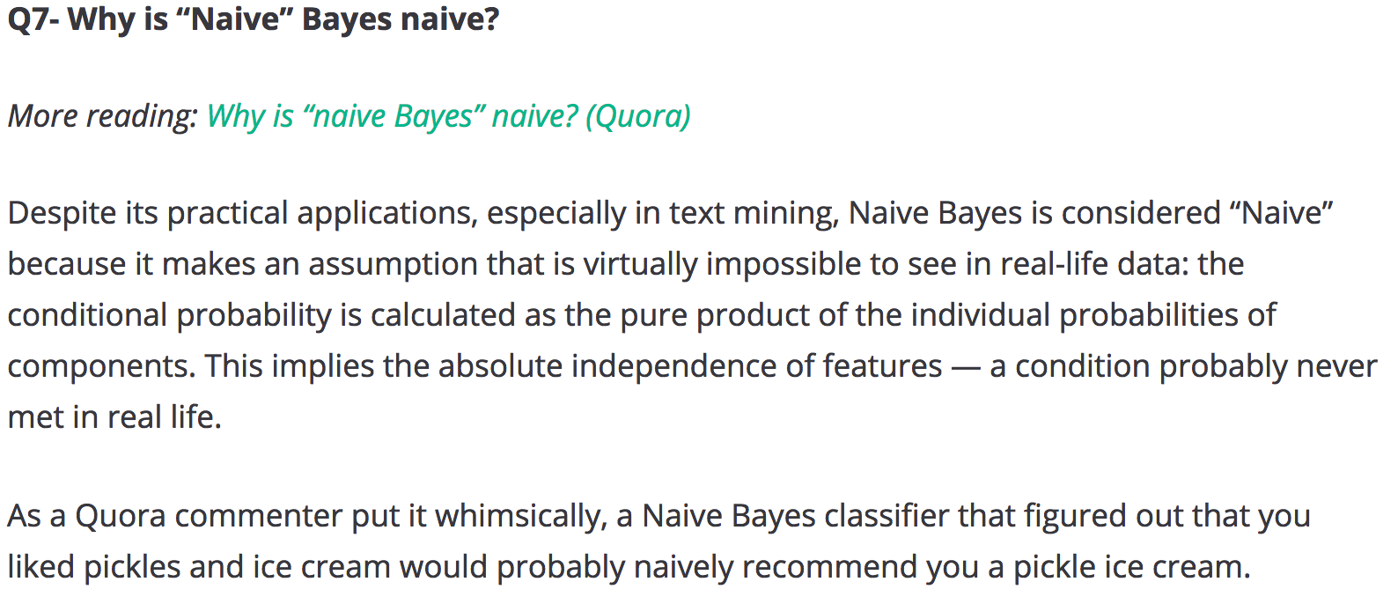
Discussion
https://www.springboard.com/blog/machine-learning-interview-questions/

Slide 14
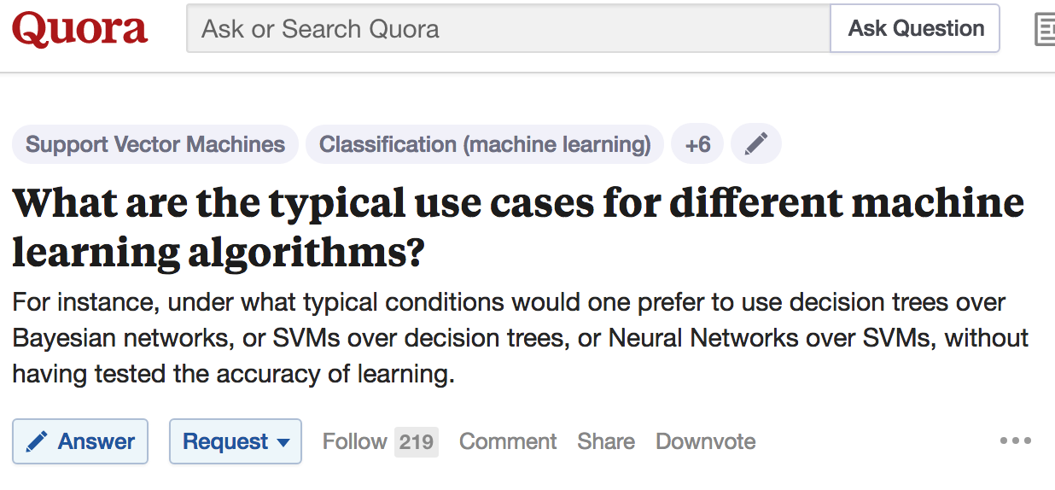
Discussion

Slide 15
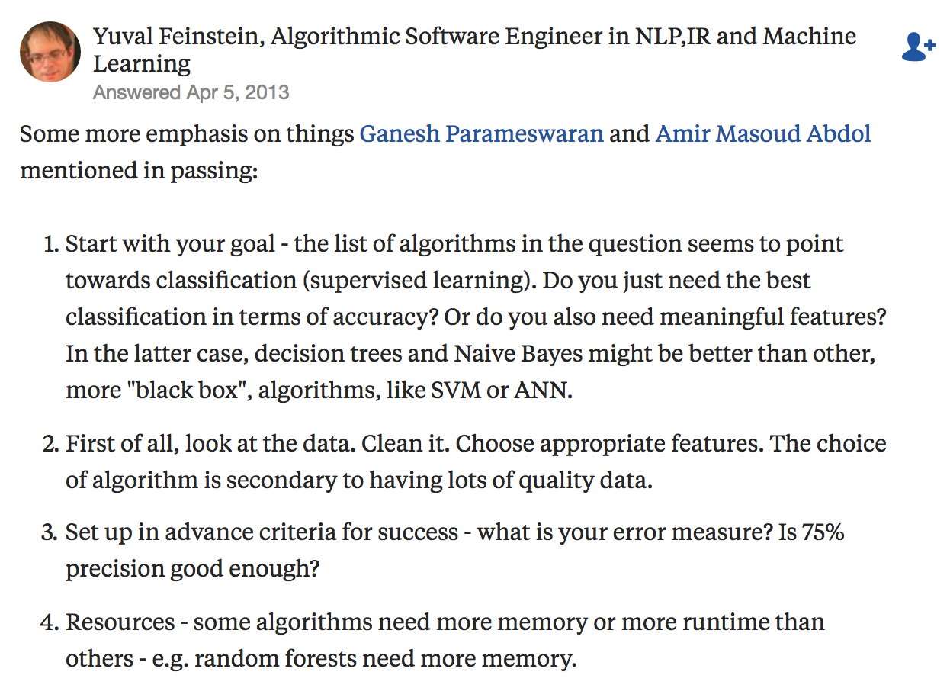
Discussion

Slide 16
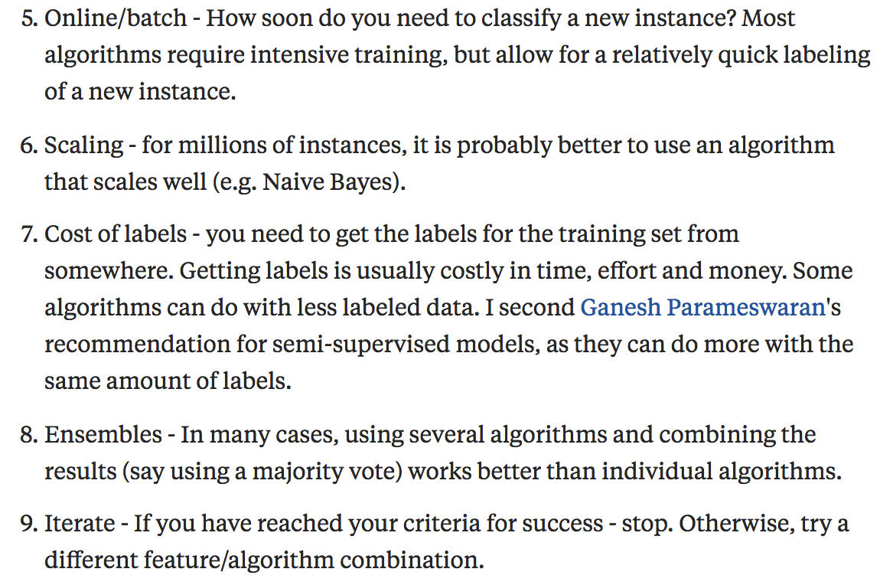
Discussion

Slide 17
Reminder: KDD Process
Knowledge
Pattern Evaluation
Data Mining
Task-relevant Data
Data Warehouse
Selection
Data Cleaning
Data Integration
Databases

Slide 18
References
C. Apte and S. Weiss. Data mining with decision trees and decision rules. Future Generation Computer Systems, 13, 1997
P. K. Chan and S. J. Stolfo. Learning arbiter and combiner trees from partitioned data for scaling machine learning. KDD'95
A. J. Dobson. An Introduction to Generalized Linear Models. Chapman & Hall, 1990.
R. O. Duda, P. E. Hart, and D. G. Stork. Pattern Classification, 2ed. John Wiley, 2001
U. M. Fayyad. Branching on attribute values in decision tree generation. AAAI’94.
Y. Freund and R. E. Schapire. A decision-theoretic generalization of on-line learning and an application to boosting. J. Computer and System Sciences, 1997.
J. Gehrke, R. Ramakrishnan, and V. Ganti. Rainforest: A framework for fast decision tree construction of large datasets. VLDB’98.
J. Gehrke, V. Gant, R. Ramakrishnan, and W.-Y. Loh, BOAT -- Optimistic Decision Tree Construction. SIGMOD'99.
T. Hastie, R. Tibshirani, and J. Friedman. The Elements of Statistical Learning: Data Mining, Inference, and Prediction. Springer-Verlag, 2001.
T.-S. Lim, W.-Y. Loh, and Y.-S. Shih. A comparison of prediction accuracy, complexity, and training time of thirty-three old and new classification algorithms. Machine Learning, 2000

Slide 19
References (cont.)
J. Magidson. The Chaid approach to segmentation modeling: Chi-squared automatic interaction detection. In R. P. Bagozzi, editor, Advanced Methods of Marketing Research, Blackwell Business, 1994
M. Mehta, R. Agrawal, and J. Rissanen. SLIQ : A fast scalable classifier for data mining. EDBT'96
T. M. Mitchell. Machine Learning. McGraw Hill, 1997
S. K. Murthy, Automatic Construction of Decision Trees from Data: A Multi-Disciplinary Survey, Data Mining and Knowledge Discovery 2(4): 345-389, 1998
J. R. Quinlan. Induction of decision trees. Machine Learning, 1:81-106, 1986.
J. R. Quinlan. C4.5: Programs for Machine Learning. Morgan Kaufmann, 1993.
J. R. Quinlan. Bagging, boosting, and c4.5. AAAI‘96.
R. Rastogi and K. Shim. Public: A decision tree classifier that integrates building and pruning. VLDB’98
J. Shafer, R. Agrawal, and M. Mehta. SPRINT : A scalable parallel classifier for data mining. VLDB’96
J. W. Shavlik and T. G. Dietterich. Readings in Machine Learning. Morgan Kaufmann, 1990
P. Tan, M. Steinbach, and V. Kumar. Introduction to Data Mining. Addison Wesley, 2005
S. M. Weiss and C. A. Kulikowski. Computer Systems that Learn: Classification and Prediction Methods from Statistics, Neural Nets, Machine Learning, and Expert Systems. Morgan Kaufman, 1991
S. M. Weiss and N. Indurkhya. Predictive Data Mining. Morgan Kaufmann, 1997
I. H. Witten and E. Frank. Data Mining: Practical Machine Learning Tools and Techniques, 2ed. Morgan Kaufmann, 2005

